Slide 1
Meeting 06/18/2020
Shuo Zhang

Slide 2
Adaptive Hand/Reacher/Acrobot Experiments
Progress
Done:
1) Planning and rollout on Acrobot to reach a goal height of 1.0
2) Built virtual environment based on the transition model of "adaptive hand", "reacher" and "acrobot"
3) Generalized and adapted my PPO code so that PPO also works for my 3 new virtual environments.
4) Trained10 seeds for "Reacher" and "Acrobot"
5) Confirmed that average return increase
6) Plotted test evaluation trajectory based on the learned policies for "Reacher" and "Acrobot".
7) Trained PPO for "adaptive hand" for 10 seeds as well, However, there is an issue currently.
The average return during training is sometimes increasing at the beginning but decreasing later.
8) Tried many different setups and adjustments on ‘adaptive hand’ and then retrained for each of these adjustments. However, the issue is still not solved.
Doing:
Still trying to solve the issue of PPO for "adaptive hand" virtual environment

Slide 3
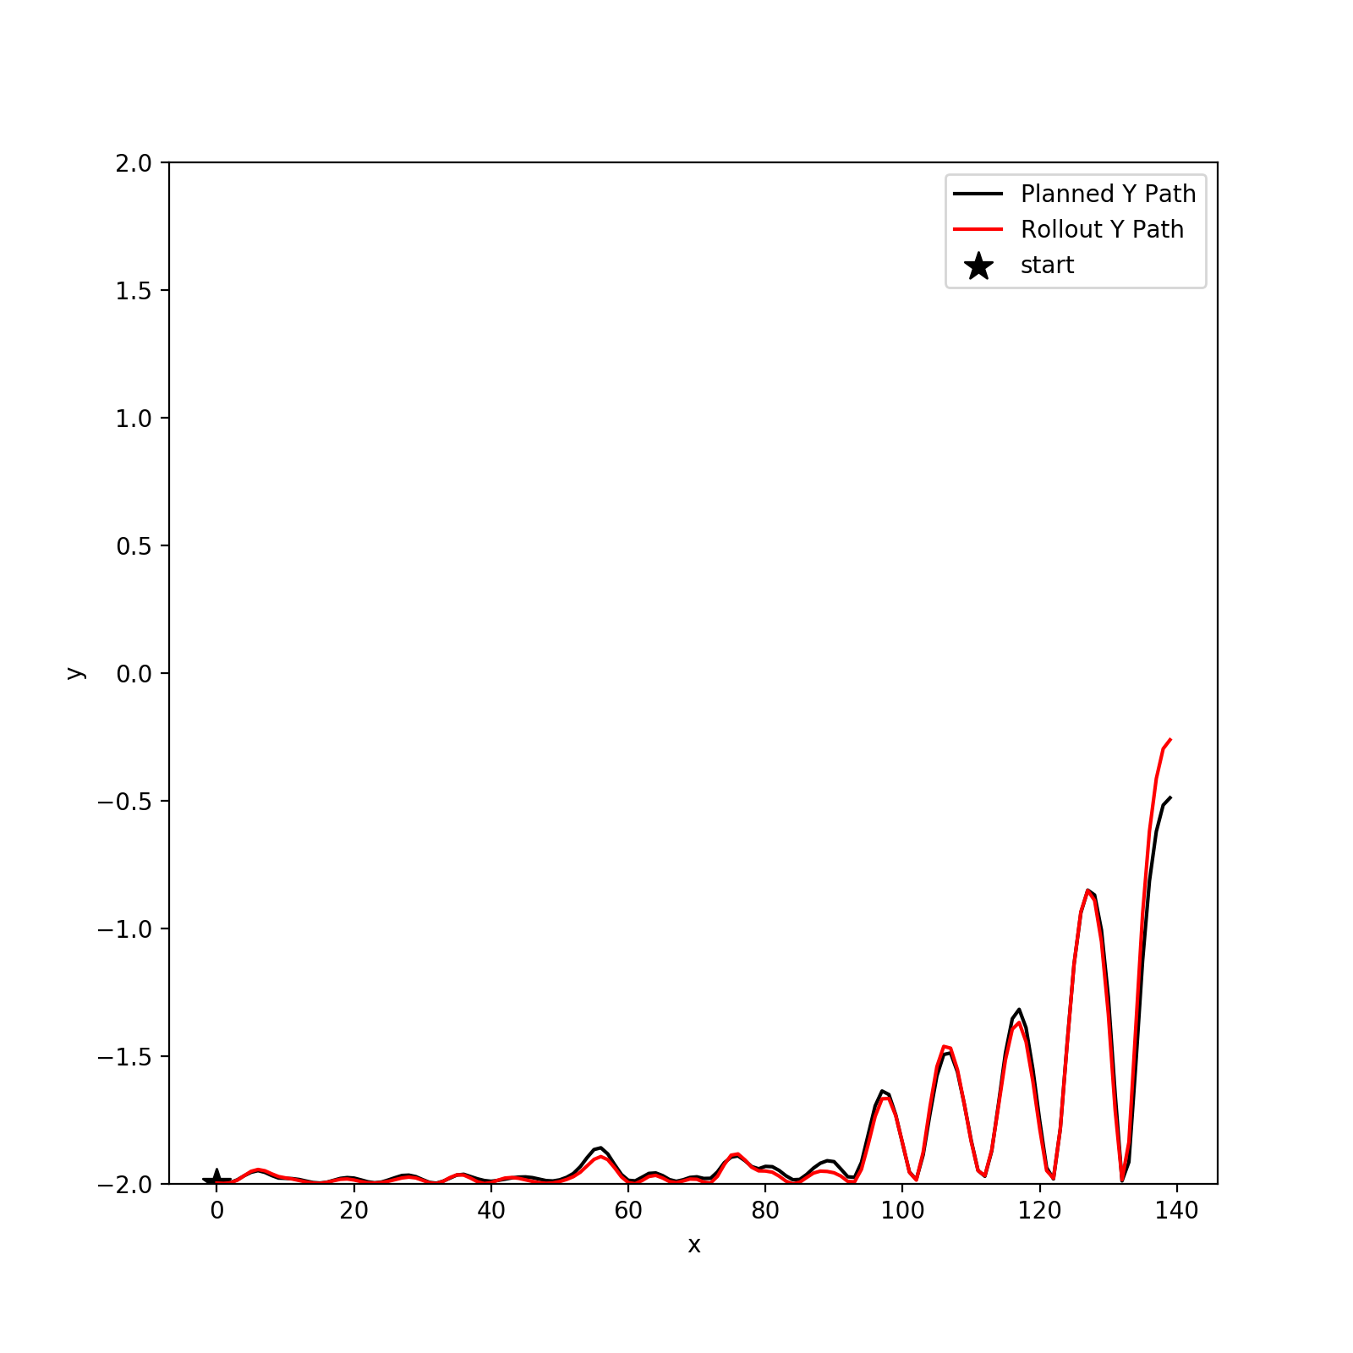
Acrobot-v1: Planning+Rollout ( Last Time)
Planner gave no results after a couple of hours planning for goal height of 1.0 and even for goal height of -0.1.
Goal Height: -0.5
Cost Fuction: length of height path so far + distance to the goal height

Slide 4
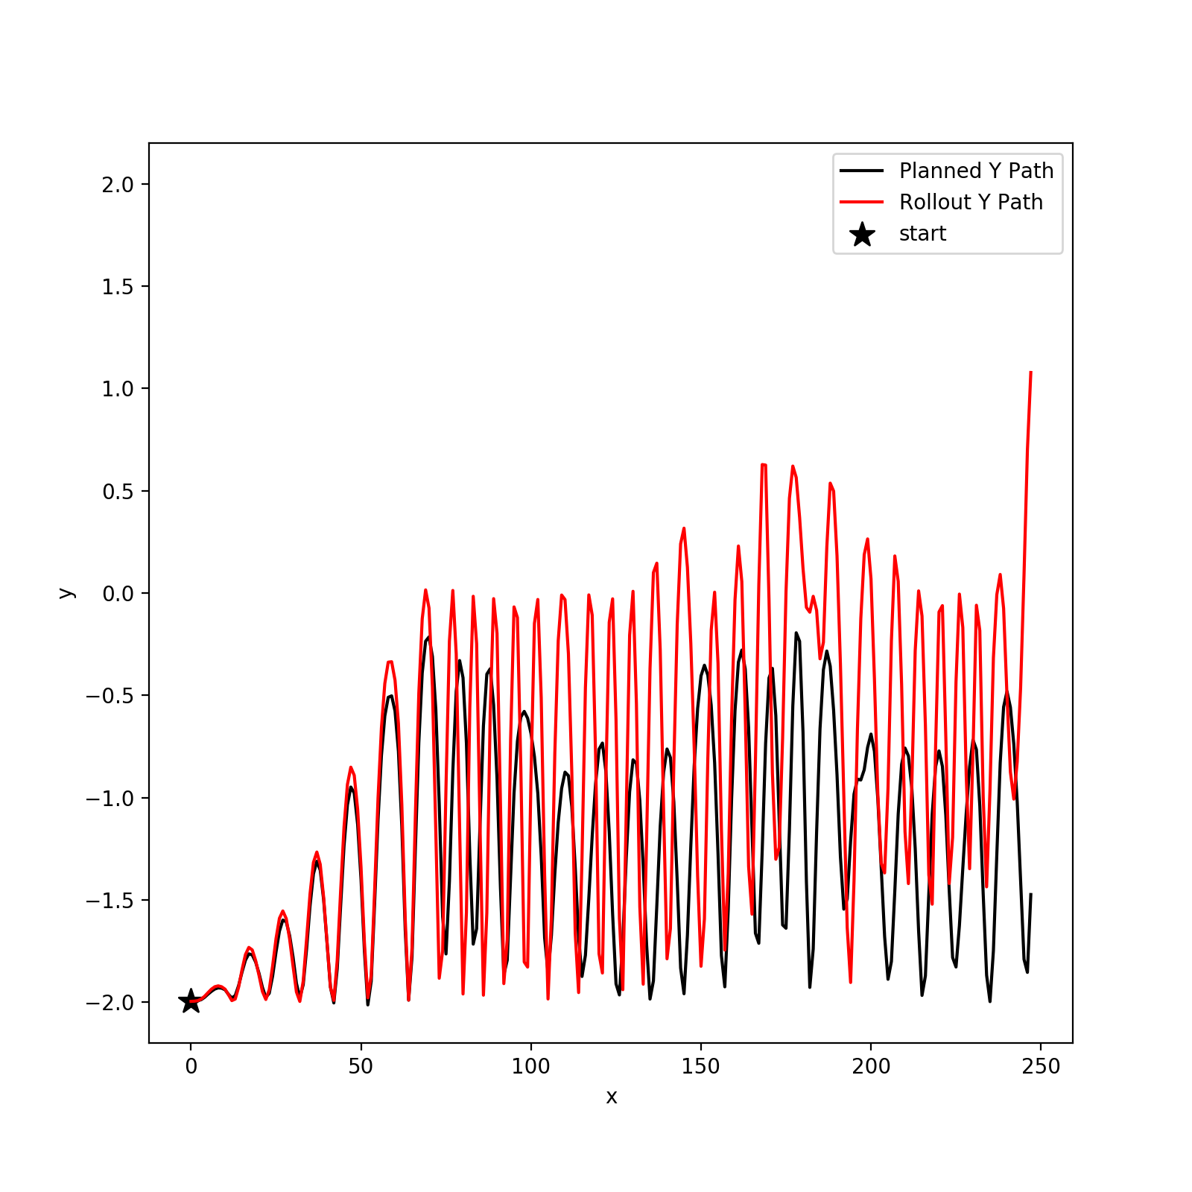
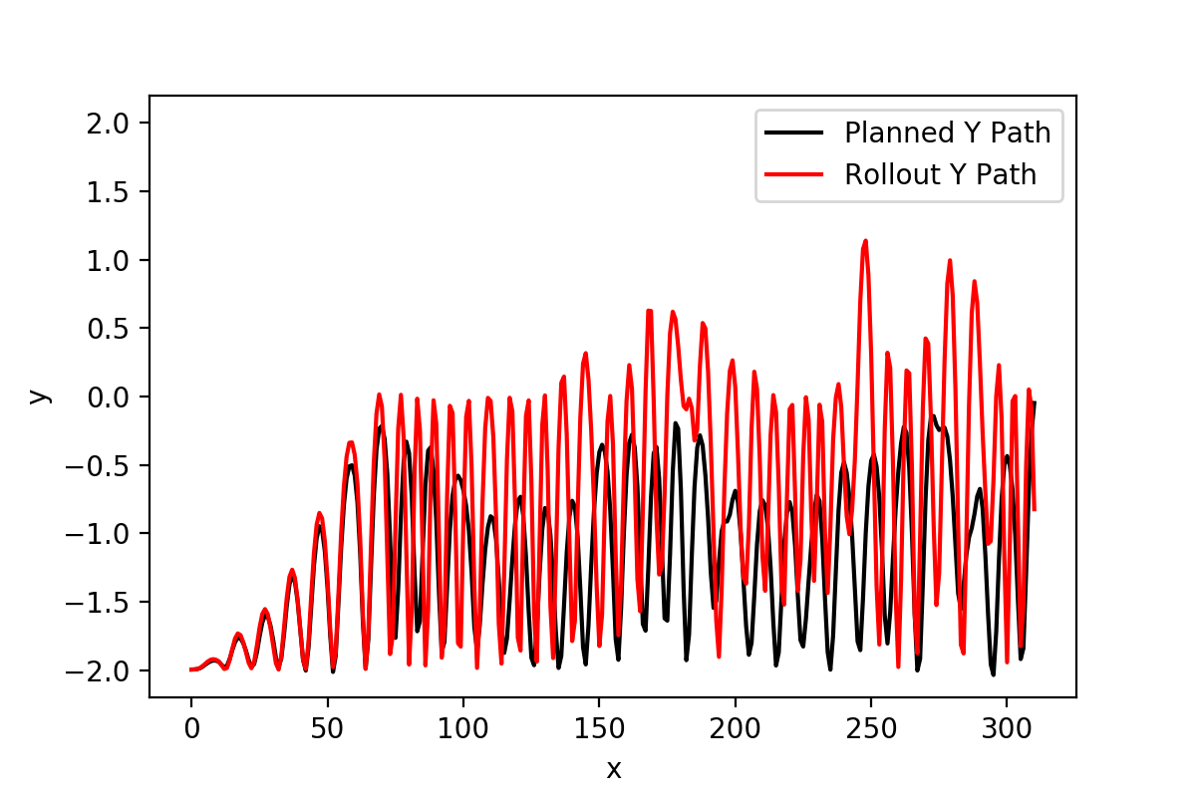
Acrobot-v1: Planning+Rollout (This Time)
This time, I changes cost function because we want as many steps as possible so that we can achieve the goal height of 1.0 in rollout.
Cost Fuction: distance to the goal height ONLY!
Planning Goal Height: -0.1

Slide 5
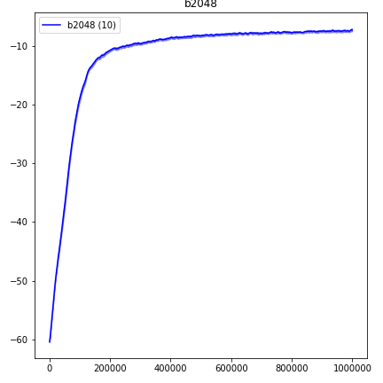
PPO Experiments: Reacher
Average return over 100-episodes

Slide 6
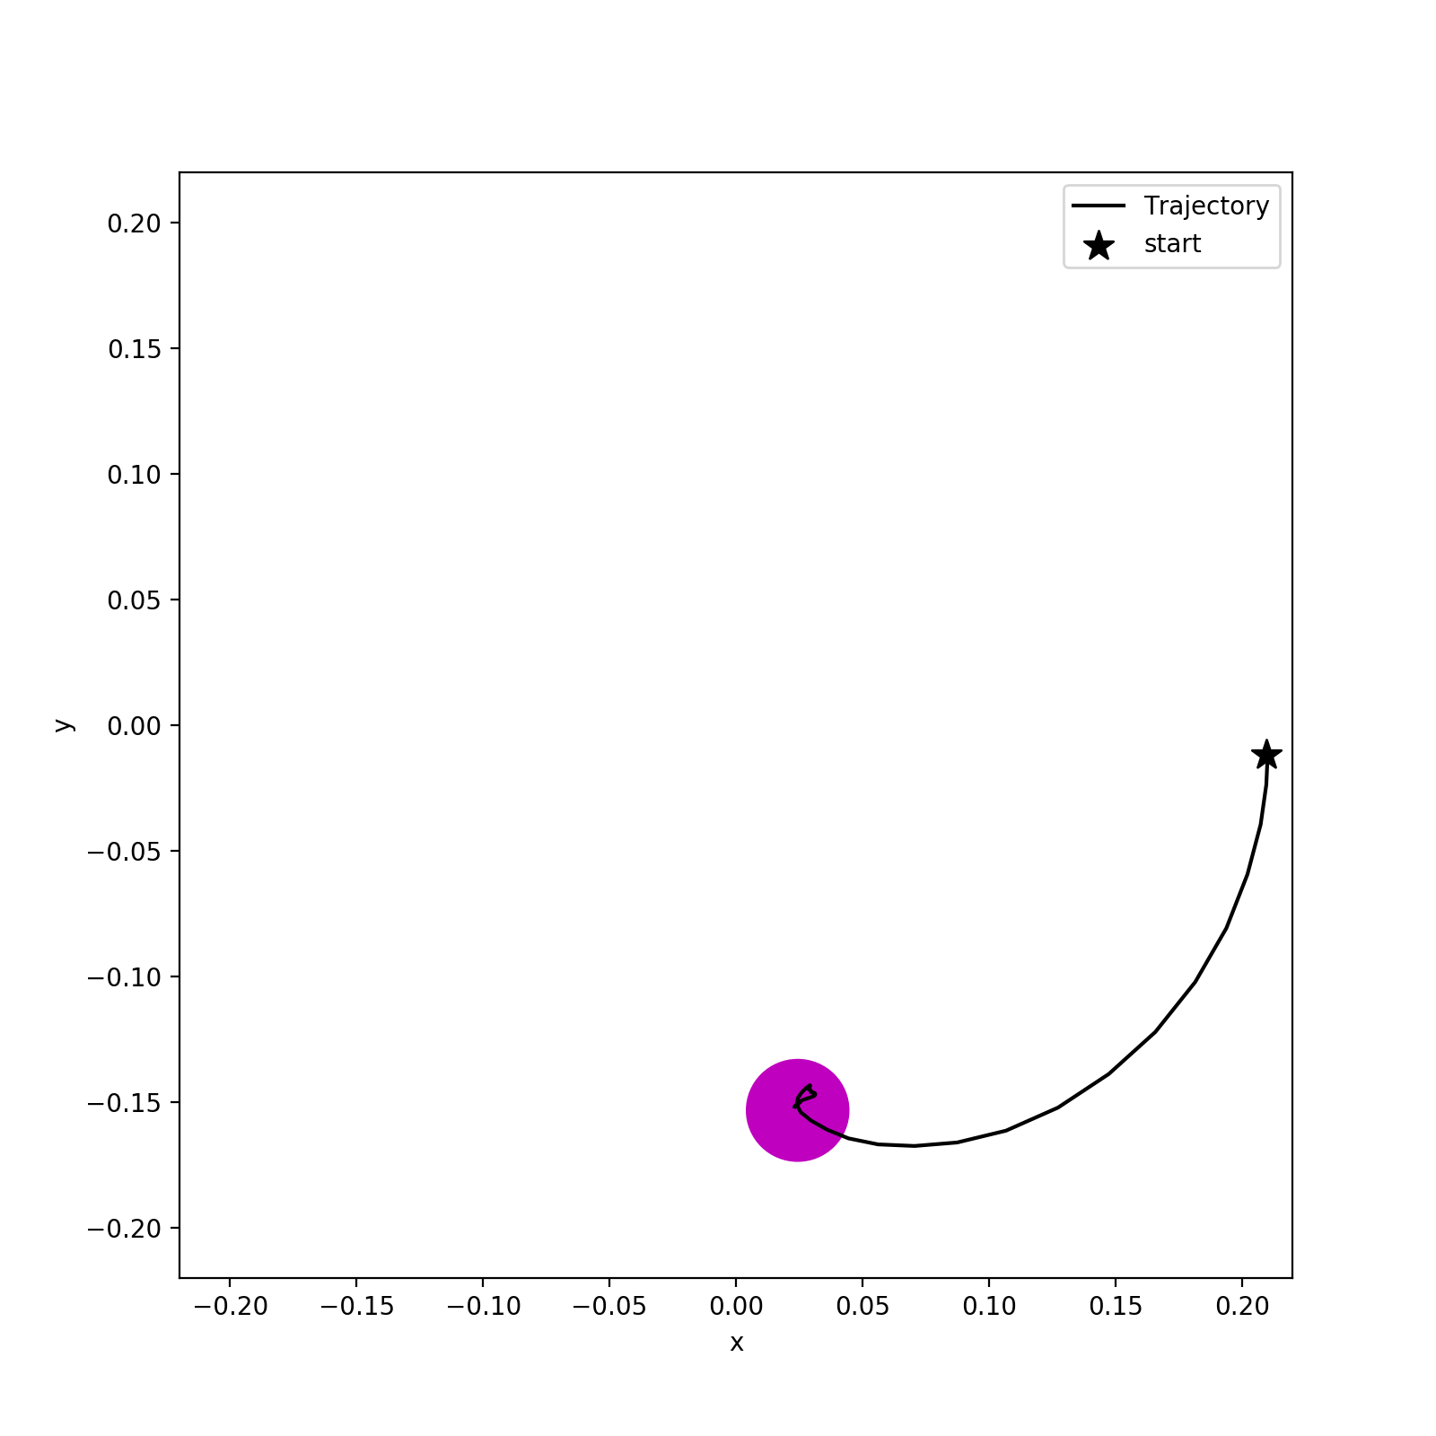
PPO Experiments: Reacher
Evaluation path using trained policy

Slide 7
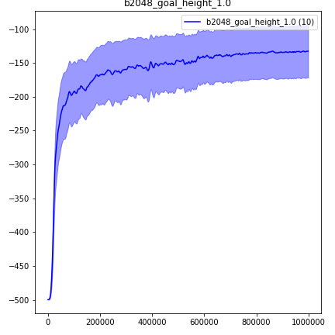
PPO Experiments: Acrobot
Average return over 100-episodes

Slide 8
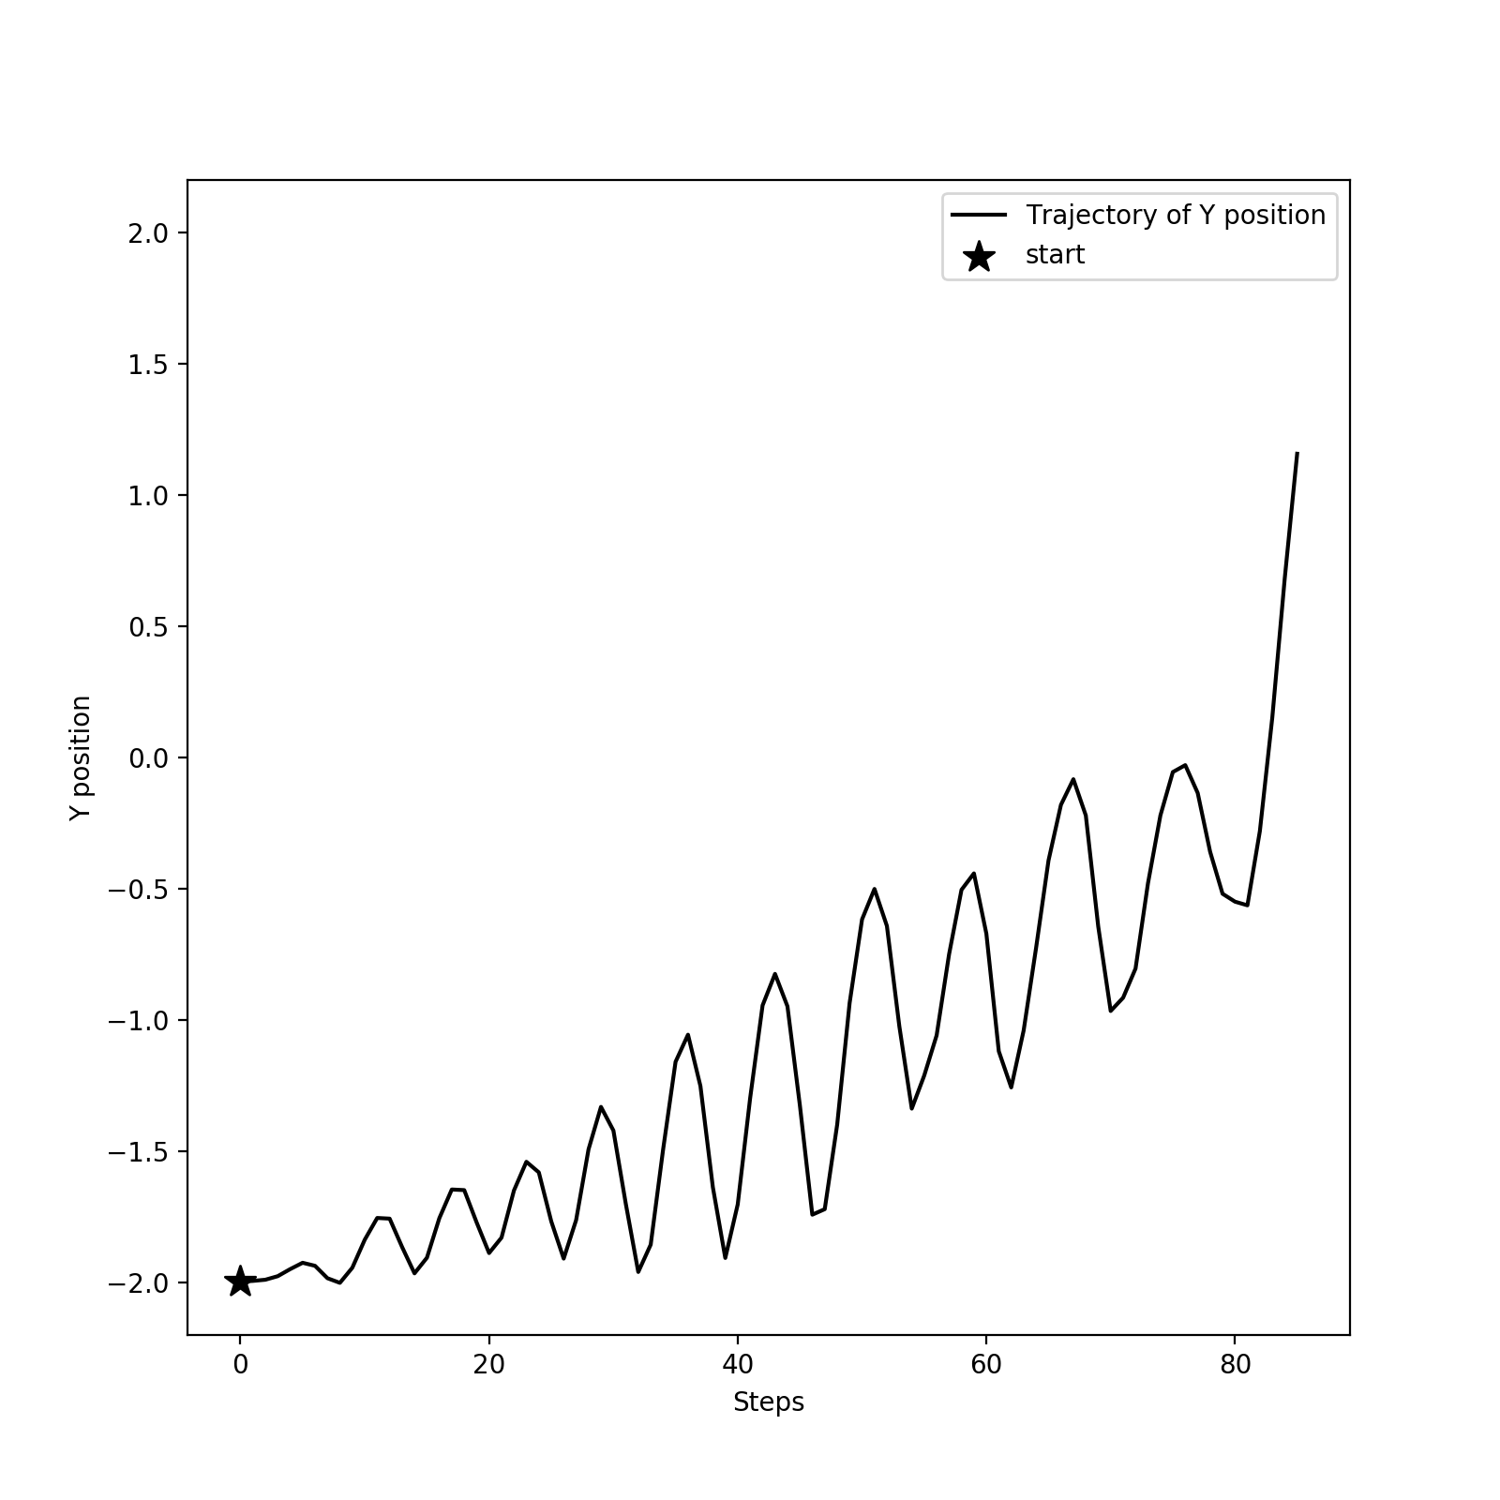
PPO Experiments: Acrobot
Evaluation path using trained policy

Slide 9
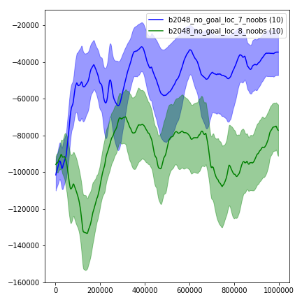
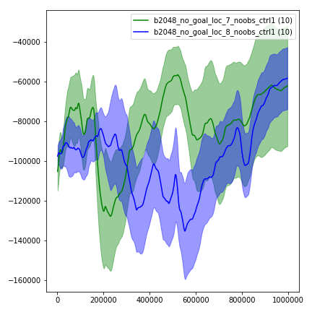
PPO Experiments: Adaptive Hand
Simplest Version: No obstacles, Goal location is not included in “state”. So, I have done training separately for different goal locations.
Without control reward
(penalty for large actions)
With control reward
(penalty for large actions)
Average return over 100-episodes

Slide 10
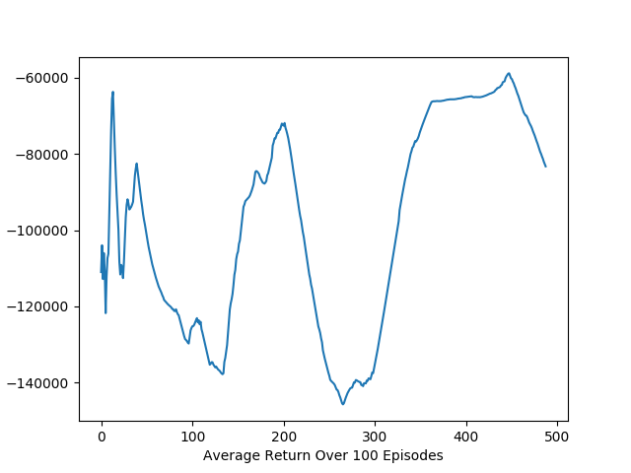
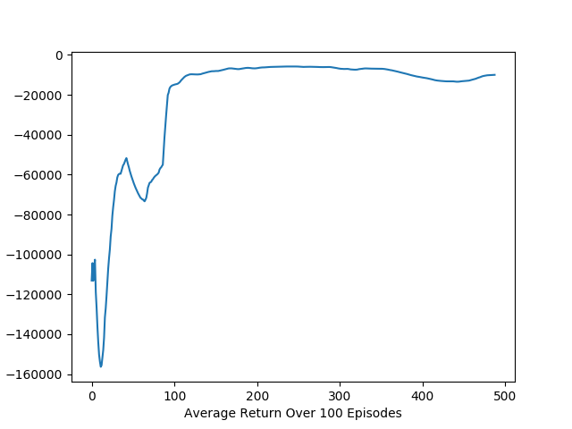
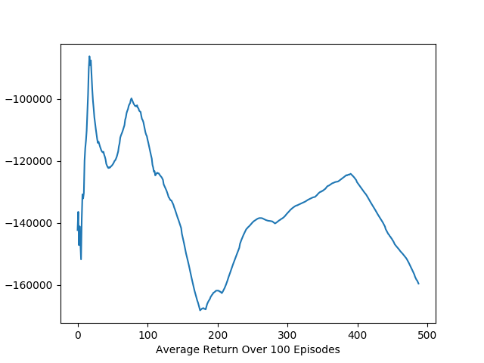
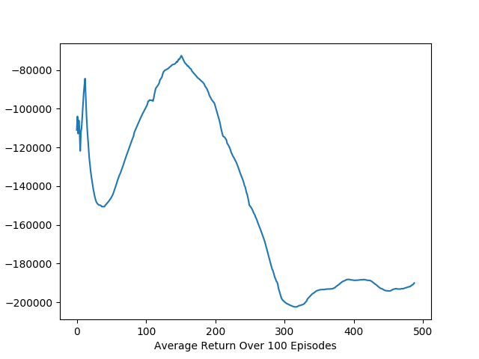
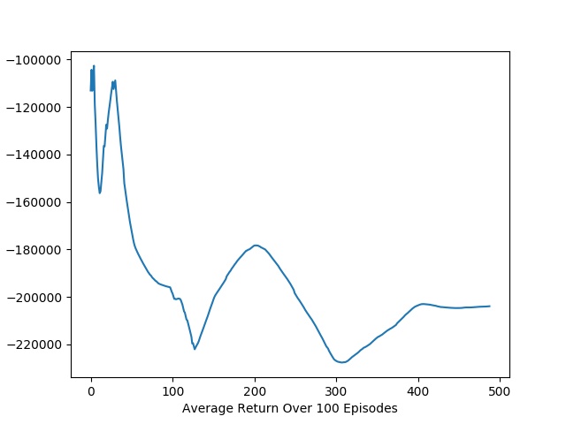
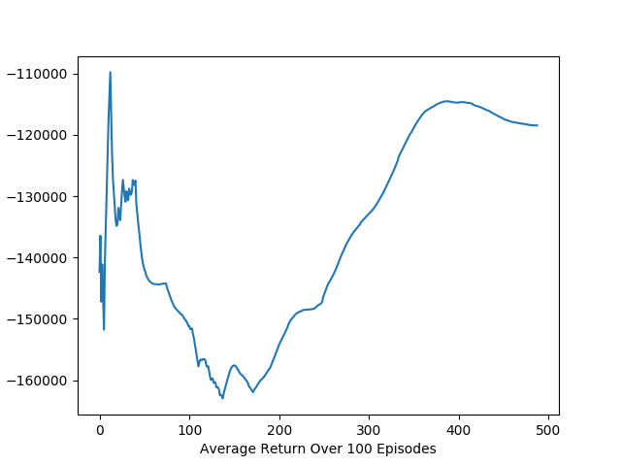
Adaptive Hand: Goal Loc 7 (seed 0)
No control reward
Control reward coefficient 1
Control reward coefficient 15
With terminal
Without terminal
Average return over 100-episodes

Slide 11
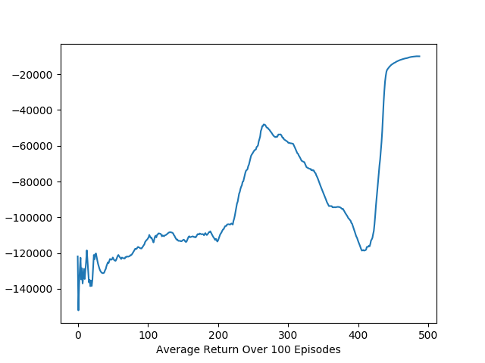
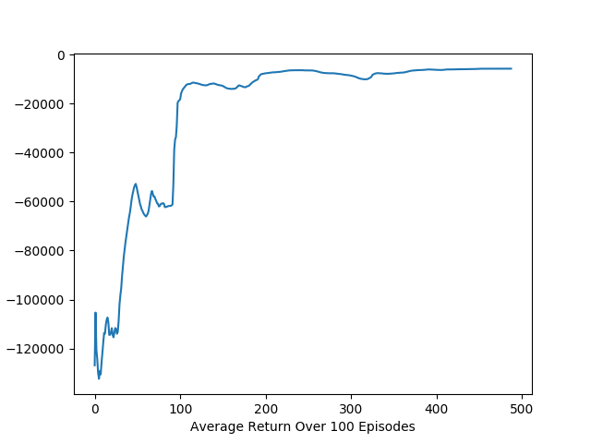
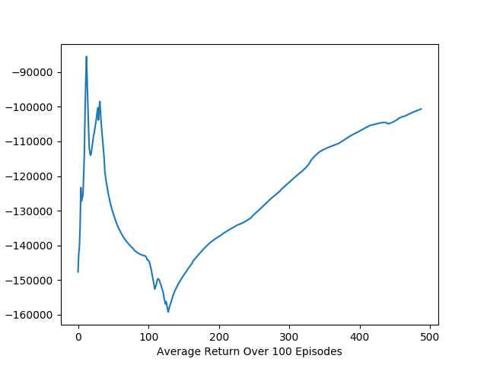
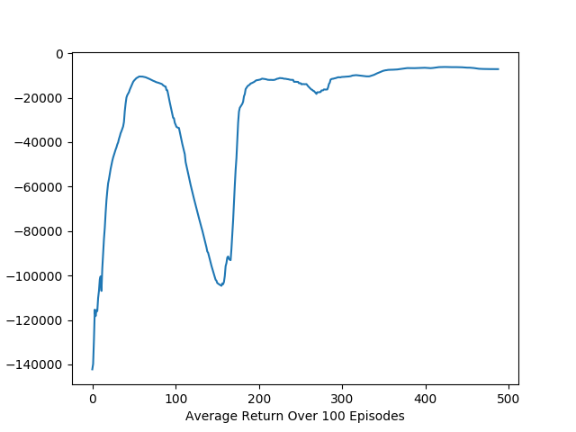
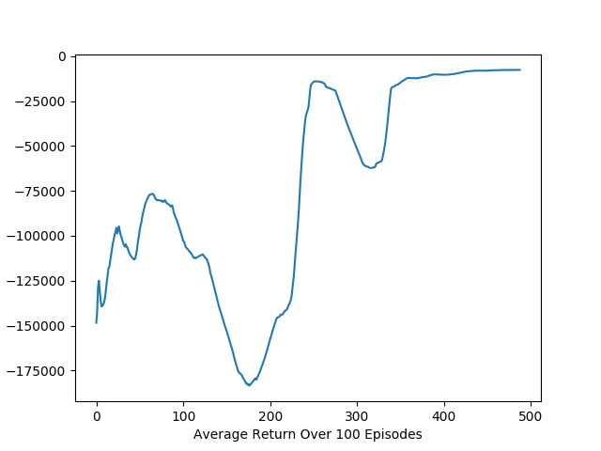
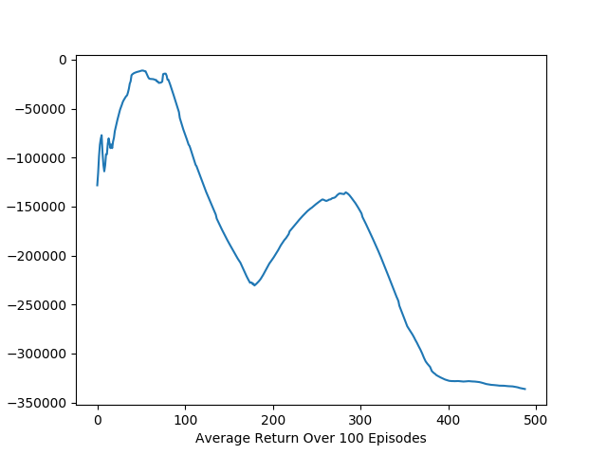
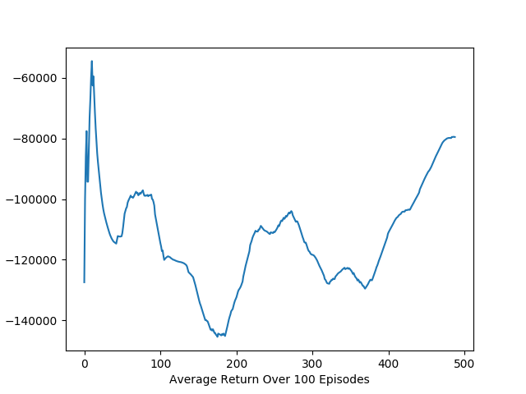
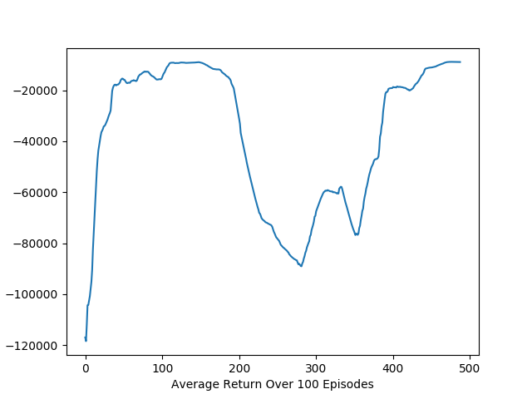
Adaptive Hand: Goal Loc 7 (some other seeds)
With terminal + Control reward coefficient 1
Average return over 100-episodes

Slide 12
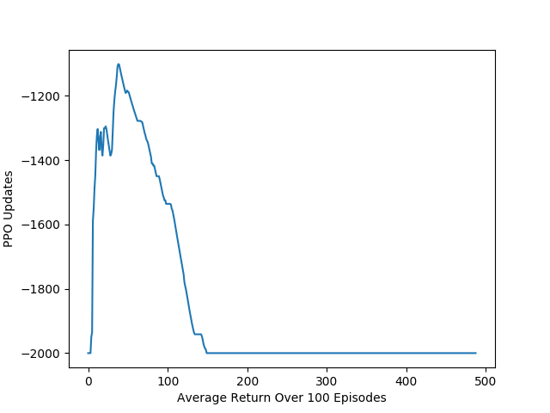
Adaptive Hand: Goal Loc 7 (seed 0)
I also tried to change the reward to be -1 for each step if the hand does not reach the goal. If the hand reaches the goal, the reward is 0 and done=True. This is exactly the same as reward system of Acrobot.
Average return over 100-episodes

Slide 13
PPO: Adaptive Hand
There are same issues for environments of goal loc 8, for environments of goal loc included in states, and for environments with obstacles.

Slide 14
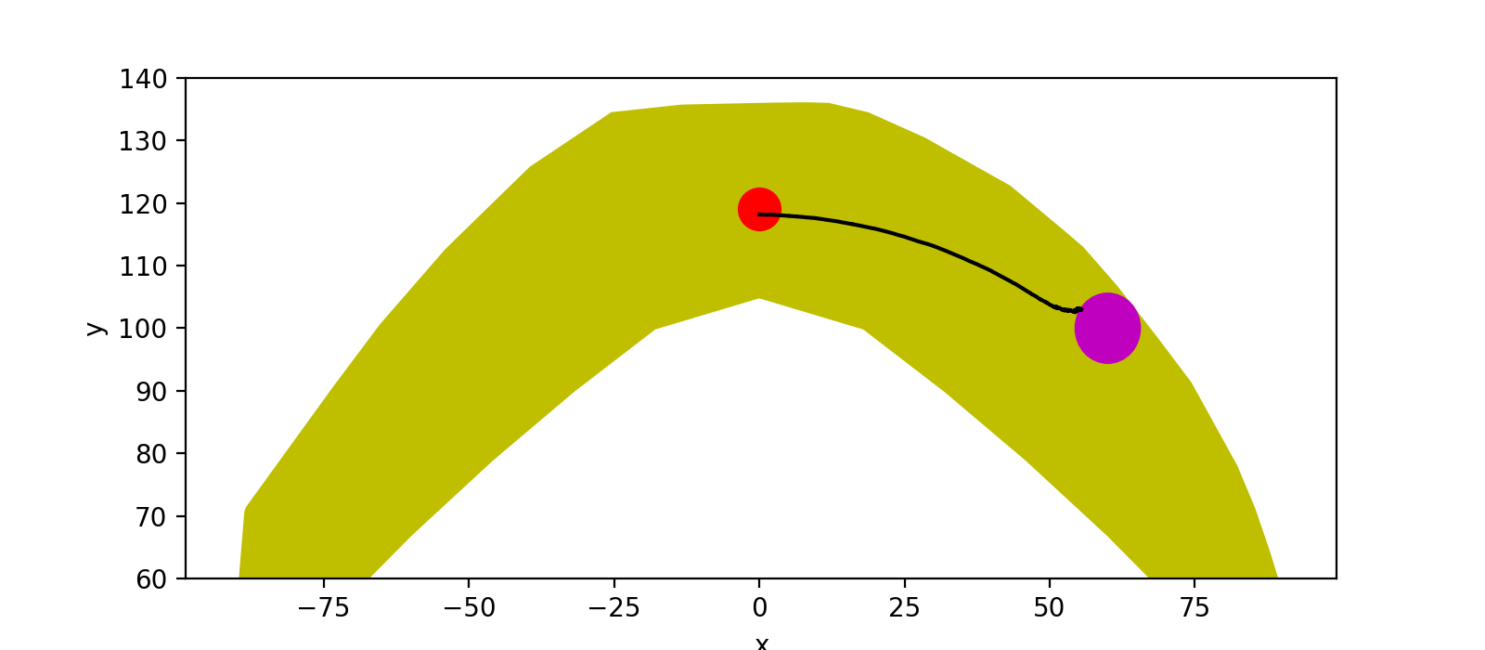

Adaptive Hand Evaluation Path: Goal Loc 7 (seed 0)
With terminal + Control reward coefficient 1
Final model path
Best model path (after 244 updates)

Slide 15
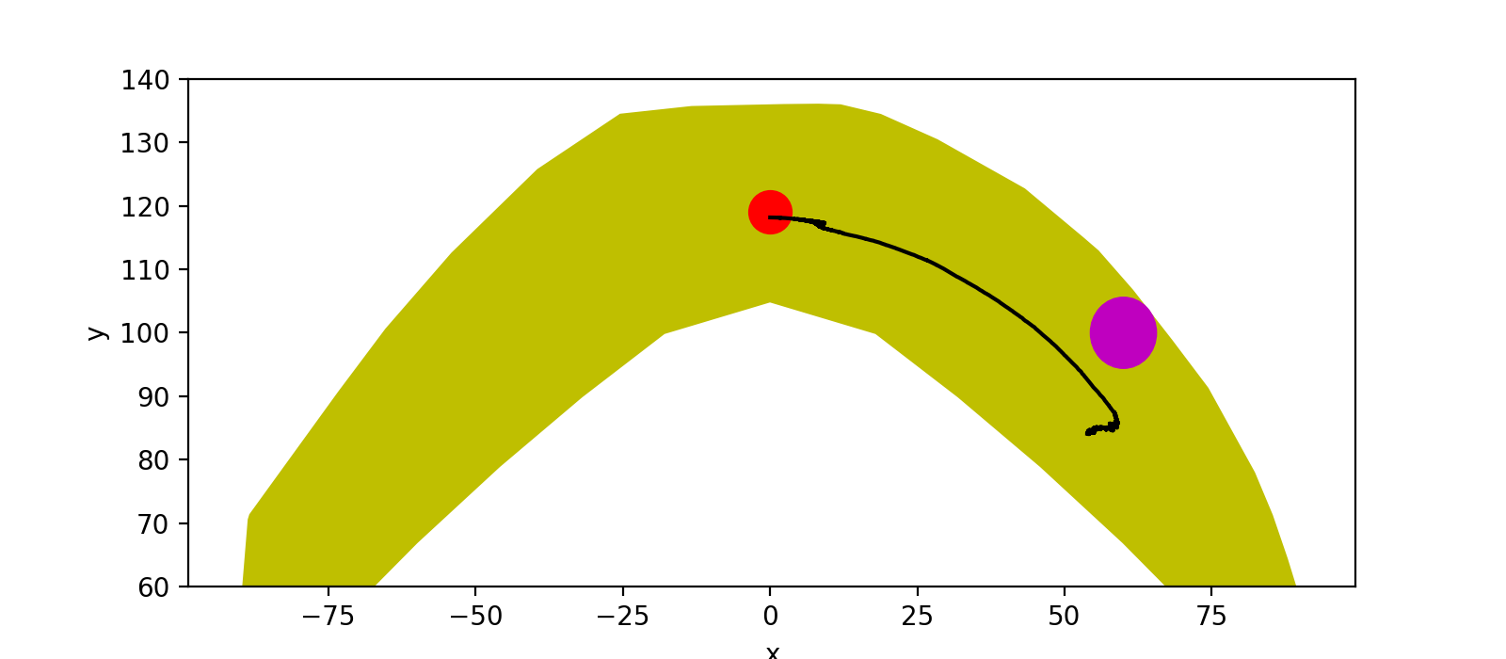
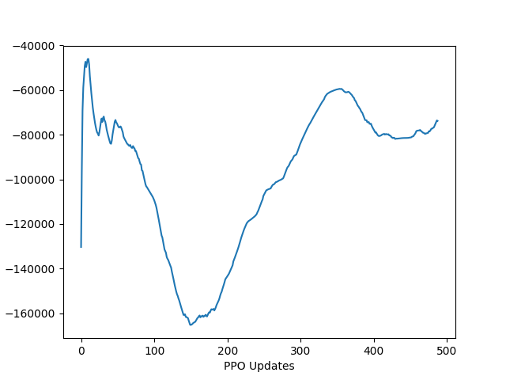
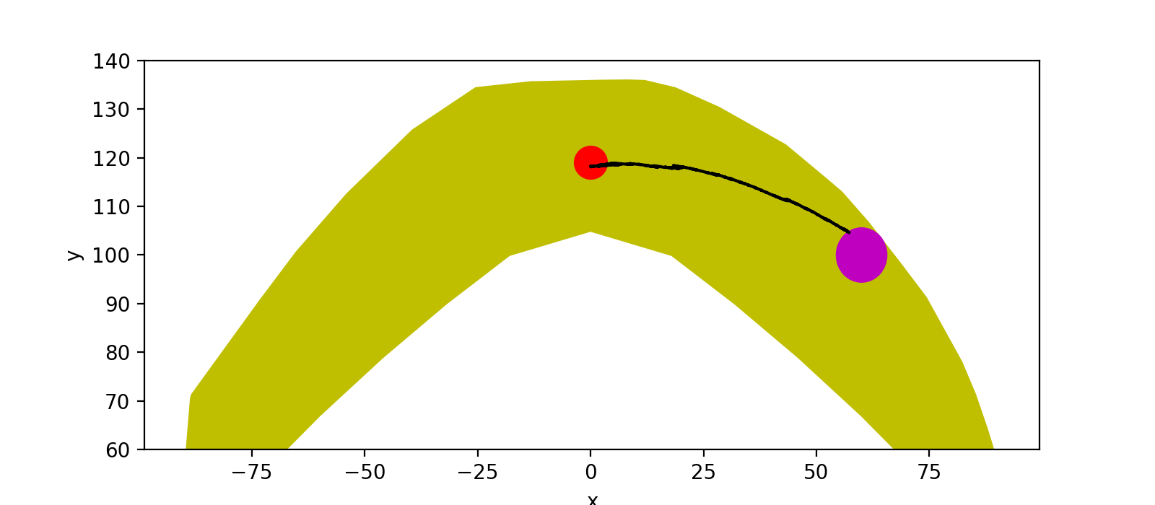
Adaptive Hand Evaluation Path: Goal Loc 7 (seed 1)
With terminal + Control reward coefficient 1
Final model path
Best model path (after 9 updates)

Slide 16

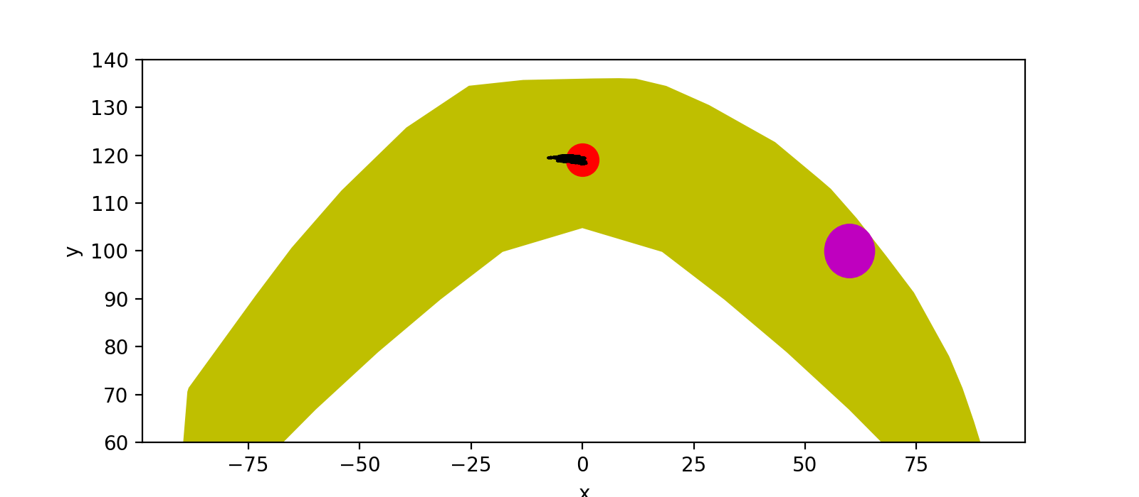

Adaptive Hand Evaluation Path: Goal Loc 7 (seed 1)
after 9 updates
after 10 updates
after 11 updates
after 12 updates

Slide 17
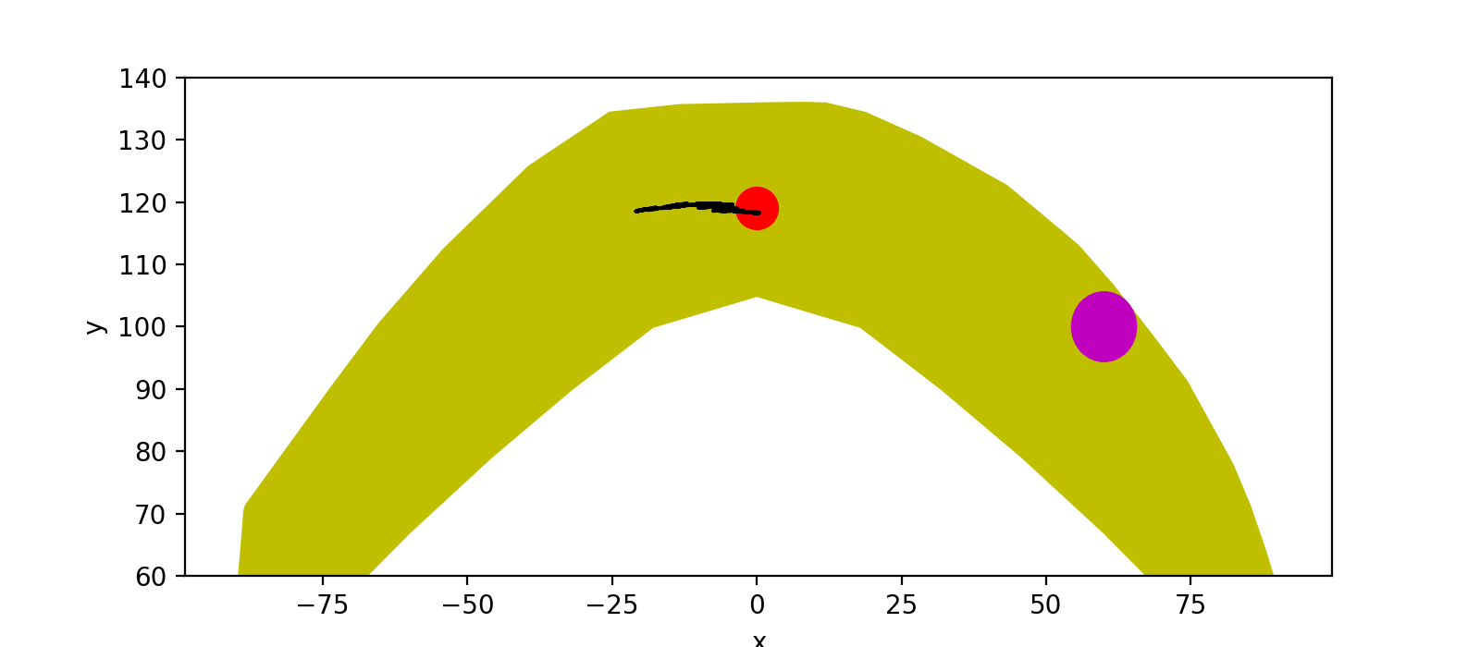



Adaptive Hand Evaluation Path: Goal Loc 7 (seed 1)
after 13 updates
after 14 updates
after 15 updates
after 16 updates

Slide 18



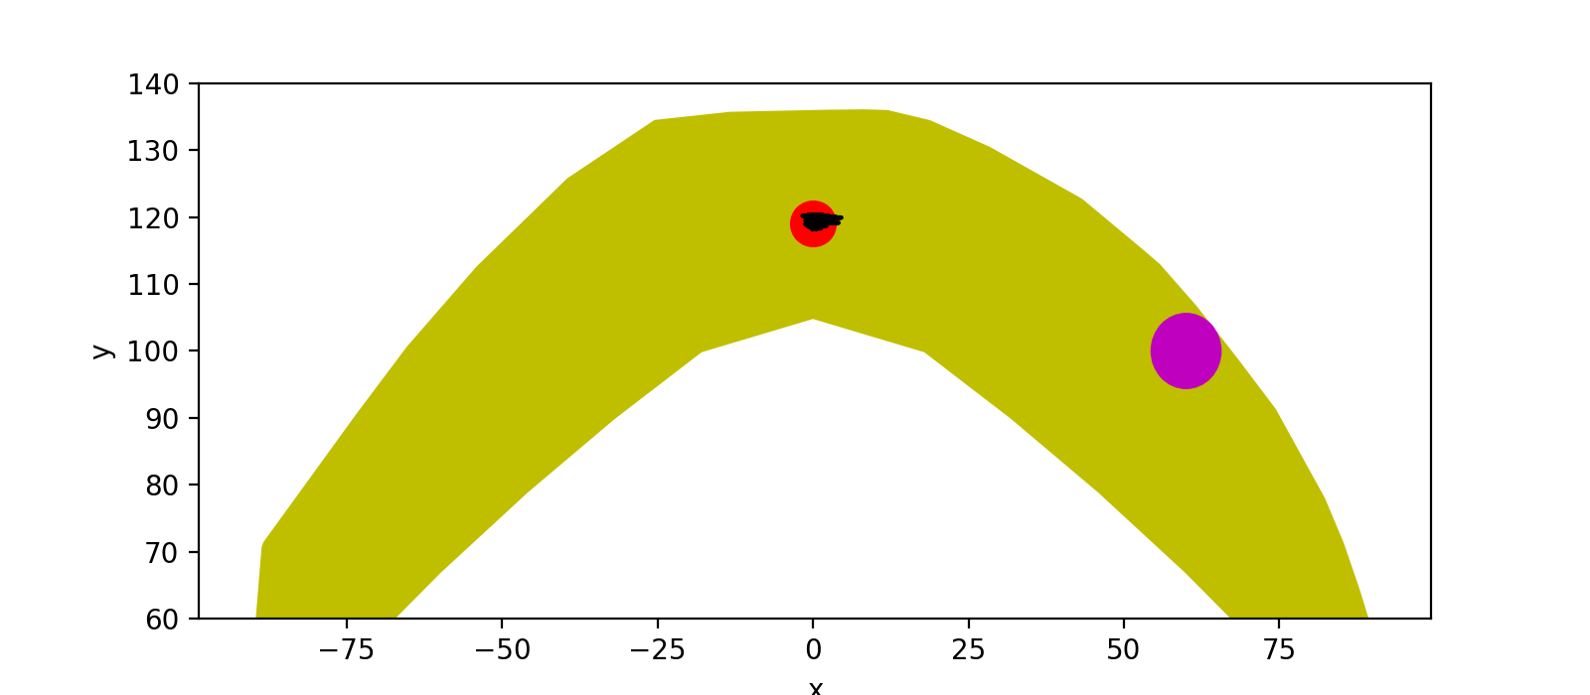
Adaptive Hand Evaluation Path: Goal Loc 7 (seed 1)
after 17 updates
after 18 updates
after 19 updates
after 20 updates

Slide 19
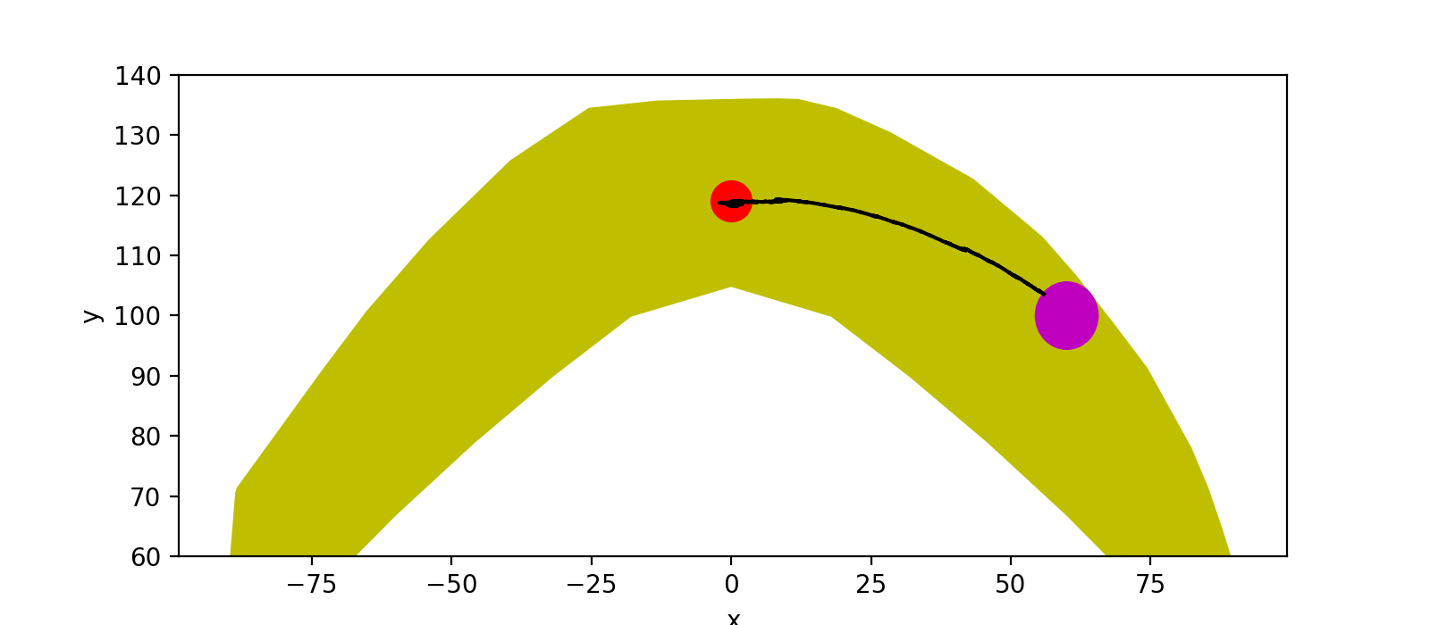
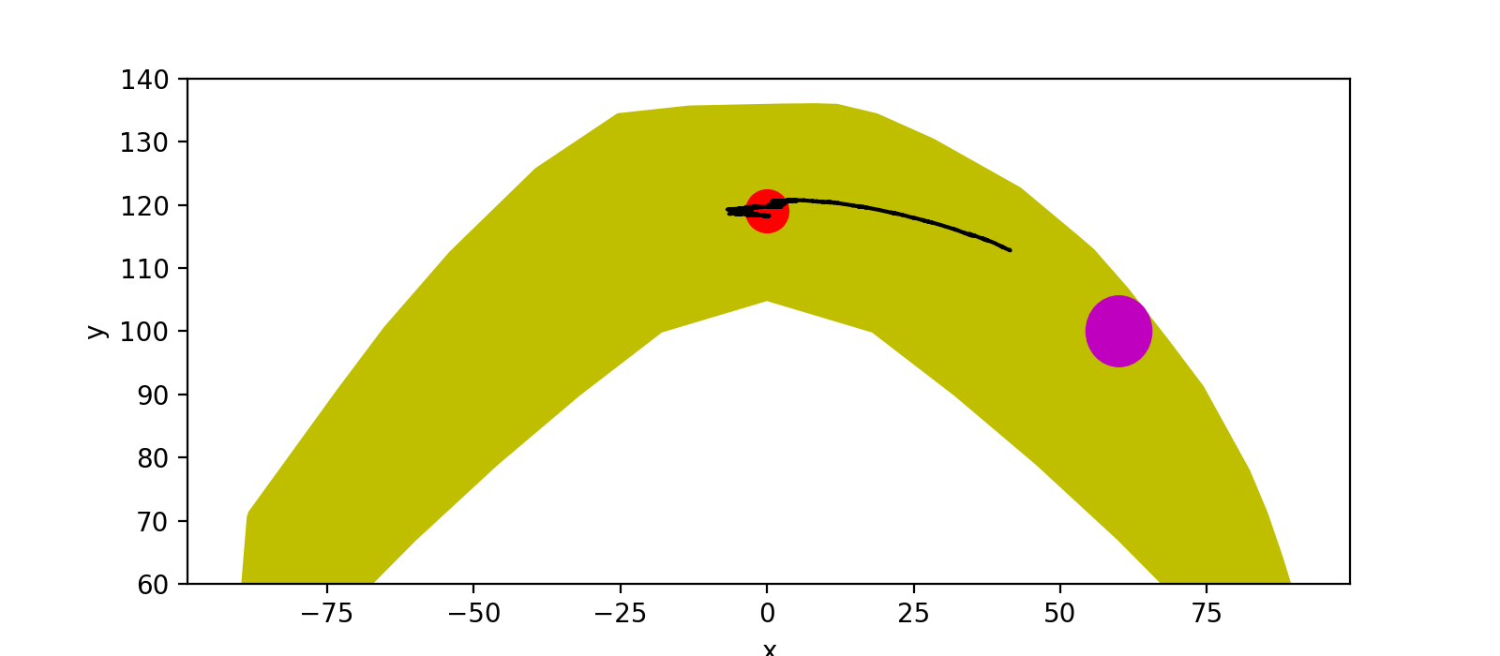

Adaptive Hand Evaluation Path: Goal Loc 7 (seed 1)
after 20 updates
after 30 updates
after 40 updates
after 50 updates

Slide 20



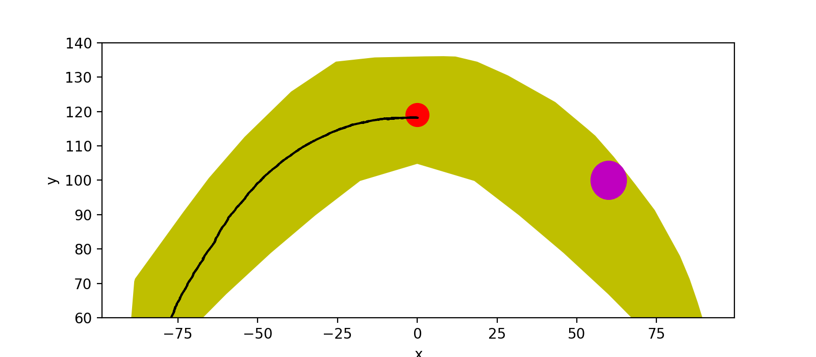
Adaptive Hand Evaluation Path: Goal Loc 7 (seed 1)
after 60 updates
after 70 updates
after 80 updates
after 90 updates

