Slide 1
Meeting 06/23/2020
Shuo Zhang

Slide 2
Progress
PPO Policy Evaluation + Rollout: Reacher-v2
PPO Policy Evaluation + Rollout: Acrobot-v1
Many experiments for PPO on adaptive hand with hyperparameter search
(Both locally and on iLab server)

Slide 3
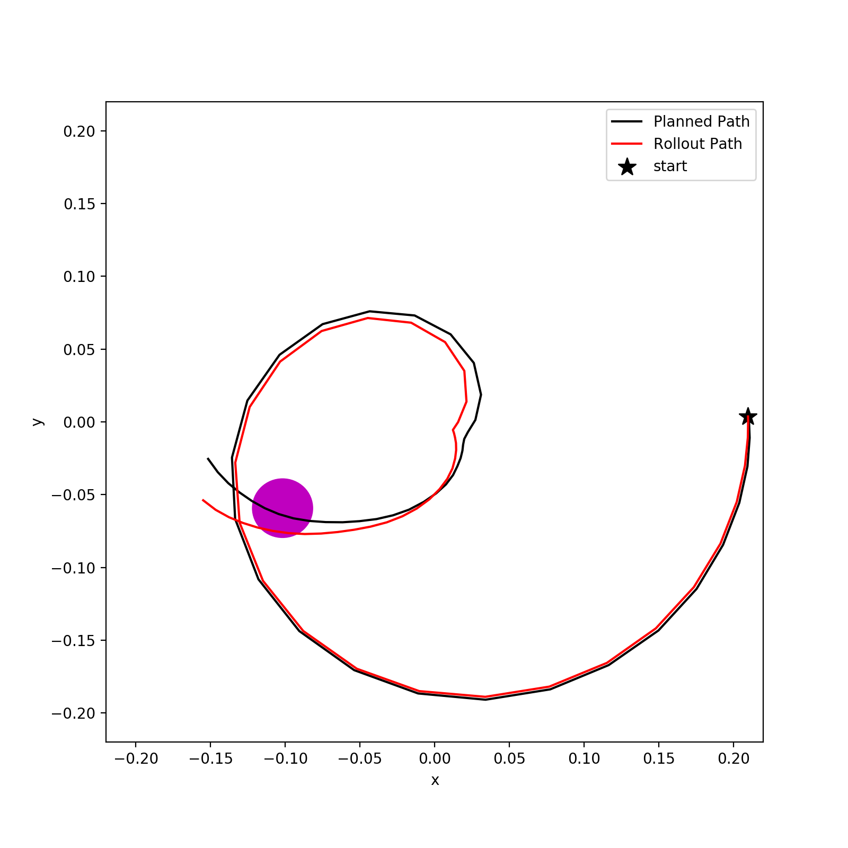
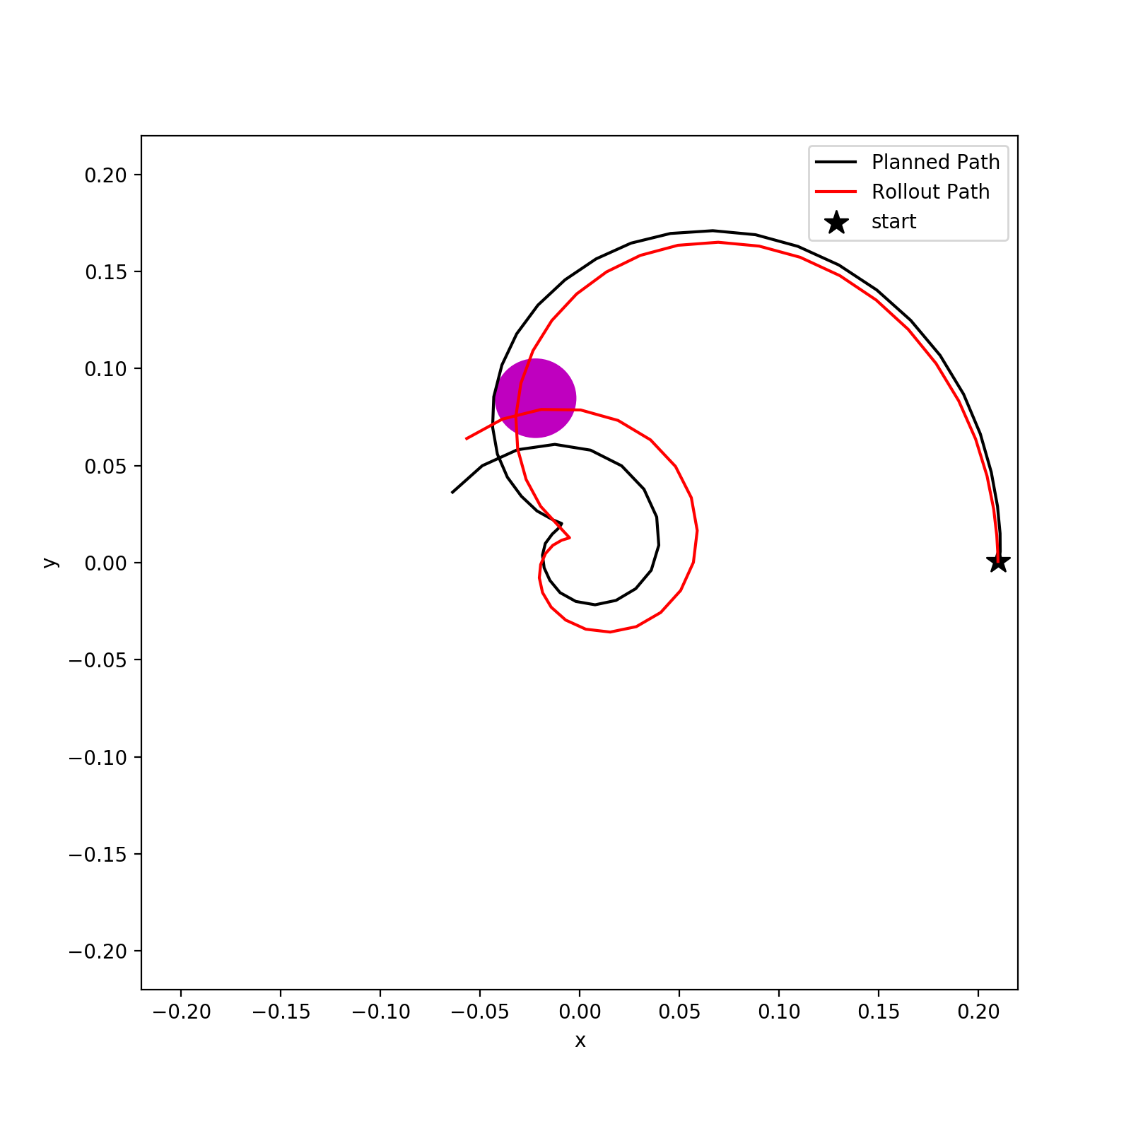
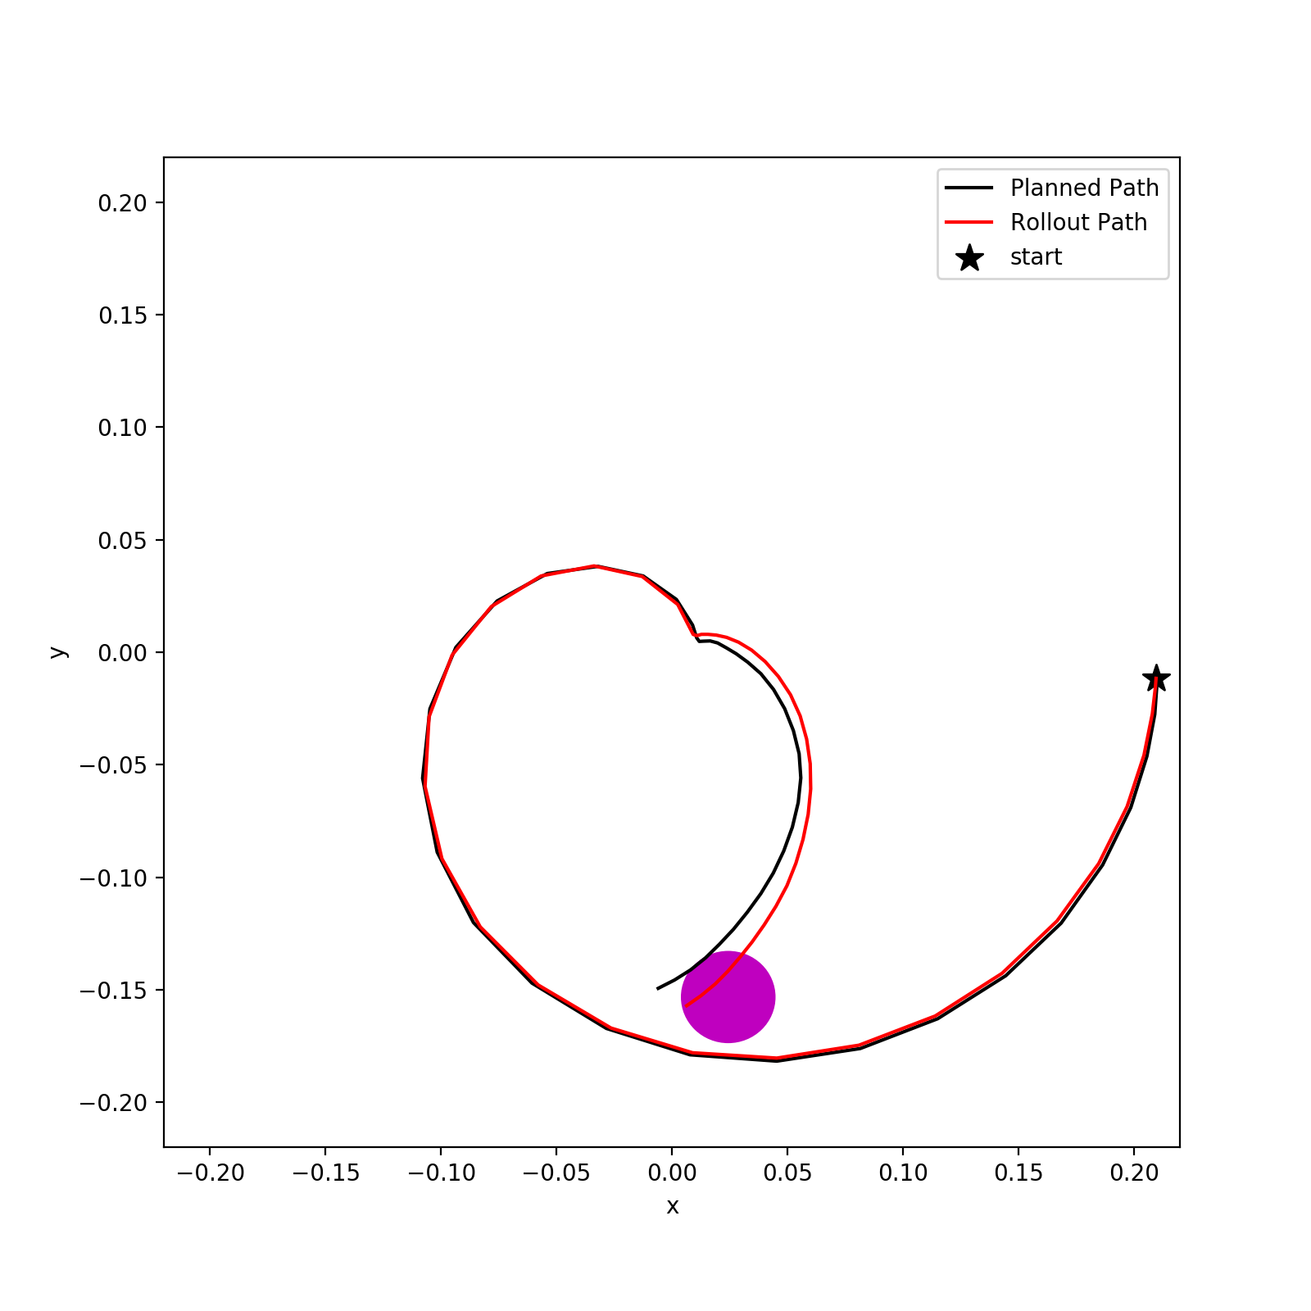
Policy Evaluation + Rollout: Reacher-v2
PPO is trained with learning rate of 3e-4 and 1 million timesteps

Slide 4
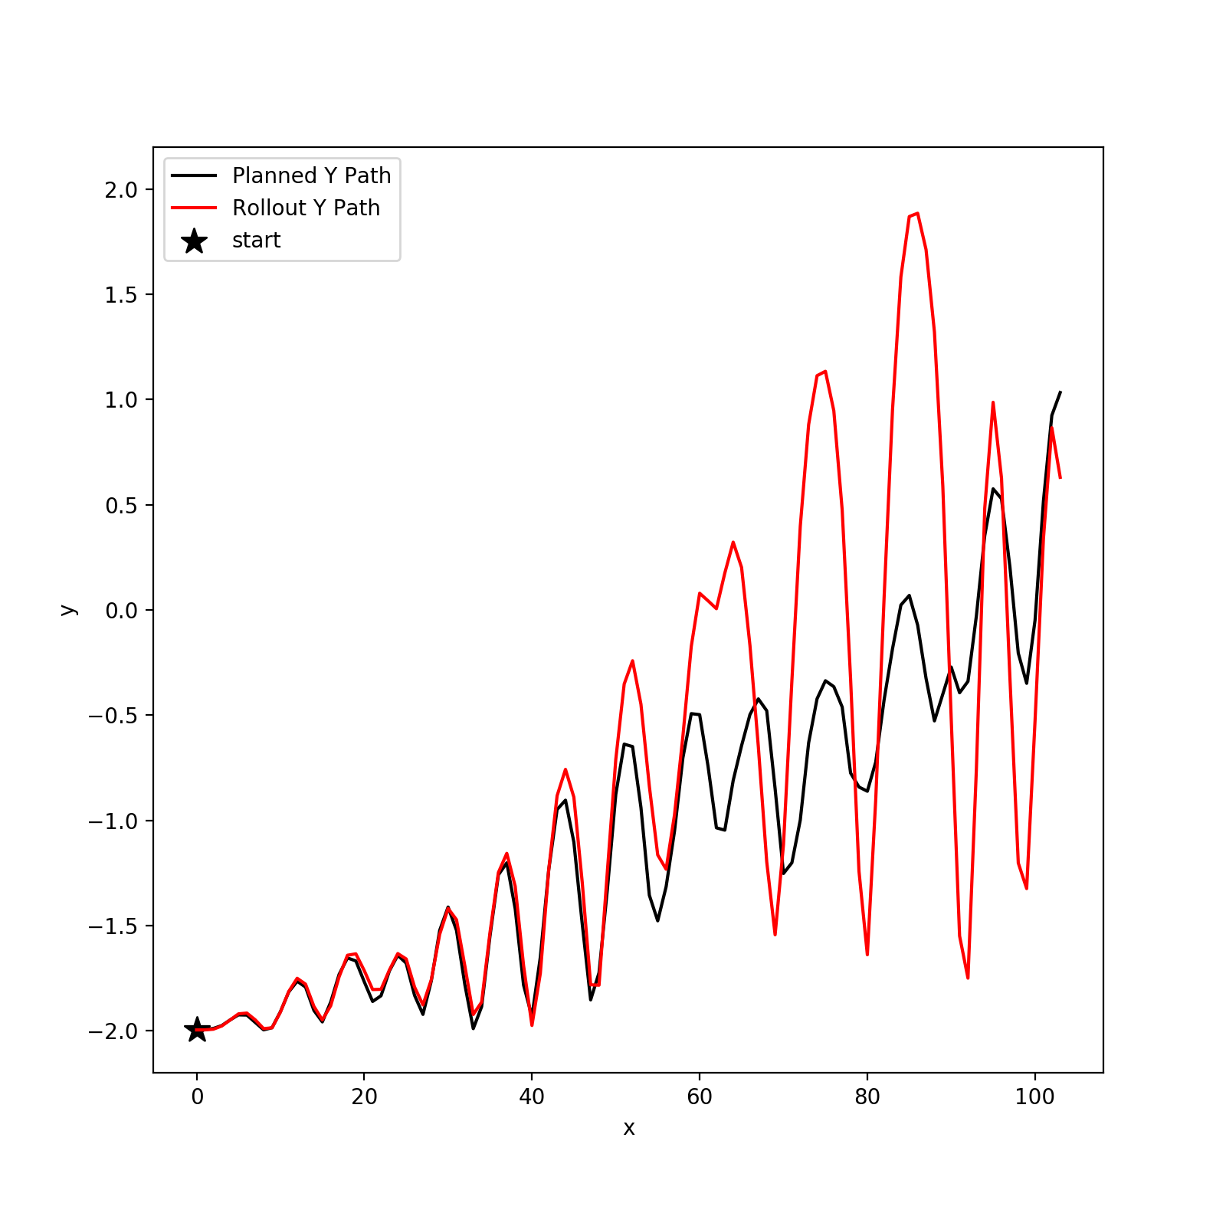
Policy Evaluation + Rollout: Acrobot-v1
PPO is trained with learning rate of 3e-4 and 1 million timesteps

Slide 5
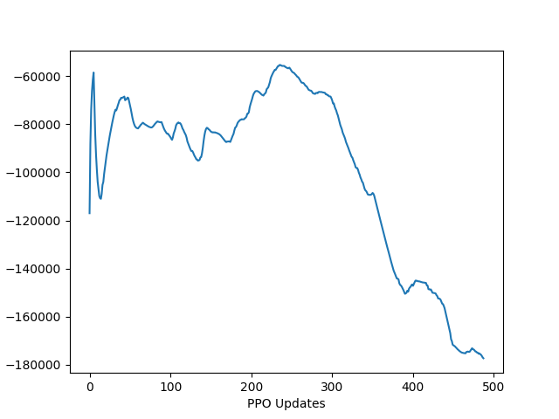
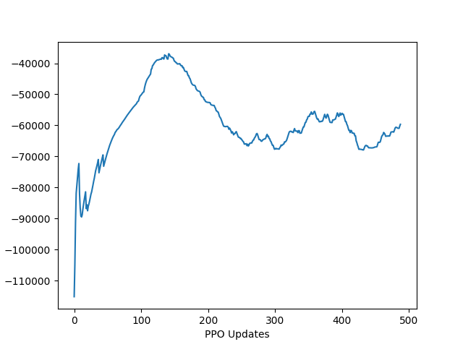
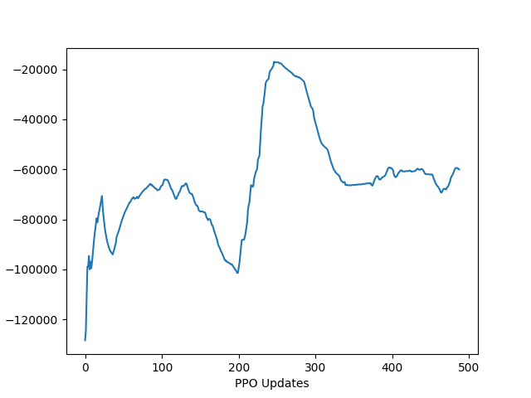
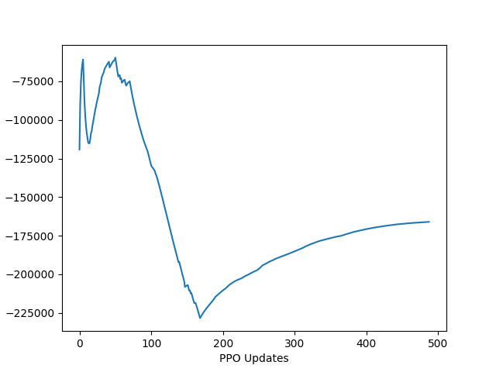
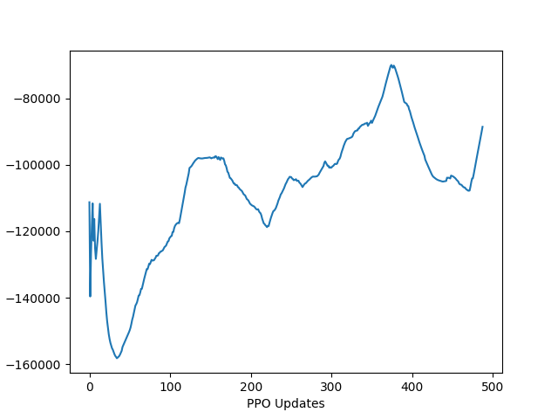
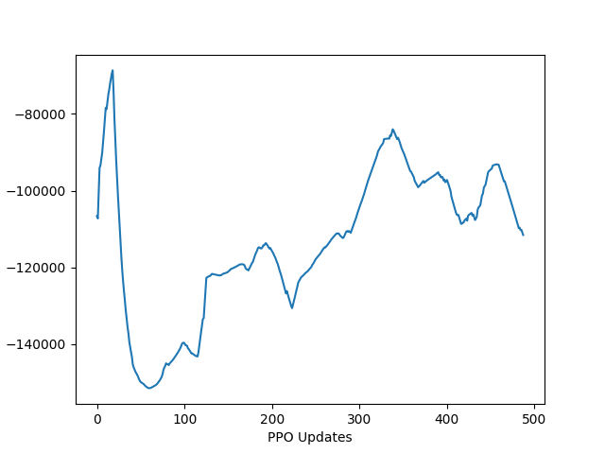
Adaptive Hand PPO: Goal Loc 8
learning rate: 3e-4; 1 million timesteps
Without control reward
With control reward
Seed 0
Seed 1
Seed 2

Slide 6
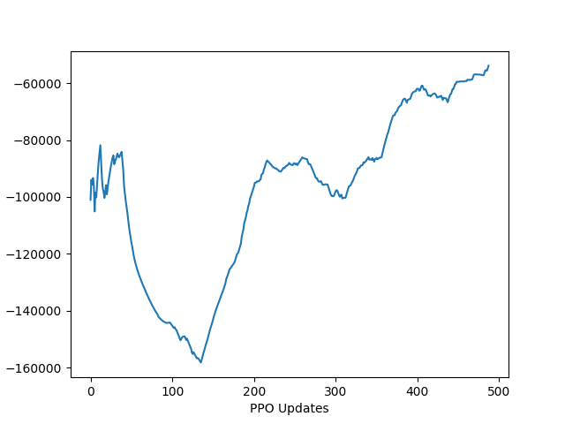
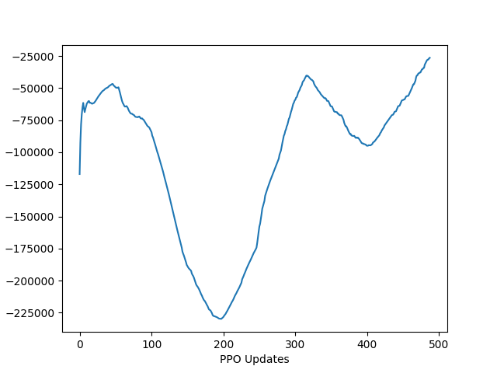
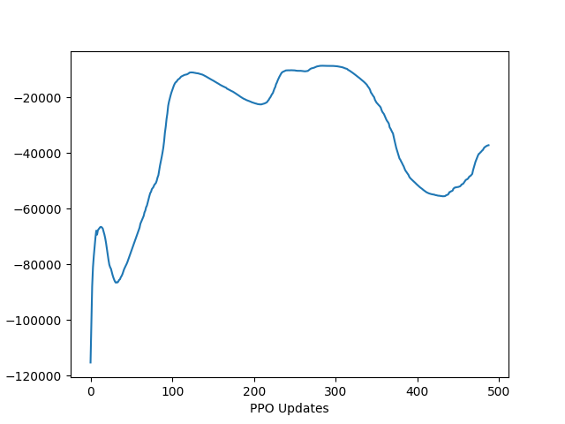
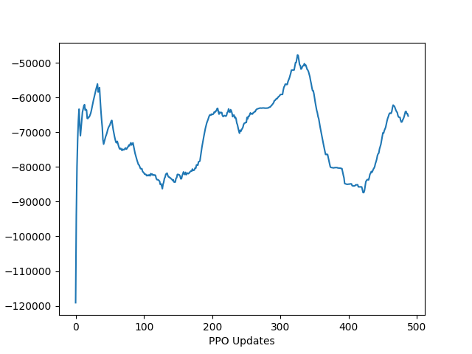
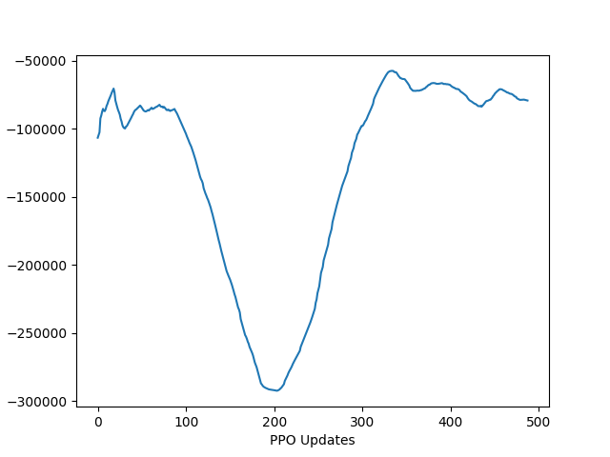
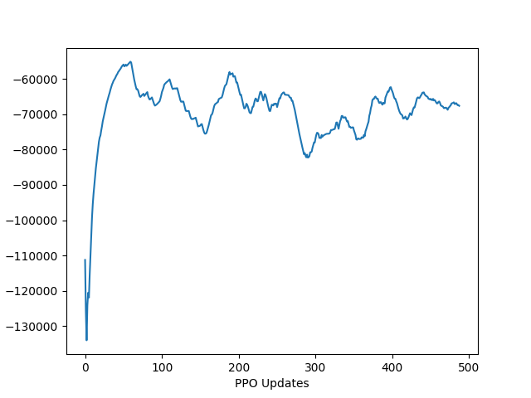
Adaptive Hand PPO: Goal Loc 8
learning rate: 1e-4; 1 million timesteps
Without control reward
With control reward
Seed 0
Seed 1
Seed 2

Slide 7
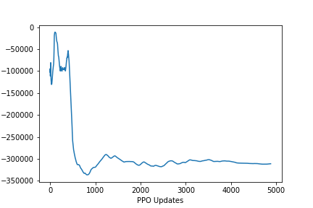
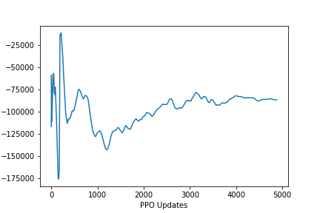
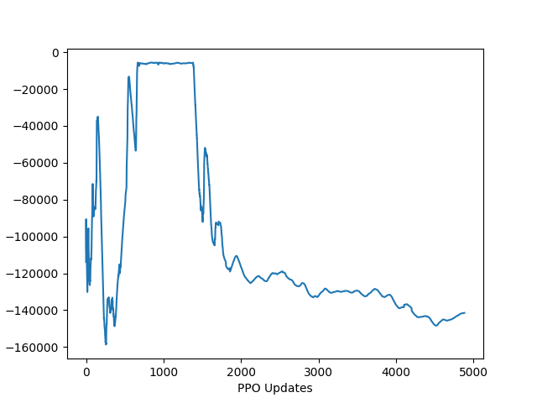
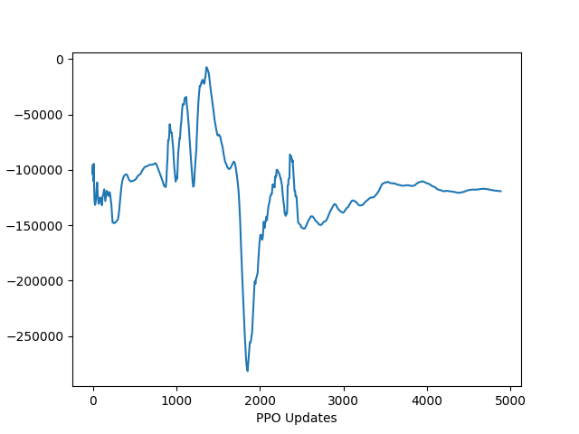
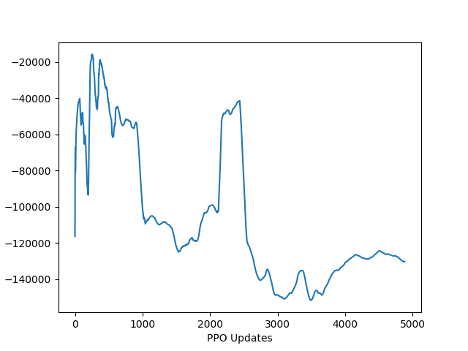
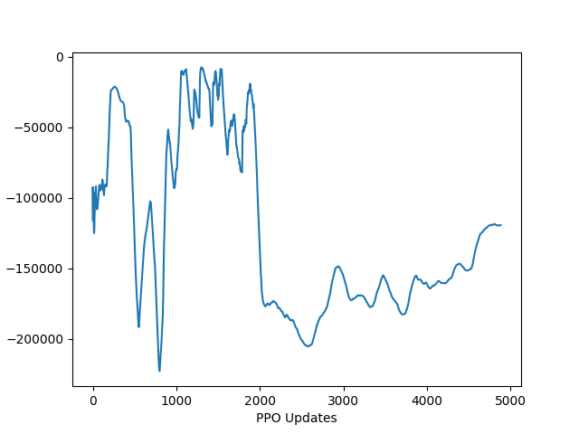
Adaptive Hand PPO: Goal Loc 8
learning rate: 3e-4; 10 million timesteps
Without control reward
With control reward
Seed 0
Seed 1
Seed 2

Slide 8
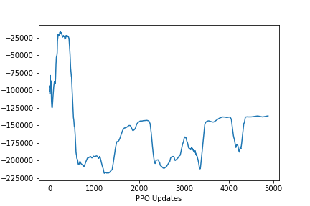
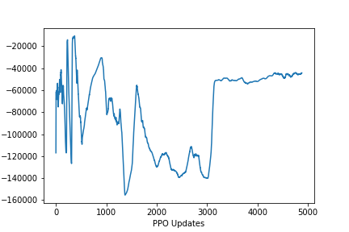
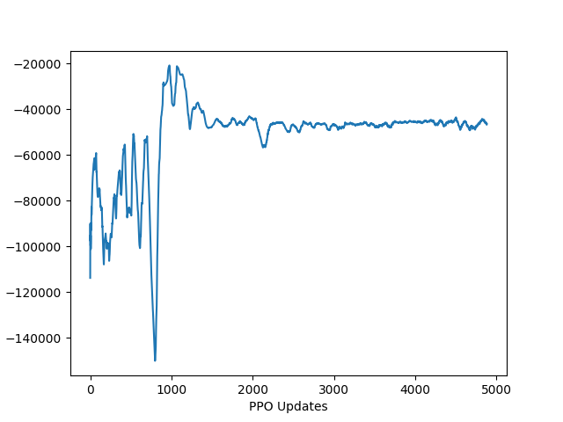
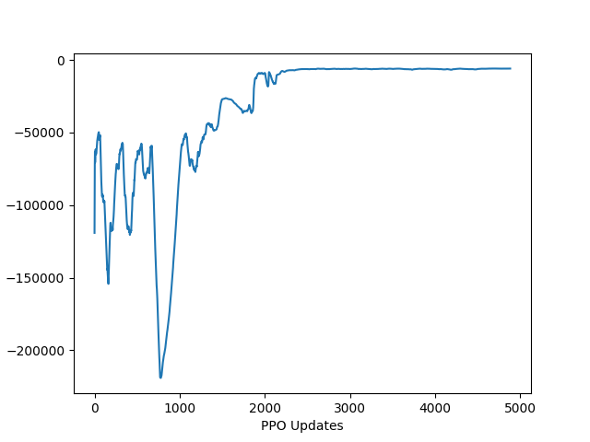
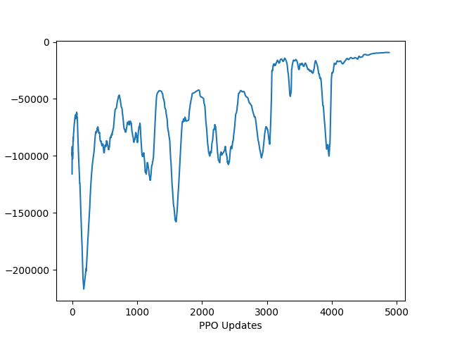
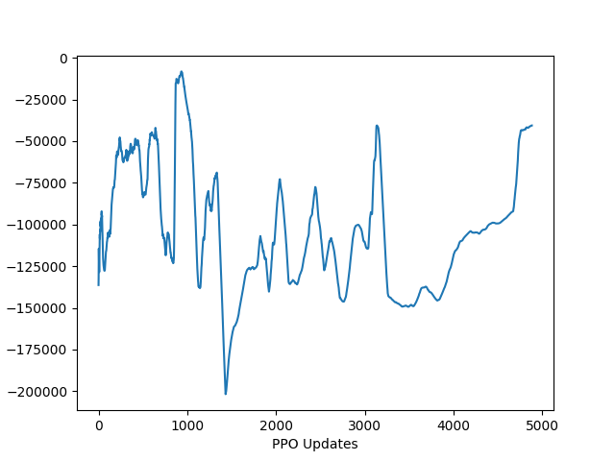
Adaptive Hand PPO: Goal Loc 8
learning rate: 1e-4; 10 million timesteps
Without control reward
With control reward
Seed 0
Seed 1
Seed 2

Slide 9
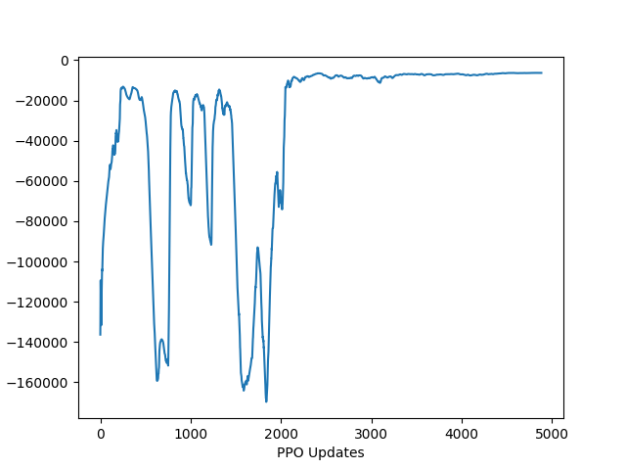
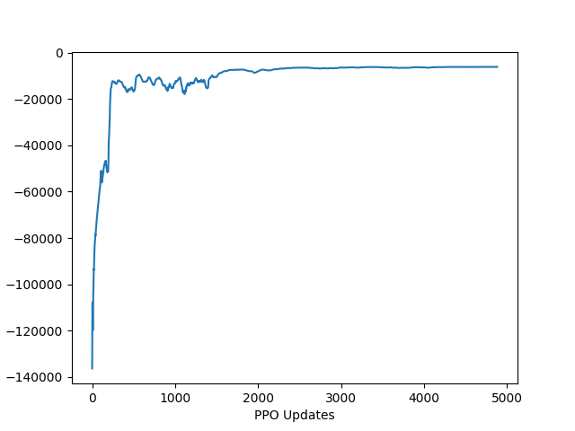
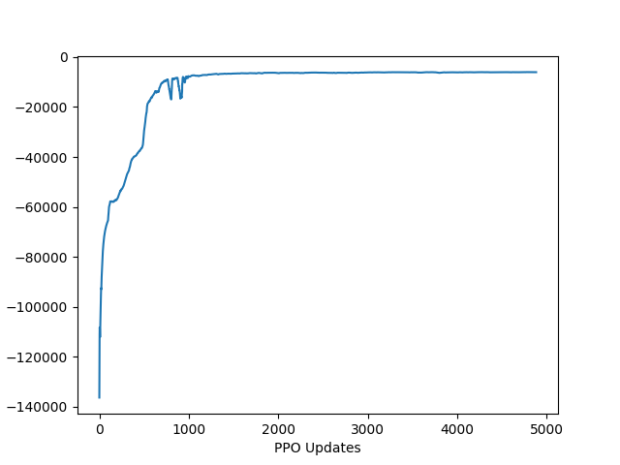
Adaptive Hand PPO: Goal Loc 8
10 million timesteps
Learning rate
5e-5
Learning rate
3e-5
Learning rate
1e-5
With control reward

Slide 10
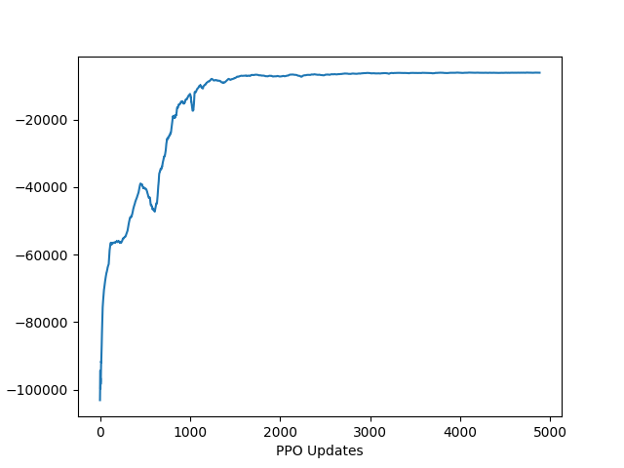
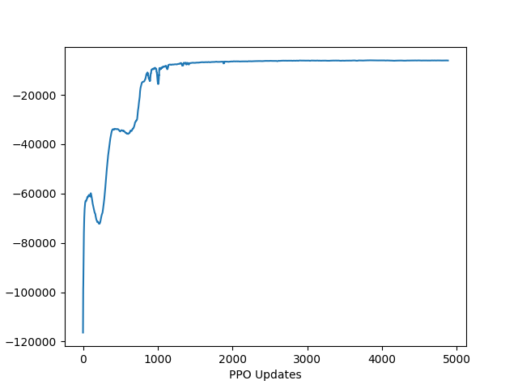
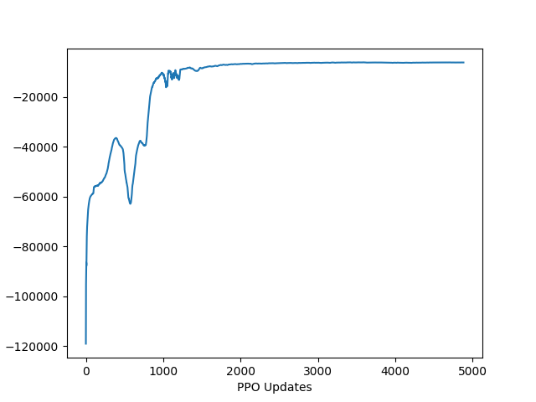
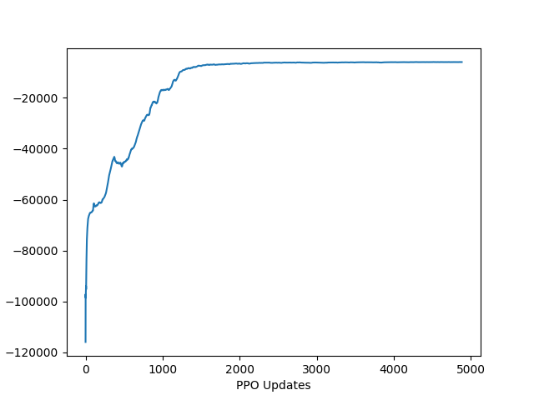
Adaptive Hand PPO: Goal Loc 8
learning rate: 1e-5; 10 million timesteps
With control reward (from seed 0 to seed 4)

Slide 11
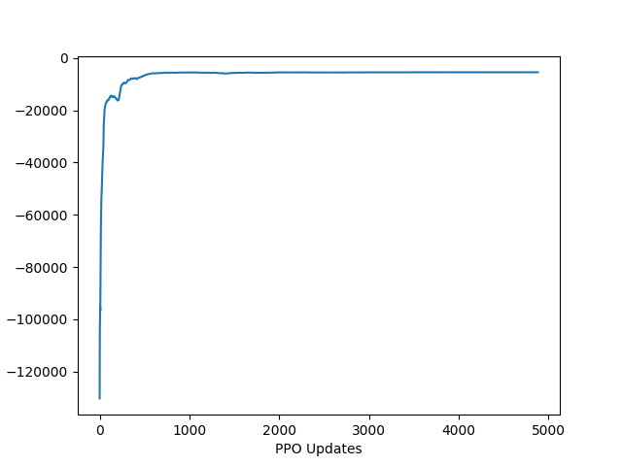
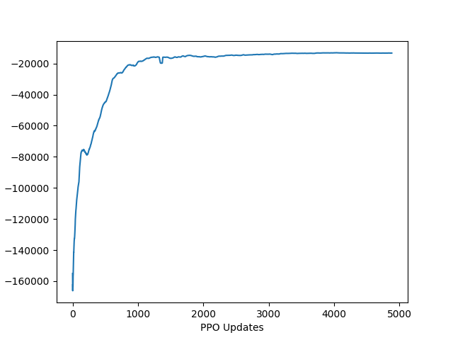
Adaptive Hand PPO: Different Goal Locations
learning rate: 1e-5; 10 million timesteps
With control reward: Goal Loc 7
With control reward: Goal Loc 0

Slide 12
To Do List
Train PPO for gazebo hand in environment with obstacles
Normal obstacles scenario for 5 different goal locations
Horsehoe obstacles scenario
Train PPO for gazebo hand in environment with obstacles (goal location as a part of state information)
Rollout actions from trained policy on real gazebo:
5 different goal locations
horsehoe scenario

