Slide 1
Meeting 05/12/2020
Shuo Zhang

Slide 2
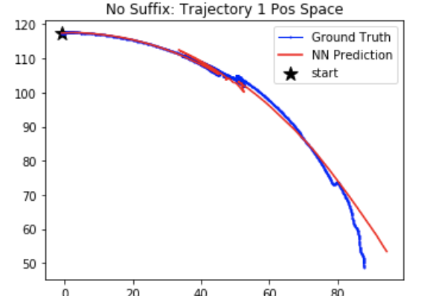
Actions:
60 steps (-0.21, -0.59)
150 steps (0.86, -0.53)
60 steps (-0.59, 0.67)
70 steps (0.29, -0.59)
40 steps (0.80, 0.18)
60 steps (0.95, 0.93)
50 steps (-0.59, -0.60)
…
Continuous Actions!

Slide 3
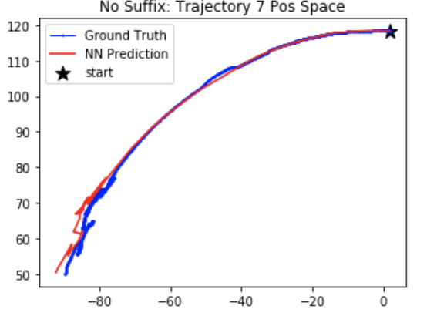
Actions:
20 steps (-0.62, -0.13)
50 steps (-0.73, 0.20)
60 steps (-0.99, -0.81)
…
Continuous Actions!

Slide 4
Discussions
It seems that last time, model could not produce accurate prediction because my actions for planning are discrete and values, -1 or 1m are higher than the raw data
Raw Data: (a1, a2) with a1 and a2 both continuous and within the range [-1, 1]
My 8 actions for planning : (1,1), (1,0), (1,-1), (0,1), (0,-1), (-1,1), (-1,0), (-1,-1)
How should we deal with this so that our rollout and model prediction can match each other more?

Slide 5
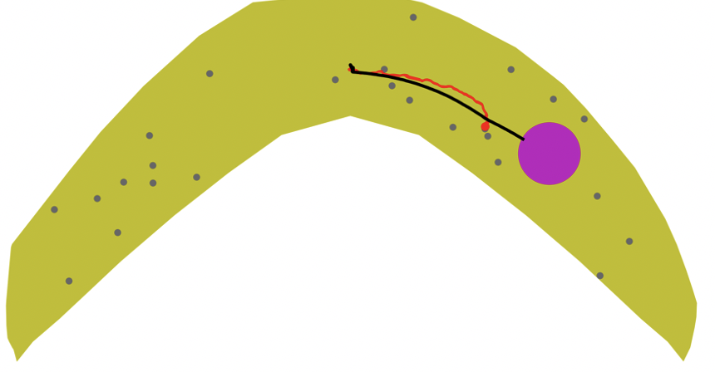
Goal 8 Obstacle 0.75mm

Slide 6
Issue Analysis
Planned Actions: 665 steps totally
First 400 actions: (1, 1) (moving down)
Later 265 actions: (1, 0) (moving right)
Rollout path: collision with obstacle after about 598 steps

Slide 7
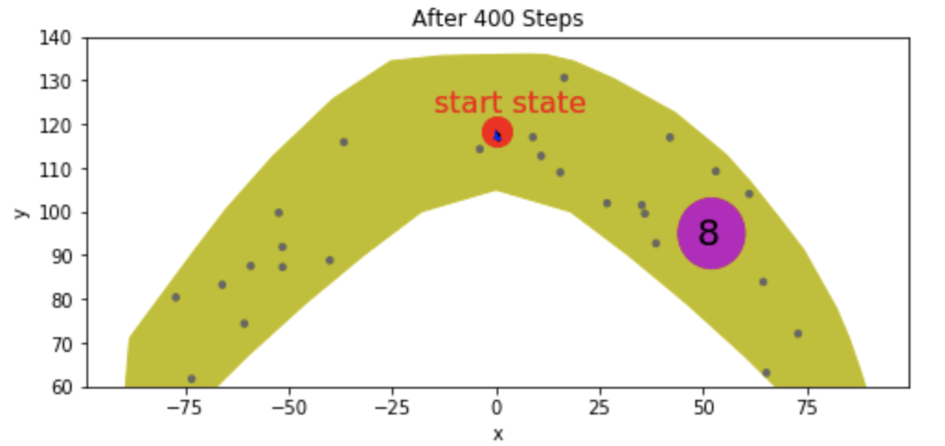
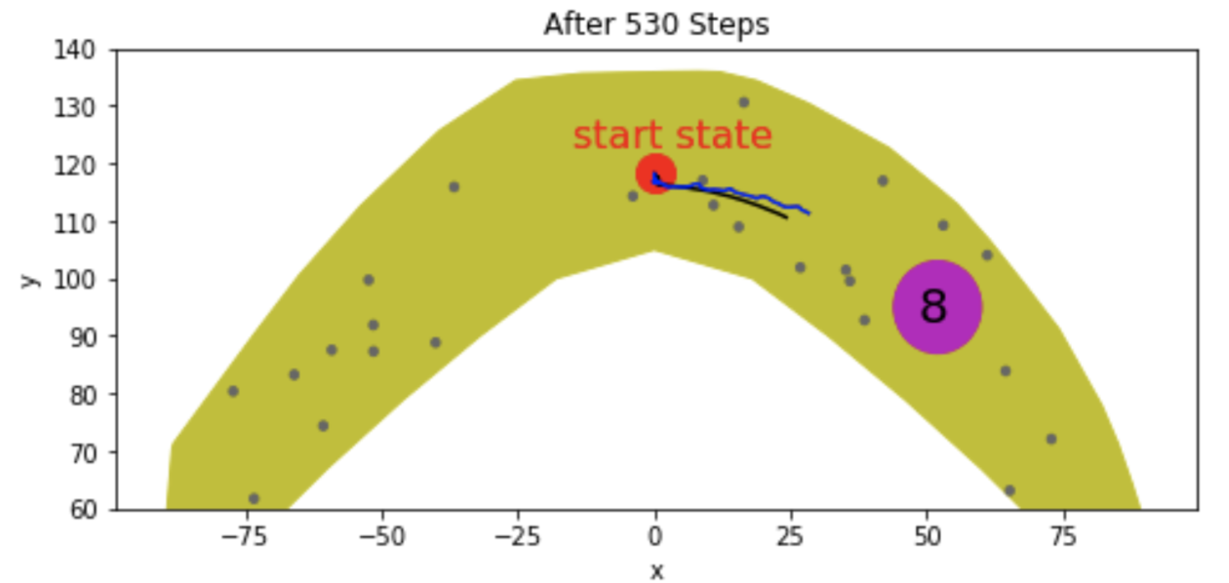
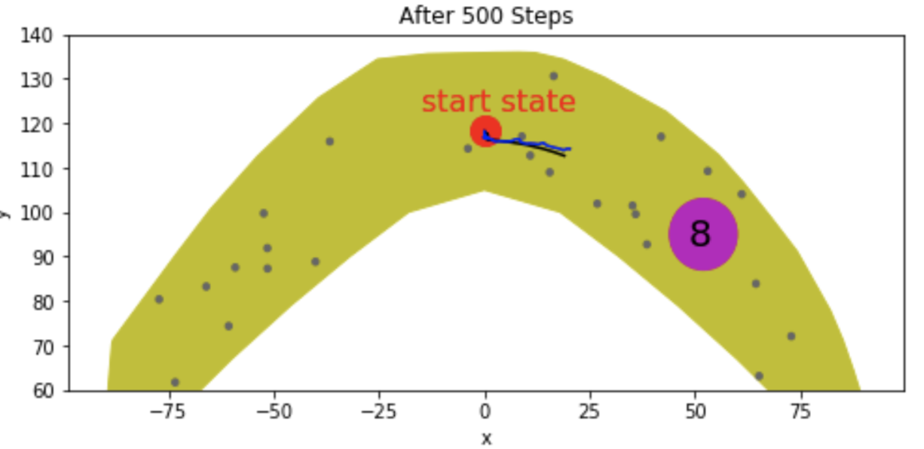
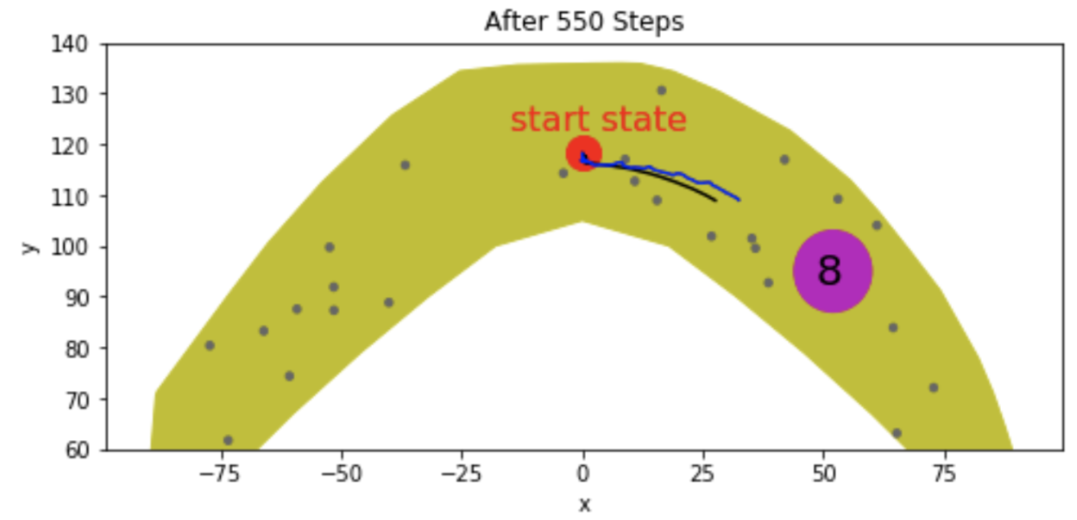
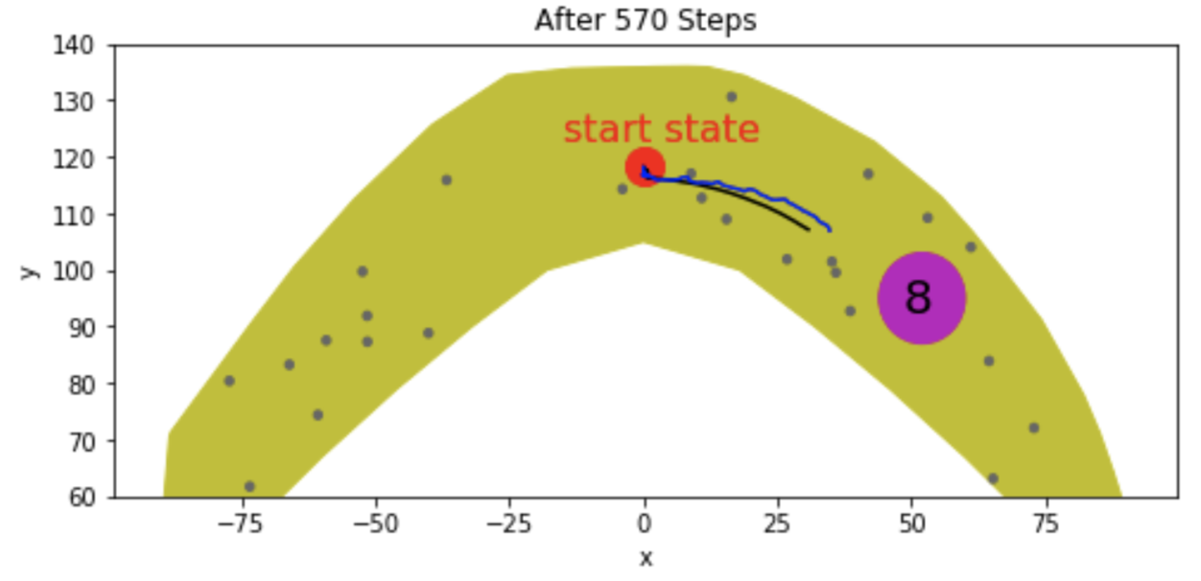
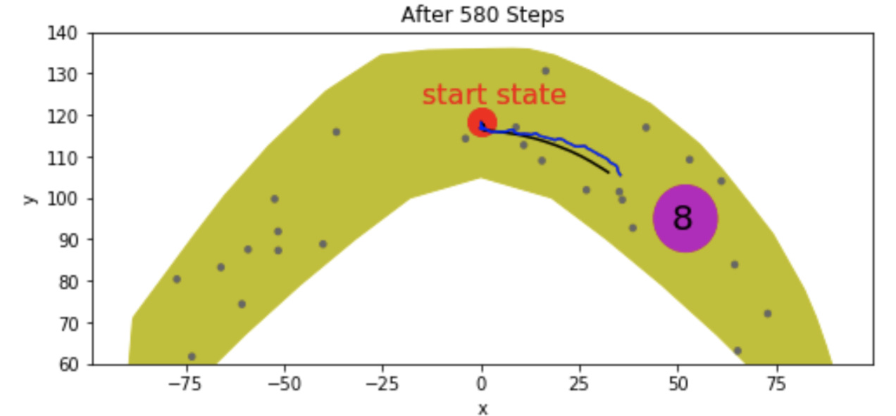
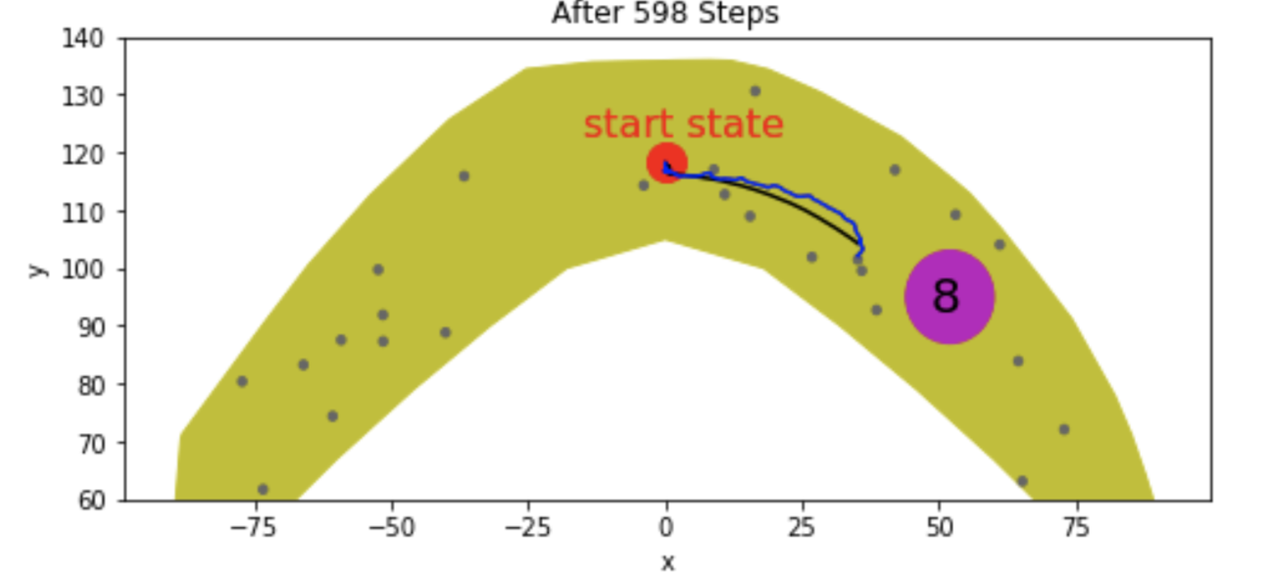
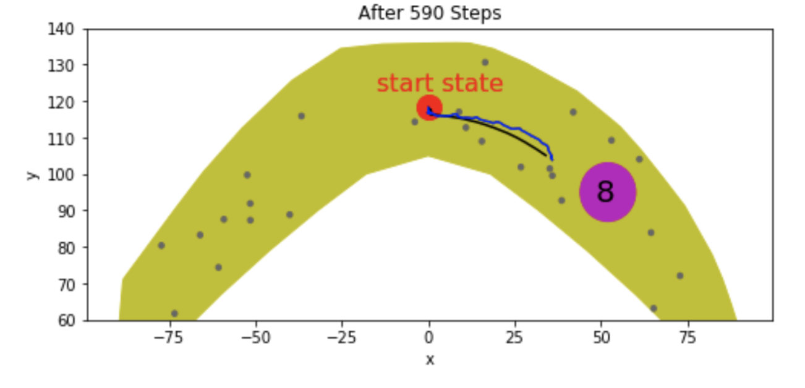
Step-by-Step Analysis

Slide 8
Discussion
Model is not accurate enough in some cases
Possible cases might be:
After many trivial steps are executed, such as 400 steps of (1, 1) only leading to a very small progress, the model became inaccurate. (Raw data has never such cases, like 400 steps of (1,1) pushing gripper to move downside. So, the NN model never learned such cases)
Because load prediction is always not as good as trajectory prediction, so when the values of load matter much, the trajectory prediction, based on the inaccurate load, would be bad. 400 steps of (1, 1) would lead to a relatively high load, which might influence the trajectory prediction afterwards, to a great extent.
Maybe predictions for steps, (1,1) or (-1,-1), themselves are not accurate enough, although predictions for (1,0),(1,-1),(0,1),(-1,1) are every good.

