Slide 1
Meeting 07/09/2020
Shuo Zhang

Slide 2
In past week
1) PPO for real hand: Done
2) Clean and wrapped codes so far + managed experiment's logistic: Done
3) 10 rollouts for A* and PPO on reacher and acrobot: Done
4) 10 rollouts for gazebo: Done (on my own machine, 14 hours)
5) Got all statistics: Done
6) Write rollout ros package codes for real hand: Just to start

Slide 3
Progress
 | A* Plan + Rollout + Statistic | PPO Plan + Rollout + Statistic | Online Method
Acrobot | Done | Done | Need to discuss in more details
Reacher | Done | Done | Need to discuss in more details
Gazebo Hand (normal obstacles + horseshoe ) | Done | Done | Need to discuss in more details
Real Had (no obstacles) | Plan is done. (Wait for Mridul until the marker issues fixed) | Plan is done. (Wait for Mridul until the marker issues fixed) | Need to discuss in more details

Slide 4
Gazebo Hand Statistics
goal location (method) | success rollout rate | goal reach rate | success rollout path RMSE relative to plan path [mm] | path length [mm] |  |  | number of path steps |  | last distance to goal [mm]
 |  |  |  | plan | success rollout | failure | plan | failure | plan | success rollout | failure
0 (A*) | 0% | 0% | - | 75.88 | - | 75.35±5.94 | 390 | 375.8±31.3 | 5.50 | - | 11.43±4.29
0 (policy) | 100% | 100% | 1.80±0.02 | 150.18 | 98.68±0.76 | - | 947 | - | 5.49 | 5.13±0.22 | -
2 (A*) | 100% | 100% | 1.26±0.06 | 63.10 | 62.79±0.11 | - | 295 | - | 5.38 | 4.89±0.10 | -
2 (policy) | 100% | 100% | 1.08±0.06 | 77.14 | 62.90±0.04 | - | 385 | - | 5.49 | 4.70±0.11 | -
7 (A*) | 100% | 100% | 0.79±0.03 | 59.08 | 58.73±0.11 | - | 197 | - | 5.49 | 5.20±0.09 | -
7 (policy) | 60% | 50% | 1.45±0.05 | 110.43 | 59.82±0.38 | 9.06±0.06 | 695 | 109.25±0.43 | 5.36 | 7.84±0.12 | 54.14±0.05
8 (A*) | 100% | 100% | 0.94±0.01 | 58.04 | 57.68±0.07 | - | 289 | - | 5.50 | 5.63±0.06 | -
8 (policy) | 40% | 40% | 1.39±0.04 | 109.89 | 59.82±0.19 | 8.90±0.12 | 752 | 94±0.57 | 5.47 | 7.22±0.37 | 48.74±0.09
15 (A*) | 100% | 100% | 1.01±0.01 | 80.85 | 80.71±0.14 | - | 436 | - | 5.46 | 6.08±0.16 | -
15 (policy) | 20% | 0% | 3.66±0.04 | 191.42 | 104.59±0.06 | 8.96±0.11 | 1299 | 90±1.87 | 5.41 | 9.35±0.32 | 72.10±0.08
horseshoe (A*) | 90% | 90% | 3.87±0.04 | 165.17 | 173.71±0.47 | 162.05±0 | 731 | 680±0 | 3.37 | 3.00±0.30 | 9.53±0
horseshoe (policy) | - | - | - | - | - | - | - | - | - | - | -

Slide 5
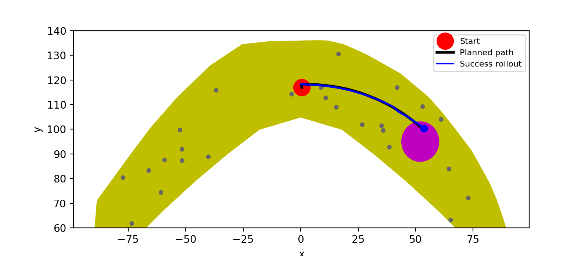
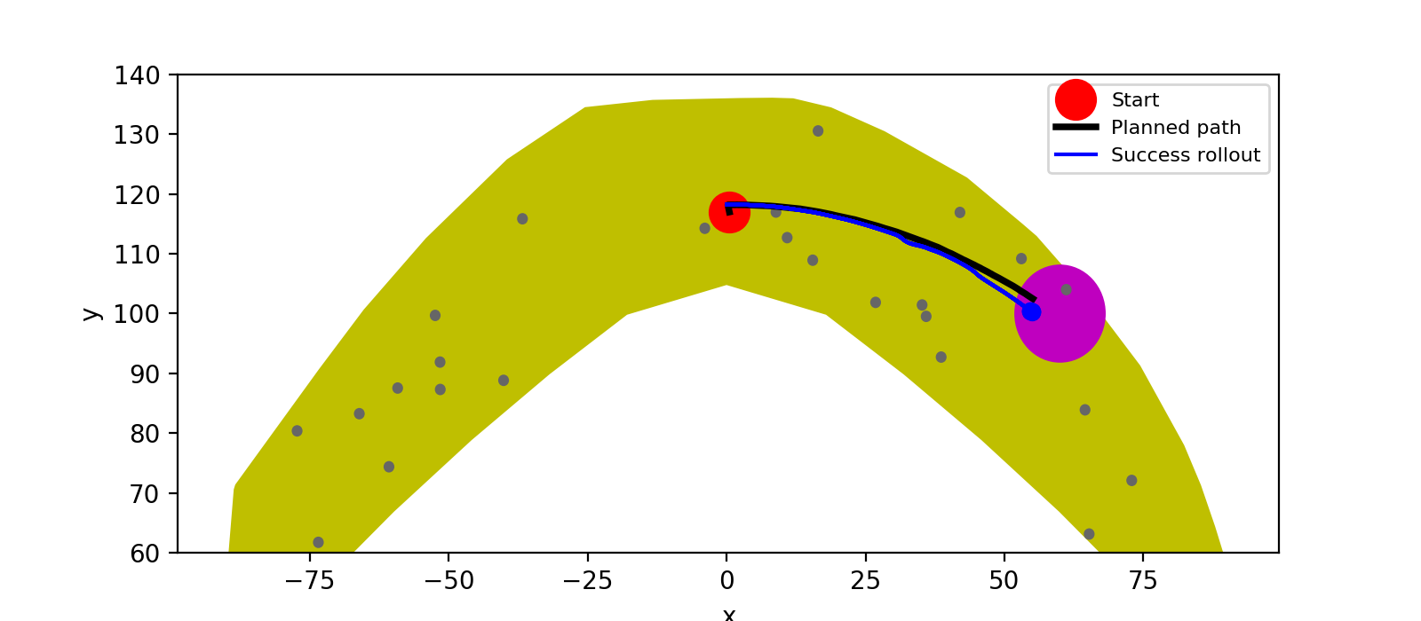
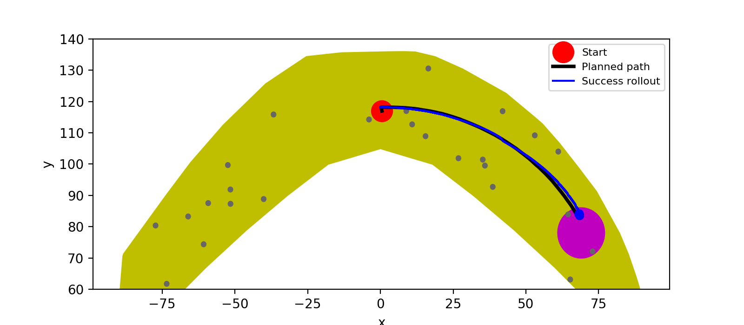
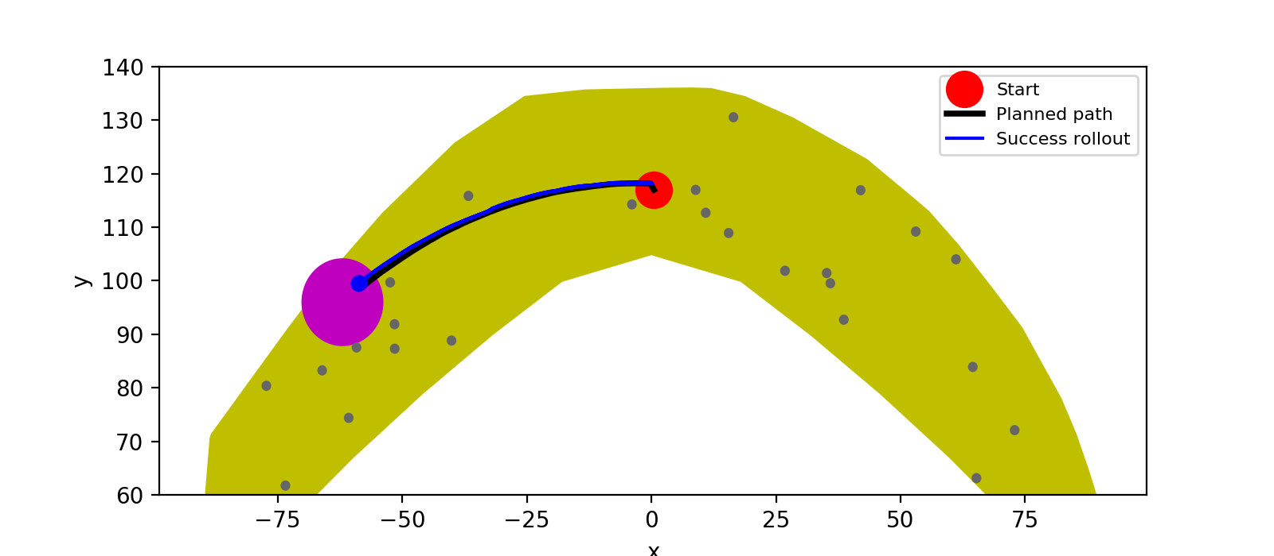
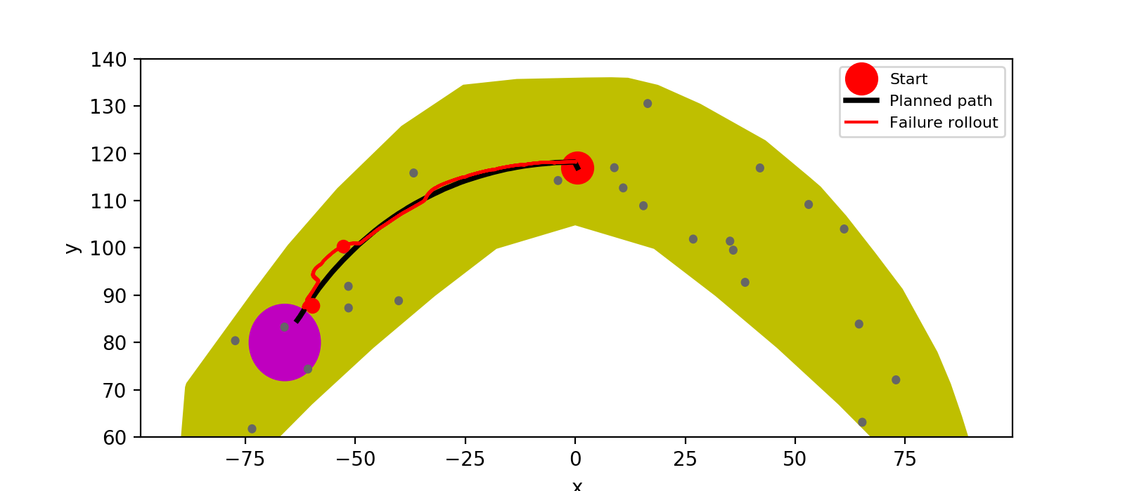
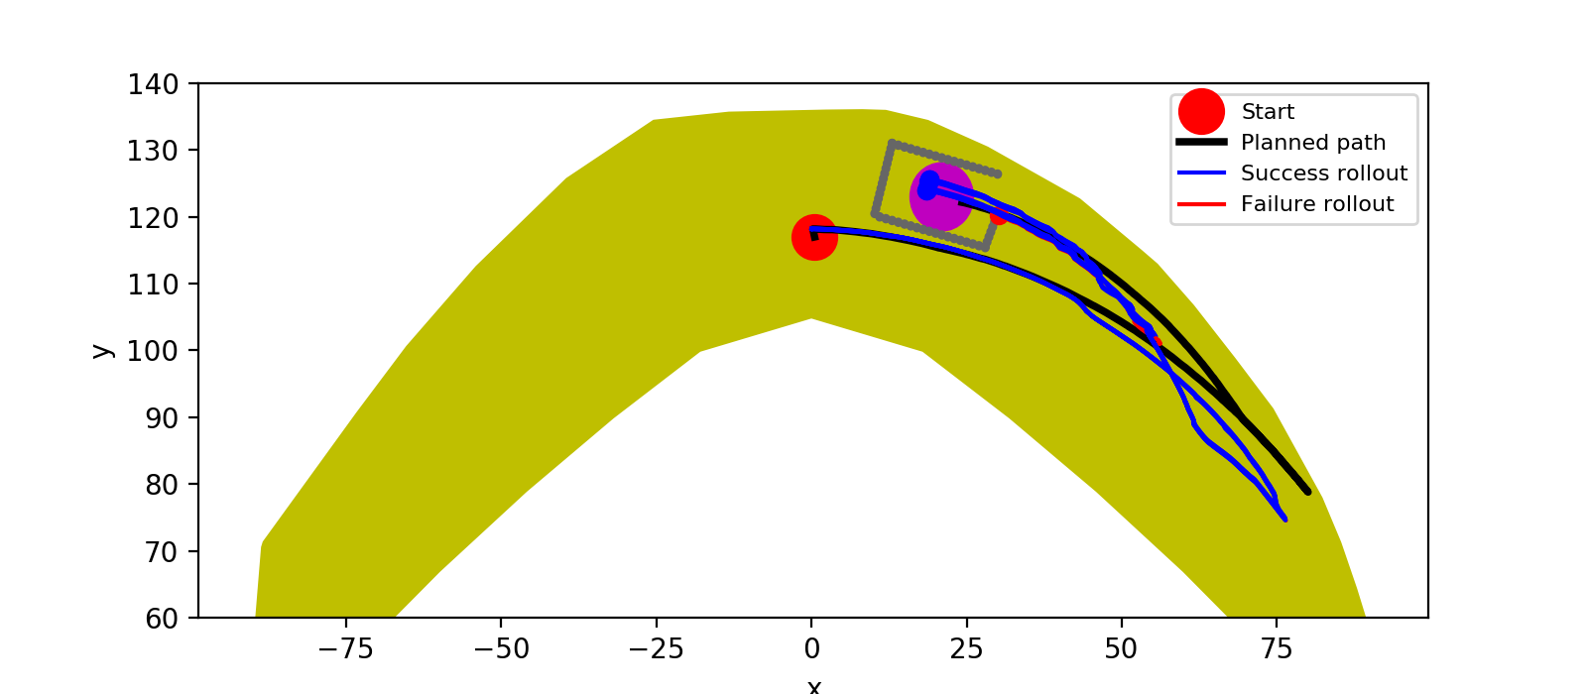
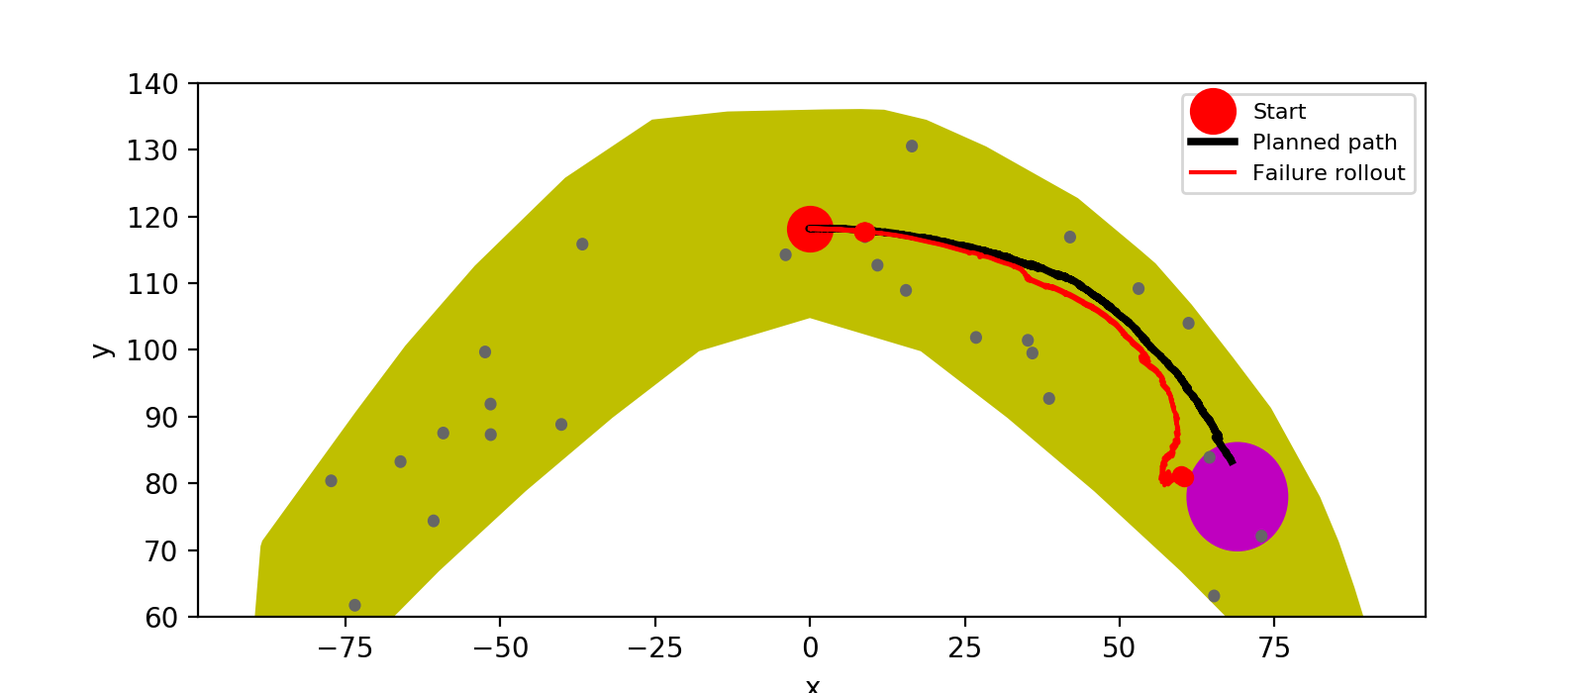
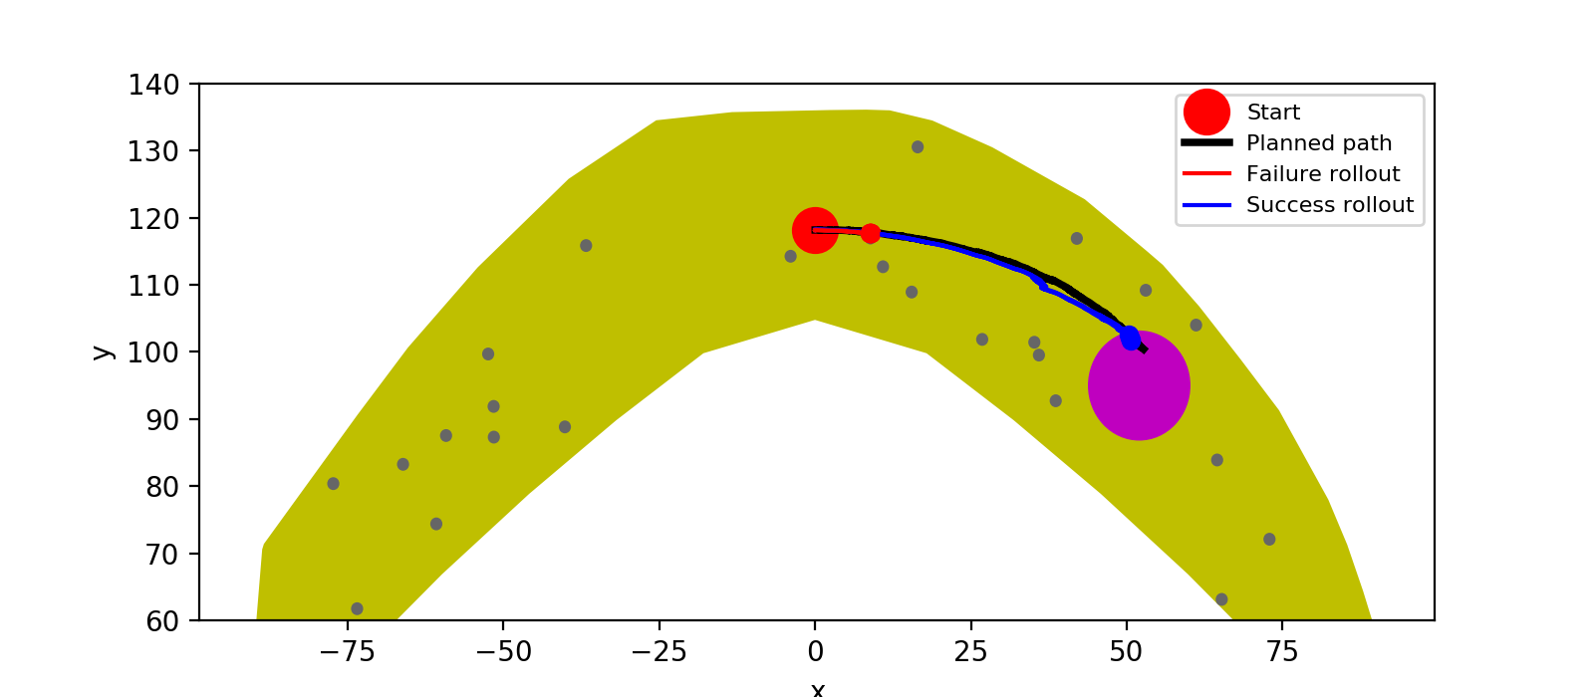
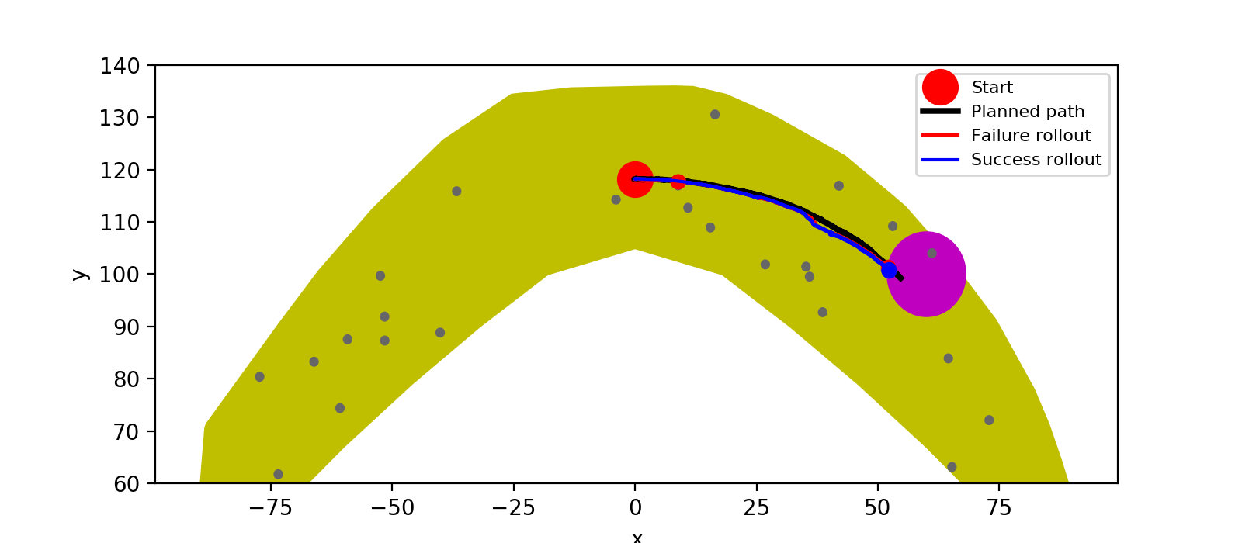
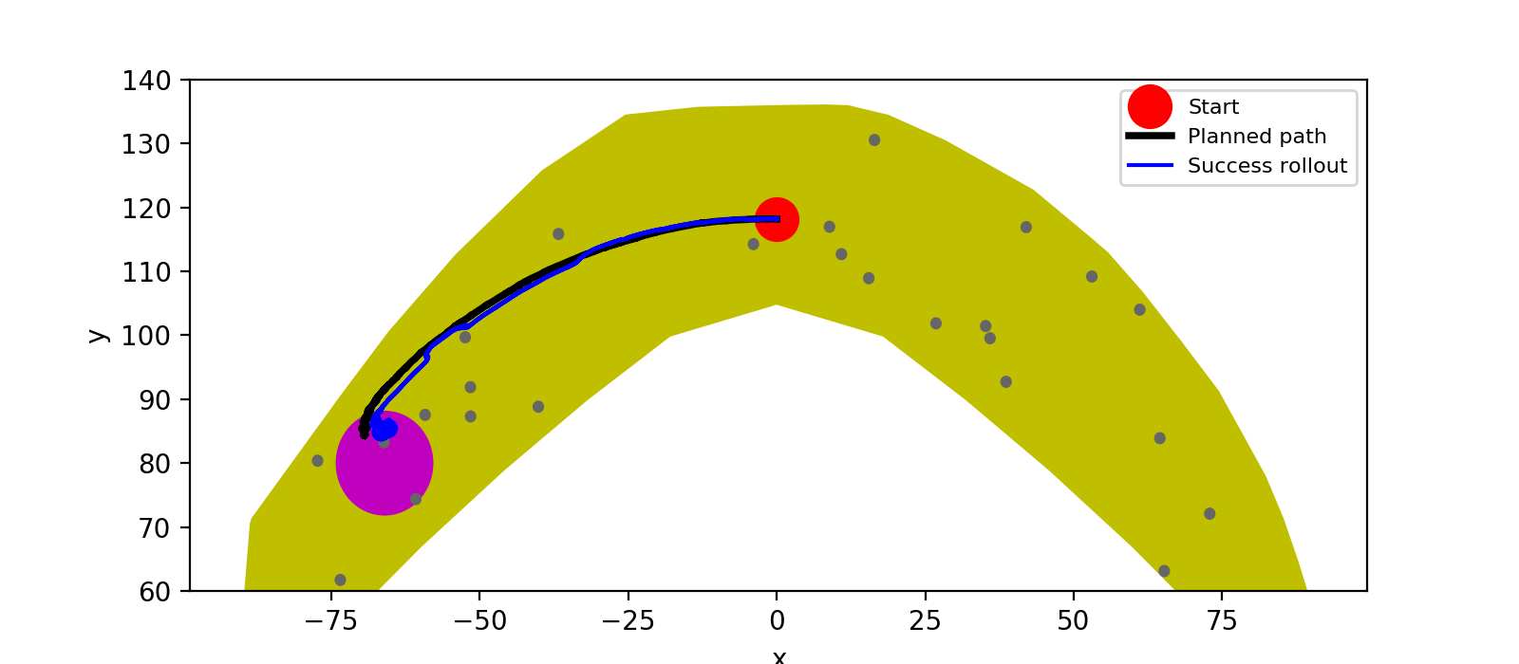
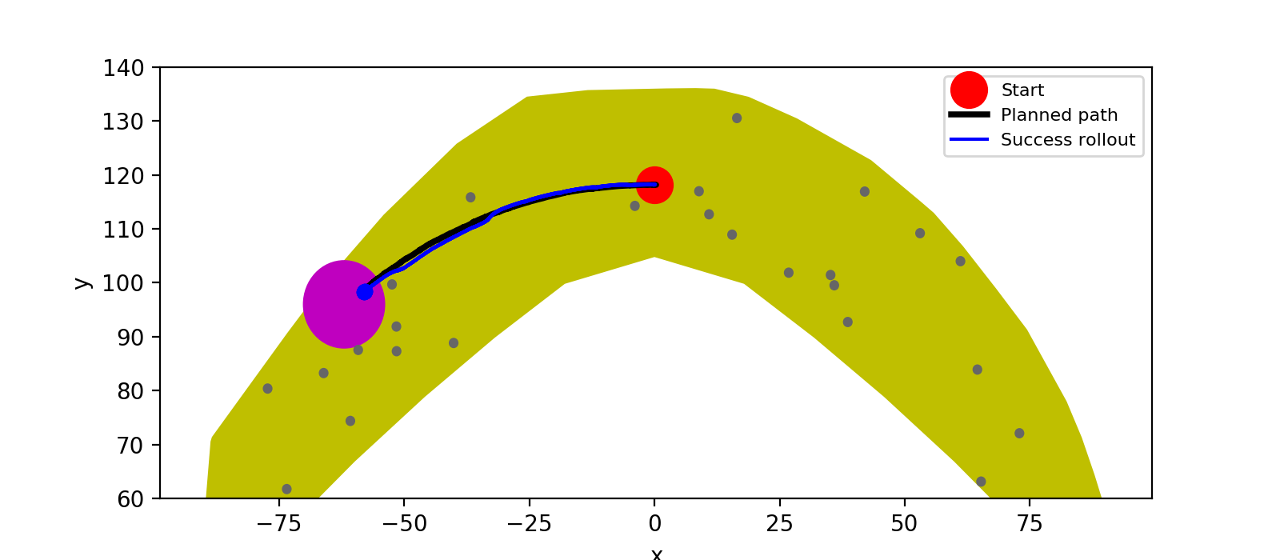
A*
Policy

Slide 6
Reacher-v2 Statistics
goal location (method) | goal reach rate | rollout path RMSE relative to plan path [mm] | path length [mm] |  | number of path steps | last distance to goal [mm]
 |  |  | plan | rollout |  | plan | rollout
1 (A*) | 100% | 0.01025±0.00091 | 0.22799 | 0.24568±0.00221 | 16 | 0.00778 | 0.00993±0.00112
1 (policy) | 60% | 0.00599±0.00203 | 0.87181 | 0.86061±0.00931 | 51 | 0.03055 | 0.02295±0.00937
2 (A*) | 100% | 0.0034±0.00065 | 0.24392 | 0.24707±0.00159 | 26 | 0.00859 | 0.00509±0.00105
2 (policy) | 0% | 0.01801±.00191 | 0.72881 | 0.78558±0.01989 | 51 | 0.06385 | 0.04545±0.00596
5 (A*) | 100% | 0.00871±0.00373 | 0.31887 | 0.32344±0.00551 | 23 | 0.00449 | 0.00598±0.00154
5 (policy) | 0% | 0.01307±0.00383 | 1.05959 | 1.00686±0.01665 | 51 | 0.06024 | 0.05161±0.00201

Slide 7
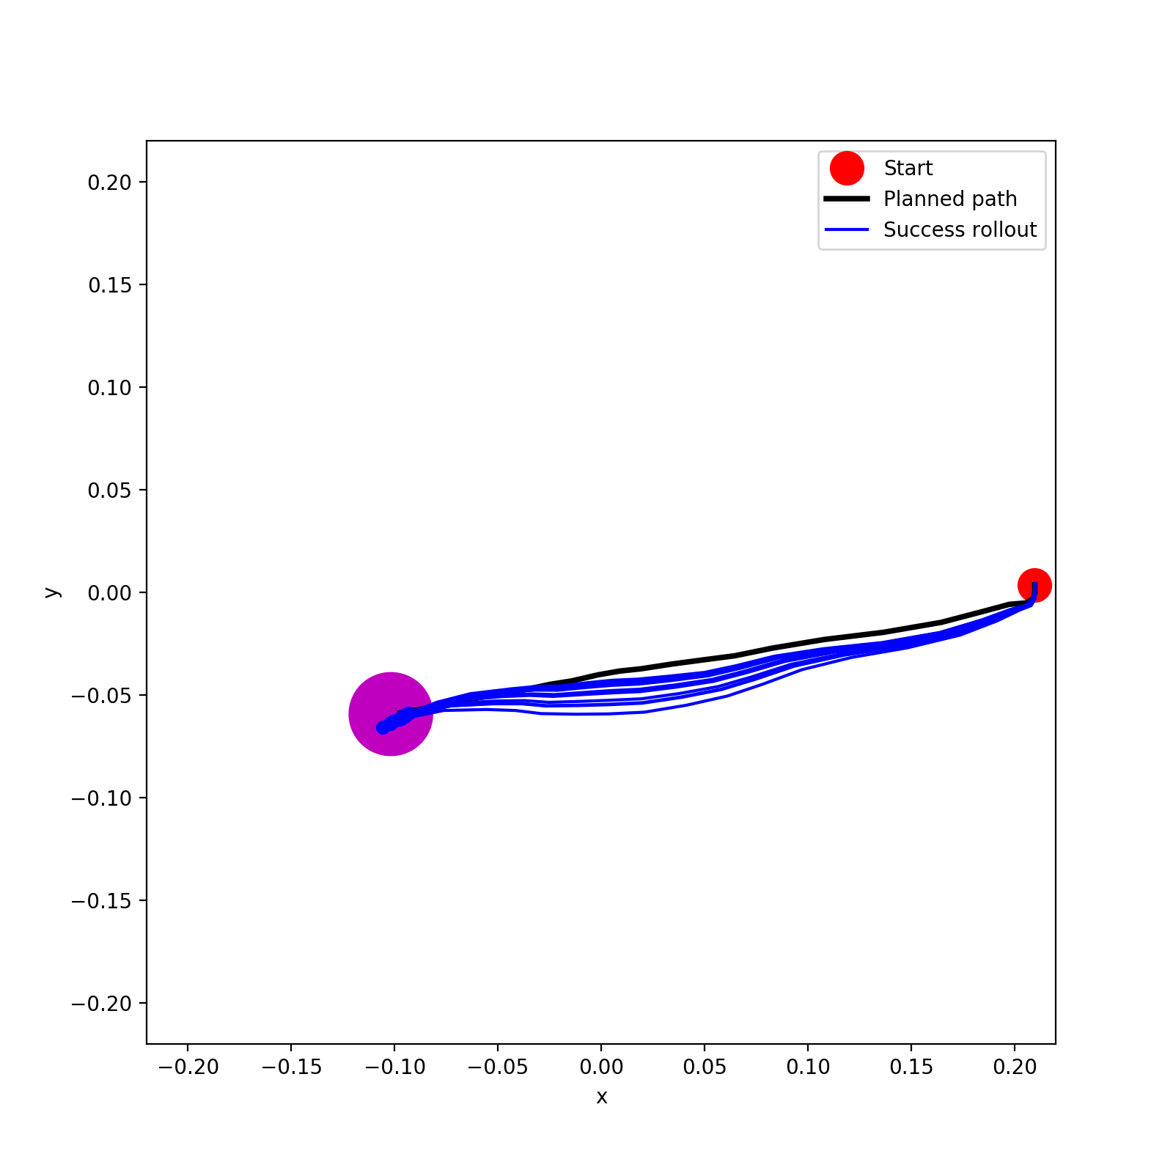
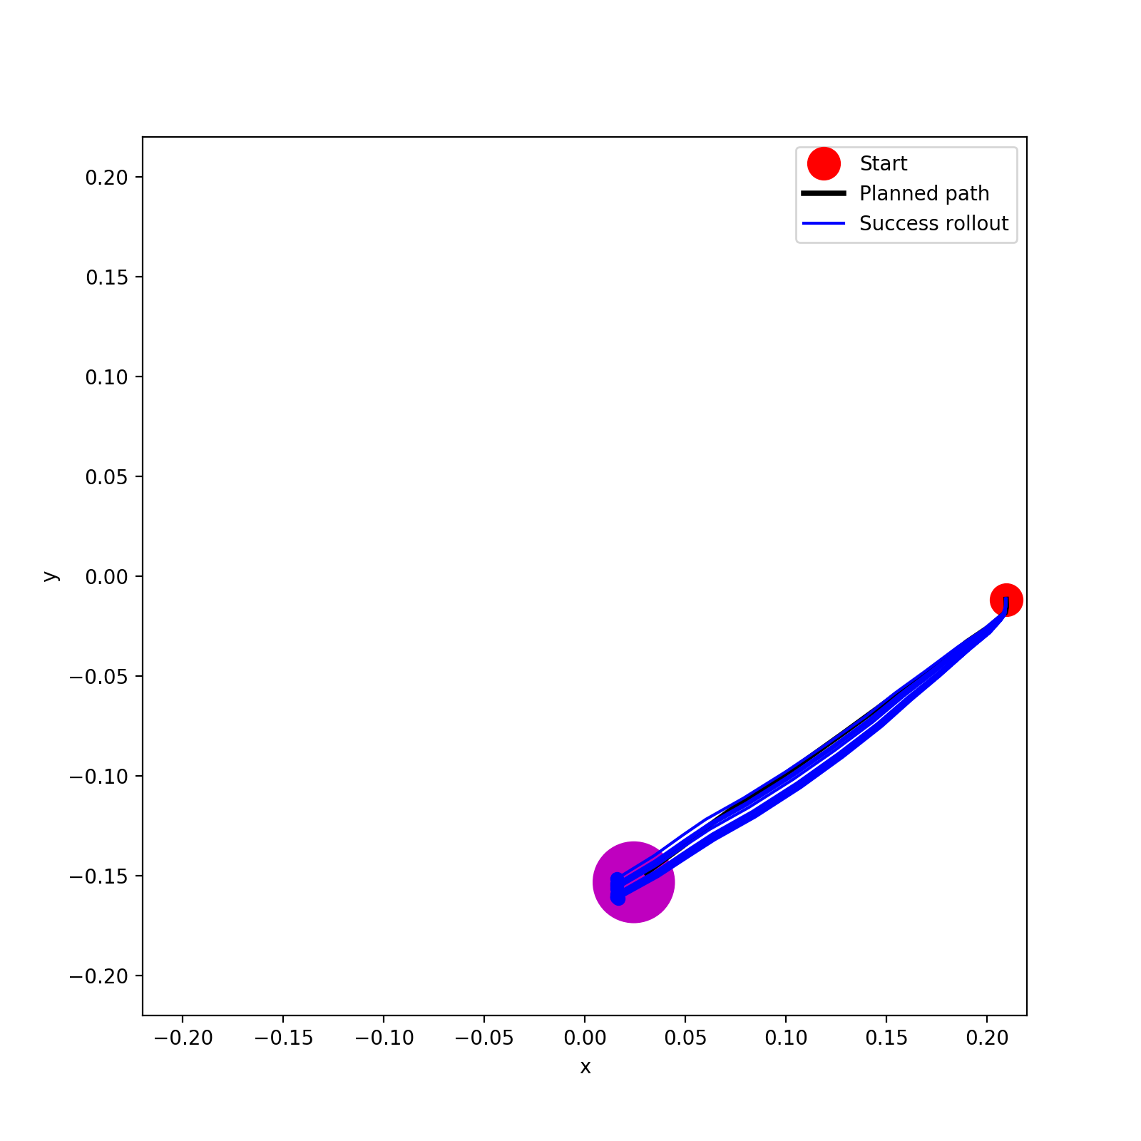
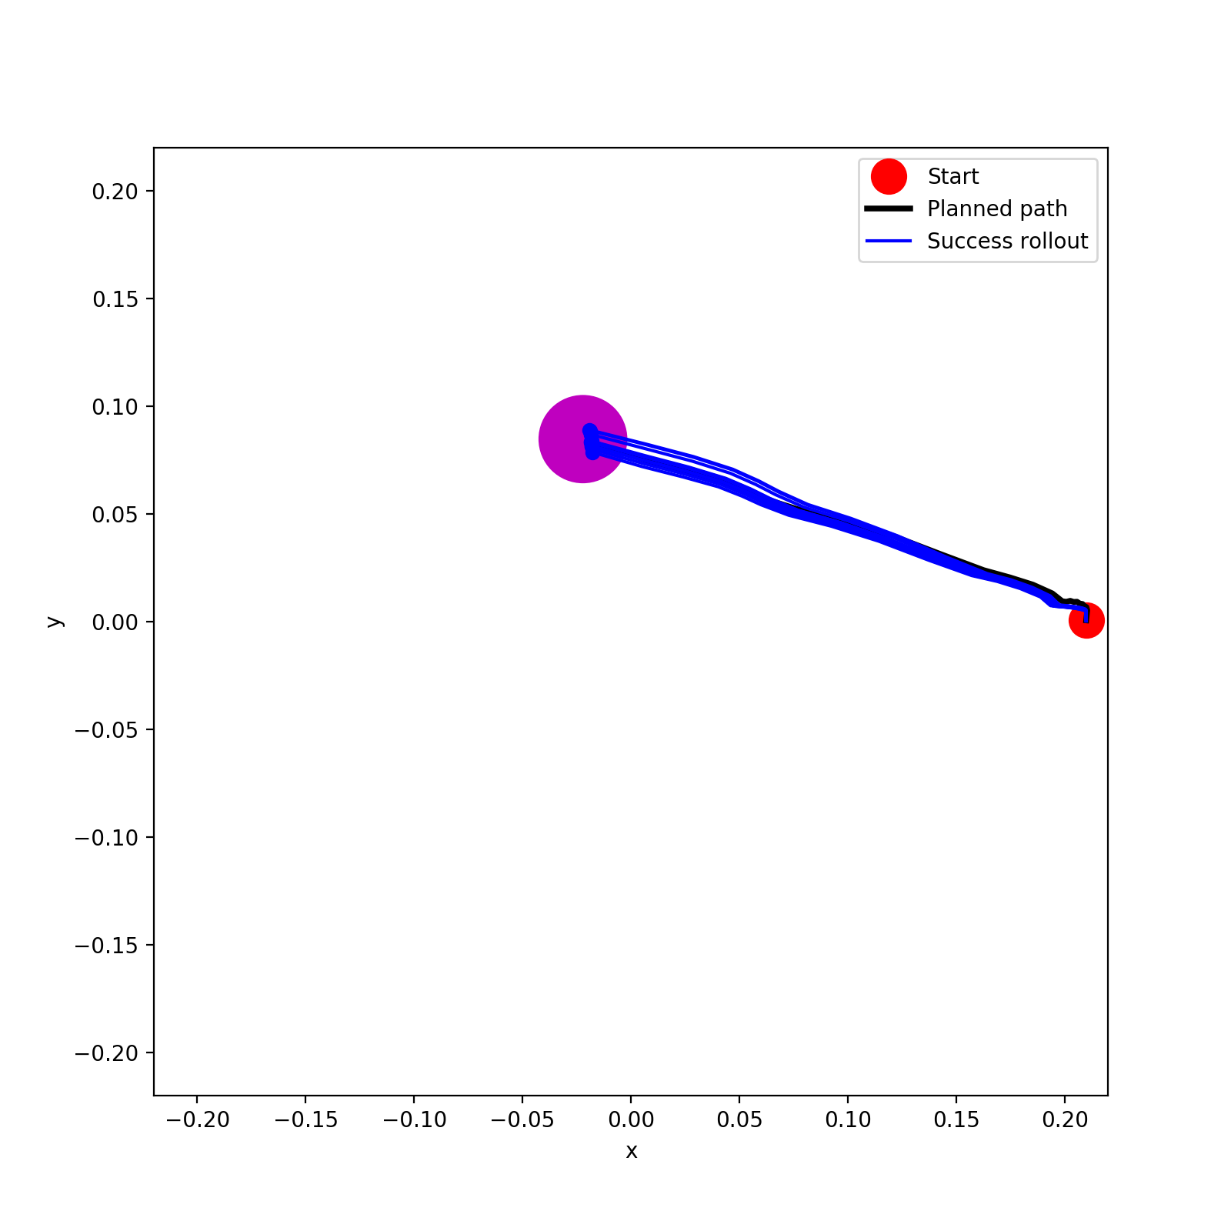
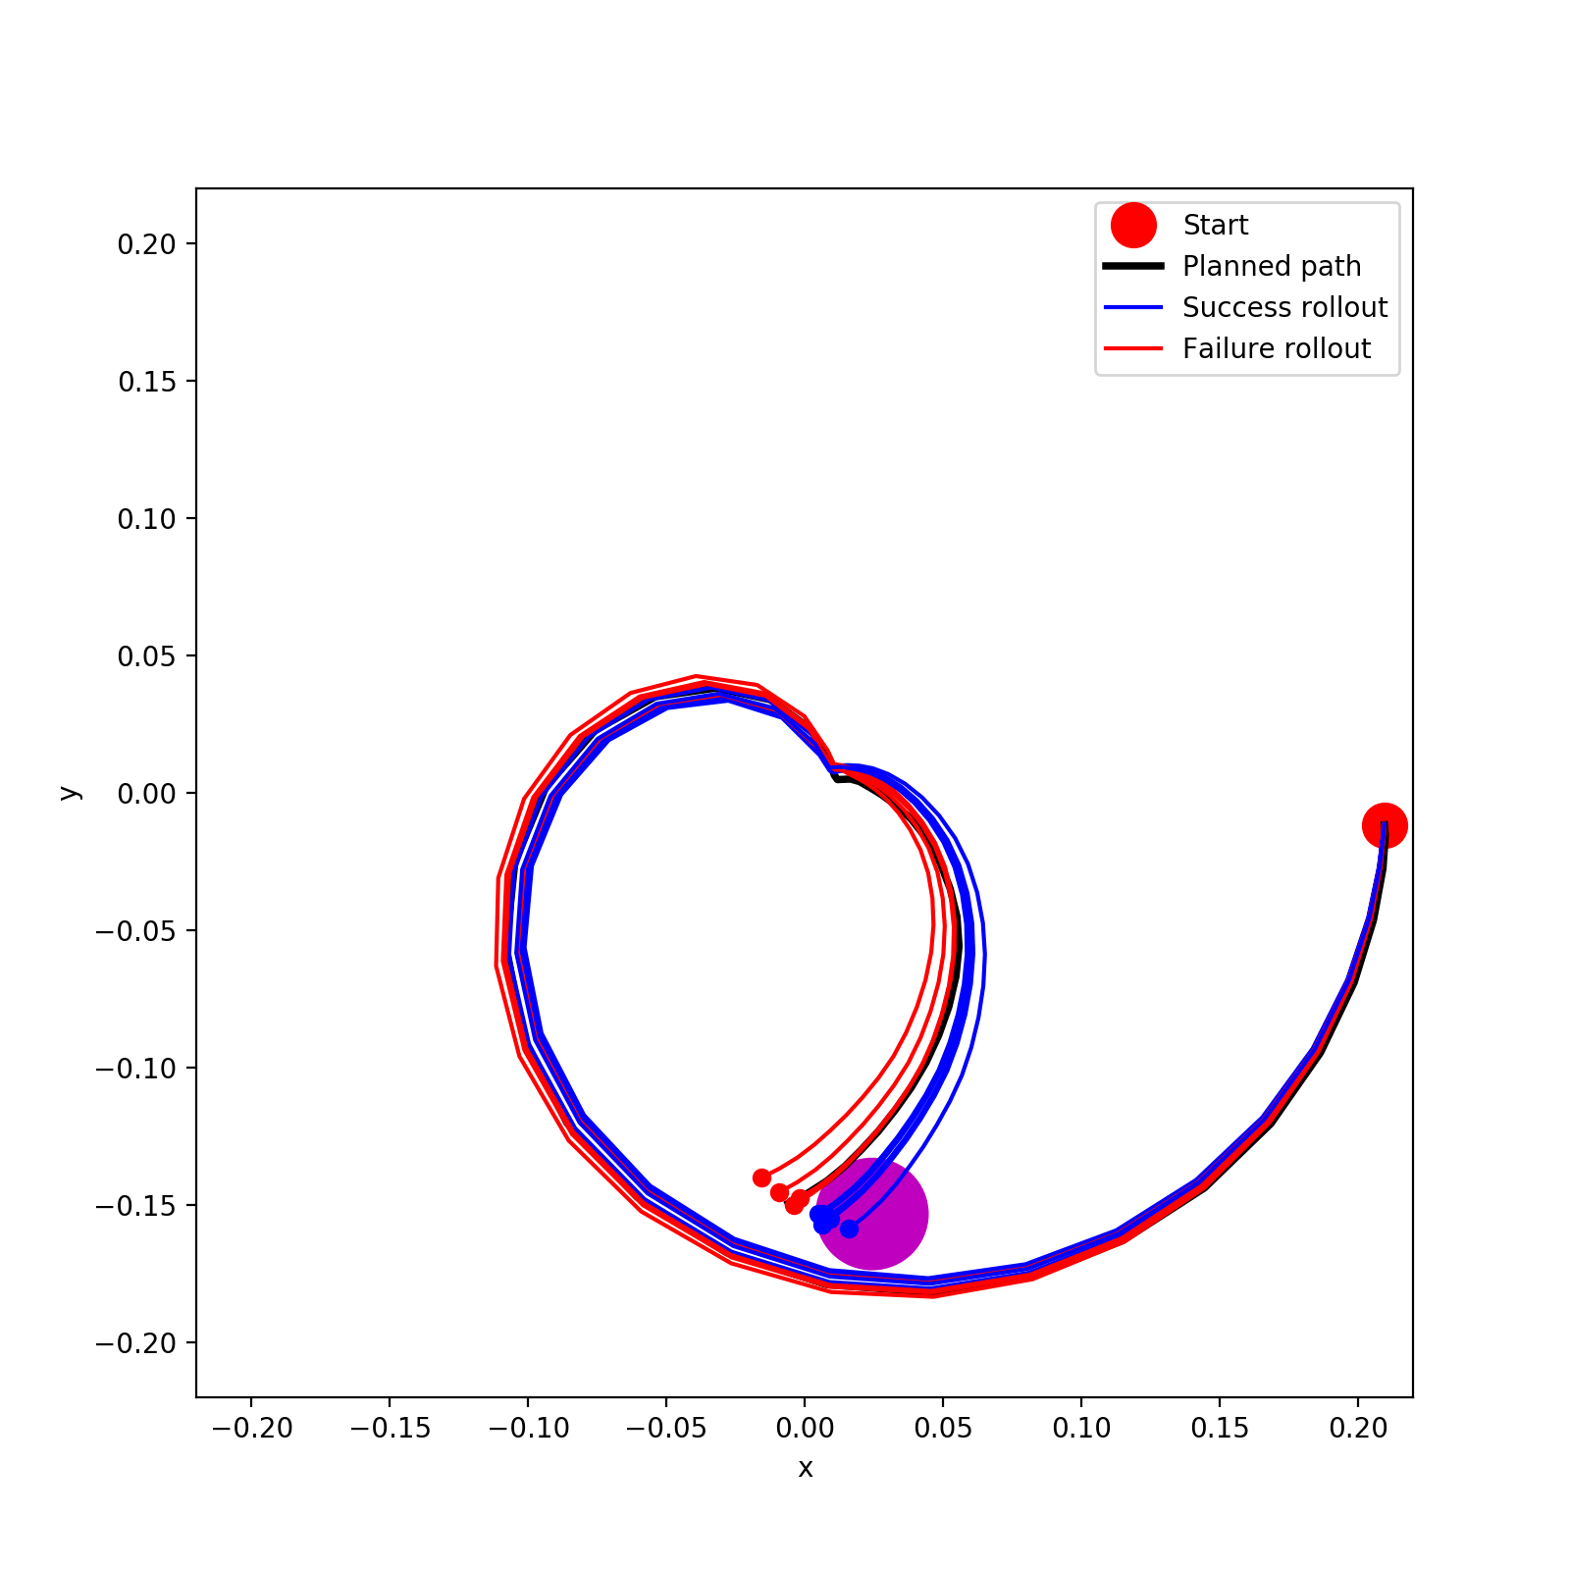
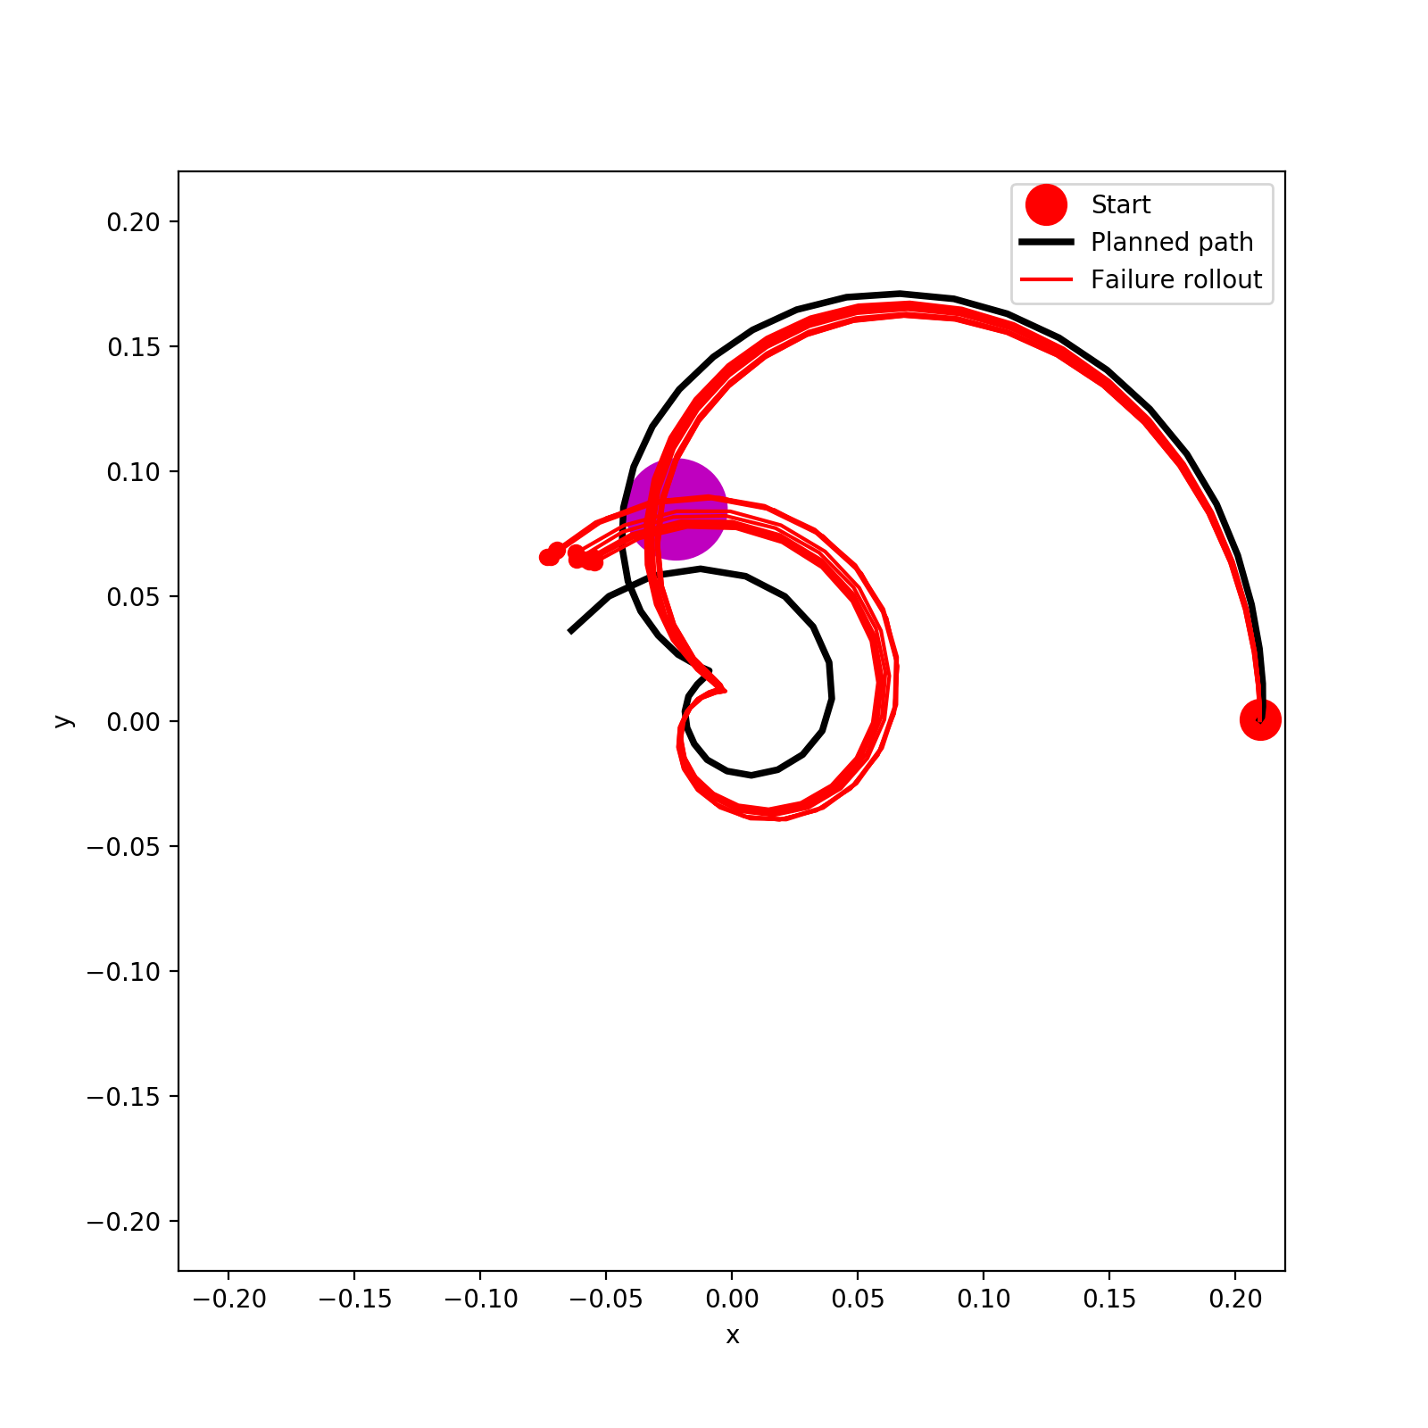
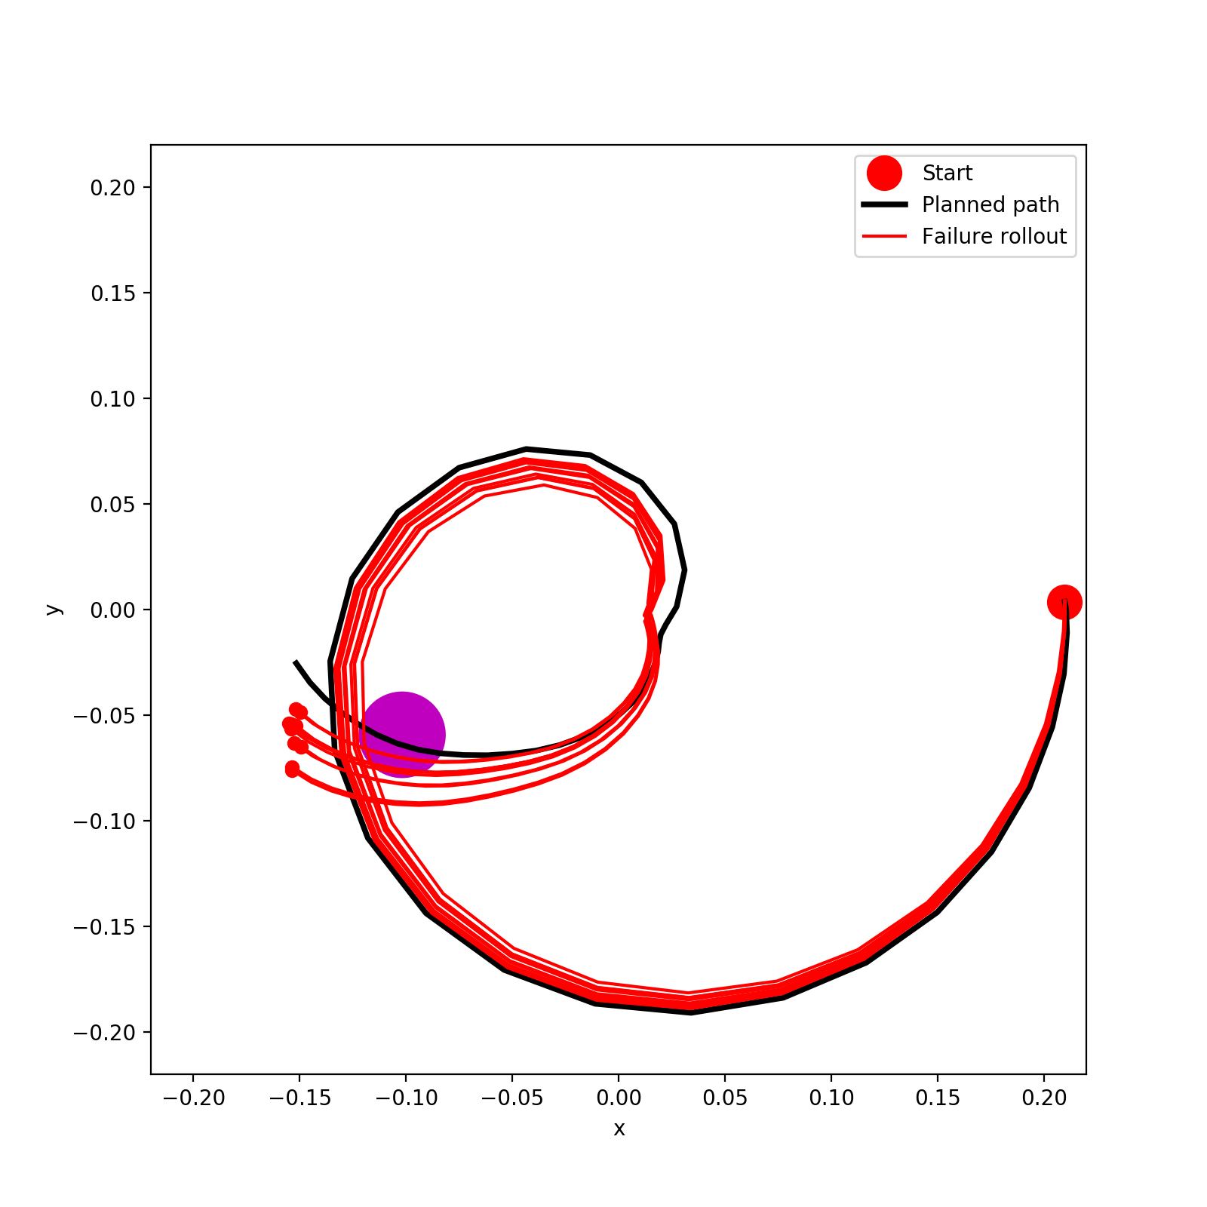
A*
Policy

Slide 8
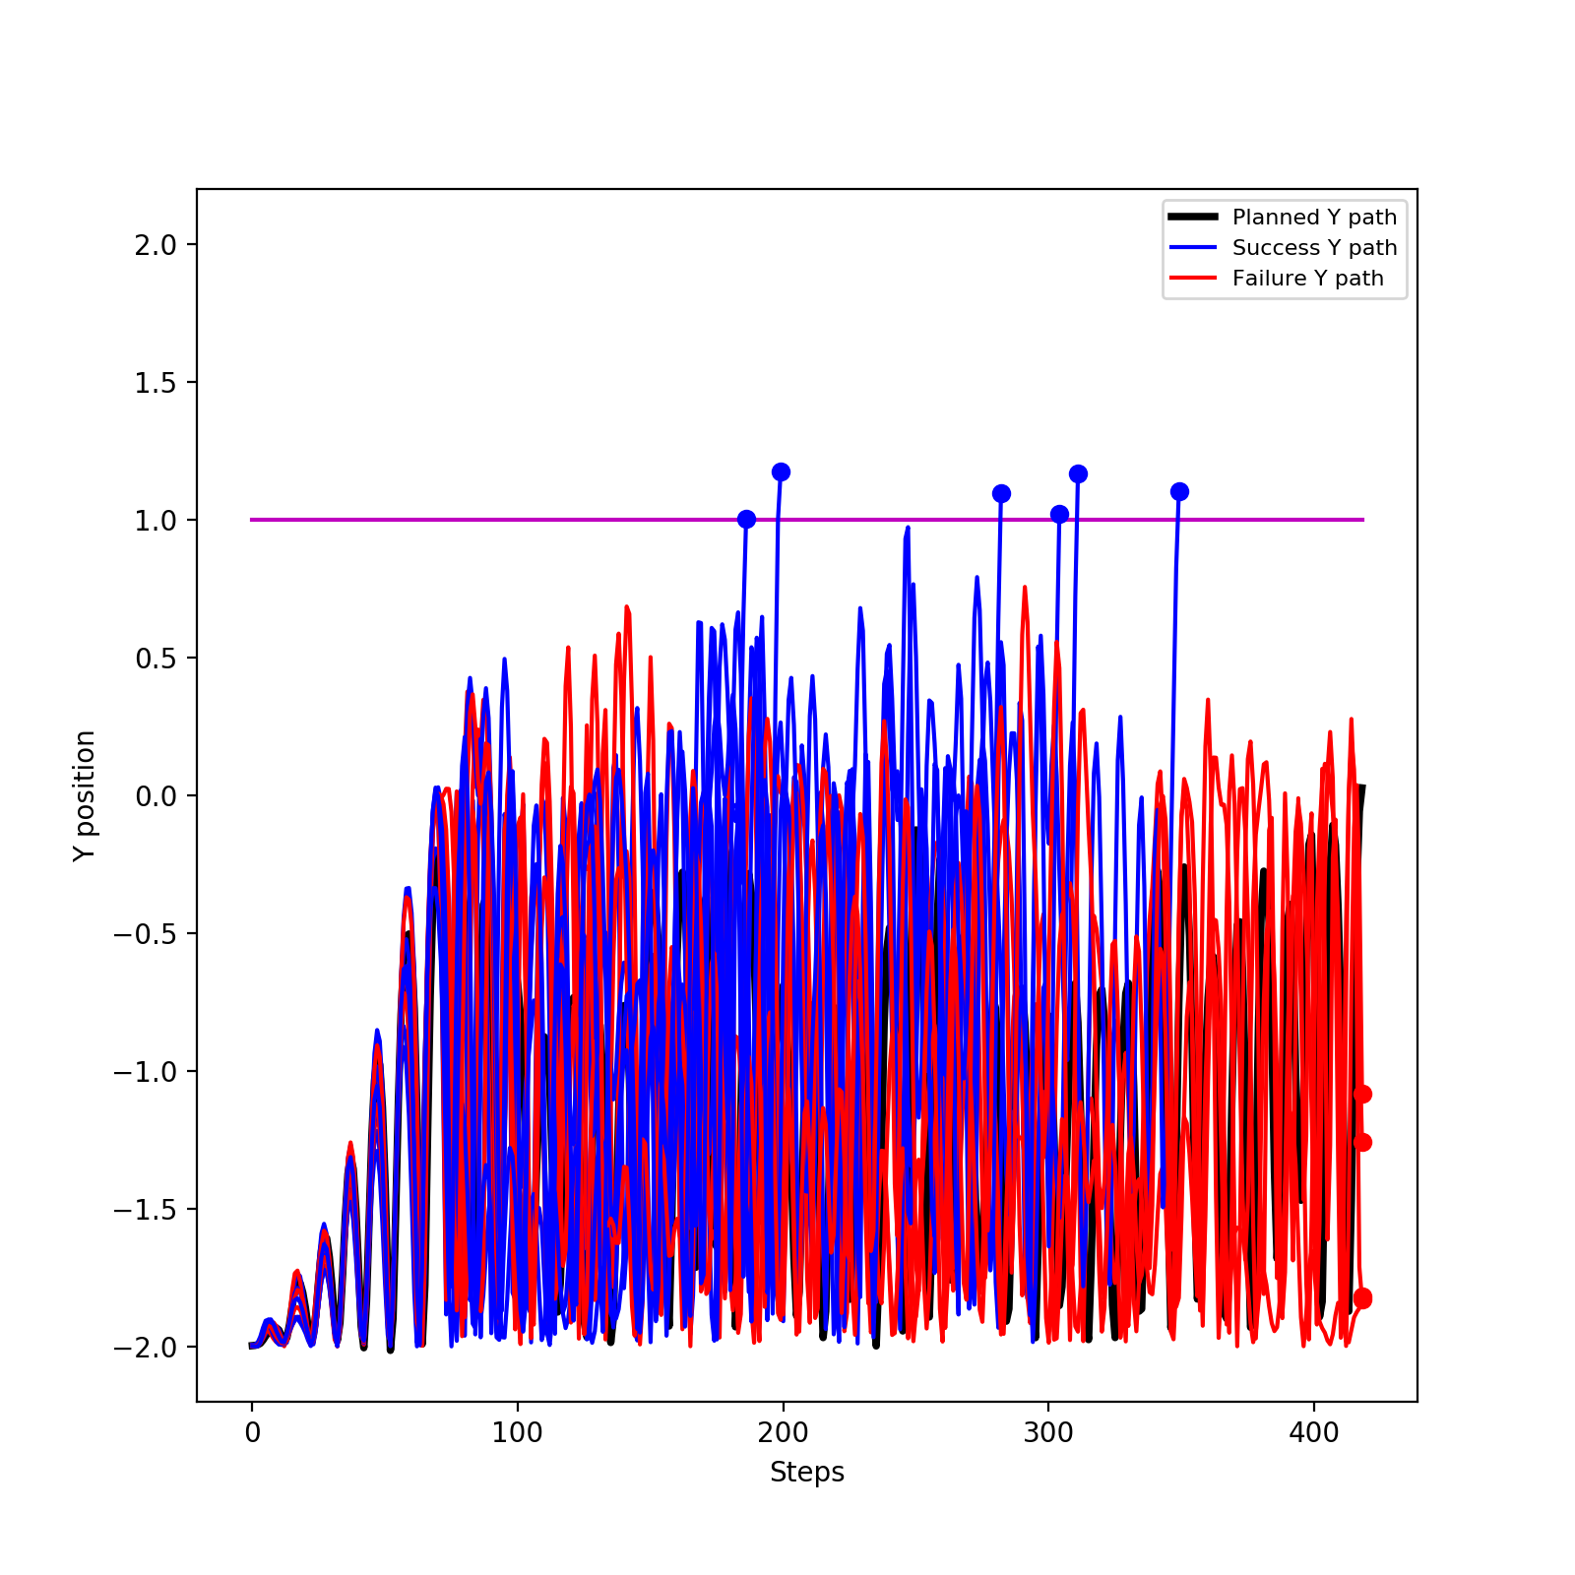
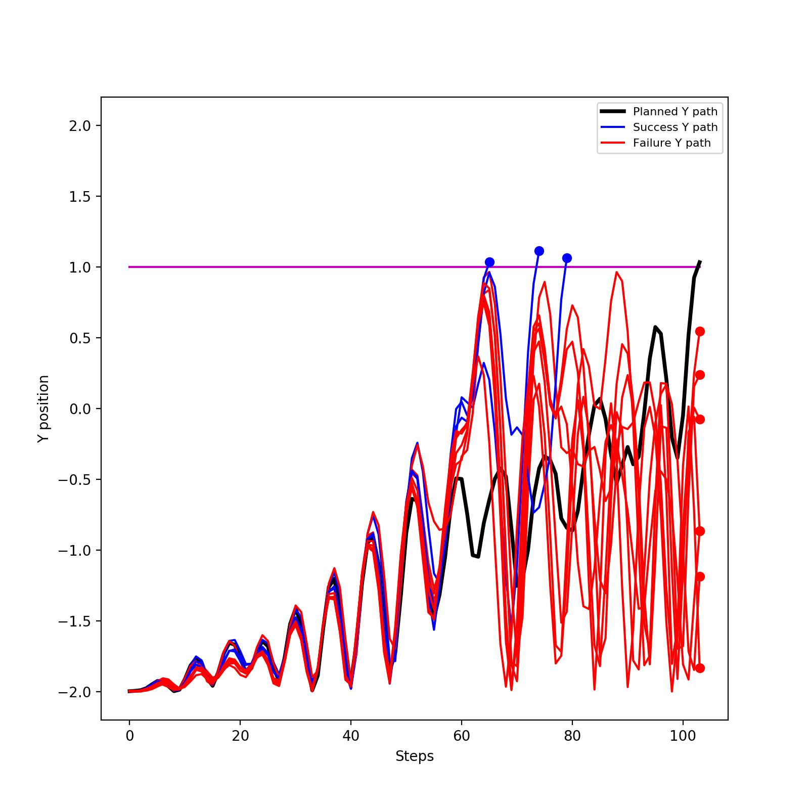
Acrobot-v1 Statistics
goal location (method) | goal reach rate | rollout path RMSE relative to plan path [mm] | path length [mm] |  | number of path steps |  | last distance to goal [mm]
 |  |  | plan | rollout | plan | rollout | plan | rollout
1 (A*) | 60% | 0.77±0.09 | 104.91 | 94.52±28.19 | 419 | 331.3±85.19 | 0.97 | 1.00±1.24
1 (policy) | 30% | 0.61±0.11 | 17.83 | 23.13±6.92 | 104 | 94.9±14.26 | 0 | 1.10±0.98
A*
Policy

Slide 9
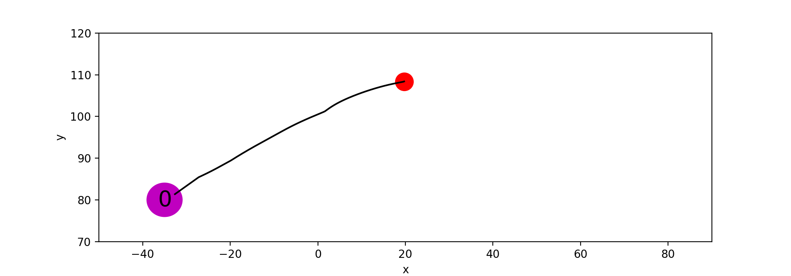
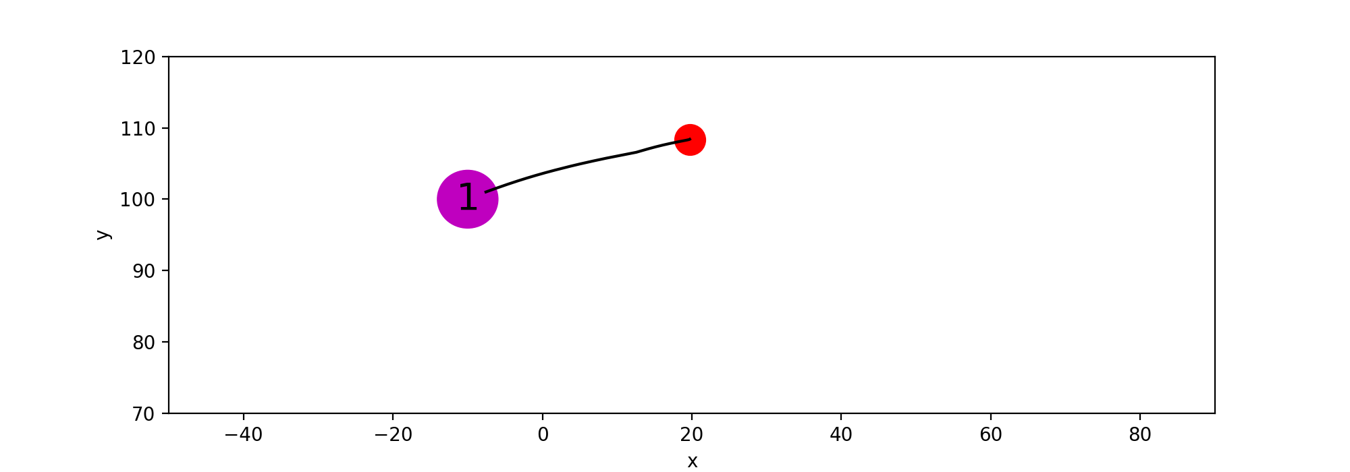
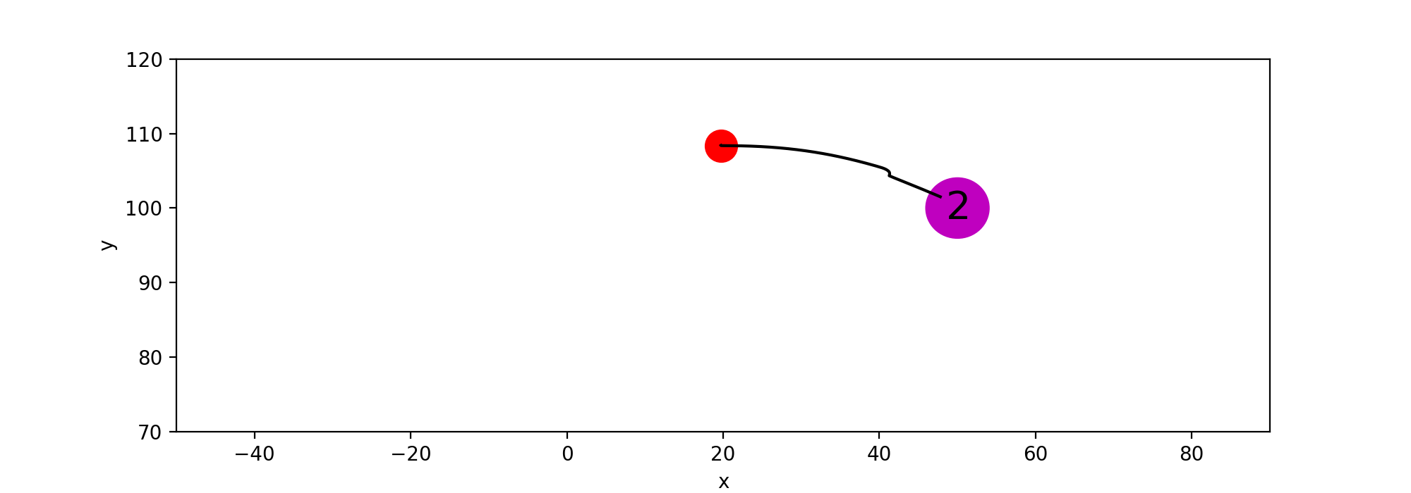
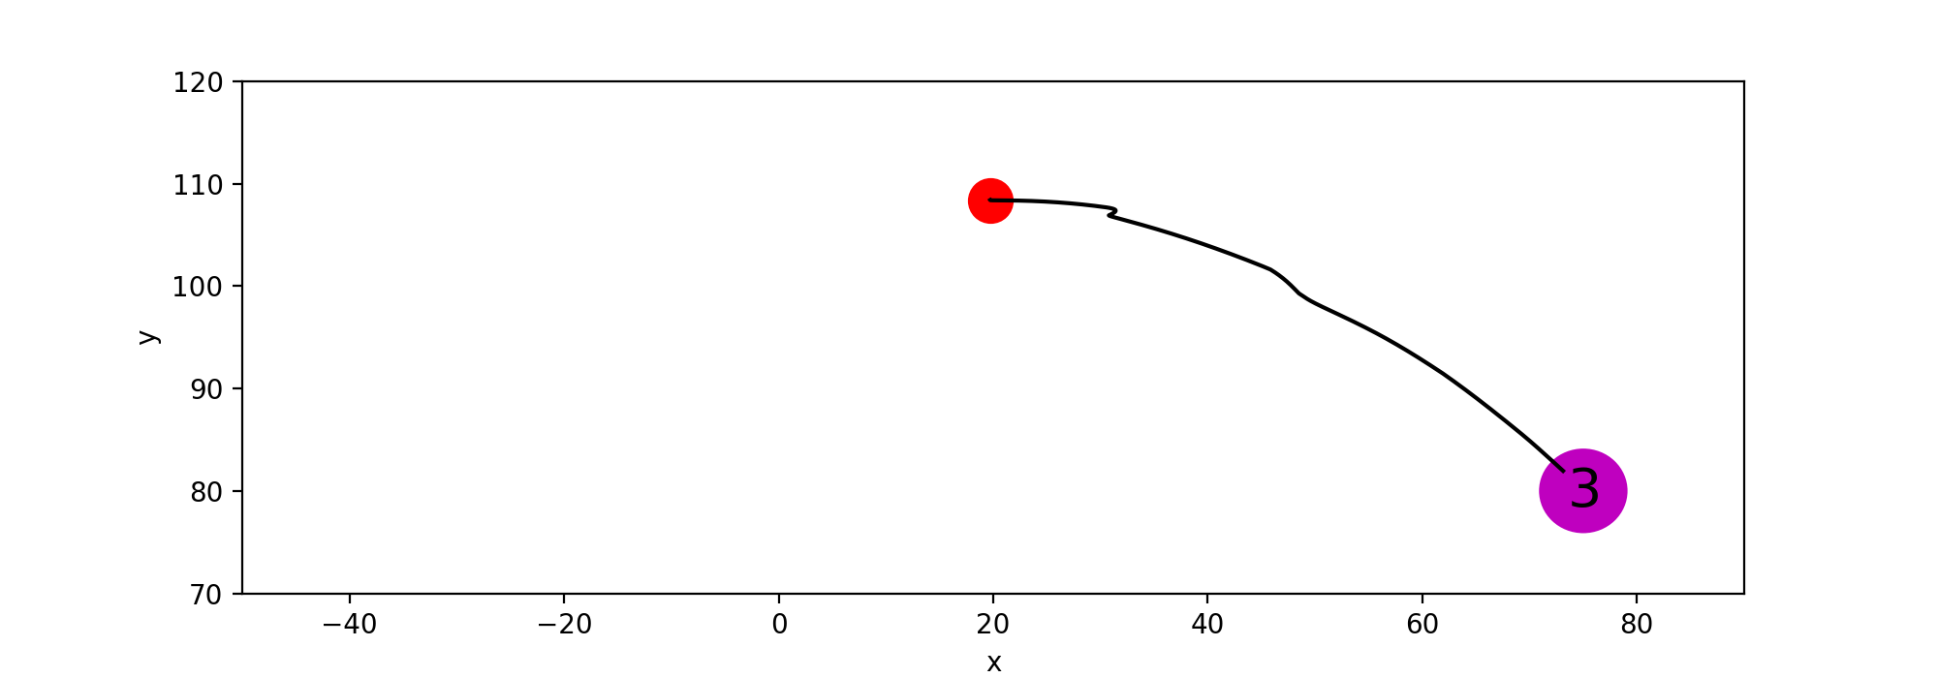
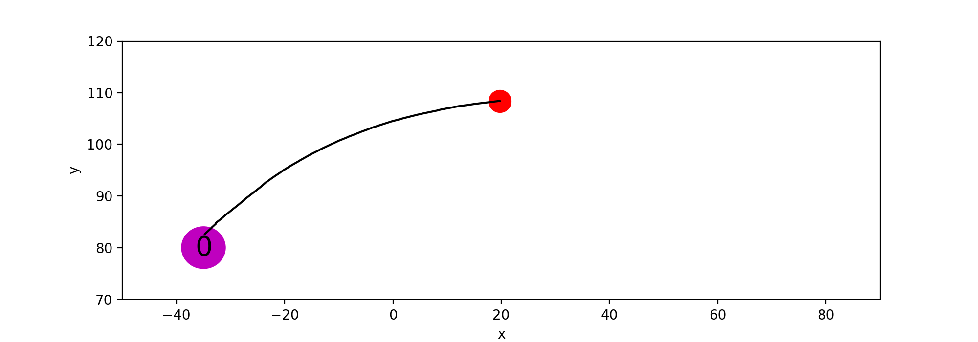


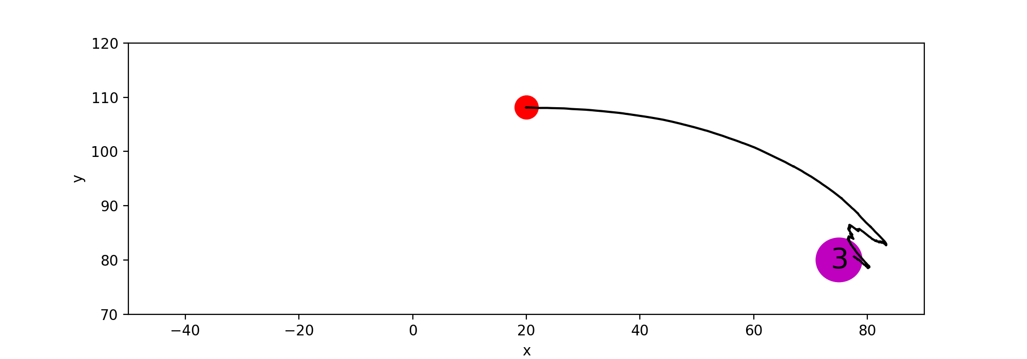
Real Hand Plan
A*
Policy

Slide 10
To Do List
Writing a ros-package for rollouts of the Real Hand.
(Avishai’s previous rollout ros-package only works on the Motoman setup)
Work on our new online method
Real Hand
Test whether the trained real hand dynamics model also works with Mridul’s new data or not
Do rollouts for A* and PPO policy on real hand
Mridul:
- Fix the issues of marker tracking
- Collect several episodes of data for testing my trained dynamics model

