Slide 1
Meeting 04/21/2020
Shuo Zhang

Slide 2
Progress So far
Rolled out planned paths for 3 different goals and 4 different size of obstacles.
Each experiment has 10 rollout paths.
10 Evaluation metrics used are: success rate, goal reach rate, plan path length, success path length, failure path length, plan path steps, failure path steps, success path last distance to goal, failure path last distance to goal, success path RMSE relative to plan path
Results are not satisfactory, generally.

Slide 3
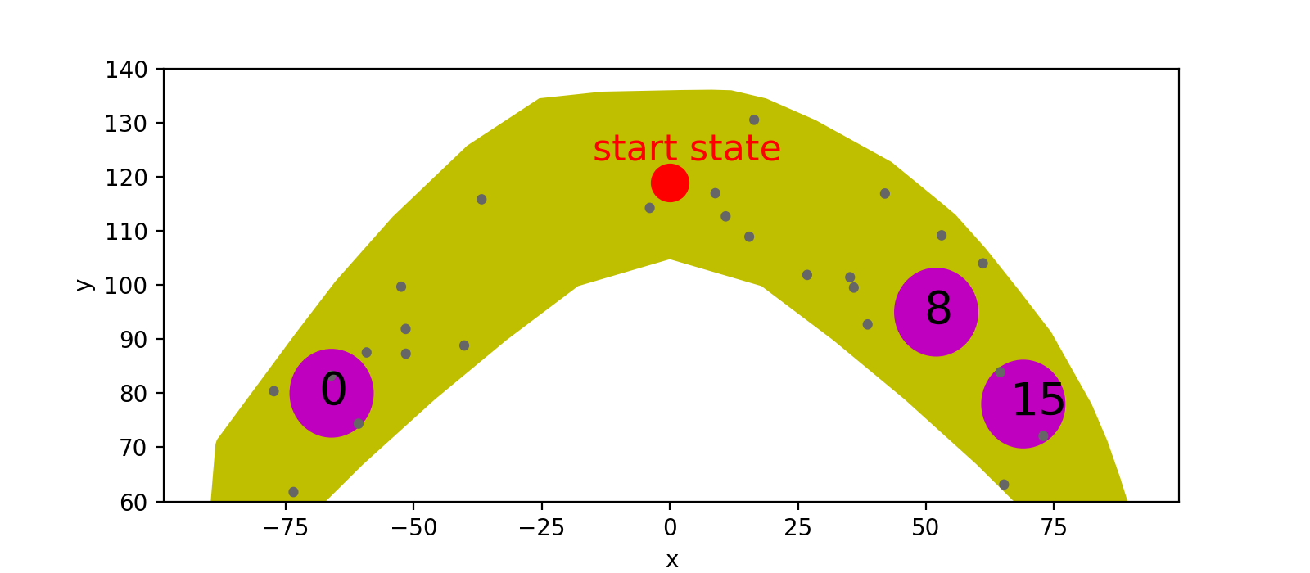
Details of Experiment
Goal Index: 0, 8, 15.
Obstacle Size: 0mm, 0.75mm, 1.5mm, 3mm.
3) All Avishai’s experiments in paper were done with 0.75mm.
4) Not able to plan a path for goal 15 with 3mm obstacle within one day(24 h).

Slide 4
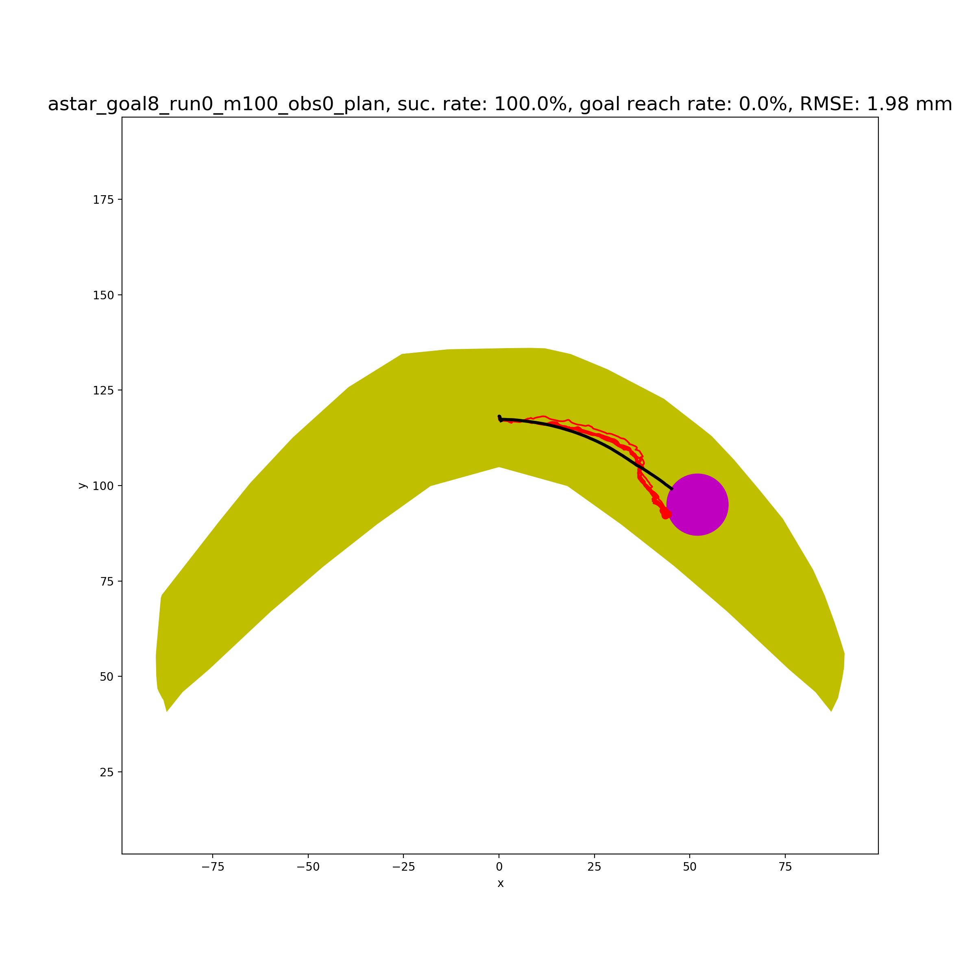
Goal 8 Obstacle 0mm
success rate | 100%
Goal reach rate | 0%
plan path length | 53.56
success path length | 57.46
failure path length | -
plan path steps | 567
failure path steps | -
success path last distance to goal | 0.793
failure path last distance to goal | -
success path RMSE relative to plan path | 1.98
All actions were successfully rolled out (100% success rate), but goal reach rate is 0%.
Goal range is a circle of radius of 8mm for both planning and rollout.
Average last distance to goal range is 0.793 mm, which is close. So, if we assume 10mm is the range of goal reach when rolling out, it would be 100% goal reach rate.

Slide 5

Goal 8 Obstacle 0.75mm
success rate | 90%
Goal reach rate | 0%
plan path length | 54.73
success path length | 61.9
failure path length | 12.1
plan path steps | 675
failure path steps | 449
success path last distance to goal | 1.14
failure path last distance to goal | 40.78
success path RMSE relative to plan path | 10.76
90% success rate (one rollout paths collided with obstacles) and 0% goal reach rate.
Already considered 20% bigger obstacle size when planning.
Average last distance to goal range is 1.14 mm, which is close. So, if we assume 10mm is the range of goal reach when rolling out, all success rollout paths would reach goal.

Slide 6
Goal 8 Obstacle 0mm
success rate | 100%
Goal reach rate | 0%
plan path length | 53.6
success path length | 57.5
failure path length | -
plan path steps | 567
failure path steps | -
success path last distance to goal | 0.8
failure path last distance to goal | -
success path RMSE relative to plan path | 1.98
All actions were successfully rolled out (100% success rate), but goal reach rate is 0%.
Goal range is a circle of radius of 8mm for both planning and rollout.
Average last distance to goal range is 0.8 mm, which is close. So, if we assume 10mm is the range of goal reach when rolling out, it would be 100% goal reach rate.

Slide 7
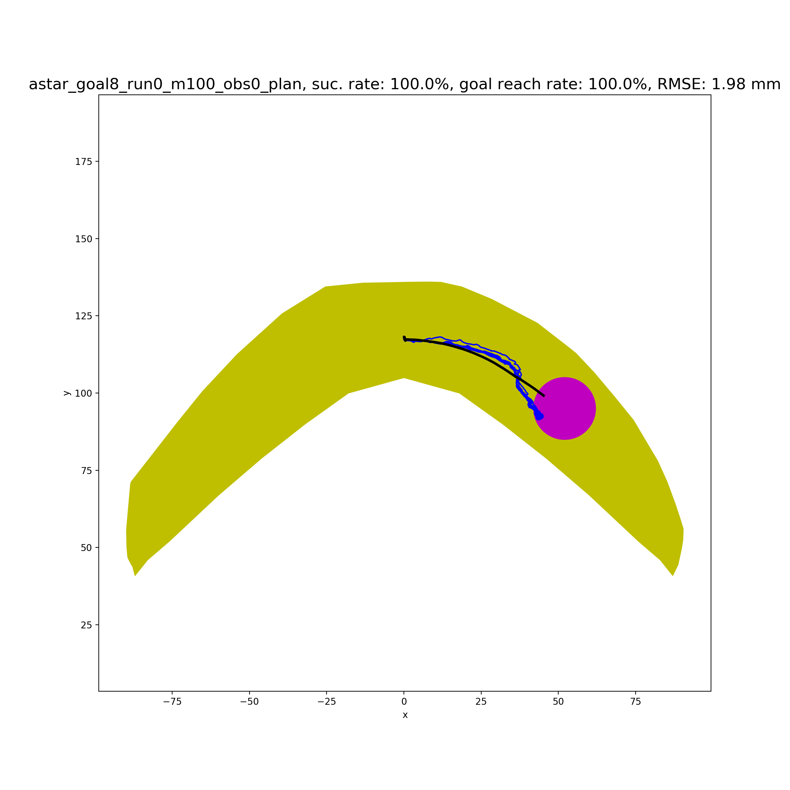
Goal 8 Obstacle 0mm (After setting the goal range of rollout as 10mm while 8mm for planning)
success rate | 100%
Goal reach rate | 100%
plan path length | 53.6
success path length | 57.5
failure path length | -
plan path steps | 567
failure path steps | -
success path last distance to goal | -1.2
failure path last distance to goal | -
success path RMSE relative to plan path | 1.98
Goal reach rate is now 100%.
Goal range is a circle of radius of 10mm for rollout and 8mm for planning.

Slide 8
Goal 8 Obstacle 0.75mm
success rate | 90%
Goal reach rate | 0%
plan path length | 54.7
success path length | 61.9
failure path length | 12.1
plan path steps | 675
failure path steps | 449
success path last distance to goal | 1.1
failure path last distance to goal | 40.8
success path RMSE relative to plan path | 2.79
90% success rate (one rollout paths collided with obstacles) and 0% goal reach rate.
Already considered 20% bigger obstacle size when planning.
Average last distance to goal range is 1.14 mm, which is close. So, if we assume 10mm is the range of goal reach when rolling out, all success rollout paths would reach goal.
Consider a bigger goal reach range for rollout and a smaller goal reach range for planning?

Slide 9
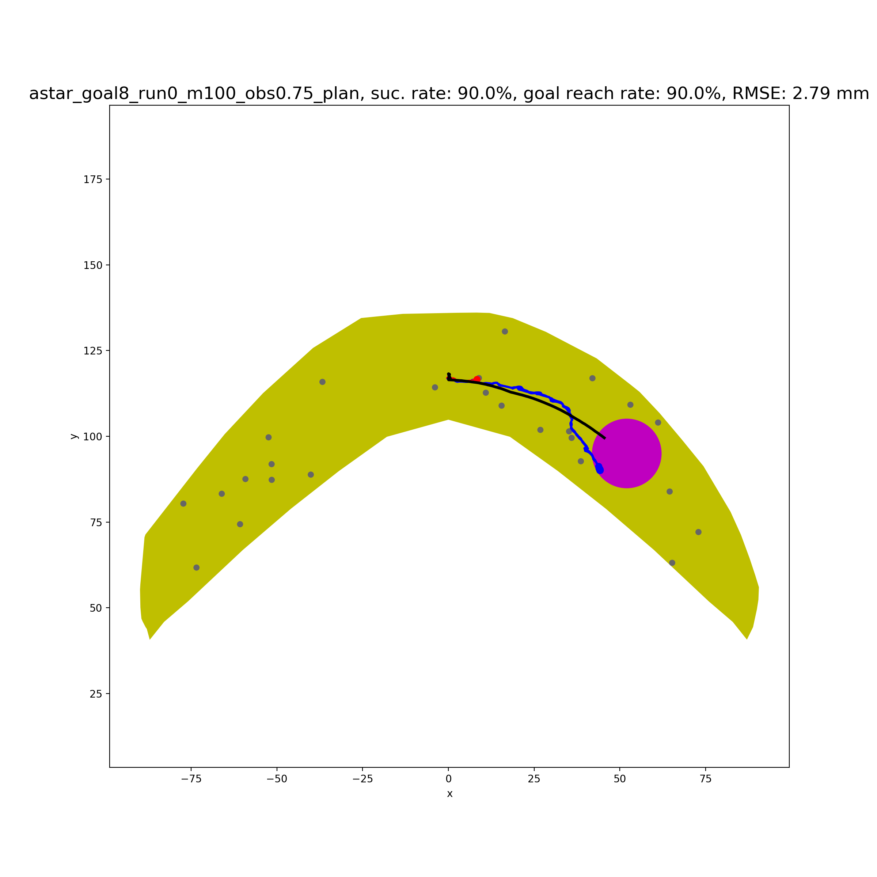
Goal 8 Obstacle 0.75mm
success rate | 90%
Goal reach rate | 90%
plan path length | 54.7
success path length | 61.9
failure path length | 12.1
plan path steps | 675
failure path steps | 449
success path last distance to goal | -0.9
failure path last distance to goal | 38.8
success path RMSE relative to plan path | 2.79
Goal reach rate is now 100%.
Goal range is a circle of radius of 10mm for rollout and 8mm for planning.

Slide 10
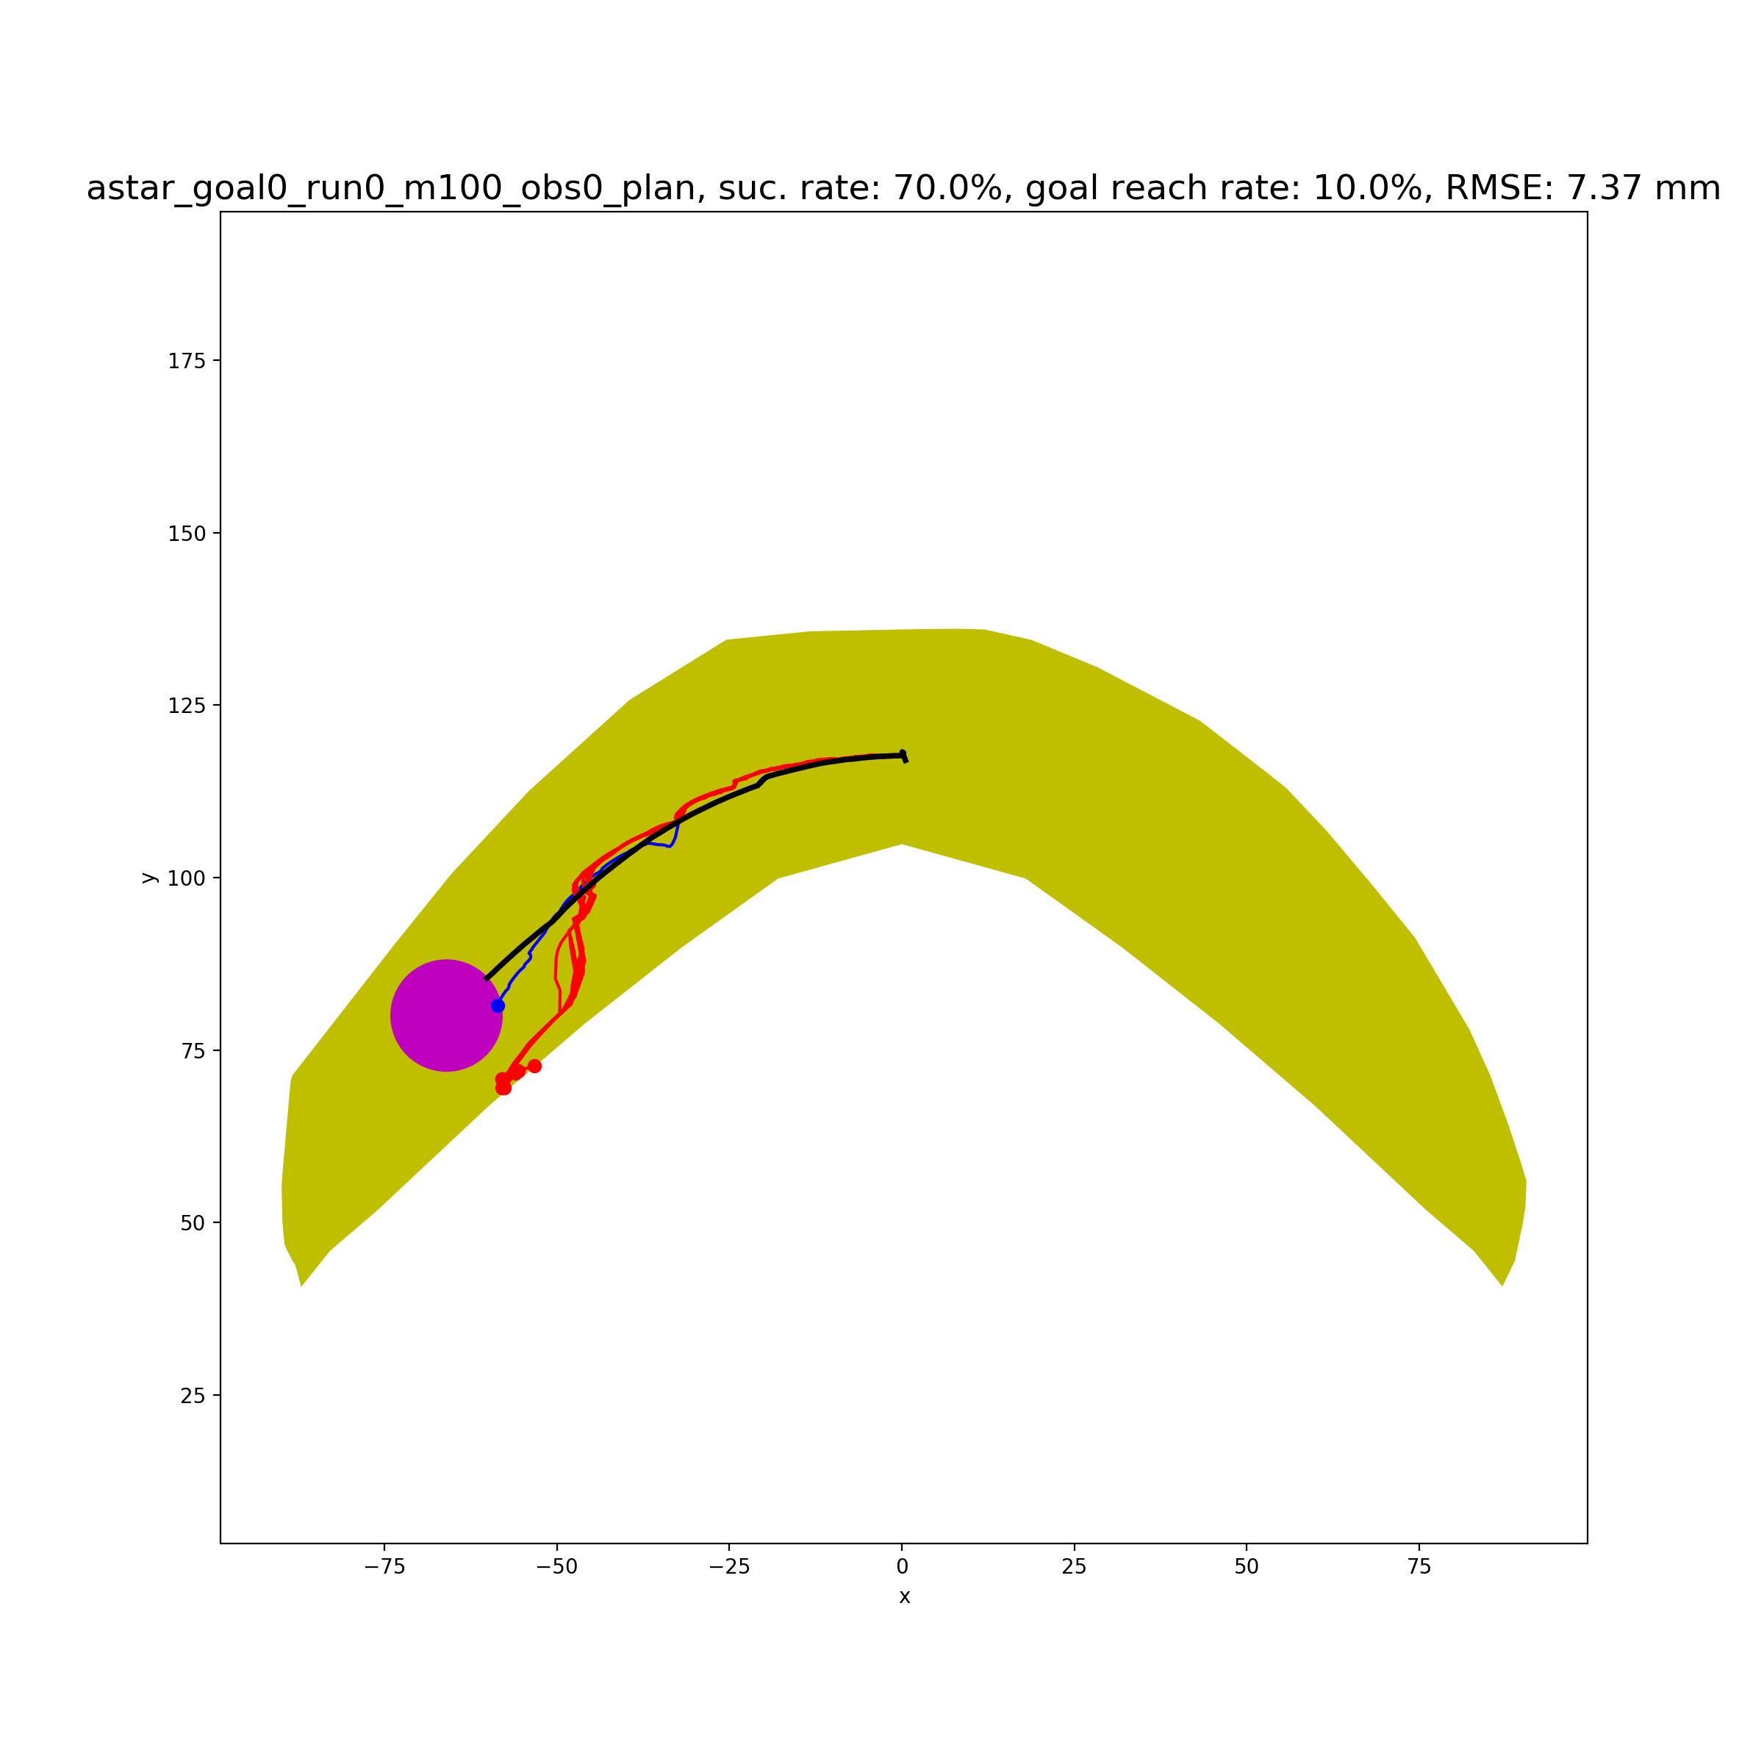
Goal 0 Obstacle 0mm
success rate | 70%
Goal reach rate | 10%
plan path length | 73.7
success path length | 84.5
failure path length | 91.1
plan path steps | 685
failure path steps | 594
success path last distance to goal | 4.0
failure path last distance to goal | 5.6
success path RMSE relative to plan path | 7.37
70% success rate (three rollout paths failed due to cylinder drop) and 10% goal reach rate.
Average last distance to goal range for success path is 4.0 mm, and for failure path is 5.6mm. So even if we set the goal range as 10mm, the goal reach rate would not increase.
The rollout path began to look quite different from the planned path from some point. NN model seemed not to be precise enough.

Slide 11
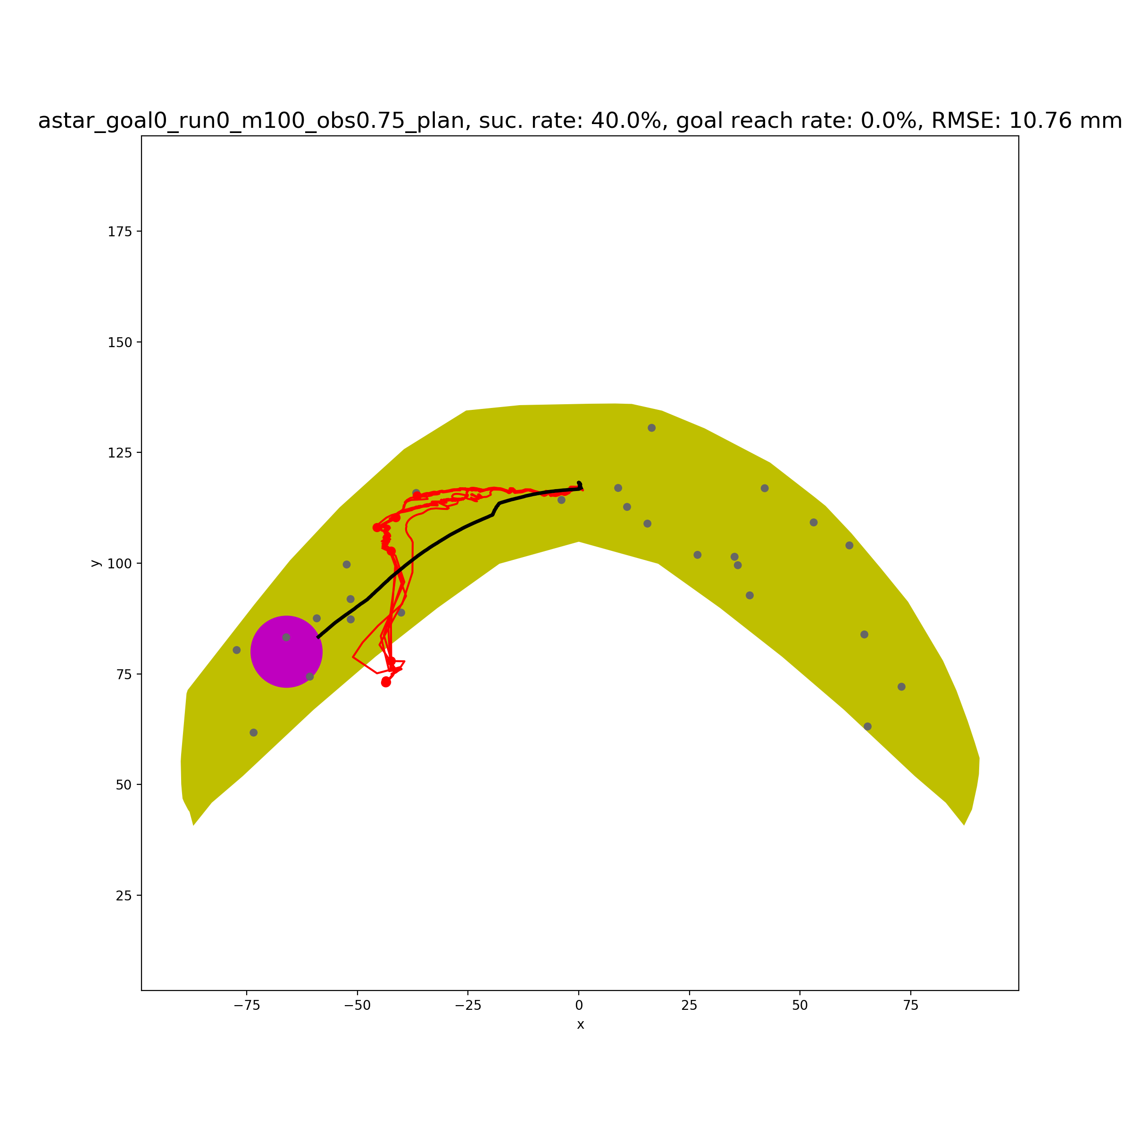
Goal 0 Obstacle 0.75mm
success rate | 40%
Goal reach rate | 0%
plan path length | 75.1
success path length | 101.8
failure path length | 76.7
plan path steps | 894
failure path steps | 701
success path last distance to goal | 15.4
failure path last distance to goal | 25.3
success path RMSE relative to plan path | 10.76
40% success rate (failure due to drop and collision) and 0% goal reach rate.
Average last distance to goal range for success path is 15.4 mm, and for failure path is 25.3mm. So even if we set the goal range as 10mm, the goal reach rate would not increase.
The rollout path began to look quite different from the planned path from some point. NN model is not precise enough for a long(many steps) and complicated path.

Slide 12
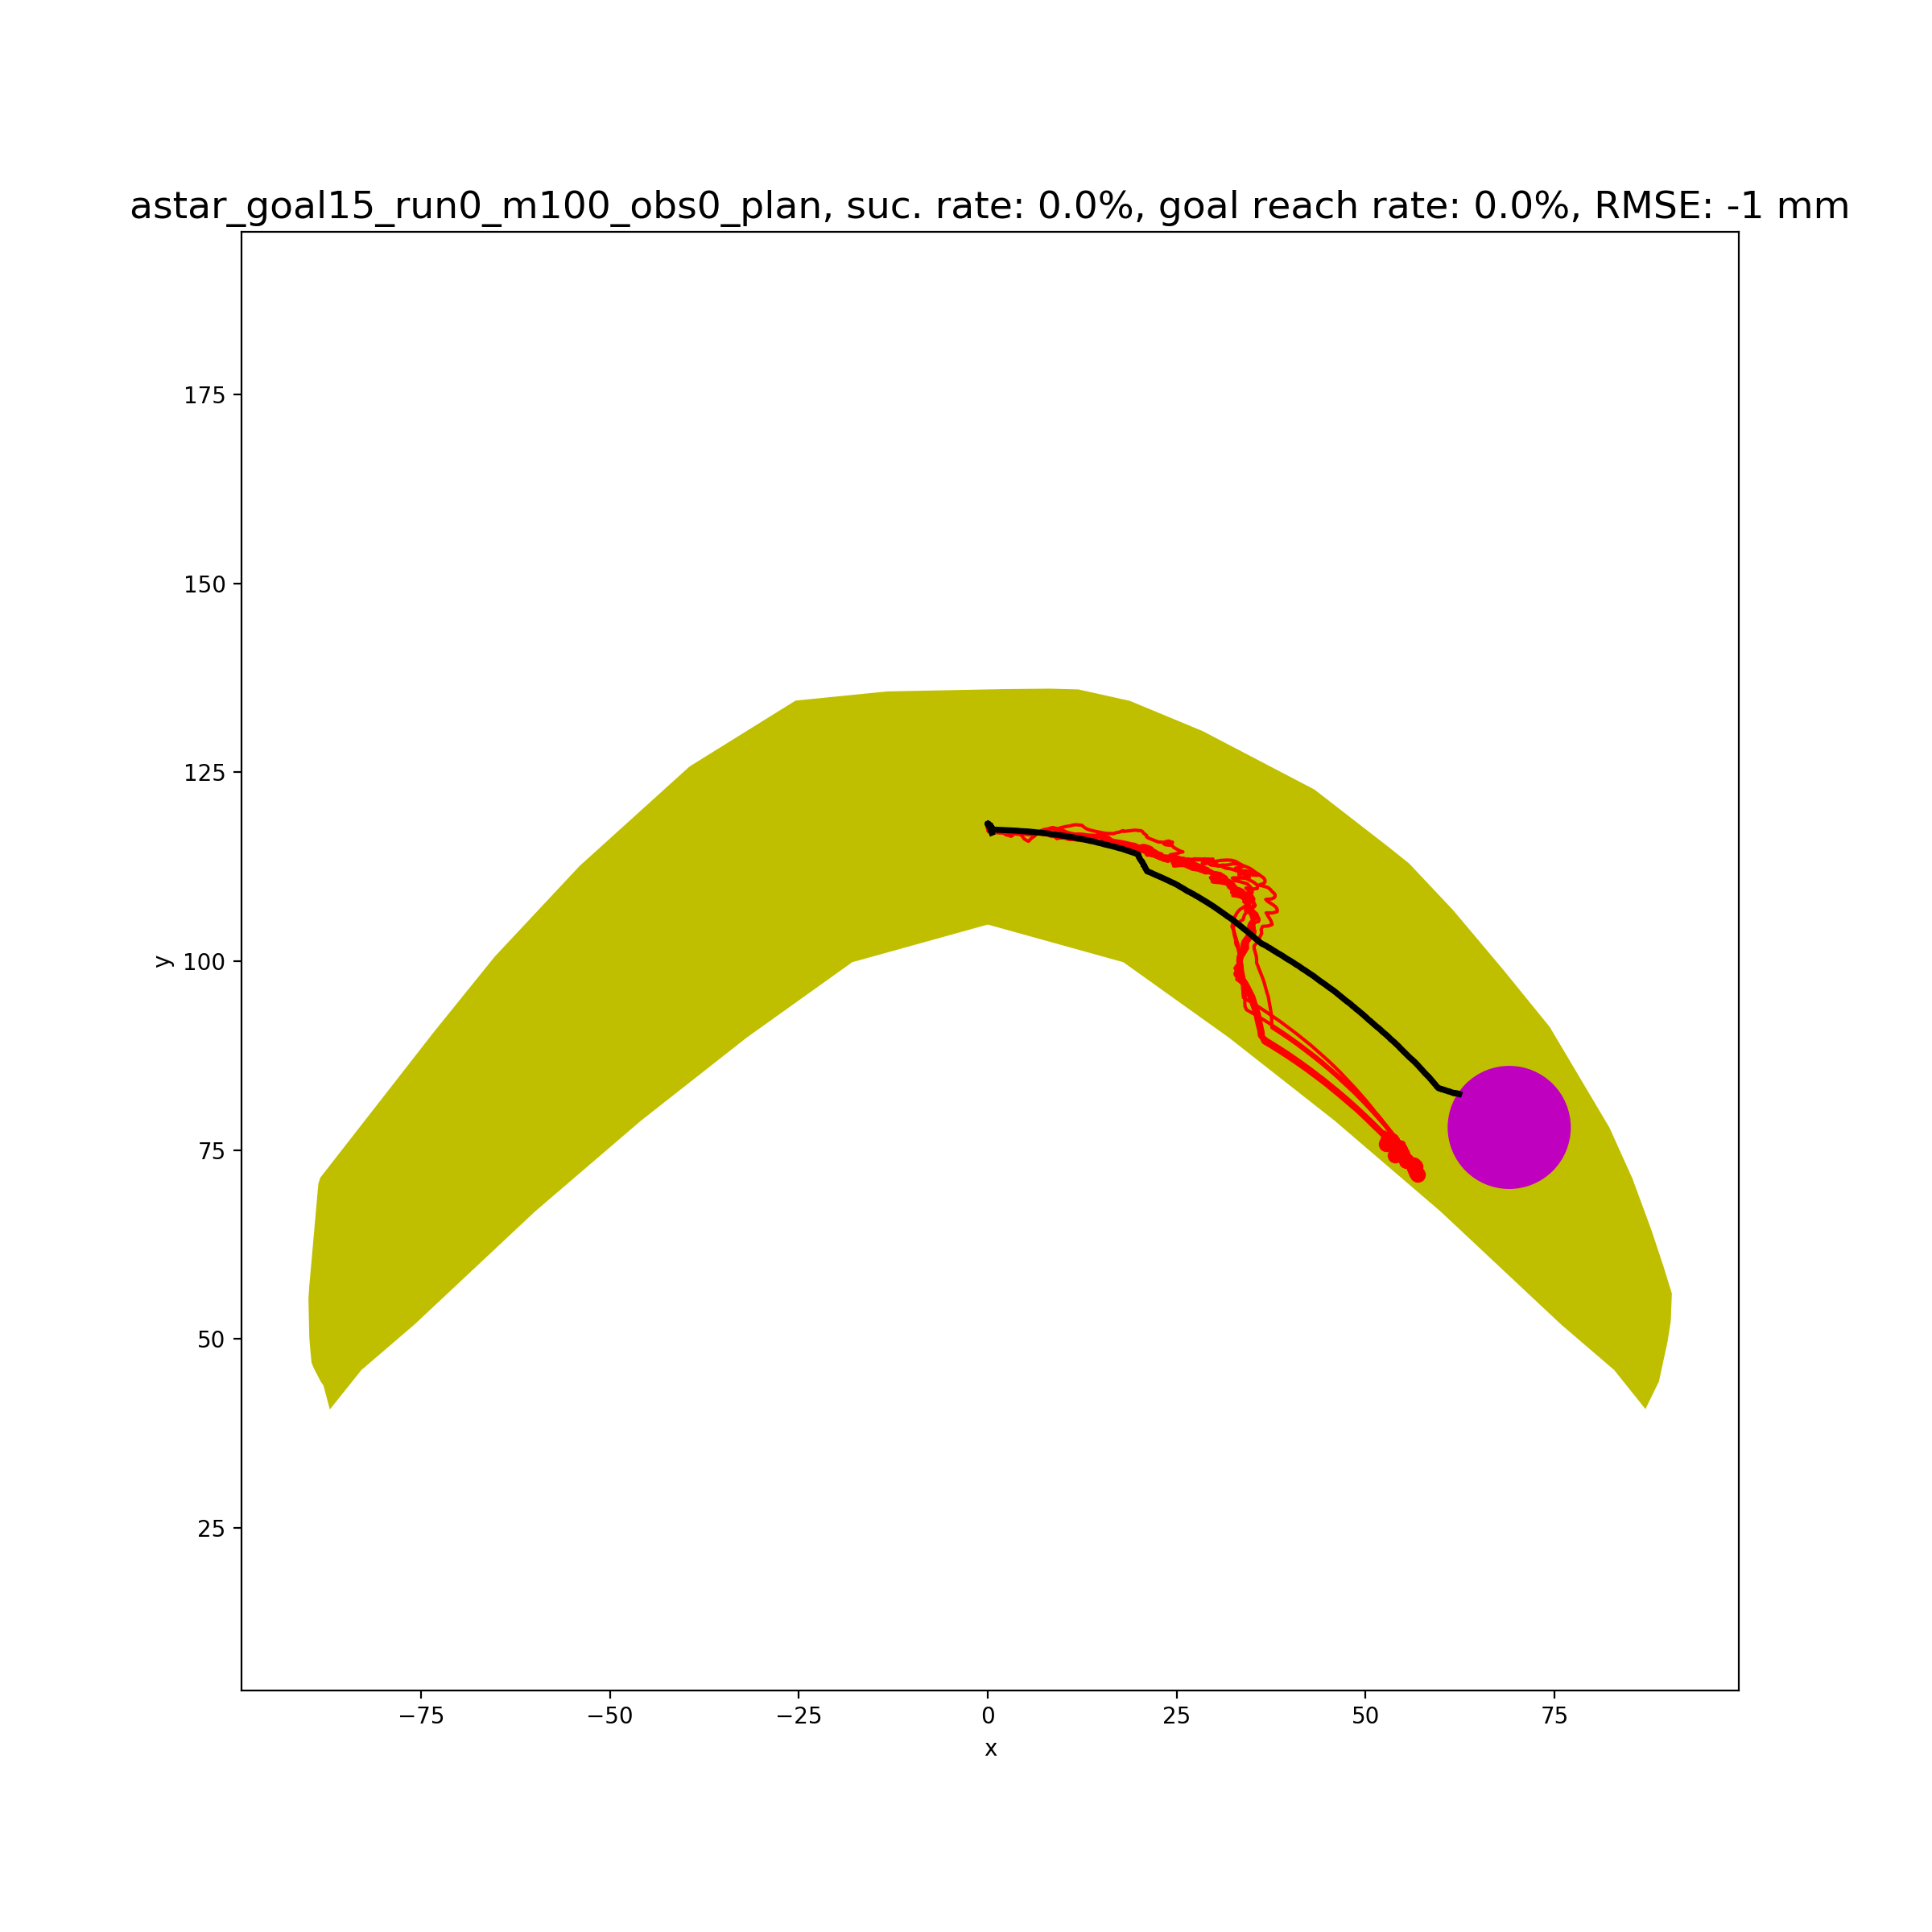
Goal 15 Obstacle 0mm
success rate | 0%
Goal reach rate | 0%
plan path length | 77.9
success path length | -
failure path length | 97.6
plan path steps | 788
failure path steps | 680
success path last distance to goal | -
failure path last distance to goal | 6.6
success path RMSE relative to plan path | -
0% success rate (All 10 rollout paths failed due to cylinder drop) and 0% goal reach rate.
Average last distance to goal range for failure path is 6.6 mm. Because of 0% success rate, there is no need to check the result if we set goal range to be 10mm.
The rollout path began to look quite different from the planned path from some point. NN model seemed not to be precise enough.

Slide 13
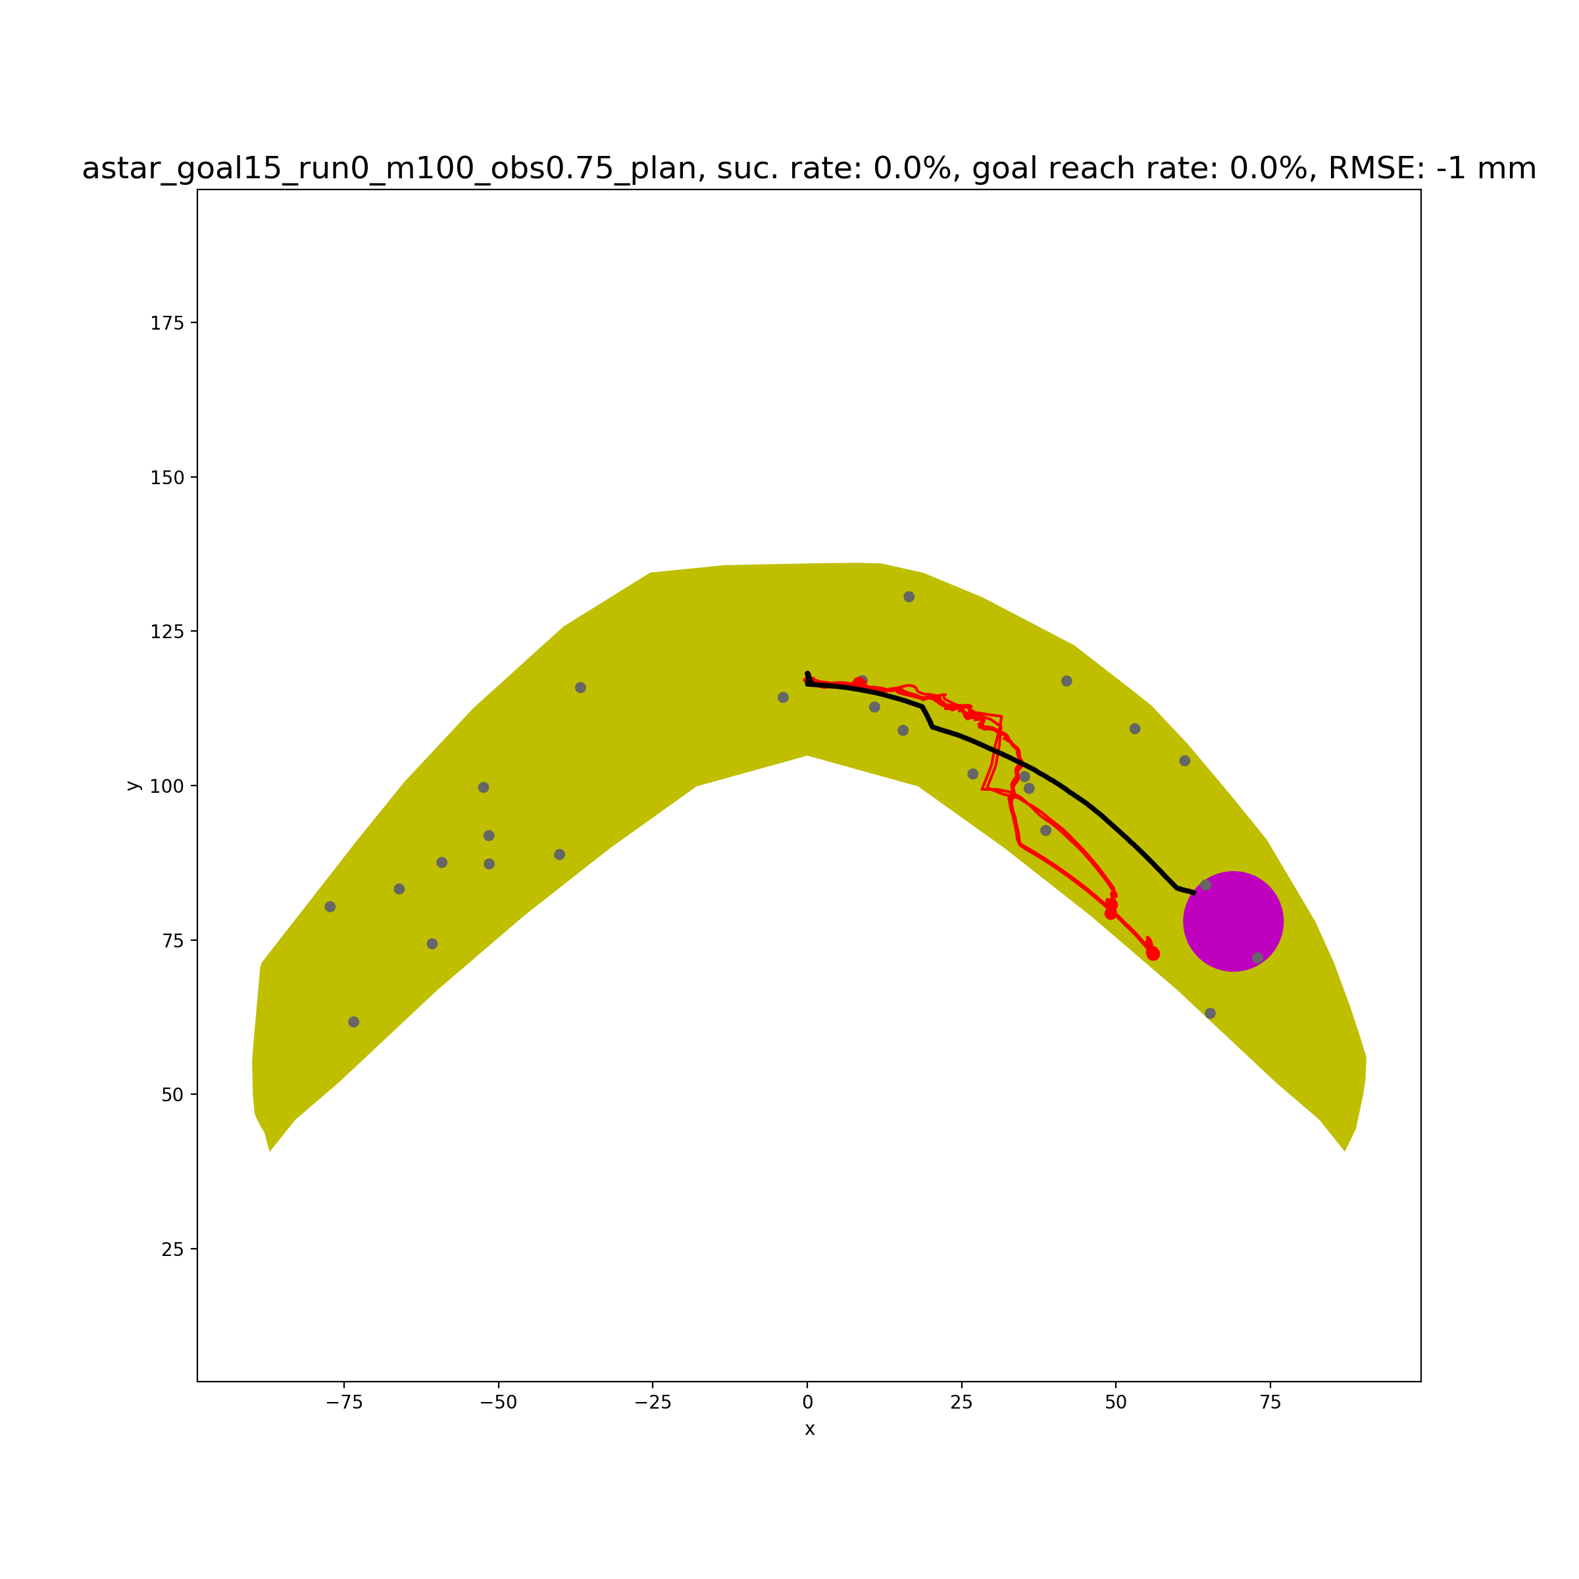
Goal 15 Obstacle 0.75mm
success rate | 0%
Goal reach rate | 0%
plan path length | 79.3
success path length | -
failure path length | 70.9
plan path steps | 891
failure path steps | 640
success path last distance to goal | -
failure path last distance to goal | 24.5
success path RMSE relative to plan path | -
0% success rate (All rollout paths failed due to drop or collision) and 0% goal reach rate.
Average last distance to goal range for failure path is 24.5mm. Because of 0% success rate, there is no need to check the result if we set goal range to be 10mm.
The rollout path began to look quite different from the planned path from some point. NN model seemed not to be precise enough.

Slide 14
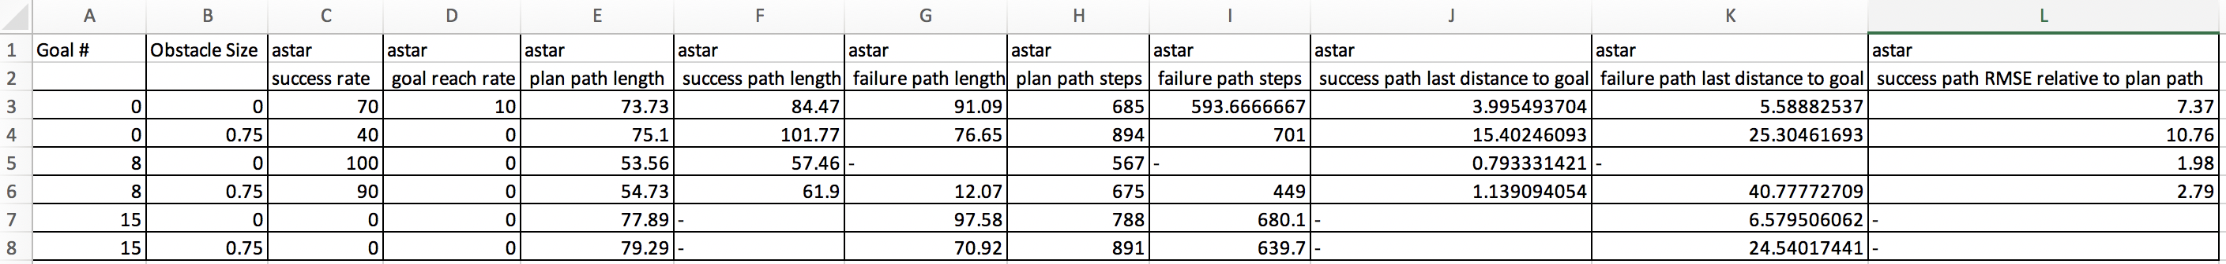
Summary of Results
For obstacle size of 1.5mm and 3mm, all rollout paths are failure, mainly because of the collision.
But since Avishai also only considered the obstacle size of 0.75mm, it is not the biggest issue for the moment.

Slide 15
Discussion
Consider a bigger goal reach range for rollout and a smaller goal reach range for planning?
YES!
NN model is not precise enough for a relatively long path or many steps of actions. Thus, Astar should not consider too many same actions (100 actions in our case)for one big step when planning? But if not do so, the planning process would take too much time.
Difference from the planner in Avishai’s paper:
The planner is not Astar. (the code is not available in Andrew’s repo)
I don’t know which NN model Avishai used in his paper. (There are 3 or 4 learned NN models in Andrew’s repo, and I asked Avishai which model file he used in paper, he told me he forgot. The exact model file name should also be in the code of his planner)
Avishai’s planner can plan a continuous action, such as [0.5241234, -0.3451234]. (I had to discretize to 8 discrete actions for my Astar)
Avishai’s planner used 10 same actions as one big step when planning.
Avishai’s planner did not give us a shortest path.( Please see figures on next page)
Avishai seemed to have also used svm claissifer for checking if the state is a drop state when planning
Avishai also had a version of planner taking critic model into account when planning

Slide 16
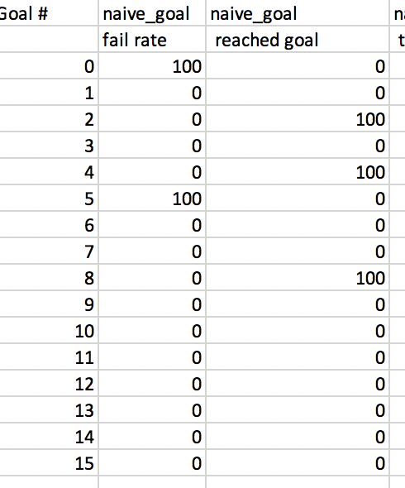
Avishai’s Naïve Planner (without critic model)
- In fact, Avishai’s naïve planner also did not work very well.
- Goal indices I used this time are [0,8,15].

Slide 17
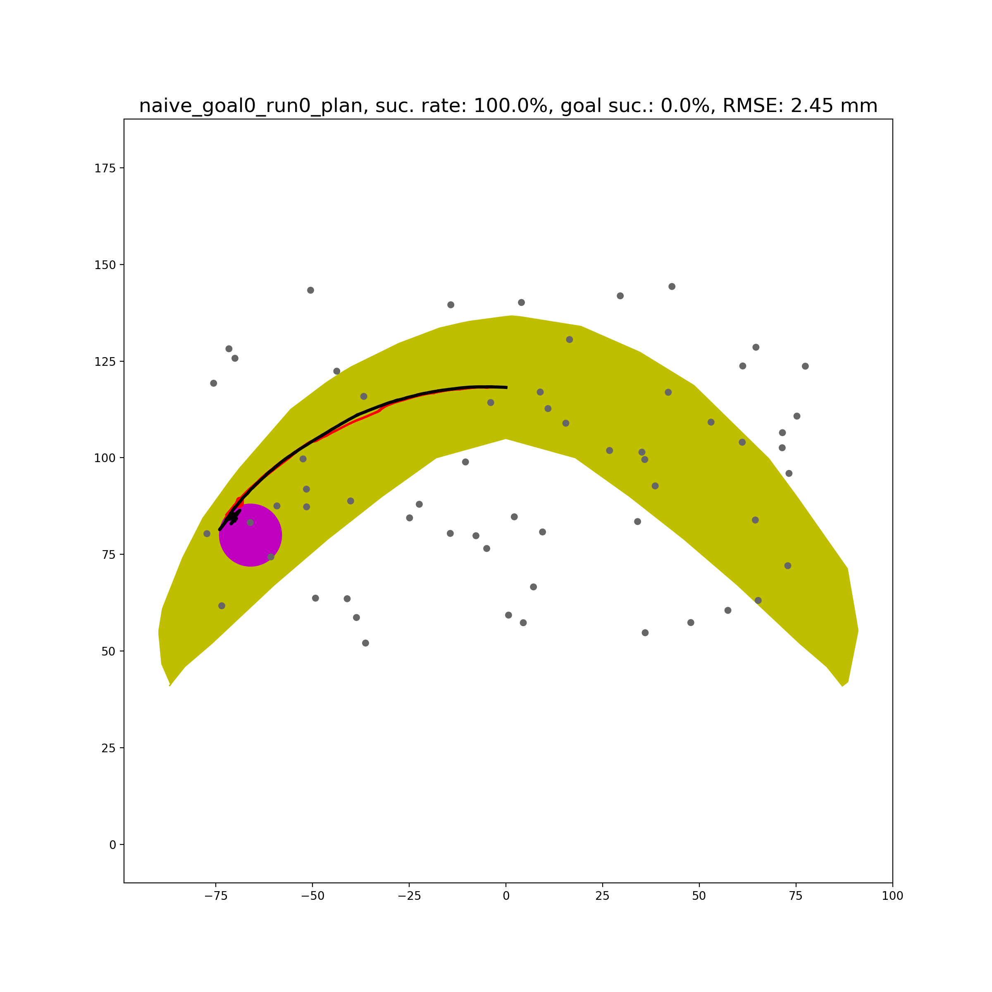
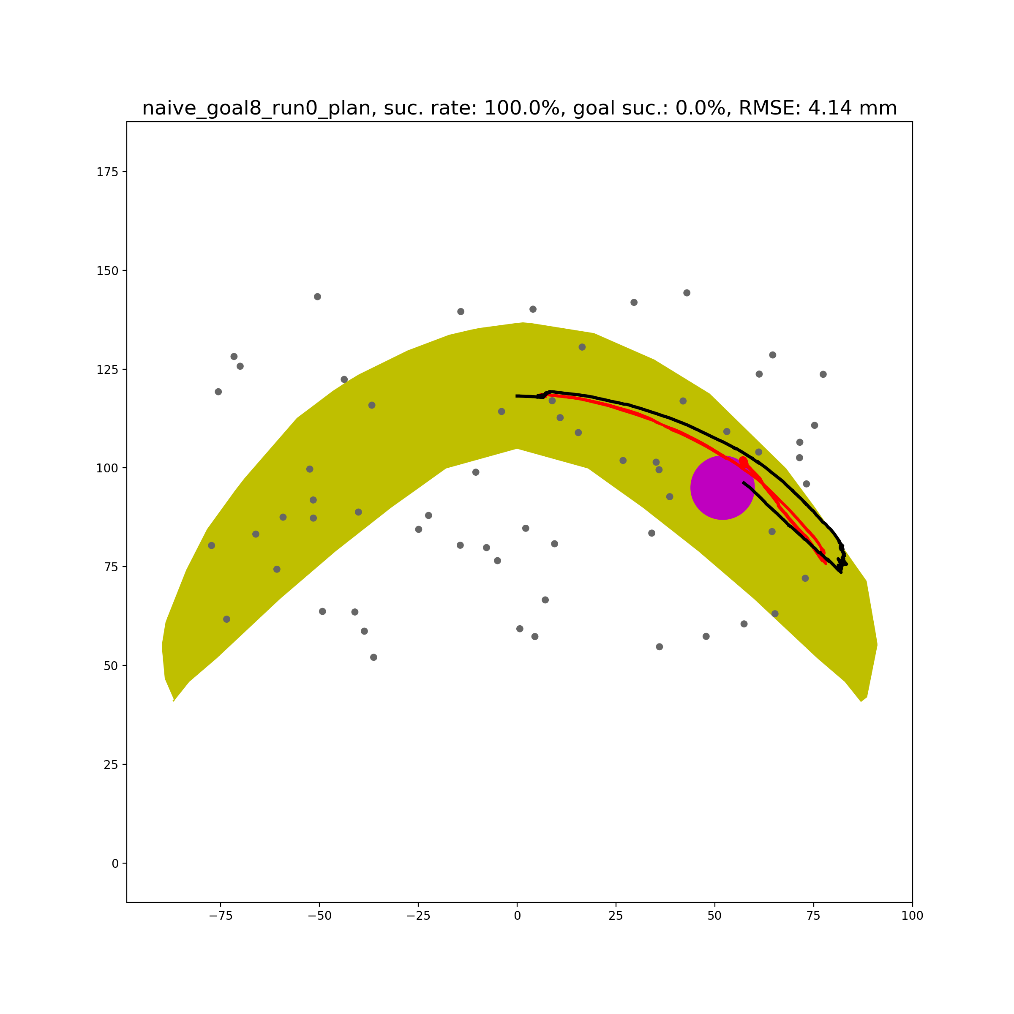
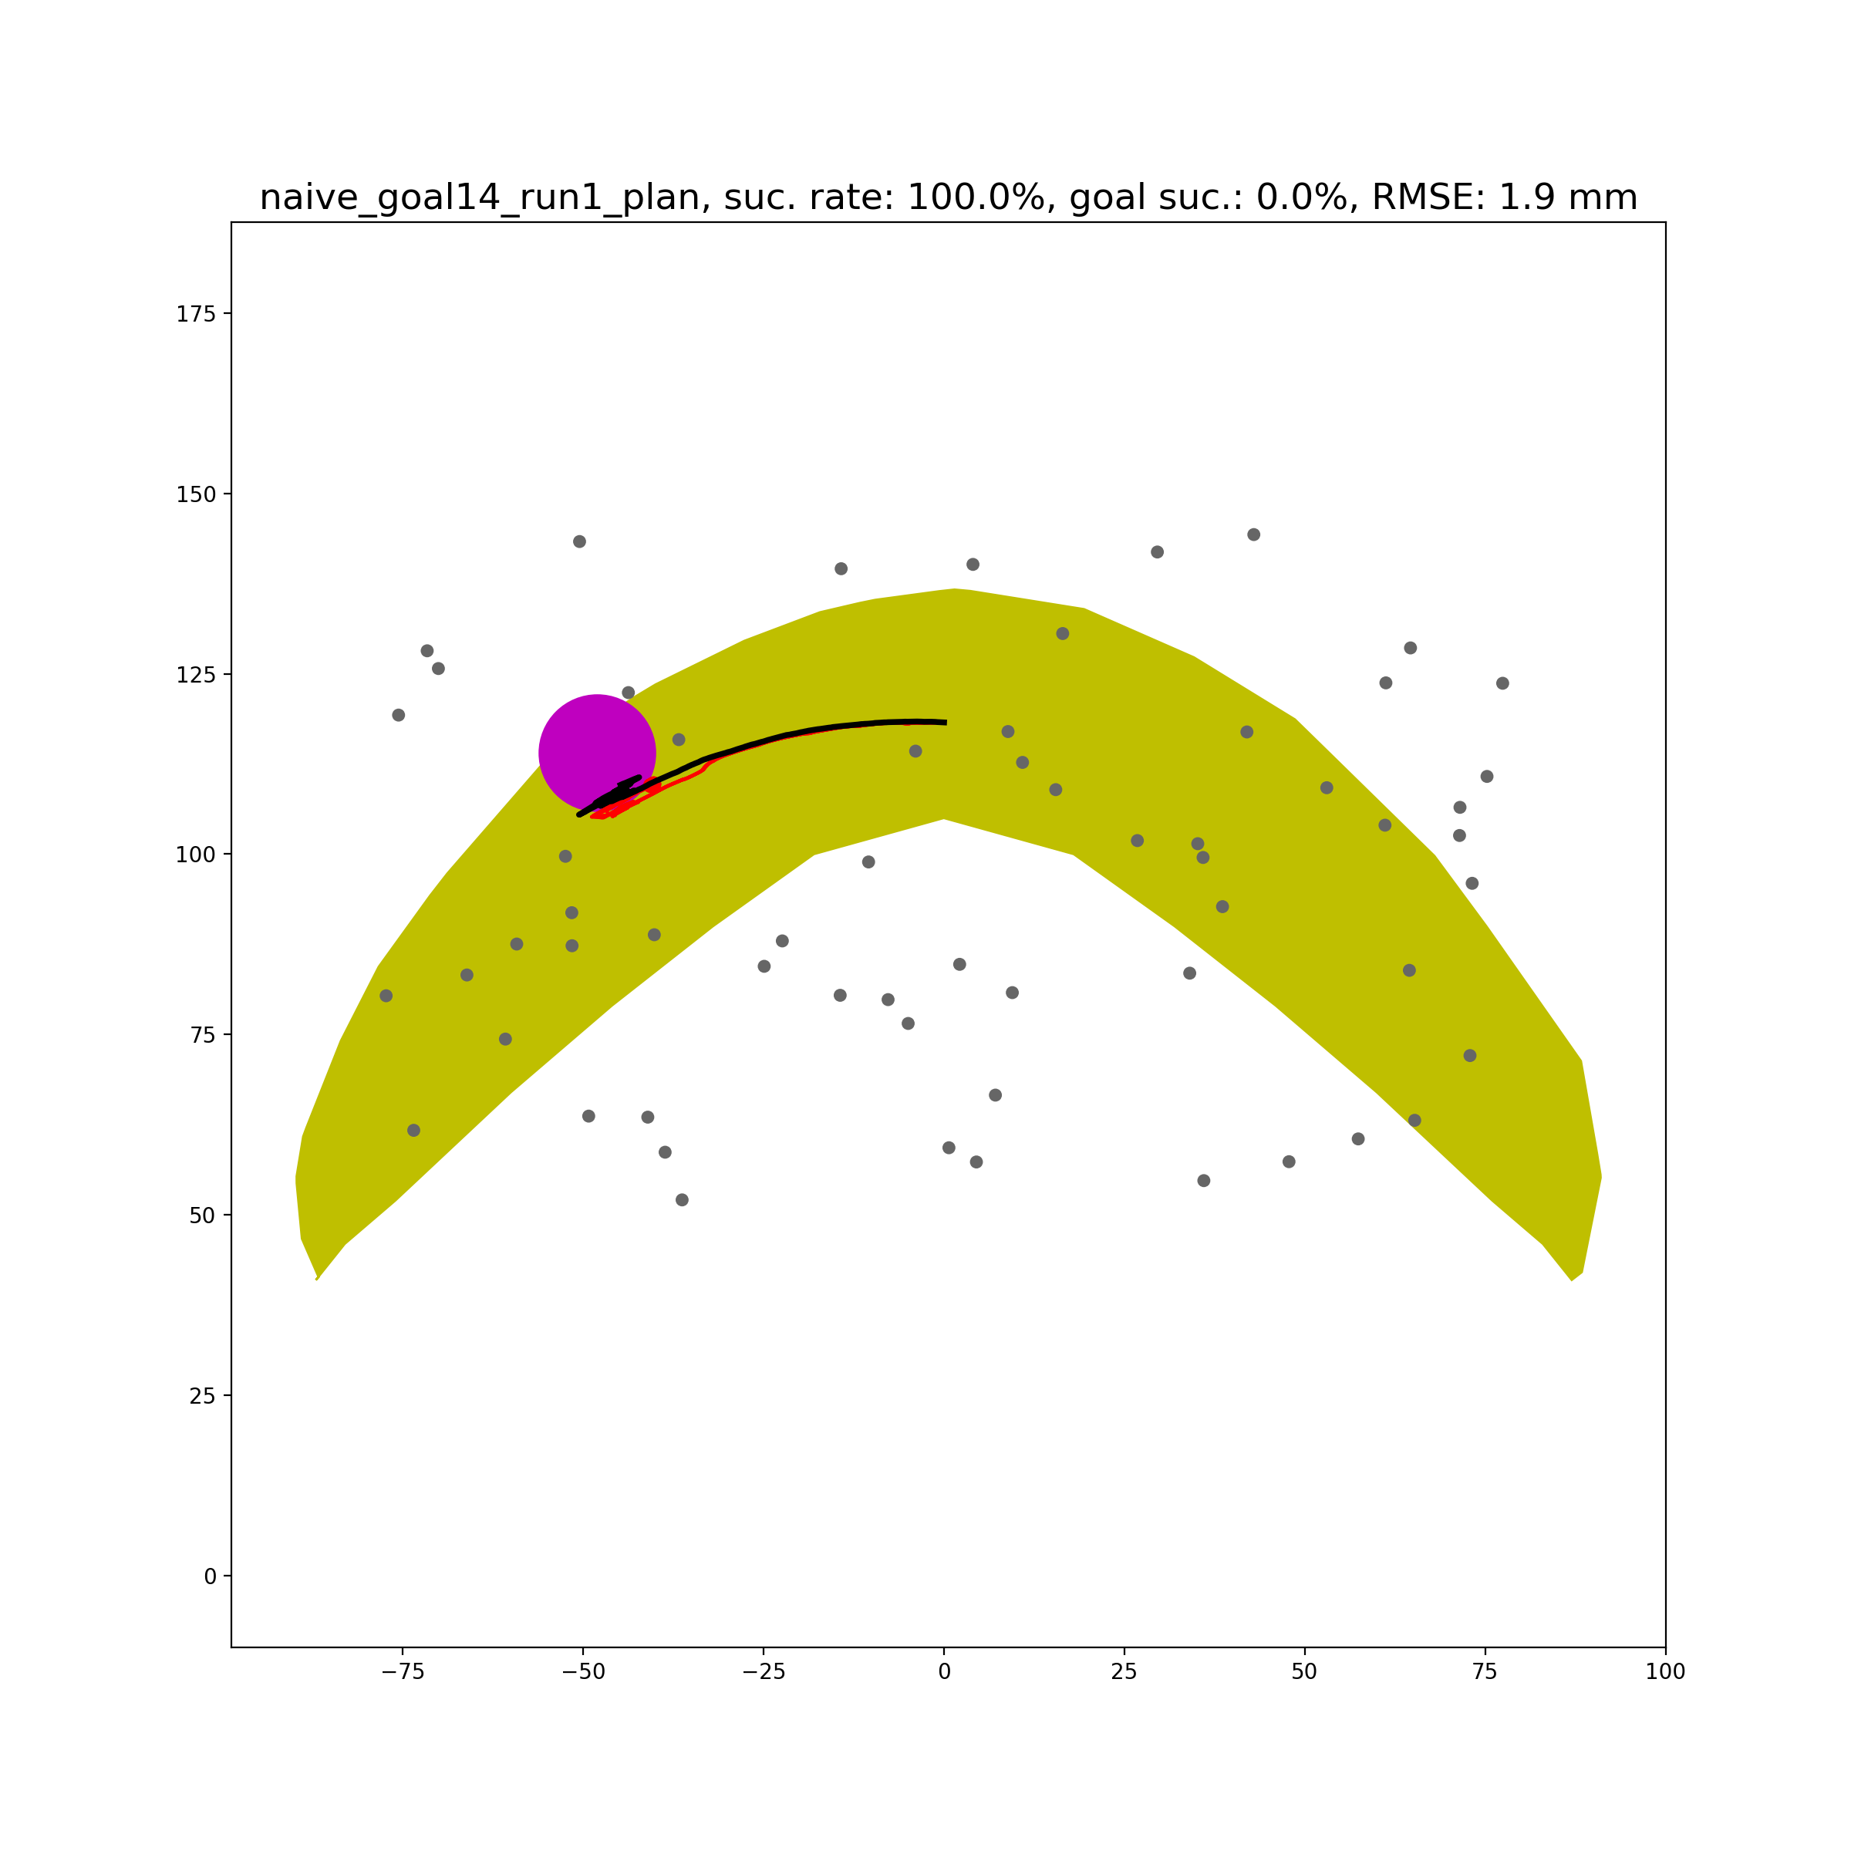
Avishai’s Naïve Planner (without critic model)
In conclusion, it would be nice if I can get access to the code of his planner. Then, I can look deeper into his planner details.

