Slide 1
Meeting 05/21/2020
Shuo Zhang

Slide 2
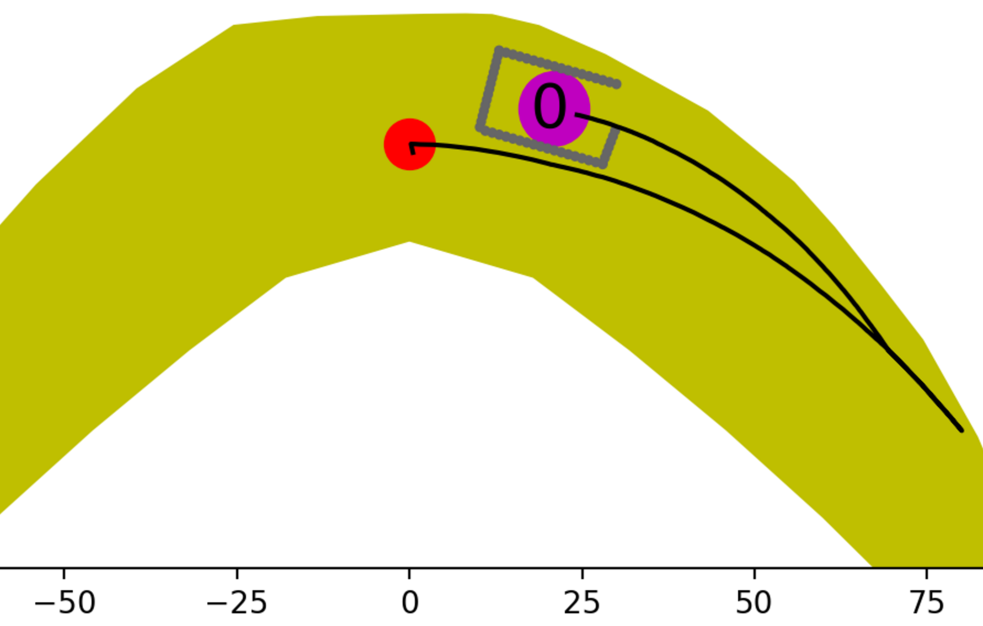
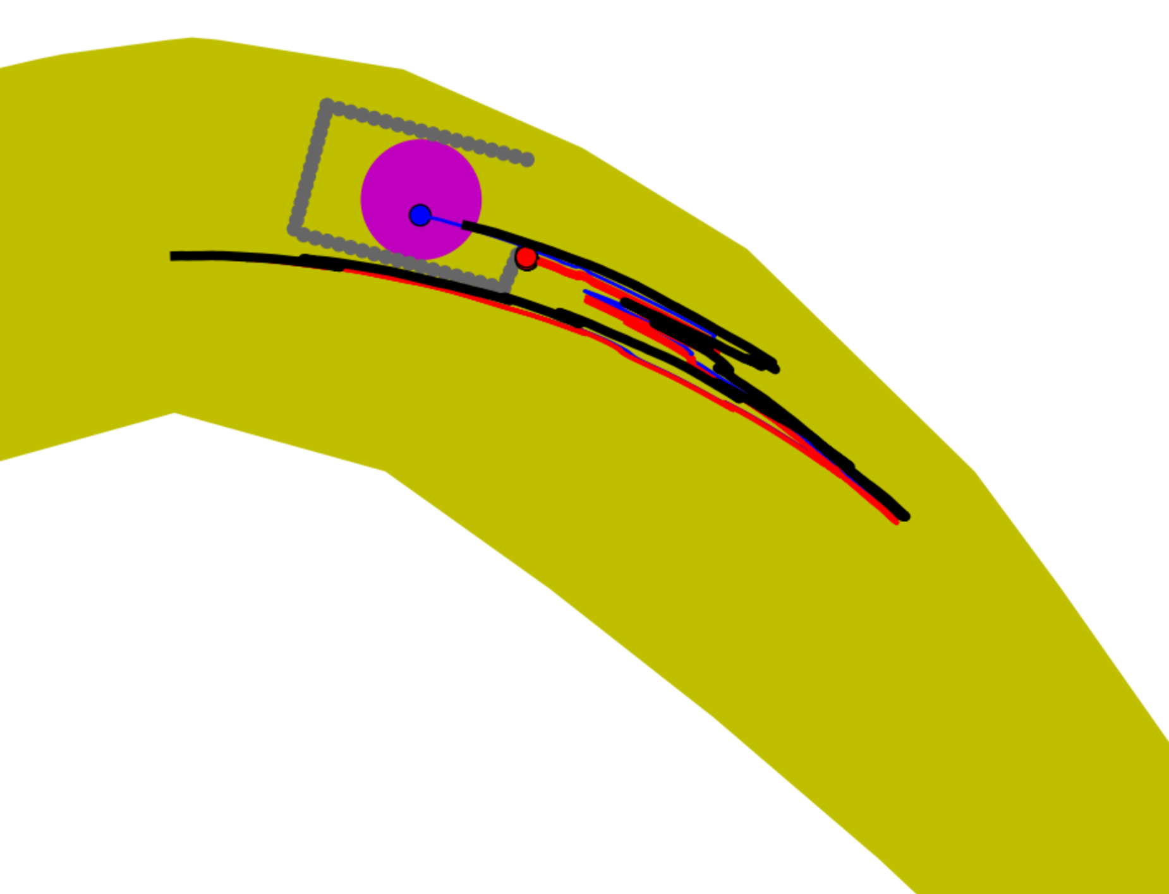
Horsehoe case
dist_sofar+dist_togoal
+10000*check_small_action
Number of same actions: 100
Planning time: 5hours 26mins
Number of expanded nodes: 31729
Maximum depth of tree: 11
Planned path depth: 8
Avishai’s planned path also work.
However, his planned path has more depth and needs more time.

Slide 3
PPO RL using Transition model as env to generate data
Progress:
1. Wrapped the transition model as a class of sample generation environment
2. Adjusting my previous PPO code(for gym env) to our case of transition model env
3. Almost ready to train

Slide 4
Discussions and Questions:
PPO RL using Transition model as env to generate data
State: (current_state + goal_location + goal_range)? Do we need goal range? Or can we just assume goal_range is some constant, ex. 5mm?
Because some testcases in Avishai’s paper used 8mm as goal range, some used 5mm
When hand reaches within goal range, should we define reward to be 0 or the actual distance to the goal? (ex. Goal range 5mm, when hand is 4.7mm far from the goal, should we define reward to be 0 or -4.7 ?)
Currently env without any obstacle. Should I implement some fixed obstacles in the env? Or the locations of obstacles are also parts of State? Like goal location?
I am going to define rewards of failure as ex. “-10000”,
in case of invalid region, invalid gripper load and collision

