Slide 1
Meeting 05/12/2020
Shuo Zhang

Slide 2
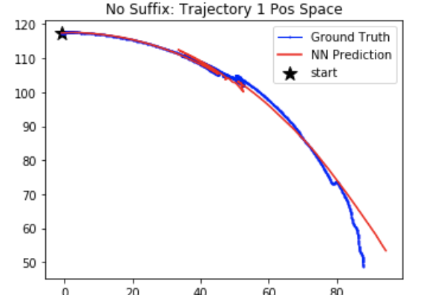
Actions:
60 steps (-0.21, -0.59)
150 steps (0.86, -0.53)
60 steps (-0.59, 0.67)
70 steps (0.29, -0.59)
40 steps (0.80, 0.18)
60 steps (0.95, 0.93)
50 steps (-0.59, -0.60)
…
Continuous Actions!

Slide 3
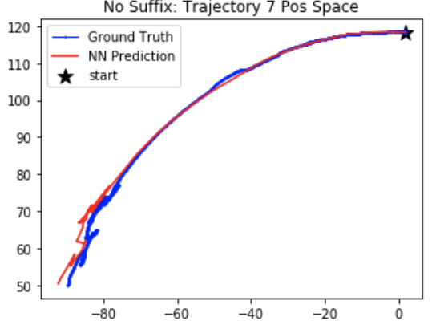
Actions:
20 steps (-0.62, -0.13)
50 steps (-0.73, 0.20)
60 steps (-0.99, -0.81)
…
Continuous Actions!

Slide 4
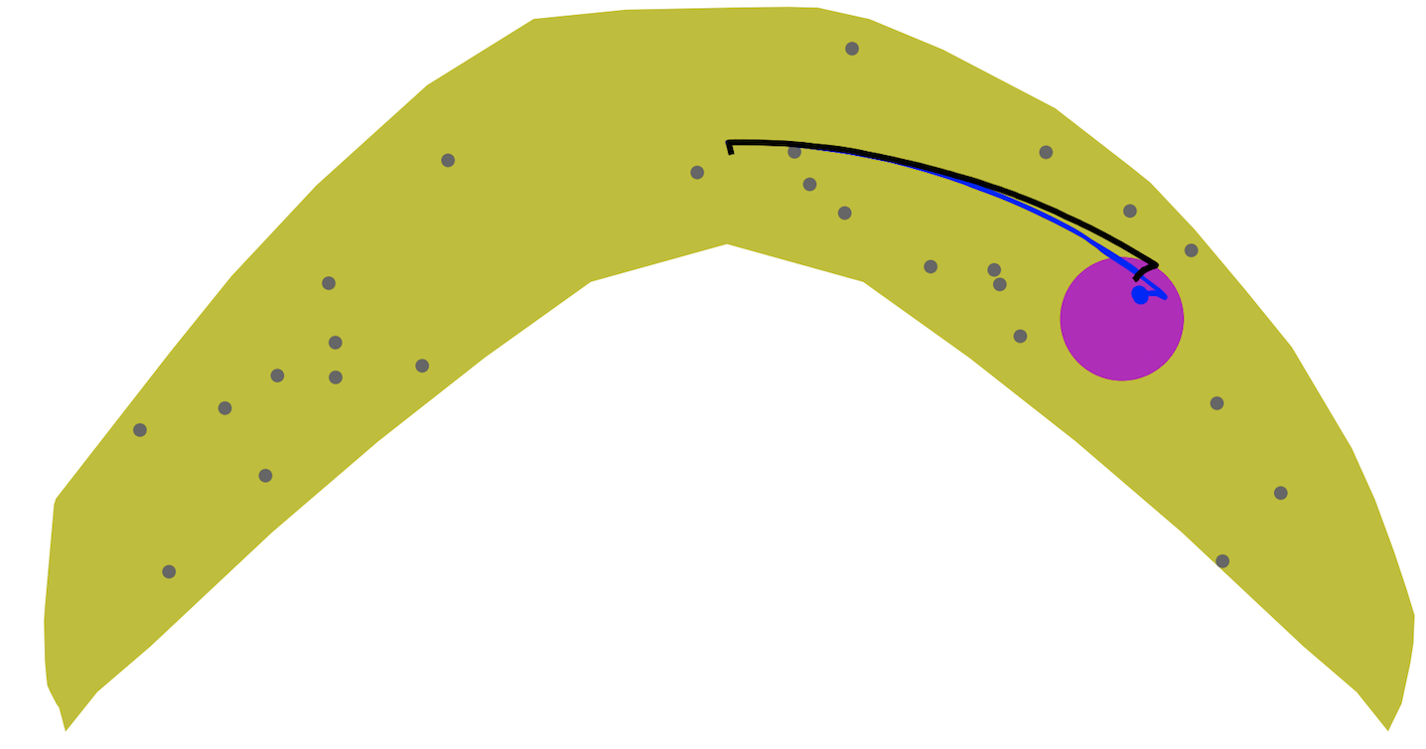
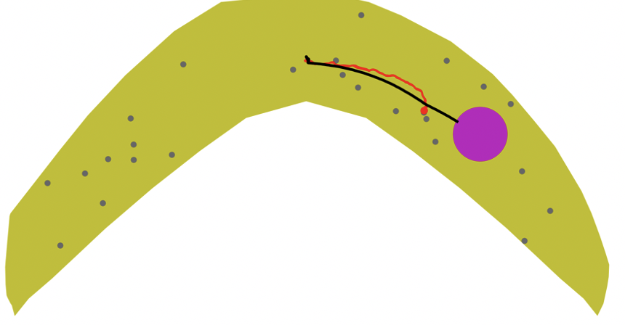
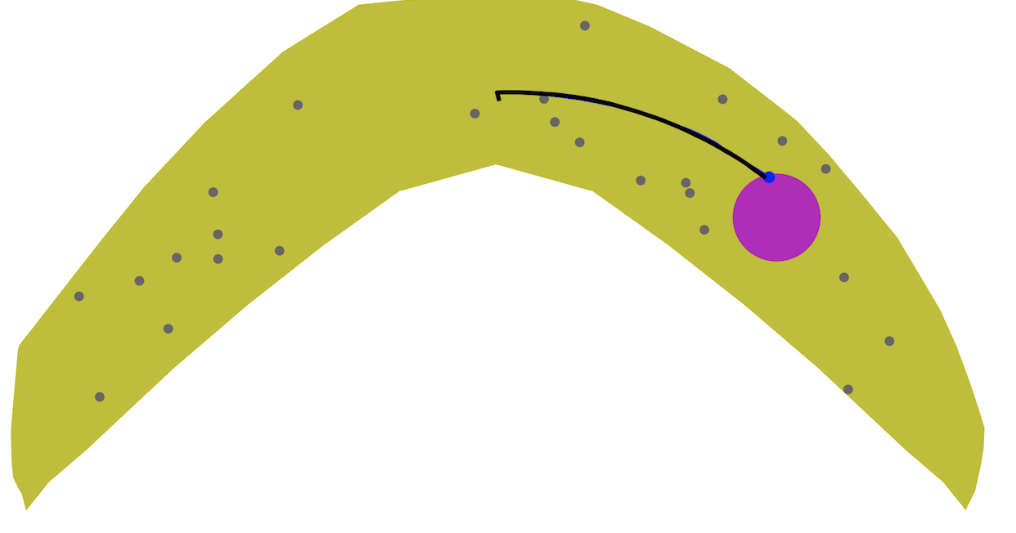
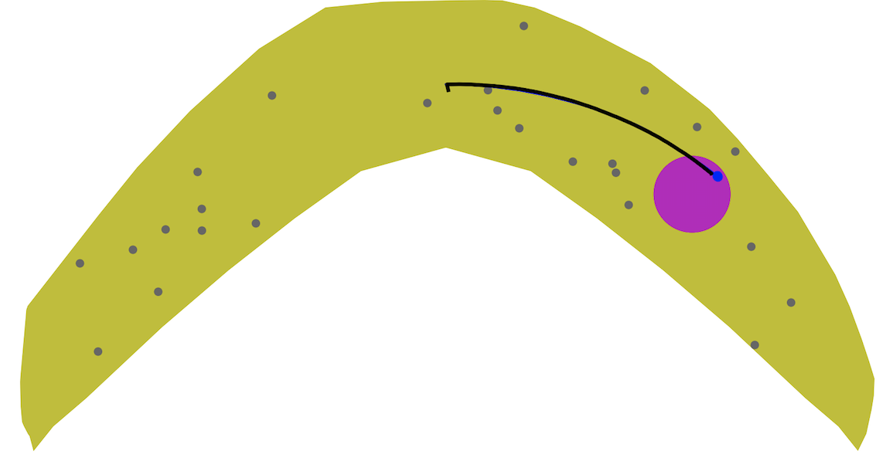
Goal 8 Obstacle 0.75mm
dist_sofar+1000*check_turnback
dist_sofar+10*dist_togoal+1000*check_turnback
dist_sofar+100*check_action+1000*check_turnback
dist_sofar+10*dist_togoal+100*check_action+1000*check_turnback

Slide 5
Discussions
It seems that last time, model could not produce accurate prediction because my actions for planning are discrete and values, -1 or 1m are higher than the raw data
Raw Data: (a1, a2) with a1 and a2 both continuous and within the range [-1, 1]
My 8 actions for planning : (1,1), (1,0), (1,-1), (0,1), (0,-1), (-1,1), (-1,0), (-1,-1)
Do we need to deal with this so that our rollout and model prediction can match each other more?

