Slide 1
Meeting 05/08/2020
Shuo Zhang

Slide 2
Progress So far
GAZEBO Correctness Check
Search for the best NN model
Plan using the best NN model
(Adjusted Planner: No node added into the search list if in the opposite direction)
Rollout the planned actions

Slide 3
Progress So far
GAZEBO Correctness Check
Search for the best NN model
Plan using the best NN model
(Adjusted Planner: No node added into the search list if in the opposite direction)
Rollout the planned actions

Slide 4
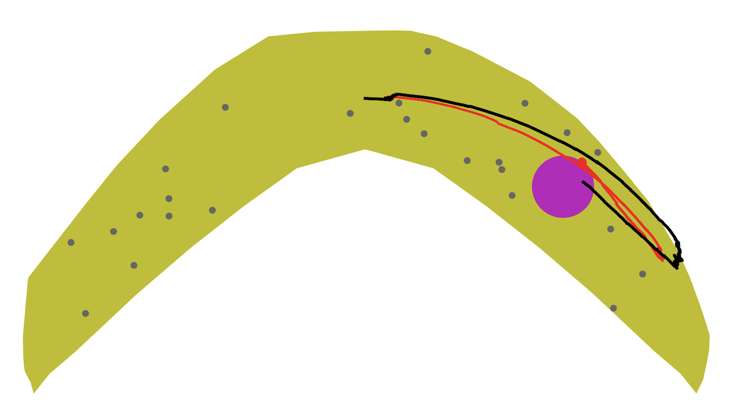
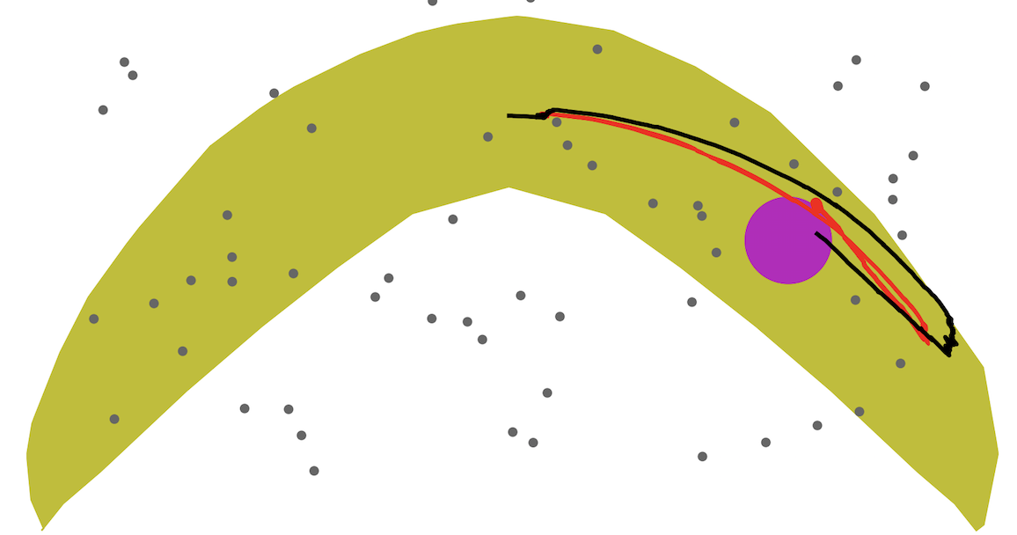
Correctness Check of “my” GAZEBO
My Results using Avishai’s actions
Avishai’s Results using Avishai’s actions
So, GAZEBO on my laptop works well!

Slide 5
Progress So far
GAZEBO Correctness Check
Search for the best NN model
Plan using the best NN model
(Adjusted Planner: No node added into the search list if in the opposite direction)
Rollout the planned actions

Slide 6
Search for the Best NN Model
All available 9 models we have:
no suffix
suffix ”ho40”
suffix ”ho0.5”
suffix ”ho0.6”
suffix ”ho0.7”
suffix ”ho0.8”
suffix ”ho0.9”
suffix ”ho0.95”
suffix ”ho0.99”
Results: Model “no suffix” works best generally

Slide 7
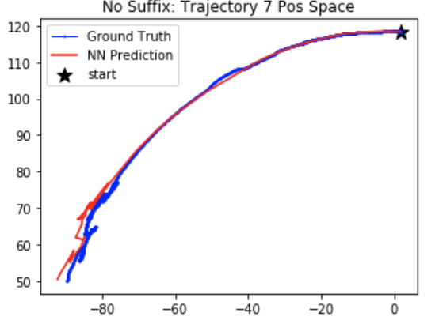
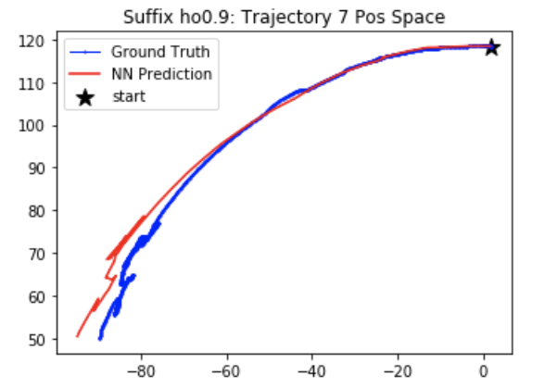
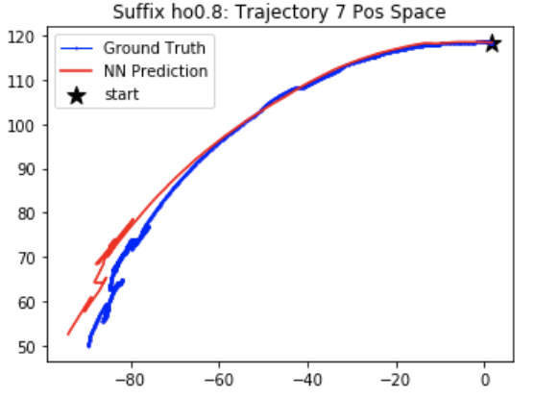
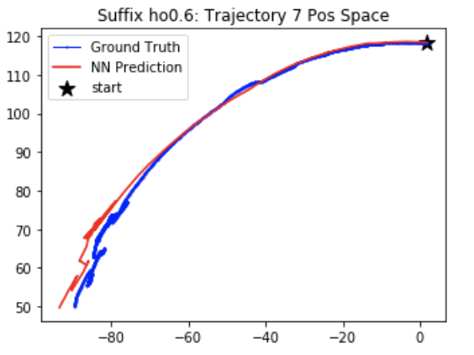
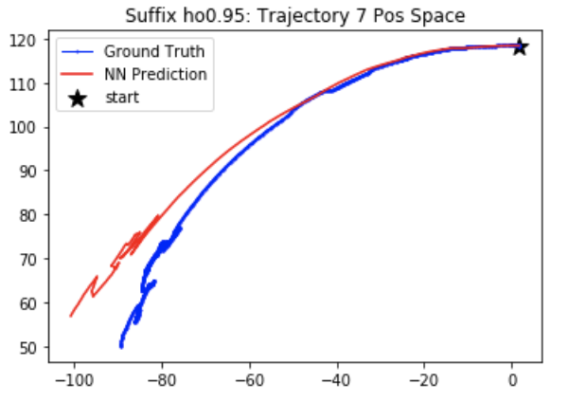
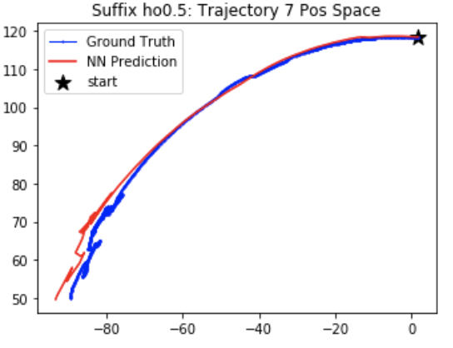
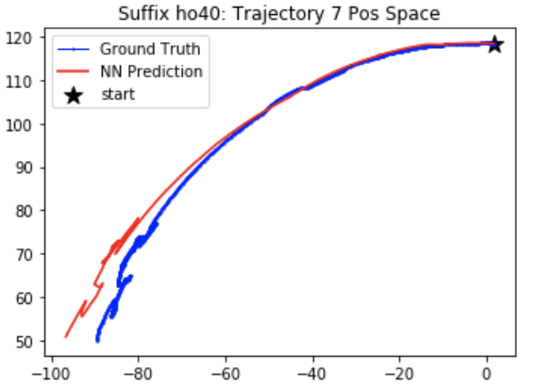
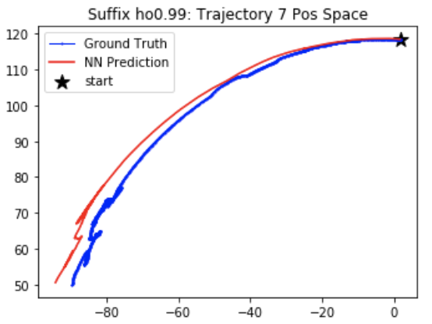
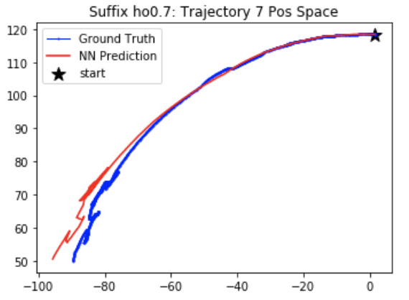

Slide 8
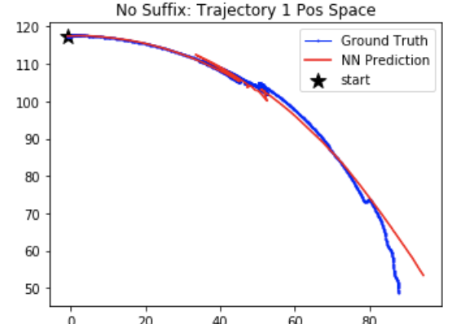
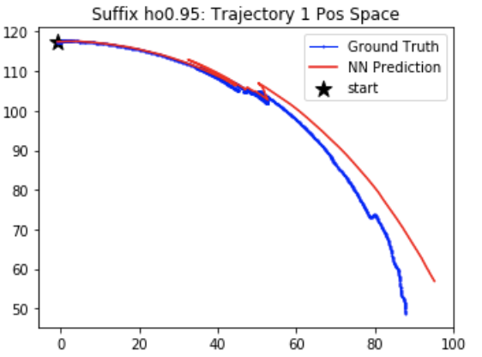
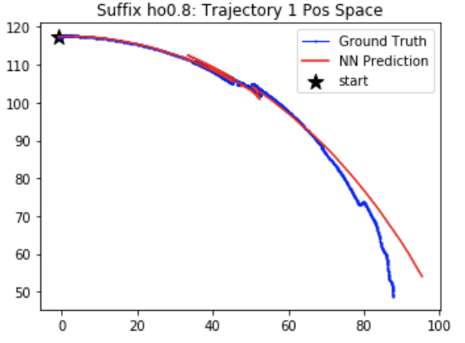
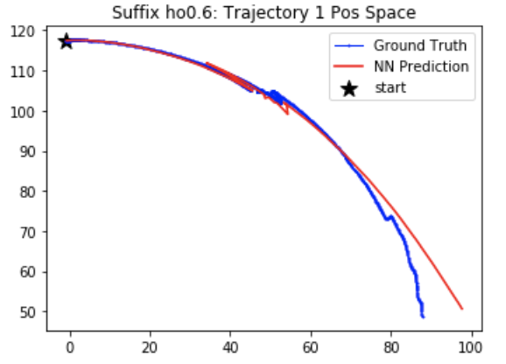
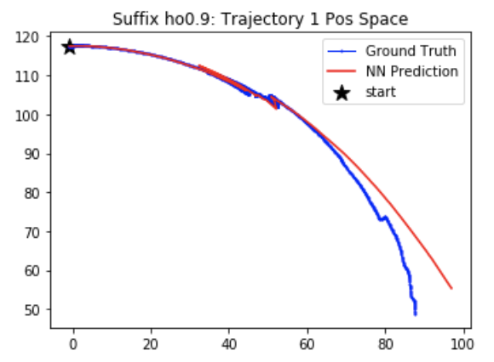
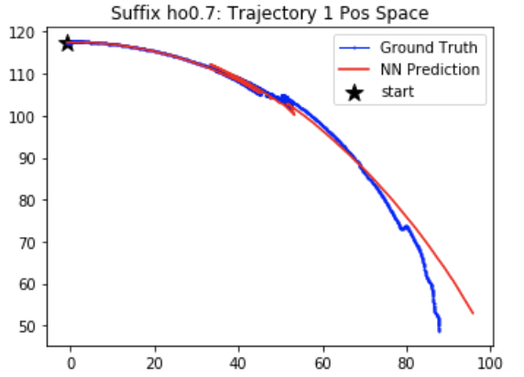
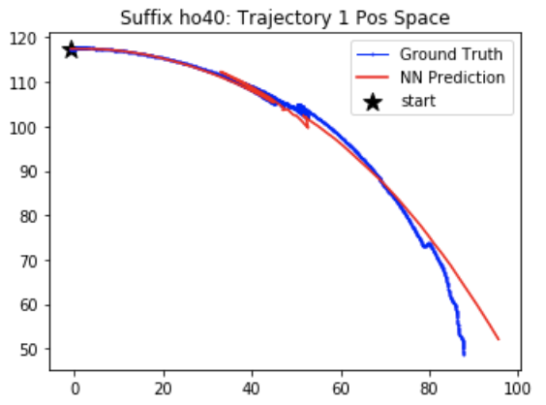
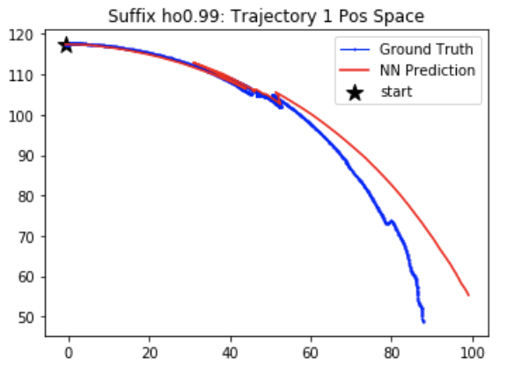
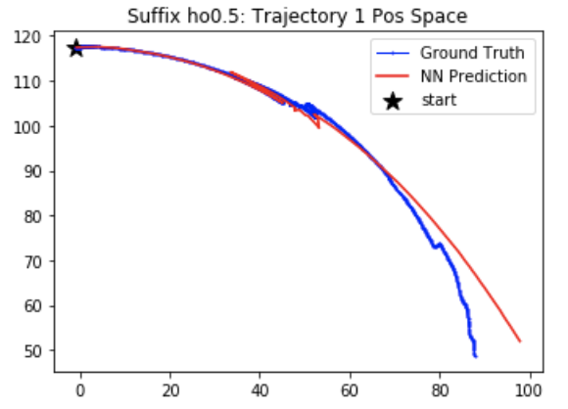

Slide 9
Progress So far
GAZEBO Correctness Check
Search for the best NN model
Plan using the best NN model
(Adjusted Planner: No node added into the search list if in the opposite direction)
Rollout the planned actions

Slide 10
Goal 8 Obstacle 0.75mm

Slide 11
Goal 15 Obstacle 0.75mm

Slide 12
Goal 0 Obstacle 0.75mm

