Slide 1
Meeting 10/08/2020
Shuo Zhang

Slide 2
Real Hand
Fixed all issues of marker tracking and data collection with Mridul
Got 20 trajectories from Mridul to recalibrate and test the validity of previously trained NN
Previous NN dynamics works not bad generally, though open-loop rollout failure might happen.
LQR closed-loop control or Reinforcement learning /AIP are likely to help rollout.

Slide 3
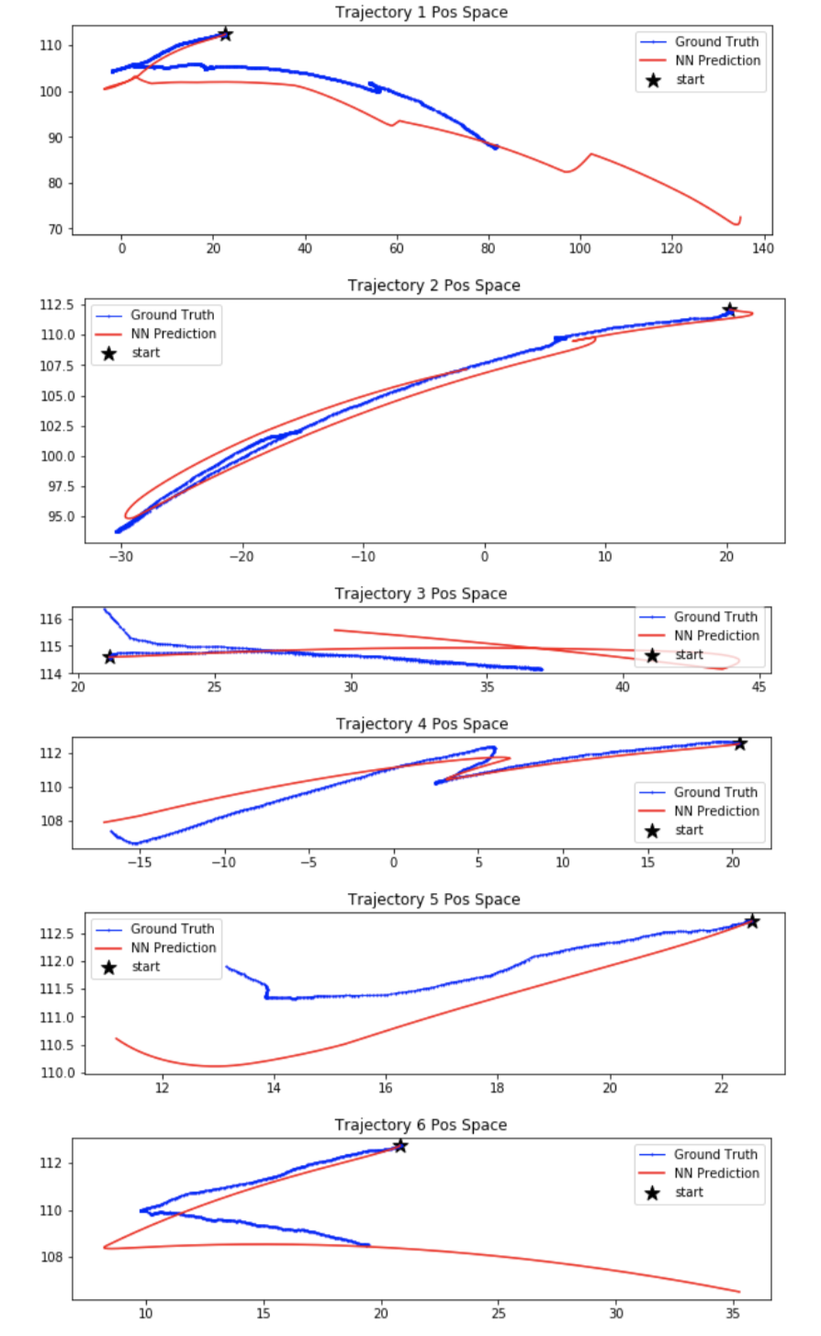
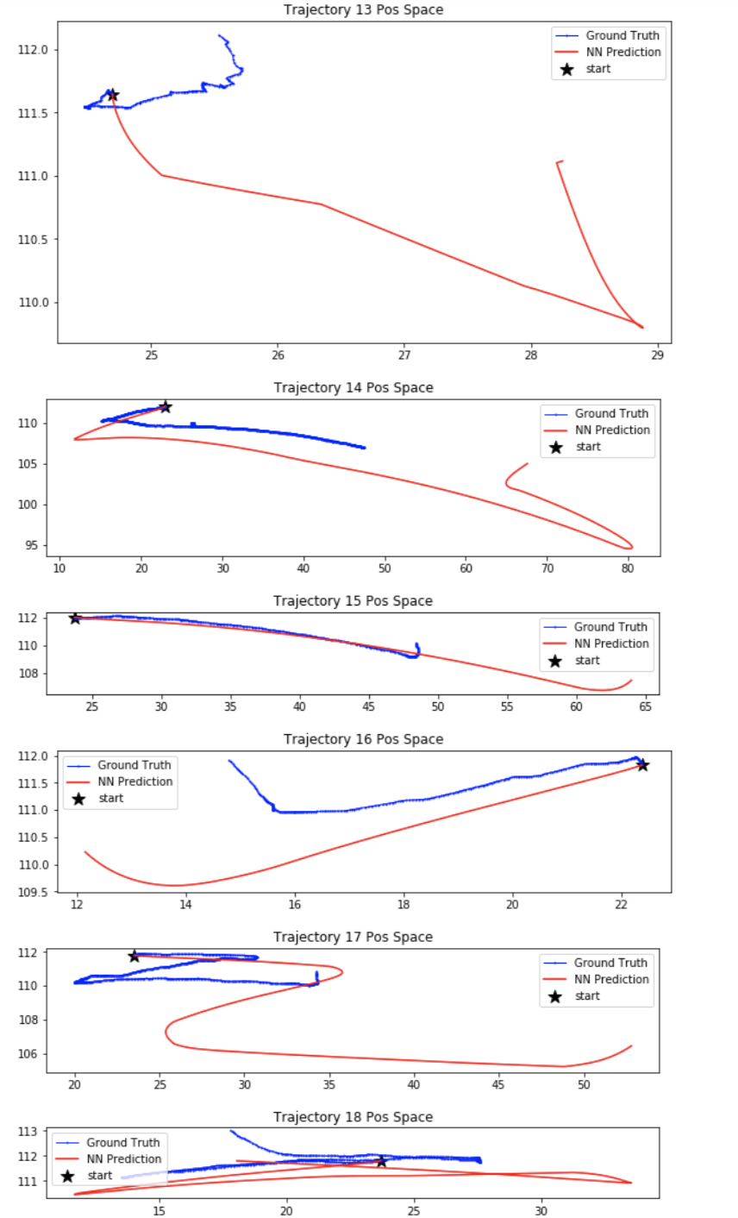

Slide 4
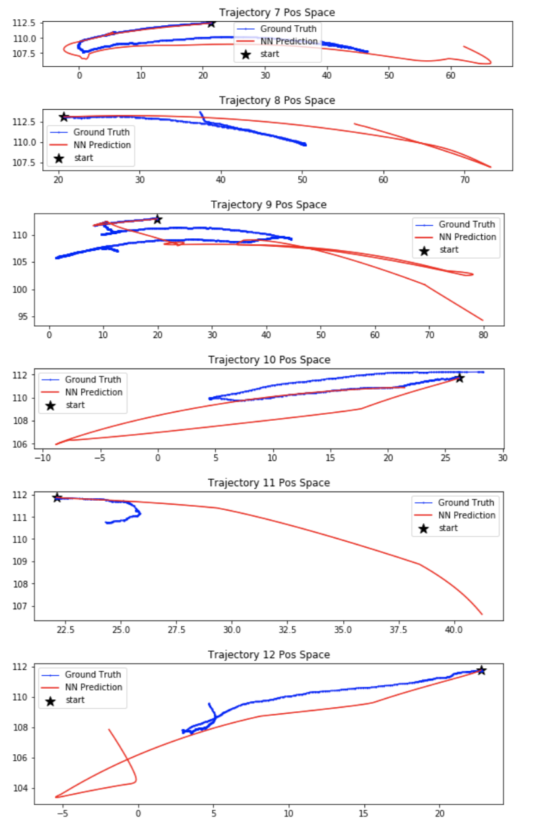
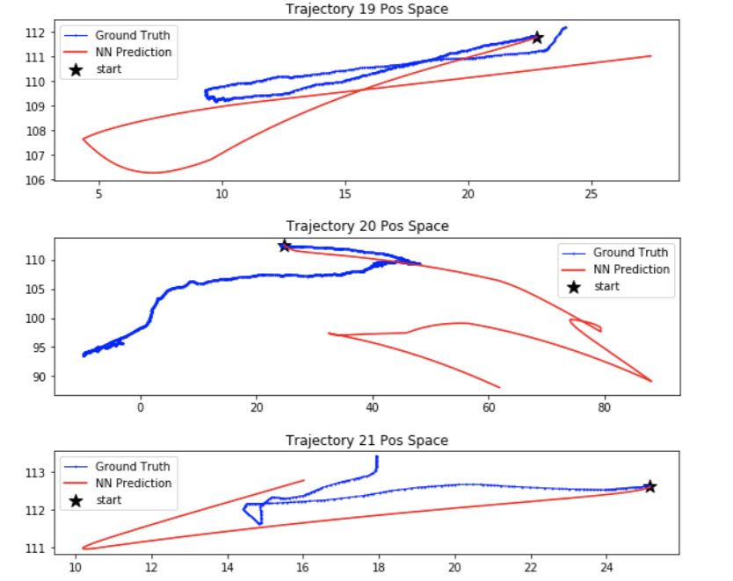

Slide 5
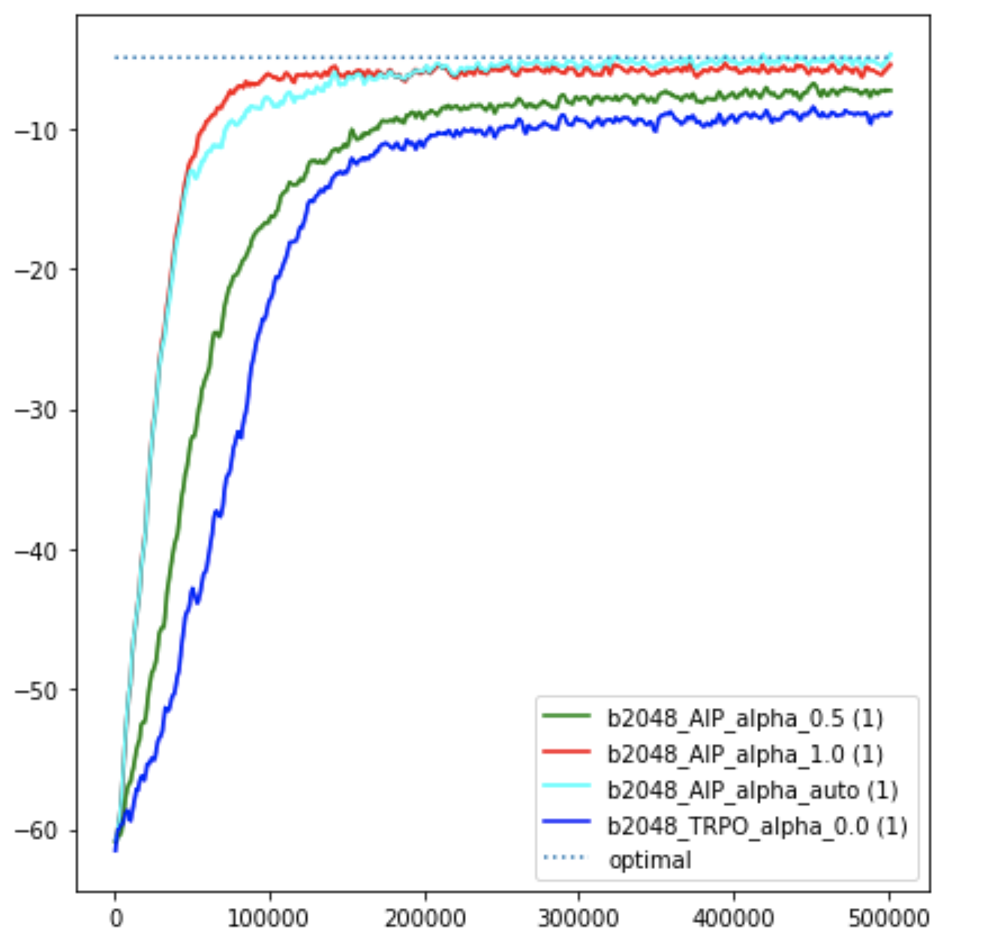
Mujoco-Reacher (Ablation Study)
Compared to TRPO(alpha=0), AIP is far more sample-efficient.
Compared to pure model-based method(alpha=1.0) which achieves a best return of -5.6, our AIP shows a better performance with an approximately optimal return of -4.9, which could also be achieved by TRPO, however, only after 1 million timesteps.
AIP works better than pure model-based method(alpha=1.0), mainly because it does not throw away the exploration. Finally, AIP finds a better policy than pure model-based method(alpha=1.0). In the case of gazebo hand with obstacles, the difference between AIP and \alpha=1.0 could be more obvious.
AIP could weigh the exploration(a_explore term in the Gaussian mean) and exploitation(a_ref term from model-based policy) intelligently using a weight \alpha dependent on the reward uncertainty r_diff.

Slide 6
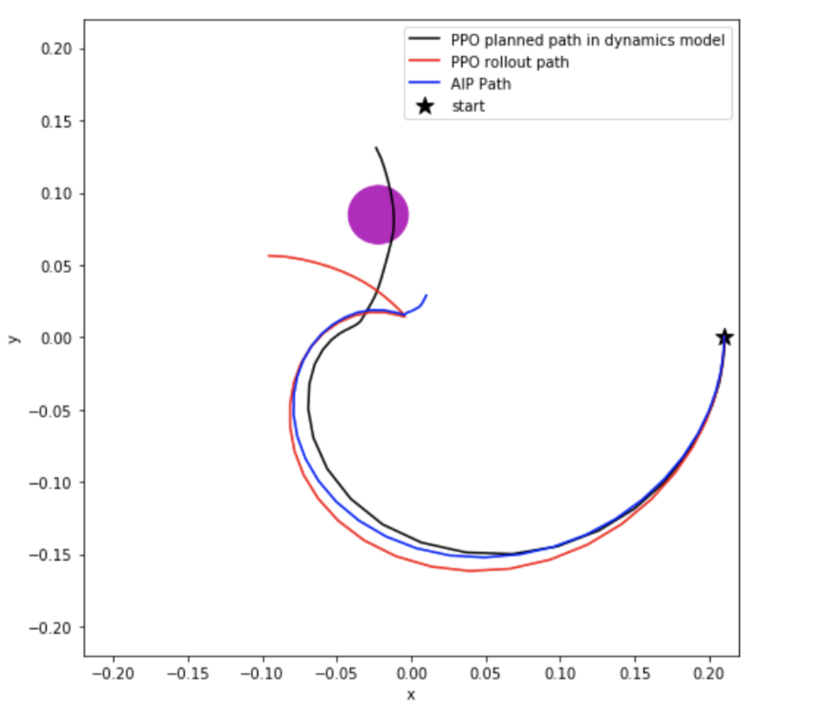
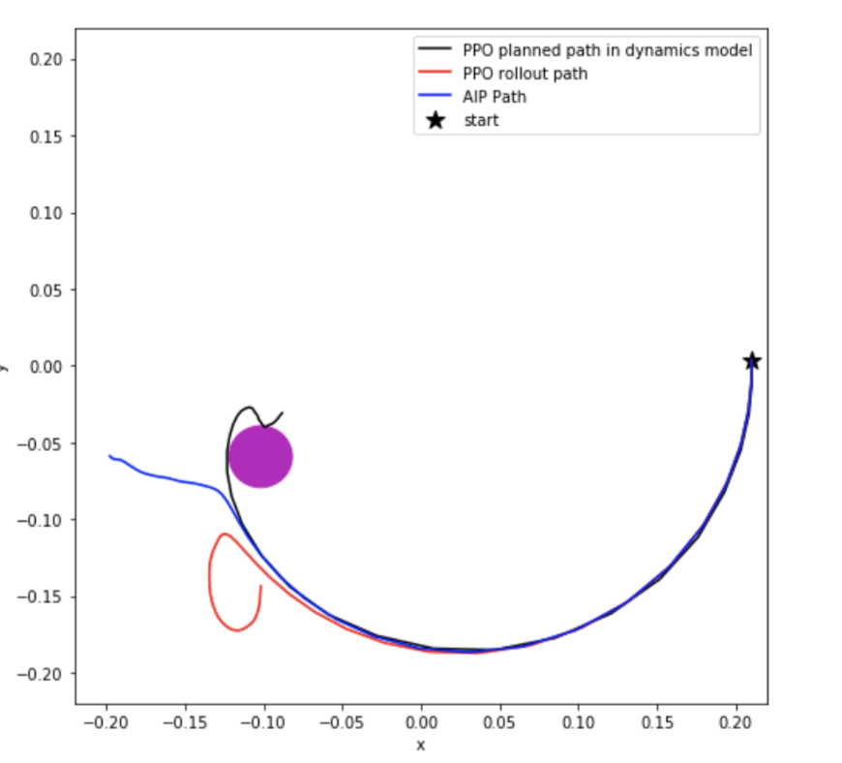
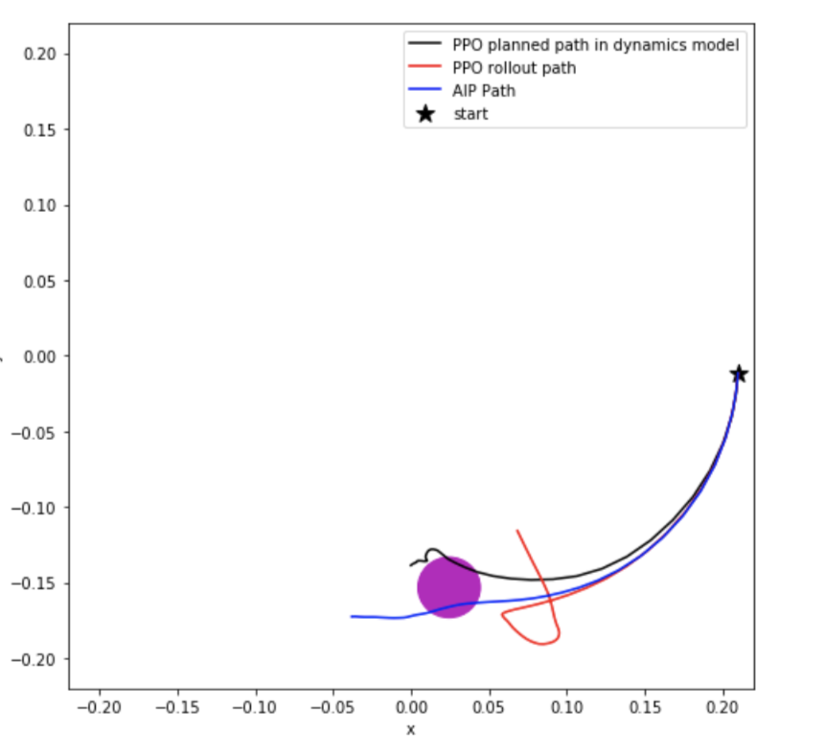

Slide 7
Gazebo Hand (Result is not yet available)
Encountered many problems when implementing AIP on ros Gazebo
Many library version dismatches (from python3 to python2, since gazebo ros is built on python2)
(e.g. pickle, tensorflow, pytorch)
Some ros issues when running ros, such as definition of ros message type
Could be solved soon

Slide 8
Next Steps
Focus on :
Gazebo Hand: AIP (by this weekend)
Real Hand: A* rollout, PPO rollout, LQR closed-loop
(by this weekend/beginning next week)
Remaining:
Acrobot: - AIP of sparse reward -1, (adapt r_diff in terms of long-term Q=r+V(s’))
- LQR of discrete actions
Acrobot: - LQR of discrete version
Real hand: AIP (if we have enough time)

