Slide 1
Meeting 08/20/2020
Shuo Zhang

Slide 2
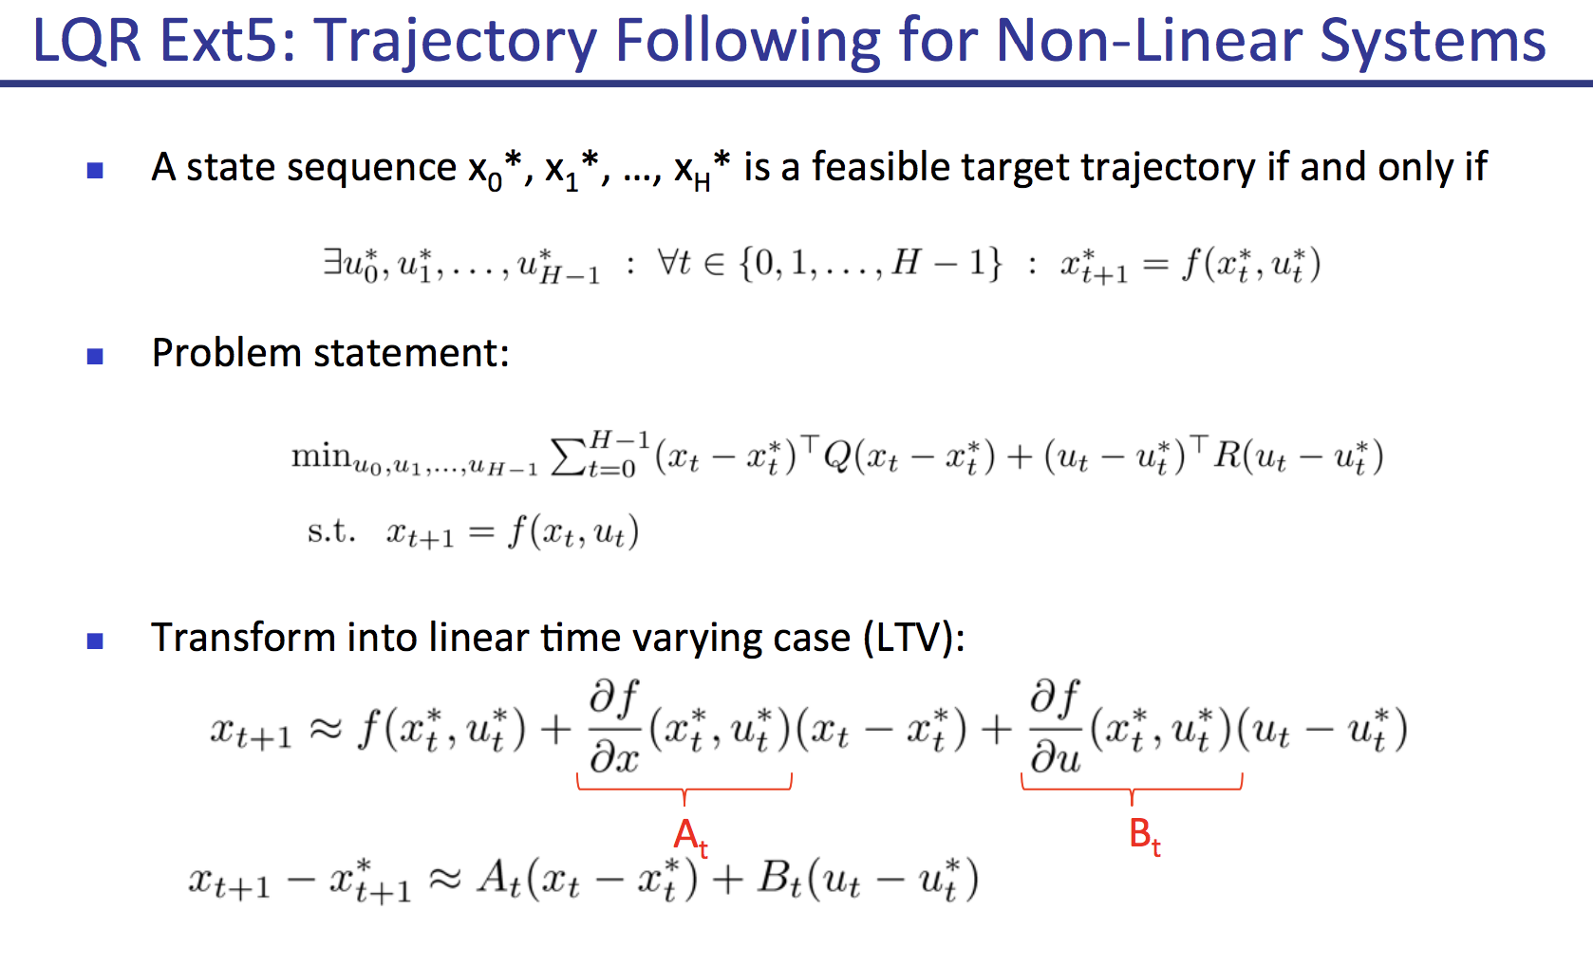
LQR
Got Matrix A_t and B_t for all 4 tasks.
Is Q_t and R_t always Identity Matrix in our case?

Slide 3
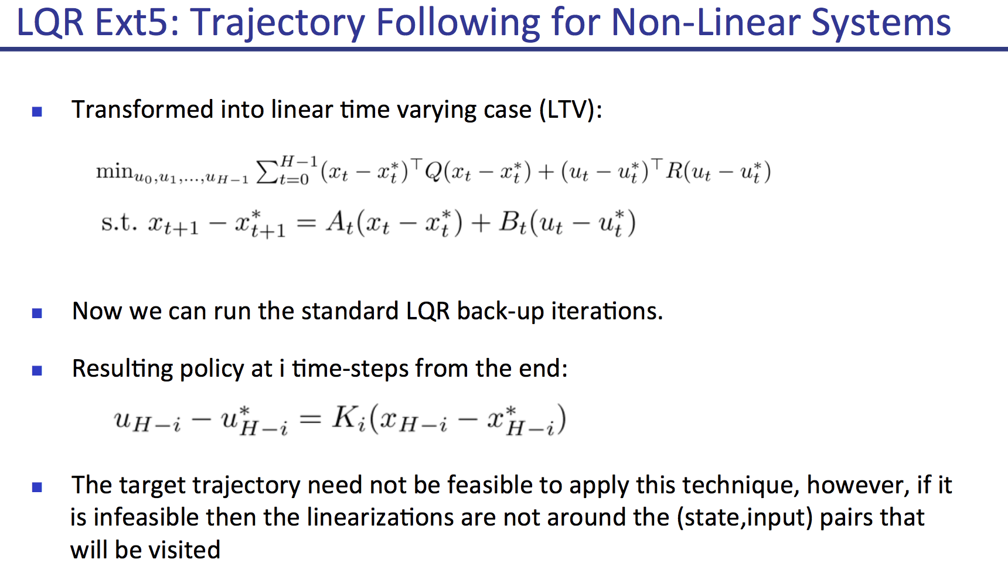
LQR
u_0 is calculated with K_H? Backward?

Slide 4
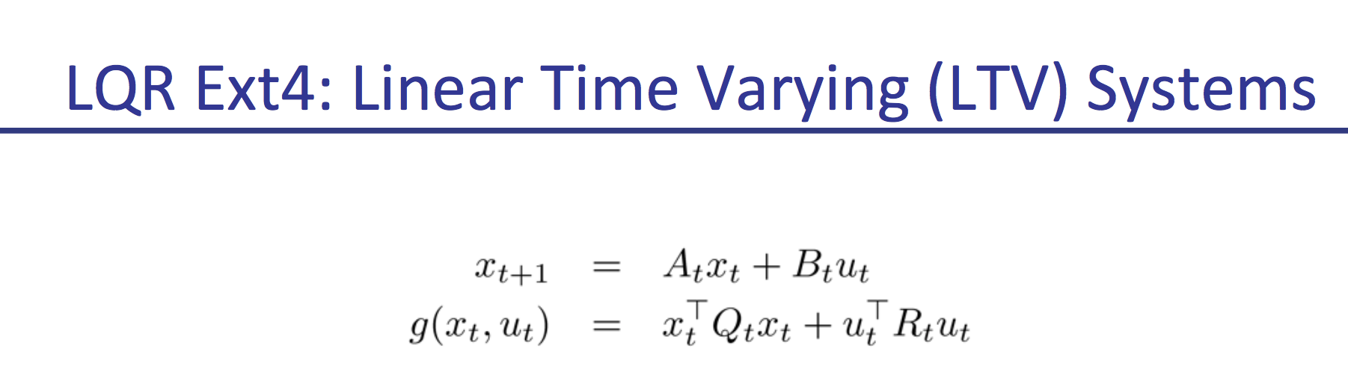
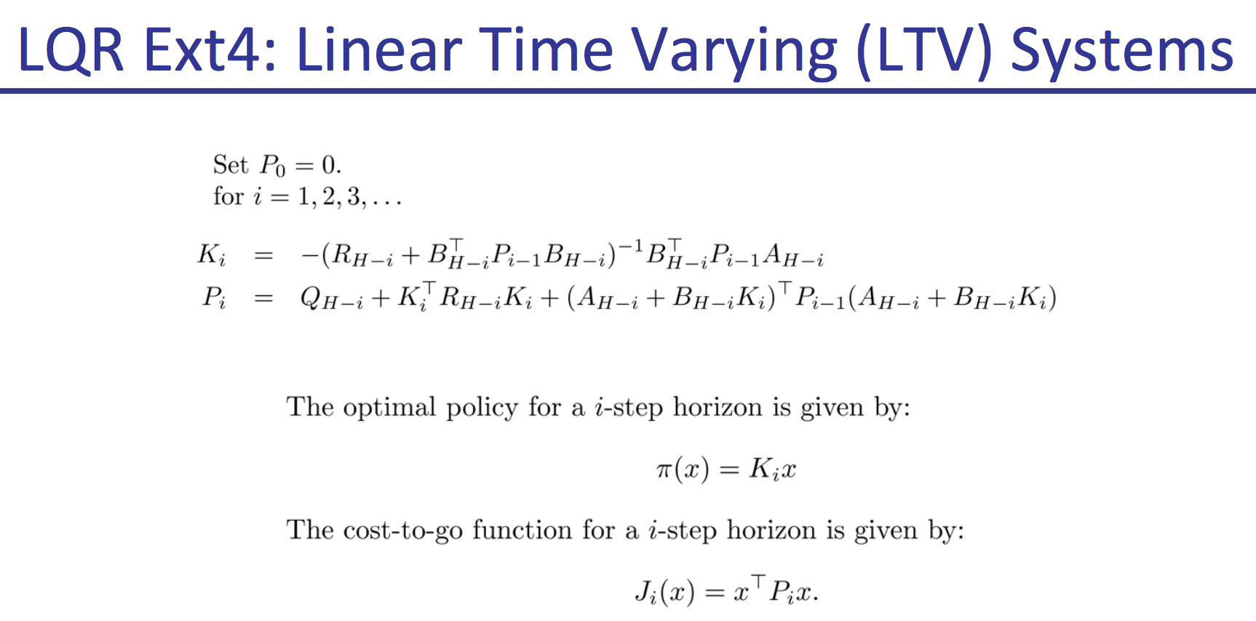
LQR

Slide 5
Next plans
After we get LQR solutions(Matrix K_i):
1) Try closed loop control using LQR(Matrix K_i) on real environments?
2) I can also try closed loop control using PPO (trained from model) on real environment?
3) Derive new equations, objective function and lambda-eta optimization procedures for our AIP?
4) Implement AIP

Slide 6
AIP Implementation (against TRPO,PPO)
Difference 1 Policy Network:
TRPO/PPO: u_final=pi_theta([x])
AIP: u_final=pi_theta([x, u_controller])
Difference 2 Constraint:
TRPO:
KL(pi_theta_new || pi_theta_old)<epsilon
PPO:
No constraint
Constraint (KL(pi_theta_new || pi_theta_old)<epsilon) combined into objective function
AIP:
KL(pi_theta_new || pi_theta_old)<epsilon
??KL(pi_theta || controller)<omega??
(Need to derive new equations and objective for optimization?)

Slide 7
Task | Open Loop A* +Rollout | Open Loop PPO + Rollout | Closed Loop PPO | Cloes Loop LQR based on A* | AIP (3 options)
Reacher (0.1% model) | Done + Done | Done + Done | Not yet | Not yet | Not yet
Gazebo Hand (0.1% model) | Done + Done | Done + Not yet | Not yet | Not yet | Not yet
Acrobot (100% model) | Done + Done | Done + Done | Not yet | Not yet | Not yet
Real Hand (100% model) | Done + Not yet | Done + Not yet | Not yet | Not yet | Not yet

