Slide 1
Meeting 08/26/2020
Shuo Zhang

Slide 2
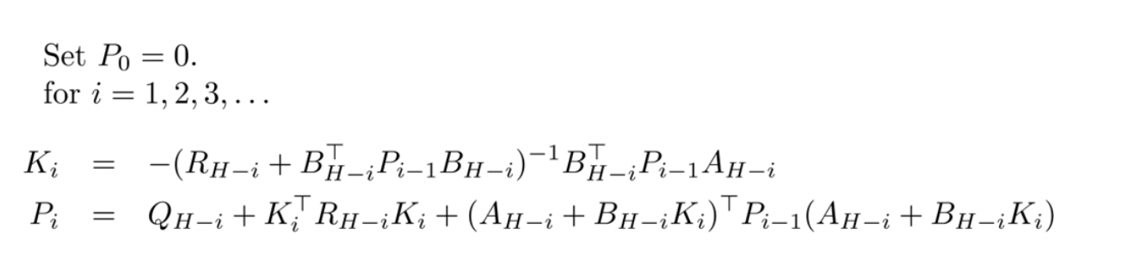
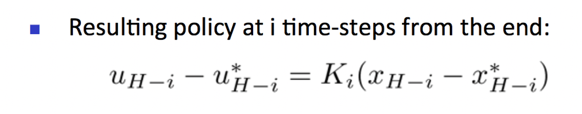
Past week
- Checked the correctness of gradient (Matrix A, B)
- Calculated Matrix K for all 4 tasks
- Implemented (A*-based)LQR closed-loop control on gazebo hand (5 goal locations)

Slide 3
Question
Acrobot: Actions are discrete(0,1,2).
How to update u_i?

Slide 4
Goal Reach Rate
Goal Location | 0 | 2 | 7 | 8 | 15
A* | 0% | 100% | 100% | 0% | 0%
LQR(A*-based) | 0% | 100% | 100% | 100% | 100%

Slide 5
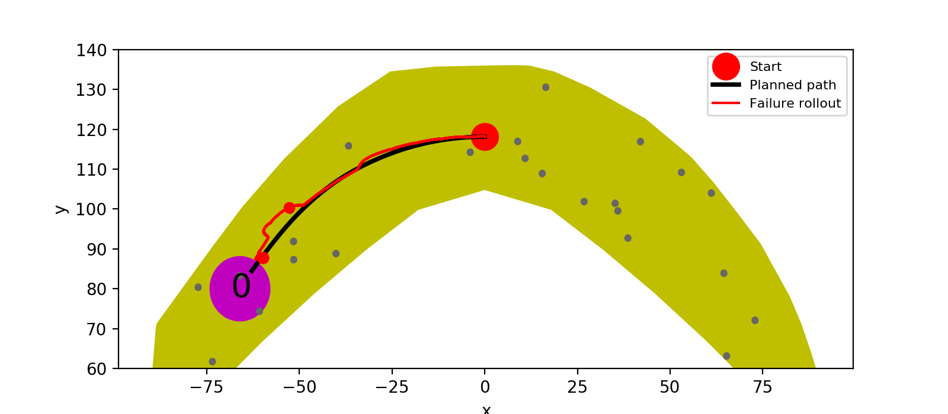
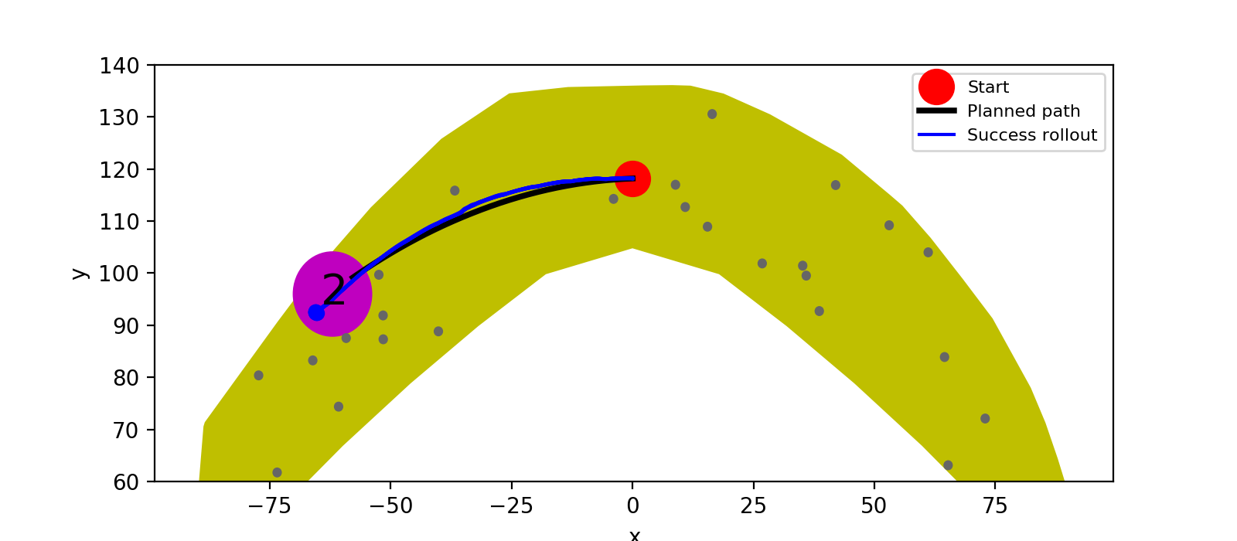
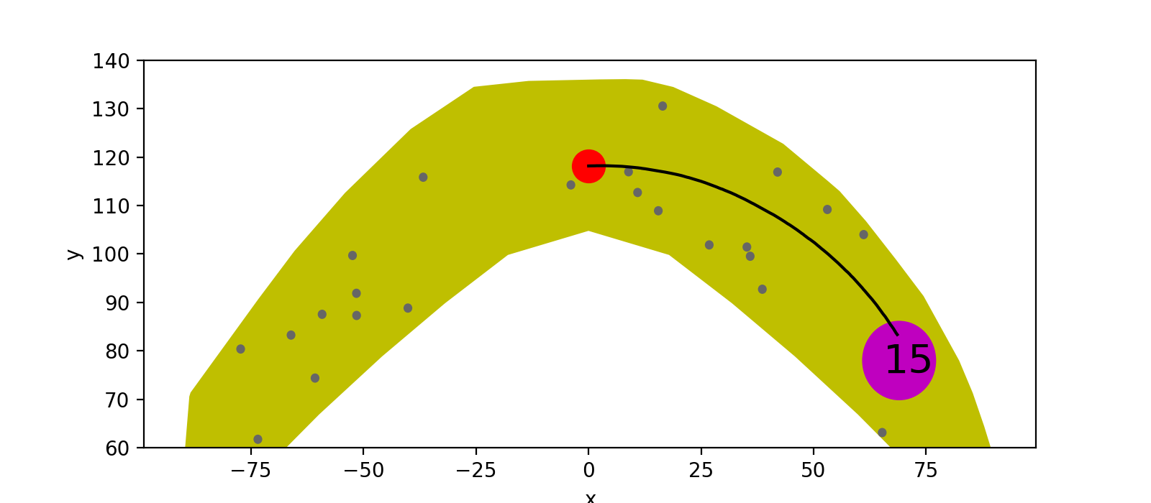
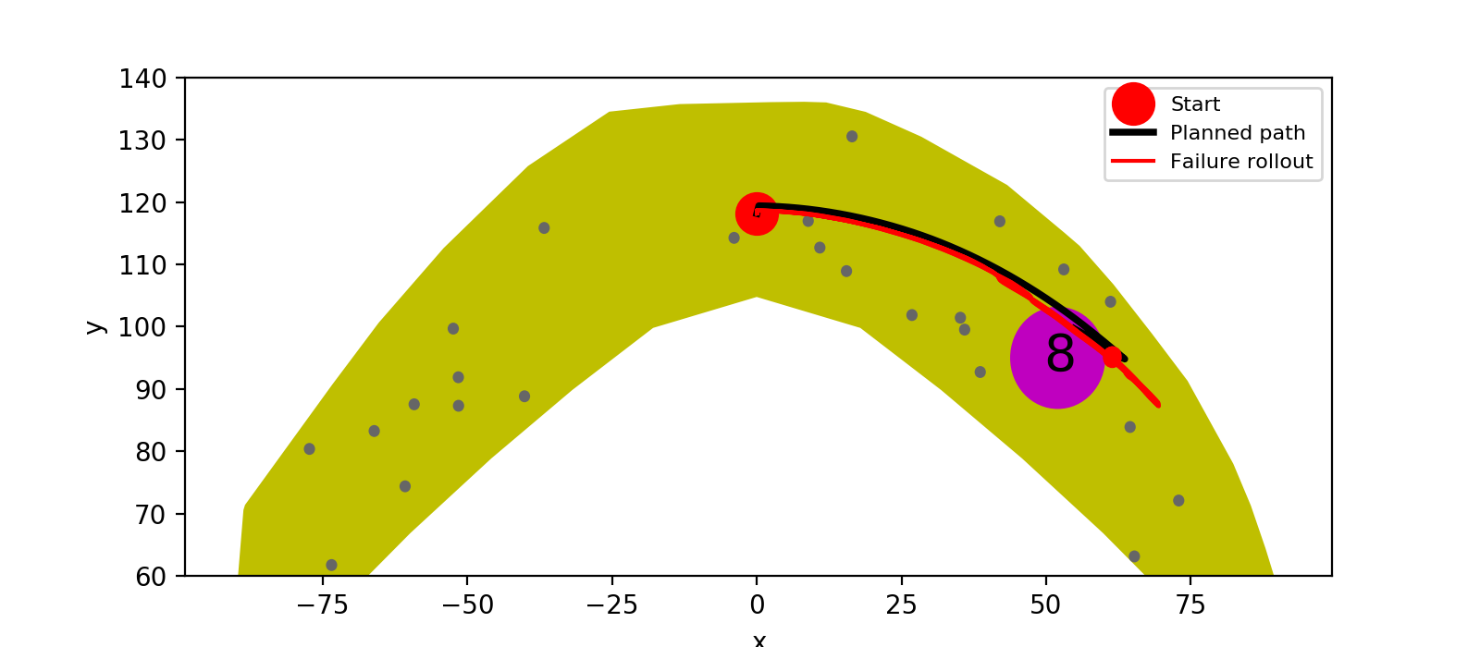
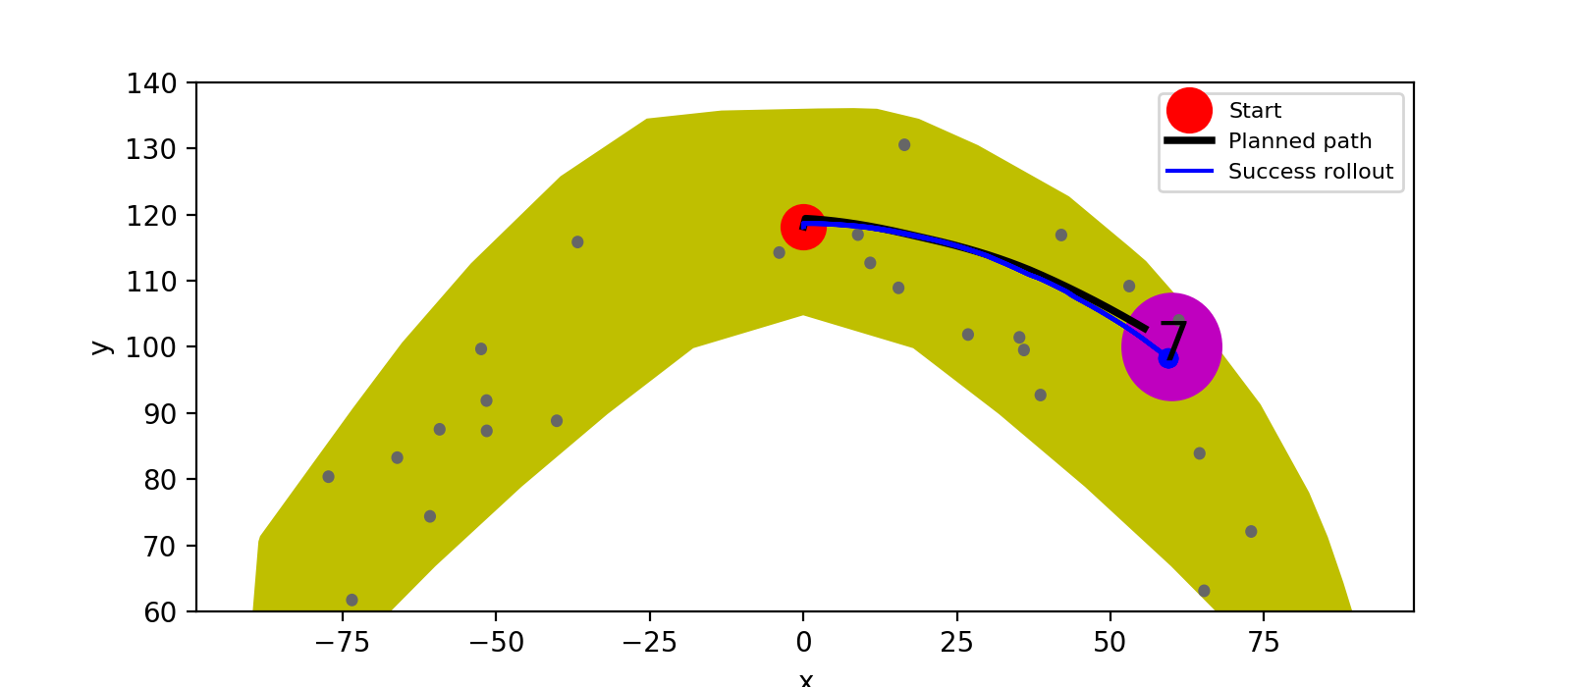
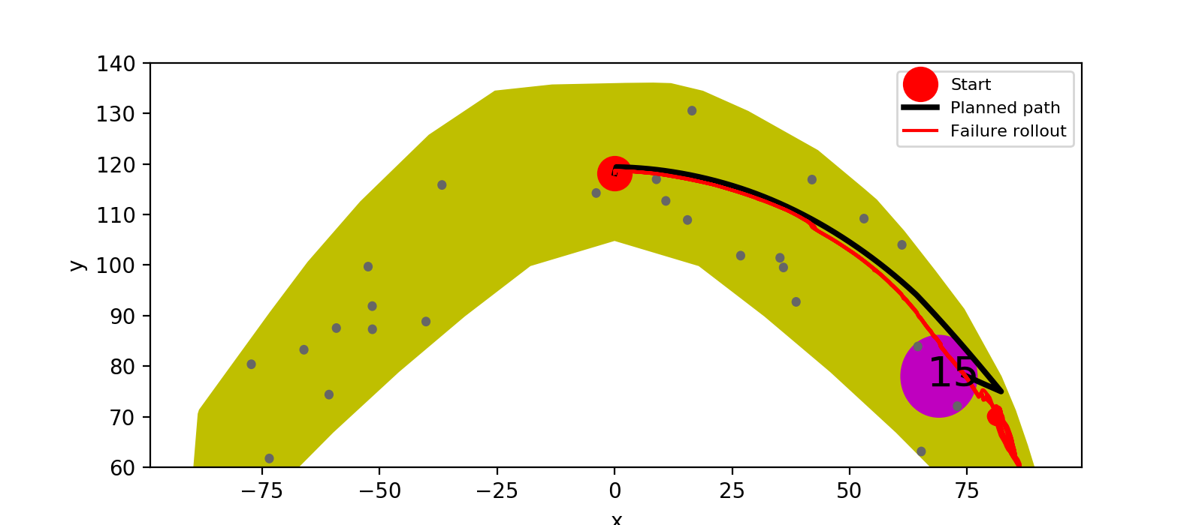
A*

Slide 6

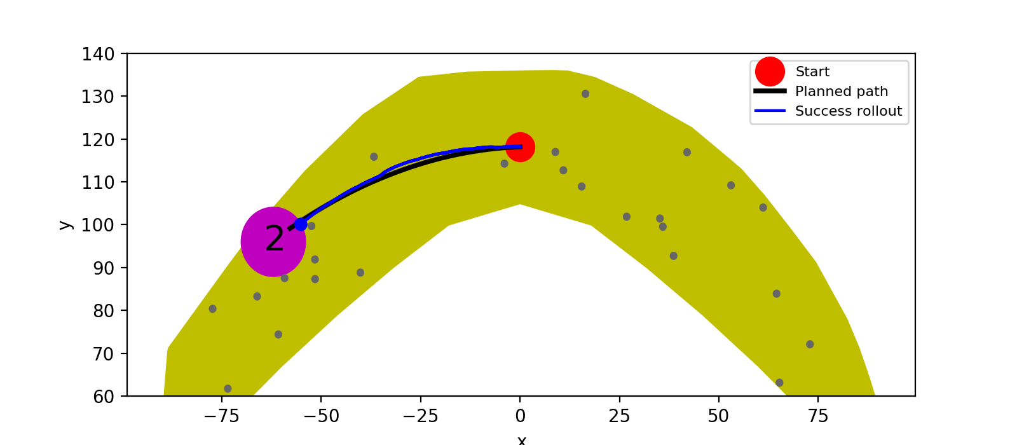


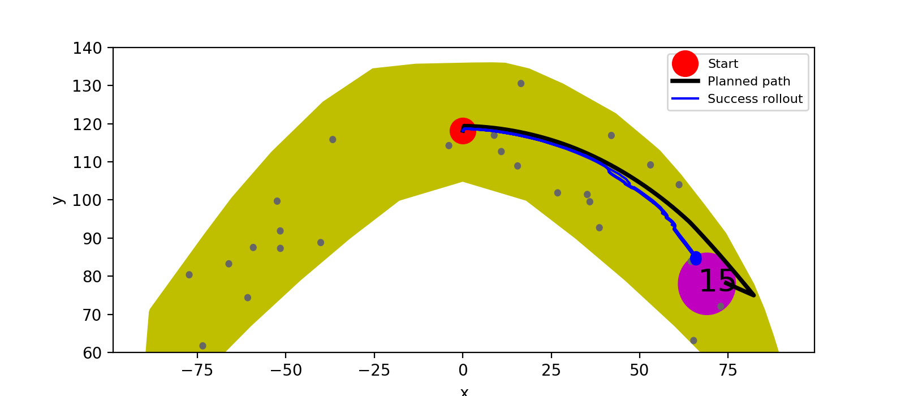
LQR (A*-based)

Slide 7
A*
LQR (A*-based)

Slide 8
A*
LQR (A*-based)

Slide 9
A*
LQR (A*-based)

Slide 10
Next plans
After we get LQR solutions(Matrix K_i):
LQR on other tasks(mujoco)
2) Should I also try closed loop control using PPO (trained from model) on real environment?
3) Learn more theory about conjugate gradient/line search/two-constraints(lambda-eta) optimization. Then, derive new equations, objective function and optimization procedures for our AIP?
4) Implement AIP

Slide 11
AIP Implementation (against TRPO,PPO)
Difference 1 Policy Network:
TRPO/PPO: u_final=pi_theta([x])
AIP: u_final=pi_theta([x, u_controller])
Difference 2 Constraint:
TRPO:
KL(pi_theta_new || pi_theta_old)<epsilon. (CG+Line Search)
PPO:
No constraint
Constraint (KL(pi_theta_new || pi_theta_old)<epsilon) combined into objective function
AIP:
KL(pi_theta_new || pi_theta_old)<epsilon
??KL(pi_theta || controller)<omega??
(Need to derive new equations and objective for optimization?)

Slide 12
Task | Open Loop A* +Rollout | Open Loop PPO + Rollout | Closed Loop PPO | Cloes Loop LQR based on A* | AIP (3 options)
Reacher (0.1% model) | Done + Done | Done + Done | Not yet | Not yet | Not yet
Gazebo Hand (0.1% model) | Done + Done | Done + Not yet | Not yet | Done | Not yet
Acrobot (100% model) | Done + Done | Done + Done | Not yet | Not yet | Not yet
Real Hand (100% model) | Done + Not yet | Done + Not yet | Not yet | Not yet | Not yet

