Slide 1
Meeting 09/07/2020
Shuo Zhang

Slide 2
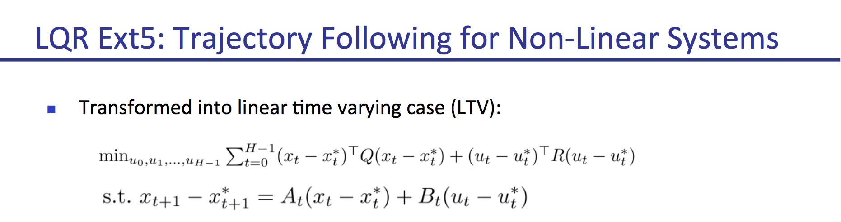
Past week
- Re-implmented LQR with Matrix R=0 rather than Identity Matrix, since we want to follow the trajectory x* rather than the action u*.
- Implemented (A*-based)LQR closed-loop control for Reacher (3 goal locs)
- Calculated Matrix K for all 4 tasks

Slide 3
Gazebo Hand: Goal Reach Rate
Goal Location | 0 | 2 | 7 | 8 | 15
A* | 0% | 100% | 100% | 0% | 0%
LQR(Q=E) | 0% | 100% | 100% | 100% | 100%
LQR(Q=0) | 100% | 100% | 100% | 100% | 100%

Slide 4
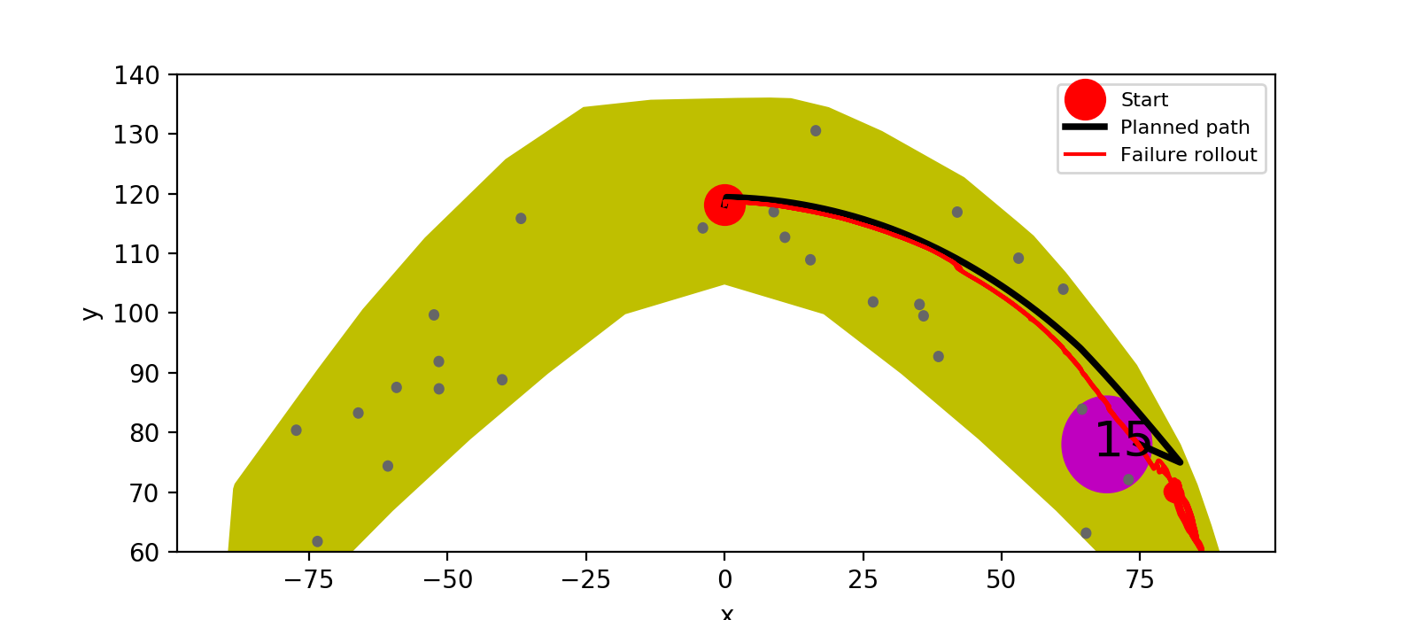
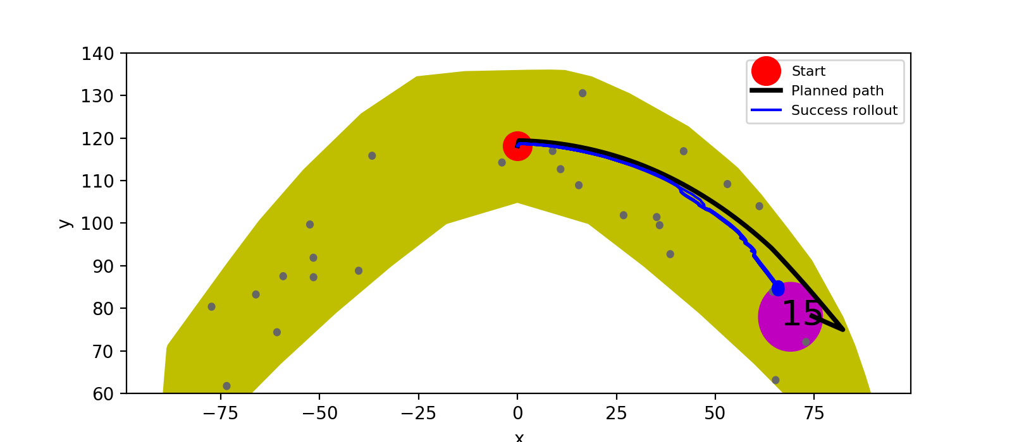

Goal Location 15
A*
LQR (R=E)
LQR (R=0)

Slide 5
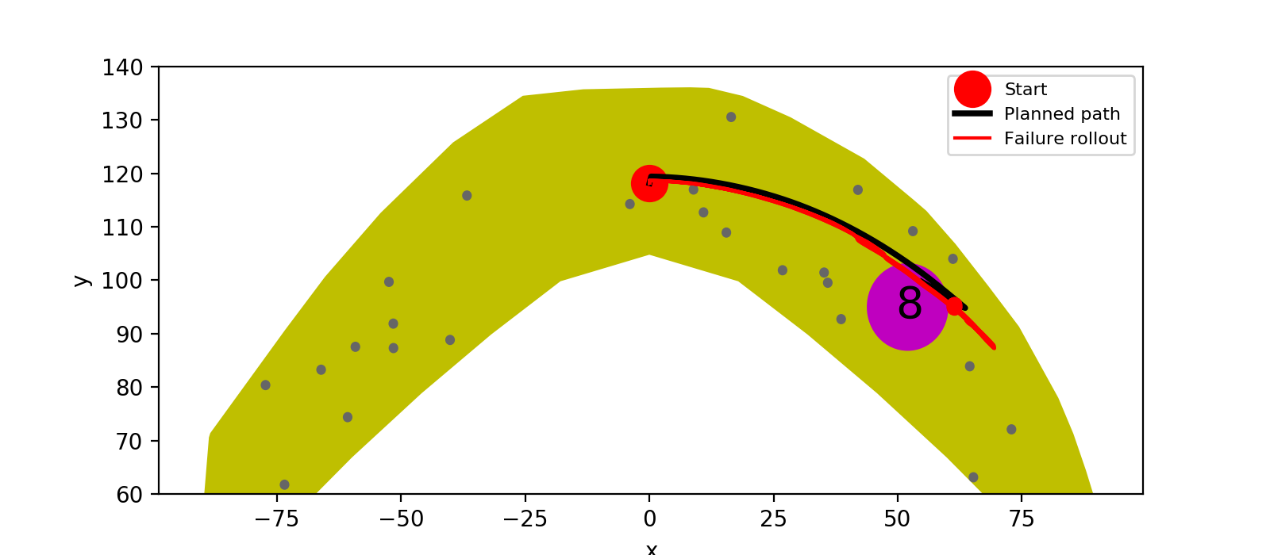


Goal Location 8
A*
LQR (R=E)
LQR (R=0)

Slide 6
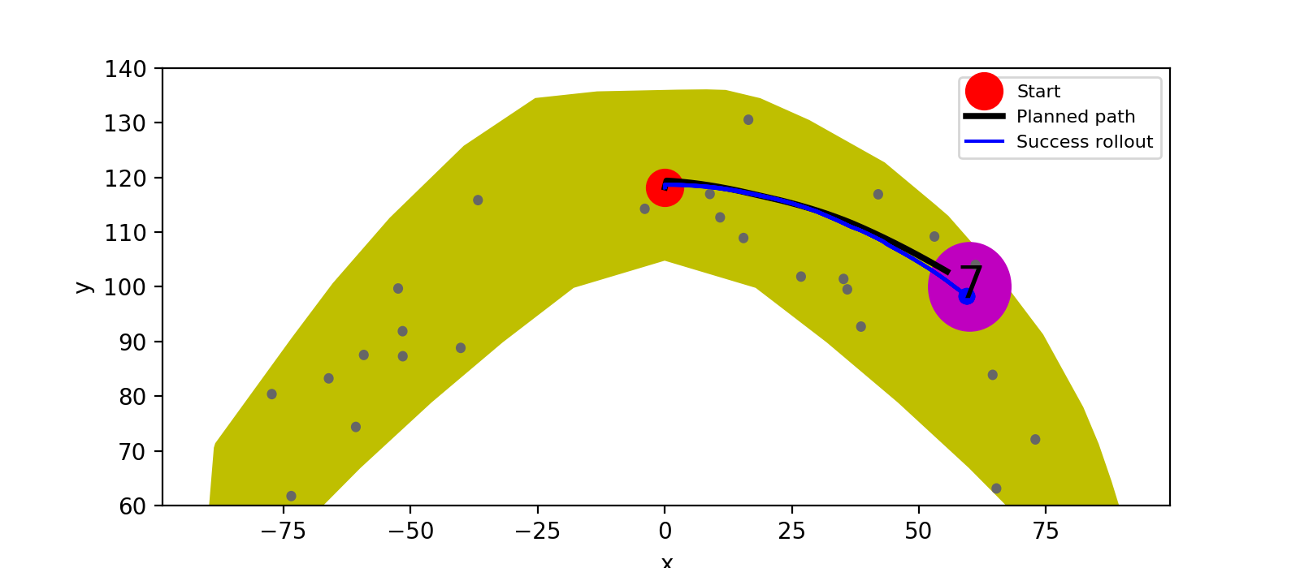


Goal Location 7
A*
LQR (R=E)
LQR (R=0)

Slide 7
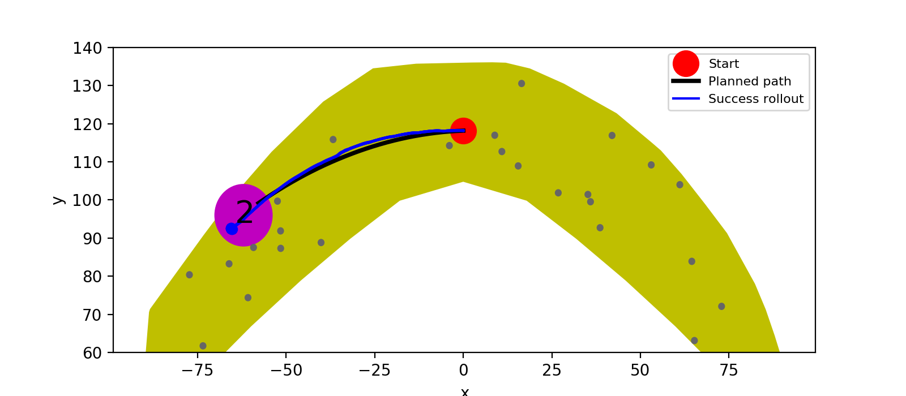
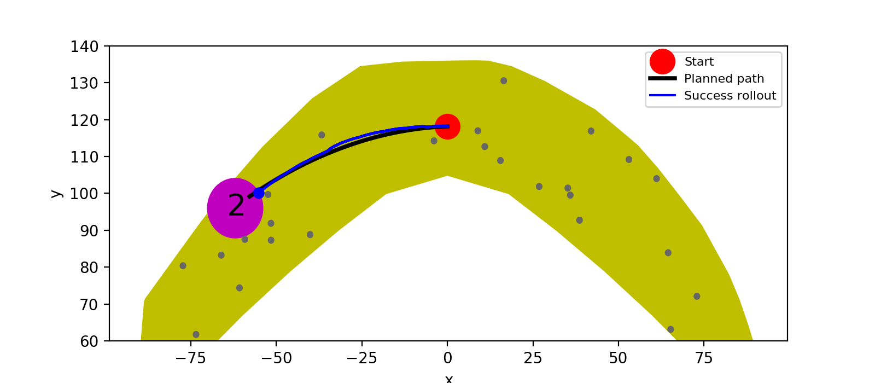

Goal Location 2
A*
LQR (R=E)
LQR (R=0)

Slide 8
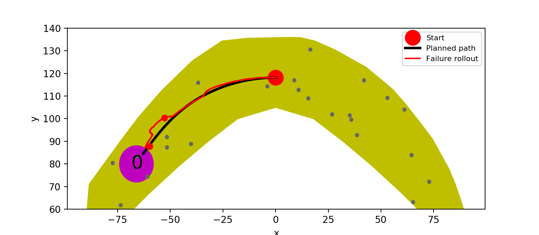

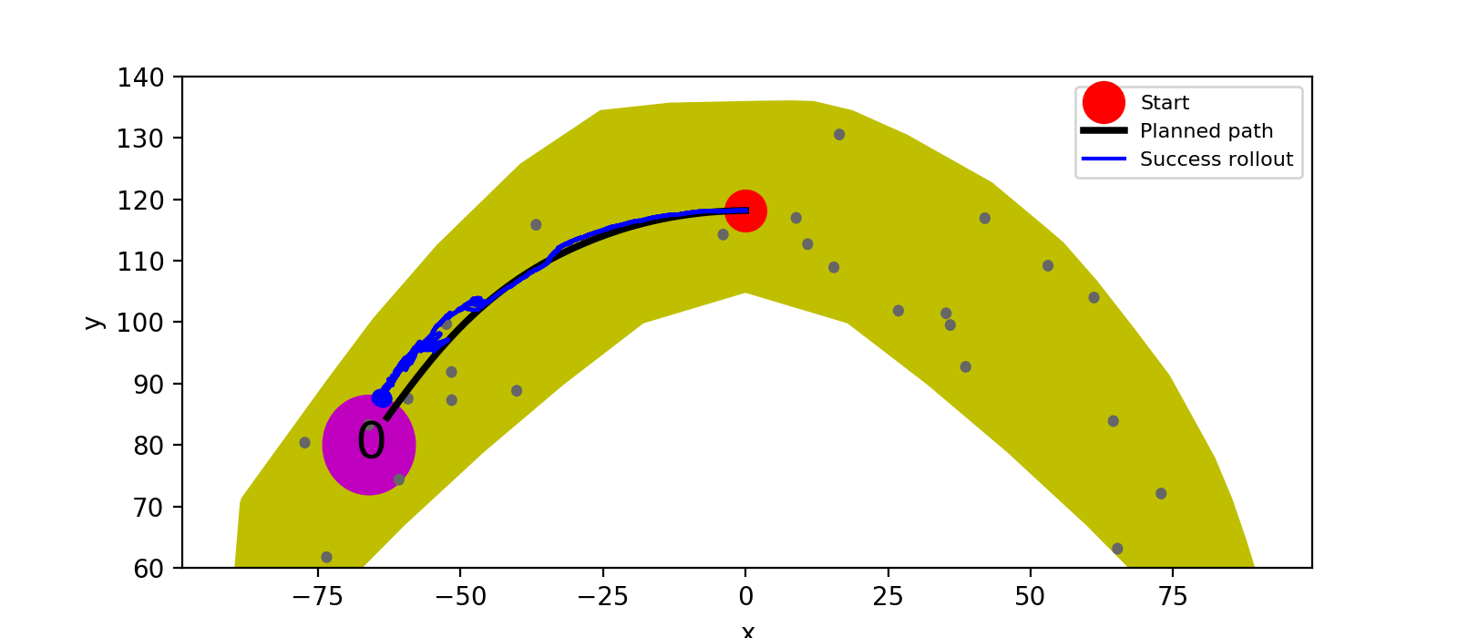
Goal Location 0
A*
LQR (R=E)
LQR (R=0)

Slide 9
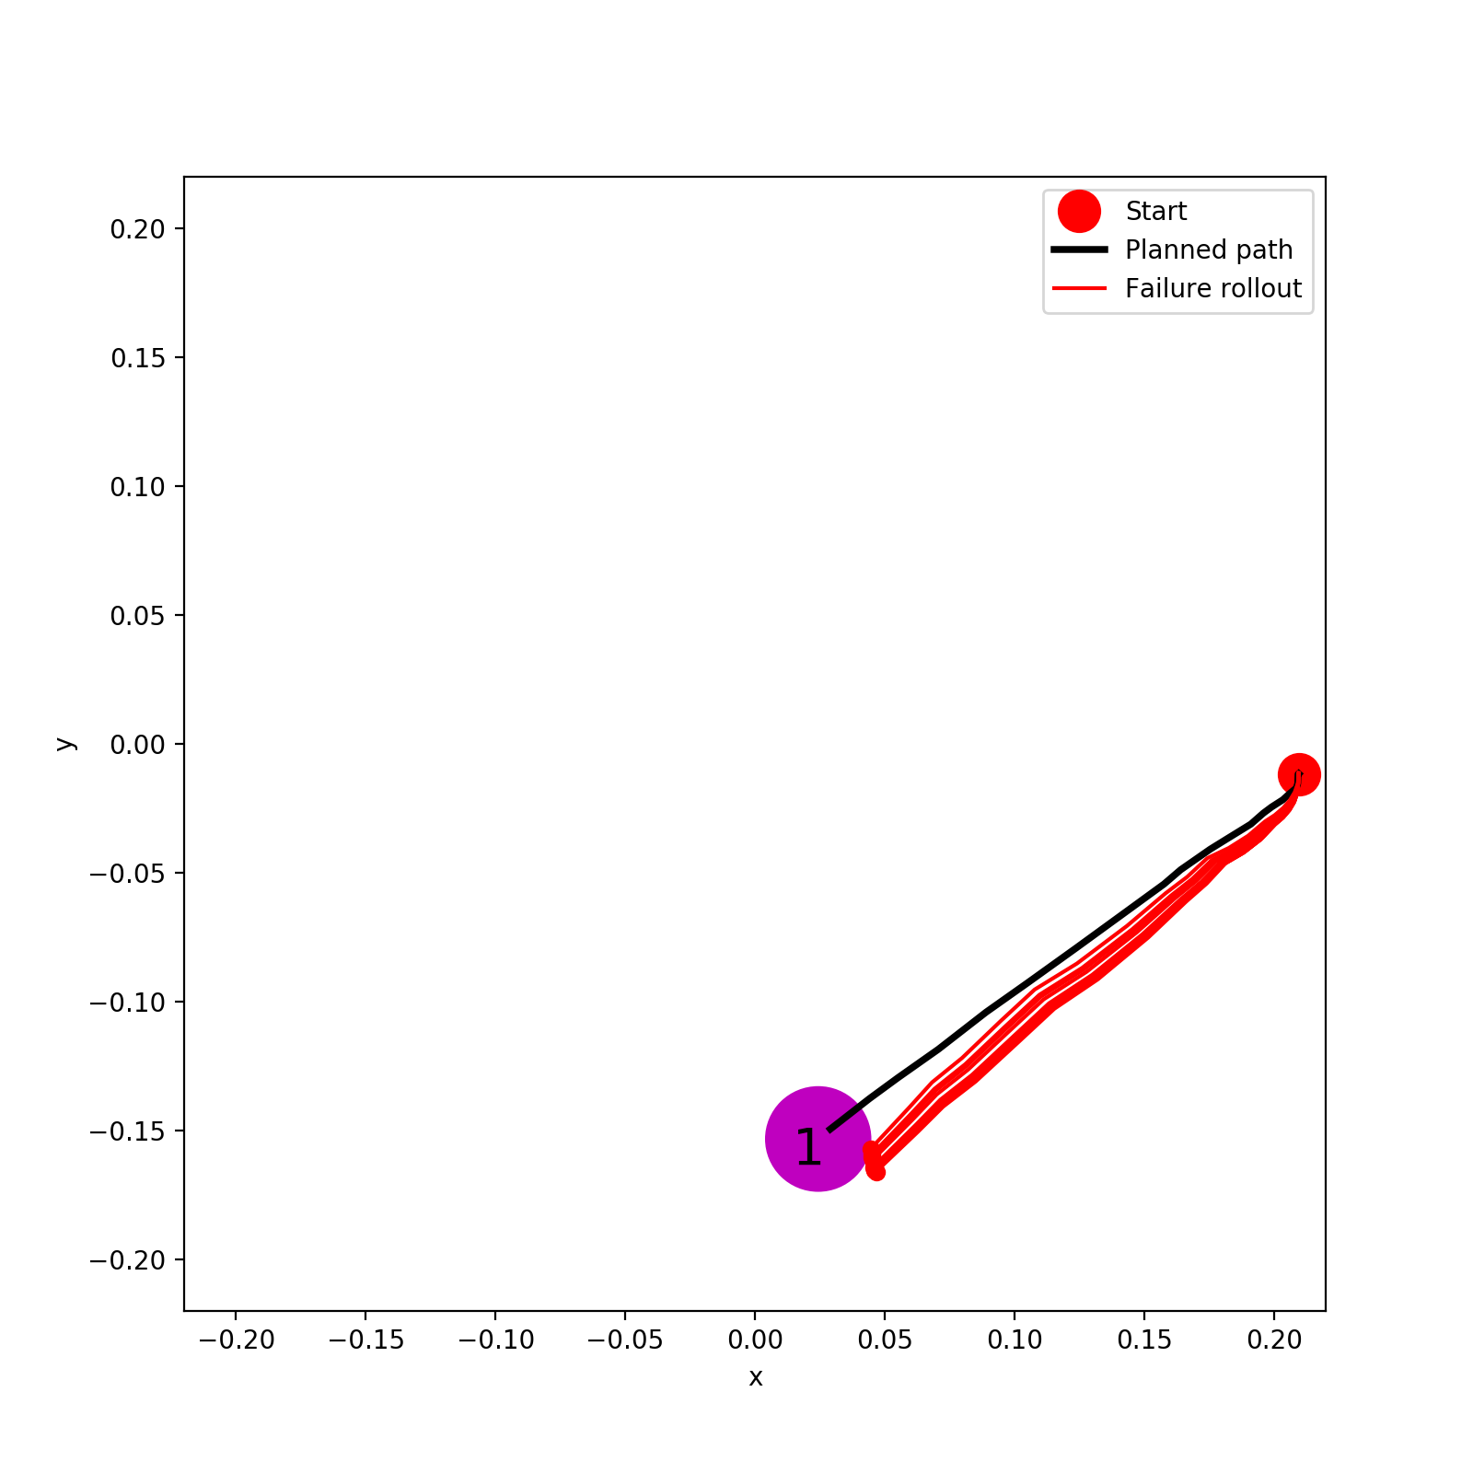
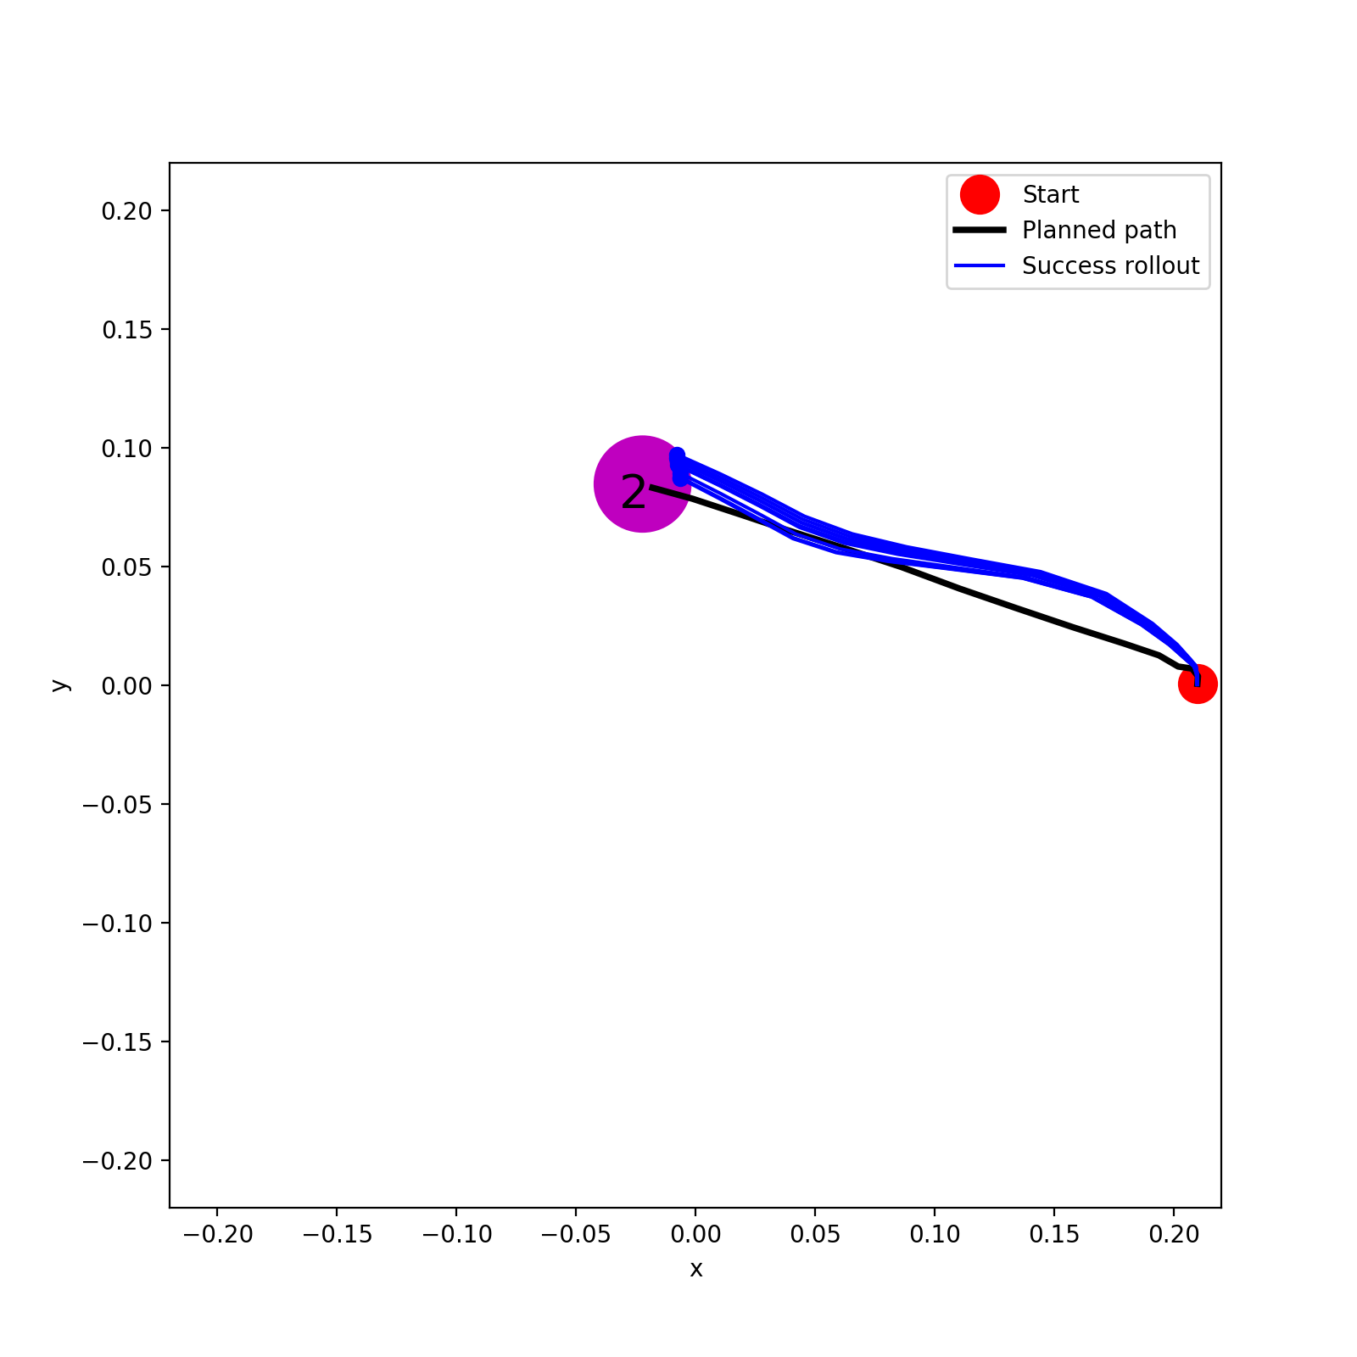
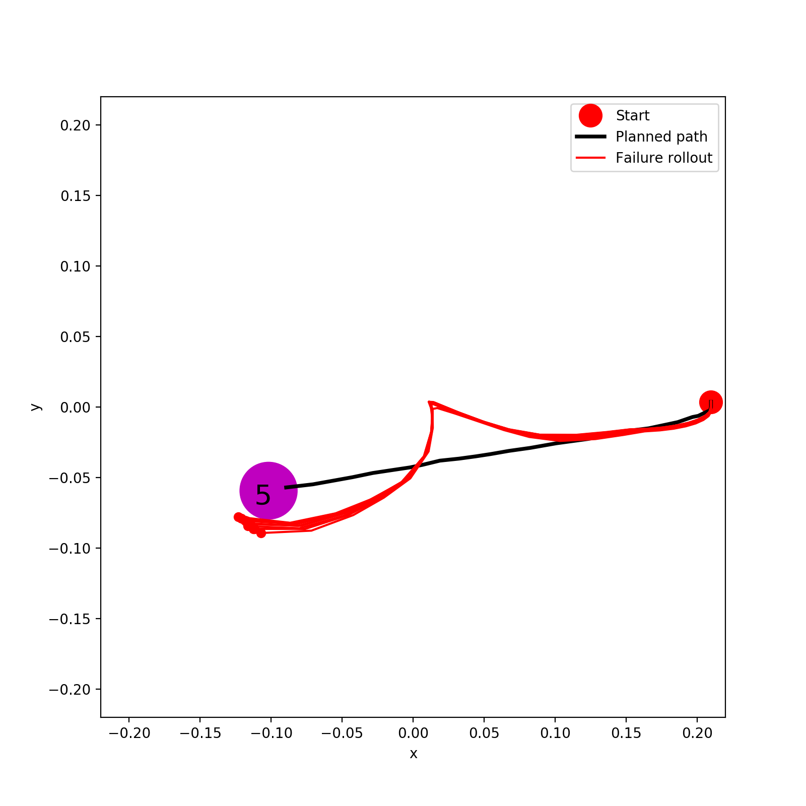
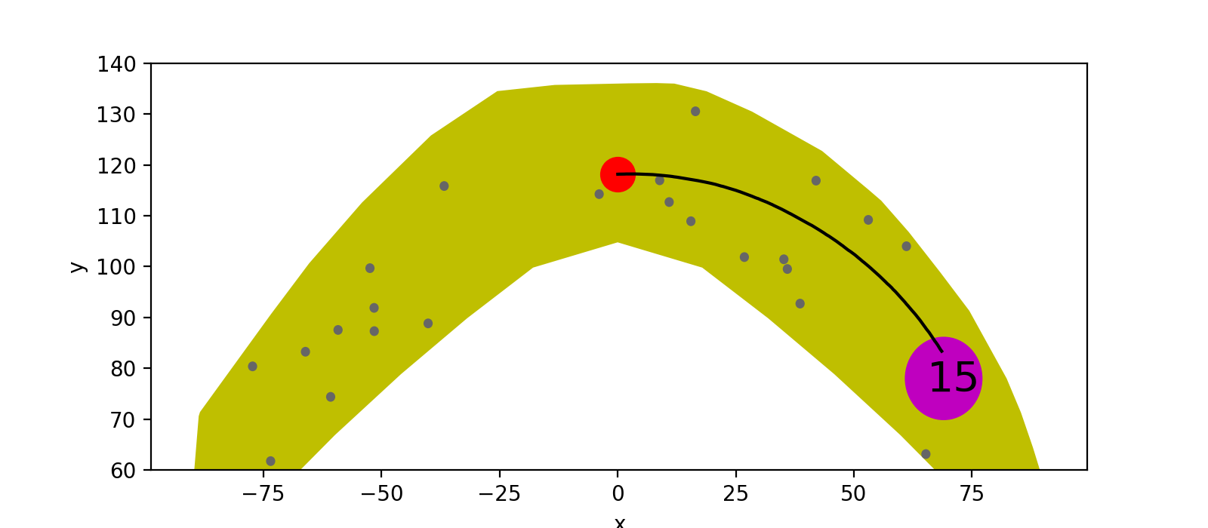
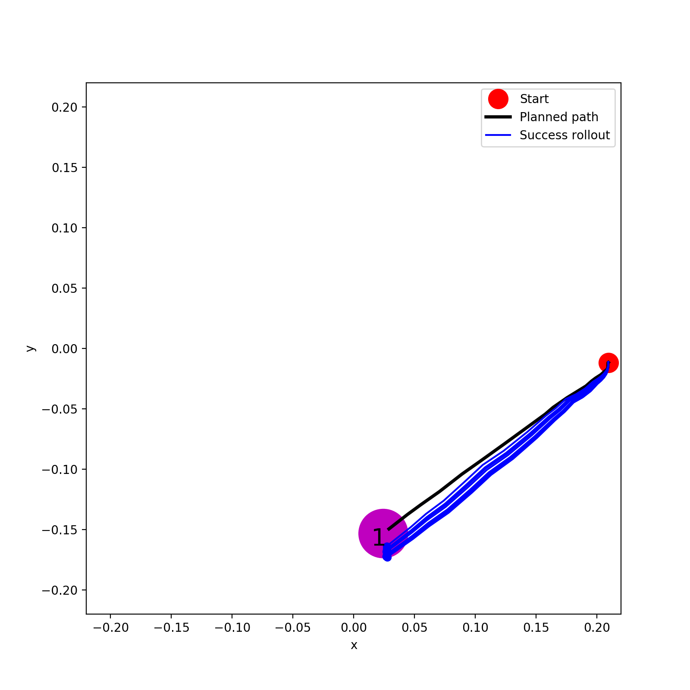
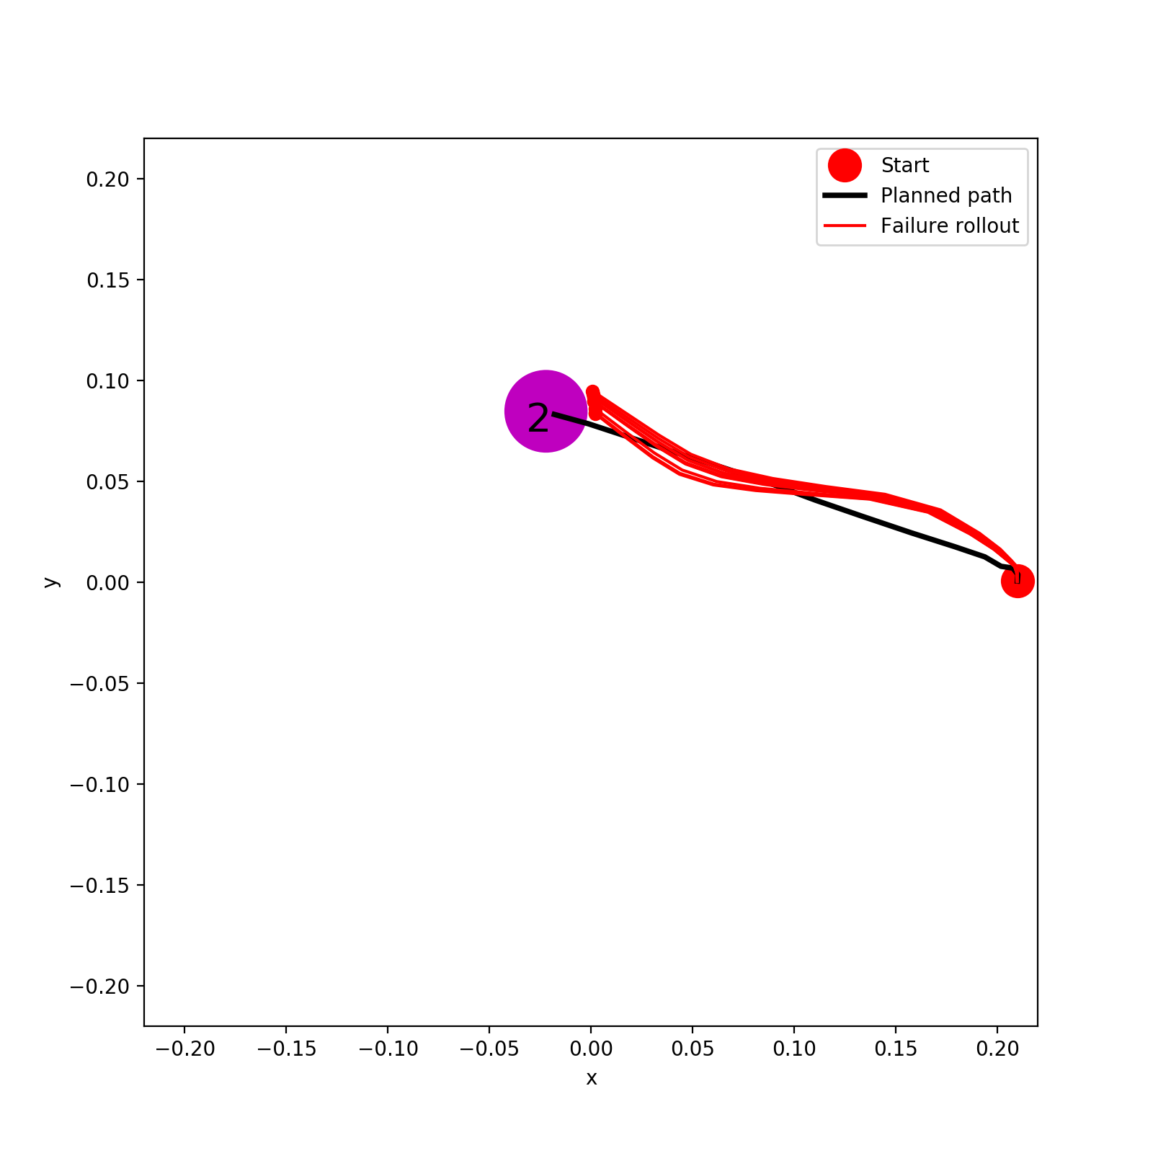
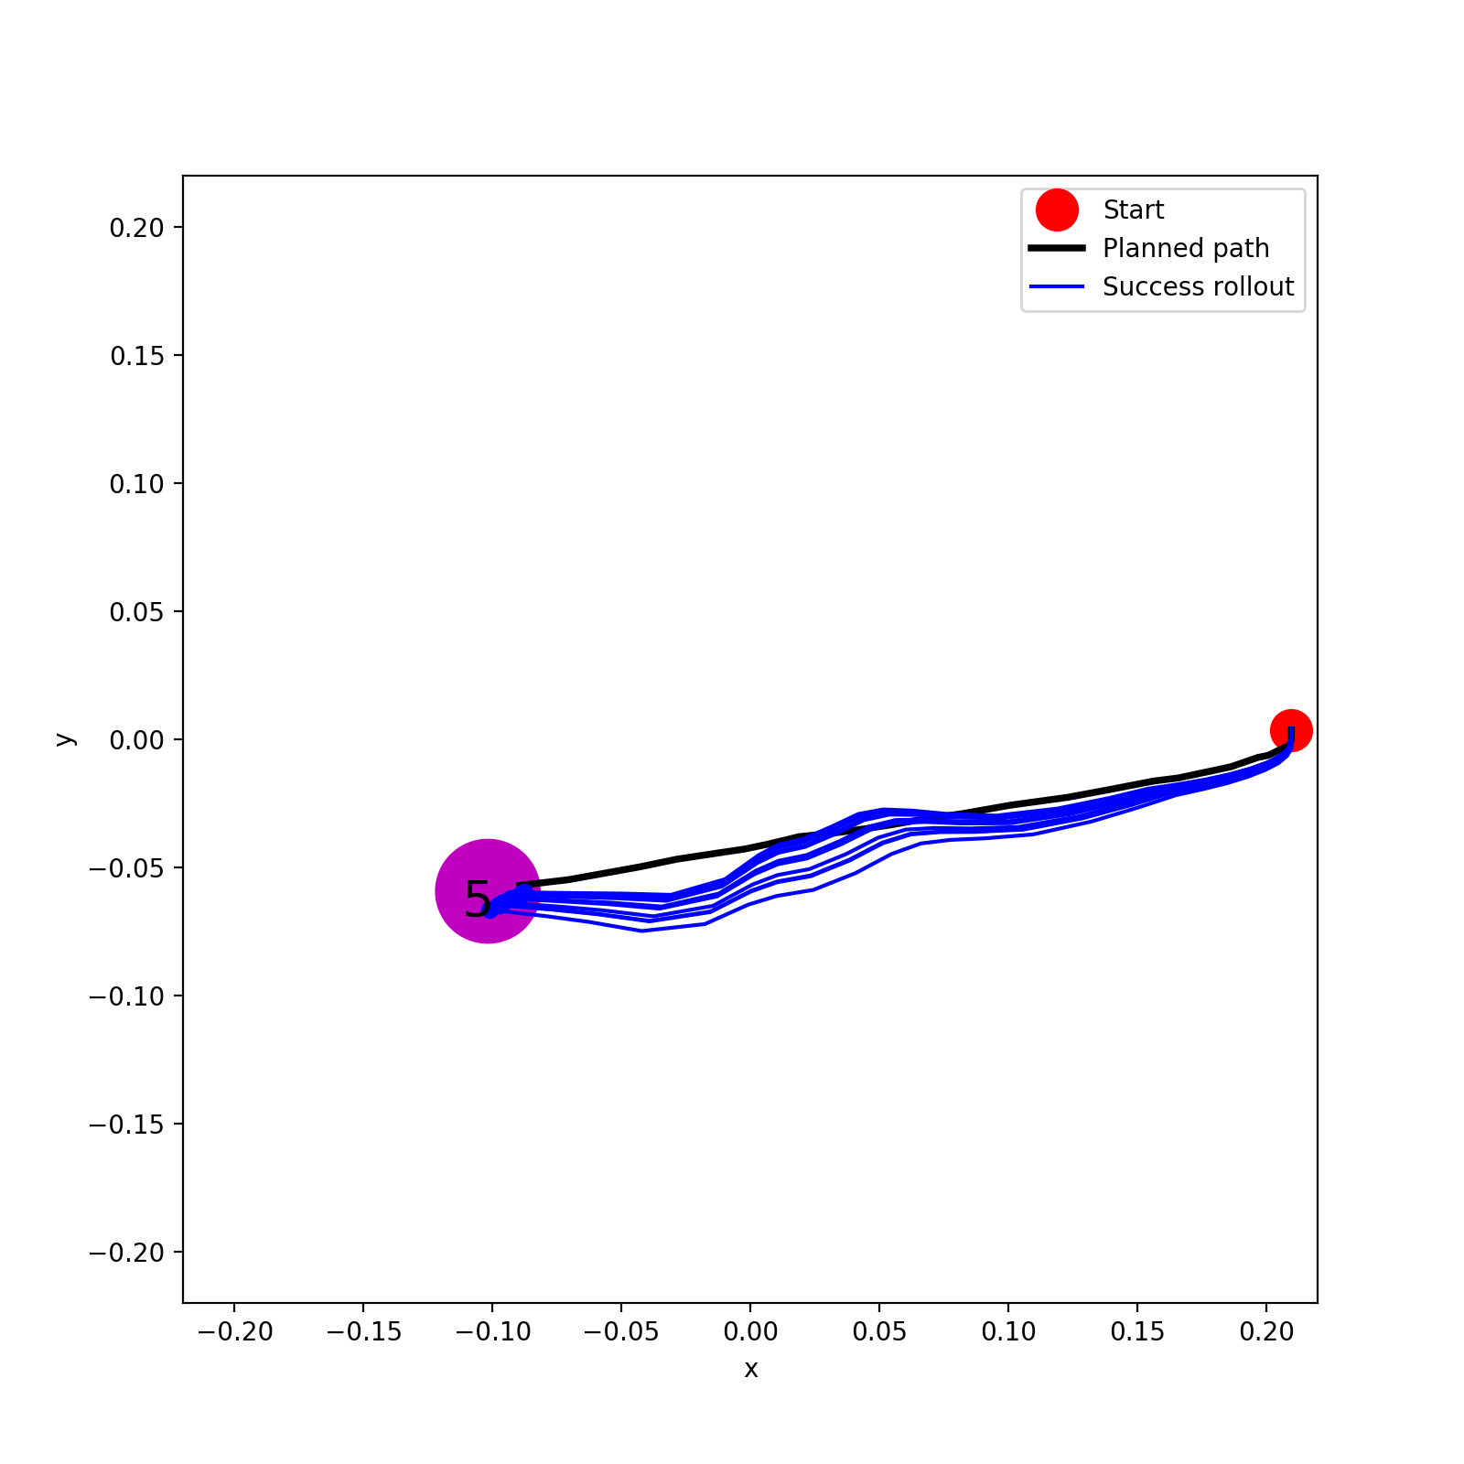
A*
Method | Goal Loc 1 | Goal Loc 2 | Goal Loc 5
A* | 0% | 100% | 0%
LQR | 100% | 0% | 100%
(A*-based) LQR

Slide 10
Next plans
Solve issues of marker tracking. Then, make sure real hand model works with new data. Then, A*+PPO Rollout(100%) on real hand. If too good, reduce data+retrain dynamics+redo A* and PPO and their rollouts? Then, LQR.
Make gazebo hand task more difficult? (e.g. 1% number of trajectories, rather than data size)
LQR on Acrobot? Switch to other Mujoco tasks?
Derive new equations, objective function and optimization theory for AIP
Implement AIP
Should also try closed loop control using PPO (trained from model) on real environment?

Slide 11
AIP Implementation (against TRPO,PPO)
Difference 1 Policy Network:
TRPO/PPO: u_final=pi_theta([x])
AIP: u_final=pi_theta([x, u_controller])
Difference 2 Constraint:
TRPO:
KL(pi_theta_new || pi_theta_old)<epsilon. (CG+Line Search)
PPO:
No constraint
Constraint (KL(pi_theta_new || pi_theta_old)<epsilon) combined into objective function
AIP:
KL(pi_theta_new || pi_theta_old)<epsilon
??KL(pi_theta || controller)<omega??
(Need to derive new equations and objective for optimization?)

Slide 12
Task | Open Loop A* +Rollout | Open Loop PPO + Rollout | Closed Loop PPO | Cloes Loop LQR based on A* | AIP (3 options)
Reacher (0.1% model) | Done + Done | Done + Done | Not yet | Done | Not yet
Gazebo Hand (0.1% model) | Done + Done | Done + Done | Not yet | Done | Not yet
Acrobot (100% model) | Done + Done | Done + Done | Not yet | Not yet | Not yet
Real Hand (100% model) | Done + Not yet | Done + Not yet | Not yet | Not yet | Not yet

