Slide 1
Meeting 05/19/2020
Shuo Zhang

Slide 2
Cases in Paper:
Simple Cases
Horsehoe case

Slide 3
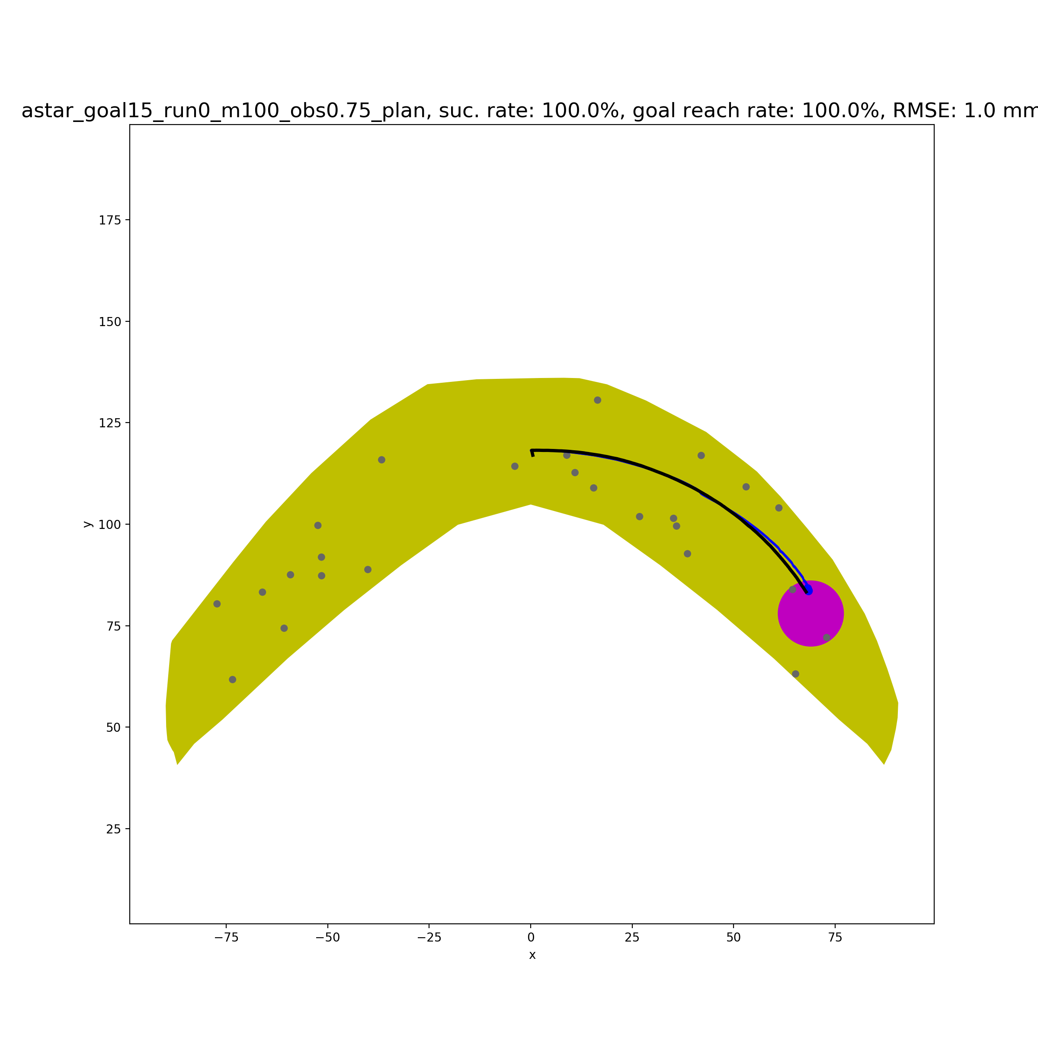
Simple Case 1
dist_sofar+dist_togoal
+100*check_small_action
+1000*check_opposite_direction

Slide 4
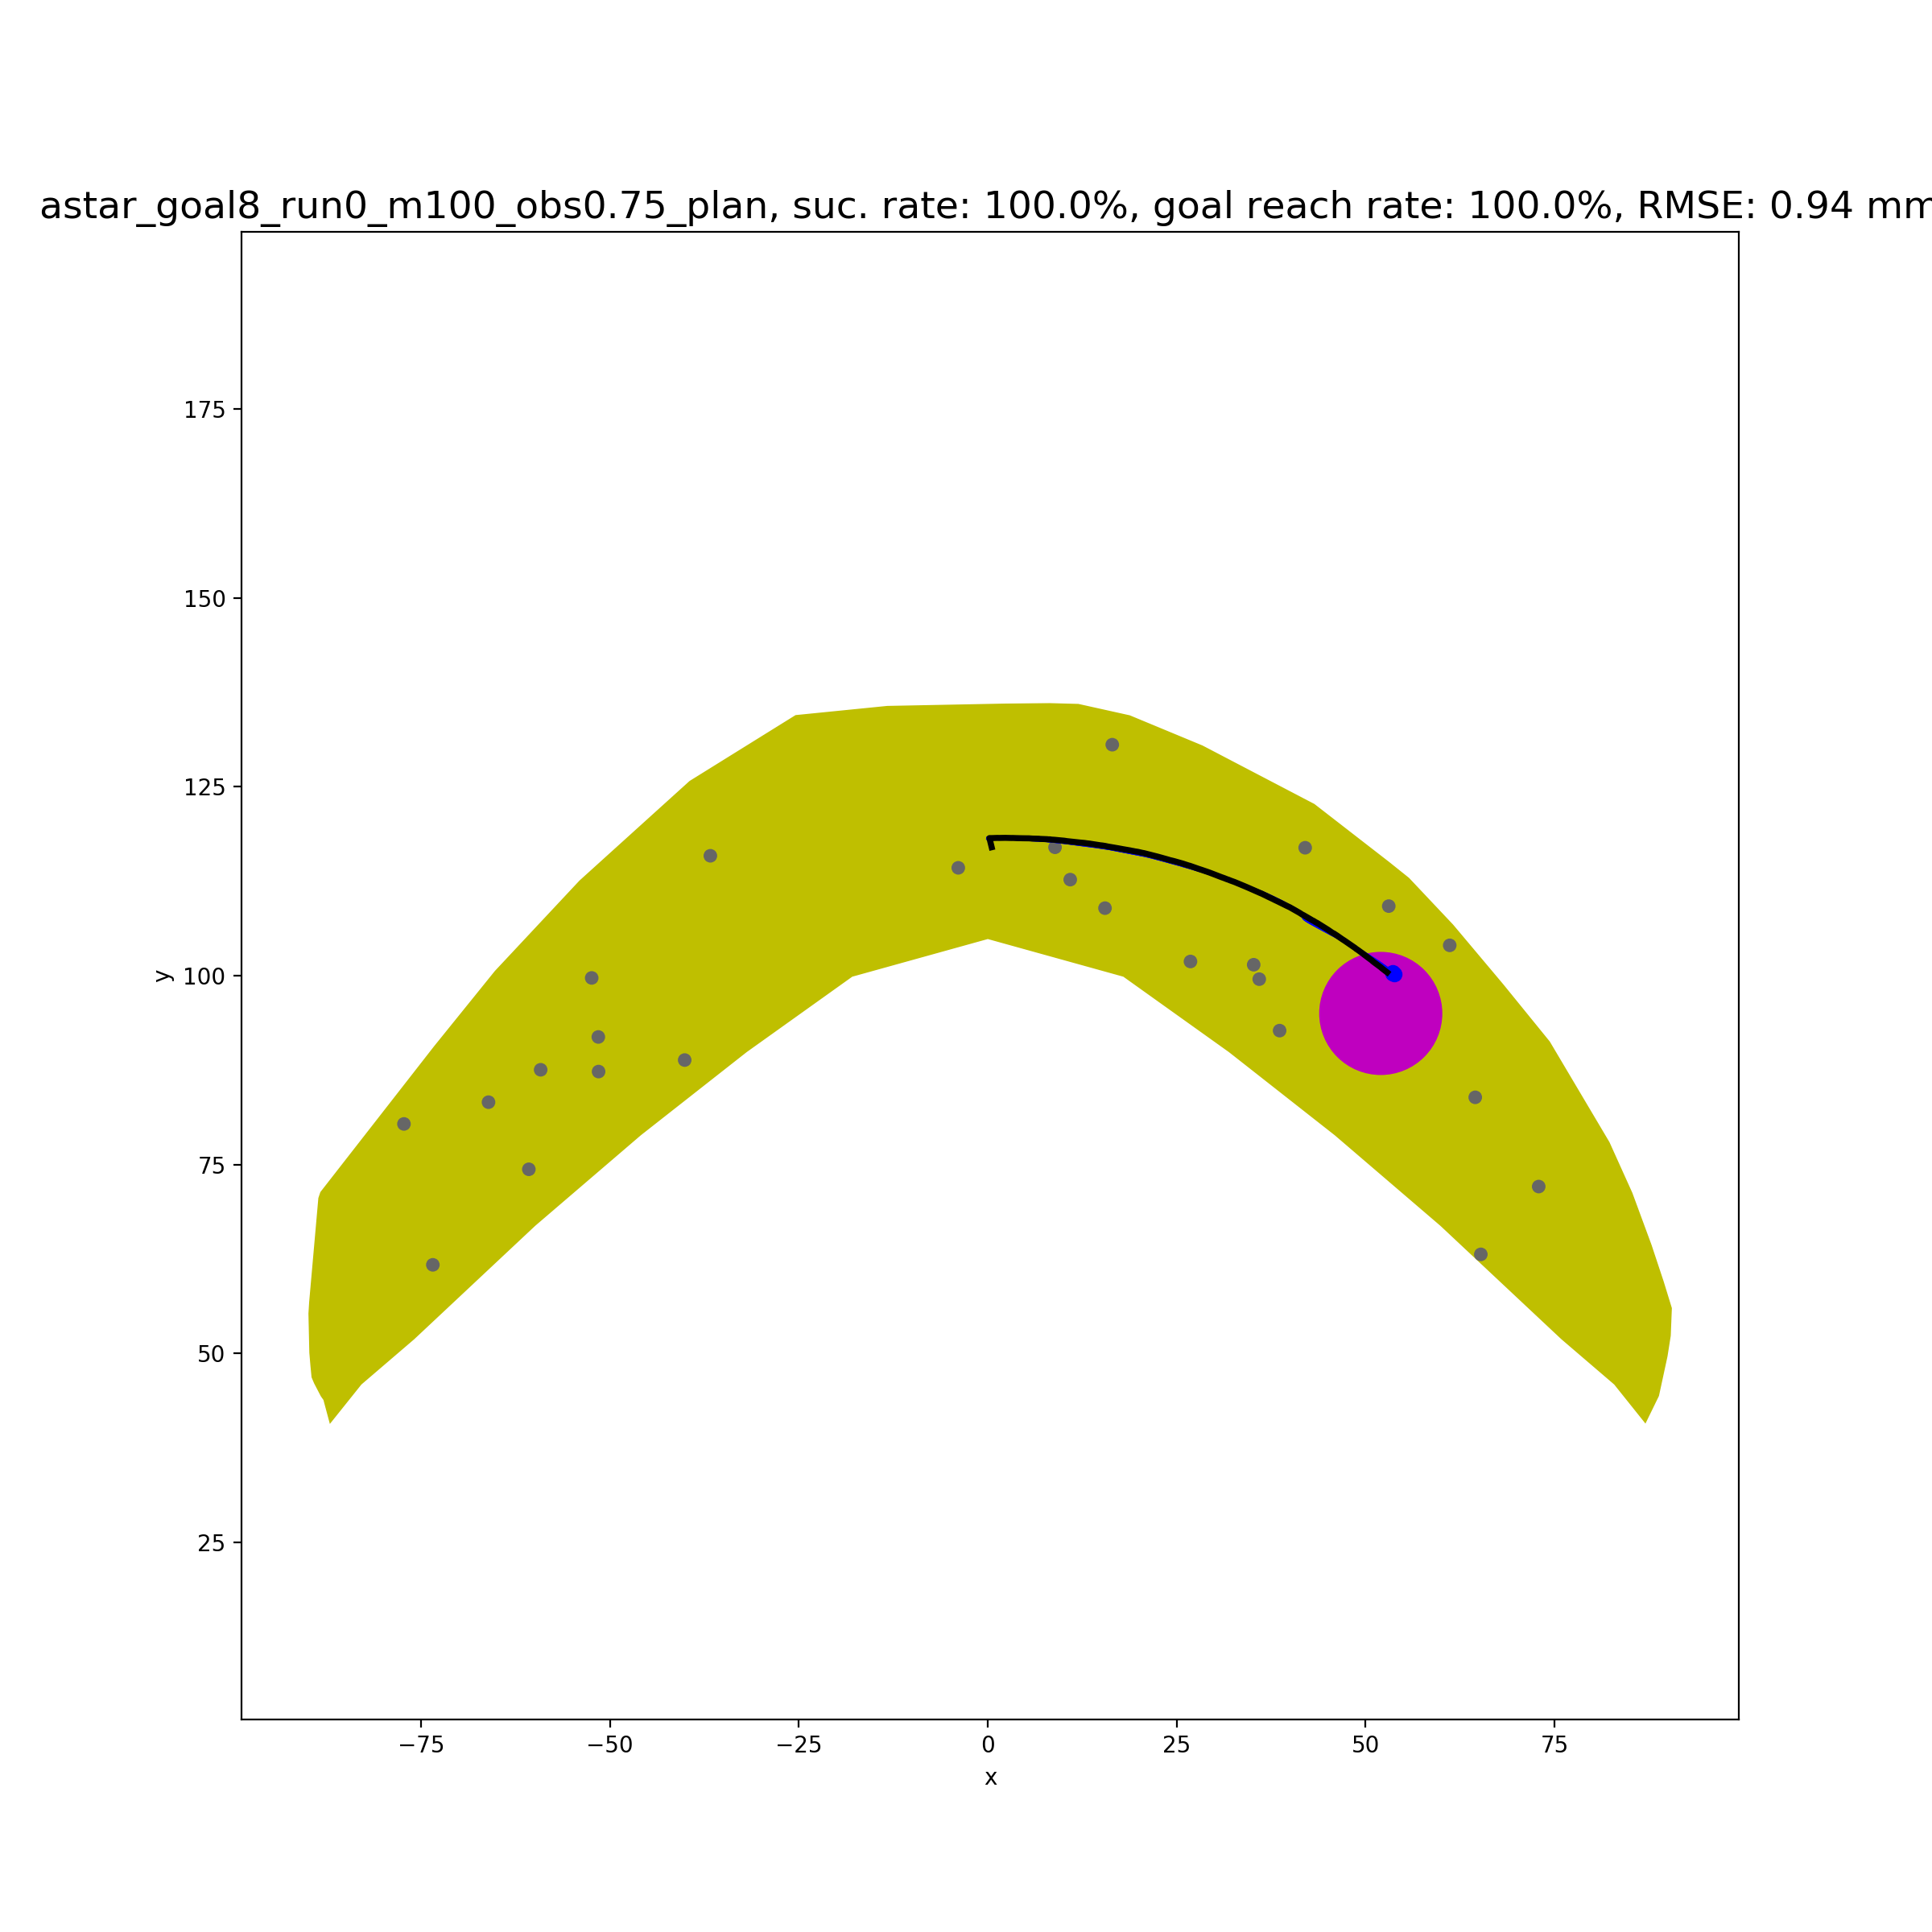
Simple Case 2
dist_sofar+dist_togoal
+100*check_small_action
+1000*check_opposite_direction

Slide 5
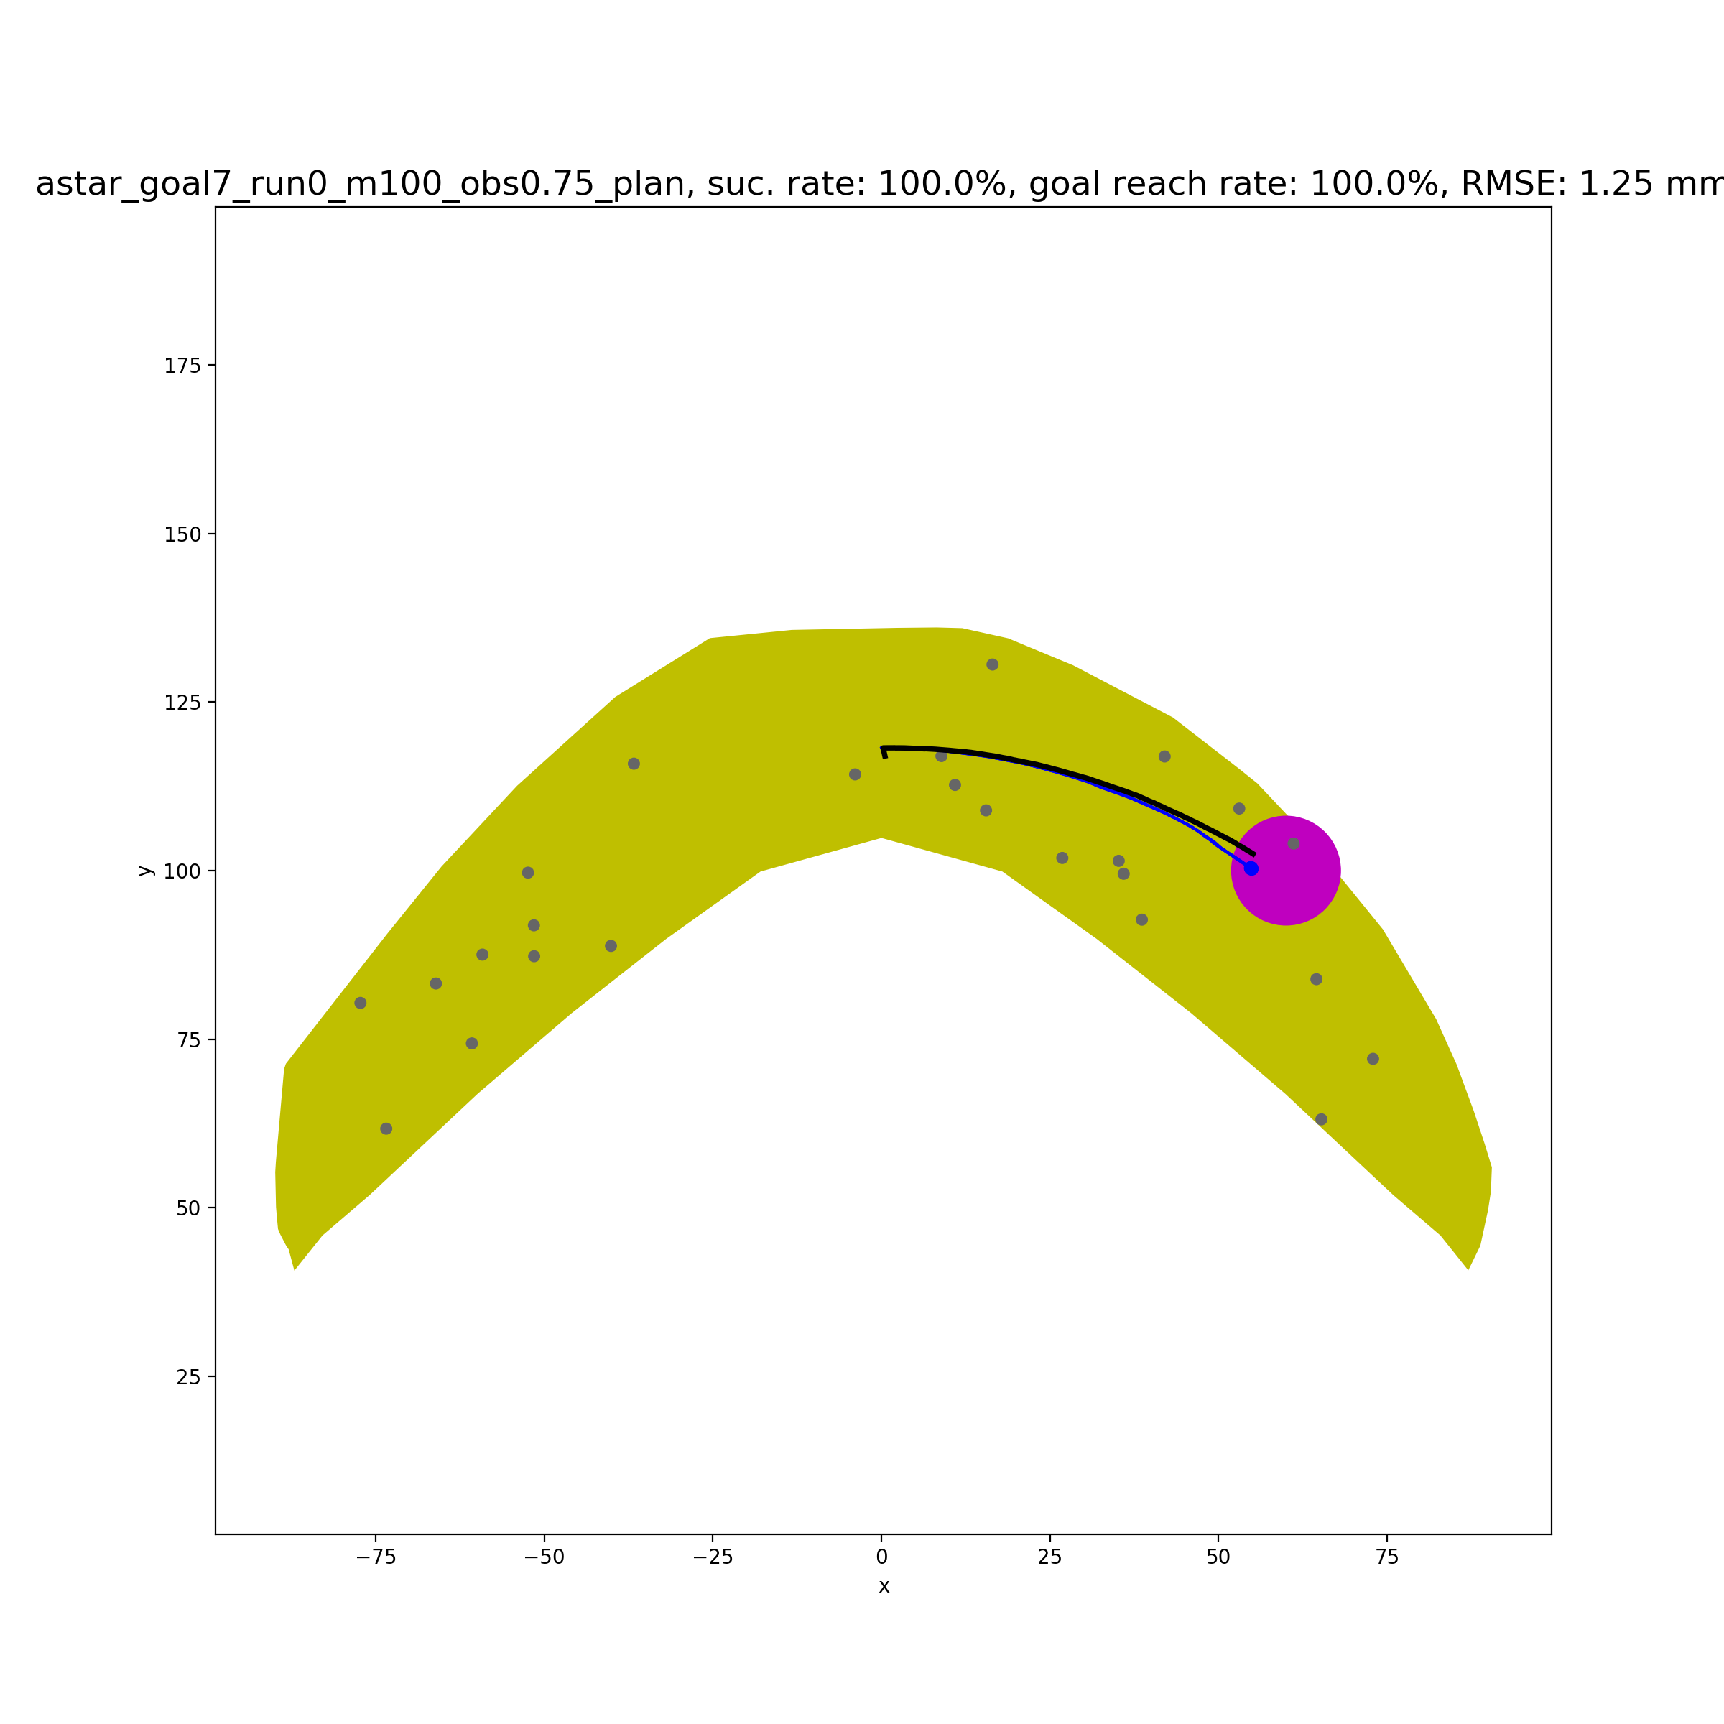
Simple Case 3
dist_sofar+dist_togoal
+100*check_small_action
+1000*check_opposite_direction

Slide 6
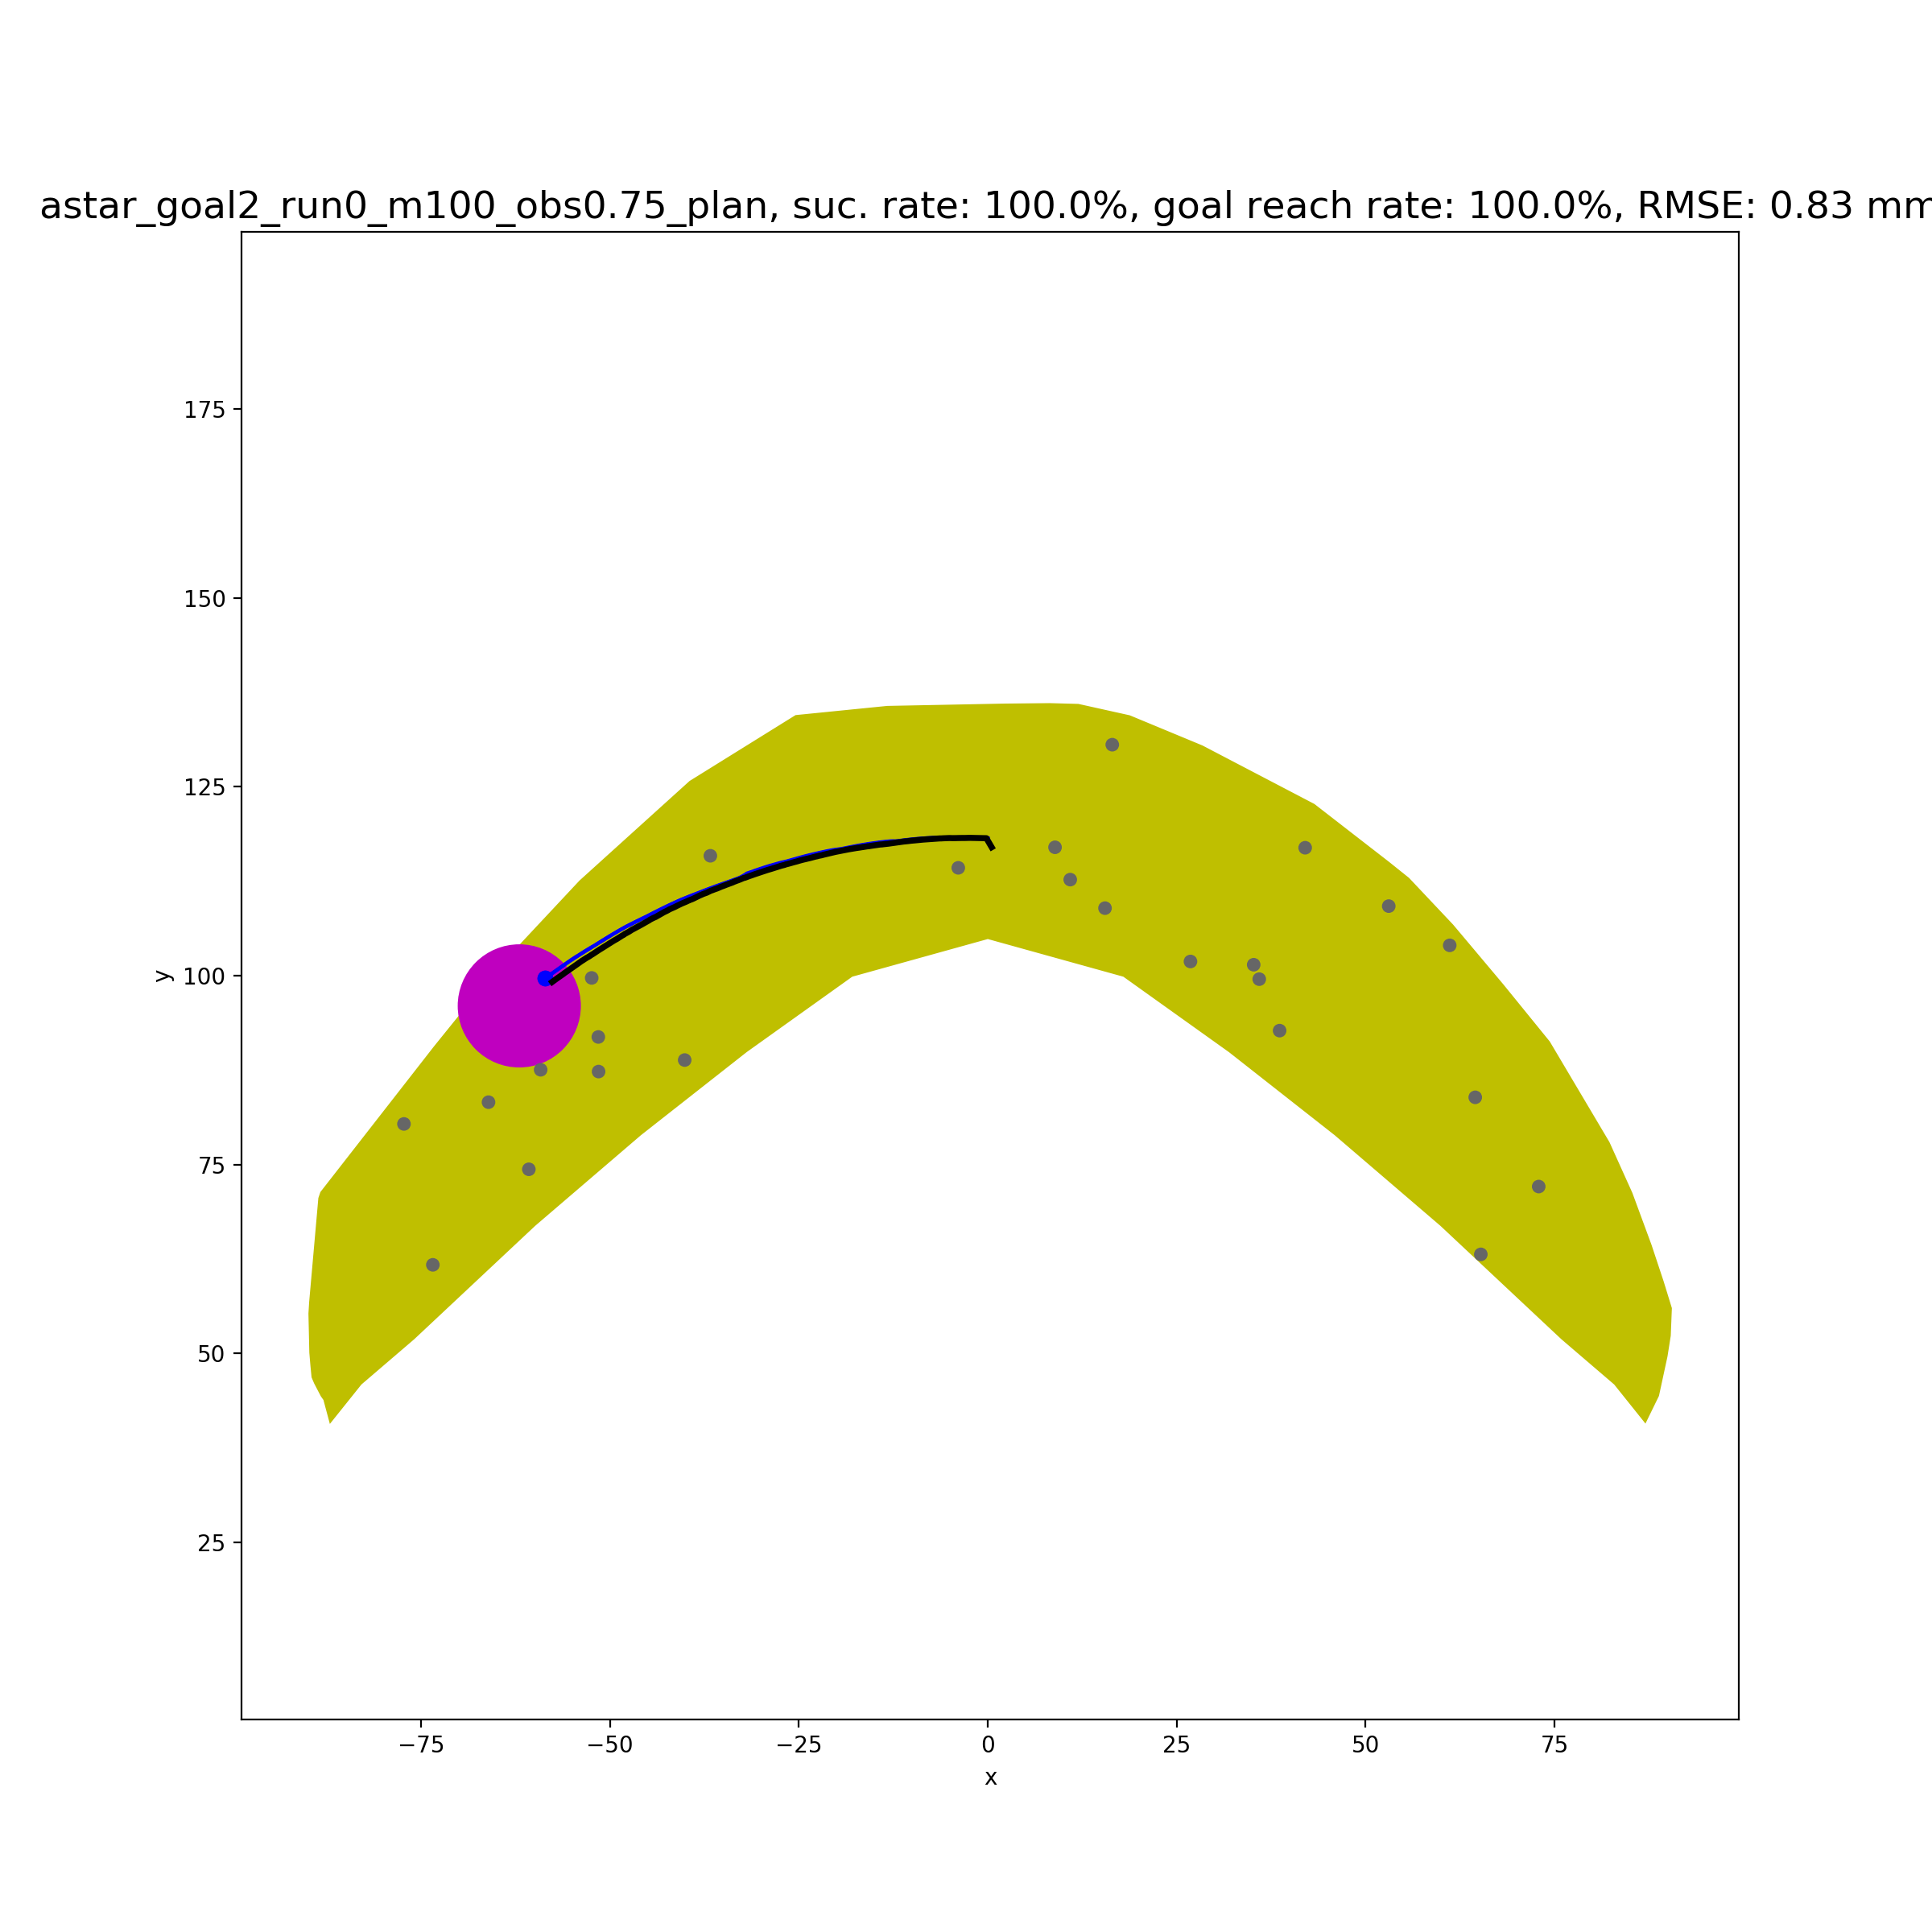
Simple Case 4
dist_sofar+dist_togoal
+100*check_small_action
+1000*check_opposite_direction

Slide 7
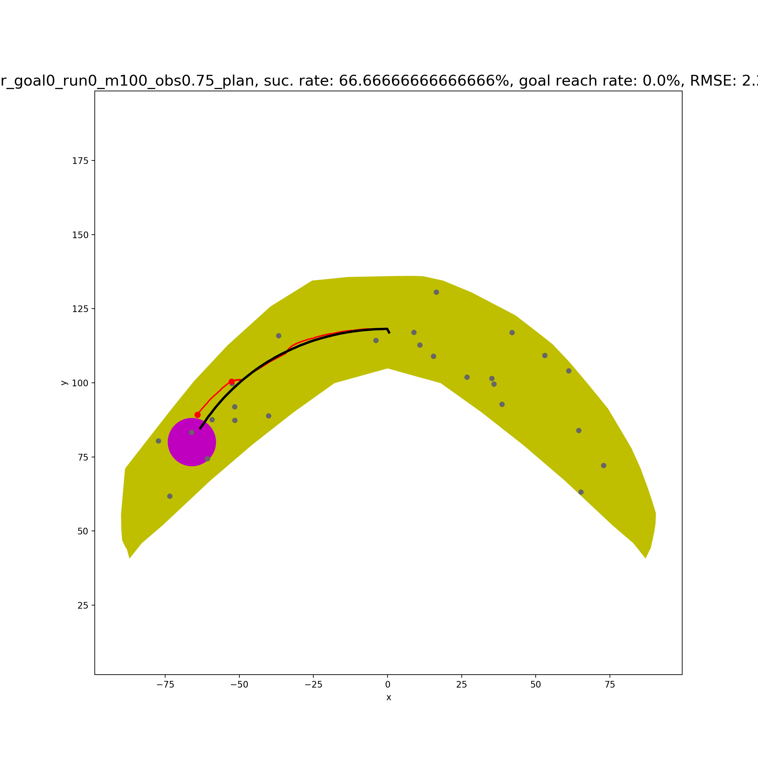
Simple Case 5
dist_sofar+dist_togoal
+100*check_small_action
+1000*check_opposite_direction

Slide 8
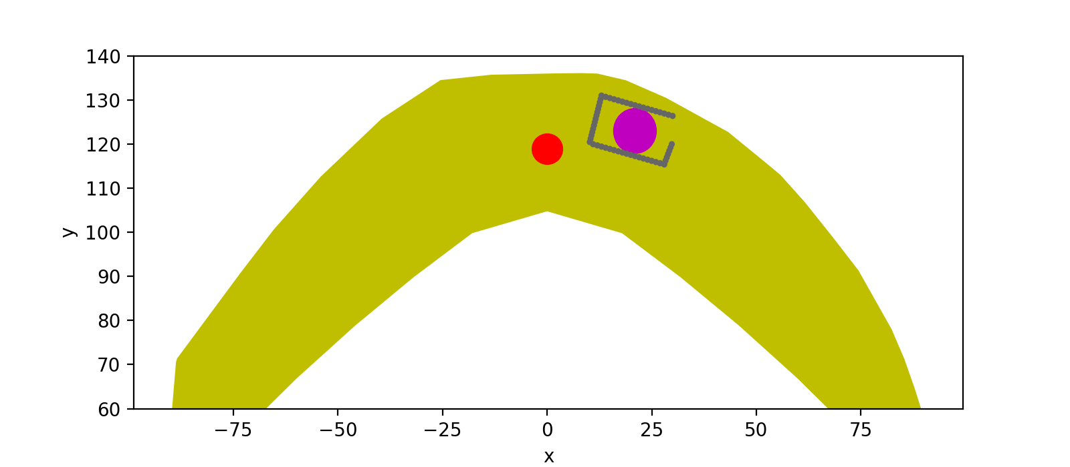
Horsehoe Case
No results yet, after couple of hours planning!
Need to adjust planner heuristic/cost function! (In Progress)

Slide 9
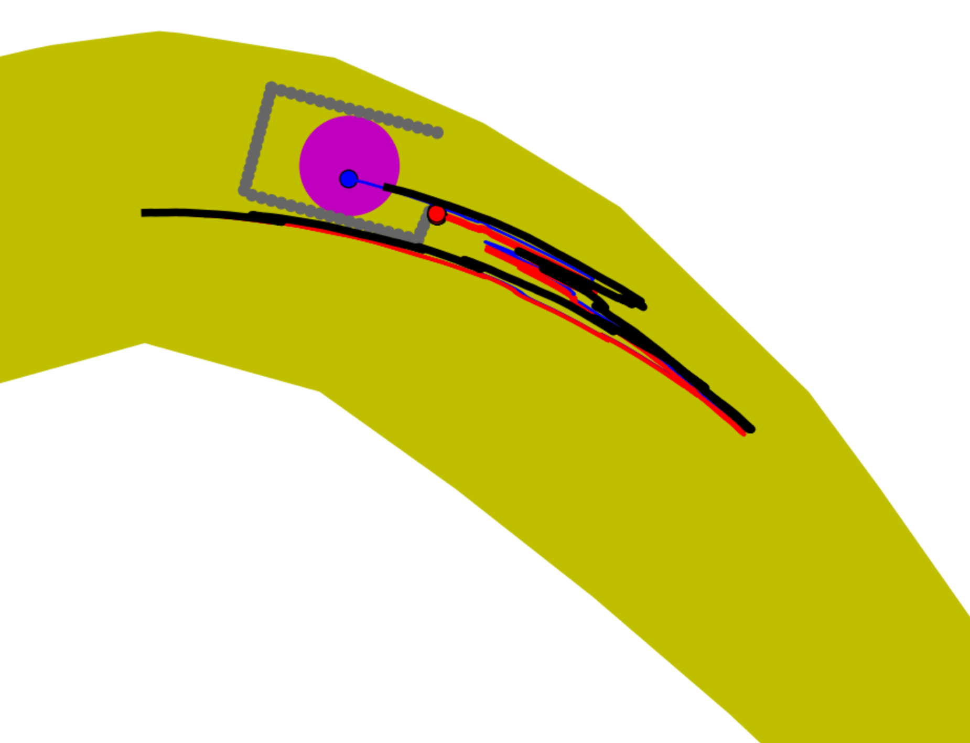
Horsehoe Case: Avishai’s Planner
There are some ations moving towards the opposite direction to goal.

Slide 10
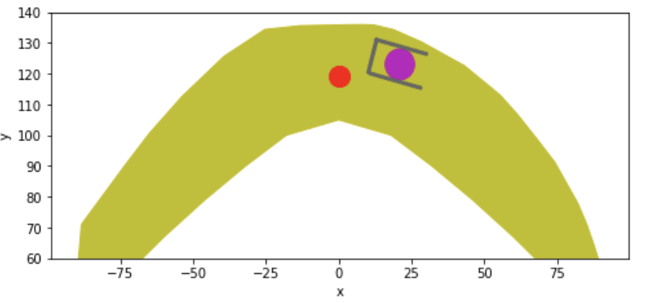
Discussions: To accelerate
Reduce number of same actions in one big step
Delete dist_sofar
Delete/Adjust weight of “towards opposite direction” penalty
Adjust weight of “small action” penalty
Try Simpler Version First

