Slide 1
Meeting 2021/07/21
Shuo

Slide 2
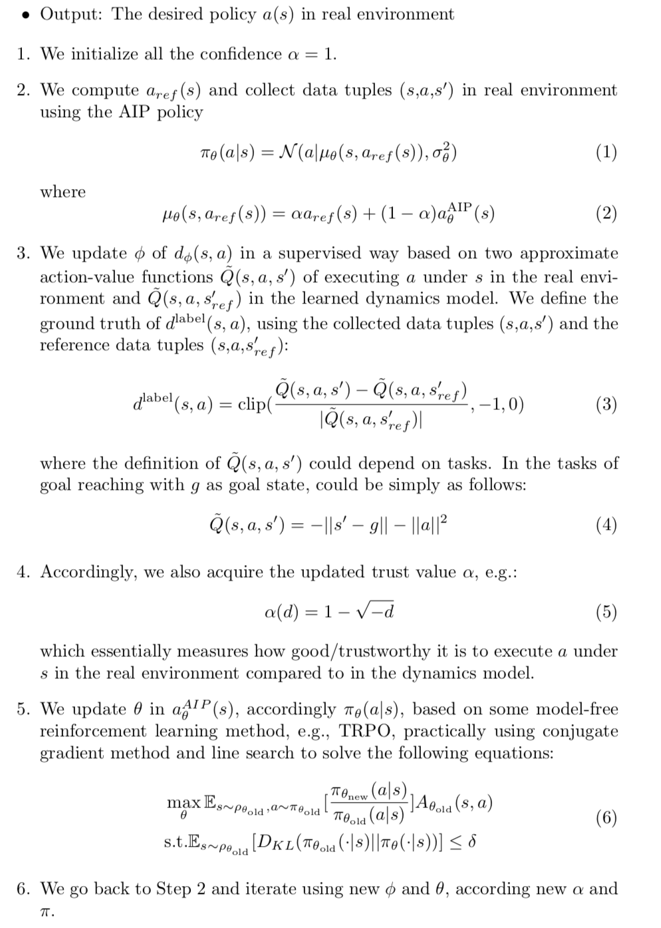
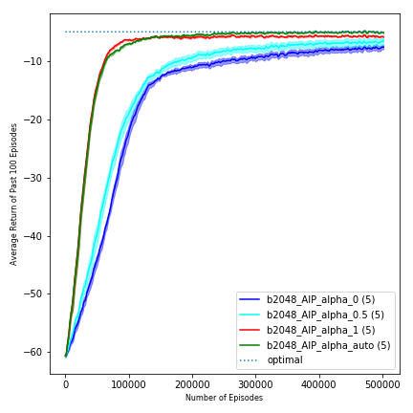
Last Time
Dynamics model: using 1k data

Slide 3
Have done so far
Trained a new dynamics model of Reacher-v2 using 100 data
Trained a new PPO policy only based on the dynamics model
Trained AIP policy based on the new reference policy and reference model
In Progress
Trying to solve the current issue of AIP

Slide 4
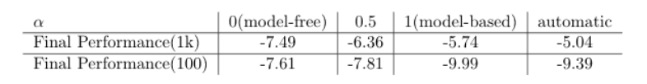
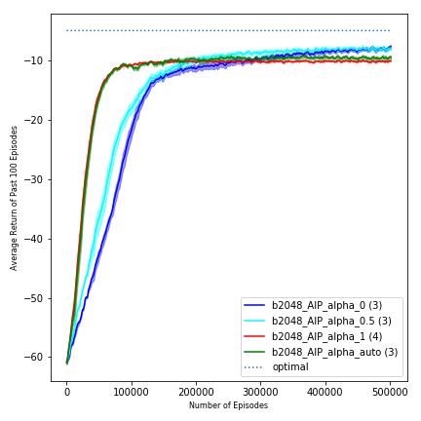
Results
Dynamics model: using 100 data
Dynamics model: using 1k data

Slide 5
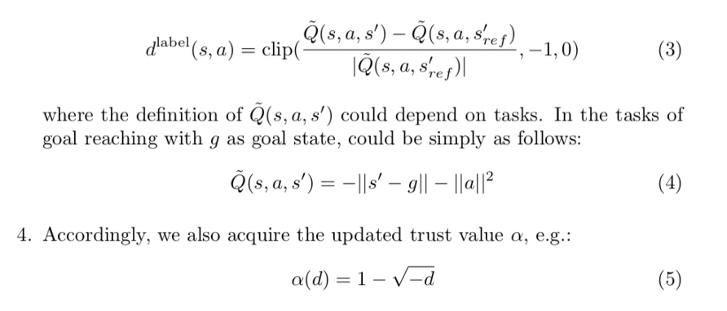
Possible Reason
Alpha maybe always too high (doesn’t deviate much from 1)(not powerful enough)
Learned Alpha valued need to be printed out and checked
If so, equation (5) (and(4)) need to be tuned/redefined/investigated

