Slide 1
Meeting 2021/08/11
Shuo

Slide 2
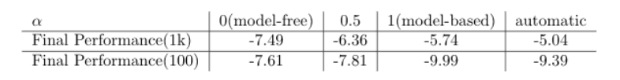
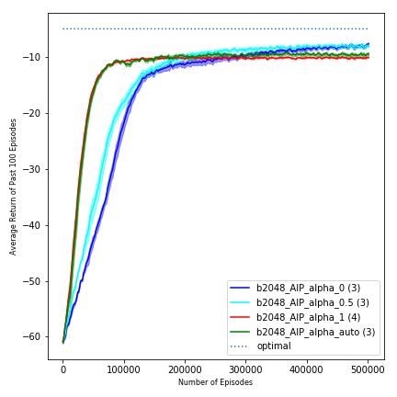
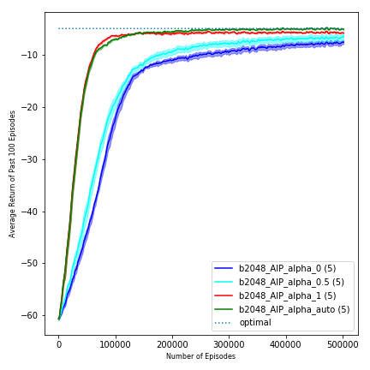
Last time
Dynamics model: using 100 data
Dynamics model: using 1k data
Problem: AIP performs better than model-based policy not significantly!

Slide 3
Have done so far
Implemented the classification version of alpha training/prediction
Deleted the meaningless exploration of model-based policy
Investigated comprehensively the AIP performance with 3 different dynamics models and 8 model-based policy for each models
In Conclusion
Classification generally works much better and more stable than regression
Stochastic model-based policy has much lower returns than deterministic due to the bigger action value. (Reacher: Reward has an action penalty)
AIP outperforms model-based policy generally, especially for stochastic model-based policy
AIP has a much faster convergence generally than model-free policy at the beginning (Sometimes, AIP’s final performance outperforms model-free policy)

Slide 4
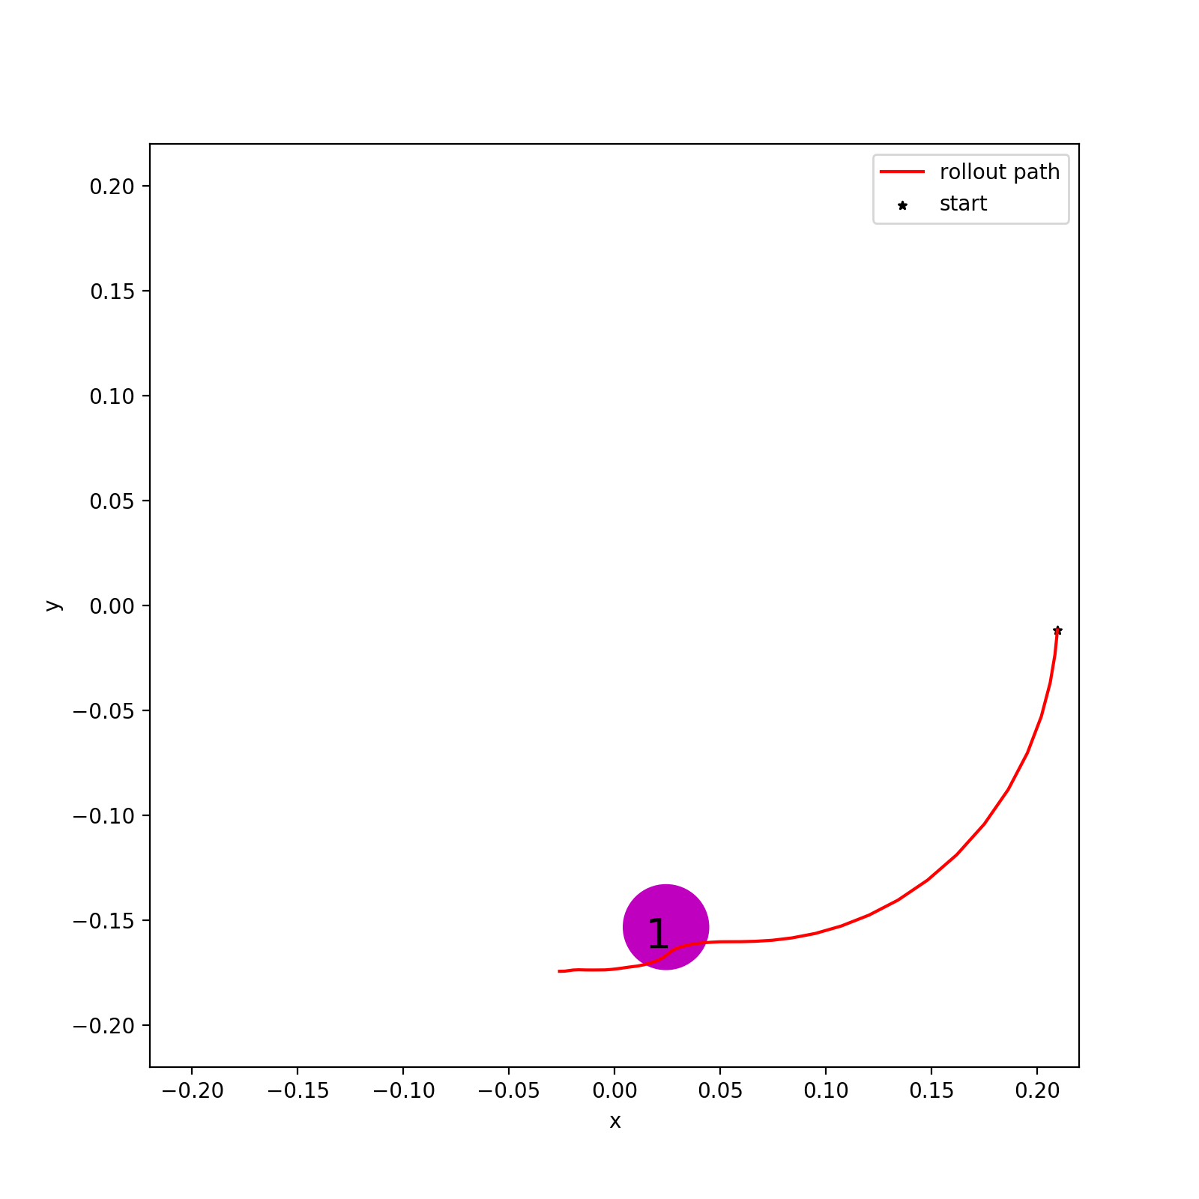
Experiments
Dynamics Model 1(DM1): Trained with 1k data without bias
Dynamics Model 2(DM2): Trained with 100 data without bias
Dynamics Model 3(DM3): Trained with 50 data with bias
Reference model-based policy: 2 versions; deterministic(det) or stochastic(sto)
Reference model-based policy: 4 degrees of pre-training using dynamics model
Reference policy 1 (RP1): most well-trained, with 1e6 data
Reference policy 2 (RP2): with 1.5e5 data
Reference policy 3 (RP3): with 1e5 data
Reference policy 4 (RP4): most slightly-trained, with 5e4 data
Bias model

Slide 5
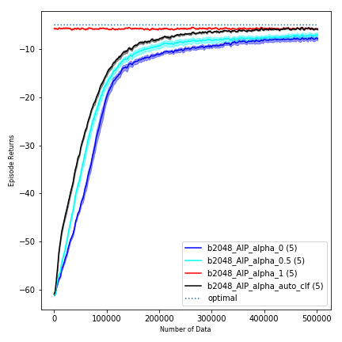
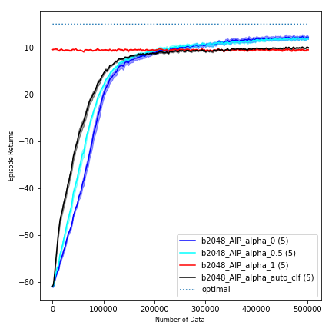
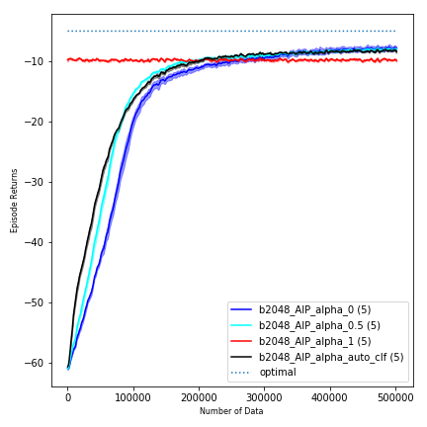
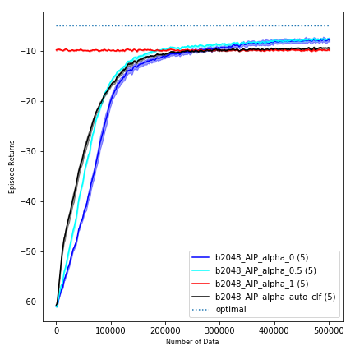
DM1(RF det)
Fig 1.1 RF1
Fig 1.2 RF2
Fig 1.3 RF3
Fig 1.4 RF4

Slide 6

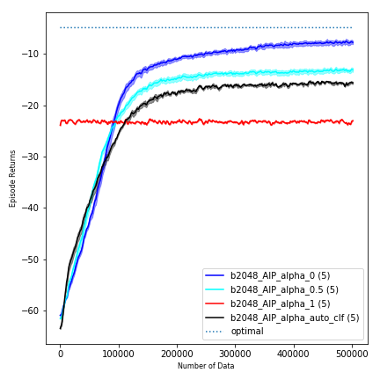
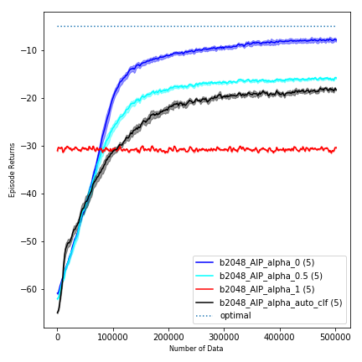
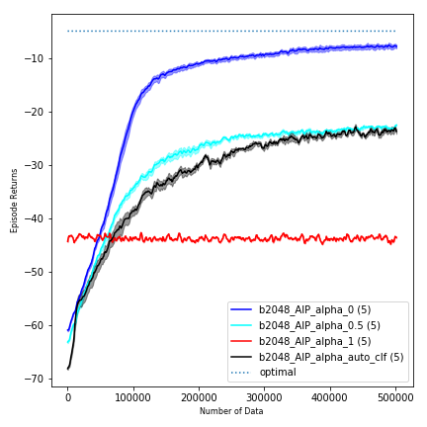
DM1(RF sto)
Fig 1.5 RF1
Fig 1.6 RF2
Fig 1.7 RF3
Fig 1.8 RF4

Slide 7

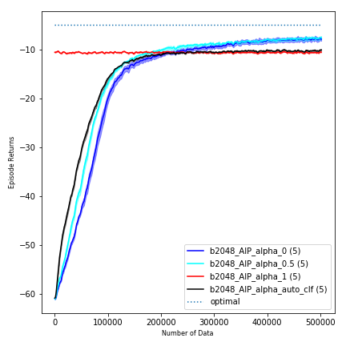
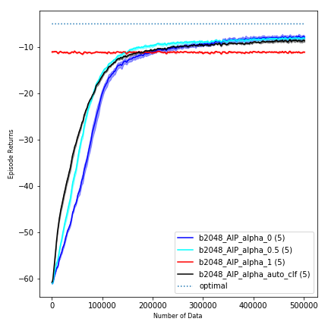

DM2(RF det)
Fig 2.1 RF1
Fig 2.2 RF2
Fig 2.3 RF3
Fig 2.4 RF4

Slide 8

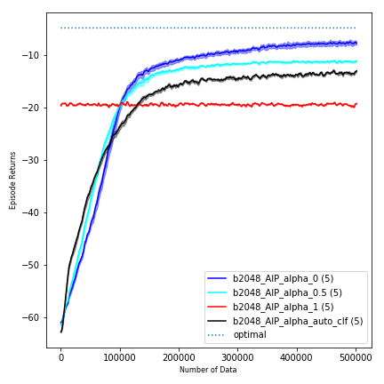
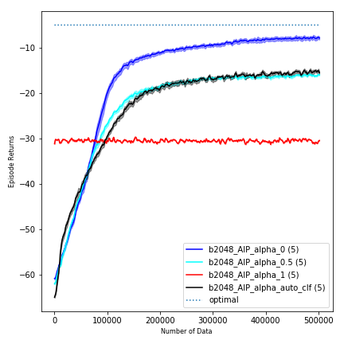
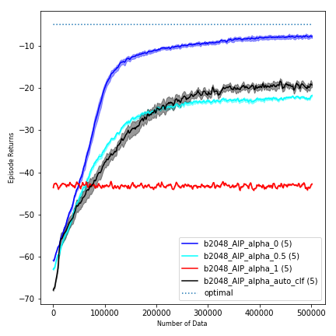
DM2(RF sto)
Fig 2.5 RF1
Fig 2.6 RF2
Fig 2.7 RF3
Fig 2.8 RF4

Slide 9
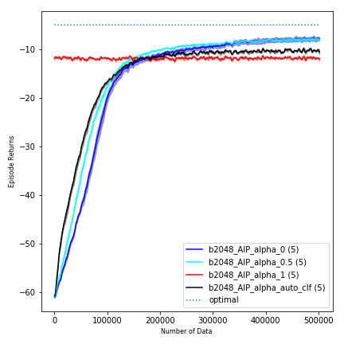
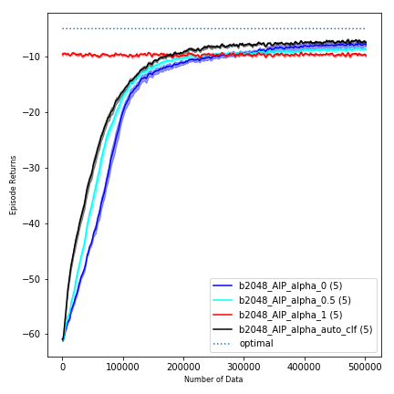

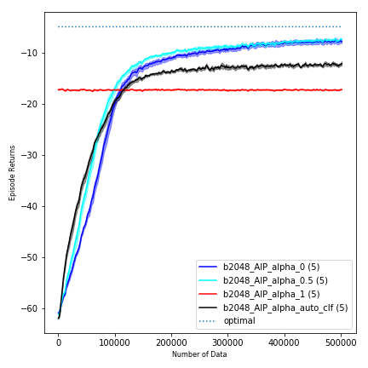
DM3(RF det)
Fig 3.1 RF1
Fig 3.2 RF2
Fig 3.3 RF3
Fig 3.4 RF4

Slide 10
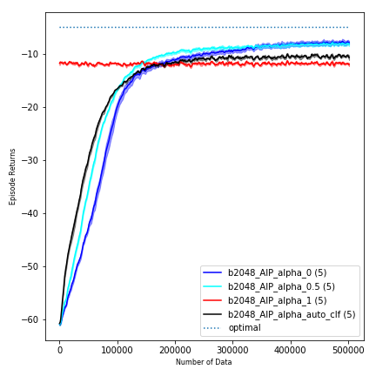
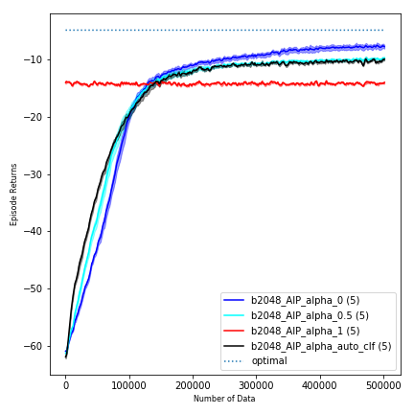

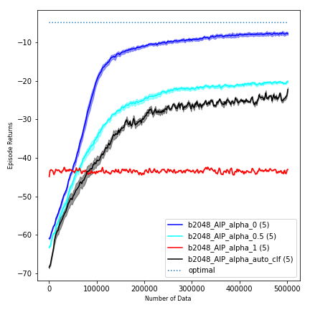
DM3(RF sto)
Fig 3.5 RF1
Fig 3.6 RF2
Fig 3.7 RF3
Fig 3.8 RF4

Slide 11
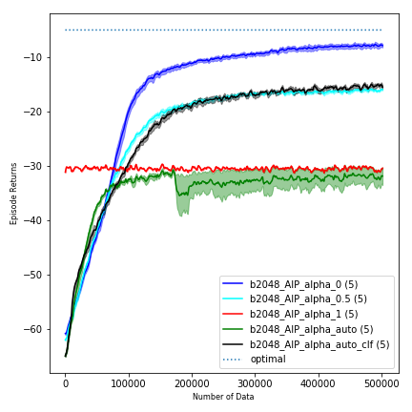
Alpha comparison (DM2 RF3 sto)

Slide 12
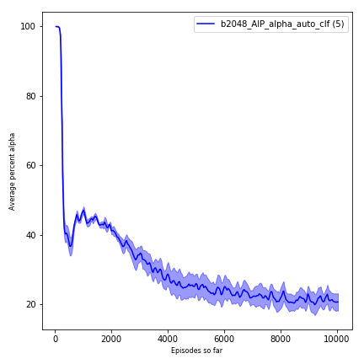
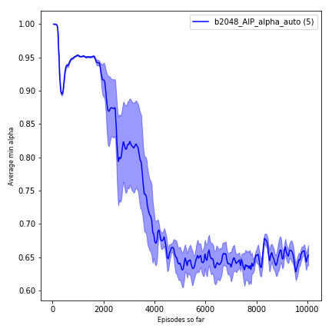
Alpha comparison (DM2 RF3 sto)
Regression
Classification

Slide 13
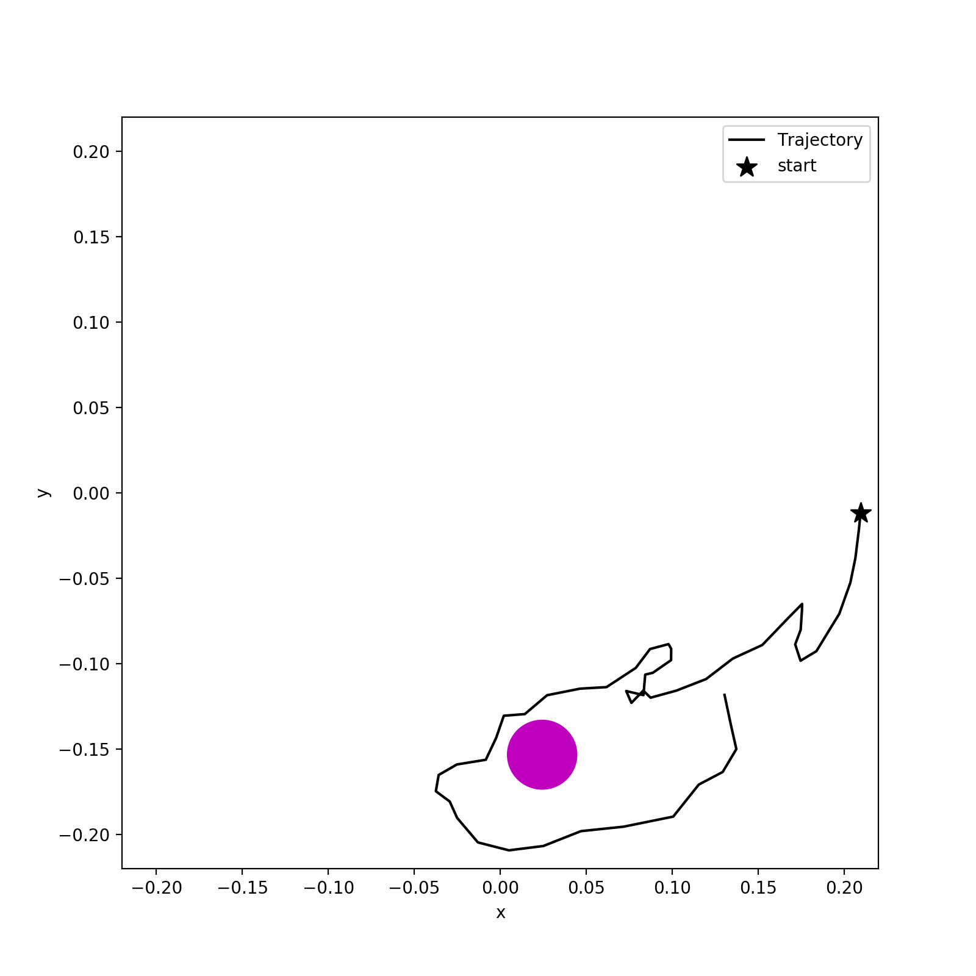
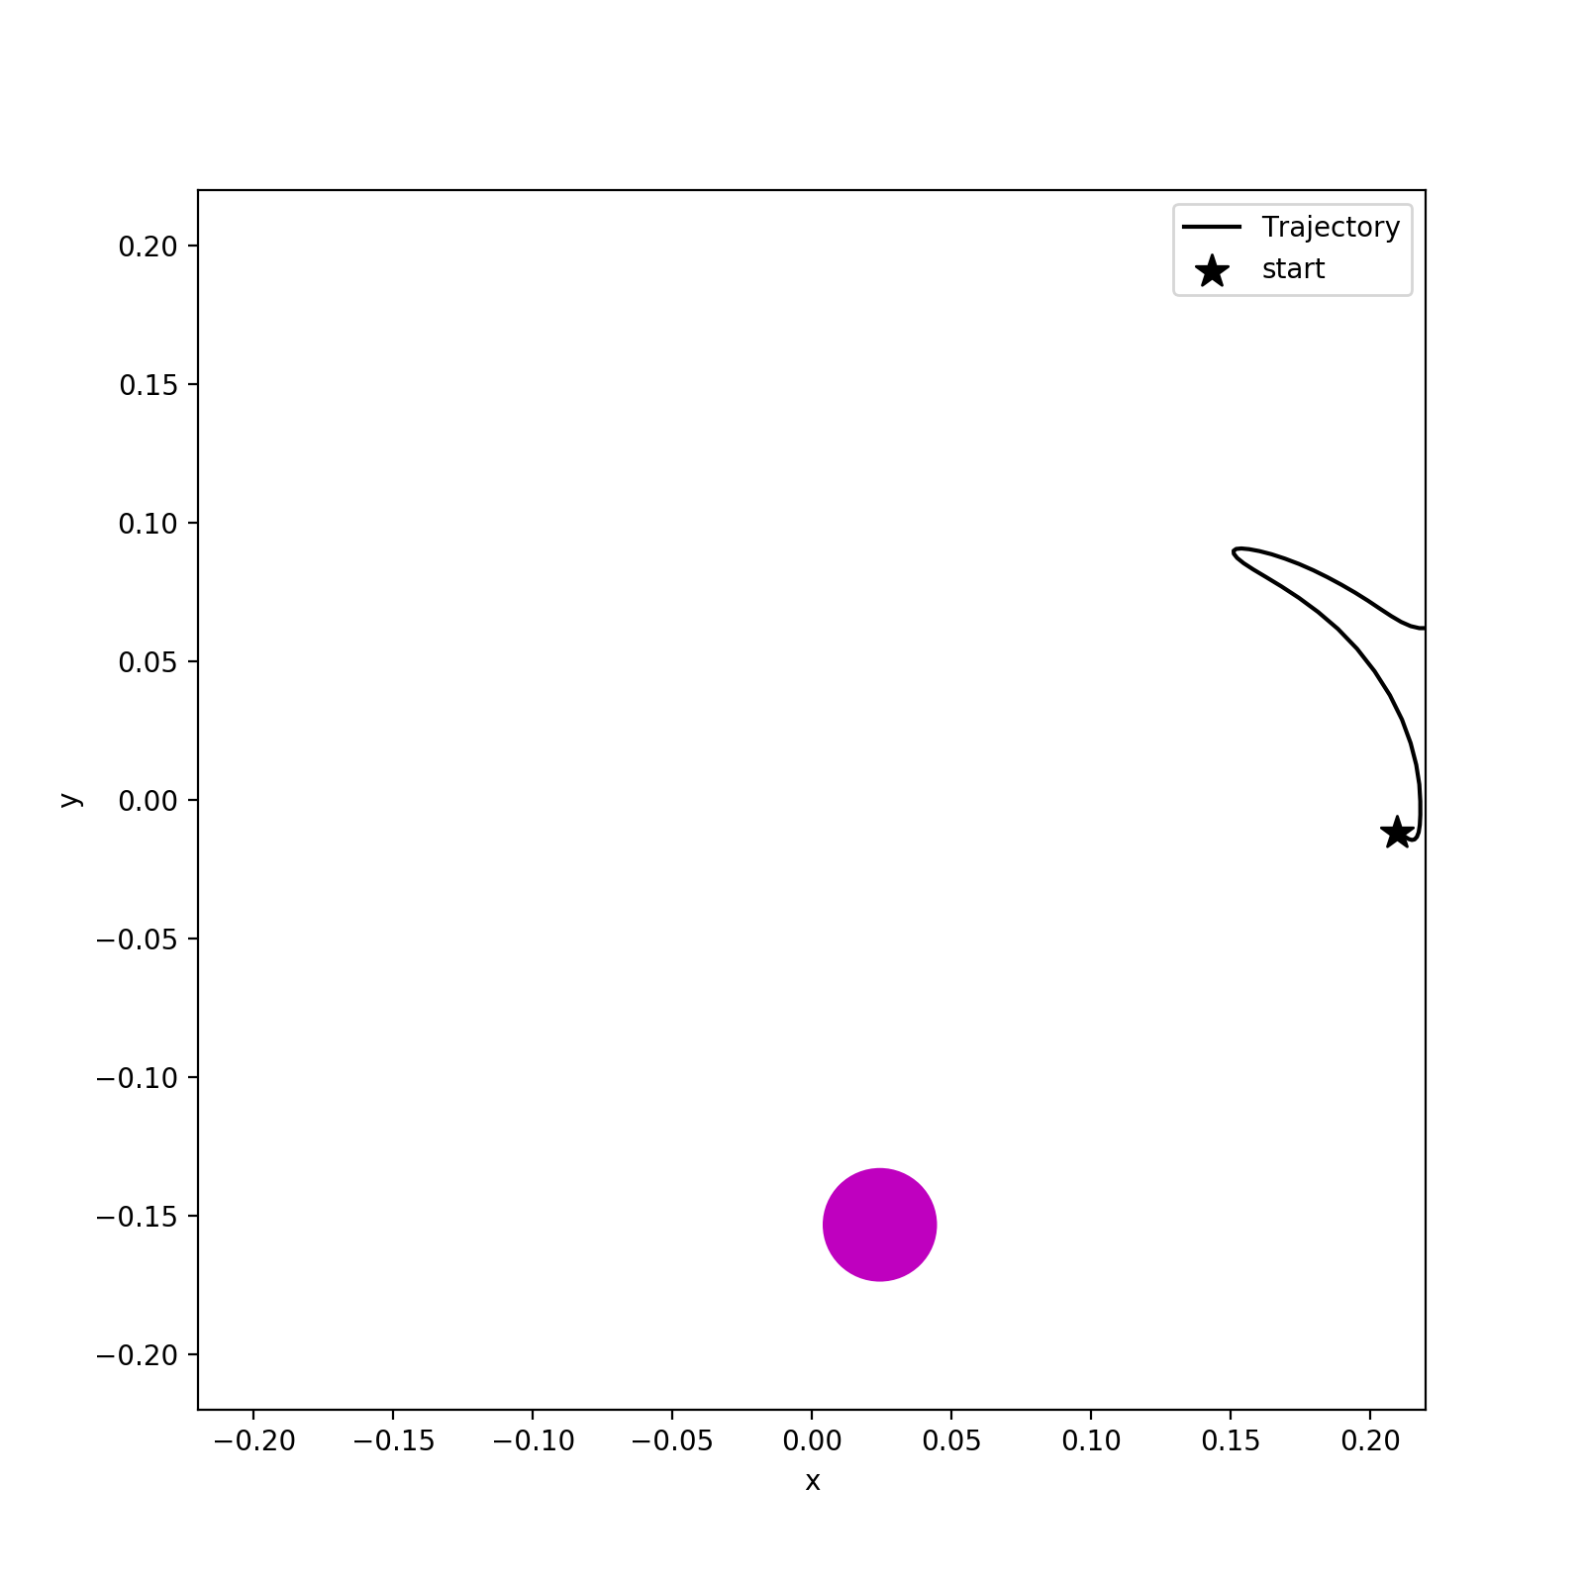
DM2 (Reference policy rollout in DM2) Action value matters much in return
Return -11
Reference policy deterministic
Return -60
Reference policy stochastic

Slide 14
Next plan
Reacher with obstacles?
Other environments: such as Fetch-Reacher in openai?

