Slide 1
Meeting 2021/08/20
Shuo

Slide 2
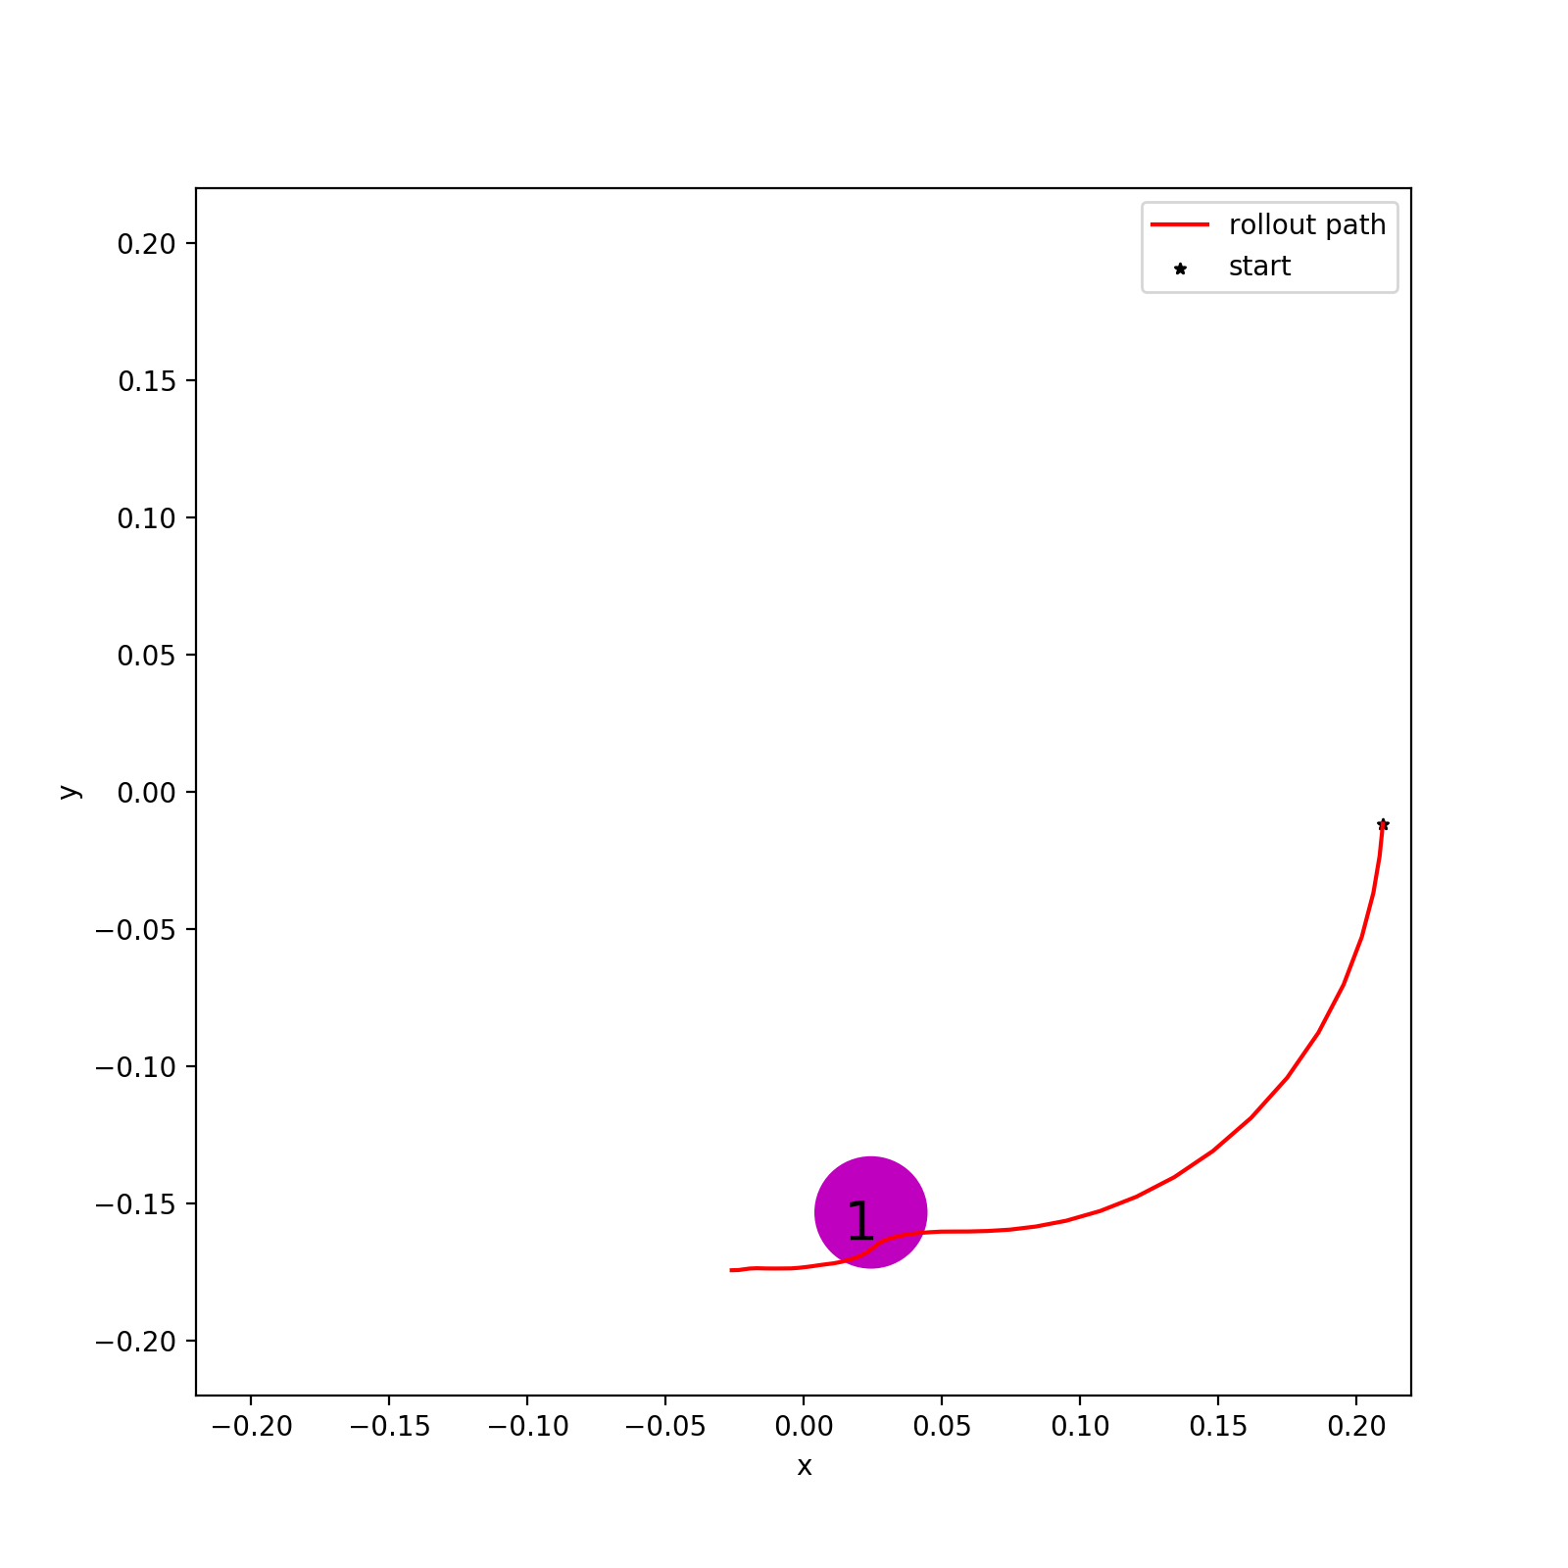
Last Time Experiments
1.Dynamics Model 1(DM1): Trained with 1k data without bias
2. Dynamics Model 2(DM2): Trained with 100 data without bias
3. Dynamics Model 3(DM3): Trained with 50 data with bias
Reference deterministic model-based policy: 4 degrees of training using dynamics
Reference policy 1 (RP1): most well-trained, with 1e6 data
Reference policy 2 (RP2): with 1.5e5 data
Reference policy 3 (RP3): with 1e5 data
Reference policy 4 (RP4): most slightly-trained, with 5e4 data
We confirmed that AIP can improve the performance of model-based method.
Issue left:
Compared to model-free method, we want to Improve AIP so that it not only converges faster but also can match or outperforms model-free method’s final performance
Bias model

Slide 3
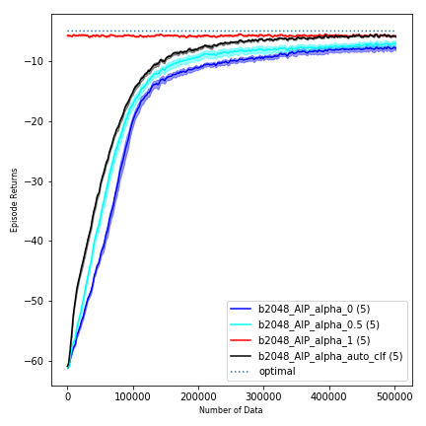
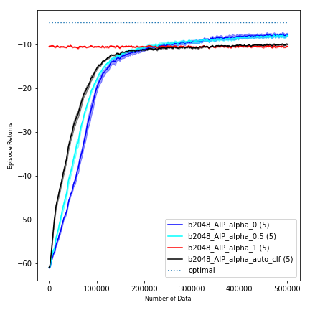
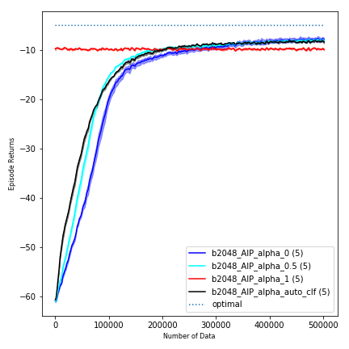
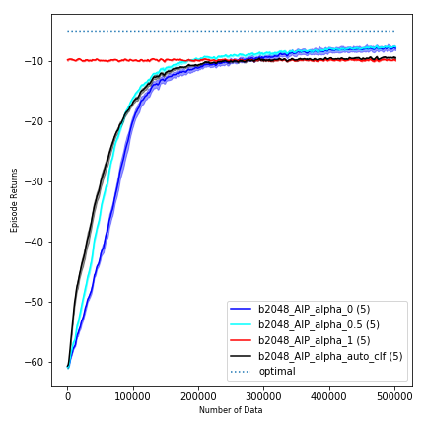

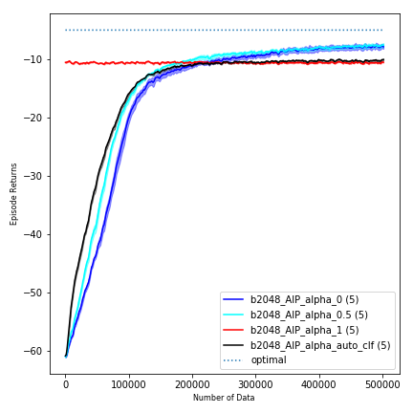
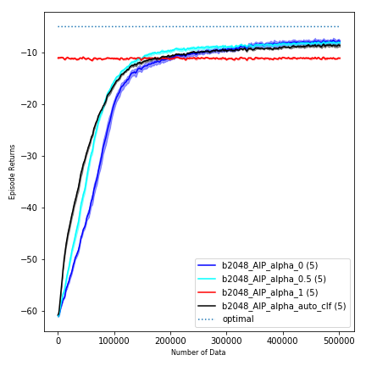

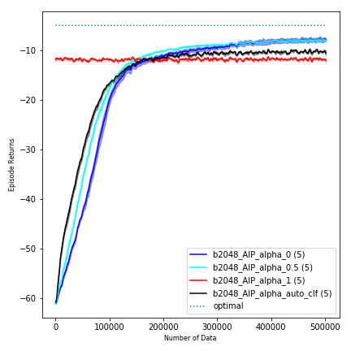
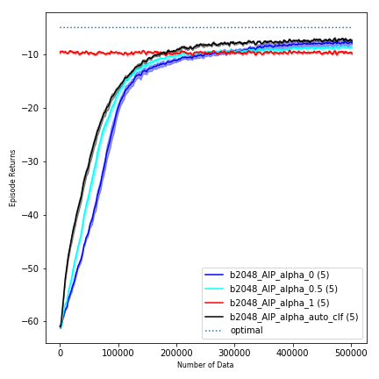

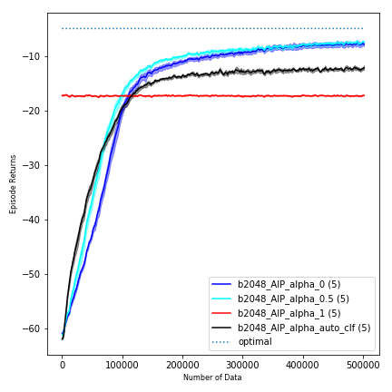

Slide 4
This Week
Experiments with 6 different ways of tuning alpha in order to improve AIP’s performance compared to model-free method
Idea is that we want more alpha=0 during the training progress, so I add a probability p that forces alpha to be zero instead of the original output of alpha prediction network. And this p is going to be bigger and bigger. At the end of the training, p=1, which means we finally switch to model-free method.
Experimented 6 ways of p tuning

Slide 5
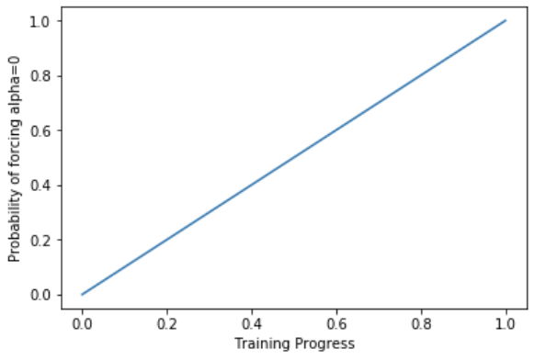
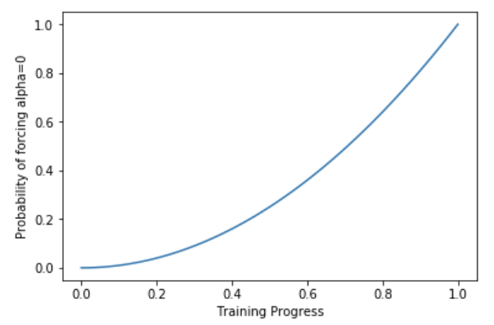
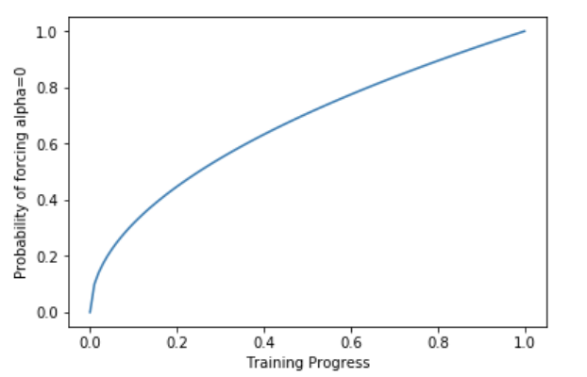
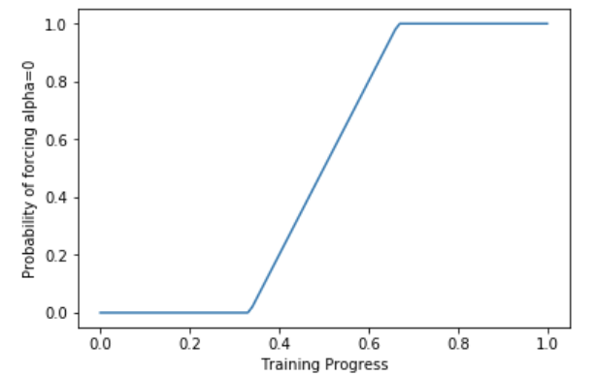
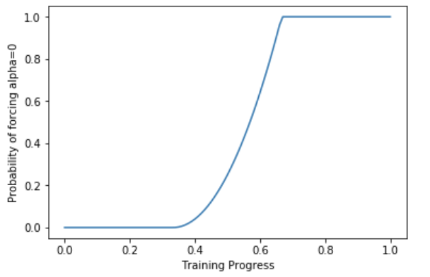
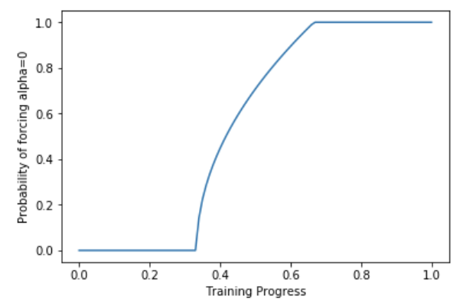
Linear (ln)
Square (sq)
Square Root (sqrt)
ln_mid
sq_mid
sqrt_mid

Slide 6
Final Performance Summary(Average over 5 seeds)
 | 1.1 | 1.2 | 1.3 | 1.4 | 2.1 | 2.2 | 2.3 | 2.4 | 3.1 | 3.2 | 3.3 | 3.4 | Avg.
model free | -7.77 | -7.77 | -7.77 | -7.77 | -7.77 | -7.77 | -7.77 | -7.77 | -7.77 | -7.77 | -7.77 | -7.77 | -7.77
model based | -5.71 | -10.38 | -9.79 | -9.78 | -9.99 | -10.42 | -10.99 | -9.68 | -11.91 | -9.73 | -10.05 | -17.18 | -10.47
baseline aip | -5.80 | -9.91 | -8.30 | -9.39 | -9.03 | -9.97 | -8.56 | -8.63 | -10.43 | -7.36 | -9.45 | -12.10 | -9.08
ln | -7.07 | -8.26 | -6.98 | -7.42 | -8.10 | -8.91 | -8.12 | -7.82 | -7.39 | -7.01 | -7.33 | -8.18 | -7.72
ln_mid | -5.87 | -8.29 | -6.64 | -7.44 | -7.93 | -8.35 | -7.65 | -7.25 | -6.83 | -6.08 | -6.31 | -7.08 | -7.14
sq | -6.08 | -8.73 | -7.14 | -7.72 | -8.63 | -8.31 | -8.03 | -7.41 | -6.23 | -6.22 | -6.48 | -8.01 | -7.42
sq_mid | -5.91 | -8.35 | -6.66 | -8.07 | -7.99 | -8.72 | -7.95 | -7.24 | -6.79 | -6.26 | -6.70 | -7.24 | -7.32
sqrt | -7.51 | -7.79 | -7.90 | -7.60 | -8.22 | -8.35 | -7.70 | -7.18 | -7.42 | -6.86 | -7.68 | -8.17 | -7.70
sqrt_mid | -5.98 | -8.40 | -6.80 | -7.39 | -8.04 | -8.34 | -7.90 | -7.41 | -6.59 | -6.08 | -6.36 | -6.89 | -7.18
Generally, linear_mid (and sqrt_mid)works best.(Especially on model 3 which is the biasedly learned dynamics model)

Slide 7
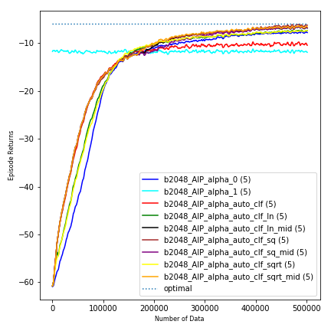
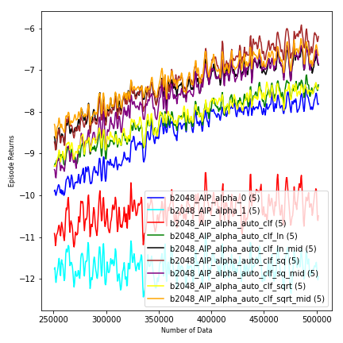
DM3(RF det RF1)
Fig 3.1 RF1

Slide 8
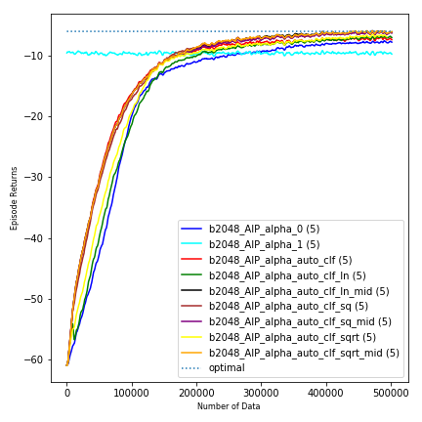
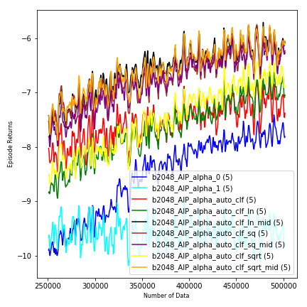
DM3(RF det RF2)
Fig 3.2 RF2

Slide 9
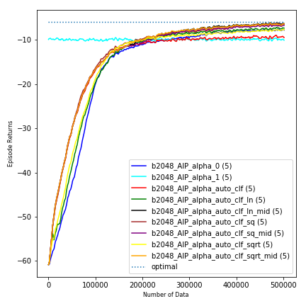
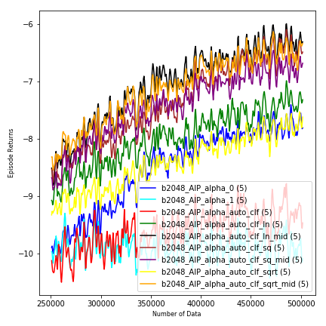
DM3(RF det RF3)
Fig 3.3 RF3

Slide 10
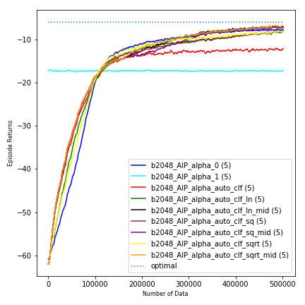
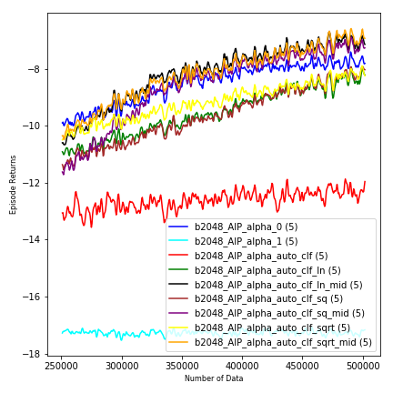
DM3(RF det RF4)
Fig 3.4 RF4

Slide 11
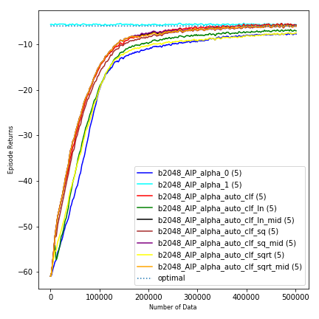
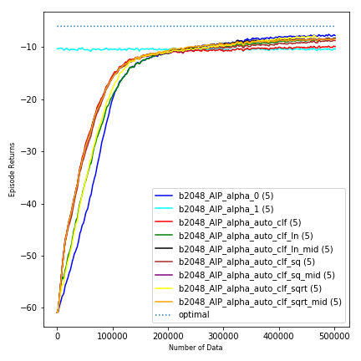
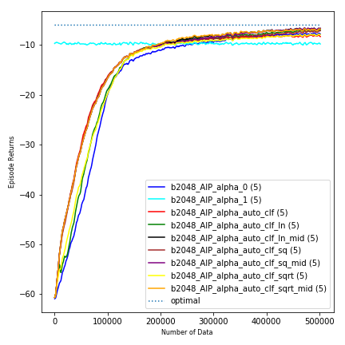
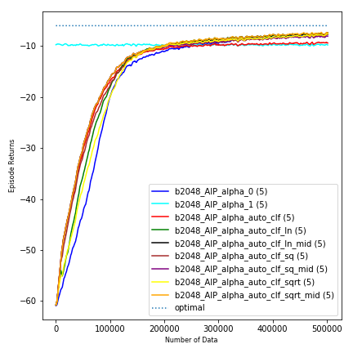
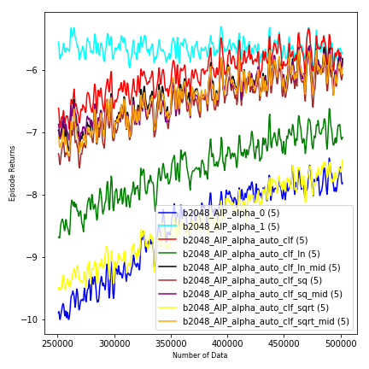
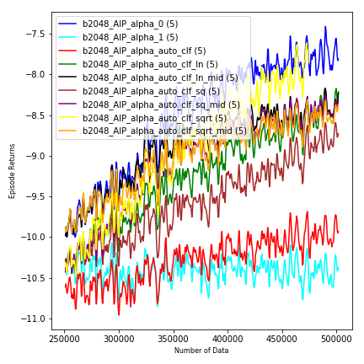
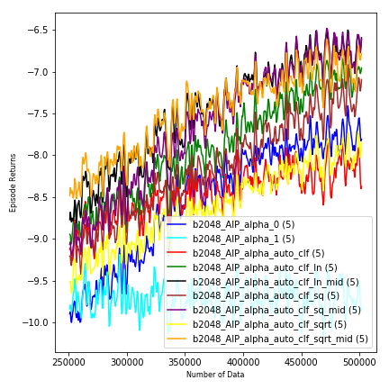
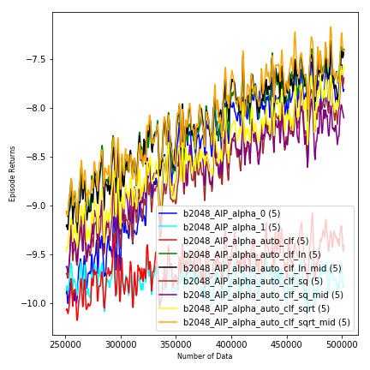
DM1(RF det)
Fig 1.1 RF1
Fig 1.2 RF2
Fig 1.3 RF3
Fig 1.4 RF4

Slide 12
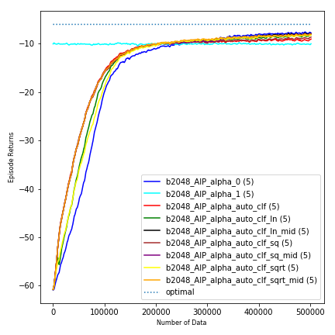
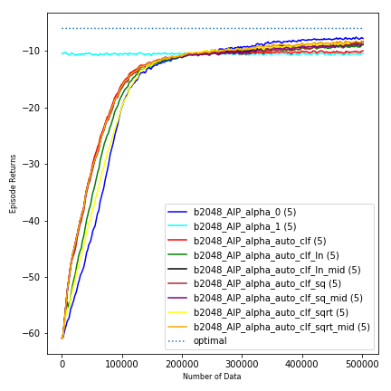
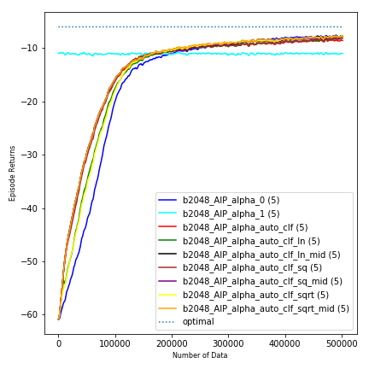
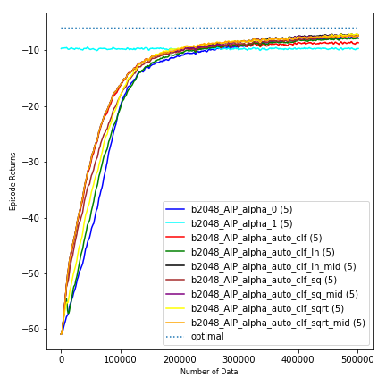
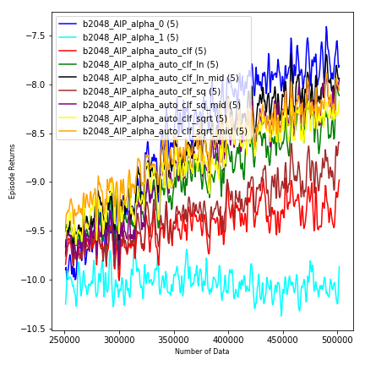
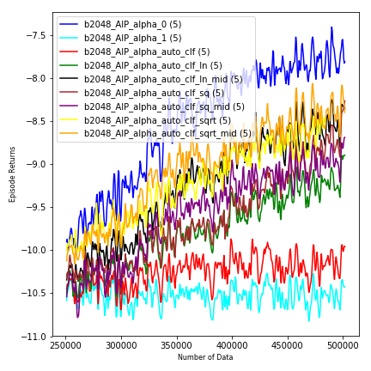
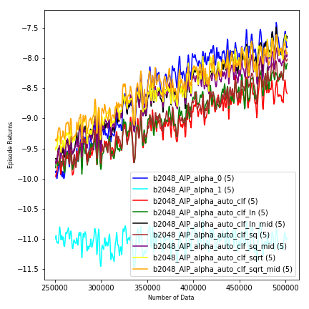
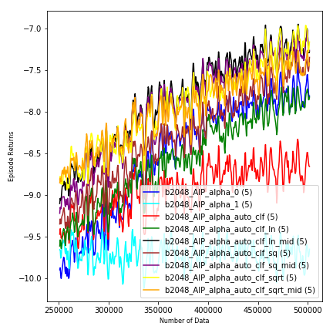
DM2(RF det)
Fig 2.1 RF1
Fig 2.2 RF2
Fig 2.3 RF3
Fig 2.4 RF4

Slide 13
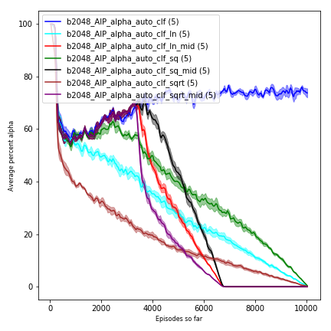
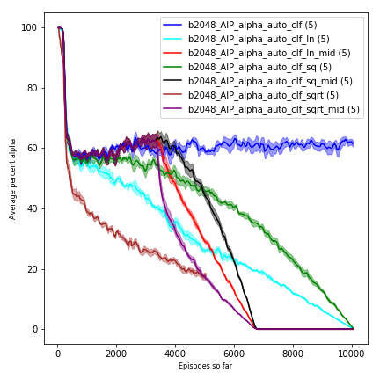
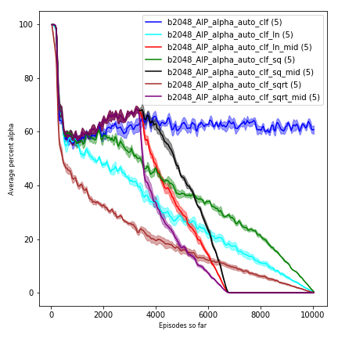
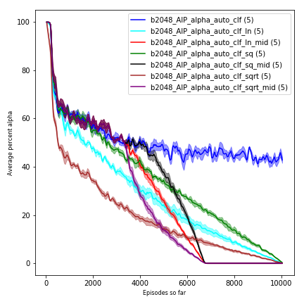
Alpha comparison (DM3)

Slide 14
Next plan
Reacher with obstacles?
Other environments: such as Fetch-Reacher in openai?
Monte-Carlo rollout(using Q in equation 3) will take much more time (half horizon times more than current one-step reward) since for every one data, we need a full-horizon rollout to acquire true Q.

