Slide 1
Meeting 05/08/2020
Shuo Zhang

Slide 2
Progress So far
GAZEBO Correctness Check
Search for the best NN model
Plan using the best NN model
(Adjusted Planner: No node added into the search list if in the opposite direction)
Rollout the planned actions
Issue Analysis

Slide 3
Progress So far
GAZEBO Correctness Check
Search for the best NN model
Plan using the best NN model
(Adjusted Planner: No node added into the search list if in the opposite direction)
Rollout the planned actions
Issue Analysis

Slide 4
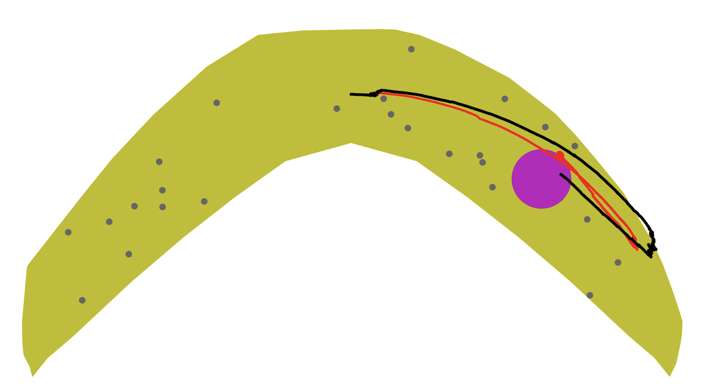
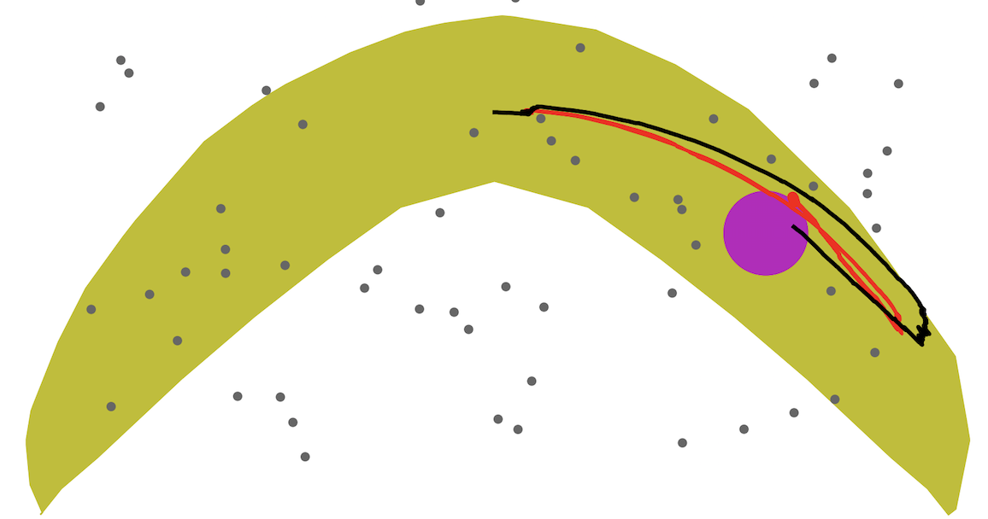
Correctness Check of “my” GAZEBO
My Results using Avishai’s actions
Avishai’s Results using Avishai’s actions
So, GAZEBO on my laptop works well!

Slide 5
Progress So far
GAZEBO Correctness Check
Search for the best NN model
Plan using the best NN model
(Adjusted Planner: No node added into the search list if in the opposite direction)
Rollout the planned actions
Issue Analysis

Slide 6
Search for the Best NN Model
All available 9 models we have:
no suffix
suffix ”ho40”
suffix ”ho0.5”
suffix ”ho0.6”
suffix ”ho0.7”
suffix ”ho0.8”
suffix ”ho0.9”
suffix ”ho0.95”
suffix ”ho0.99”
Results: Model “no suffix” works best generally

Slide 7
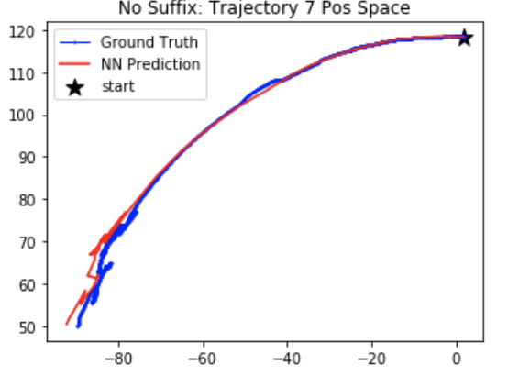
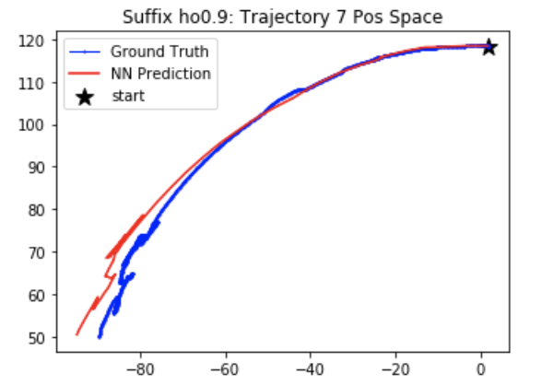
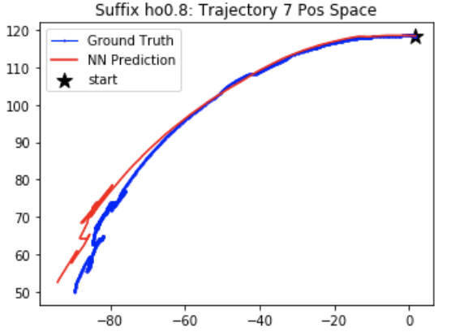
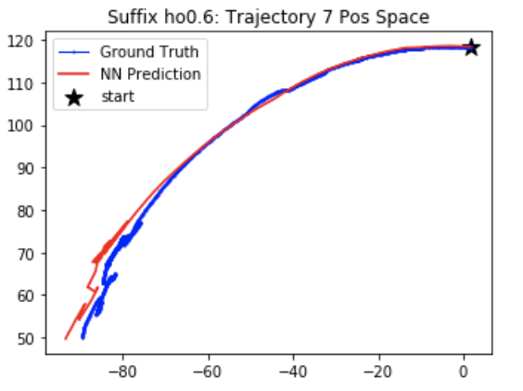
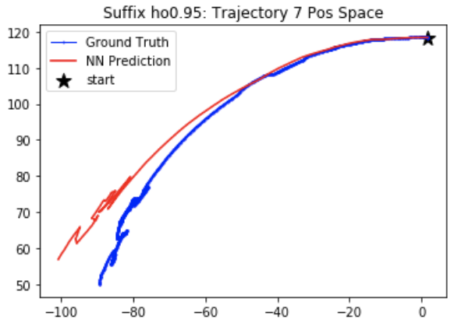
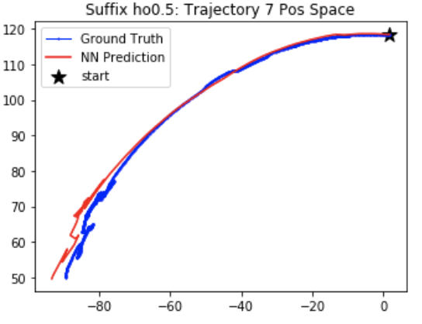
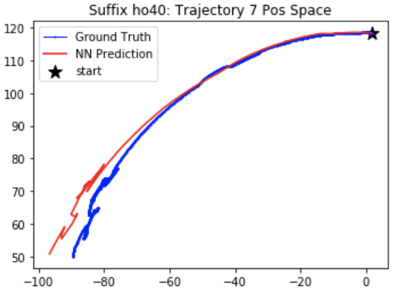
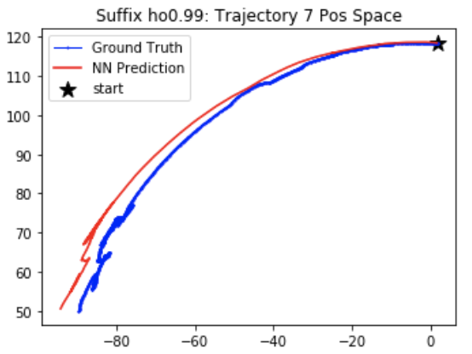
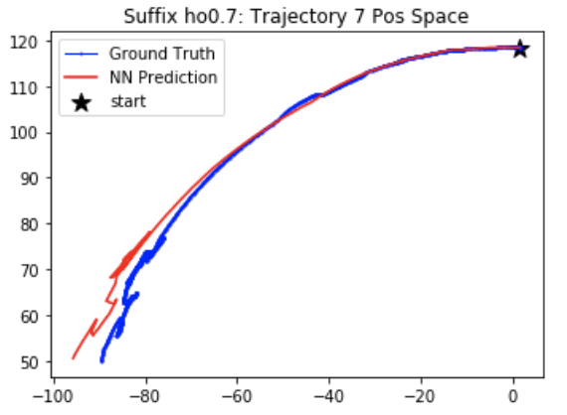

Slide 8
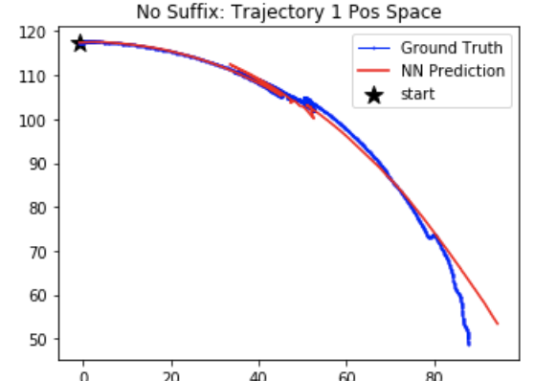
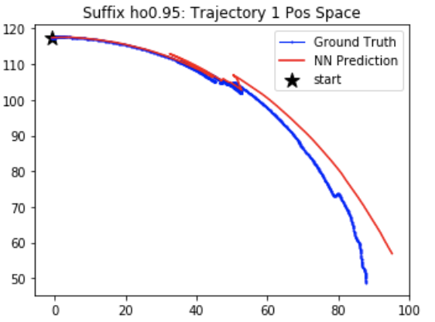
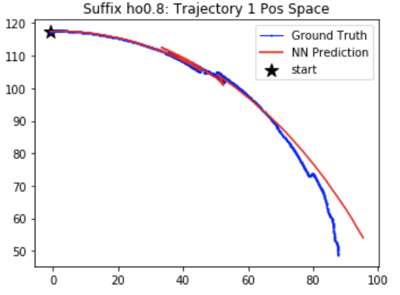
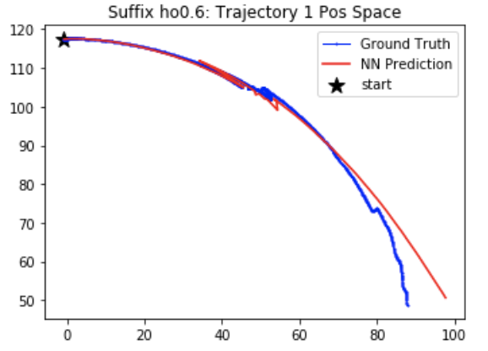
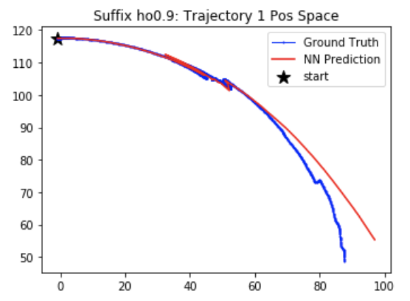
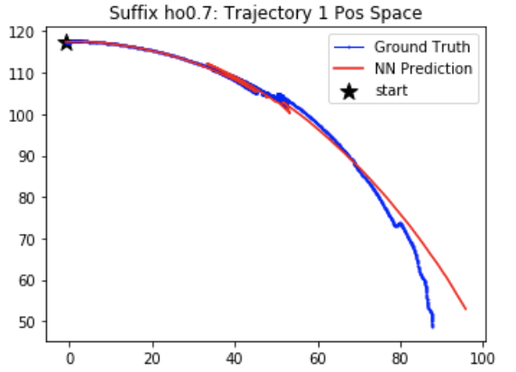
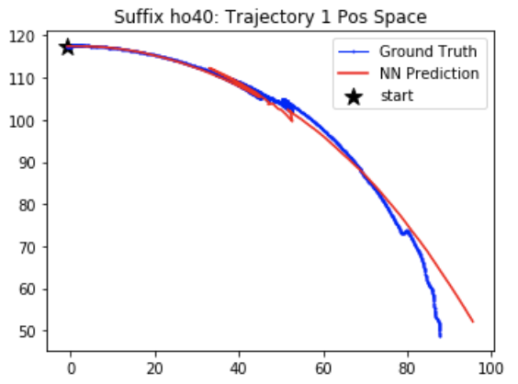
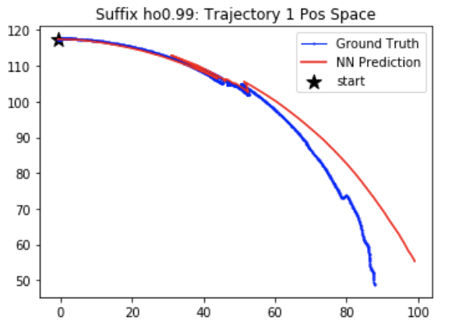
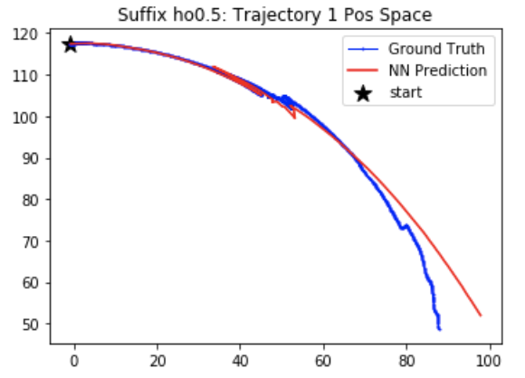

Slide 9
Progress So far
GAZEBO Correctness Check
Search for the best NN model
Plan using the best NN model
(Adjusted Planner: No node added into the search list if in the opposite direction)
Rollout the planned actions
Issue Analysis

Slide 10
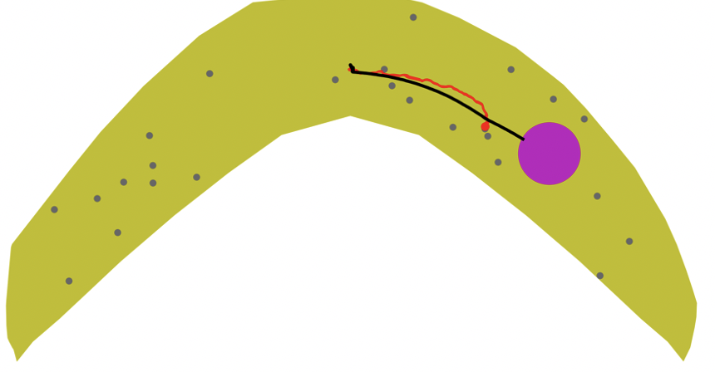
Goal 8 Obstacle 0.75mm

Slide 11
Issue Analysis
Planned Actions: 665 steps totally
First 400 actions: (1, 1) (moving down)
Later 265 actions: (1, 0) (moving right)
Rollout path: collision with obstacle after about 598 steps

Slide 12
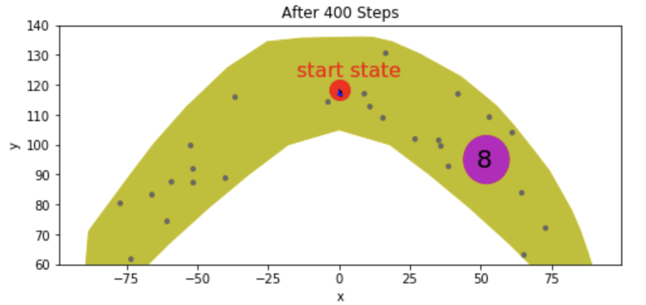
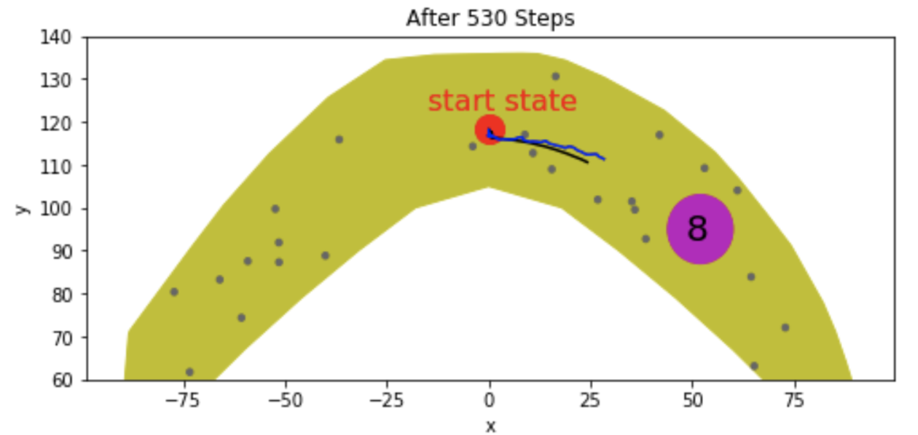
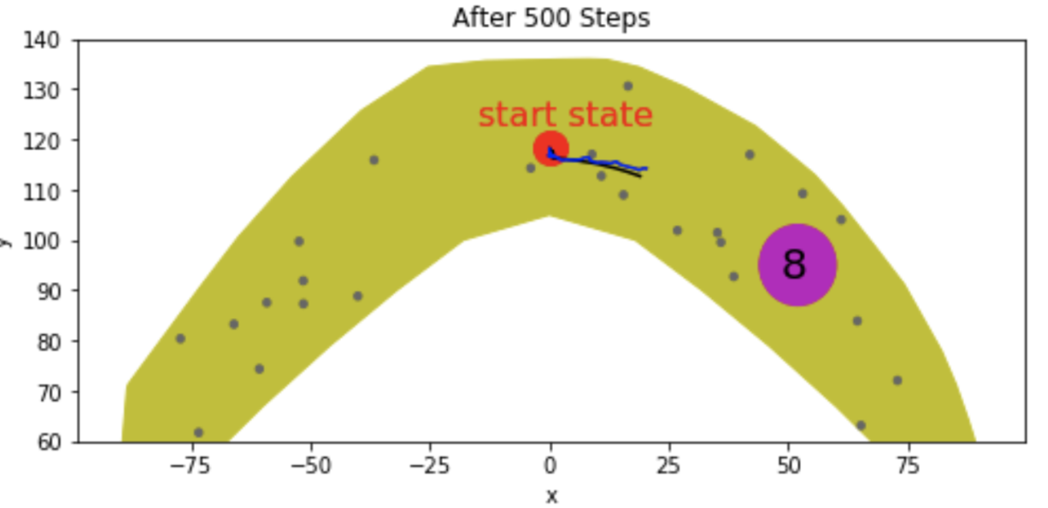
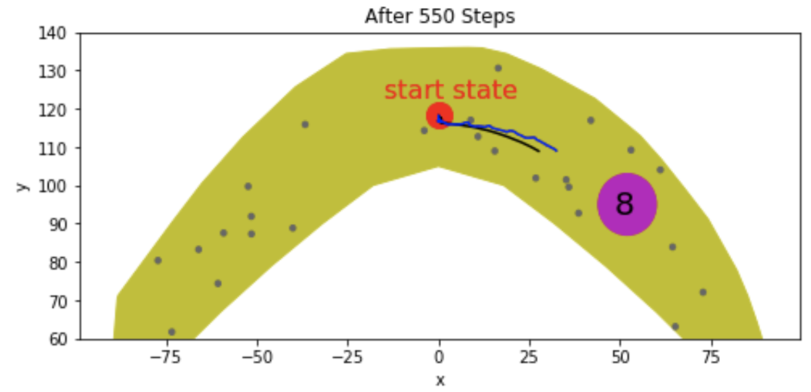
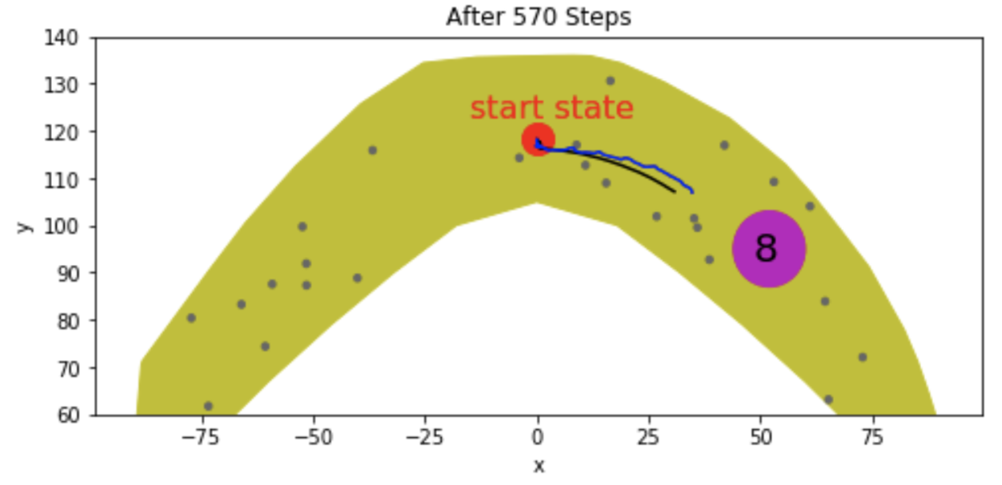
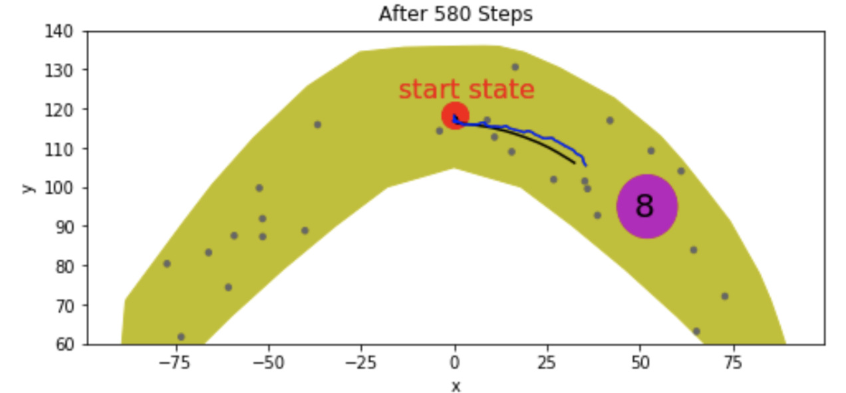
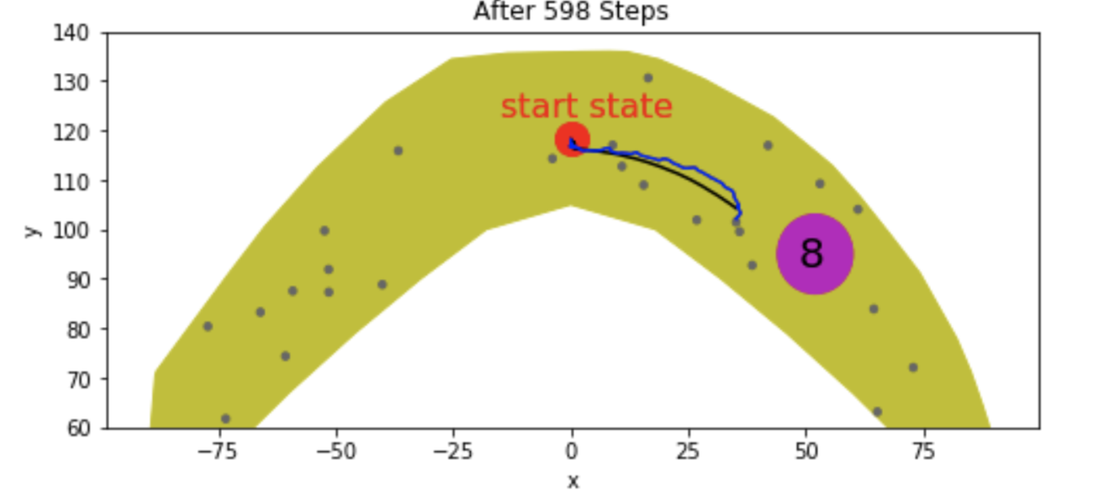
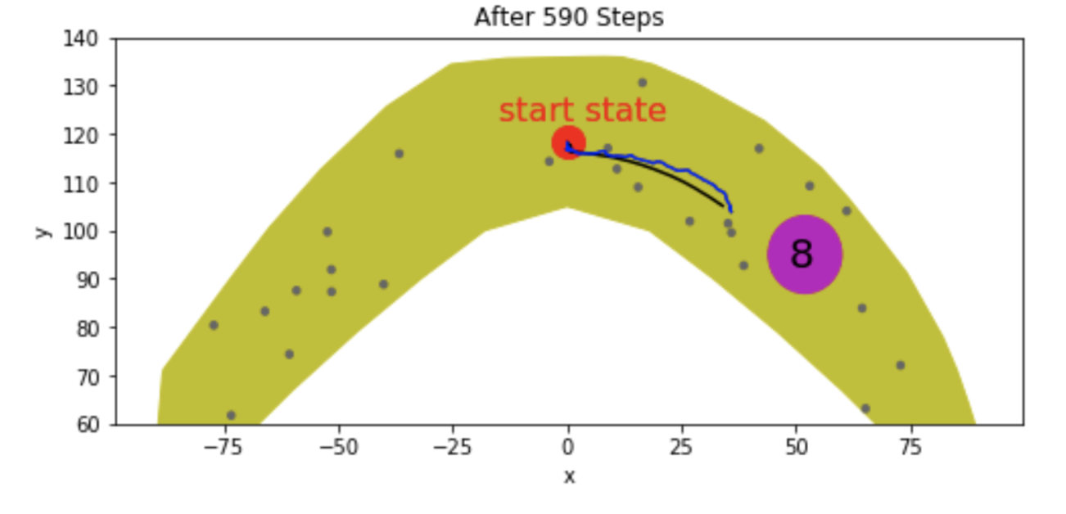
Step-by-Step Analysis

Slide 13
Discussion
Model is not accurate enough in some cases
Possible cases might be:
After many trivial steps are executed, such as 400 steps of (1, 1) only leading to a very small progress, the model became inaccurate. (Raw data has never such cases, like 400 steps of (1,1) pushing gripper to move downside. So, the NN model never learned such cases)
Because load prediction is always not as good as trajectory prediction, so when the values of load matter much, the trajectory prediction, based on the inaccurate load, would be bad. 400 steps of (1, 1) would lead to a relatively high load, which might influence the trajectory prediction afterwards, to a great extent.
Maybe predictions for steps, (1,1) or (-1,-1), themselves are not accurate enough, although predictions for (1,0),(1,-1),(0,1),(-1,1) are every good.

