Slide 1
Meeting 03/26/2020
Shuo Zhang

Slide 2
Progress
Real Data:
Retrained 12 hyperparameter combinations without data d) and e)
Retrained 12 hyperparameter combinations without data d)
Smoothed data with many options(filter_size, remove b))
Simulation:
Read 2 paper in very details
Learned how to control simulation hand in Gazebo
Tried to collect one episode of raw data (using Andrew’s and Avishai’s code)
Predicted trajectories using data from Lance and sim_nn_node in the repo
Looked deeper into the code about ”rollout” and learned how to evaluate “finished episode success rate”, “goal reach success rate”, “mean squared error”, “planned path length” for different goals and with different planners

Slide 3
Exclude Bad Data – Without Smooth
Types of Bad Training Data
a) data of bad detection and drop?
b) data step in which position transition exceeds 1.2mm (outlier)?
c) data step in which the previous state and the next state are exactly the same?
d) data step of drastic transition at the end phase of episode (final 10 steps)?
e) data of very short episodes (less than 100 steps)?
Training Results after removing data type of d) and e):
No Obvious Improvement.

Slide 4
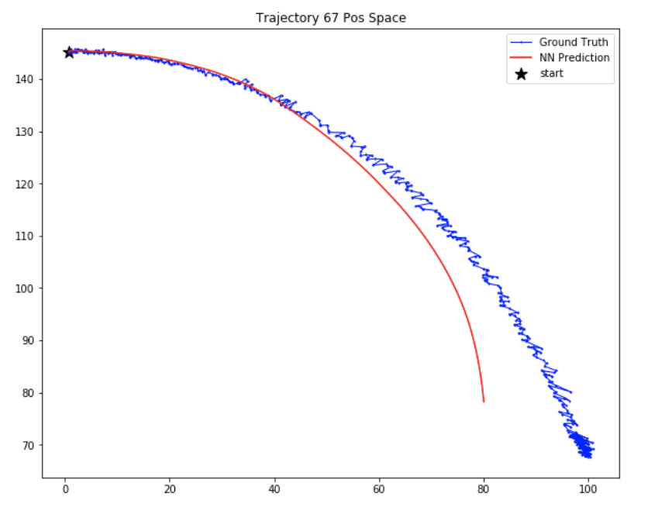
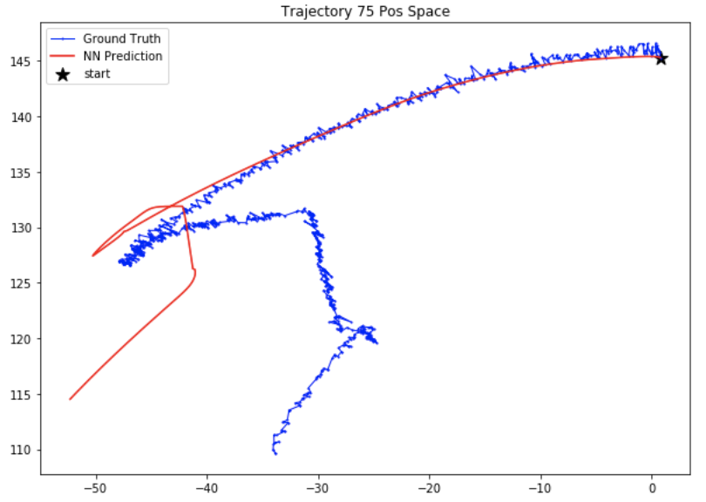
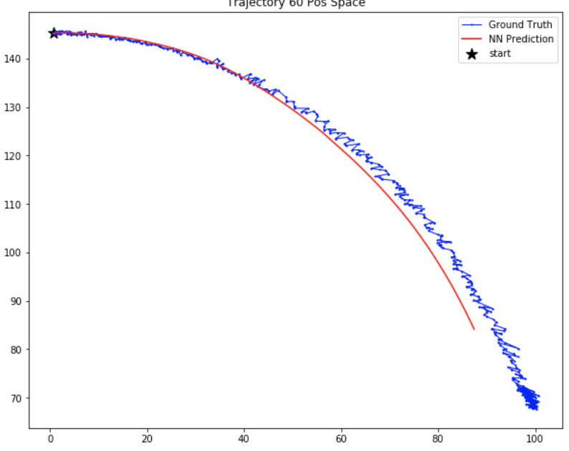
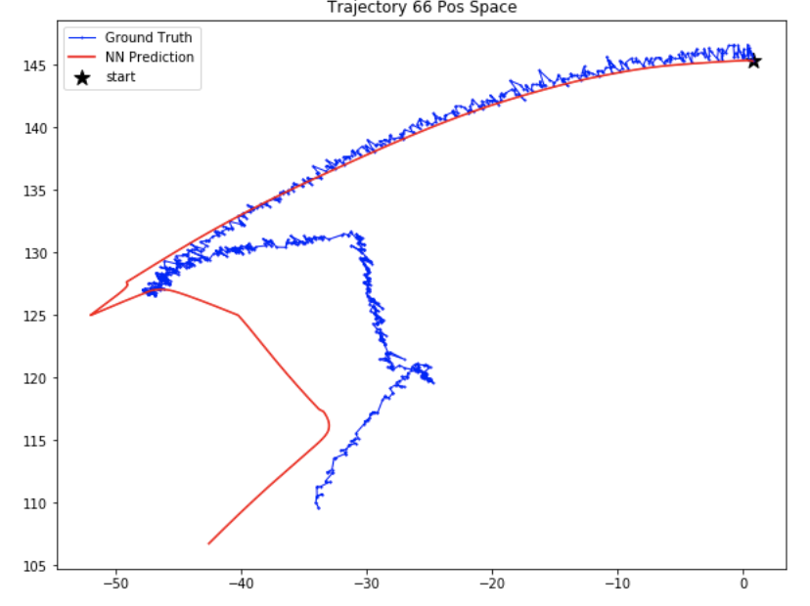
Some are better
Without Removing d) and e)
After Removing d) and e)

Slide 5
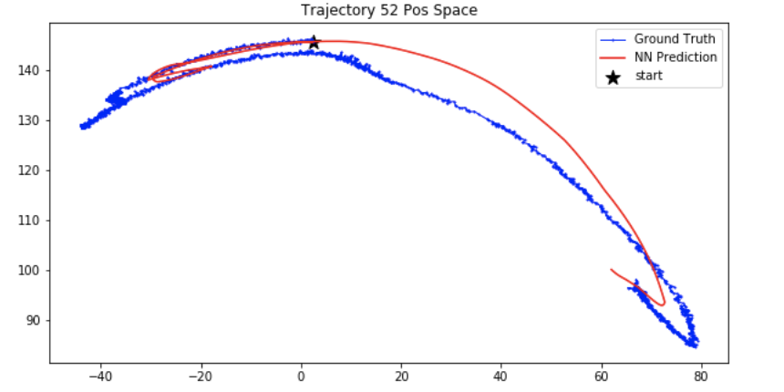
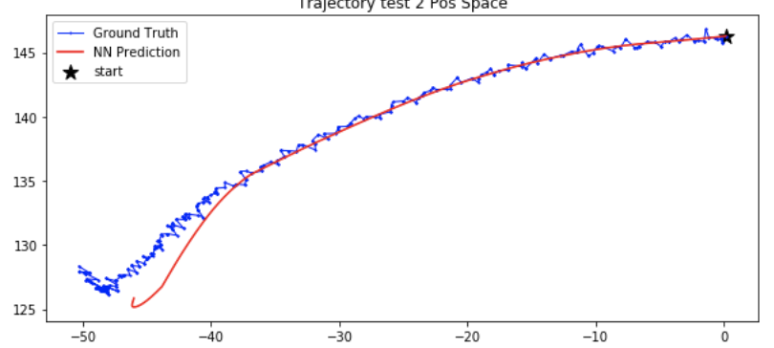
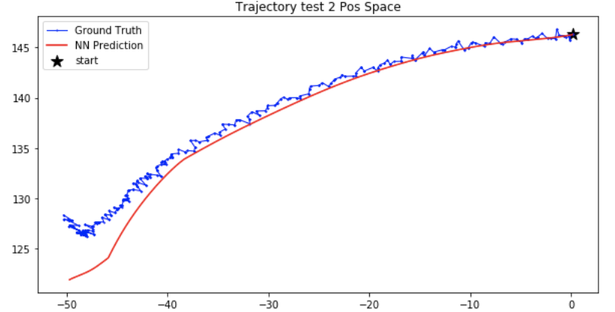
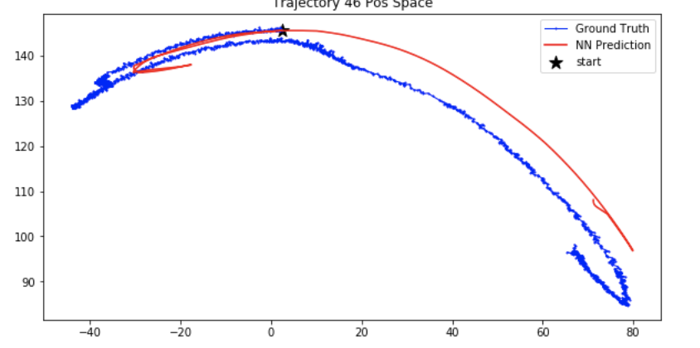
Some are worse
Without Removing d) and e)
After Removing d) and e)

Slide 6
Exclude Bad Data – Without Smooth
Types of Bad Training Data
a) data of bad detection and drop?
b) data step in which position transition exceeds 1.2mm (outlier)?
c) data step in which the previous state and the next state are exactly the same?
d) data step of drastic transition at the end phase of episode (final 10 steps)?
e) data of very short episodes (less than 100 steps)?
Training Results after only removing data type of d):
No Obvious Improvement as well. (plots not attached)
Training Results after only removing data type of e):
Not trained.
Discussion:
In case of without smoothing,
no significant improvement by removing d) and/or e).

Slide 7
With Smooth
Types of Bad Training Data
a) data of bad detection and drop?
b) data step in which position transition exceeds 1.2mm (outlier)?
c) data step in which the previous state and the next state are exactly the same?
d) data step of drastic transition at the end phase of episode (final 10 steps)?
e) data of very short episodes (less than 100 steps)?
Smoothing with following Options:
1) Window size: [4,6,8,10,14,20,40]
2) Recalibrate or Not
3) Smooth Initial State or Not
4) Remove data d) or Not
5) Remove data e) or Not
6) Remove data b) or Not (Discussion: Before smooth, all outlier data b) , about 4%, already been removed. However after smooth, 0.005% of smoothed data are still type b))
7) Remove data c) or Not (Discussion: even after smooth, 1% of smoothed data are type c))

Slide 8
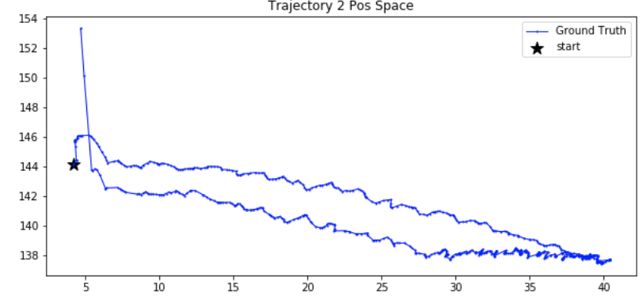
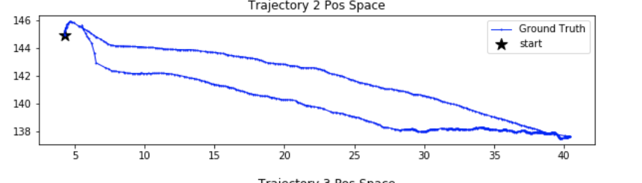
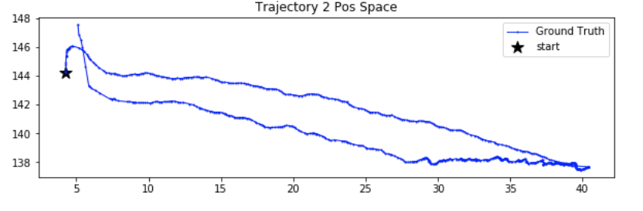
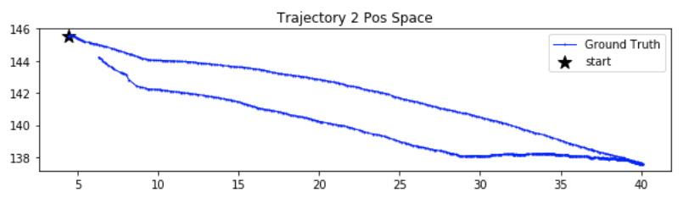
Smoothed Data (not yet trained) (1)
Window 4
Window 20
Window 10
Window 40

Slide 9
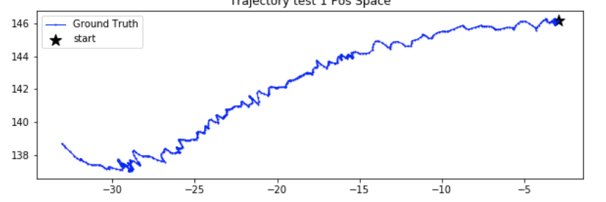
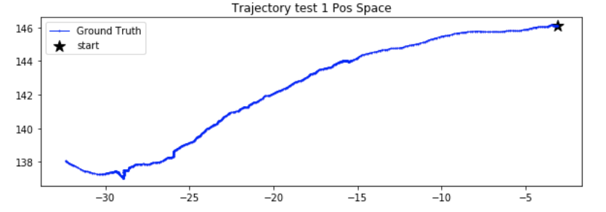
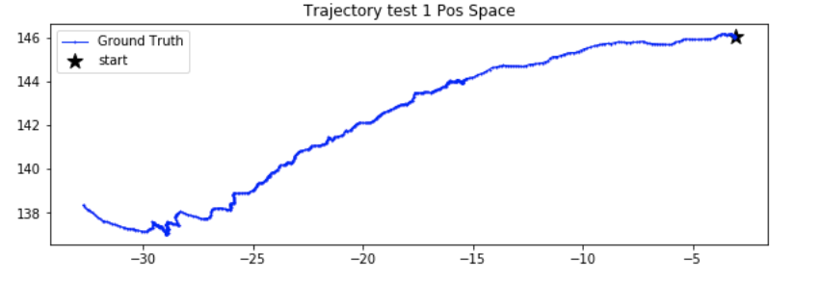
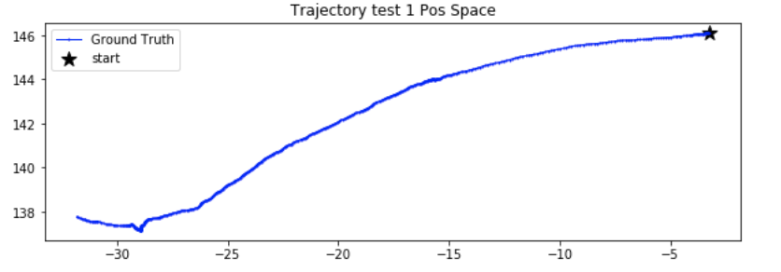
Smoothed Data (not yet trained) (2)
Window 4
Window 20
Window 10
Window 40

Slide 10
Progress
Real Data:
Retrained 12 hyperparameter combinations without data d) and e)
Retrained 12 hyperparameter combinations without data d)
Smoothed data with many options(filter_size, remove b))
Simulation:
Read 2 paper in very details
Learned how to control simulation hand in Gazebo
Tried to collect one episode of raw data (using Andrew’s and Avishai’s code)
Predicted trajectories using data from Lance and sim_nn_node in the repo
Looked deeper into the code about ”rollout” and learned how to evaluate “finished episode success rate”, “goal reach success rate”, “mean squared error”, “planned path length” for different goals and with different planners

Slide 11
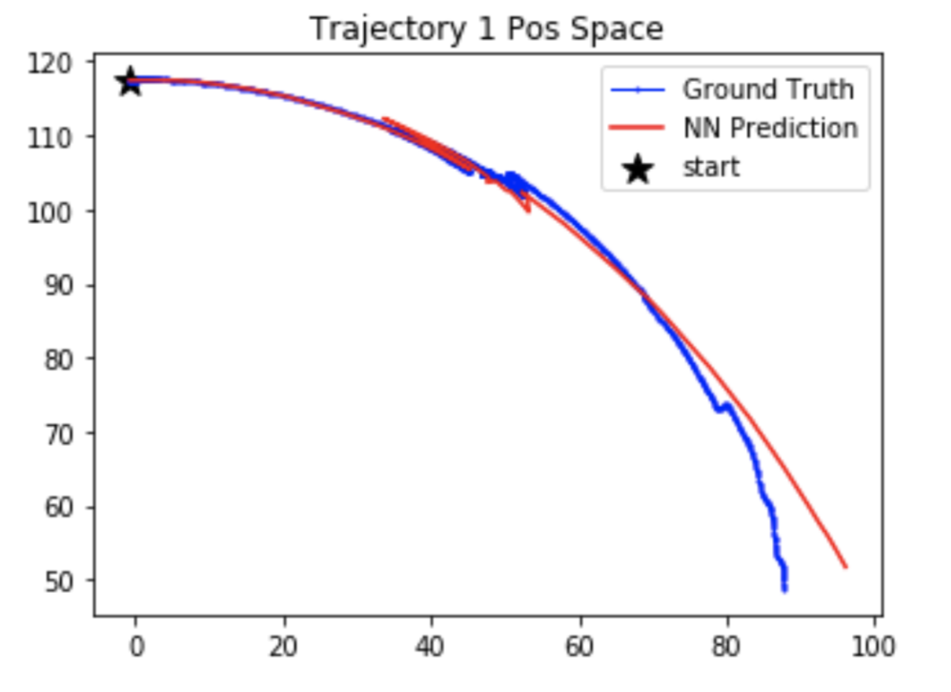
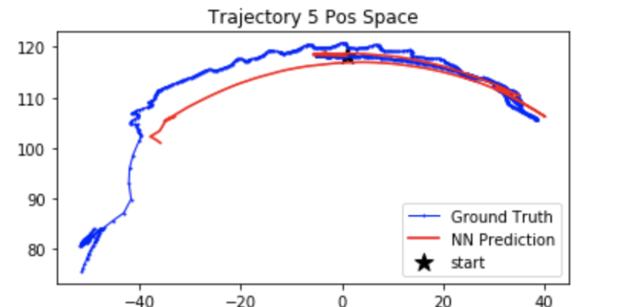
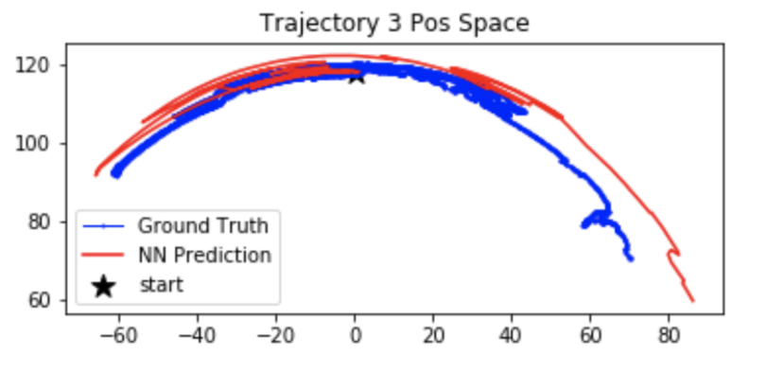
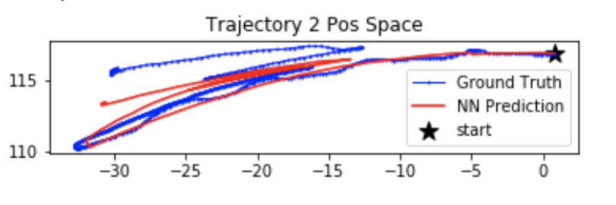
Trajectory Predictions (Continuous Actions)

Slide 12
Next Plans and Questions
Simulation(Try to finish by next meeting):
0) Look into the code about “planner” (Critic, Standard, History Critic)
(Not in the Andrew’s repo, where are they?)
1) Look into the code about Critic model
(Did we get Critic model by GP or NN?)
2) Need to look into the code about SVM Model for validity check?
(For Beliefspaceplanning, we used validity constraint; but for competency-aware model,
did we also use validity constraint and success rate constraint?)
3) Confirm the whole experiment process by running a test experiment set!
(including planning + rollout)
Real Hand: (Not Urgent)
0) Training with smoothed data of different experiment hyperparameters.

