Slide 1
Meeting 04/14/2020
Shuo Zhang

Slide 2
Astar Planner I used
Is based on the learned stochastic Neural Network model
Has a check if the state is valid based on
If the location is in the range of valid locations
If both loads are greater than 1
If the location would collide with any of obstacles
Has an option whether one step of action or 10 steps of the same action are used to predict next states
Uses discretized 8 actions to expand nodes: [[1,-1],[-1,1],[1,1],[-1,-1],[1,0],[0,1],[-1,0],[0,-1]]
Uses the distance to the goal location as cost function(heuristic), while using “distance to the goal location + length of path so far” as cost function can not give us a planned path within a reasonable time

Slide 3
Summary of Limitations
The planned path is not the shortest path due to the cost function
If the scene is difficult enough (obstacle radius is large enough), the planner can not give us a path within a reasonable time. (Might also due to the cost function)

Slide 4
Summary of Limitations
The planned path is not the shortest path due to the cost function

Slide 5
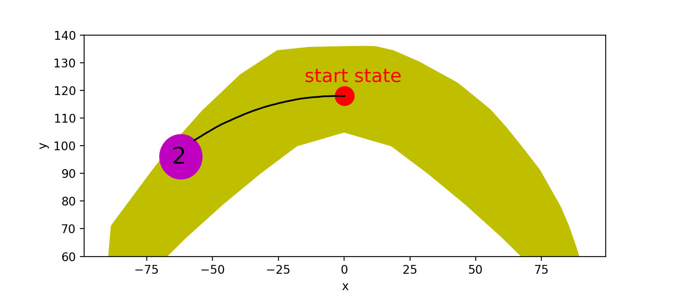
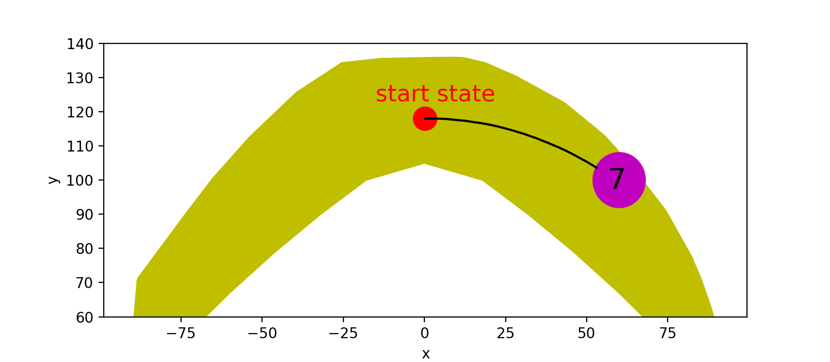
Good Cases without Obstacles

Slide 6
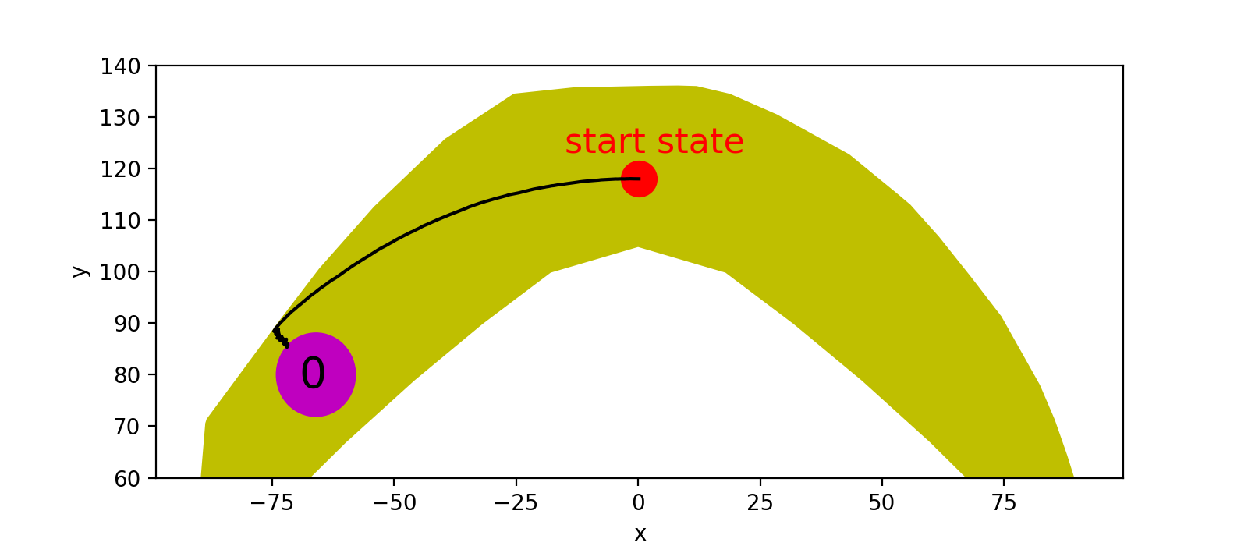
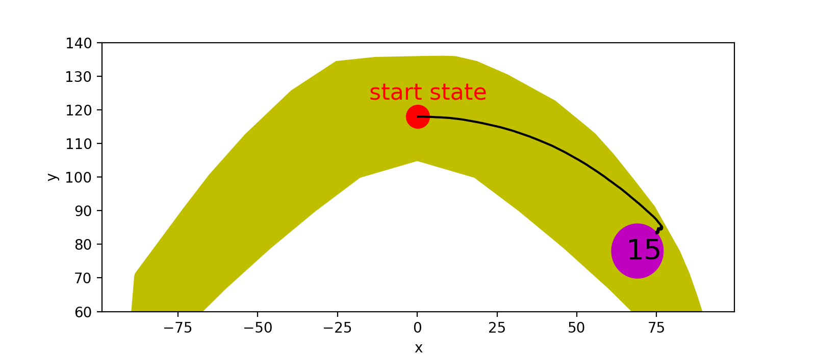
Bad Cases without Obstacles (due to the cost function, not shortest path)

Slide 7
Summary of Limitations
The planned path is not the shortest path due to the cost function
If the scene is difficult enough (obstacle radius is large enough), the planner can not give us a path within a reasonable time. (Might also due to the cost function)

Slide 8
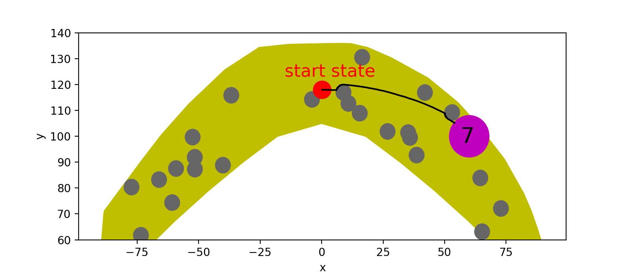
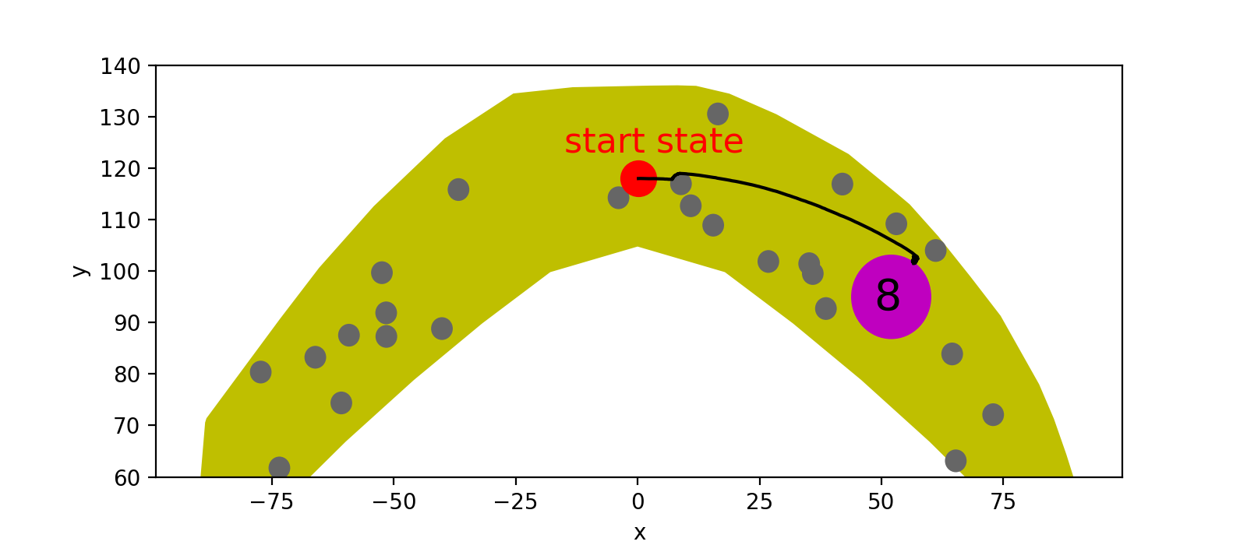
Good Cases with Obstacles
obstacle radius is 3
obstacle radius is 2

Slide 9
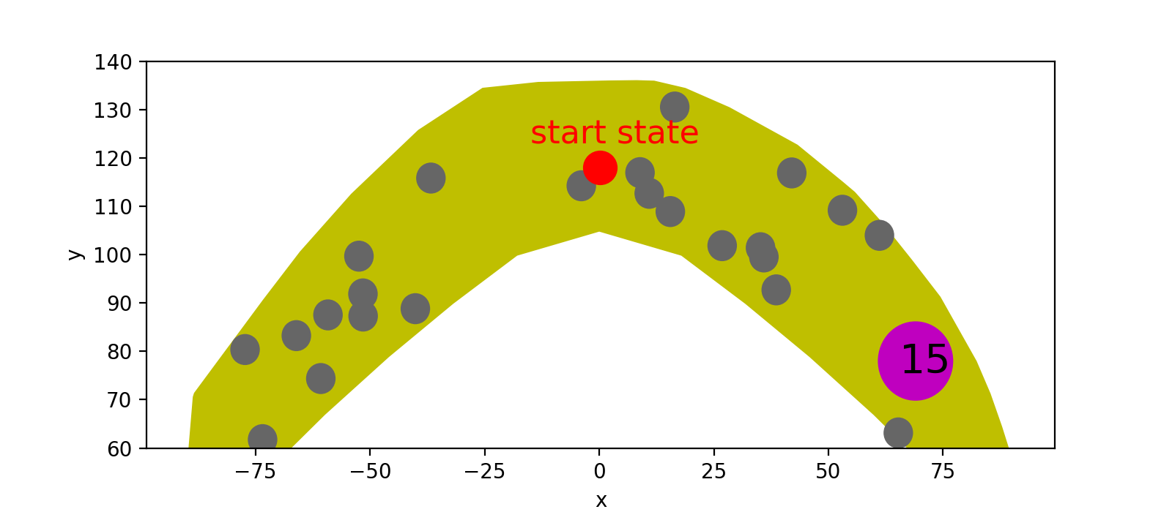
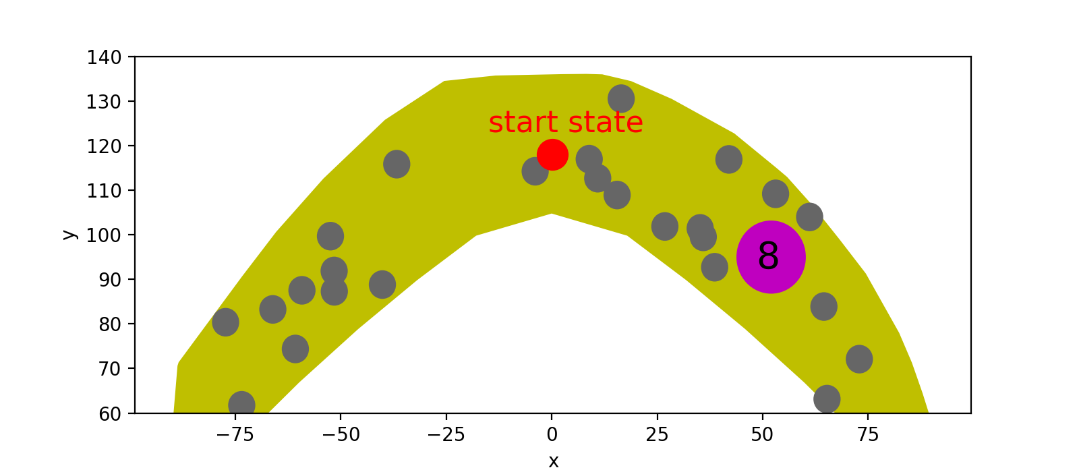
Bad Cases with Obstacles (no path planned within 10 mins, if the scene is difficult (obstacle radius is 3))

Slide 10
Questions and Discussions
The planned path is not the shortest path due to the cost function.
--How should we deal with this?
If the scene is difficult enough (obstacle radius is large enough), the planner can not give us a path within a reasonable time. (Might also due to the cost function)
--How should we deal with this?

Slide 11
Update of Today
The planned path is not the shortest path due to the cost function.
--How should we deal with this?
Solved! (using multiple steps (num_steps=100) and
“distance to the goal location + length of path so far” as
cost function)

Slide 12
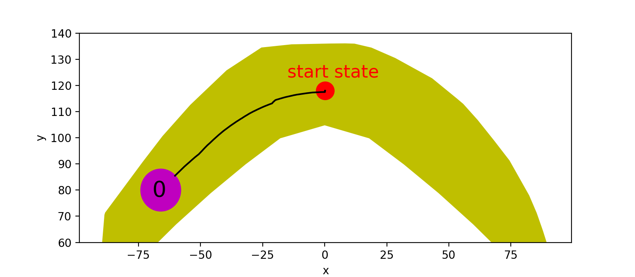
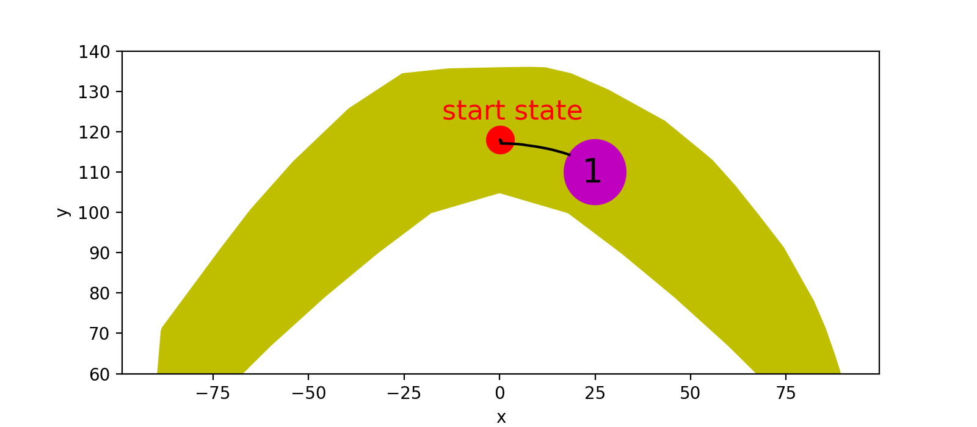
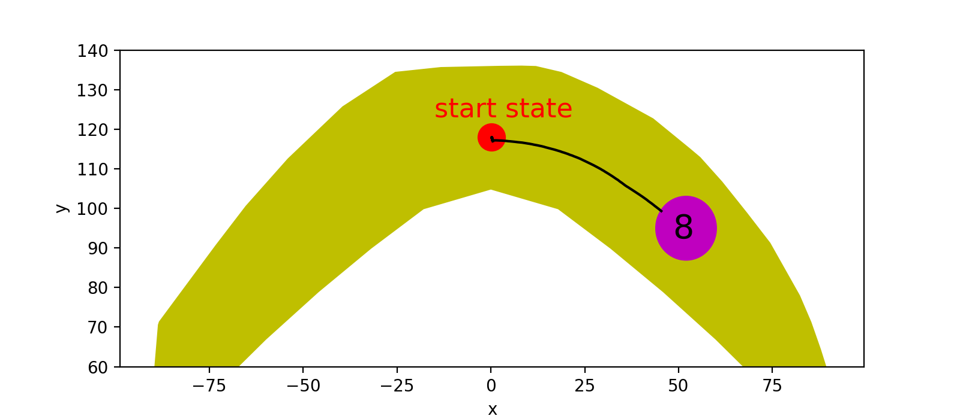
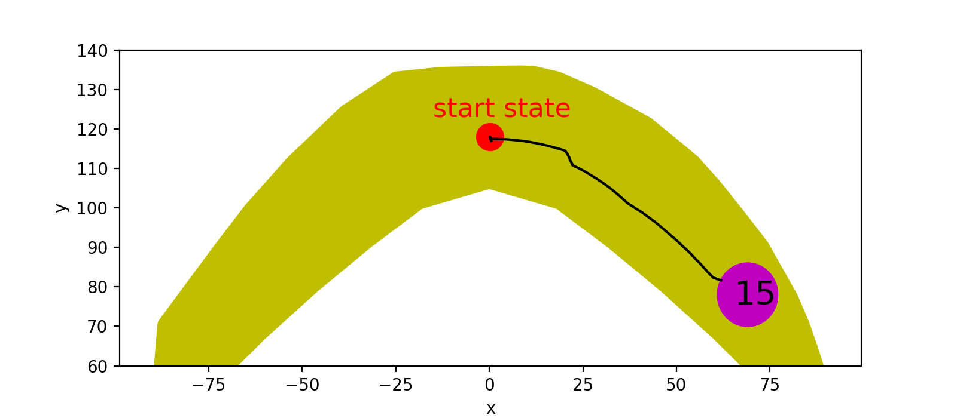

Slide 13
Update of Today
If the scene is difficult enough (obstacle radius is large enough), the planner can not give us a path within a reasonable time. (Might also due to the cost function)
--How should we deal with this?
Solved! (using multiple steps (num_steps=100) and
“distance to the goal location + length of path so far” as
cost function) (Got a path within 10 or 20 minutes)

Slide 14
