Slide 1
Meeting 08/06/2020
Shuo Zhang

Slide 2
In past week
Learn one of GPS papers:
Reacher 0.1% model: PPO training + Rollout
Gazebo Hand 0.1% model: PPO training (currently fixing an issue)
“Learning neural network policies with guided policy search under unknown dynamics”

Slide 3
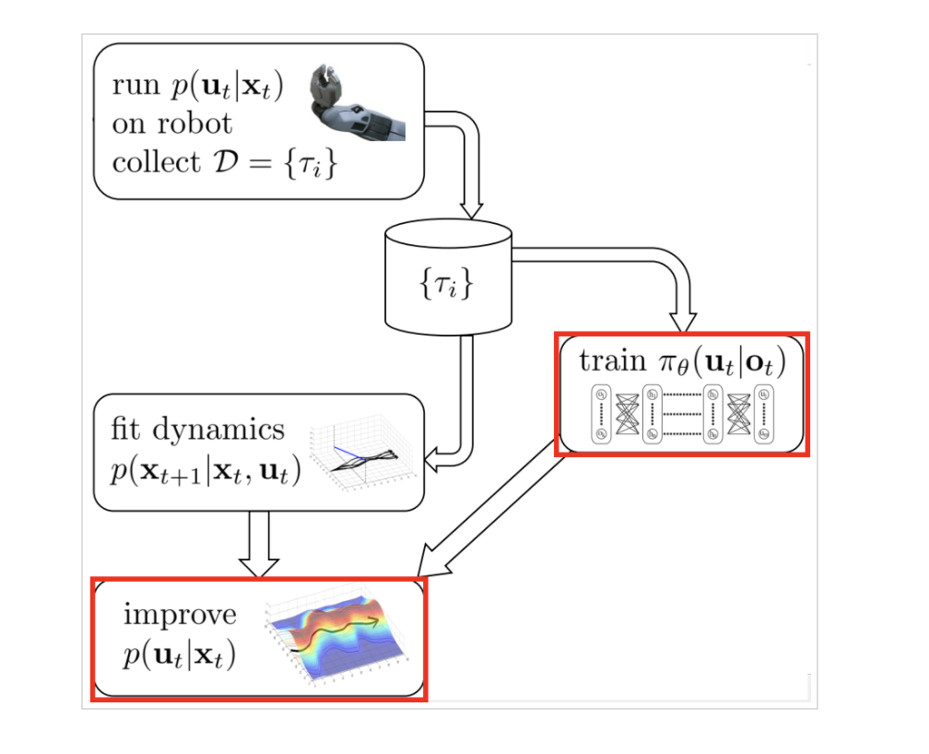
GPS Features
Time-varying dynamics model
+ Iterative data collection
+ Iterative dynamics model training
Optimization for both controller and policy
Controller: use iLQR for deterministic case (LQ-Gaussian for stochastic case ) to solve
Policy Optimization: Formulate problem to be a constrained optimization, then use Lagrange duality and Dual Gradient Descent(DGD) to train policy parameter theta

Slide 4
Reacher “Goal Reach Rate” (All Goal Locations) for PPO
Percentage of Data | Goal Location 1 | Goal Location 2 | Goal Location 5 | Average
100% (1M) | 60% | 0% | 0% | 20%
0.1% (1.6k) (100 Epochs are trained) | 0% | 0% | 0% | 0%

Slide 5
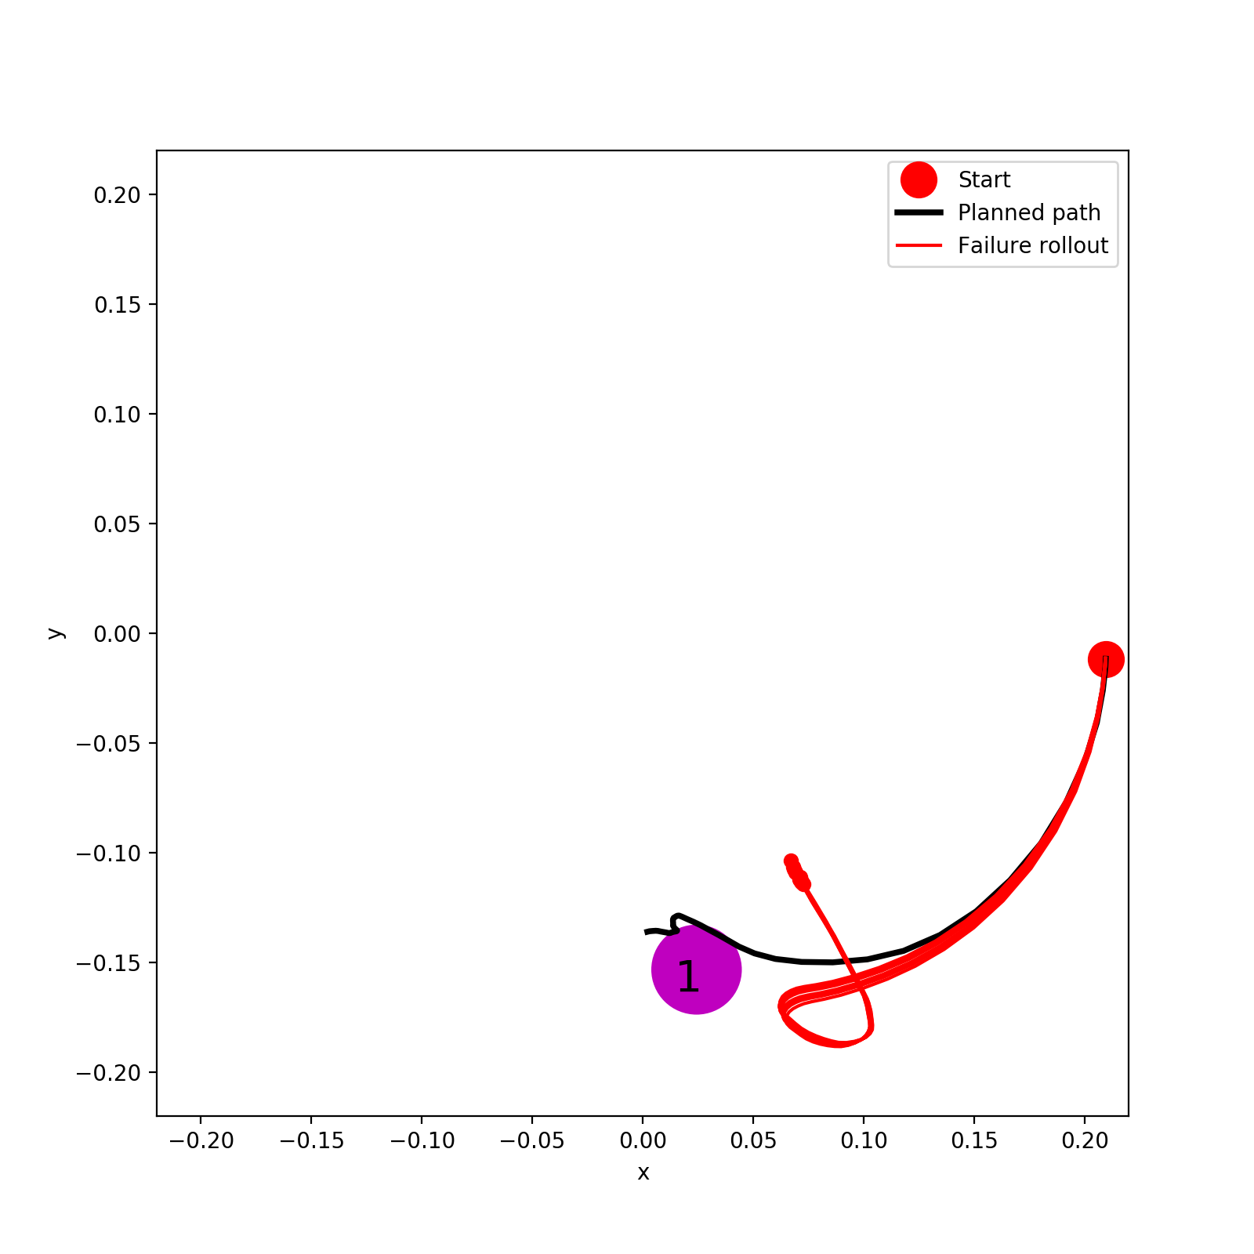
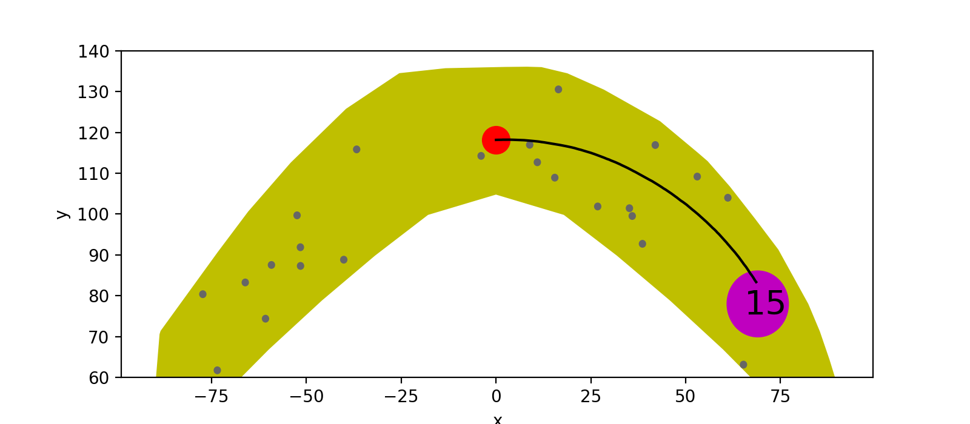
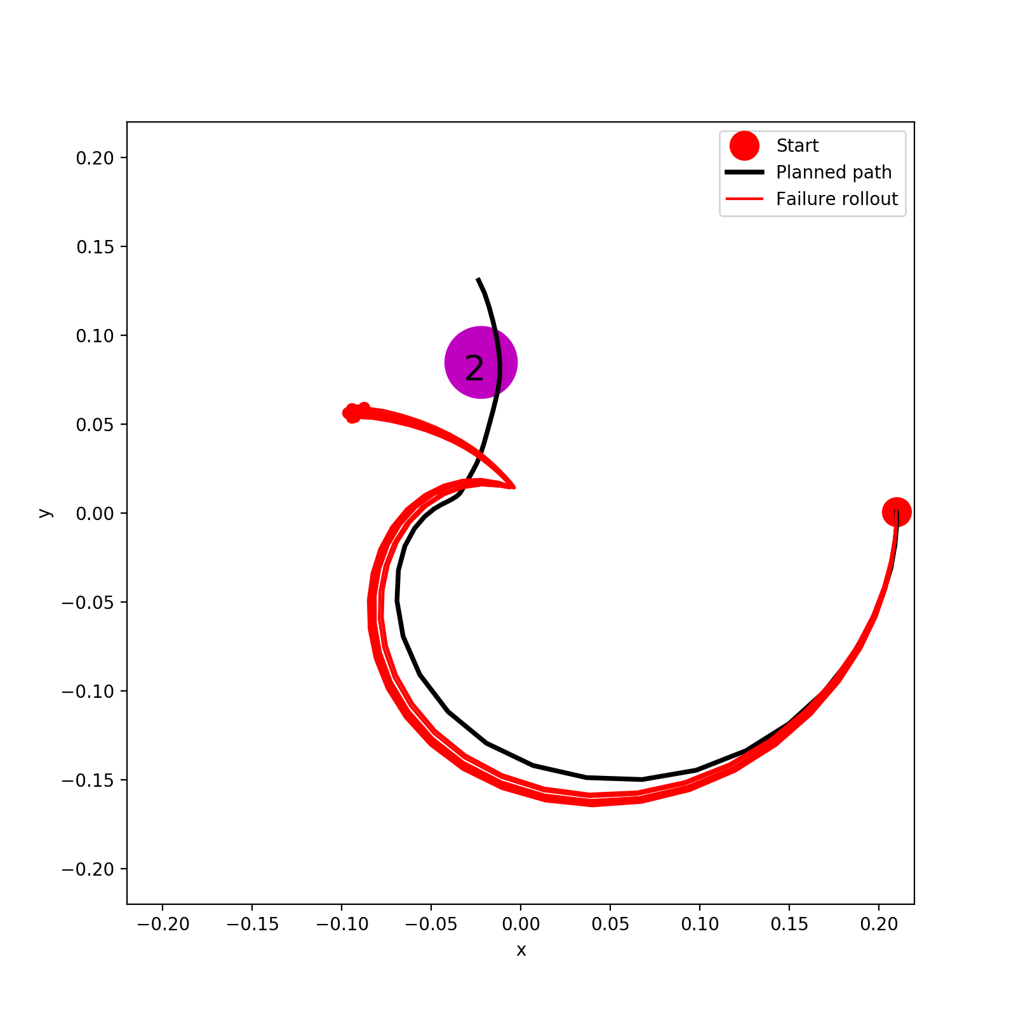
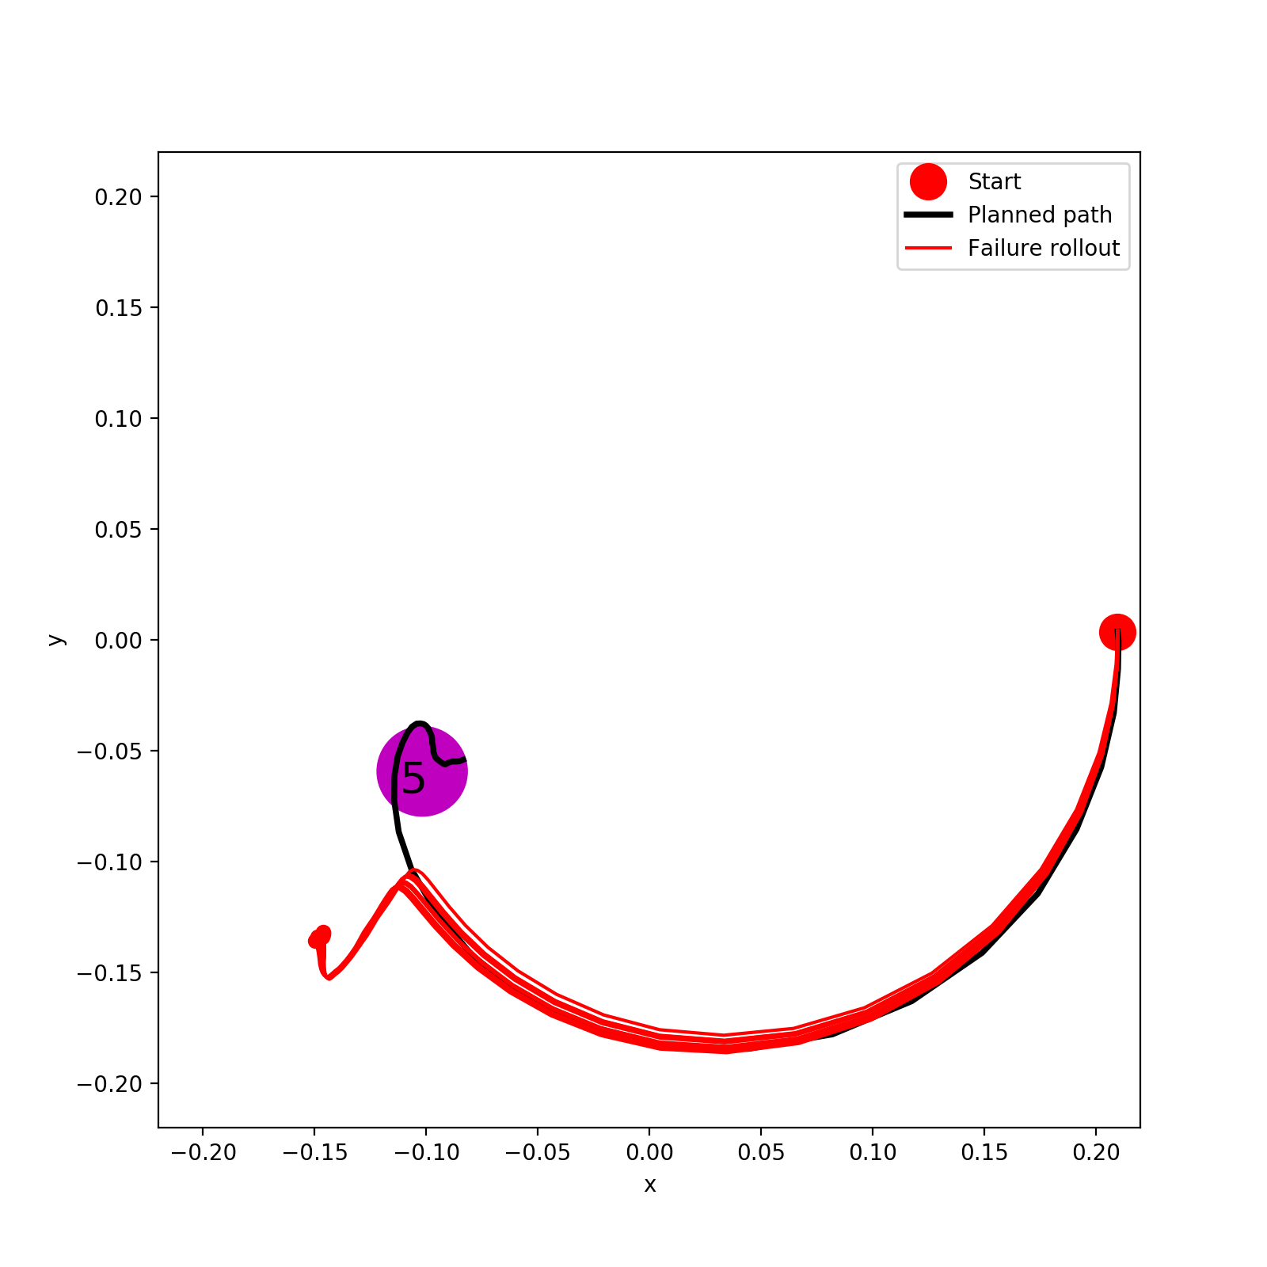
0.1% (PPO)

Slide 6
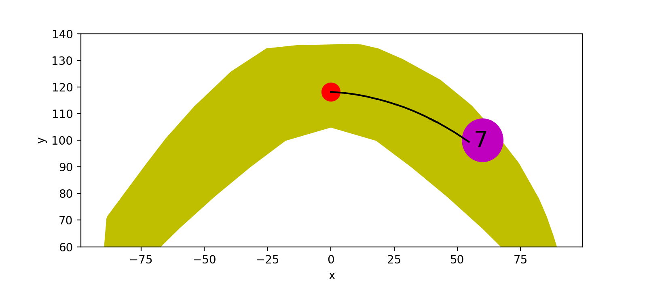
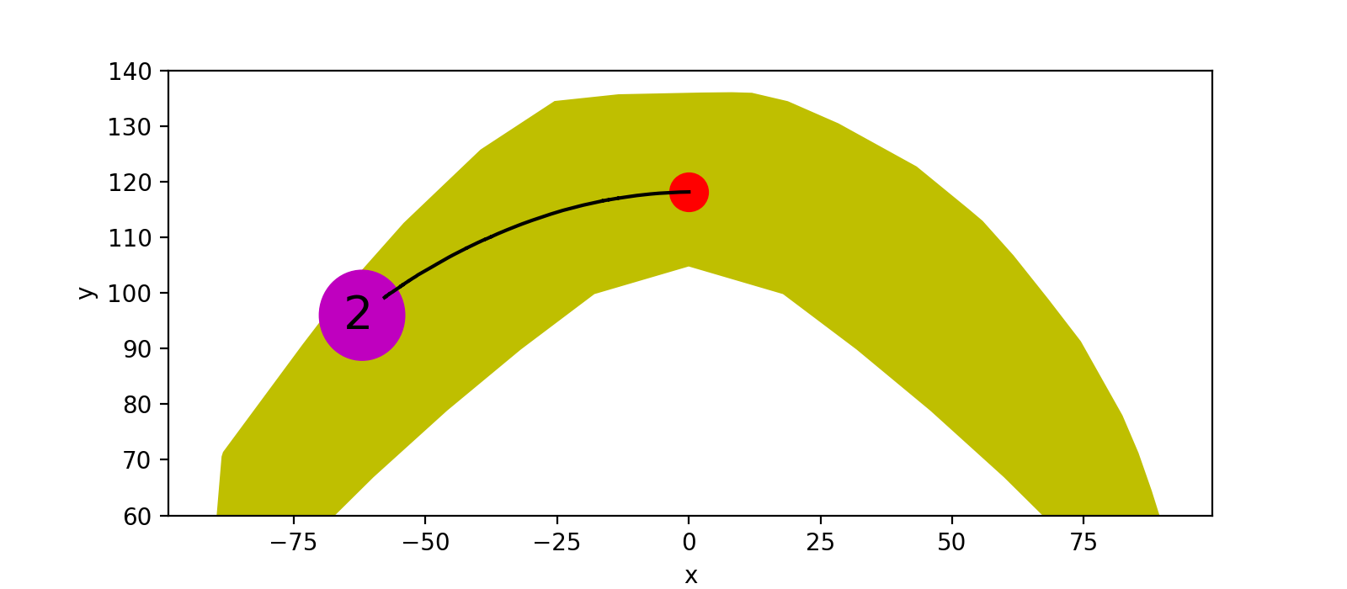
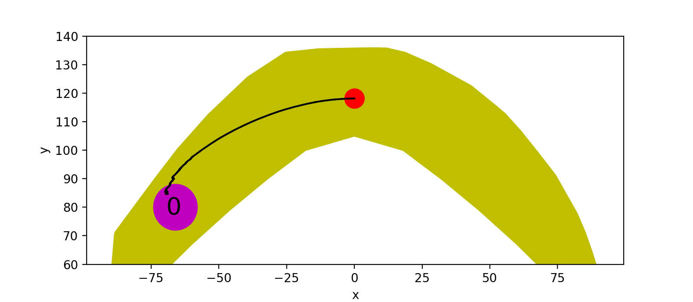
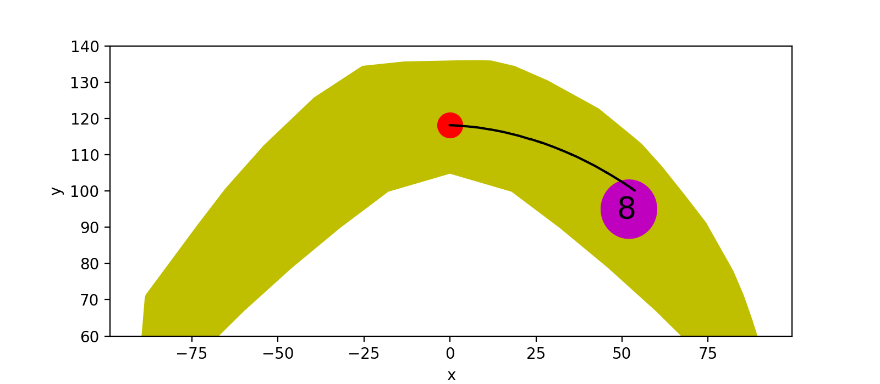
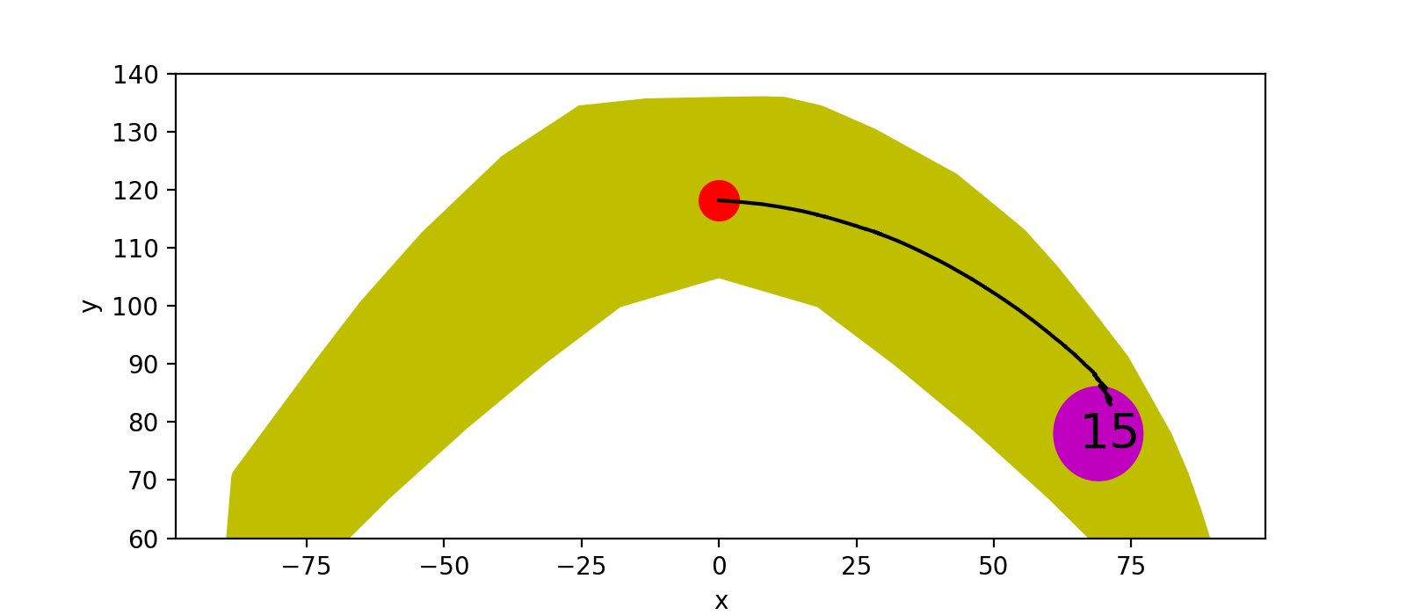
Gazebo Hand for PPO (0.1% model)
Trained general PPO model including goal locations as a part of state.
- Without obstacles all work verywell

Slide 7


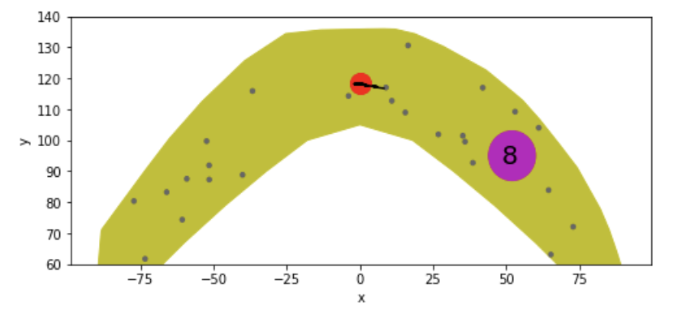

Gazebo Hand for PPO (0.1% model)
Trained general PPO model including goal locations as a part of state.
With obstacles only goal locations on the left side work well (Goal location 0 and 2), while on the right side (Goal location 15, 7 and 8) the hand either collides with obstacles or can not reach goal after 10M training steps.

Slide 8
To fix the issue
Just train a PPO for a fixed goal location (e.g. goal location 8) and see what happens
Adjust penalty value for collision with an obstacle (currently 40000)
(Maybe 40000 is too small?)
Do not end an episode when the hand collides with an obstacle

