Slide 1
Meeting 09/09/2020
Shuo Zhang

Slide 2
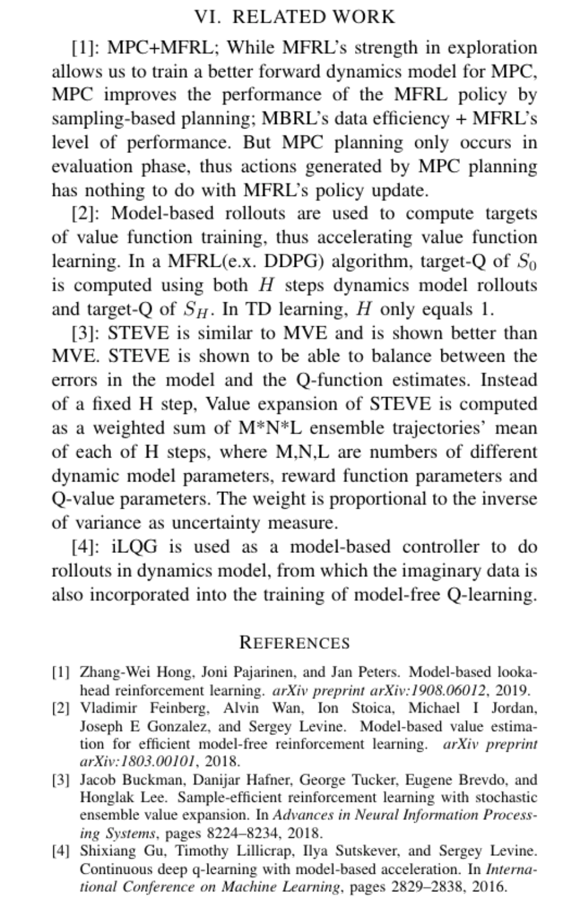

Slide 3
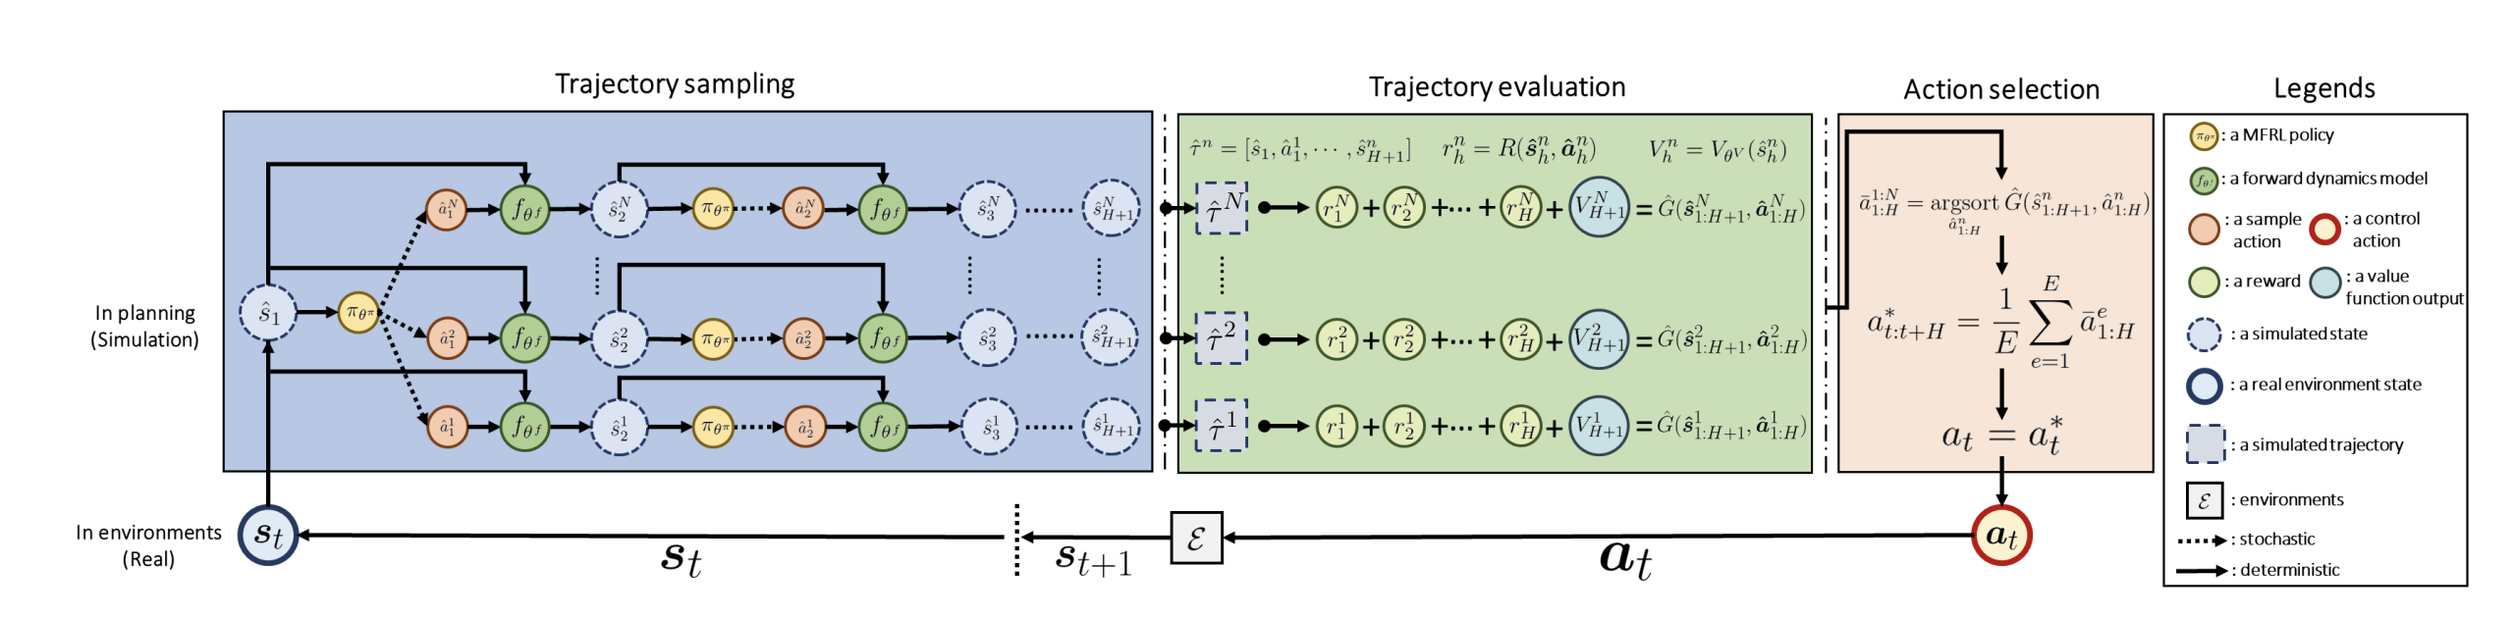
MPC-MFRL

Slide 4
MPC-MFRL (new ideas?)
So far, MPC does not affect trpo update directly. We can try to incorporate MPC into TRPO policy update as well? (MPC not in evaluation phase, but the generated action could guide policy network’s update? (like supervised learning))
i.e. Rollouts in dynamics models could not only be considered for the target of value function, but also for the ’target’ of actions? )
Also, so far contemporary methods try to incorporate rollouts in dynamics models for the target of value function, not for the guidance of actions.

