Slide 1
Meeting 03/17/2020
Shuo Zhang

Slide 2
Exclude Bad Data
data of bad detection(tag not detected, coordinate system not parallel, …) and drop
Information coming from raw data, due to bad visual detection
Calibration Matrix Computing & Dealing with Bad Missing Data Point
Should be excluded from both Calibration Matrix Computing and Training Data
Training results until beginning of March:
learning rate: [0.01, 0.001, 0.0001]; network: [split, nonsplit]; hidden nodes: [200 ,512]

Slide 3
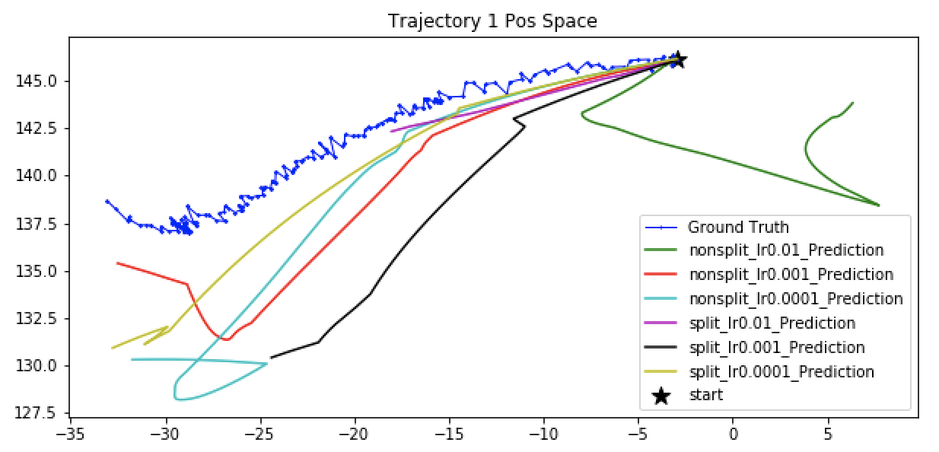
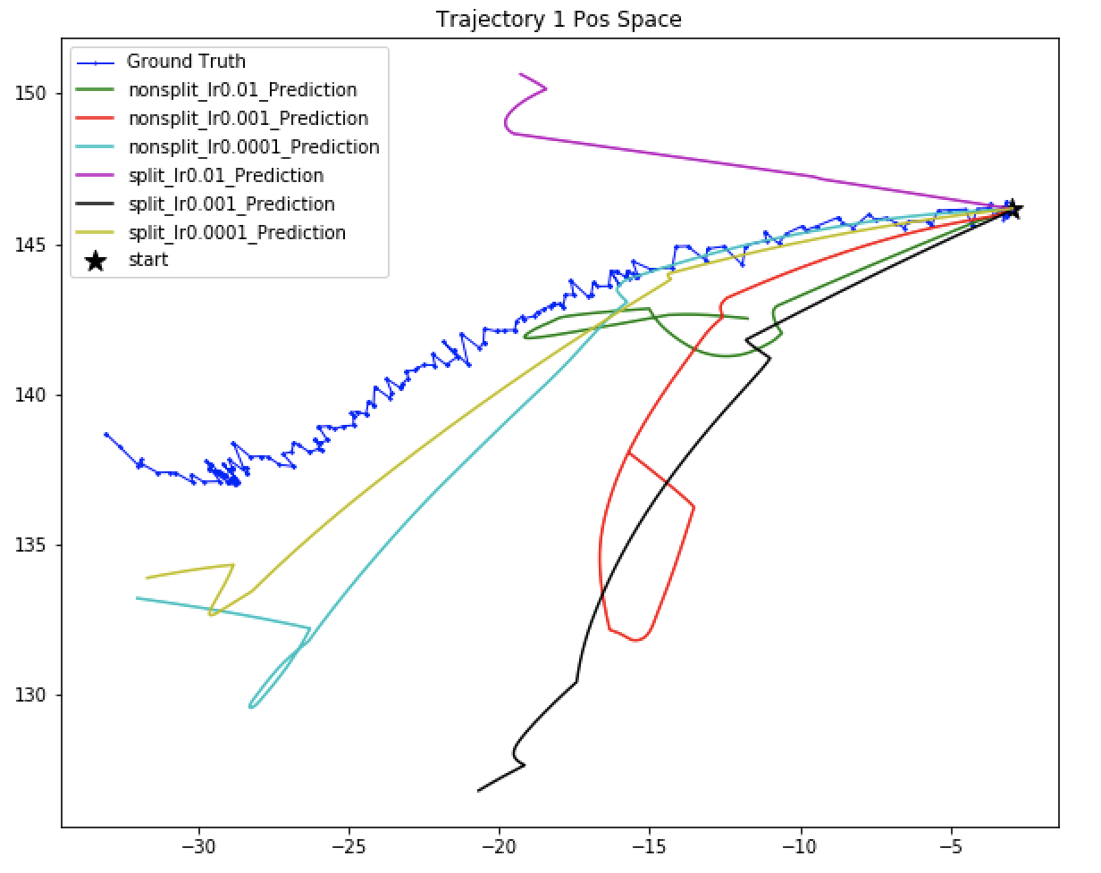
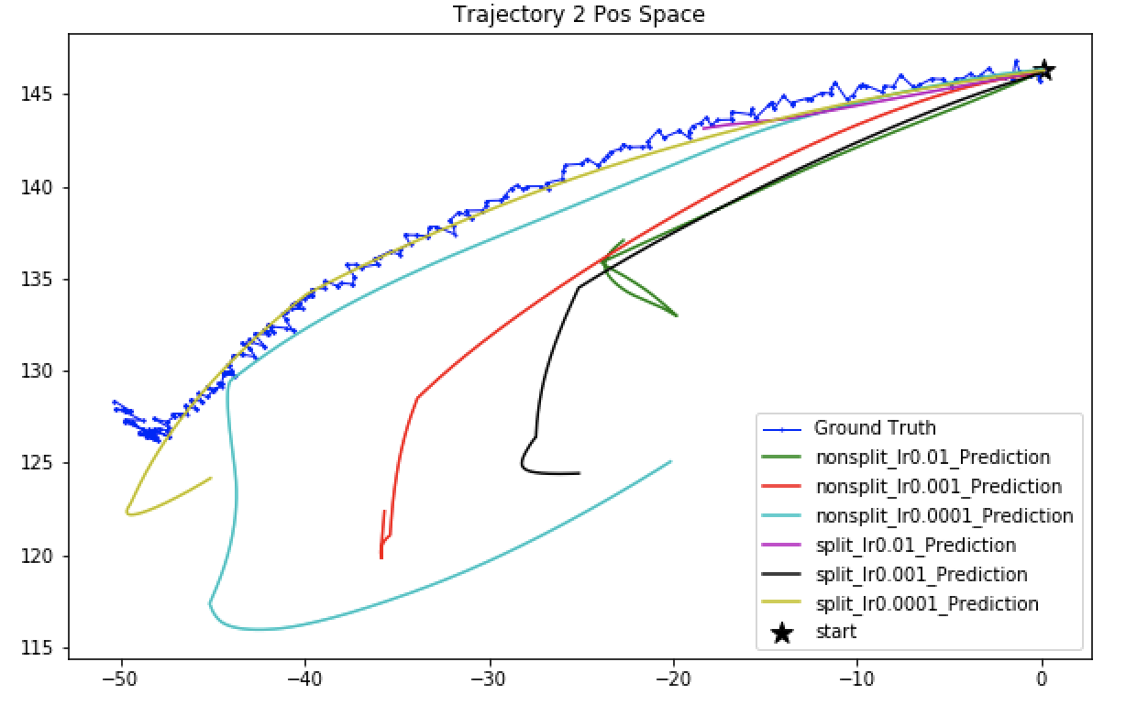
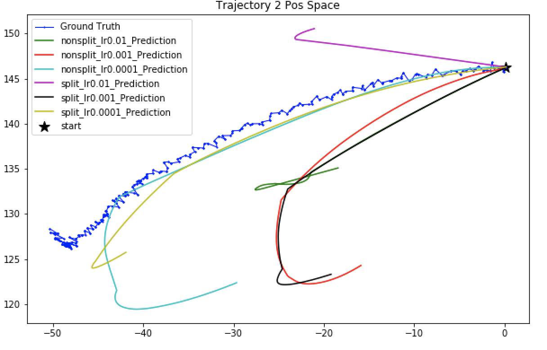
Nodes: 200
Nodes: 512

Slide 4
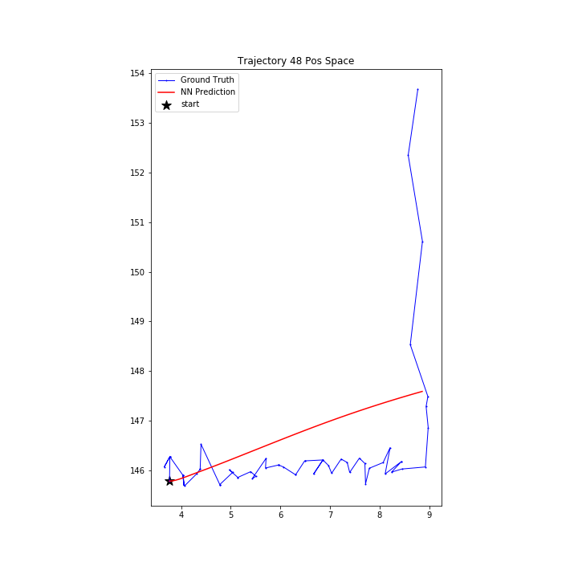
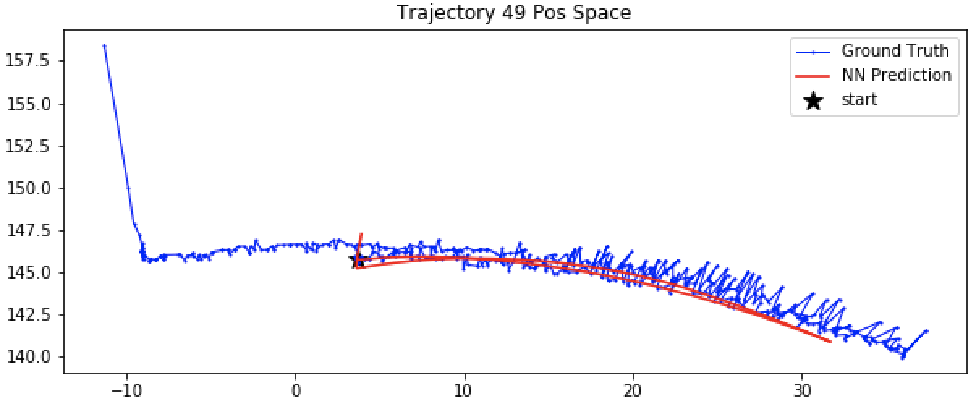
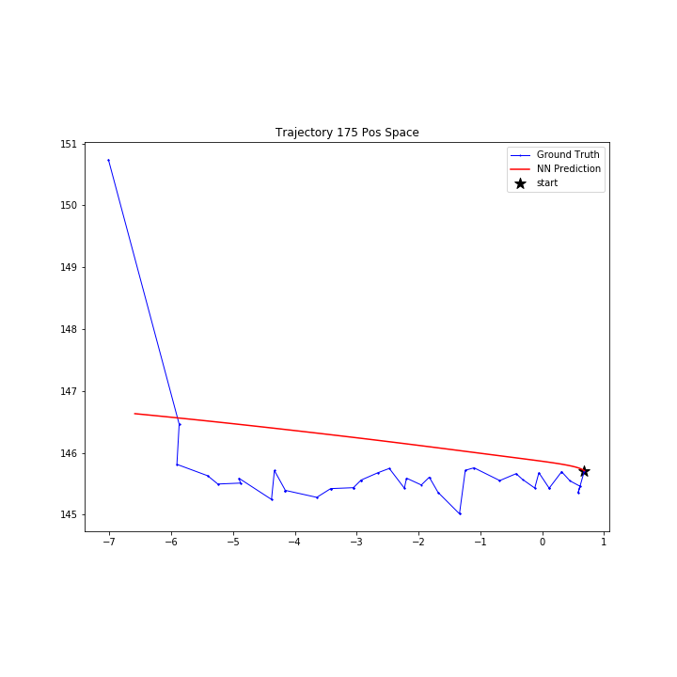
In most cases, predictions inaccurate. Data too messy!
Some train trajectories prediction with models of 200 Nodes, Learning rate 0.0001

Slide 5
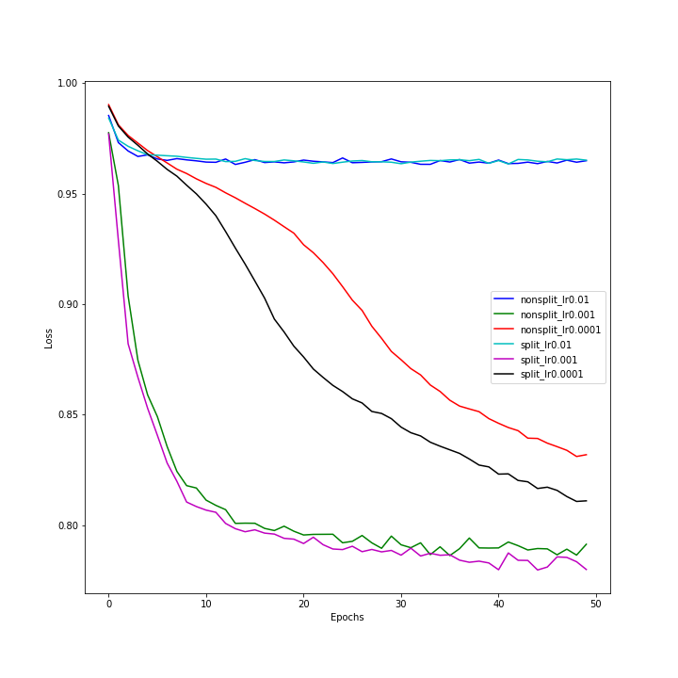
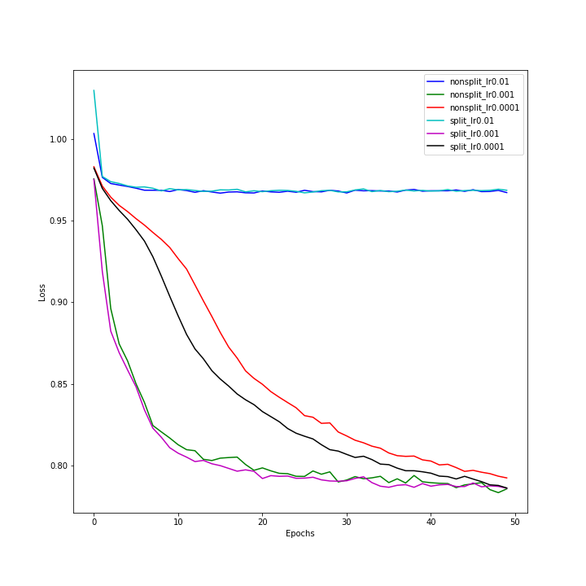
Training Error
Nodes: 200
Nodes: 512

Slide 6
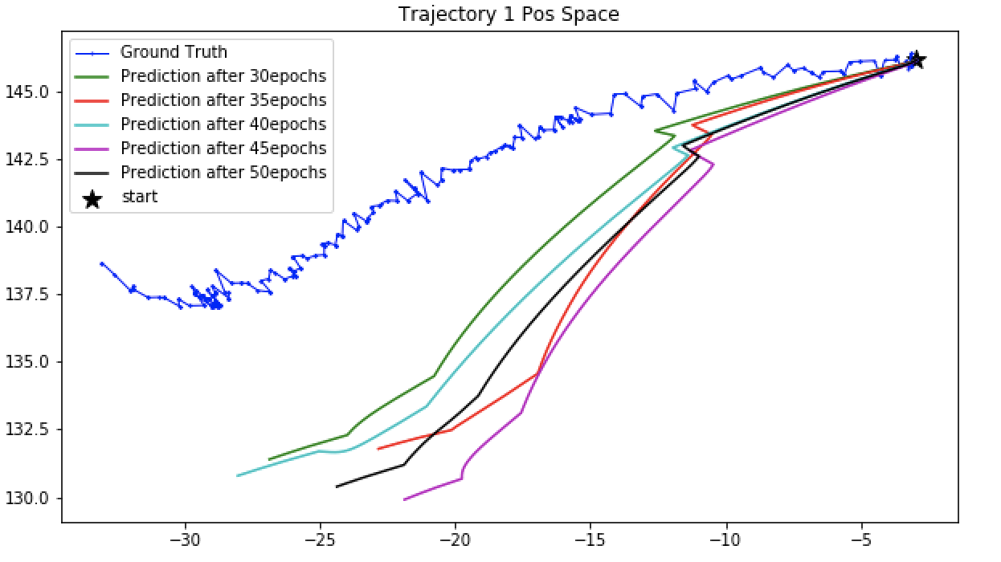
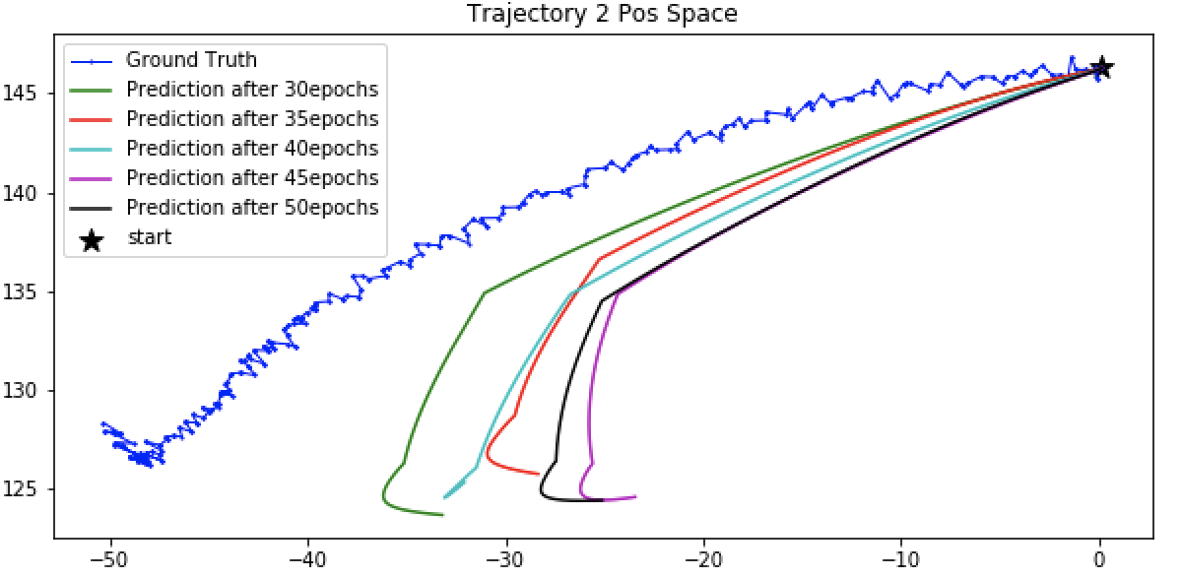
Overfit observed
Split Model, 200 Nodes, Learning rate 0.001

Slide 7
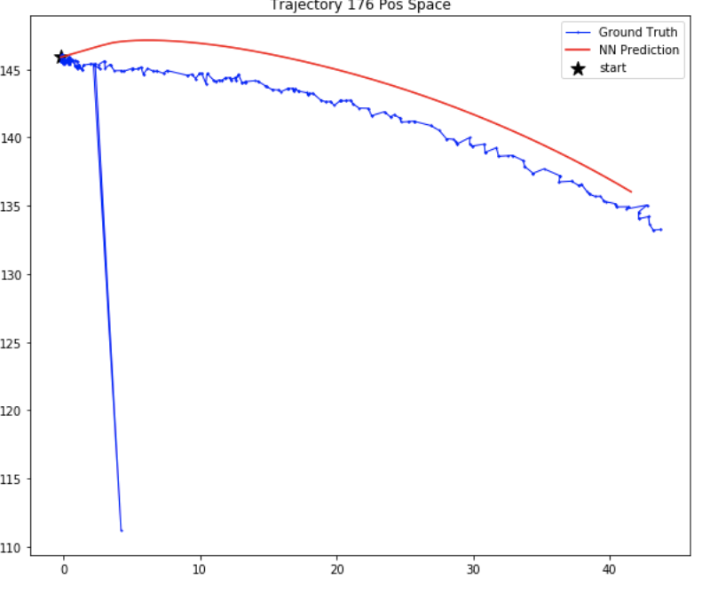
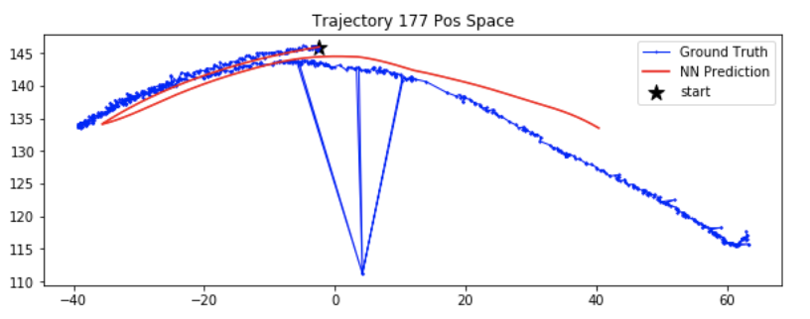
Exclude Bad Data
data of bad detection(tag not detected, coordinate system not parallel, …) and drop
data step in which position transition exceeds 1.2mm (outlier)?
Should be excluded from Training Data.
Remove such Outliers and retrain;
Training results until Last Week:
learning rate: [0.0002, 0.0001, 0.00005]; network: [split, nonsplit]; hidden nodes: [200 ,512]

Slide 8
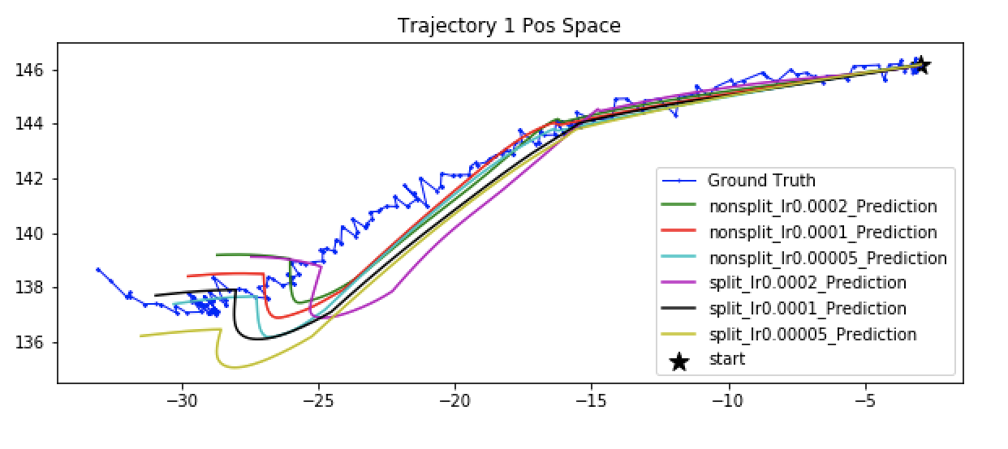
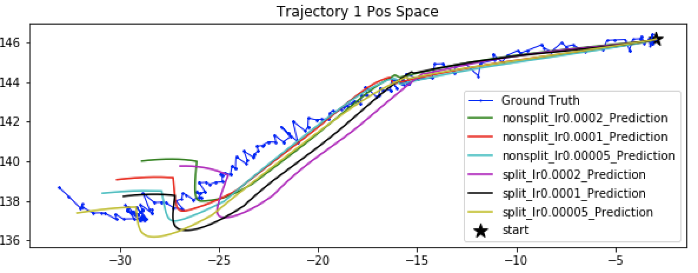
Before Filter Outlier
Nodes: 200
After Filter Outlier
Nodes: 512

Slide 9
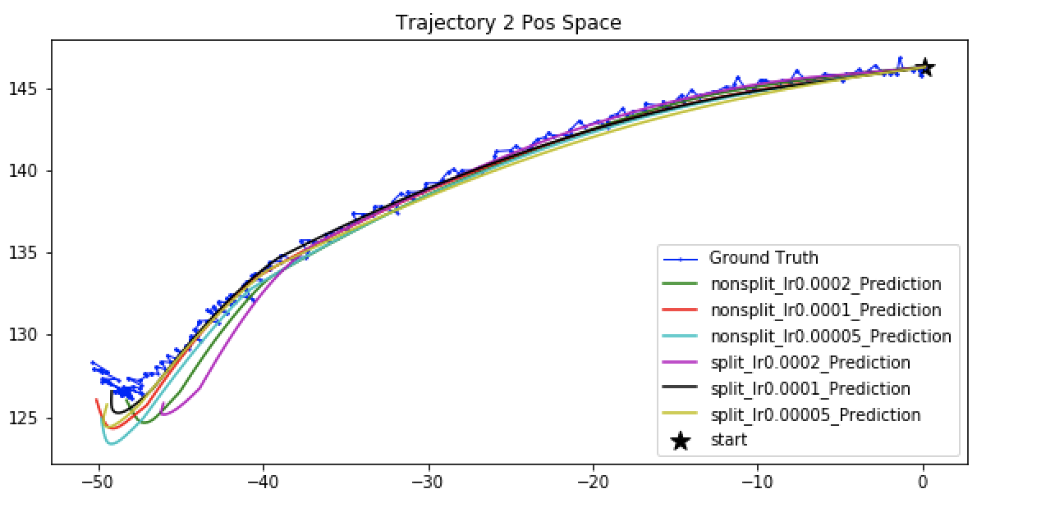
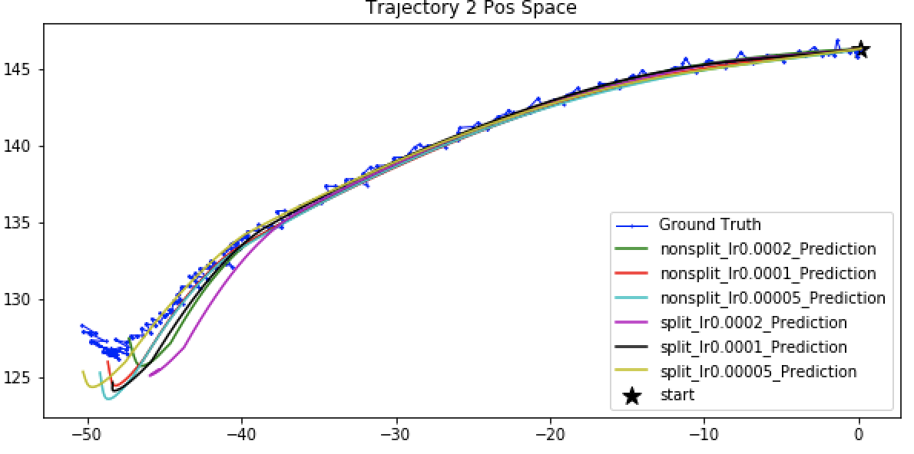
Before Filter Outlier
Nodes: 200
After Filter Outlier
Nodes: 512

Slide 10
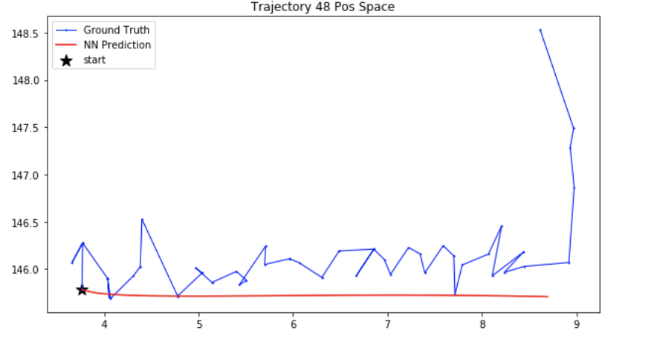
In most cases, predictions are better
Some train trajectories prediction
After Filter Outlier (200 Nodes, Learning rate 0.0001, 50 Epochs)
Before Filter Outlier(200 Nodes, Learning rate 0.0001, 50 Epochs)

Slide 11
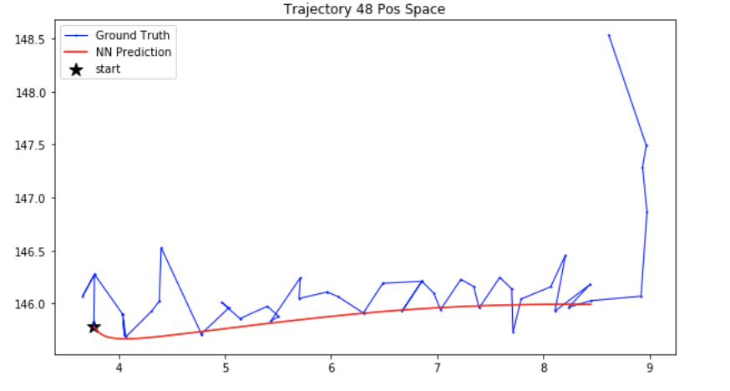
In most cases, predictions are better
Some train trajectories prediction
After Filter Outlier (200 Nodes, Learning rate 0.0002, 100 Epochs)
Before Filter Outlier(200 Nodes, Learning rate 0.0001,50 Epochs)

Slide 12
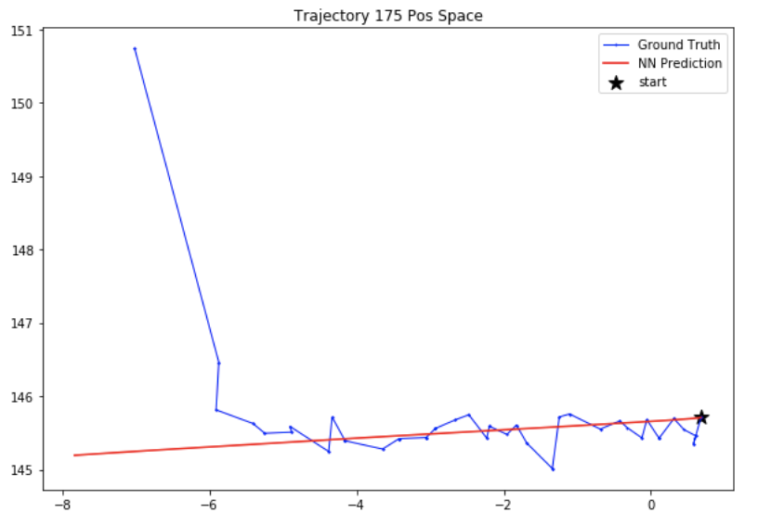
In most cases, predictions are better
Some train trajectories prediction
Before Filter Outlier(200 Nodes, Learning rate 0.0001, 50 Epochs)
After Filter Outlier (200 Nodes, Learning rate 0.0001, 50 Epochs)

Slide 13
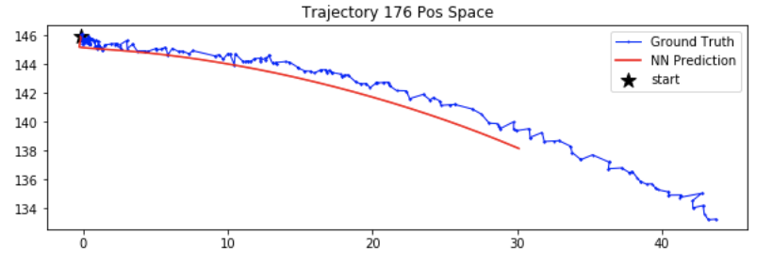
In most cases, predictions are better
Some train trajectories prediction
Before Filter Outlier(200 Nodes, Learning rate 0.0001, 50 Epochs)
After Filter Outlier (200 Nodes, Learning rate 0.0001, 50 Epochs)

Slide 14
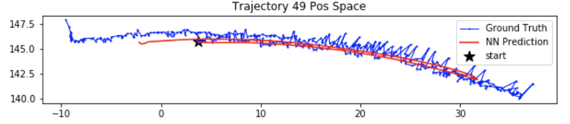
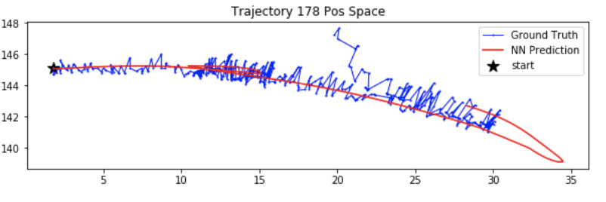
In most cases, predictions are better
Some train trajectories prediction
After Filter Outlier(200 Nodes, Learning rate 0.0002,100 Epochs)
After Filter Outlier (200 Nodes, Learning rate 0.0002, 100 Epochs)

Slide 15
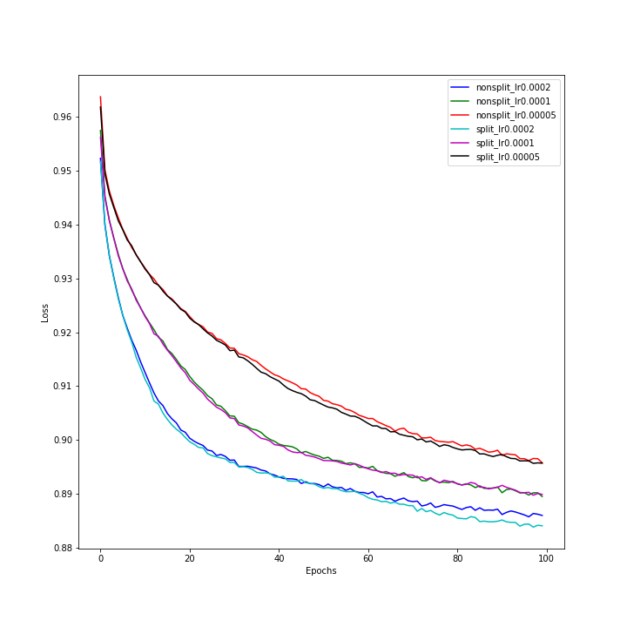
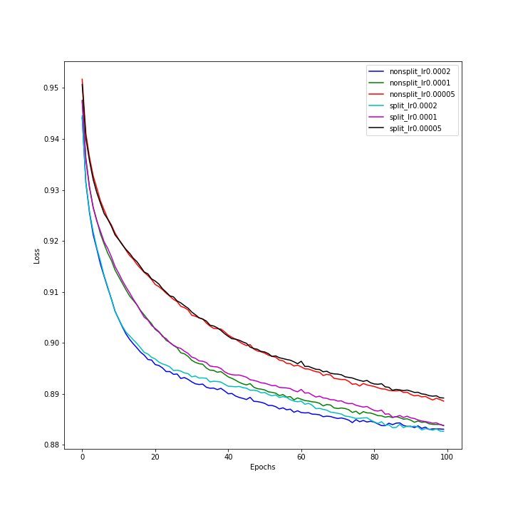
Training Error
Nodes: 200
Nodes: 512

Slide 16
Exclude Bad Data
data of bad detection(tag not detected, coordinate system not parallel, …) and drop
data step in which position transition exceeds 1.2mm (outlier)
data step in which the previous state and the next state are exactly the same
data step of drastic transition at the end phase of episode (final 10 steps)
data from very short episodes (less than 100 steps)
After Checked each training trajectory,

Slide 17
Exclude Bad Data
data of bad detection(tag not detected, coordinate system not parallel, …) and drop
data step in which position transition exceeds 1.2mm (outlier)
data step in which the previous state and the next state are exactly the same
E.g. x1 y1 LL1 RL1 → LA1 RA2 → x1 y1 LL1 RL1,
x1 y1 LL1 RL1 → LA1 RA2 → x2 y2 LL2 RL2,
……
Should not happen, since if happens, one input(state) would have 2 possible outputs (next states).
They should be excluded from training data or use smoothing(mean_filter) to deal with them.
Training results after processing c) until Today:
No smoothing at all. Excluded from training data.
learning rate: [0.0002, 0.0001, 0.00005]; network: [split, nonsplit]; hidden nodes: [200 ,512]

Slide 18
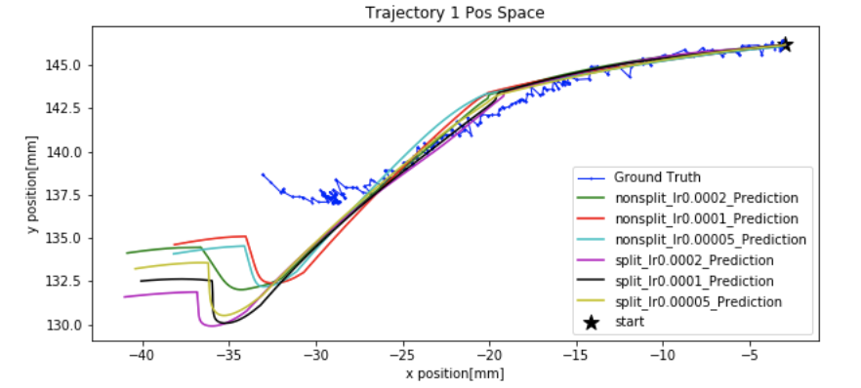
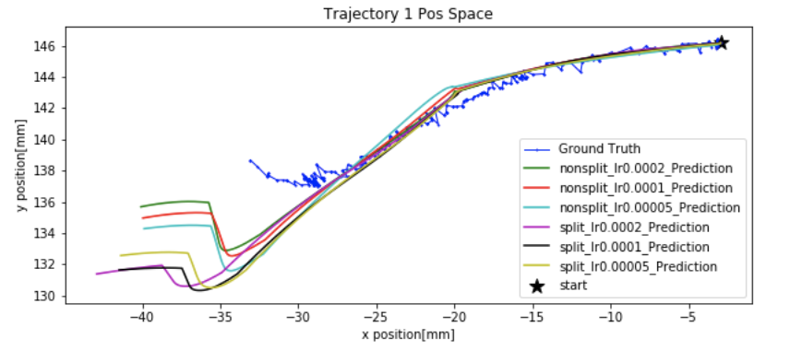
Without Removing c)
Nodes: 200
After Removing c)
Nodes: 512

Slide 19
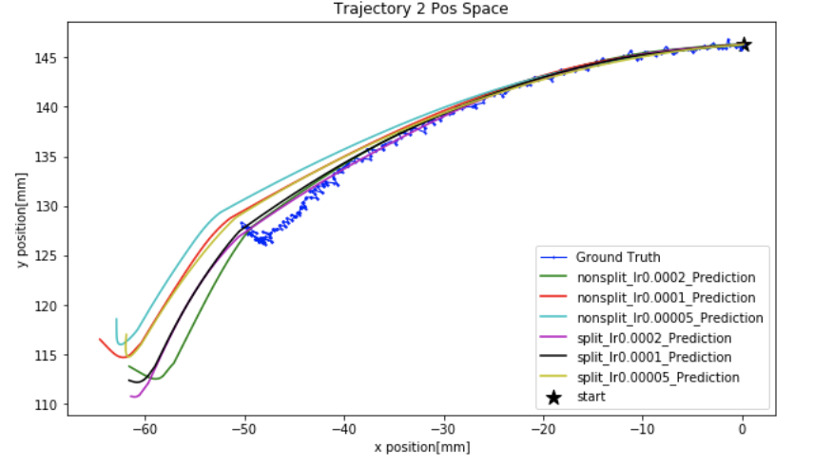
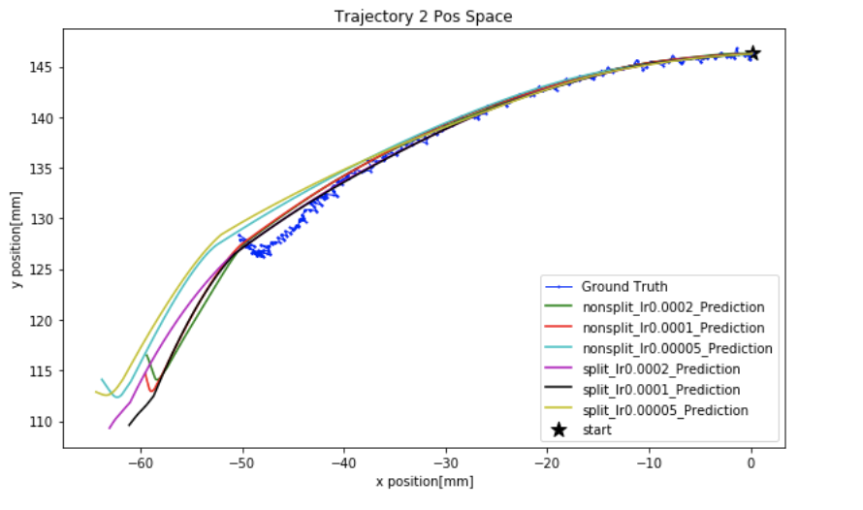
Without Removing c)
Nodes: 200
After Removing c)
Nodes: 512

Slide 20
Discussion
In other trajectories, predictions are also much longer than the ground truth. Possible because we have wrongly removed the state transition of data type c) which we shouldn’t remove.
E.g. x1 y1 LL1 RL1 → LA1 RA2 → x1 y1 LL1 RL1,
x1 y1 LL1 RL1 → LA1 RA2 → x2 y2 LL2 RL2,
……
In the example, two steps of action pairs (LA1 RA2 ) would transit x1 y1 LL1 RL1 to x2 y2 LL2 RL2 .
However, if we delete the first step, we falsely assume only one step of action pairs (LA1 RA2 ) would transit x1 y1 LL1 RL1 to x2 y2 LL2 RL2 . Thus, we got longer prediction trajectory.
To avoid this problem, Smoothing!

Slide 21
Exclude Bad Data
data of bad detection(tag not detected, coordinate system not parallel, …) and drop
data step in which position transition exceeds 1.2mm (outlier)
data step in which the previous state and the next state are exactly the same
data step of drastic transition at the end phase of episode (final 10 steps)
data from very short episodes (less than 100 steps)
After Checked each training trajectory,
Training is still running after processing d) and e)
learning rate: [0.0002, 0.0001, 0.00005]; network: [split, nonsplit]; hidden nodes: [200 ,512]

Slide 22
Exclude Bad Data
data of bad detection(tag not detected, coordinate system not parallel, …) and drop
data step in which position transition exceeds 1.2mm (outlier)
data step in which the previous state and the next state are exactly the same
data step of drastic transition at the end phase of episode (final 10 steps)
Happened, possibly due to unstable transition and visual detection at the end of an episode, though the visual detection worked well and did not detect drop.
Discussion:
Should be excluded from training data?
Current training: excluded

Slide 23
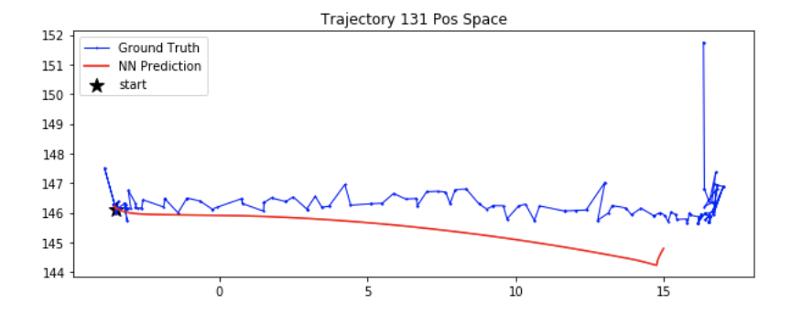
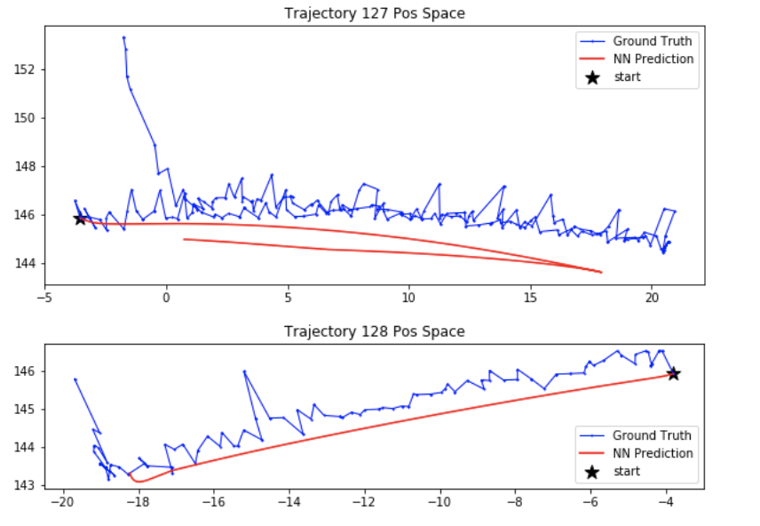
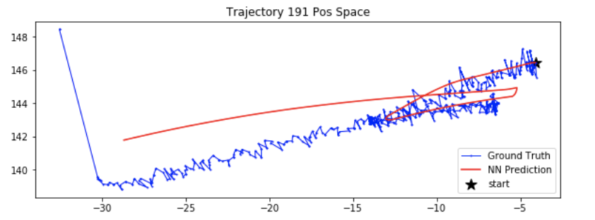
Examples (Bad Tails)
Nonsplit Model, 200 Nodes, Learning rate 0.0002

Slide 24
Exclude Bad Data
data of bad detection(tag not detected, coordinate system not parallel, …) and drop
data step in which position transition exceeds 1.2mm (outlier)
data step in which the previous state and the next state are exactly the same
data step of drastic transition at the end phase of episode (final 10 steps)
data of very short episodes (less than 100 steps)
A very short episode could appear if the general visual detection in that episode is very bad and thus only few valid data steps are collected. Finally, they became very messy.
Discussion:
Should be excluded from training data?
Current training: excluded

Slide 25
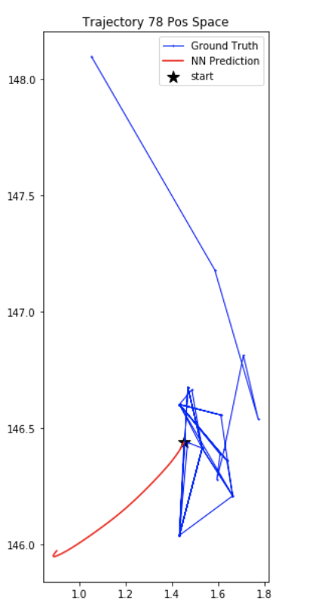
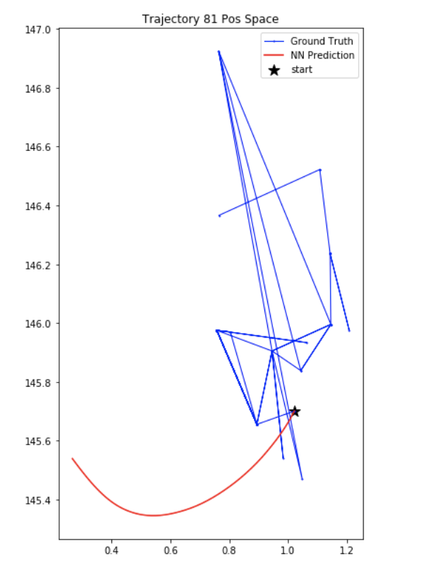
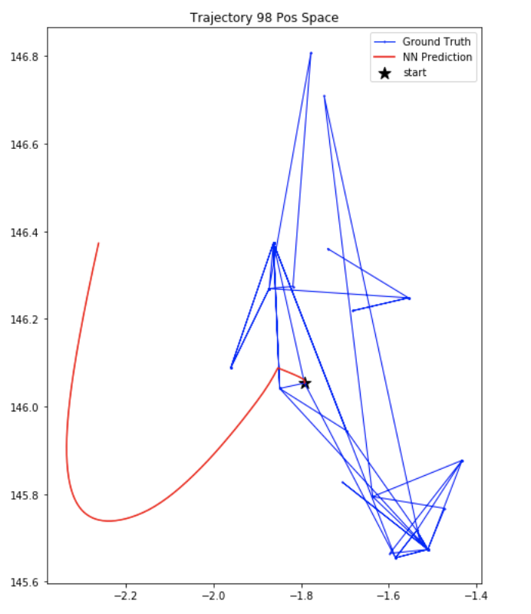
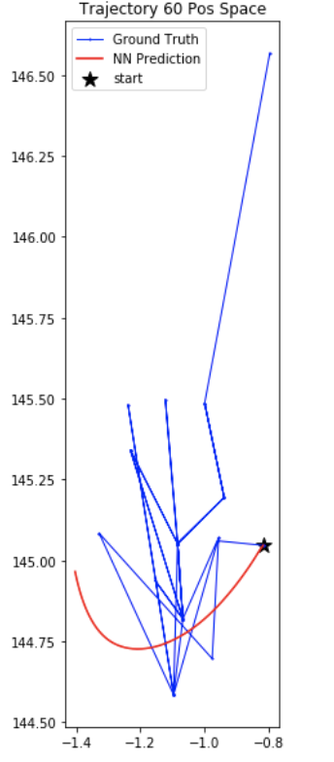
Examples (Short Episodes, Very Messy)
Nonsplit Model, 200 Nodes, Learning rate 0.0002

Slide 26
If Smoothing
Types of Bad Training Data
a) data of bad detection and drop?
b) data step in which position transition exceeds 1.2mm (outlier)?
c) data step in which the previous state and the next state are exactly the same?
d) data step of drastic transition at the end phase of episode (final 10 steps)?
e) data of very short episodes (less than 100 steps)?
Discussion:
1) Before Smoothing, also remove data of type b) and d) besides a) and then recalibrate?
2) When Smoothing, should skip data of type a), b) and d).
(e.g. smoothing window of 40, only 20 are valid, then take average of valid 20 data)
Also smooth the start state?
3) Smoothing could eliminate data of type c).
After Smoothing, remove data of type e)?

Slide 27
Next Plans
0) Wait training results after processing data type of d) and e)
Data Smoothing (Recalibration?+Processing d) and e)?) + Retrain
2) Read papers carefully + think about further exploration of the hand project

