Slide 1
Meeting 07/21/2020
Shuo Zhang

Slide 2
In past 4 days
1) Data efficiency for Gazebo Hand (1 goal location)
2) Data efficiency for Reacher (all 3 goal locations)

Slide 3
Gazebo Hand Statistics (Goal Location 15)
goal location (method) (data size) | success rollout rate | goal reach rate | success rollout path RMSE relative to plan path [mm] | path length [mm] |  |  | number of path steps |  | last distance to goal [mm]
 |  |  |  | plan | success rollout | failure | plan | failure | plan | success rollout | failure
15 (A*) (Full) | 100% | 100% | 1.01±0.01 | 80.85 | 80.71±0.14 | - | 436 | - | 5.46 | 6.08±0.16 | -
15 (A*) (50%) | 100% | 100% | 0.88±0.04 | 80.23 | 80.74±0.95 | - | 433 | - | 5.37 | 6.64±0.37 | -
15 (A*) (40%) | 100% | 100% | 0.75±0.05 | 80.45 | 80.11±0.50 | - | 431 | - | 5.47 | 6.88±0.32 | -
15 (A*) (30%) | 100% | 100% | 1.08±0.05 | 81.74 | 83.01±0.69 | - | 445 | - | 5.41 | 4.38±0.23 | -
15 (A*) (20%) | 100% | 100% | 0.82±0.03 | 81.41 | 82.08±0.70 | - | 440 | - | 5.40 | 5.13±0.20 | -
15 (A*) (10%) | 100% | 100% | 0.99±0.05 | 84.77 | 84.74±0.69 | - | 652 | - | 5.50 | 3.78±0.11 | -
15 (A*) (5%) | 100% | 100% | 1.78±0.09 | 83.99 | 86.07±0.71 | - | 469 | - | 5.46 | 2.67±0.10 | -
15 (A*) (1%) | 100% | 100% | 3.32±0.02 | 101.37 | 97.19±0.08 | - | 552 | - | 5.49 | 2.03±0.10 | -

Slide 4
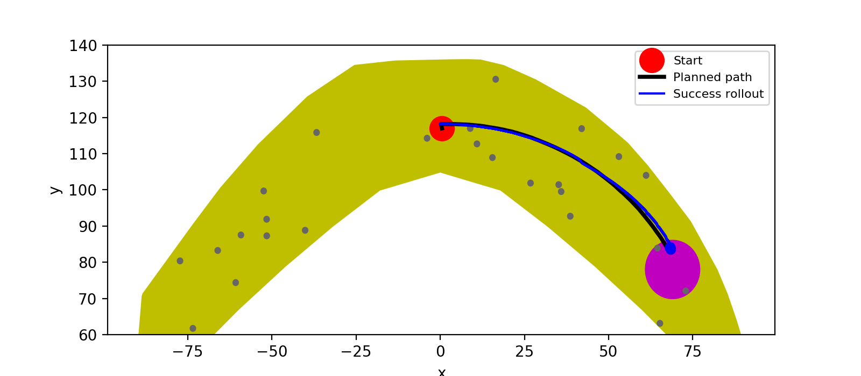

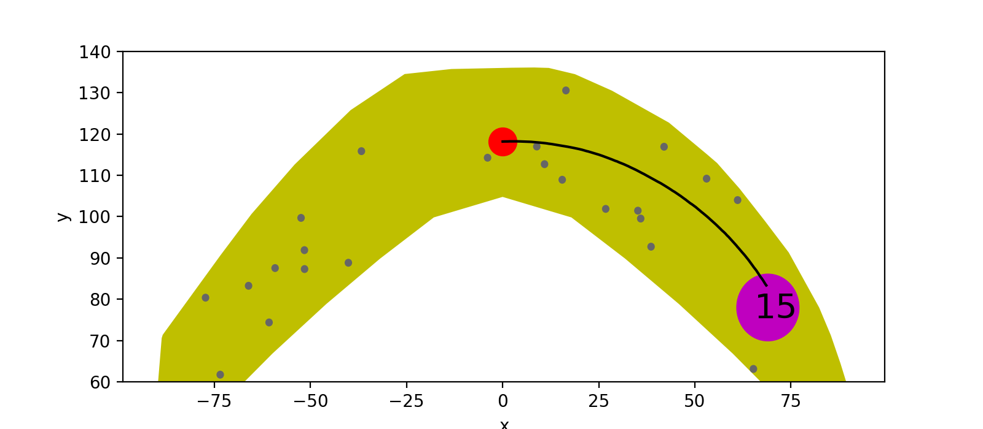


Full
50%
40%
30%

Slide 5


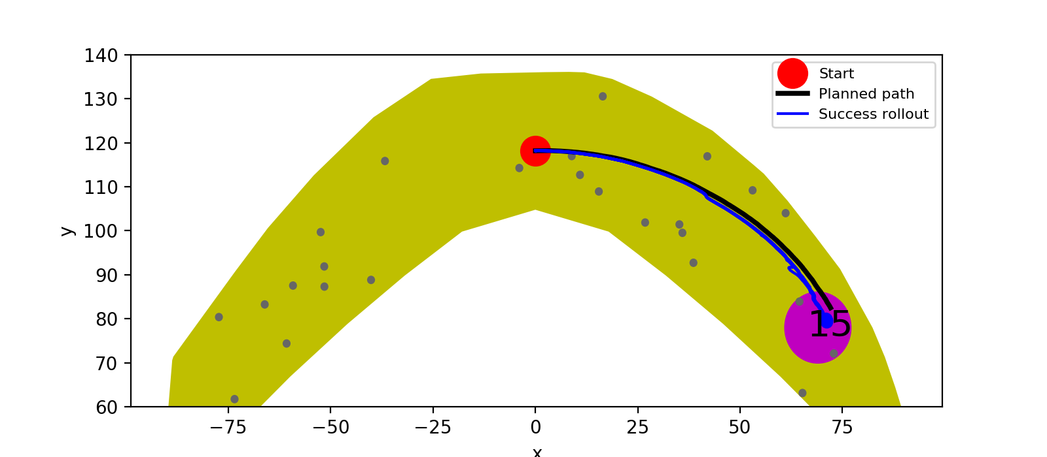

20%
10%
5%
1%

Slide 6
Reacher Statistics (Goal Location 1)
goal location (method) (data size) | goal reach rate | rollout path RMSE relative to plan path [mm] | path length [mm] |  | number of path steps | last distance to goal [mm]
 |  |  | plan | rollout |  | plan | rollout
1 (A*) (Full) | 100% | 0.01025±0.00091 | 0.22799 | 0.24568±0.00221 | 16 | 0.00778 | 0.00993±0.00112
1 (A*) (50%) | 100% | 0.01261±0.00138 | 0.22831 | 0.25237±0.00216 | 14 | 0.00639 | 0.01662±0.00195
1 (A*) (40%) | 100% | 0.00409±0.00072 | 0.23242 | 0.22773±0.00120 | 20 | 0.00254 | 0.00931±0.00059
1 (A*) (30%) | 0% | 0.01242±0.00121 | 0.22347 | 0.20847±0.00054 | 21 | 0.01164 | 0.04026±0.00147
1 (A*) (20%) | 100% | 0.00542±0.00136 | 0.22386 | 0.22738±0.00148 | 16 | 0.01200 | 0.00883±0.00151
1 (A*) (10%) | 100% | 0.00590±0.00178 | 0.22312 | 0.22686±0.00189 | 17 | 0.01159 | 0.00997±0.00113
1 (A*) (5%) | 0% | 0.02607±0.00156 | 0.22650 | 0.19342±0.00017 | 27 | 0.00916 | 0.06306±0.00278
1 (A*) (1%) | 100% | 0.00927±0.00162 | 0.23205 | 0.24439±0.00219 | 18 | 0.00307 | 0.00941±0.00282

Slide 7
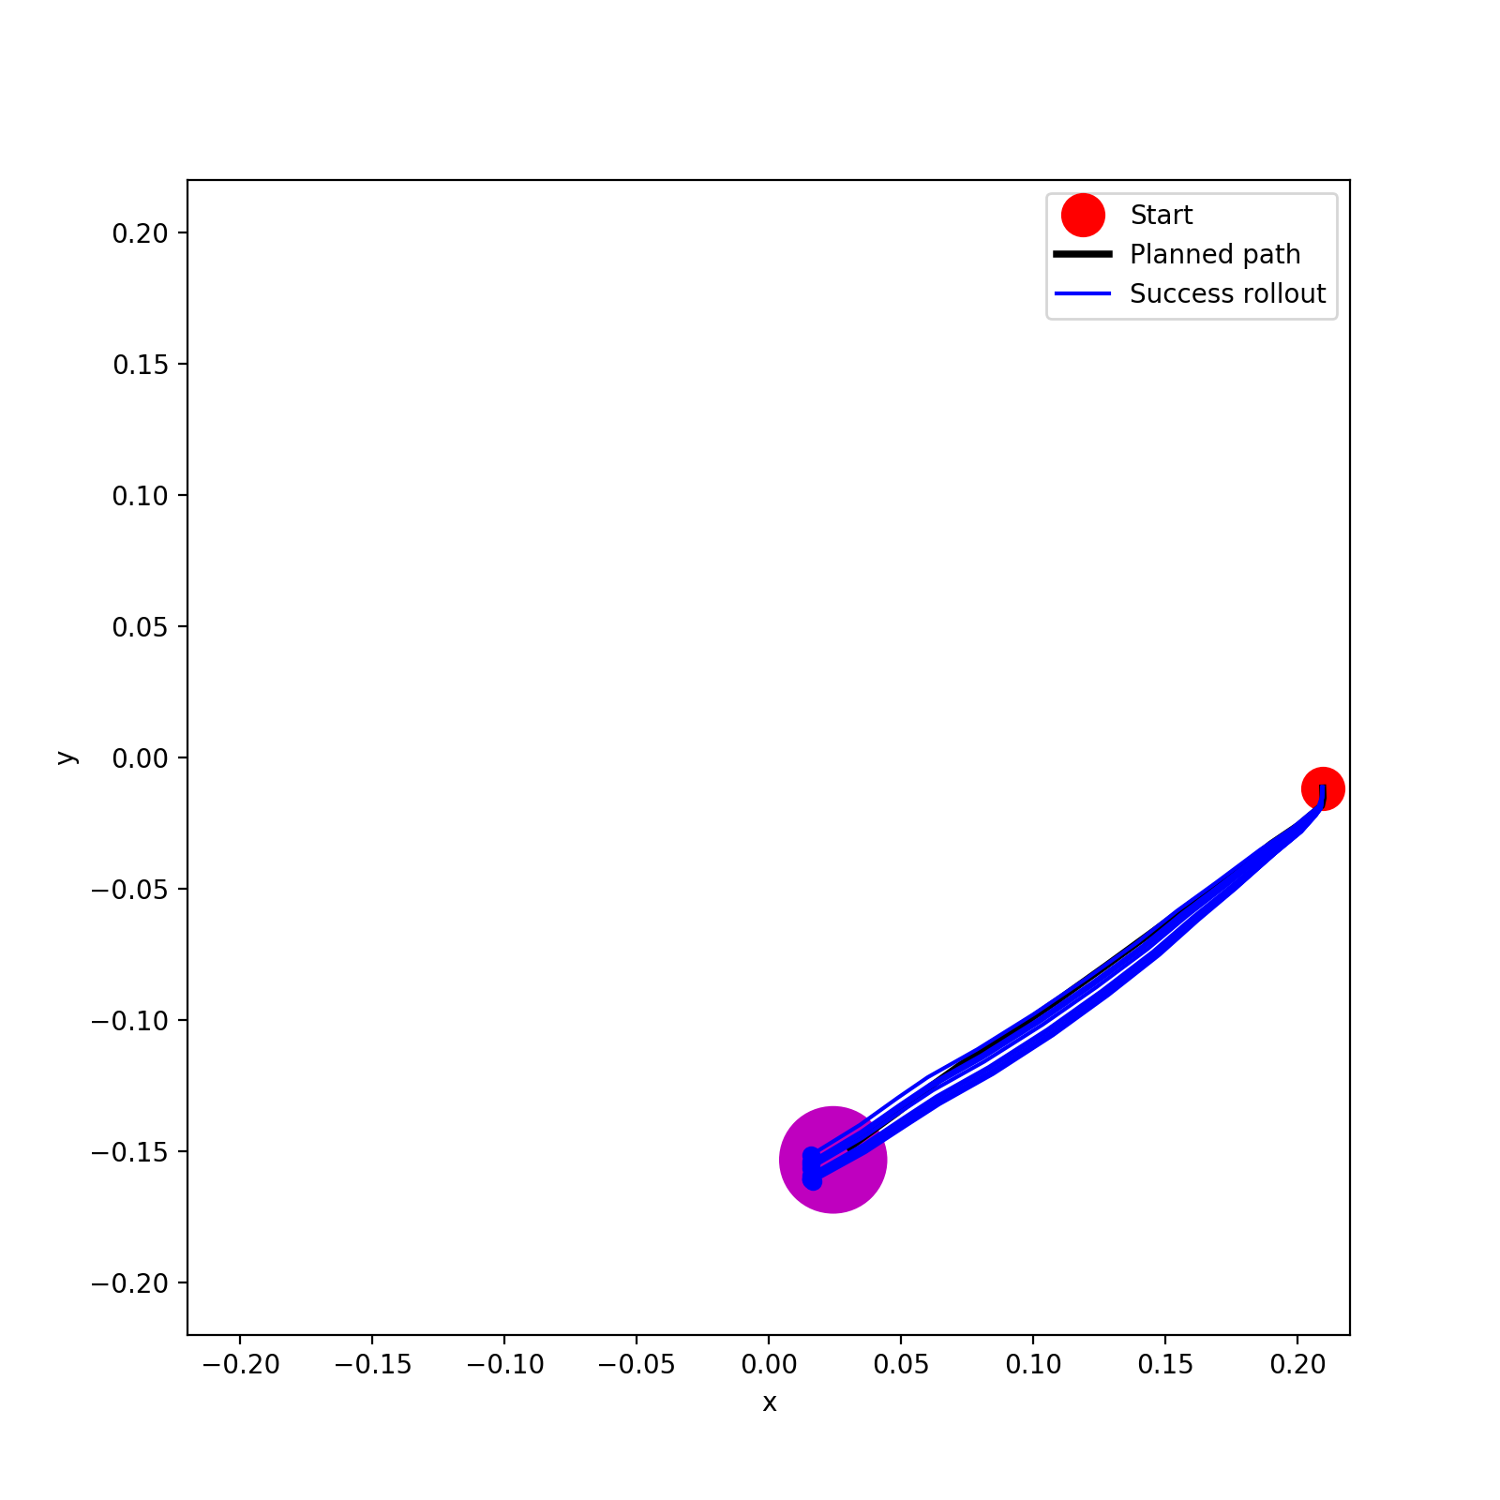
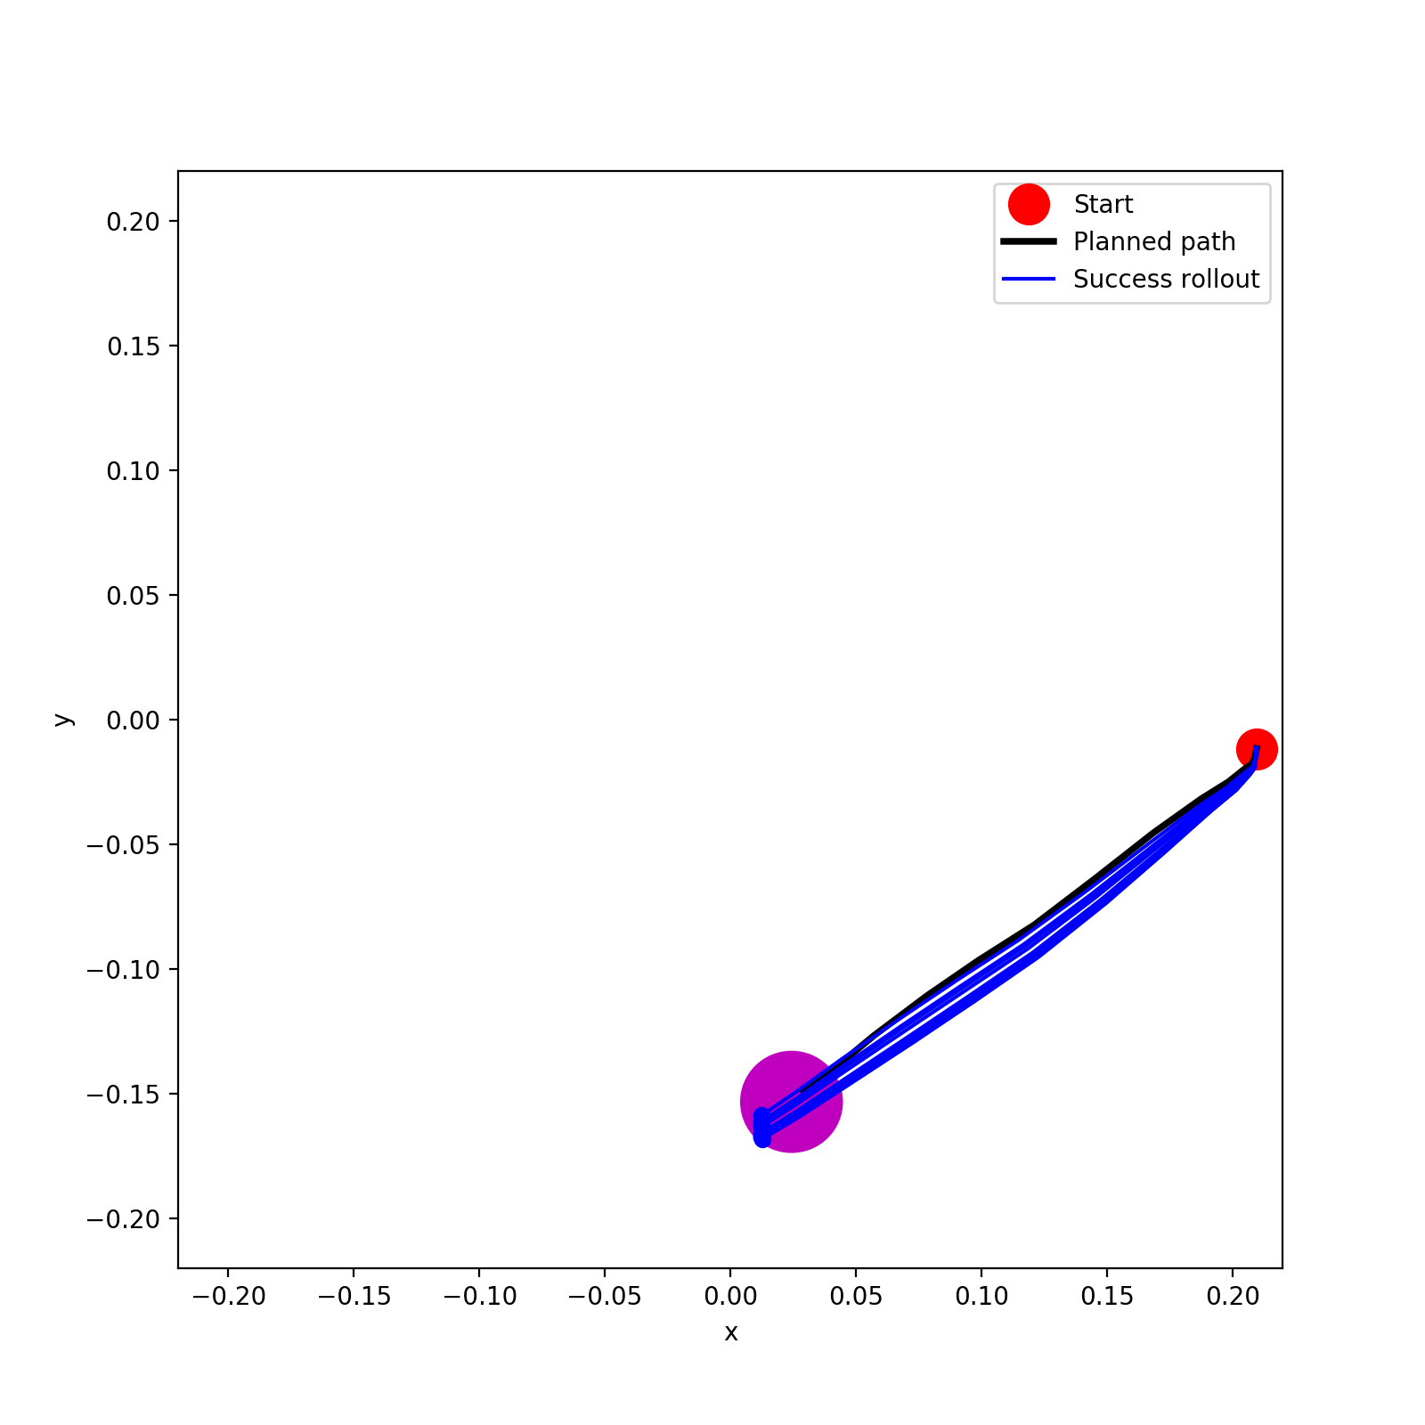
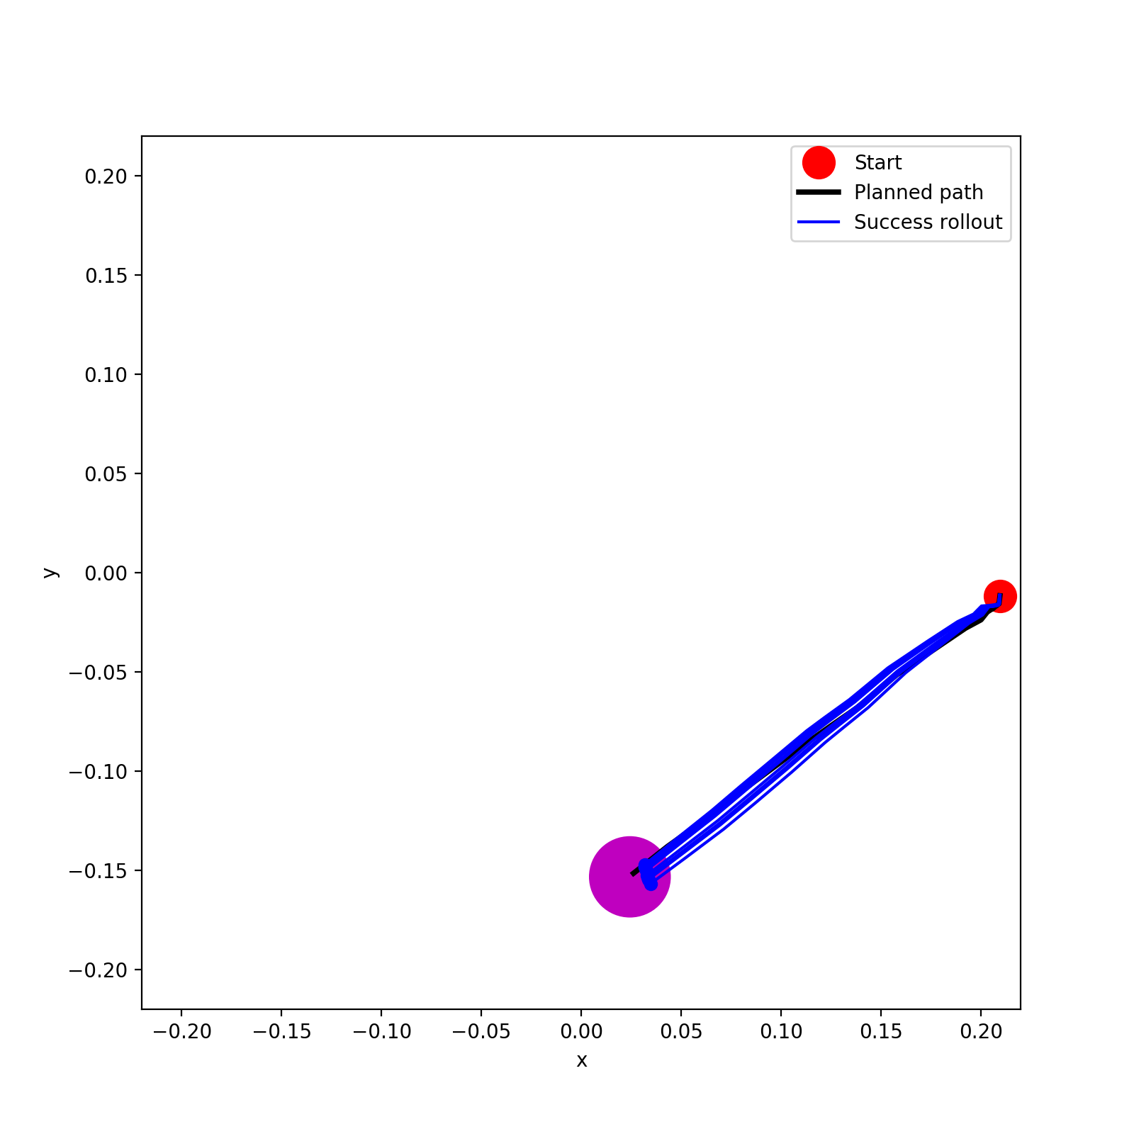
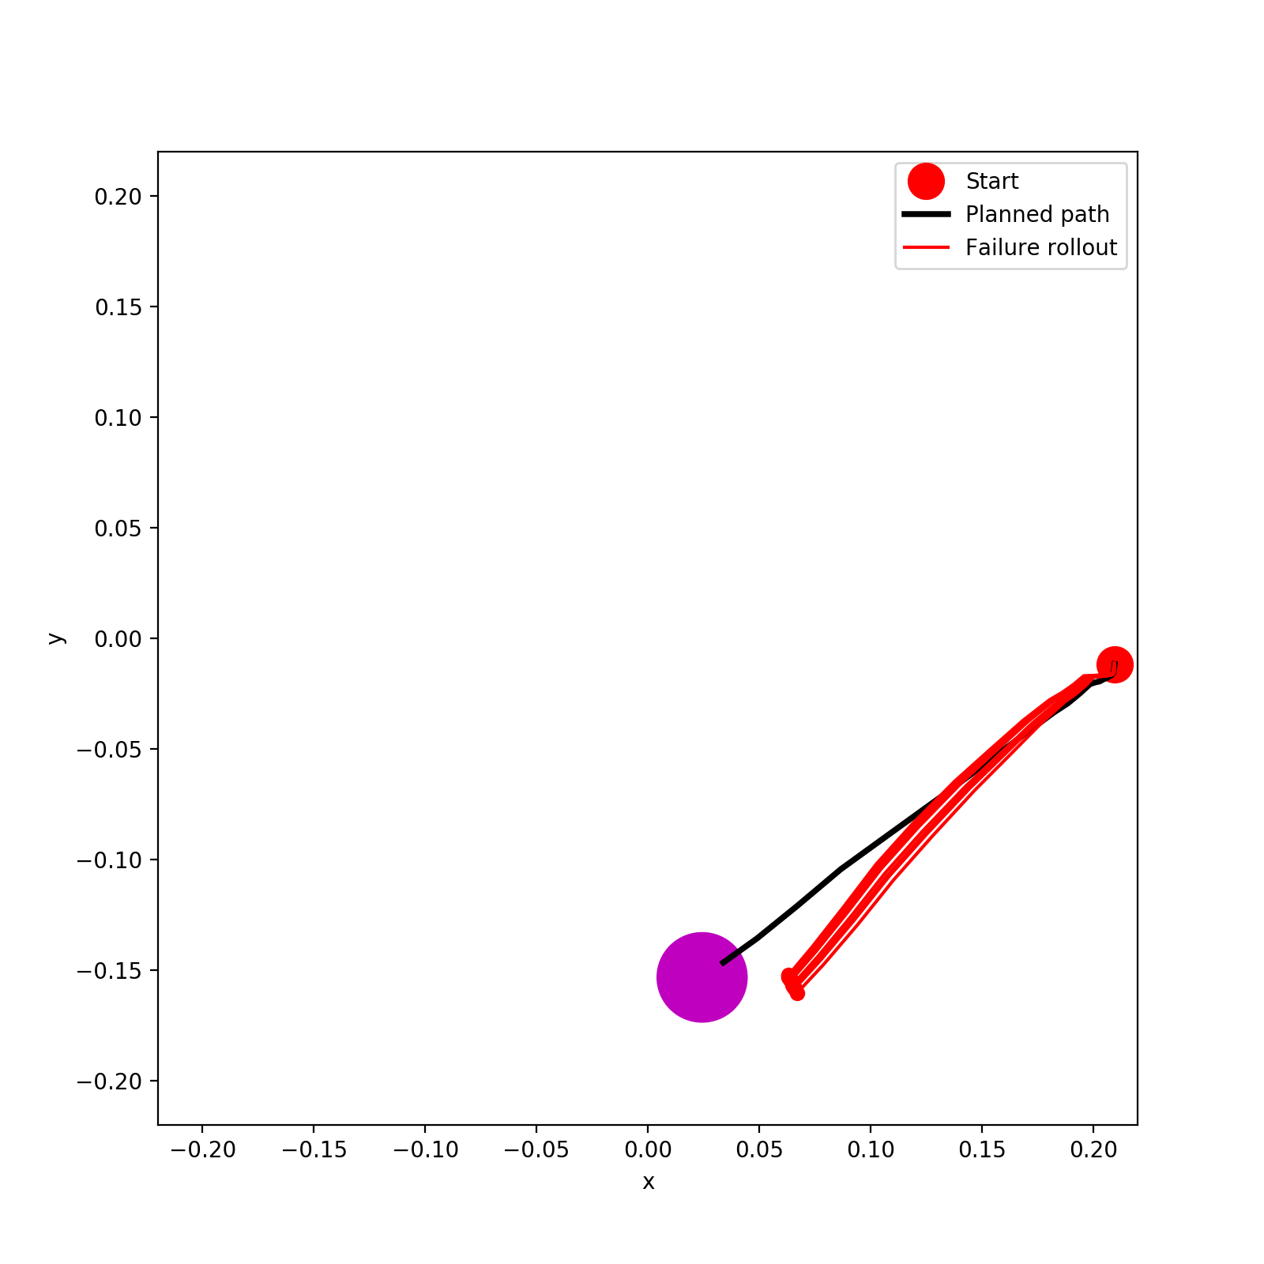
Full
50%
40%
30%

Slide 8


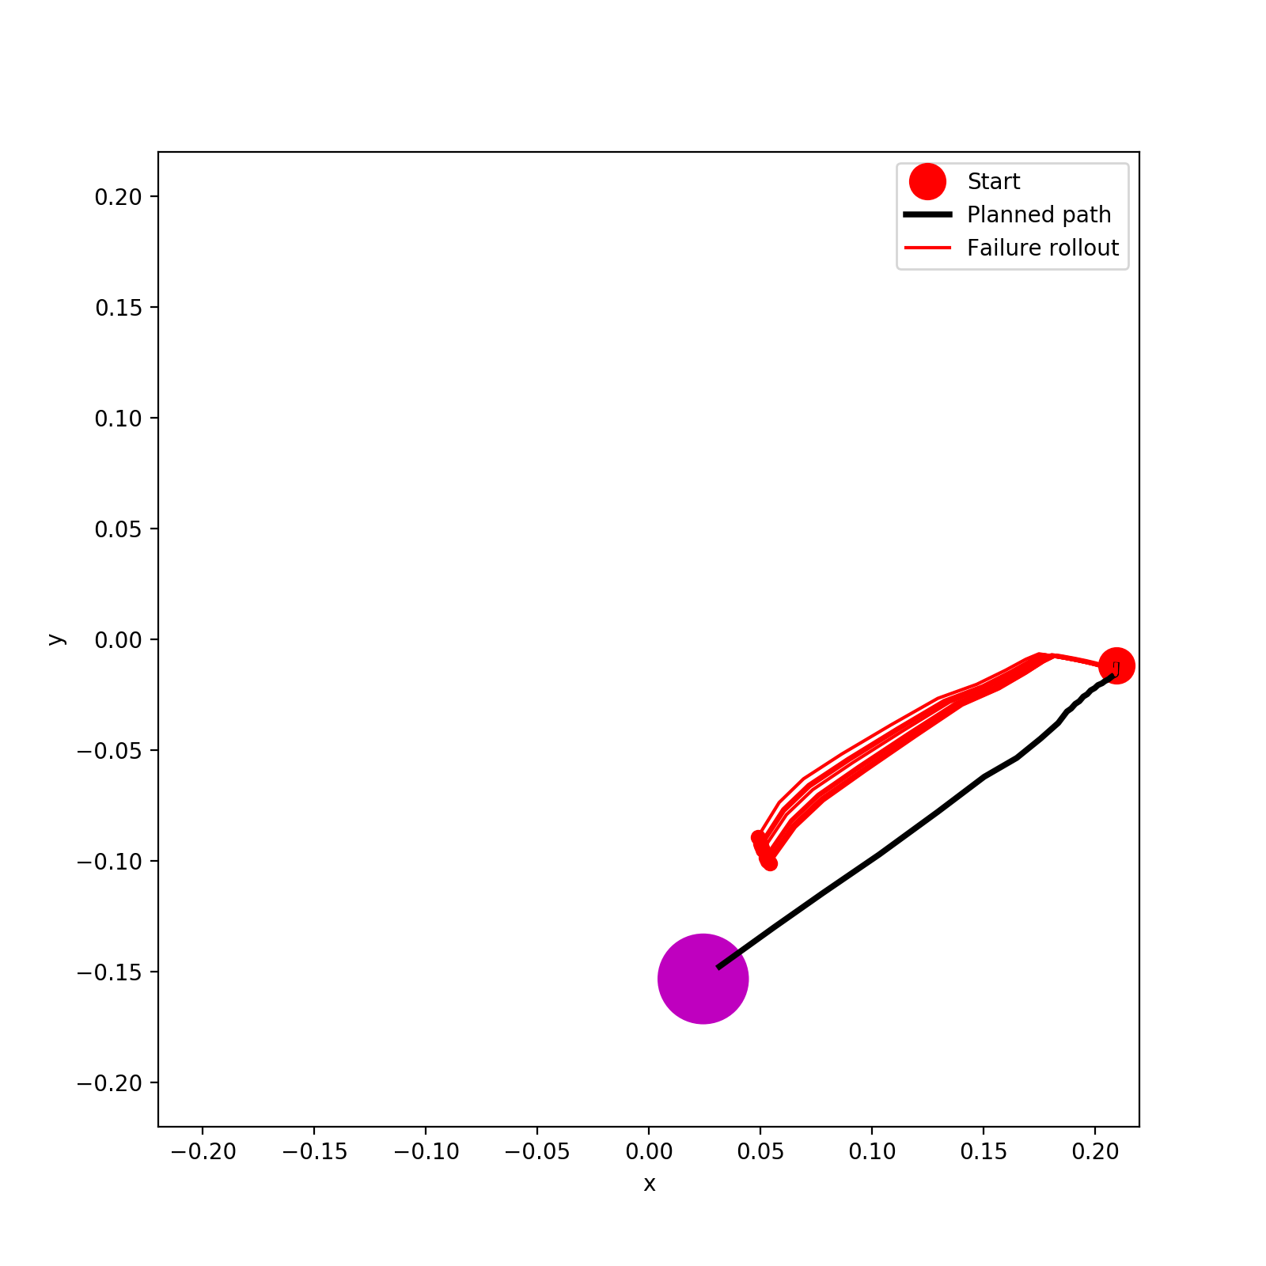

20%
10%
5%
1%

Slide 9
Reacher Statistics (Goal Location 2)
goal location (method) (data size) | goal reach rate | rollout path RMSE relative to plan path [mm] | path length [mm] |  | number of path steps | last distance to goal [mm]
 |  |  | plan | rollout |  | plan | rollout
2 (A*) (Full) | 100% | 0.00340±0.00065 | 0.24392 | 0.24707±0.00159 | 26 | 0.00859 | 0.00509±0.00105
2 (A*) (50%) | 100% | 0.00777±0.00047 | 0.24484 | 0.25917±0.00275 | 21 | 0.00579 | 0.00772±0.00148
2 (A*) (40%) | 0% | 0.01893±0.00135 | 0.24507 | 0.24537±0.00112 | 34 | 0.00649 | 0.04160±0.00260
2 (A*) (30%) | 100% | 0.00983±0.00144 | 0.23959 | 0.25906±0.00268 | 19 | 0.01195 | 0.00948±0.00322
2 (A*) (20%) | 0% | 0.04577±0.00152 | 0.23970 | 0.28048±0.00010 | 41 | 0.01160 | 0.10470±0.00201
2 (A*) (10%) | 70% | 0.00933±0.00196 | 0.24183 | 0.24906±0.00150 | 23 | 0.00808 | 0.01909±0.00280
2 (A*) (5%) | 100% | 0.01187±0.00129 | 0.23958 | 0.24499±0.00244 | 18 | 0.01206 | 0.01436±0.00341
2 (A*) (1%) | 100% | 0.00439±0.00081 | 0.23858 | 0.24125±0.00212 | 15 | 0.01366 | 0.01133±0.00118

Slide 10
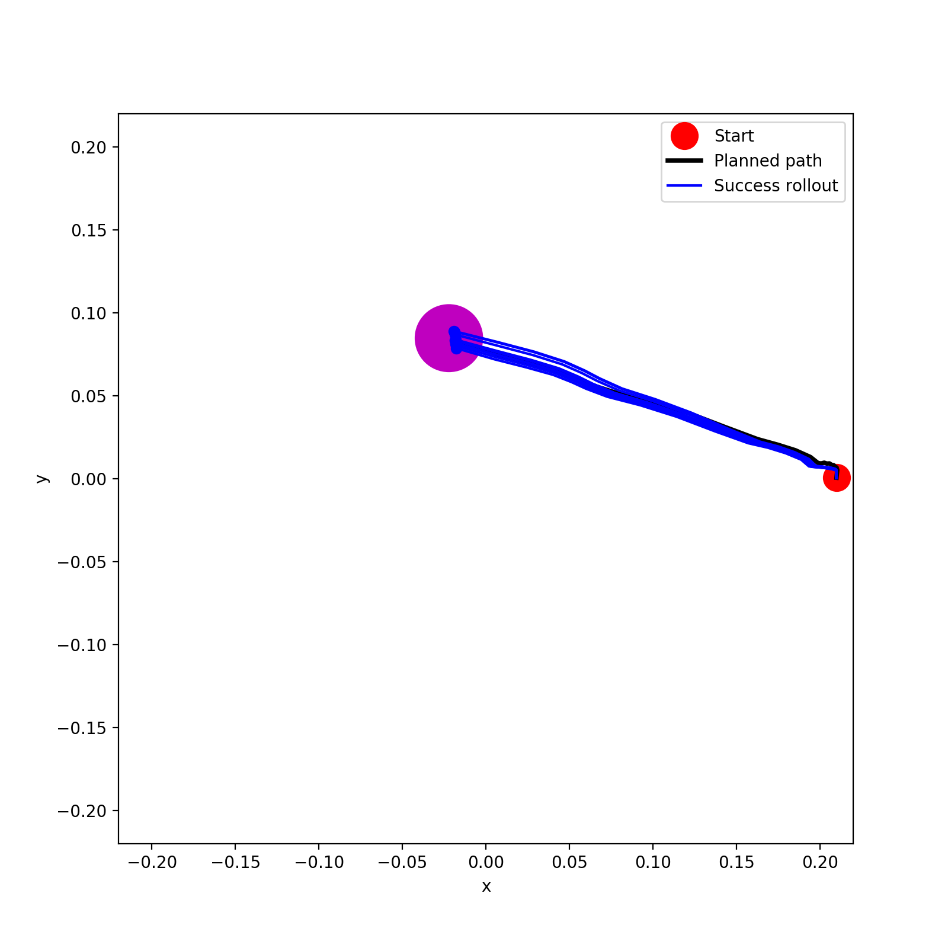
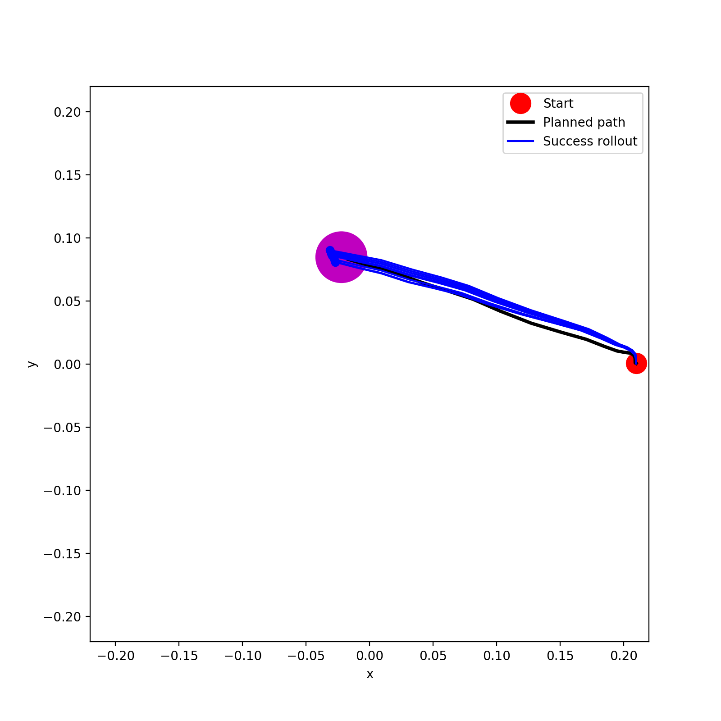
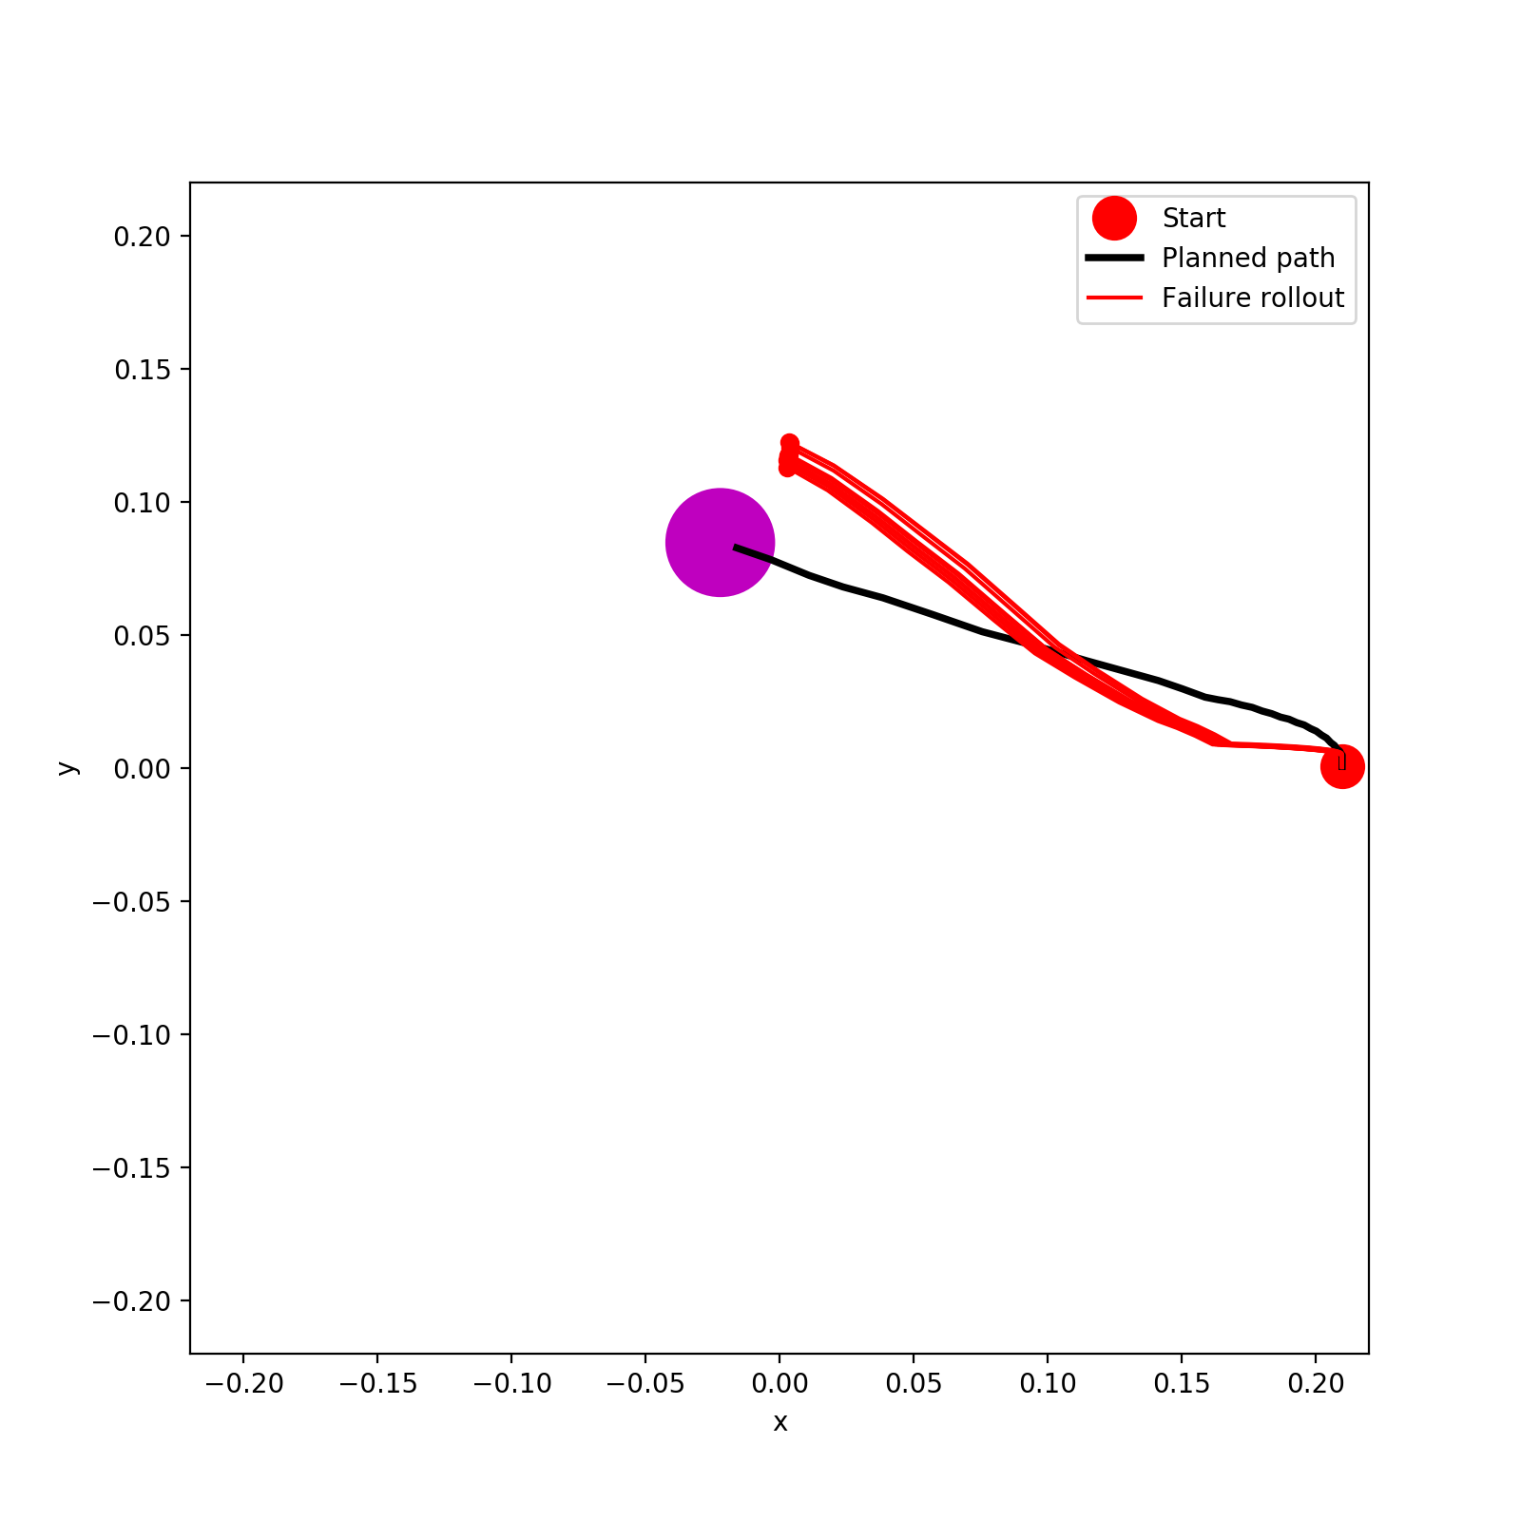
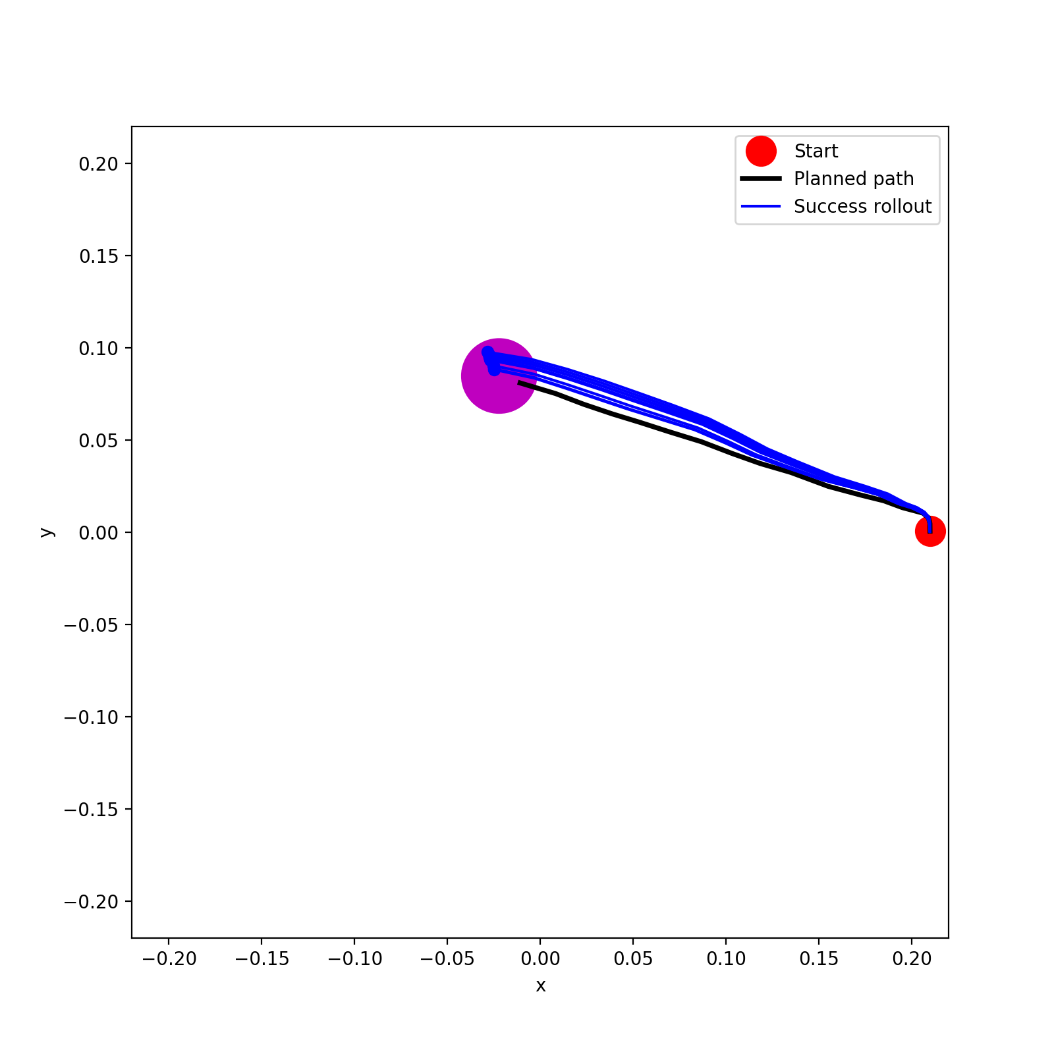
Full
50%
40%
30%

Slide 11
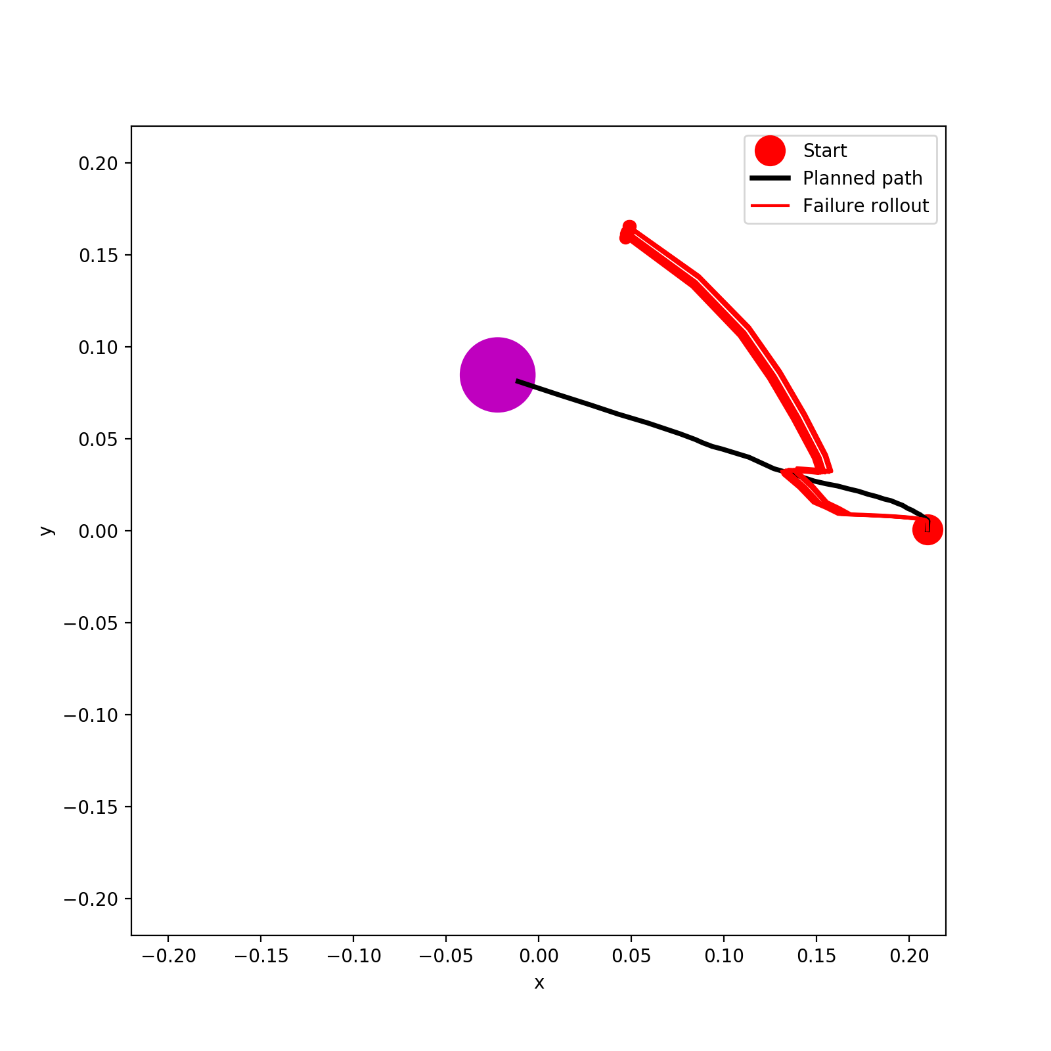
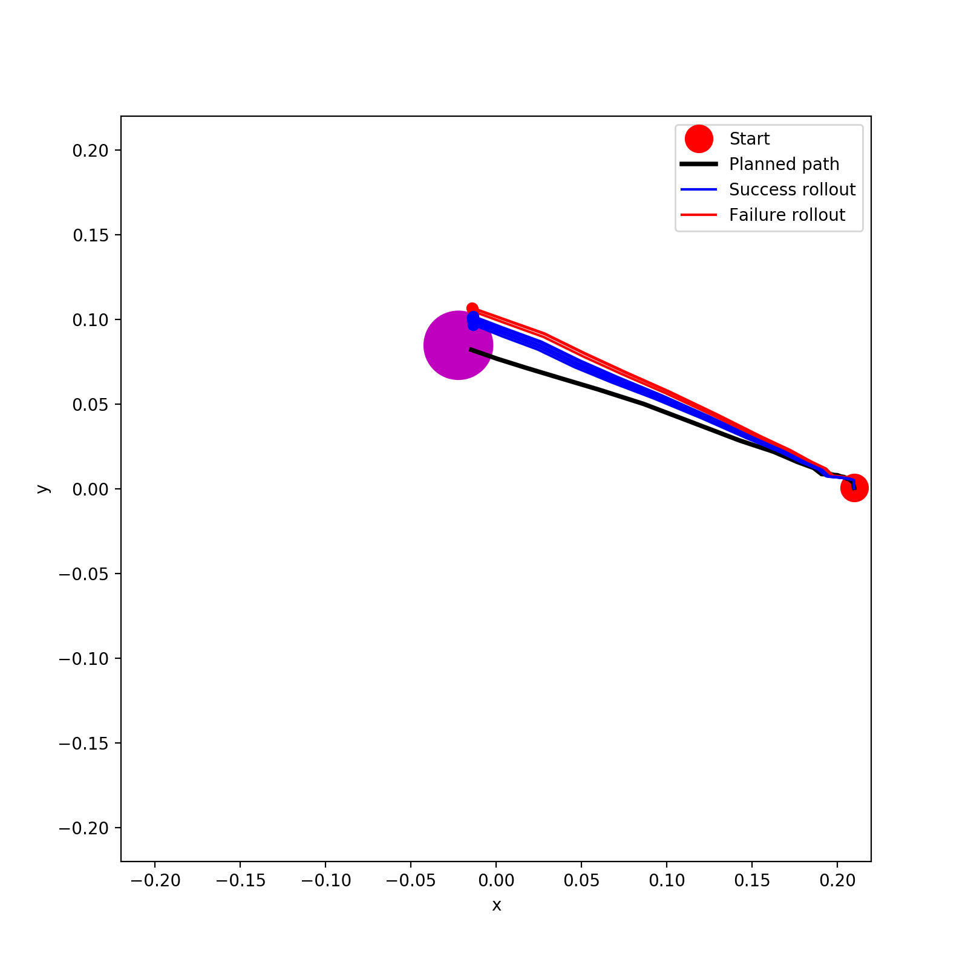
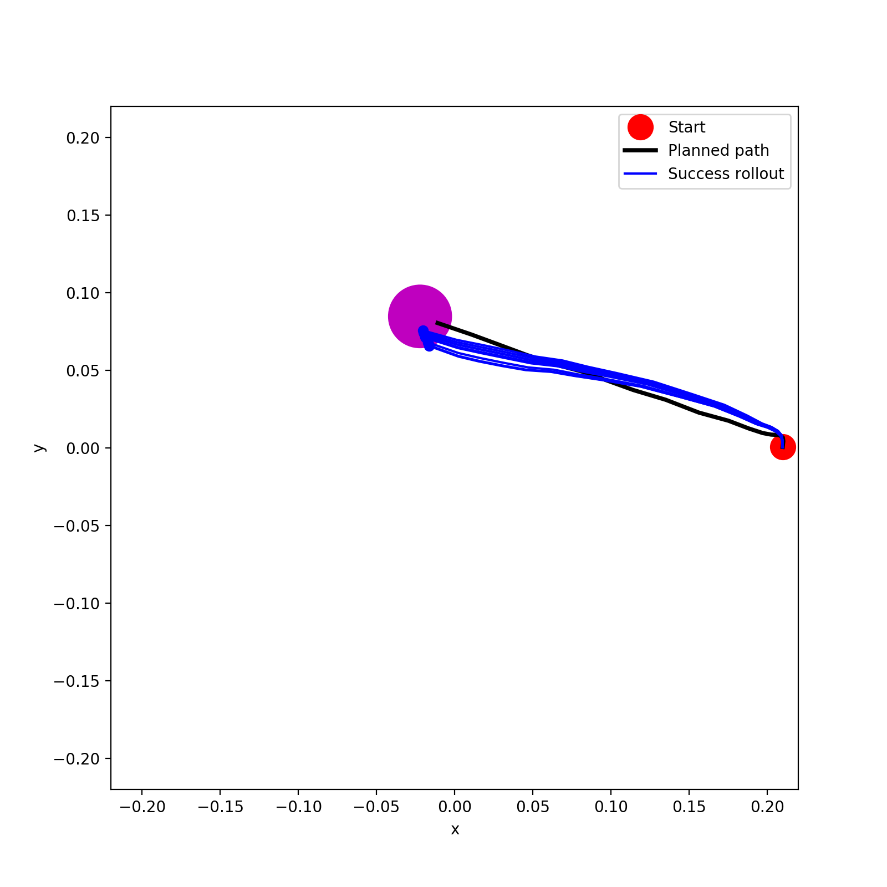
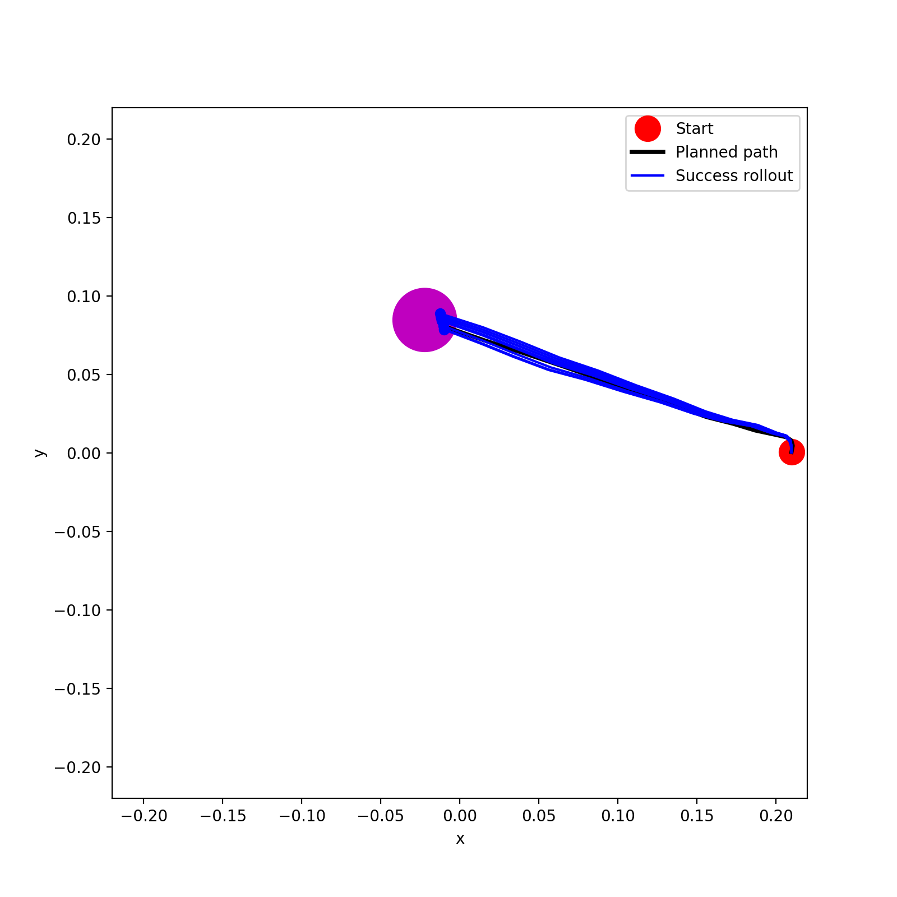
20%
10%
5%
1%

Slide 12
Reacher Statistics (Goal Location 5)
goal location (method) (data size) | goal reach rate | rollout path RMSE relative to plan path [mm] | path length [mm] |  | number of path steps | last distance to goal [mm]
 |  |  | plan | rollout |  | plan | rollout
5 (A*) (Full) | 100% | 0.00871±0.00373 | 0.31887 | 0.32344±0.00551 | 23 | 0.00449 | 0.00598±0.00154
5 (A*) (50%) | 0% | 0.02734±0.00371 | 0.31571 | 0.35954±0.00590 | 23 | 0.00601 | 0.02933±0.00371
5 (A*) (40%) | 80% | 0.00818±0.00085 | 0.31776 | 0.31436±0.00518 | 23 | 0.00508 | 0.01544±0.00407
5 (A*) (30%) | 0% | 0.01648±0.00153 | 0.31226 | 0.29017±0.00490 | 24 | 0.01091 | 0.04908±0.00433
5 (A*) (20%) | 0% | 0.04170±0.00304 | 0.31758 | 0.39340±0.00630 | 26 | 0.00603 | 0.06782±0.00271
5 (A*) (10%) | 50% | 0.00743±0.00205 | 0.31047 | 0.30949±0.00593 | 26 | 0.01166 | 0.01924±0.00456
5 (A*) (5%) | 50% | 0.01594±0.00151 | 0.31194 | 0.32587±0.00516 | 25 | 0.01241 | 0.01986±0.00137
5 (A*) (1%) | 0% | 0.01770±0.00099 | 0.31736 | 0.34413±0.00406 | 23 | 0.00486 | 0.03746±0.00527

Slide 13
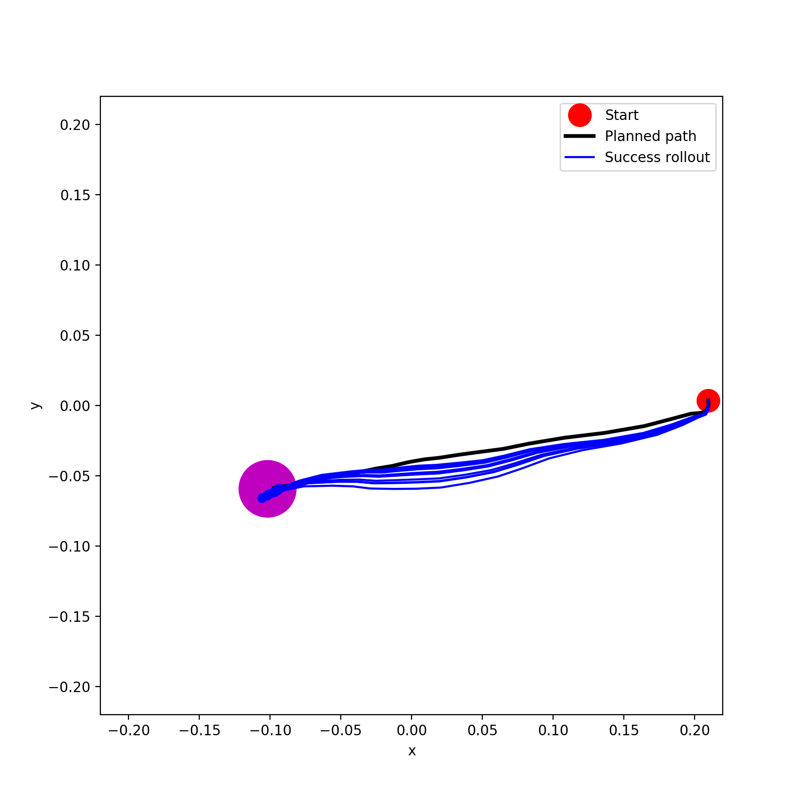
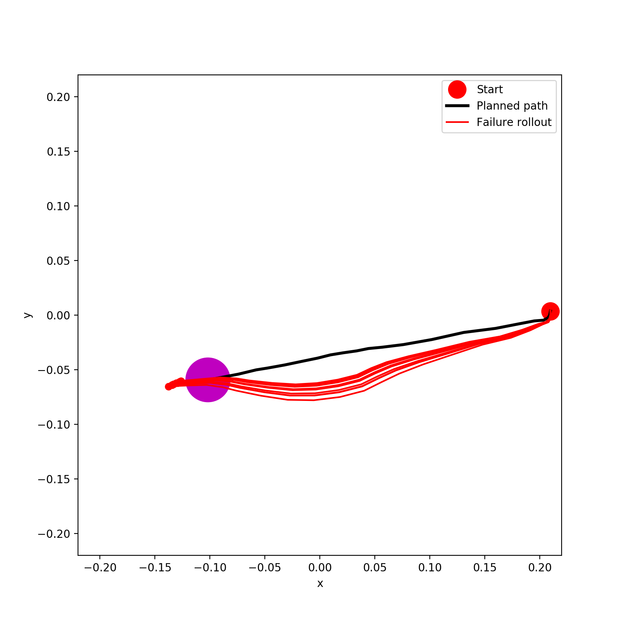
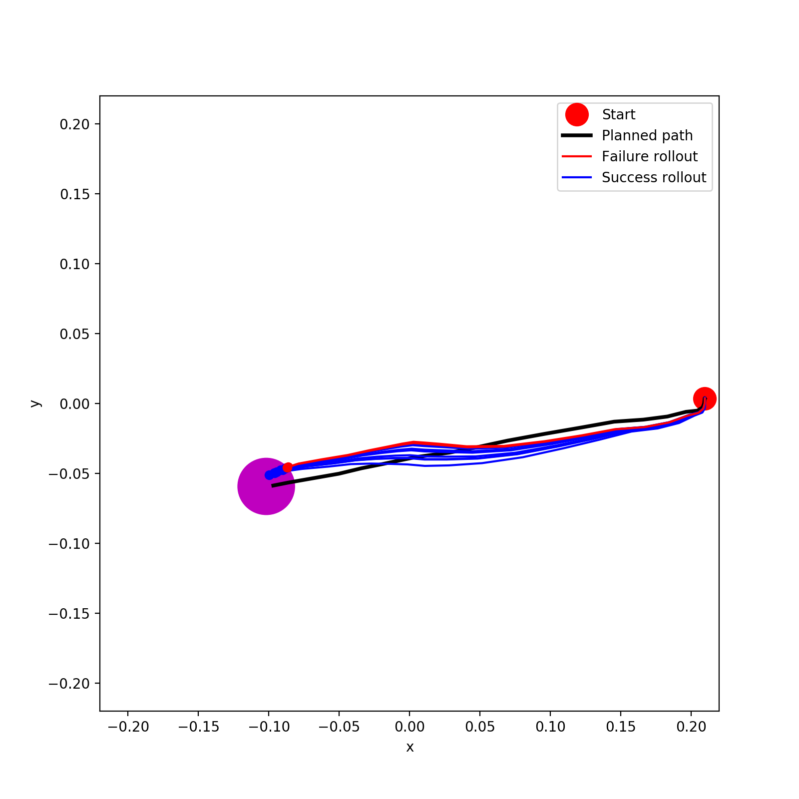
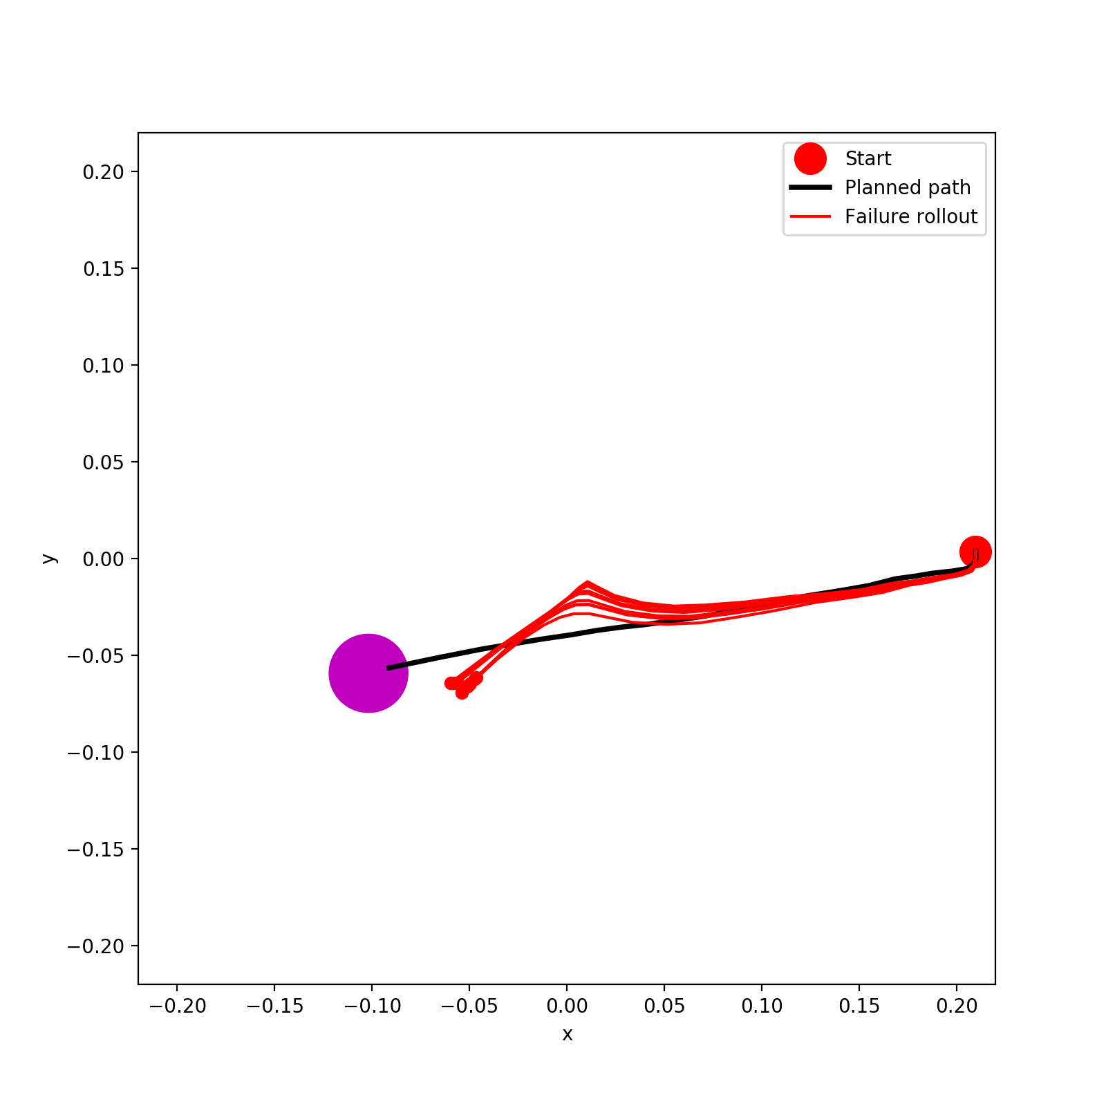
Full
50%
40%
30%

Slide 14
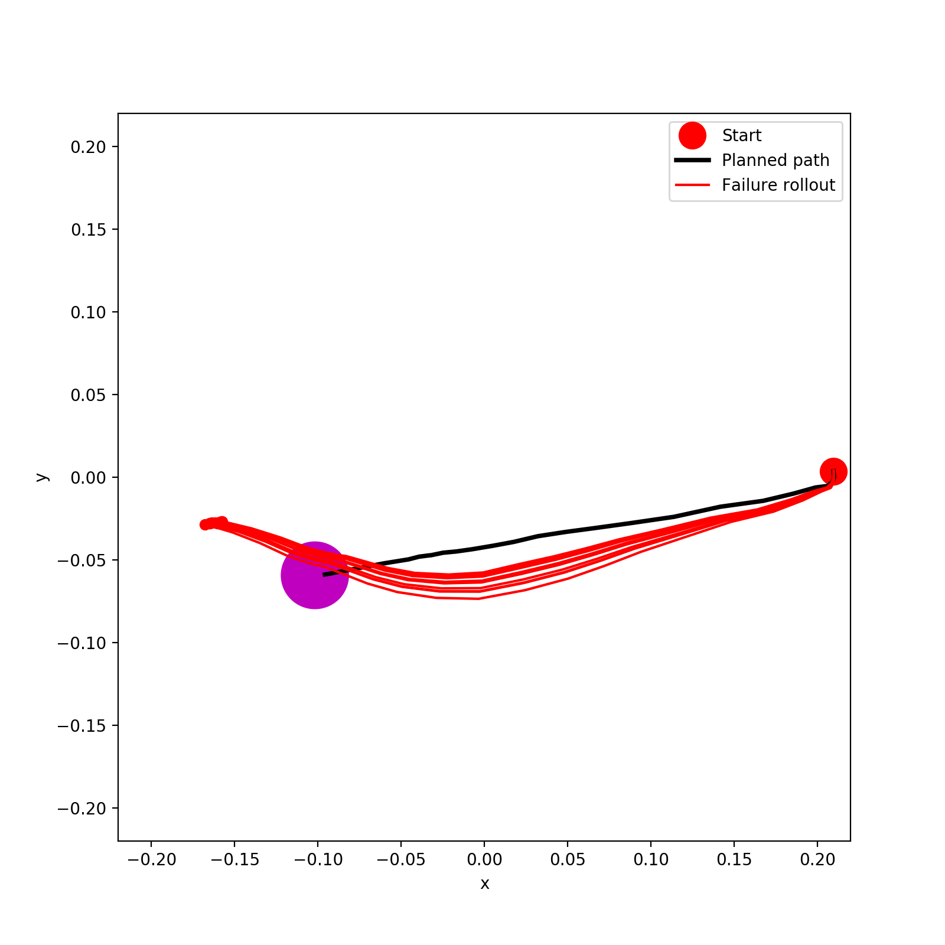
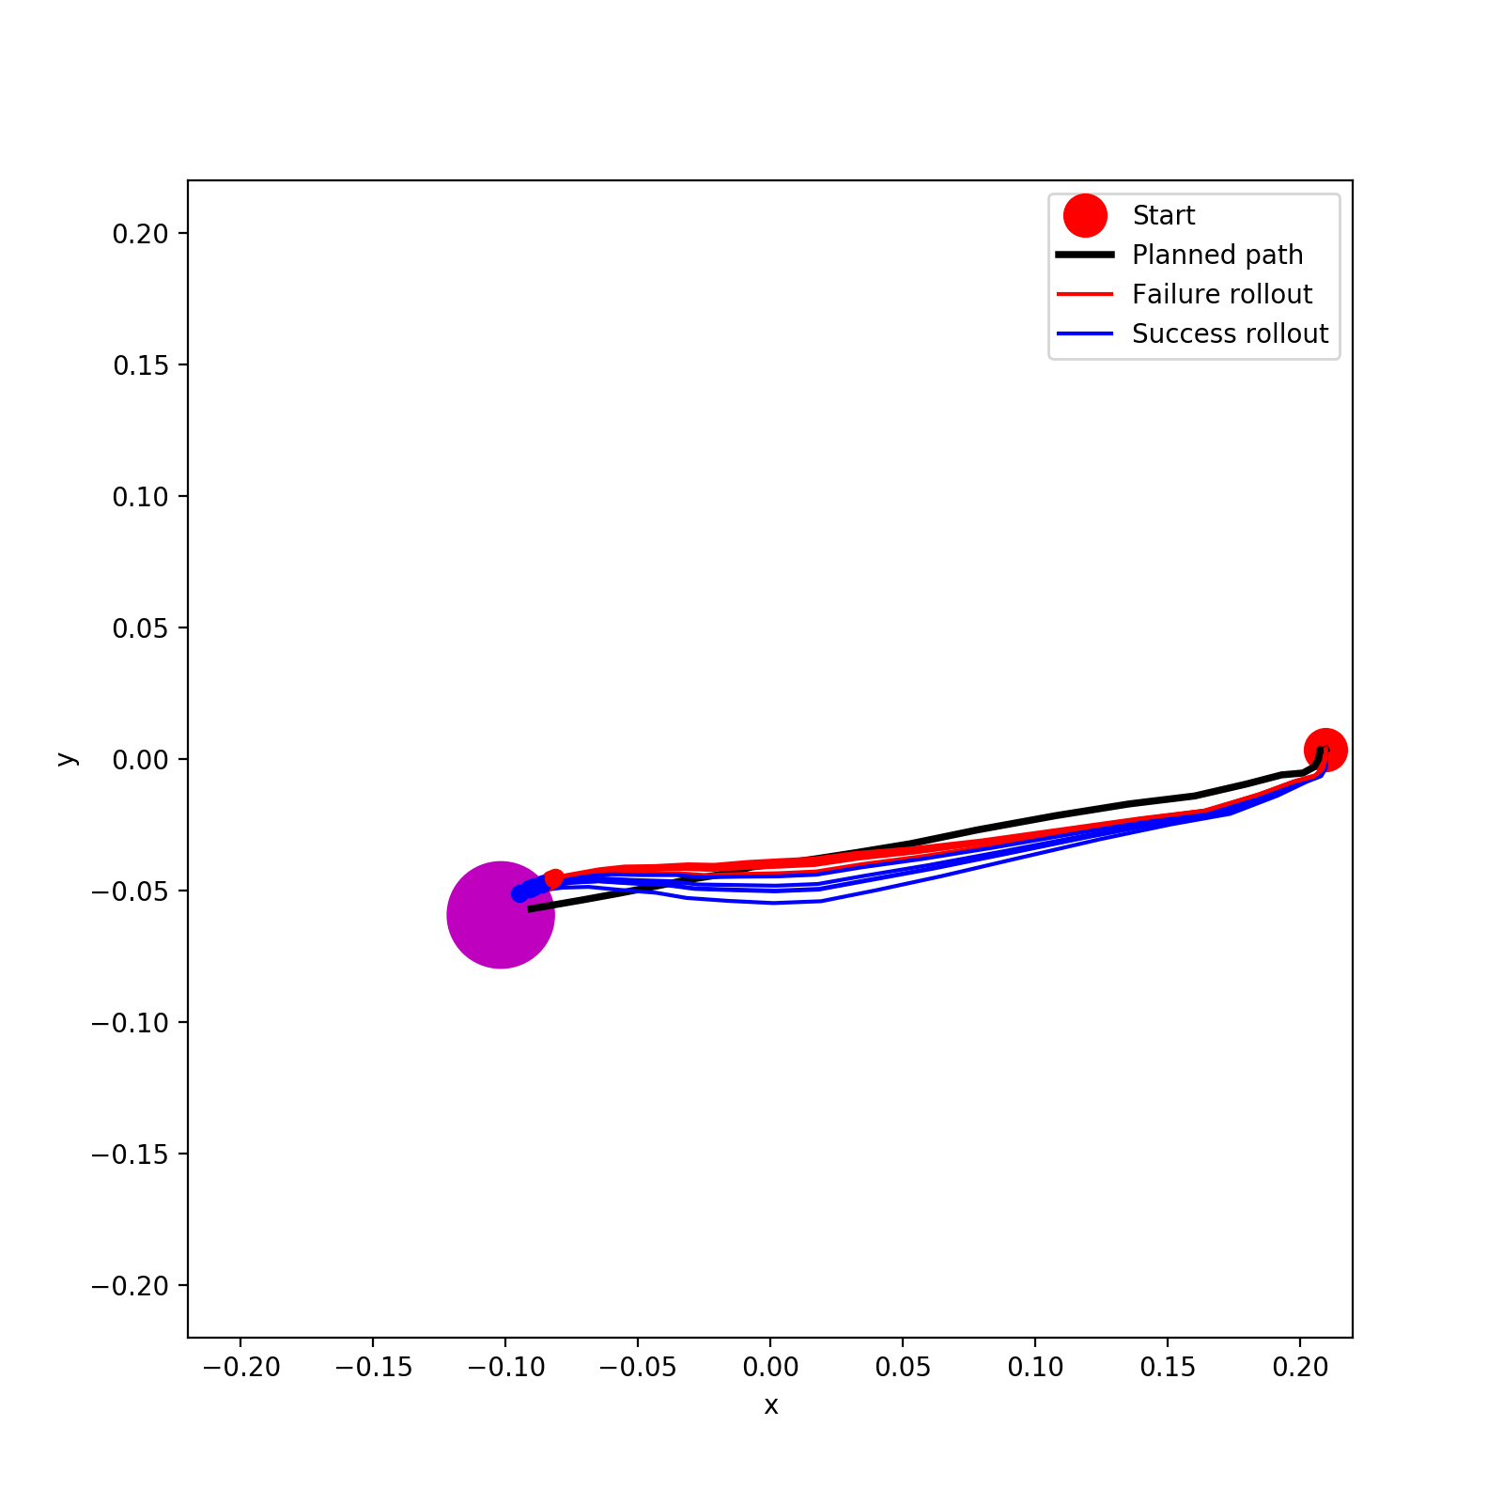
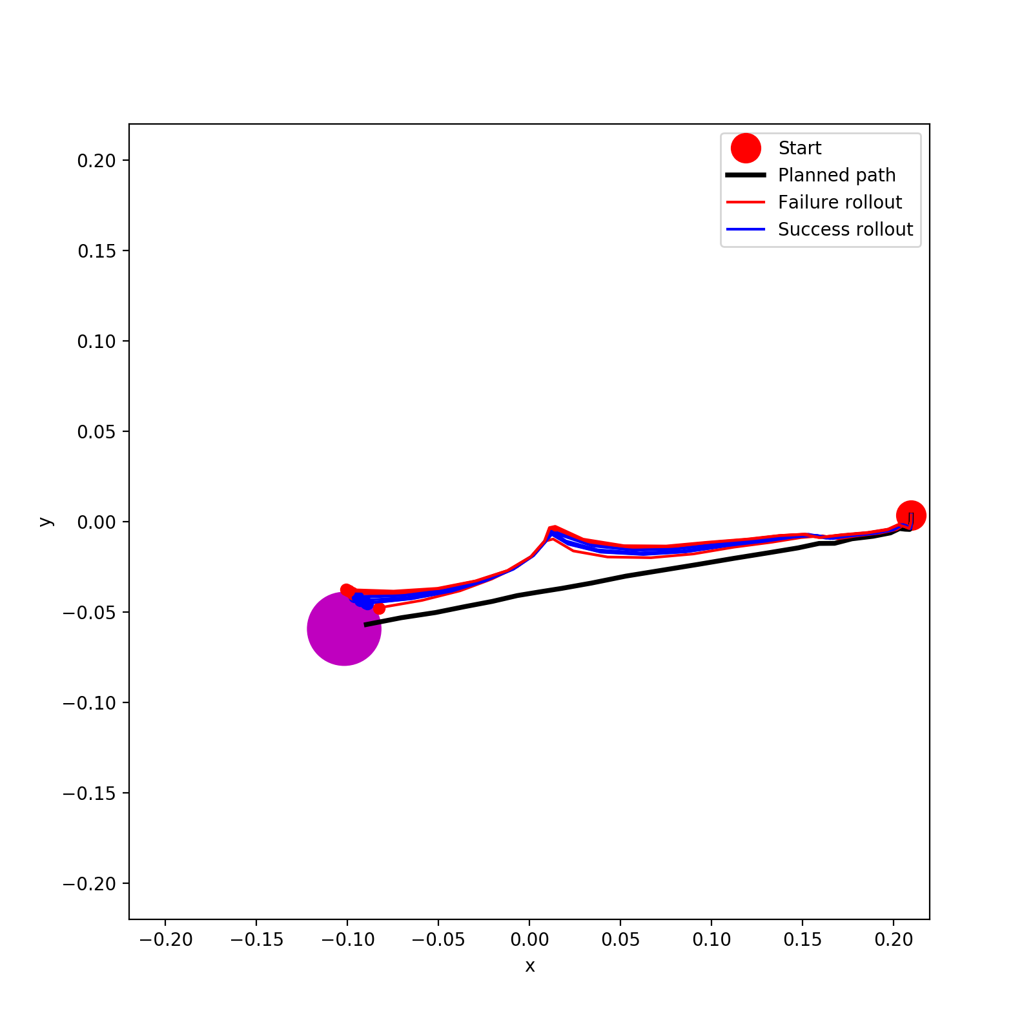
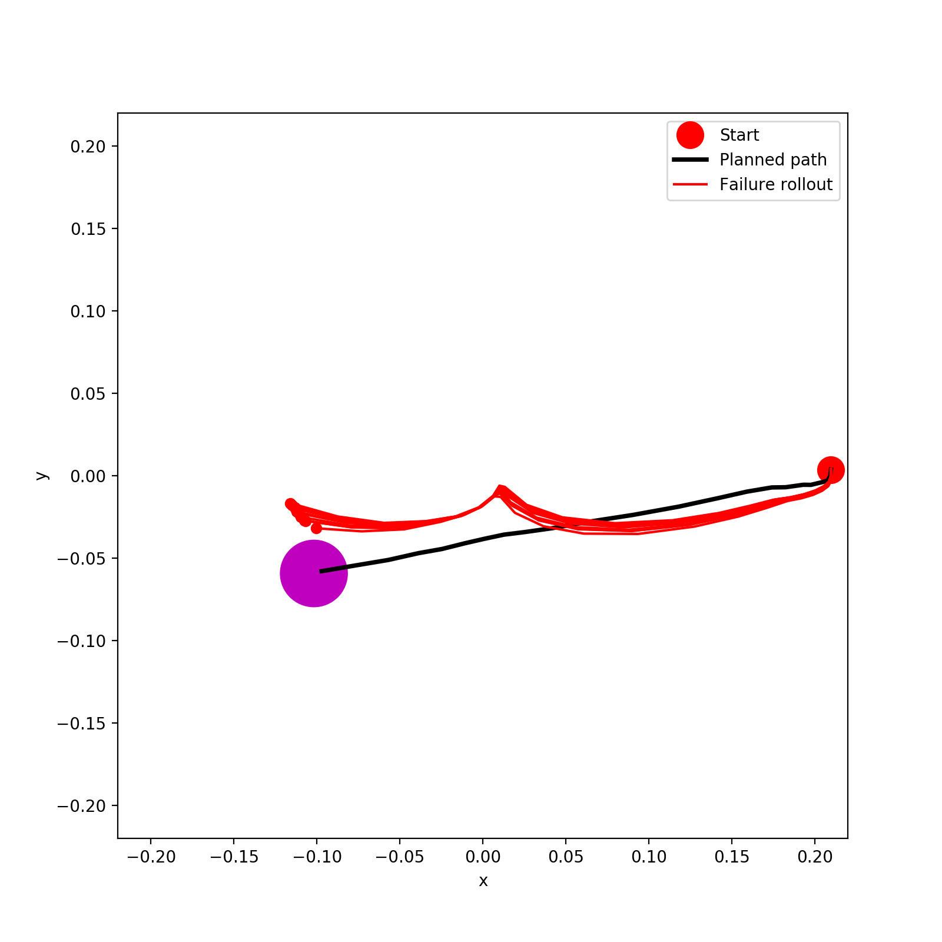
20%
10%
5%
1%

Slide 15
To Do List
Data efficiency of other goal locations for gazebo hand?
Work on our new online method
Real Hand
Redo calibration
Test whether the trained real hand dynamics model also works with Mridul’s new data or not
Do rollouts for A* and PPO policy on real hand
Data efficiency for rollout?
Mridul:
- Fix marker tracking error + Initial opening position
- Collect several episodes of data for testing my trained dynamics model

