Slide 1
Meeting 07/30/2020
Shuo Zhang

Slide 2
In past week
1) Data efficiency for Gazebo Hand (all 5 goal locations, except horseshoe)
2) Data efficiency for Reacher (all 3 goal locations)

Slide 3
Gazebo Hand “Goal Reach Rate” (All Goal Locations)
Percentage of Data | Goal Location 0 | Goal Location 2 | Goal Location 7 | Goal Location 8 | Goal Location 15 | Average
1% (16k) | 0 | 0 | 100 | 100 | 100 | 60
0.5% (8k) | 0 | 100 | 0 | 0 | 0 | 20
0.1% (1.6k) | 0 | 100 | 100 | 0 | 0 | 40

Slide 4
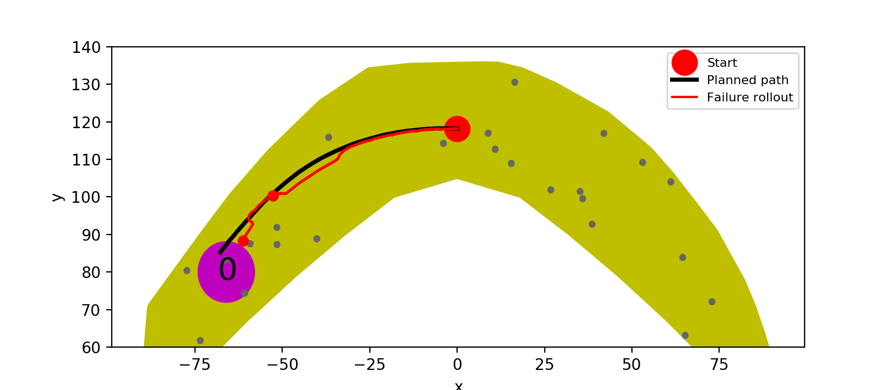
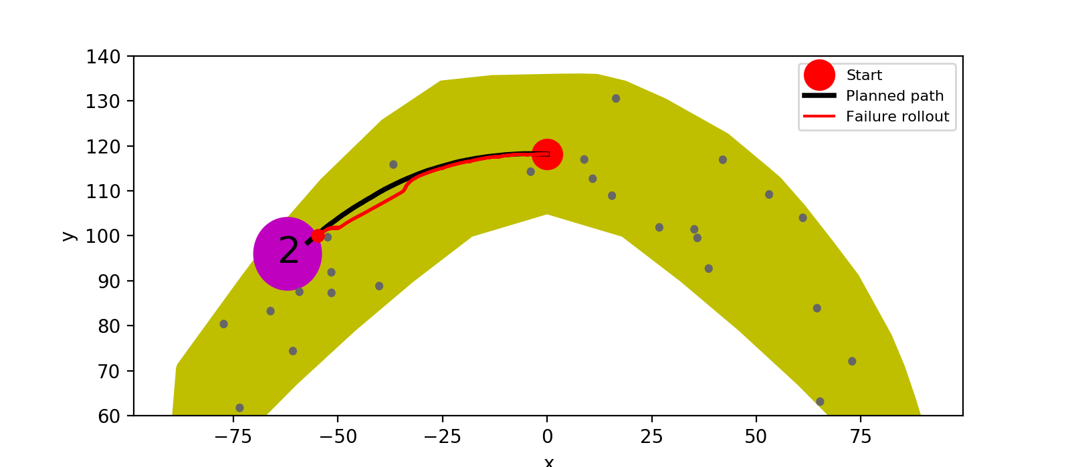
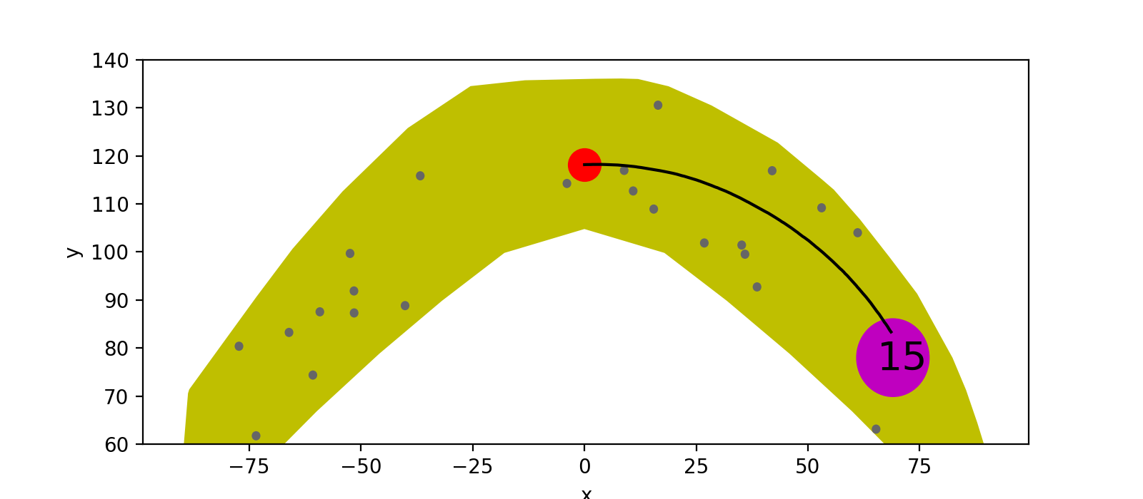
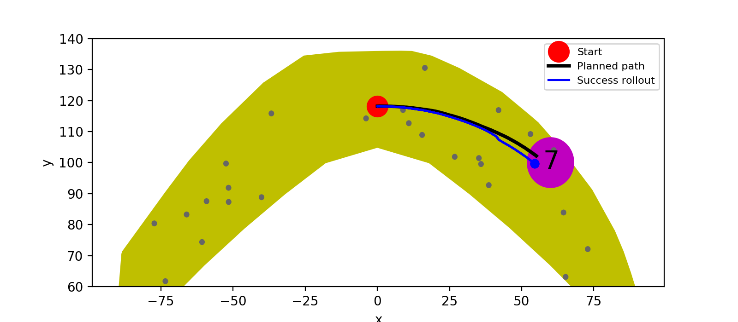
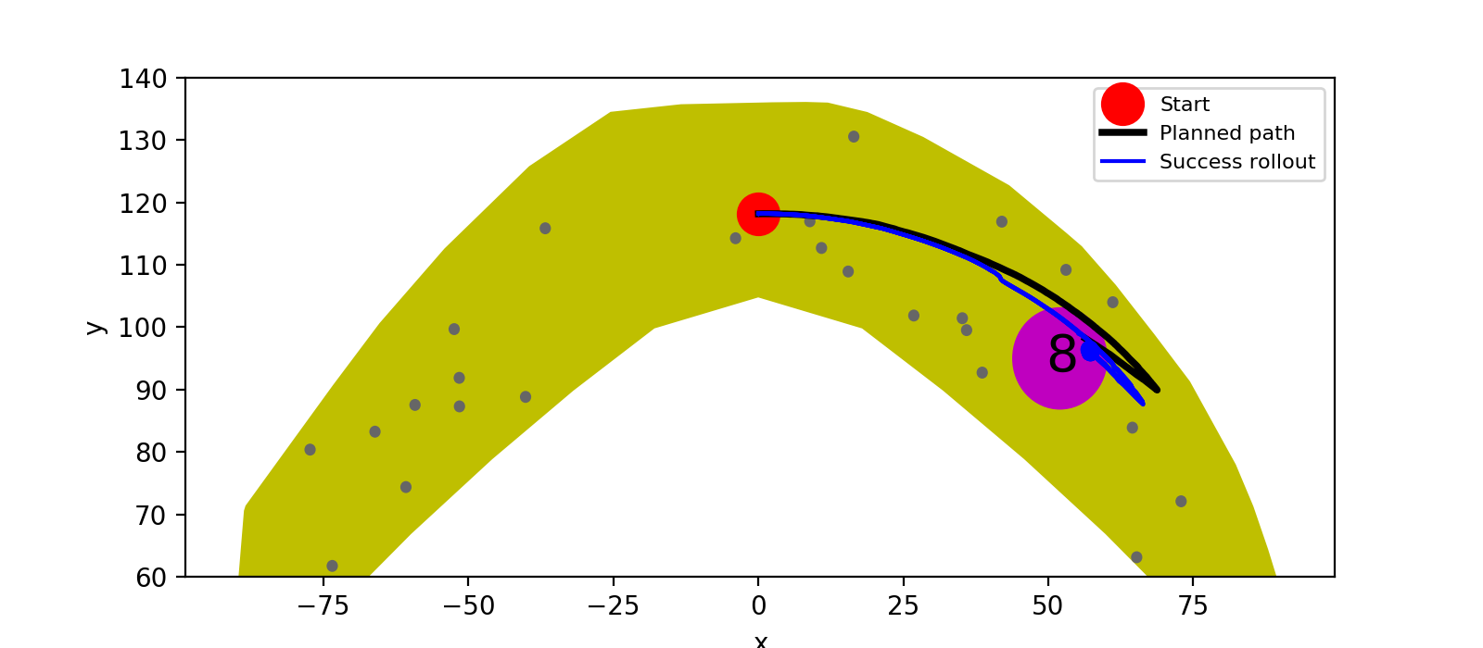
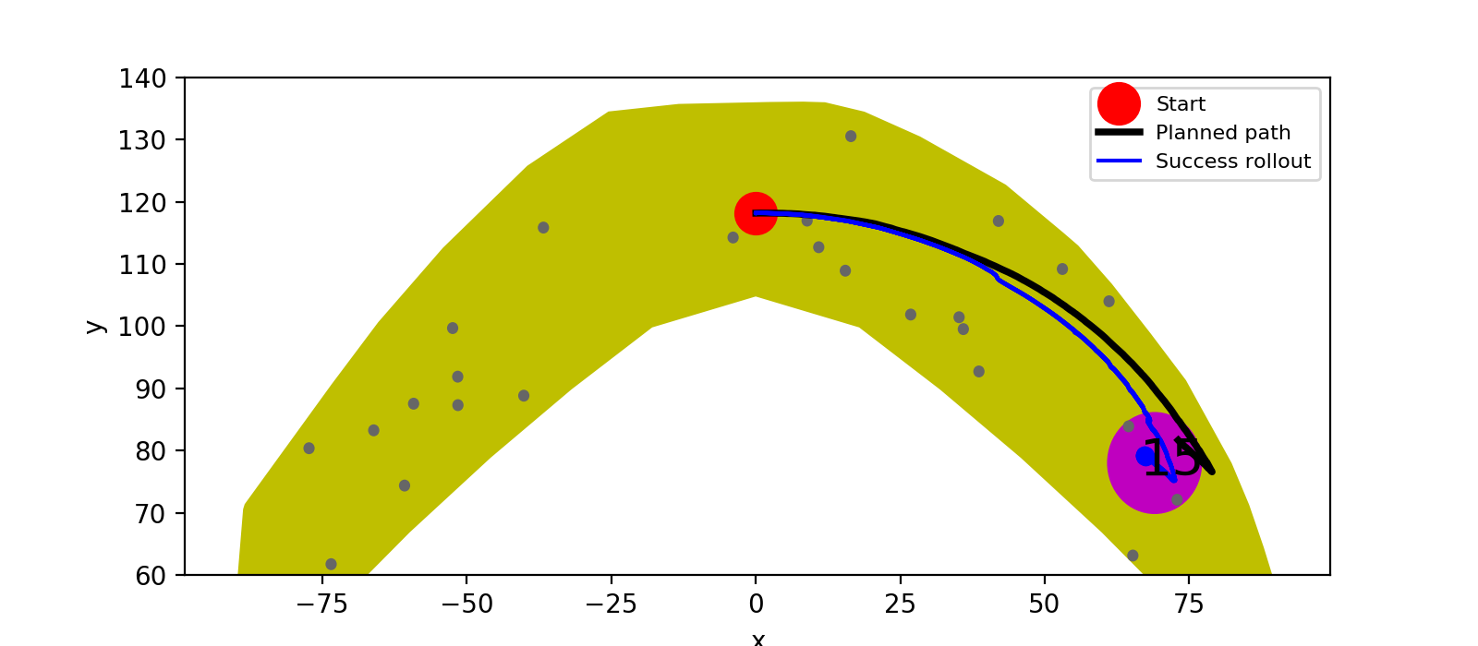
1%

Slide 5

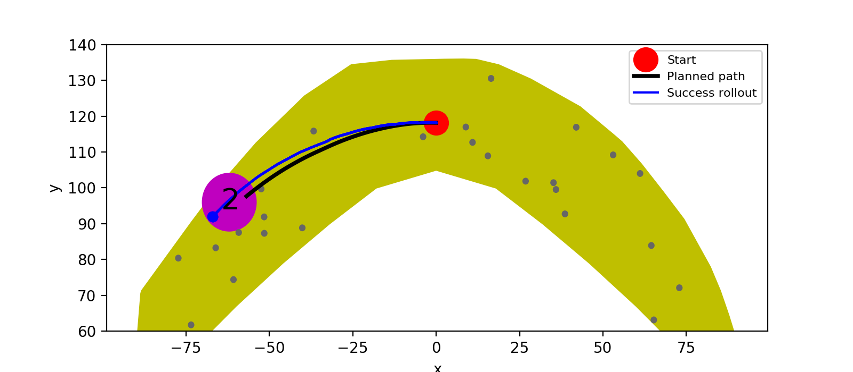
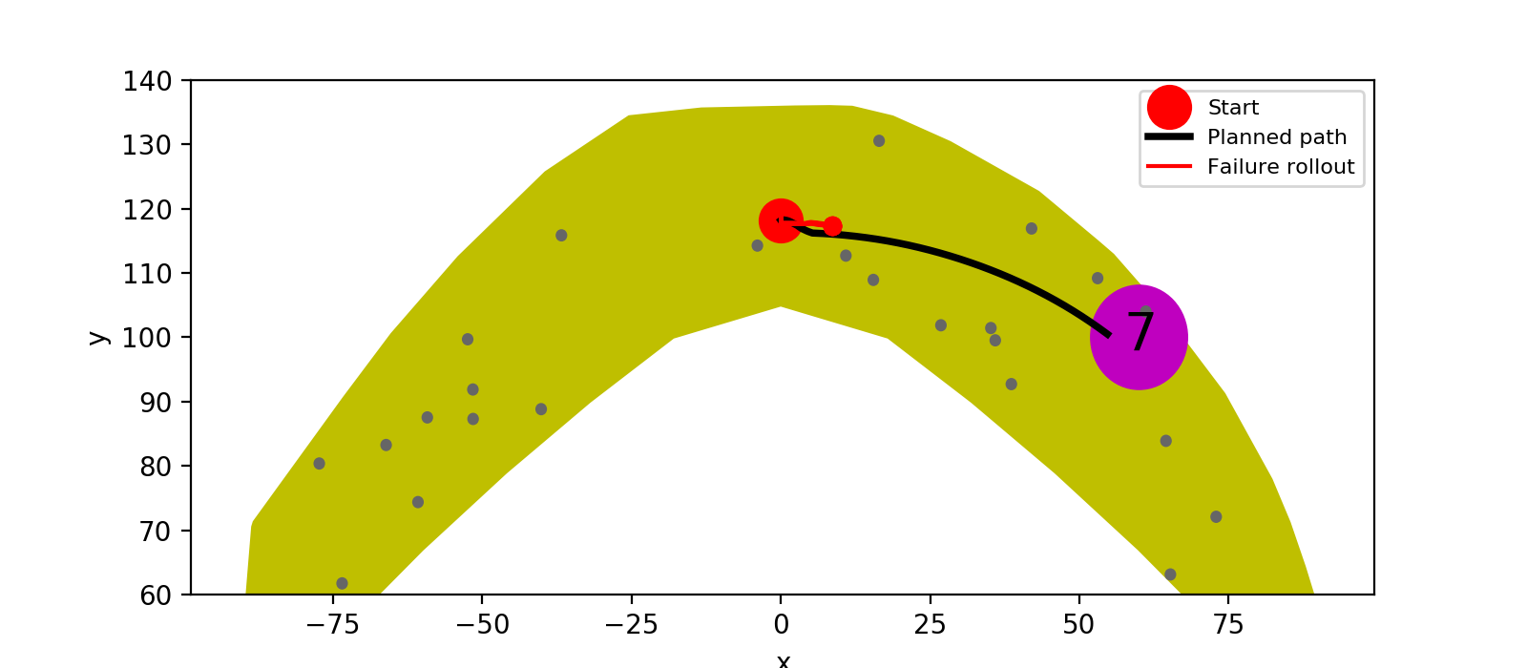
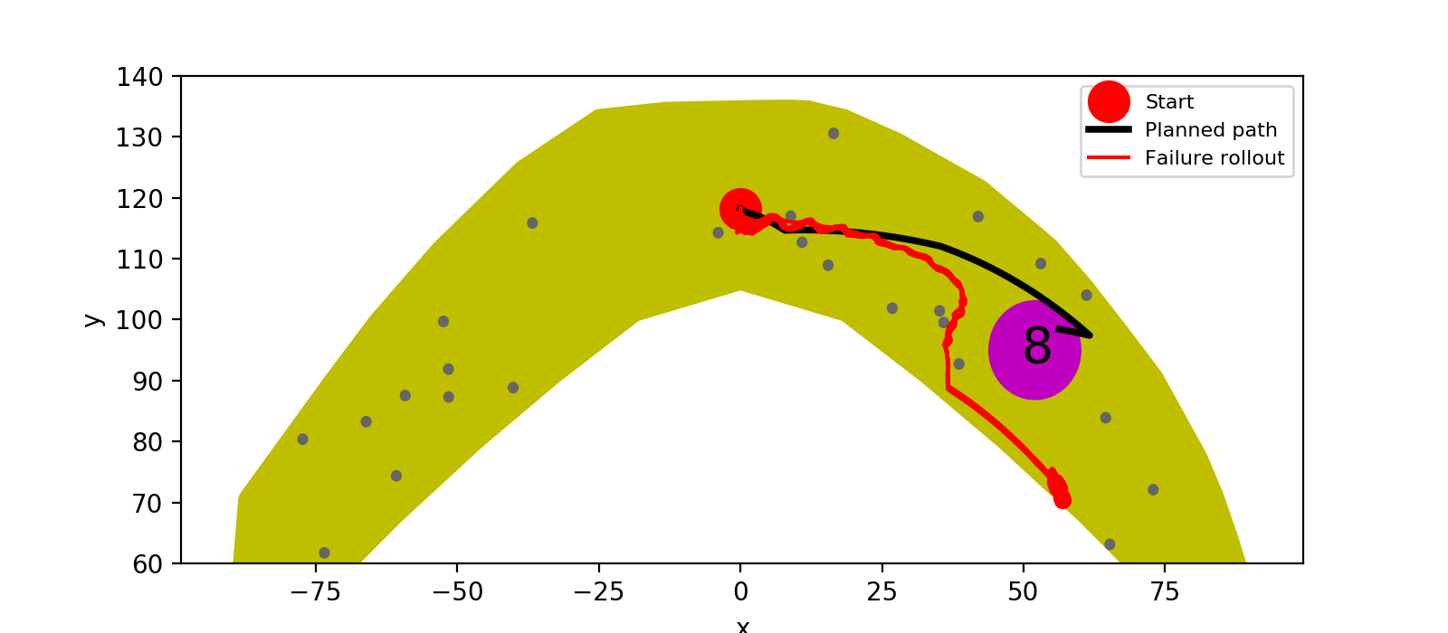
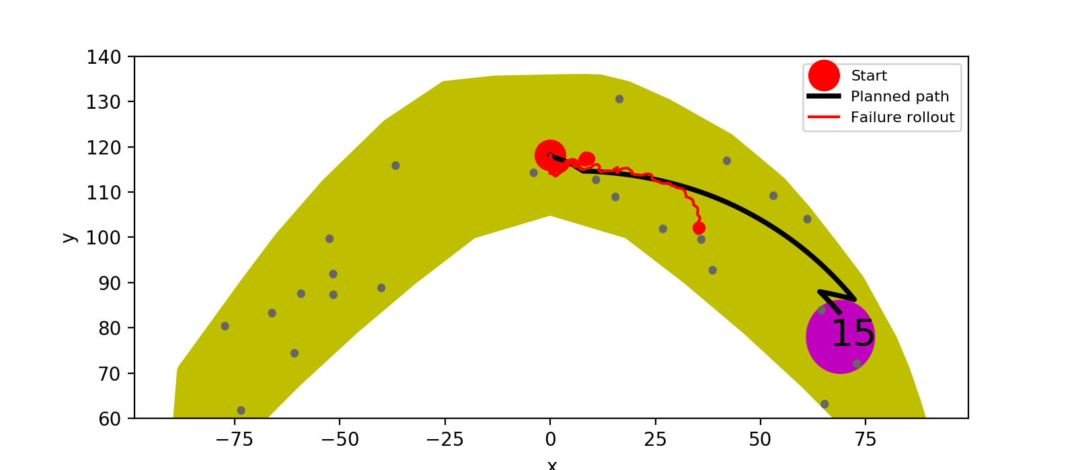
0.5%

Slide 6
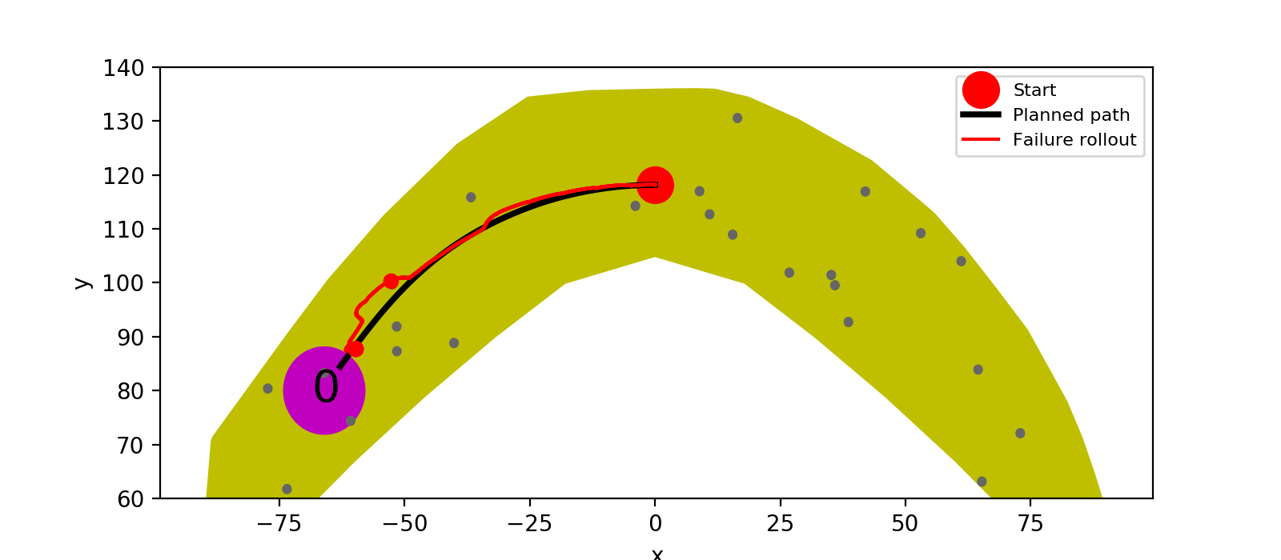
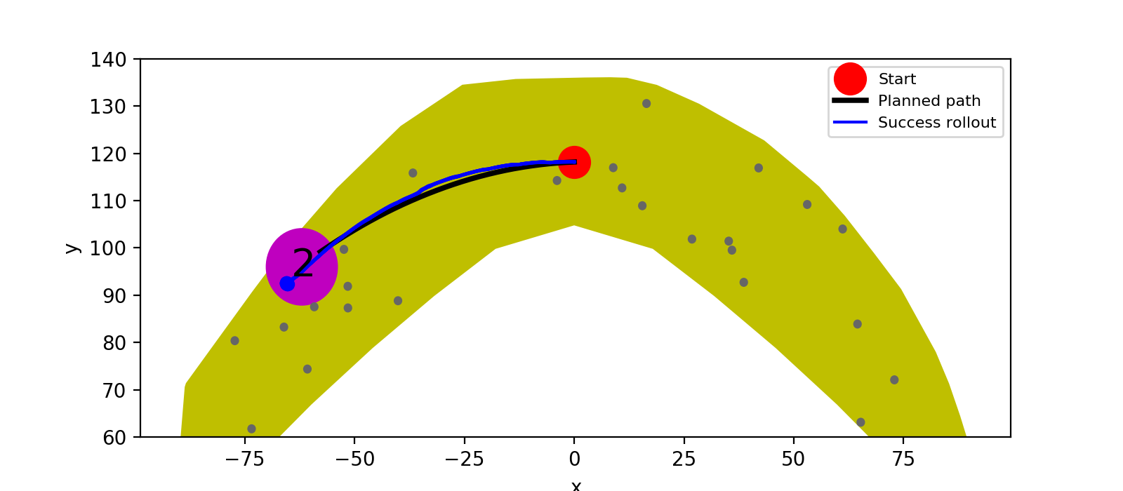

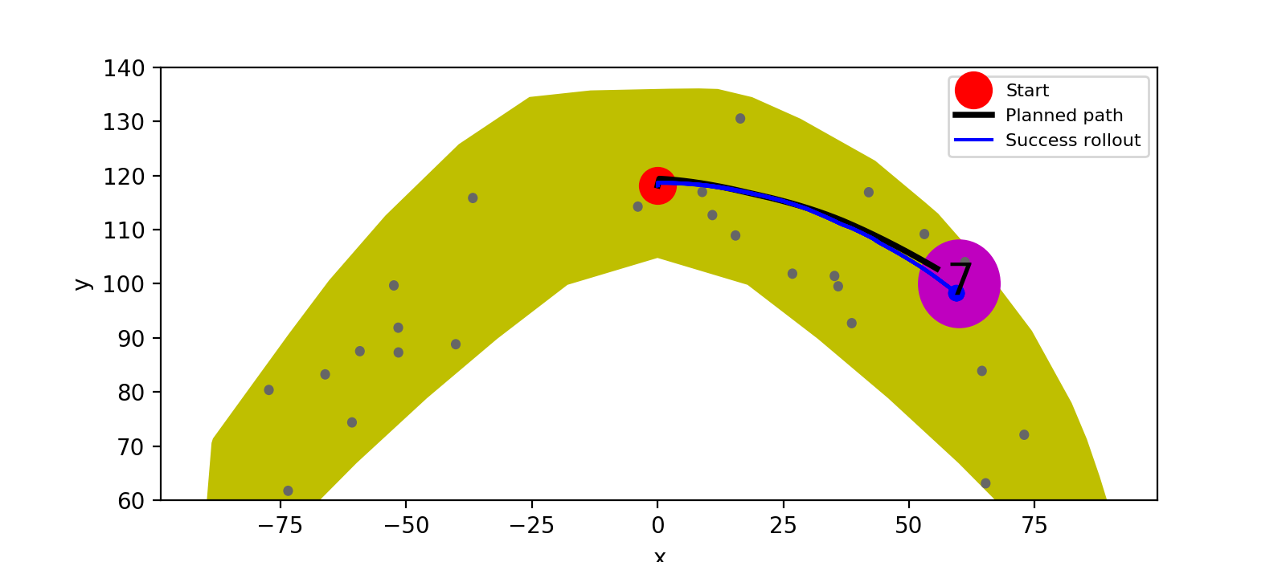
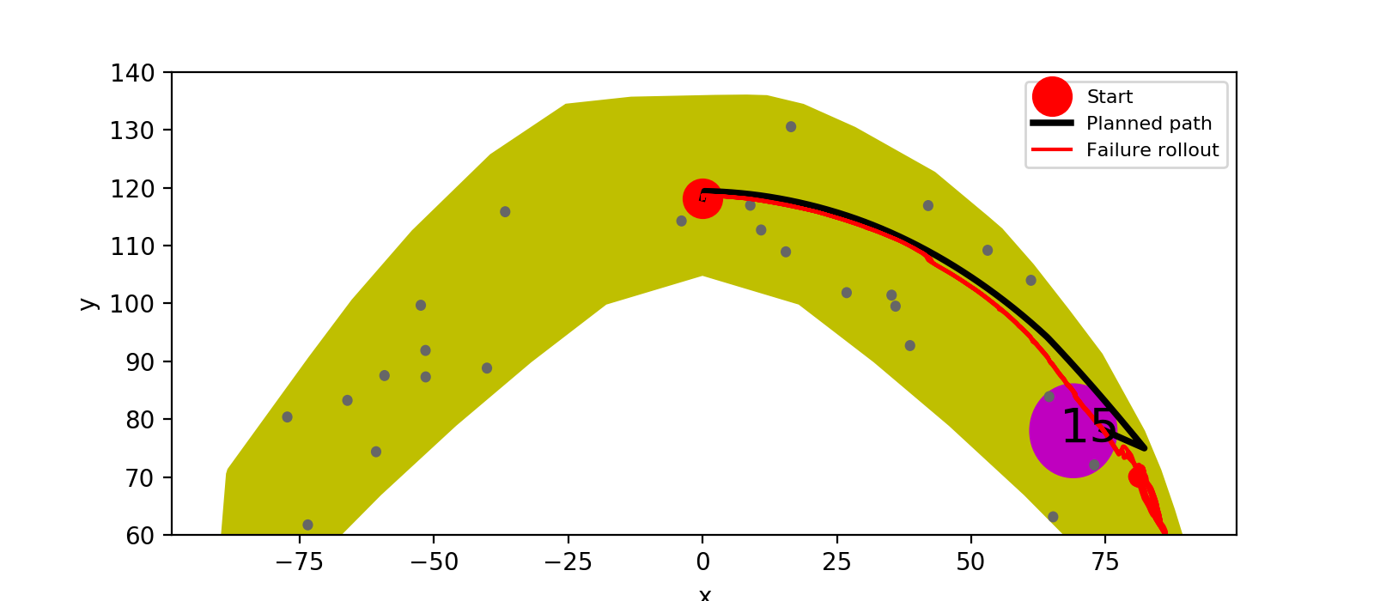
0.1%

Slide 7
Reacher “Goal Reach Rate” (All Goal Locations)
All models are trained with 50 epochs, except that 100 epochs are trained for 0.1% datasize, because 50 epochs training for 0.1% datasize did not find a path for goal location 5 within 3 hours.
Percentage of Data | Goal Location 1 | Goal Location 2 | Goal Location 5 | Average
100% (1M) | 100% | 100% | 100% | 100%
50% | 100% | 100% | 0% | 67%
40% | 100% | 0% | 80% | 60%
30% | 0% | 100% | 0% | 33%
20% | 100% | 0% | 0% | 33%
10% | 100% | 70% | 50% | 73%
5% | 0% | 100% | 50% | 50%
1% (16k) | 100% | 100% | 0% | 67%
0.5% (8k) | 0% | 70% | 0% | 23%
0.1% (1.6k) (100 Epochs are trained) | 0% | 100% | 0% | 33%

Slide 8
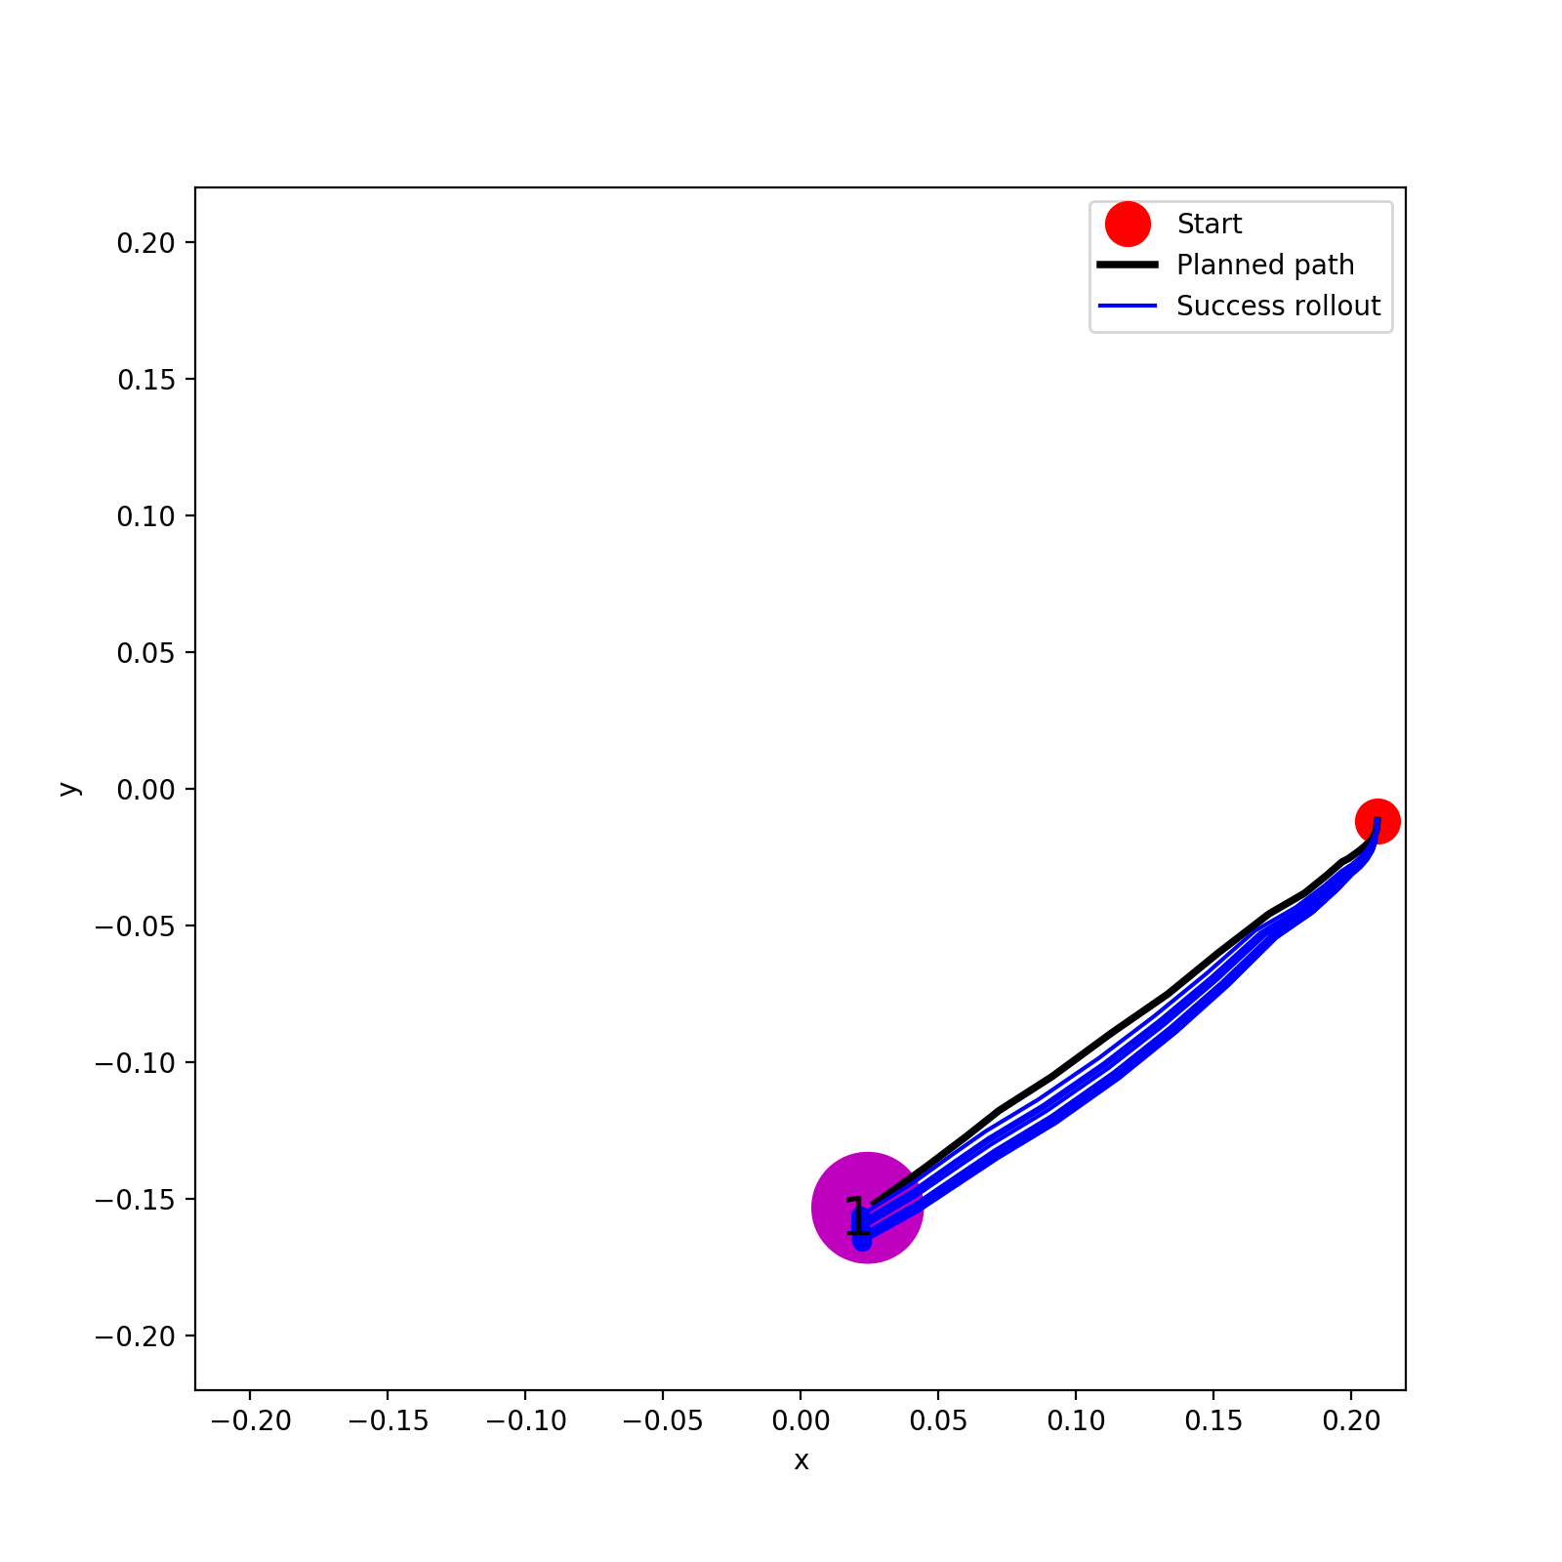
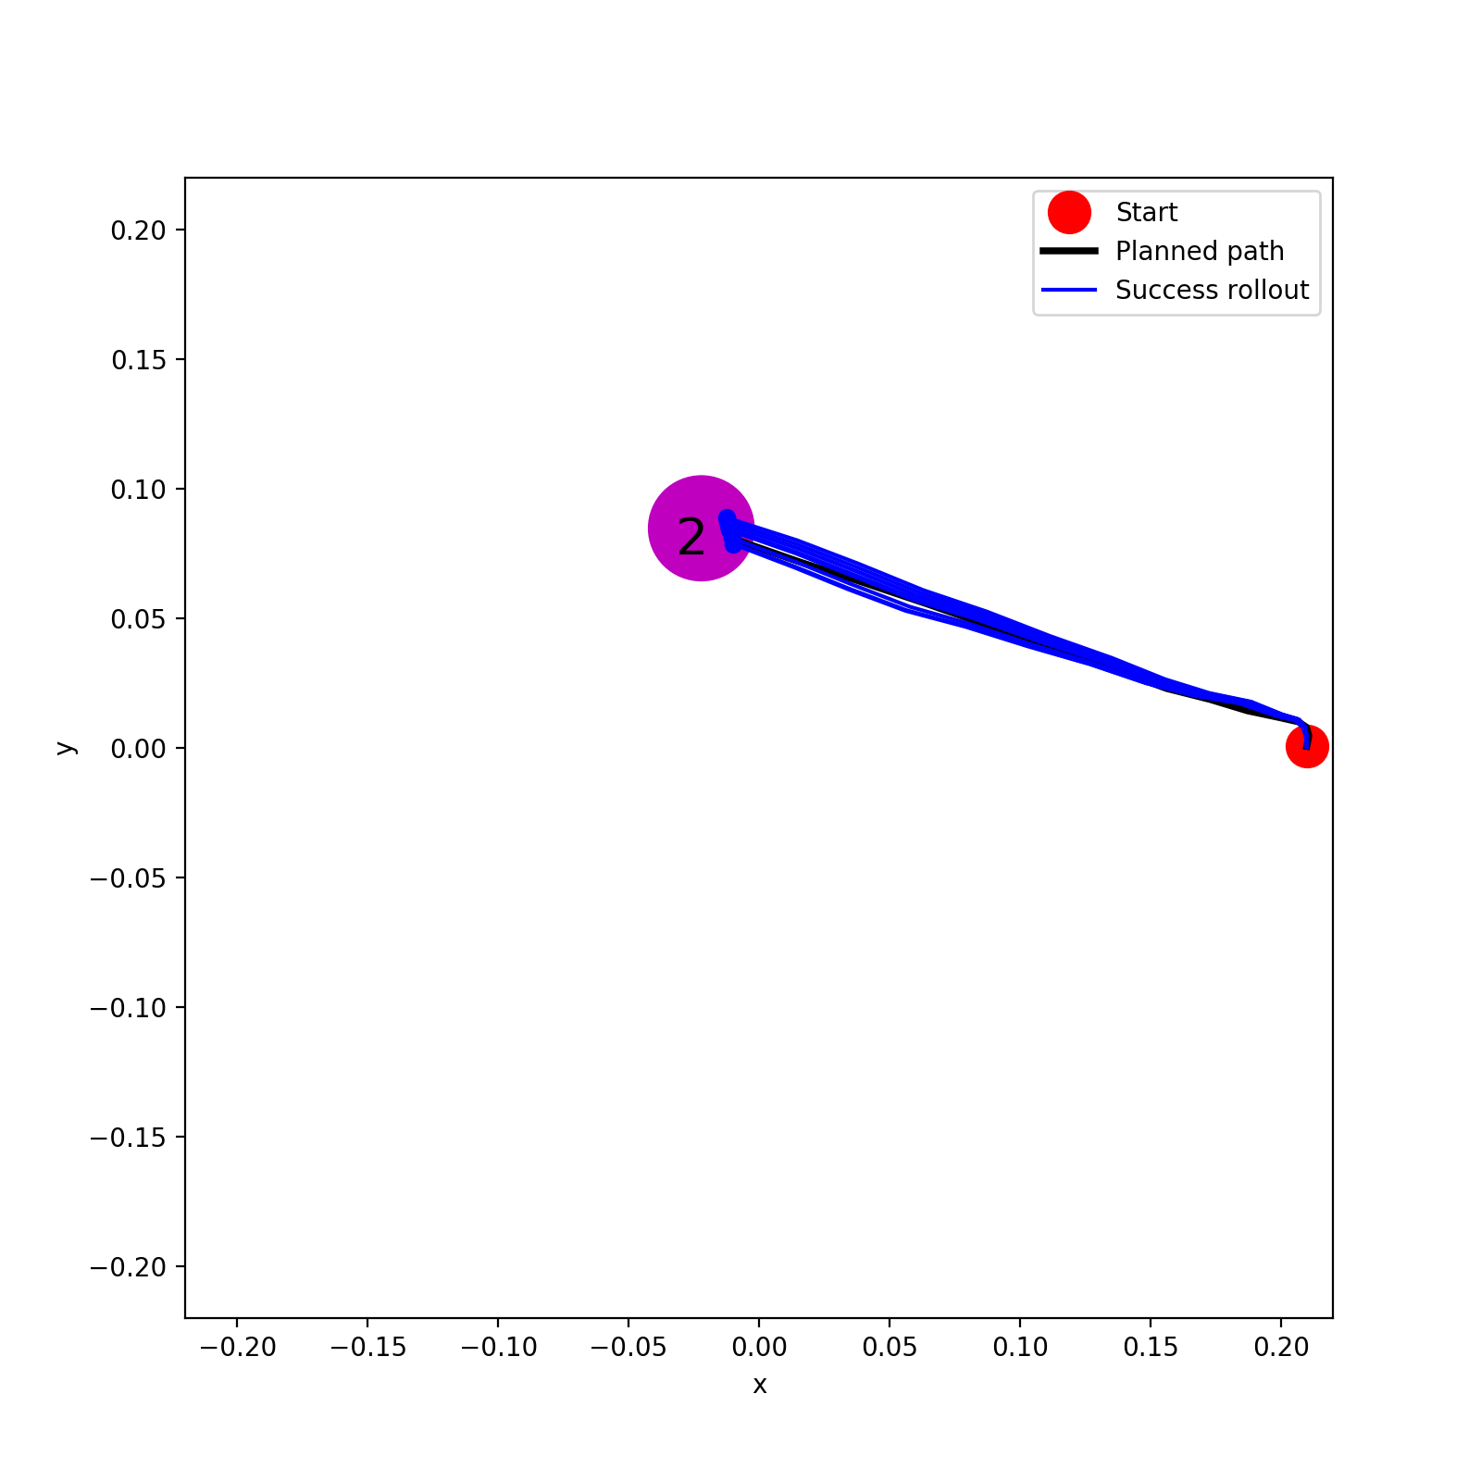
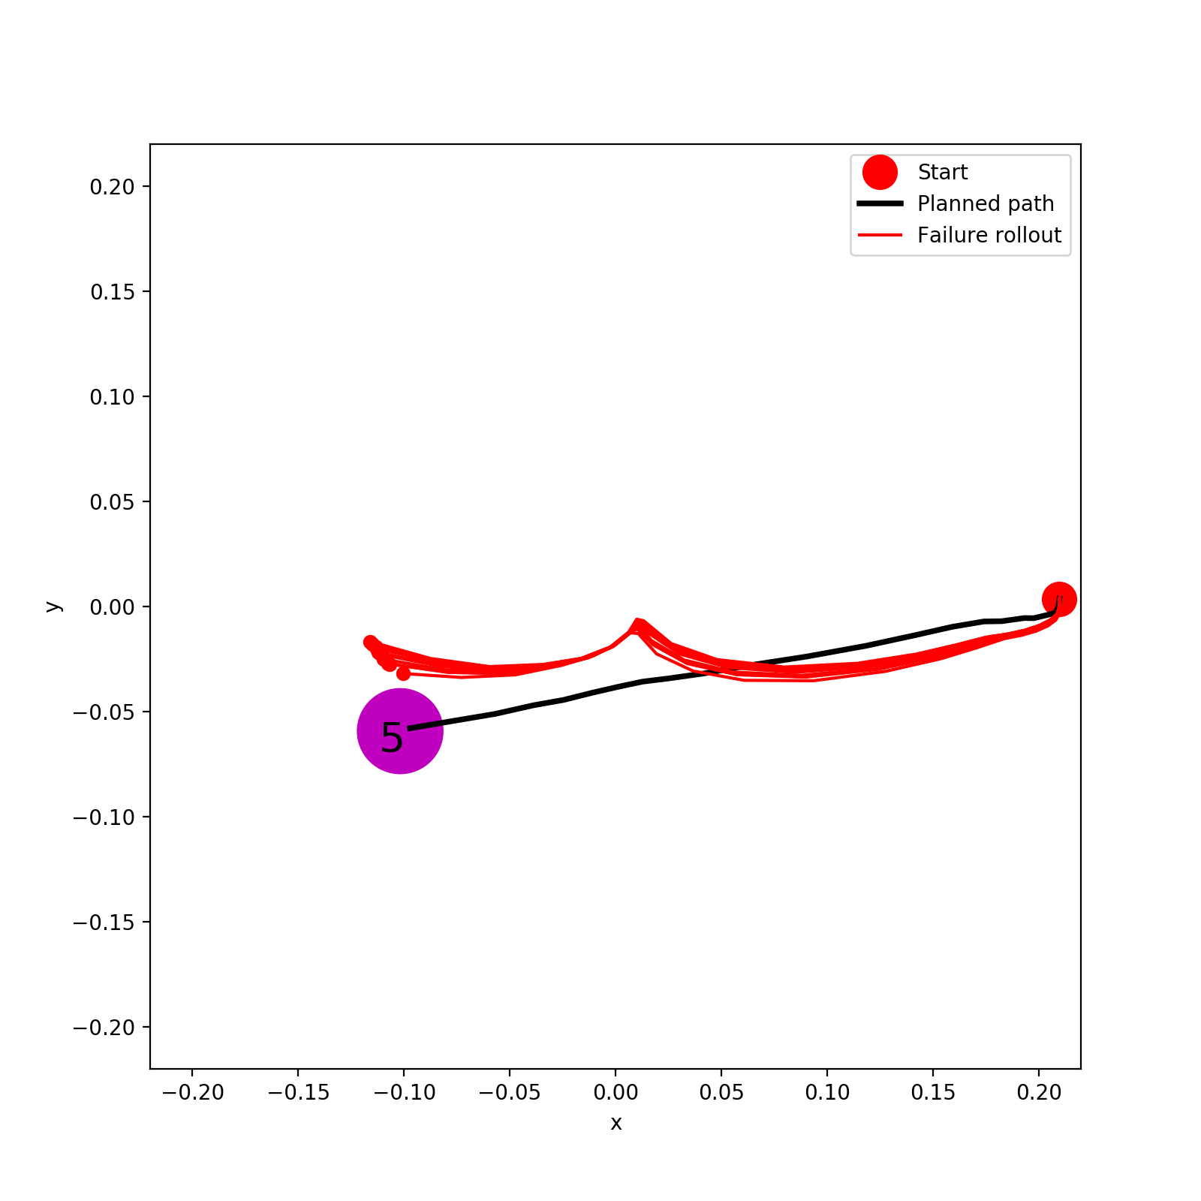
1%

Slide 9
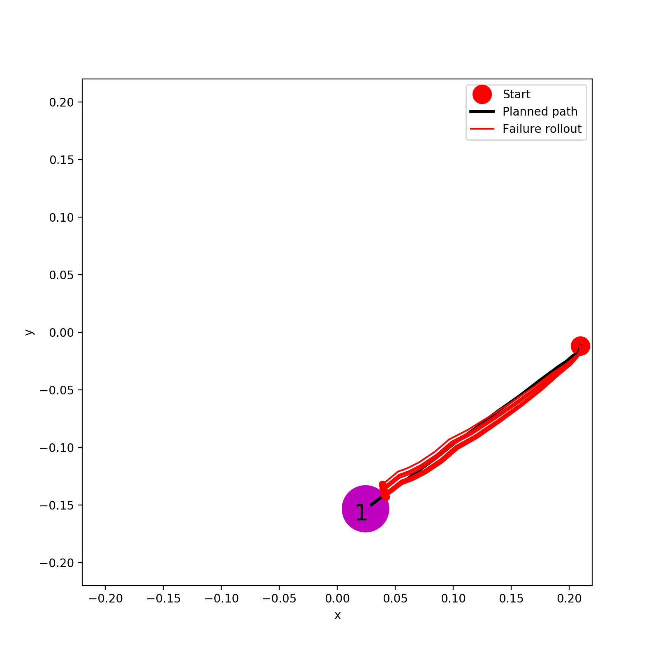
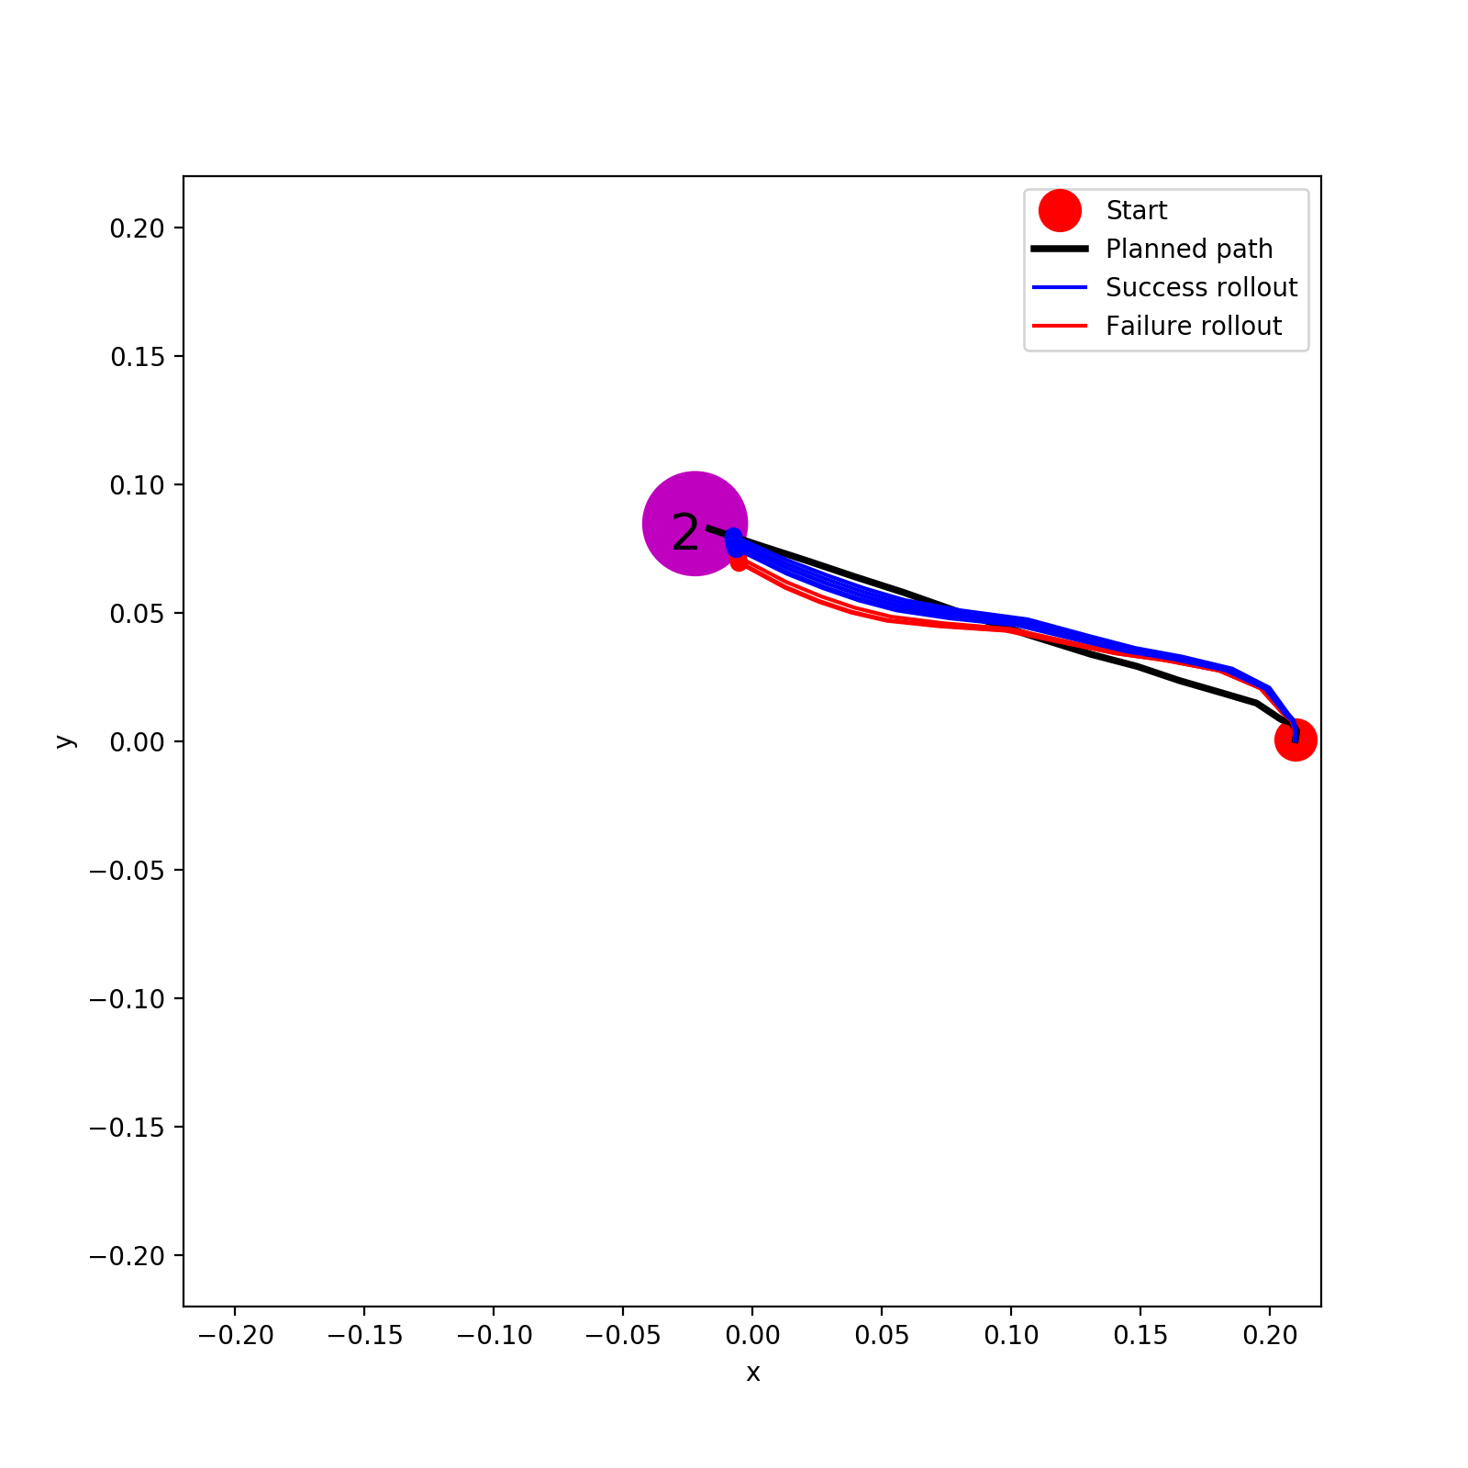
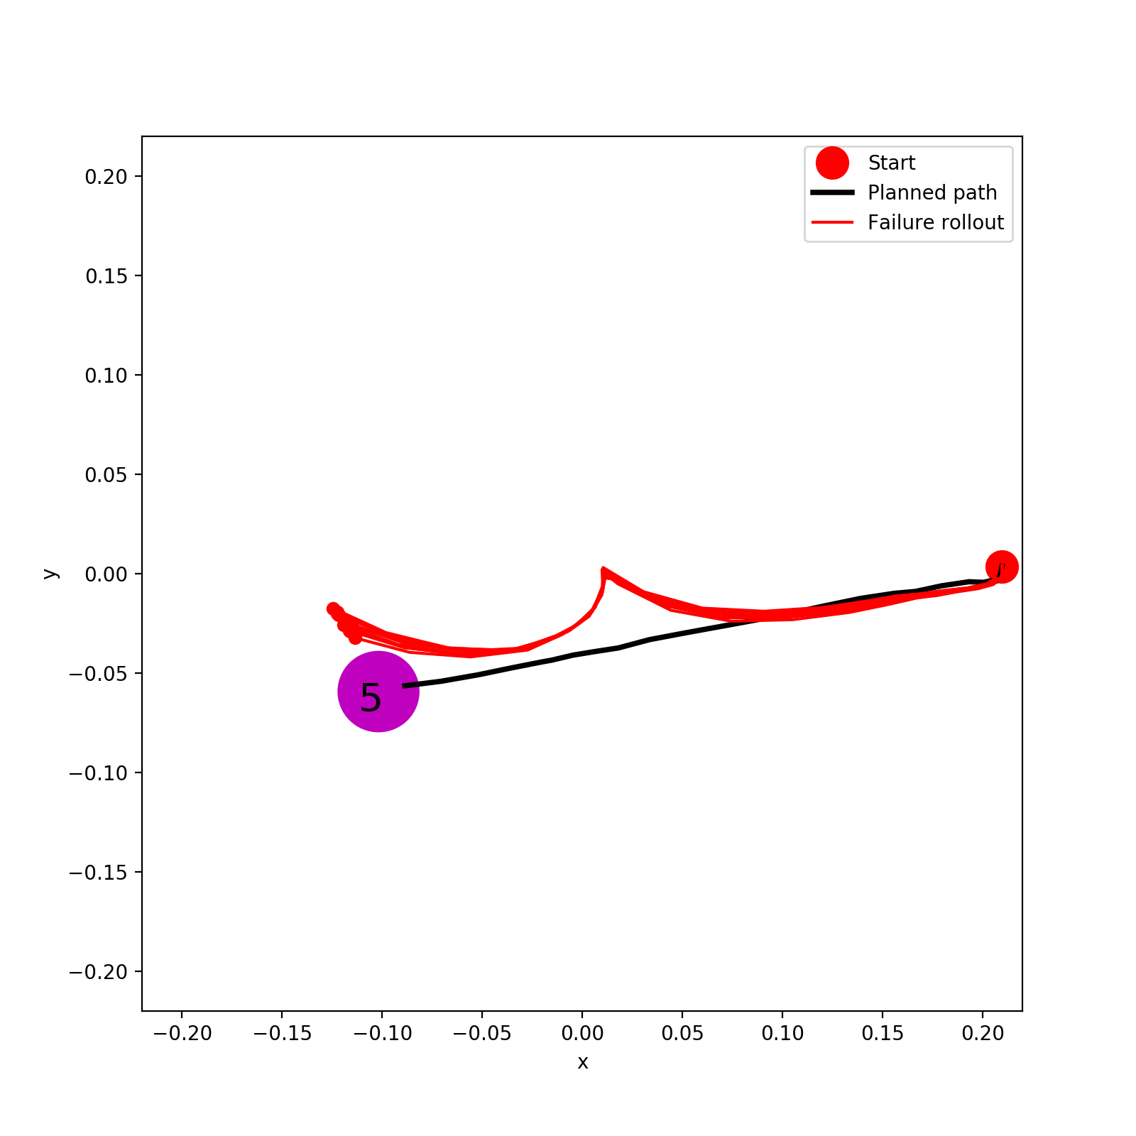
0.5%

Slide 10
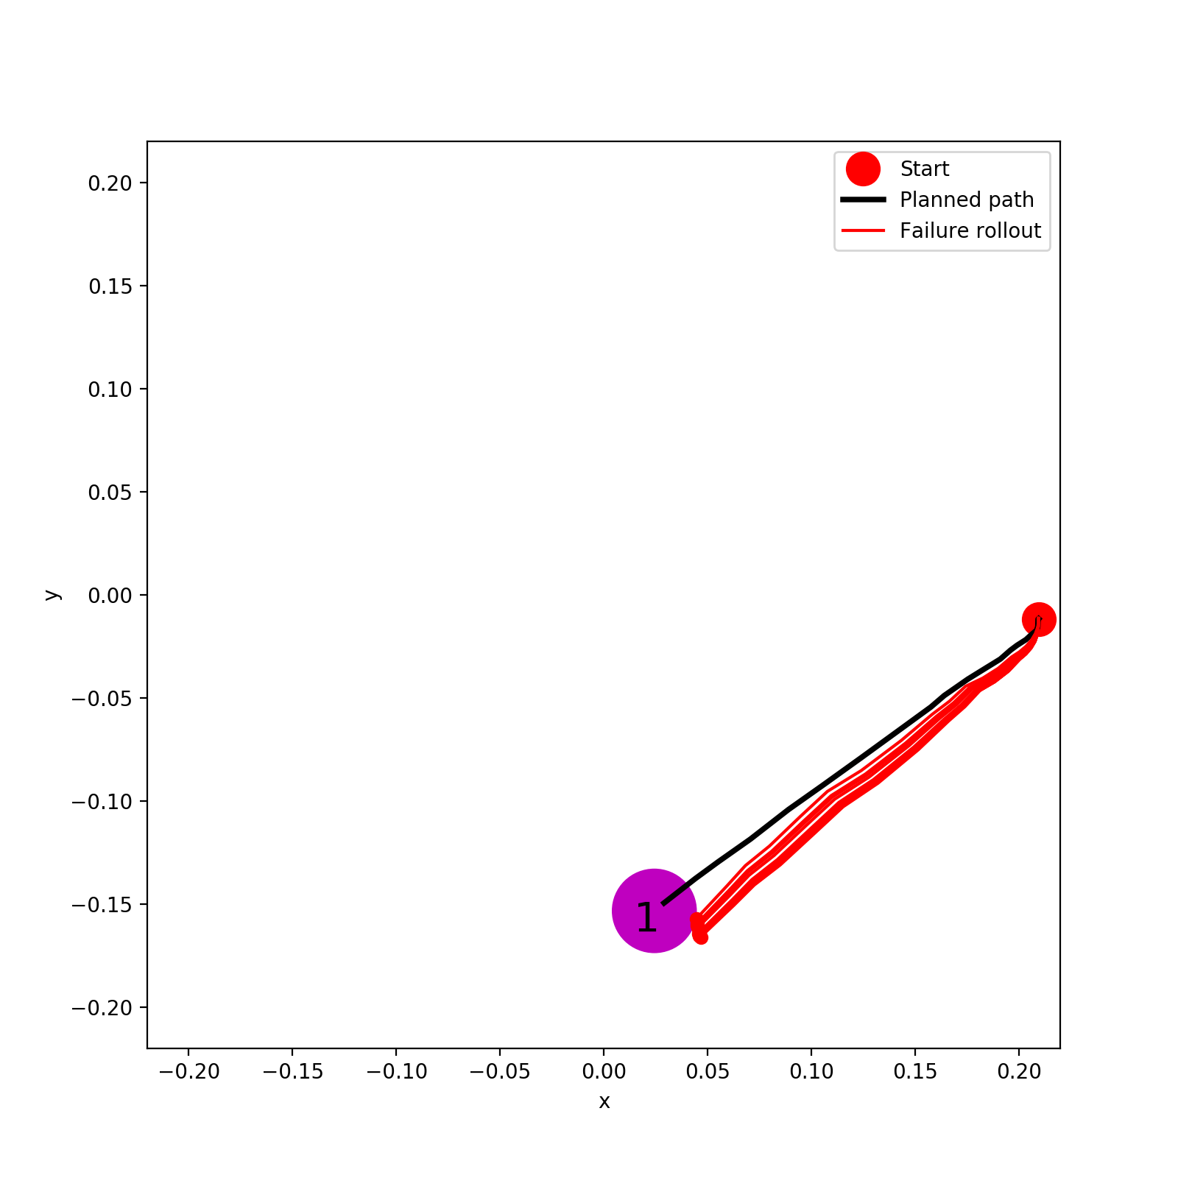
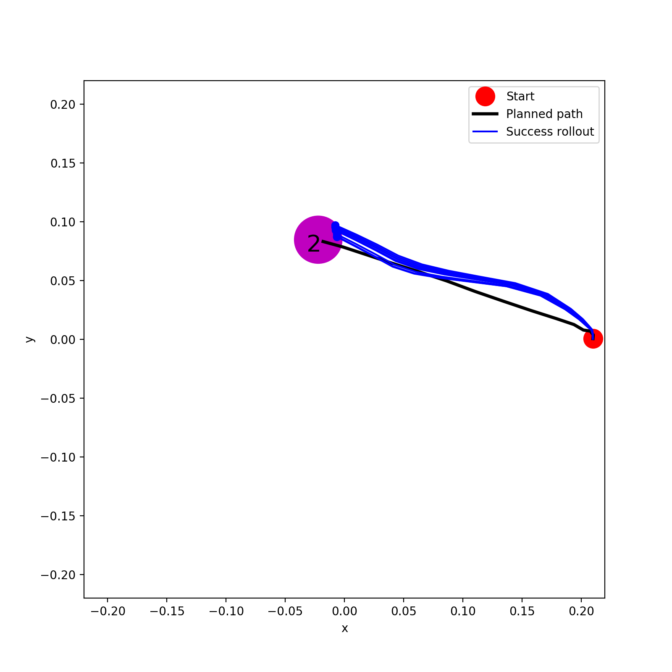
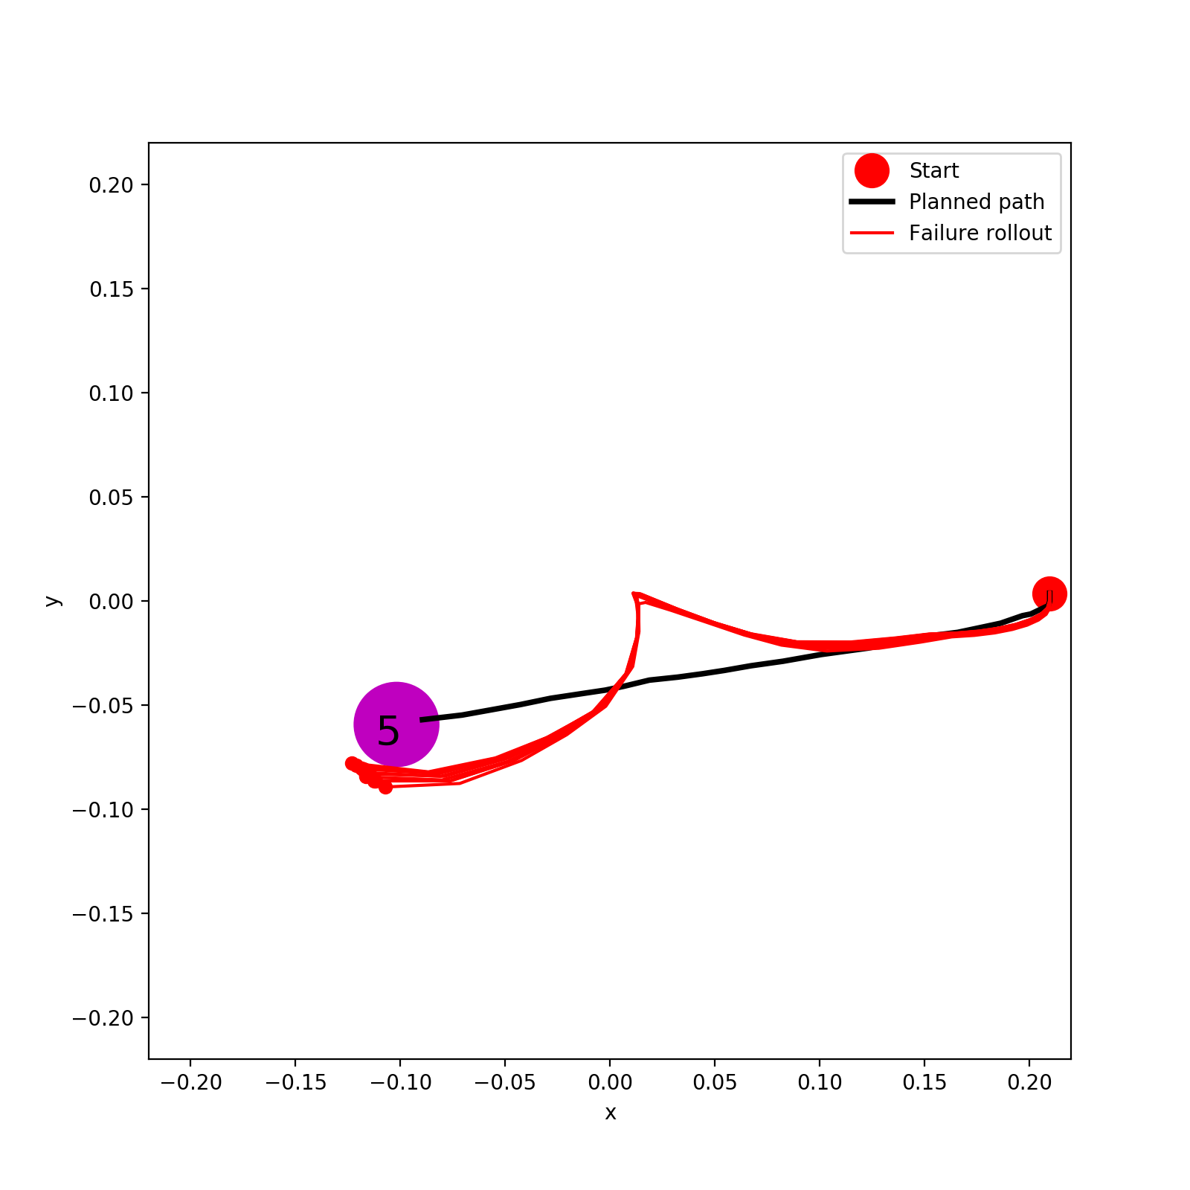
0.1%

Slide 11
To Do List and Questions
Possible two options for the input of our AIP
- AIP (based on A*)
- AIP (based on PPO)
Datasize for Neural Network Model | A* | PPO from model + Offline planning + Rollout | PPO from model + Online rollout | Online vanilla PPO + Rollout | AIP (based on A*) + Rollout
100% | Done | Done | Missing? Not necessary? | Missing? Not necessary? | Missing
?% (Which model to use?) (0.5% or 0.1% or ?) | Done | Missing? Not necessary? | Missing? Not necessary? | Missing? Not necessary? | Missing

