Slide 1
Meeting 09/07/2020
Shuo Zhang

Slide 2
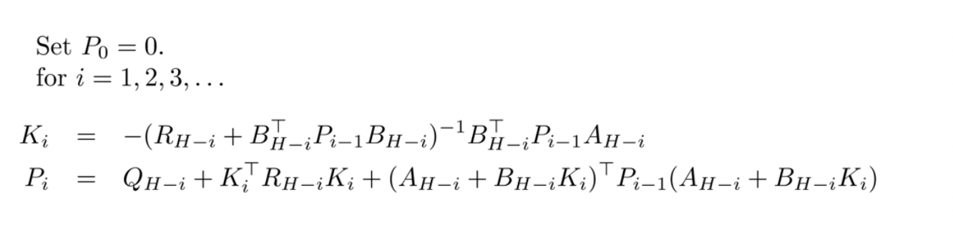
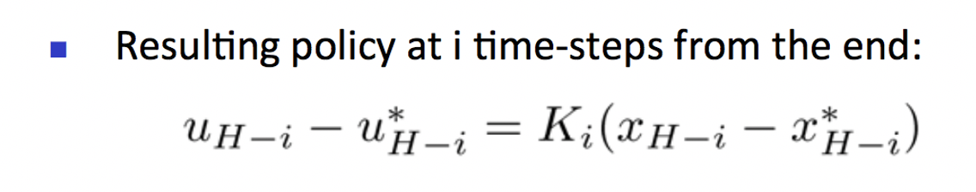
Past week
- Implemented (A*-based)LQR closed-loop control for Reacher (3 goal locs)
- Calculated Matrix K for all 4 tasks

Slide 3
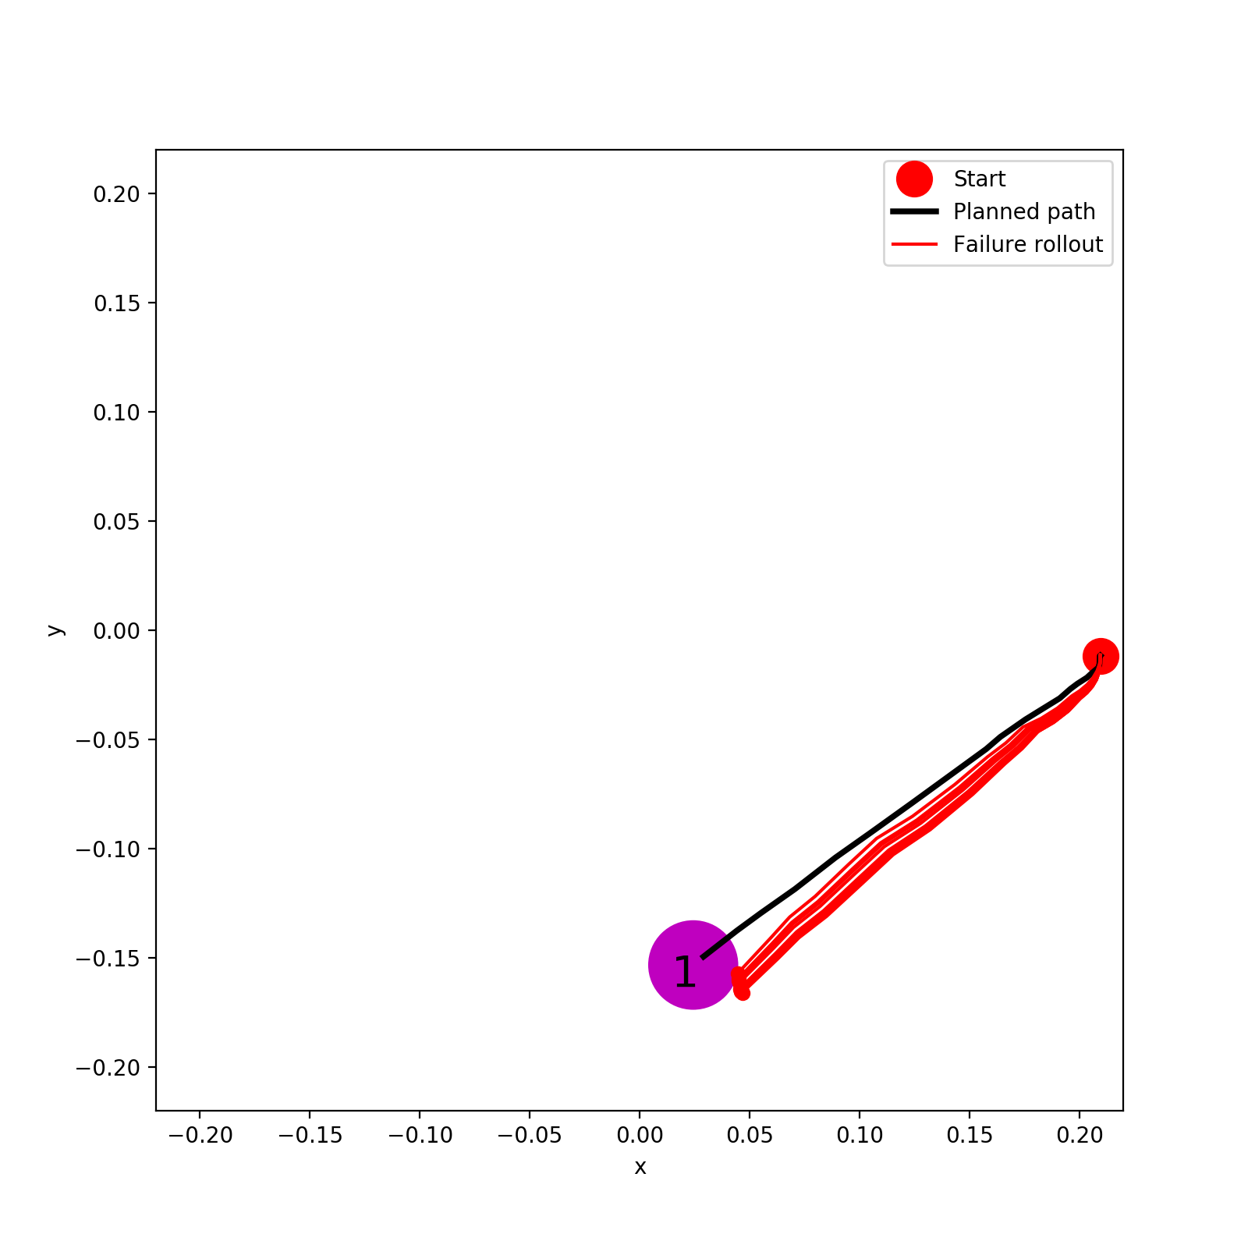
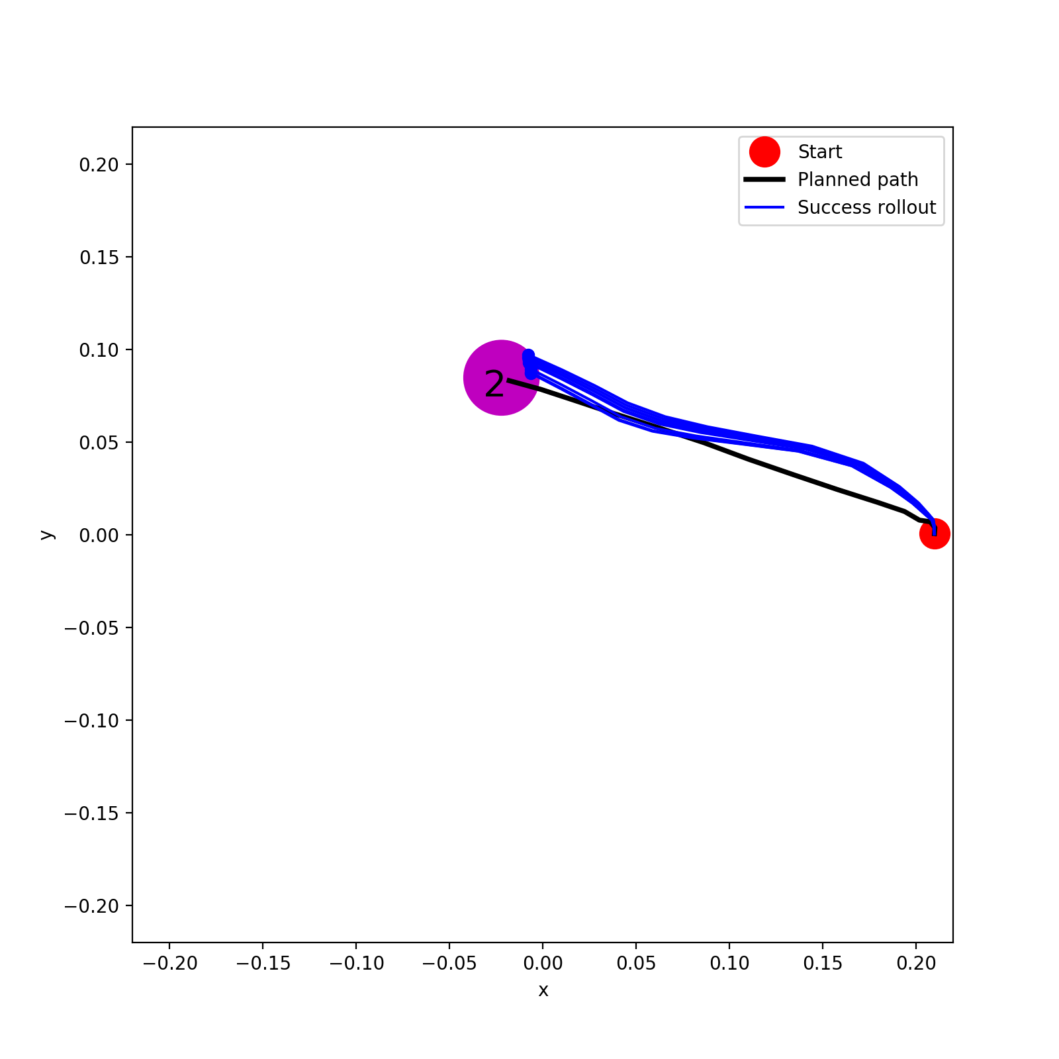
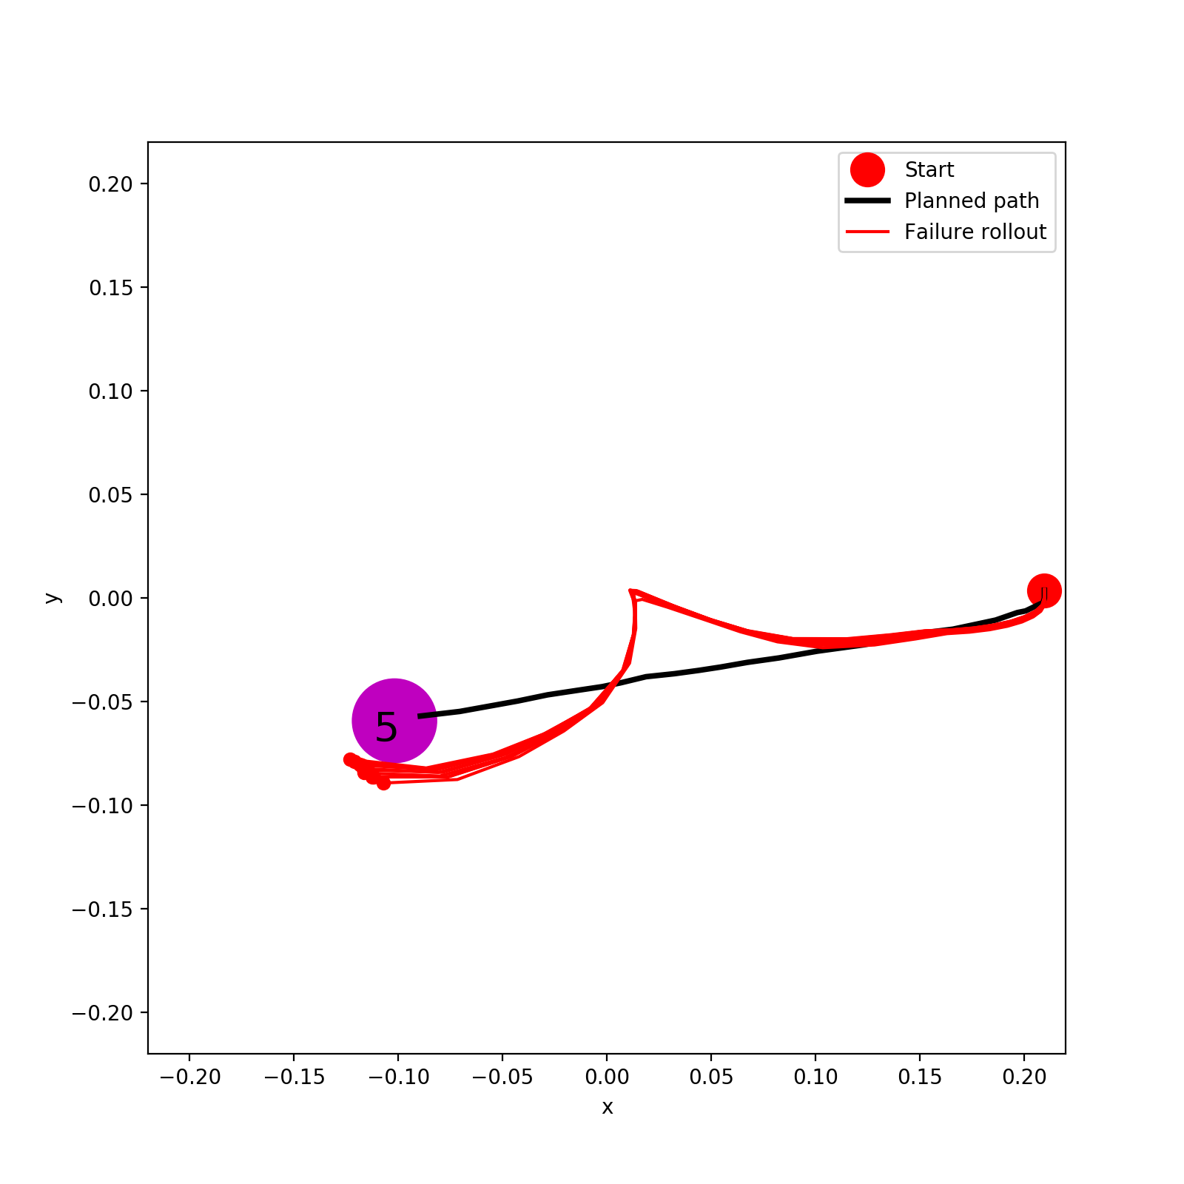
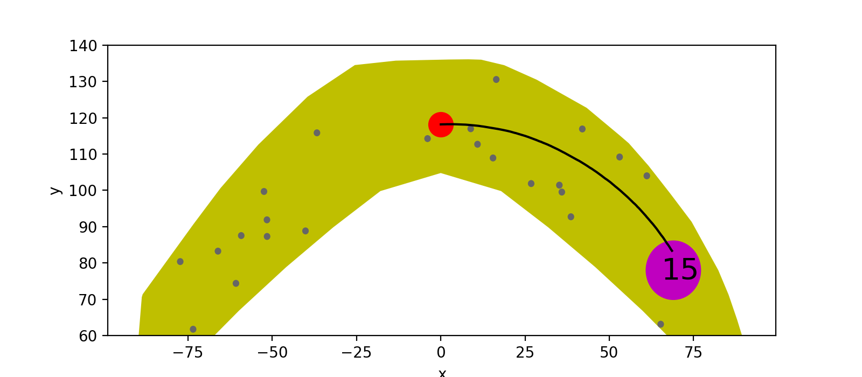
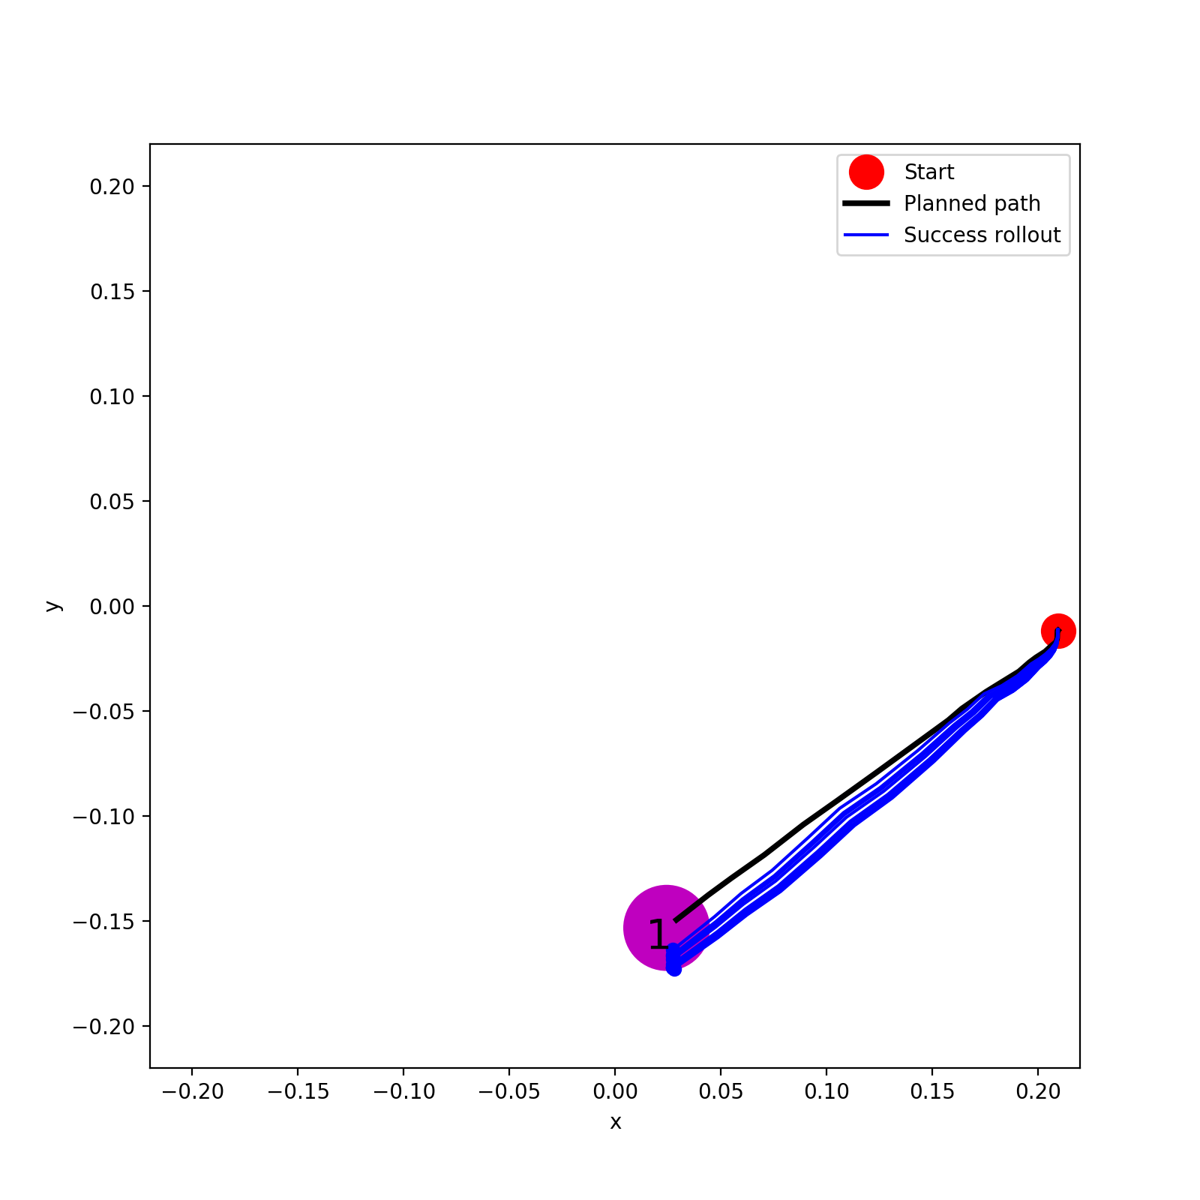
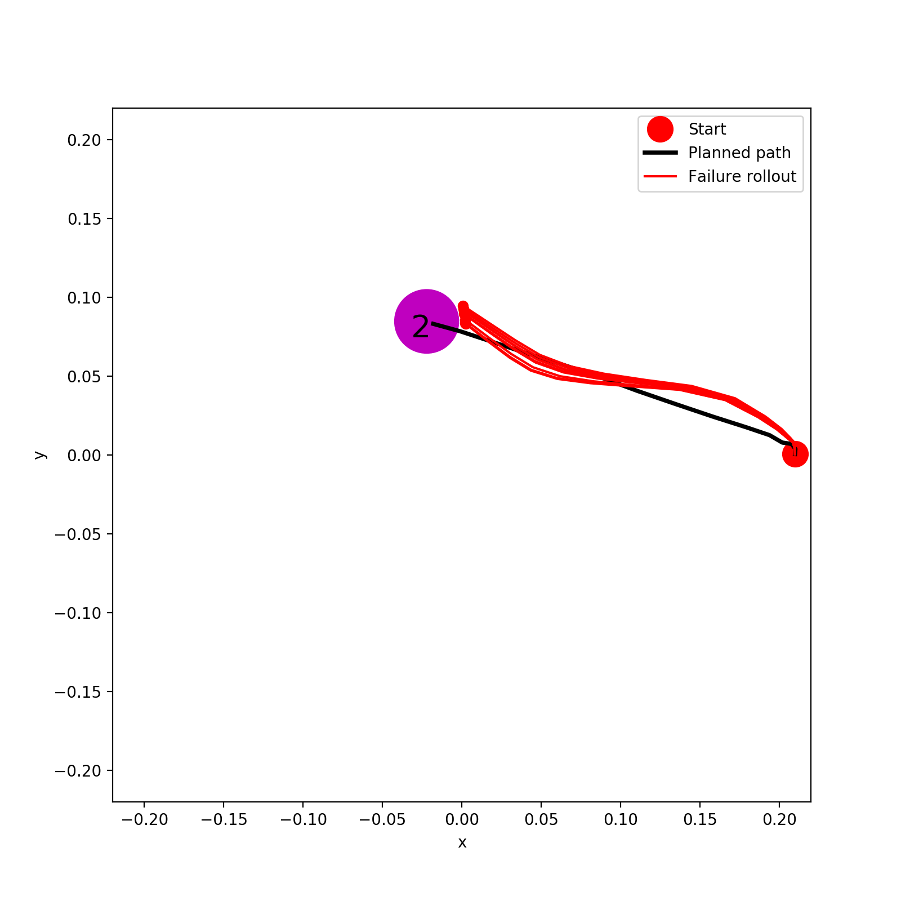
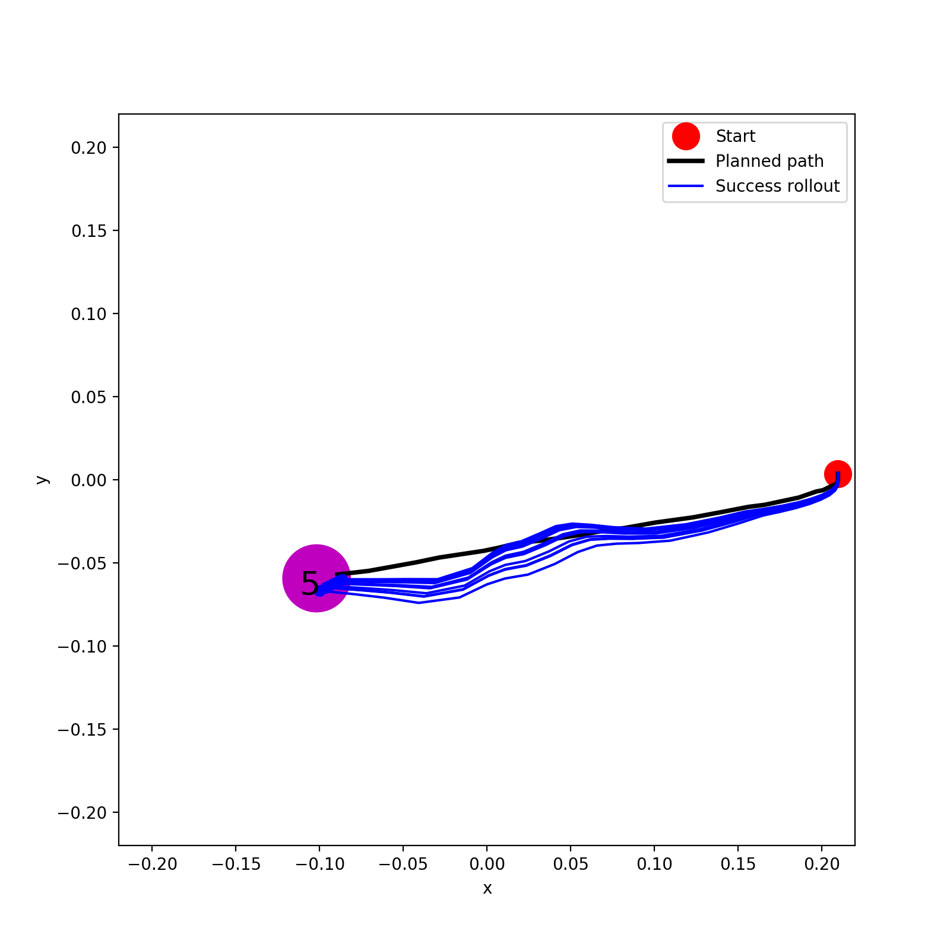
A*
Method | Goal Loc 1 | Goal Loc 2 | Goal Loc 5
A* | 0% | 100% | 0%
LQR | 100% | 0% | 100%
(A*-based) LQR

Slide 4
Next plans
Solve issues of marker tracking. Then, make sure real hand model works with new data. Then, A*+PPO Rollout(100%) on real hand. If too good, reduce data+retrain dynamics+redo A* and PPO and their rollouts? Then, LQR.
Make gazebo hand task more difficult?
LQR on Acrobot? Switch to other Mujoco tasks?
Derive new equations, objective function and optimization procedures for our AIP
Implement AIP
Should also try closed loop control using PPO (trained from model) on real environment?

Slide 5
AIP Implementation (against TRPO,PPO)
Difference 1 Policy Network:
TRPO/PPO: u_final=pi_theta([x])
AIP: u_final=pi_theta([x, u_controller])
Difference 2 Constraint:
TRPO:
KL(pi_theta_new || pi_theta_old)<epsilon. (CG+Line Search)
PPO:
No constraint
Constraint (KL(pi_theta_new || pi_theta_old)<epsilon) combined into objective function
AIP:
KL(pi_theta_new || pi_theta_old)<epsilon
??KL(pi_theta || controller)<omega??
(Need to derive new equations and objective for optimization?)

Slide 6
Task | Open Loop A* +Rollout | Open Loop PPO + Rollout | Closed Loop PPO | Cloes Loop LQR based on A* | AIP (3 options)
Reacher (0.1% model) | Done + Done | Done + Done | Not yet | Done | Not yet
Gazebo Hand (0.1% model) | Done + Done | Done + Done | Not yet | Done | Not yet
Acrobot (100% model) | Done + Done | Done + Done | Not yet | Not yet | Not yet
Real Hand (100% model) | Done + Not yet | Done + Not yet | Not yet | Not yet | Not yet

