Slide 1
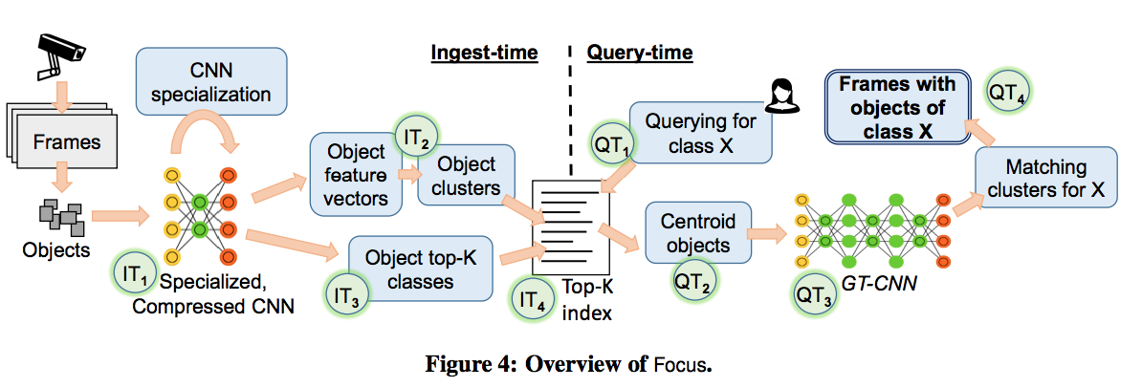
share convolution layers results of ingest-time to save query-time

