Slide 1
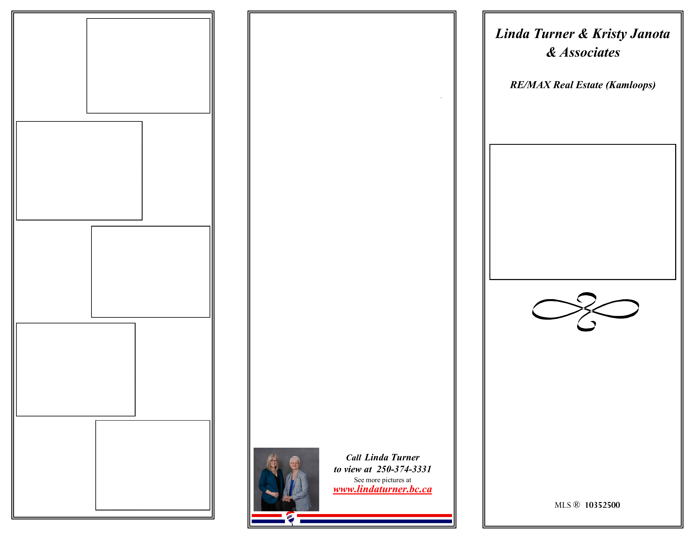
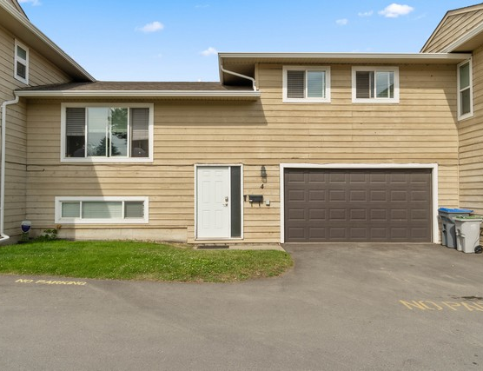
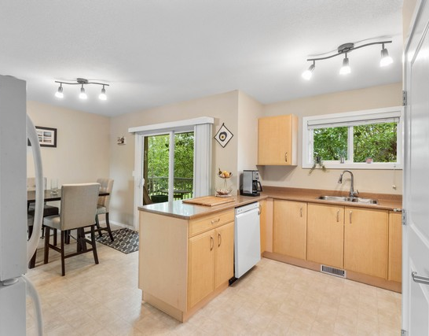
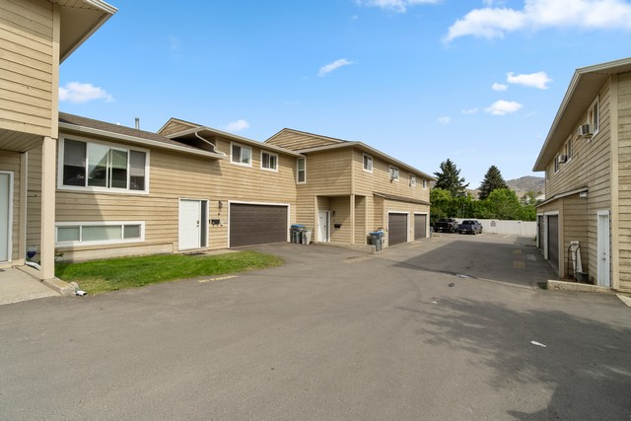
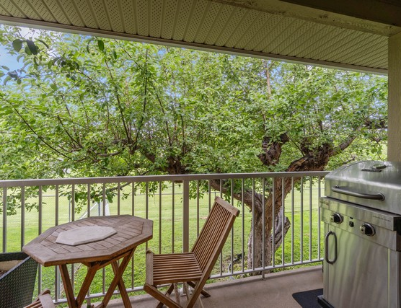
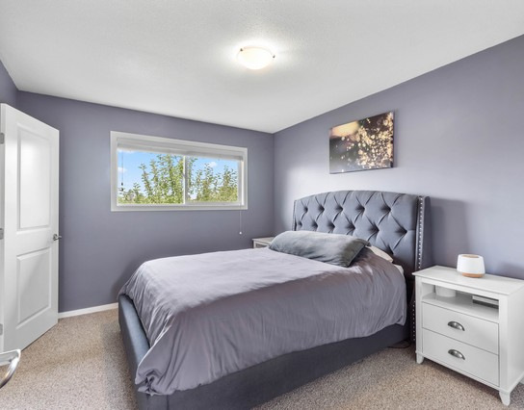
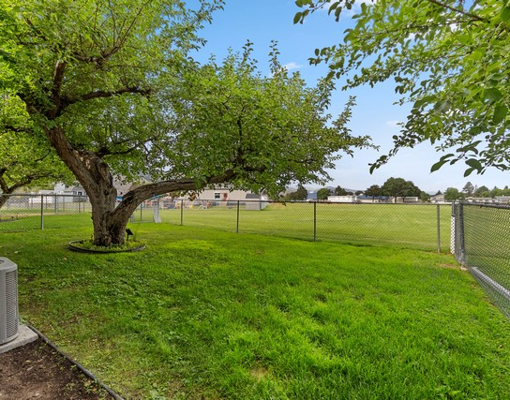
Front-facing garage and entry with a neat lawn and inviting driveway curb appeal.
4-1616 Happyvale Ave
Bright, functional 3-level split townhome on desirable Happyvale Avenue backing onto school-district land for added privacy.
Enjoy over 1,700 sq. ft. with a practical layout for families or flexible work-from-home living spaces.
Double garage plus four total parking spaces, including an assigned stall and driveway parking for everyday convenience.
Renovated in 2012 with kitchen updates and improvements including flooring, windows, roof, decks, and railings.
Pet- and rental-friendly complex with strata fees covering contingency reserve, insurance, maintenance, and utilities.
4-1616 Happyvale Ave
Bright kitchen with abundant cabinetry, neutral finishes, and natural light for everyday.
Covered deck for relaxing outdoors with a view of lush greenery and a convenient setup.
Comfortable primary bedroom featuring a statement upholstered headboard and calm, bright.
4-1616 Happyvale Ave: Family-Ready Split Townhome With Privacy and Double Garage
Bright, grassy backyard with mature shade tree and fencing that adds everyday privacy.
4 Bedrooms & 2 Baths
$499,900.00

Slide 2
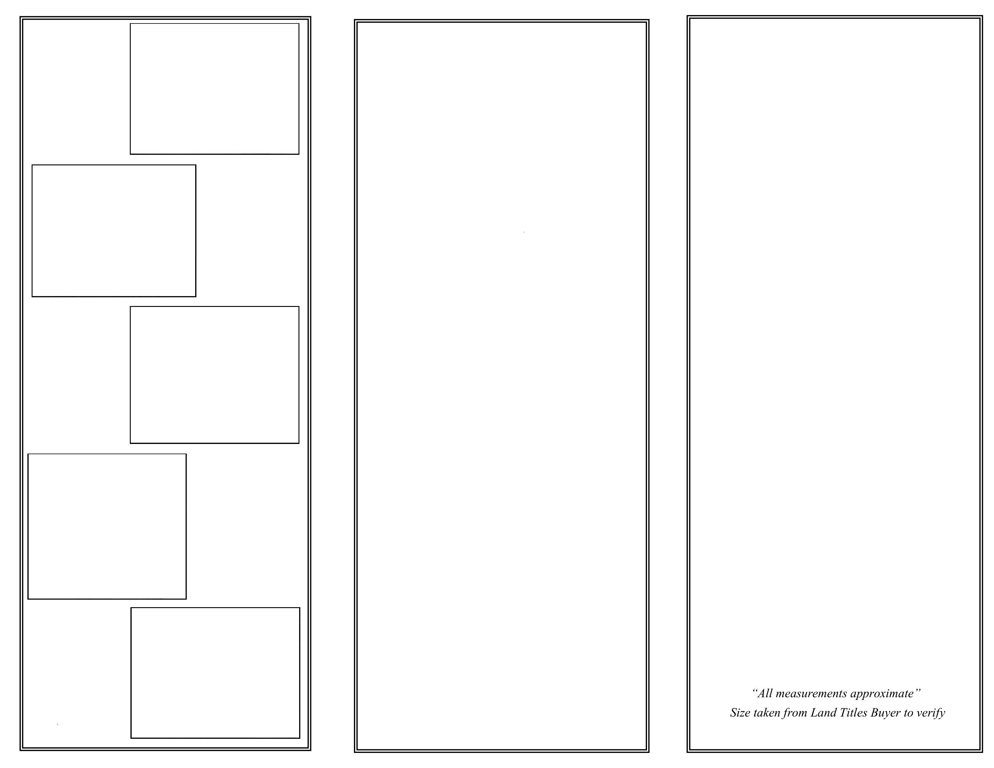
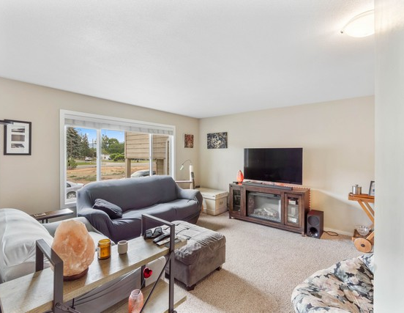
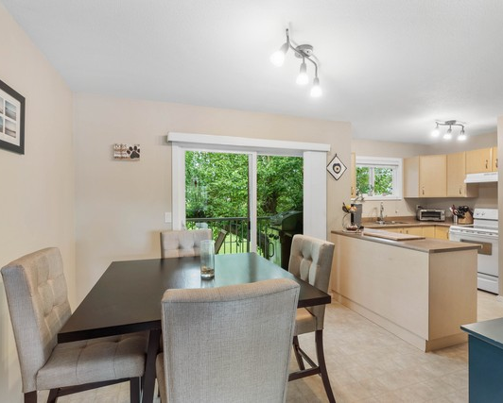
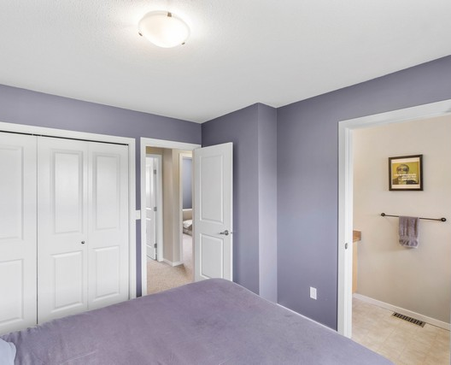
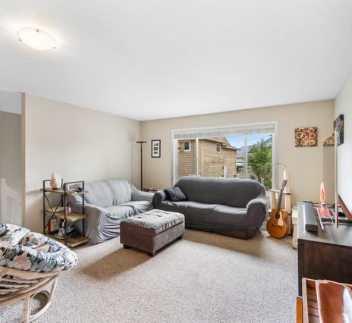
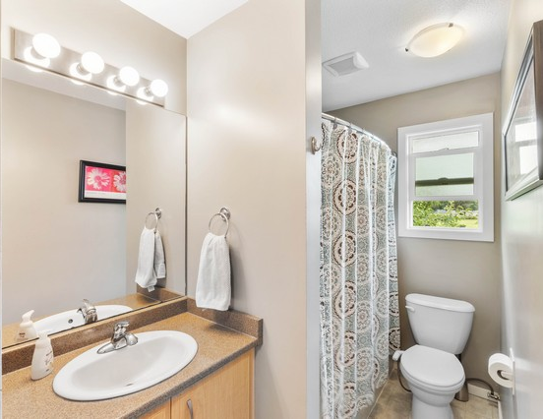
Cozy living room with a large window letting in light and a stylish media-wall focal point.
4-1616 Happyvale Ave
4-1616 Happyvale Ave
Location: KAM - Brocklehurst
Style: Cathedral Entry
Heating: Forced Air
Central Air
Includes: Dishwasher
Electric Range
Refrigerator
Washer/Dryer
Taxes: $3,145 (2025)
Main (1,046 sq. ft.)
Kitchen 10' 4" x 13' 11"
Living Room 14' 4" x 14' 9"
Dining Room 9' 2" x 8' 9"
Primary Bedroom 11' 8" x 10' 6"
Bedroom 8' 3" x 8' 9"
Lower (674.9 sq. ft.)
Bedroom 12' 7" x 12' 9"
Bathroom 4 piece
Ensuite 2 piece
Laundry 9' 3" x 3'
Family Room 19' 3" x 12' 6"
Storage 18' 9" x 6'
Dining area flows from the kitchen and opens to backyard views through large doors.
Spacious bedroom with fresh color, roomy closet storage, and easy access from the hall.
Inviting living room seating in a bright, airy layout made for relaxing and hosting.
Clean, well-lit bathroom with a spacious vanity and bright walk-in shower area.
Total (1,721 sq. ft.)

