Slide 1
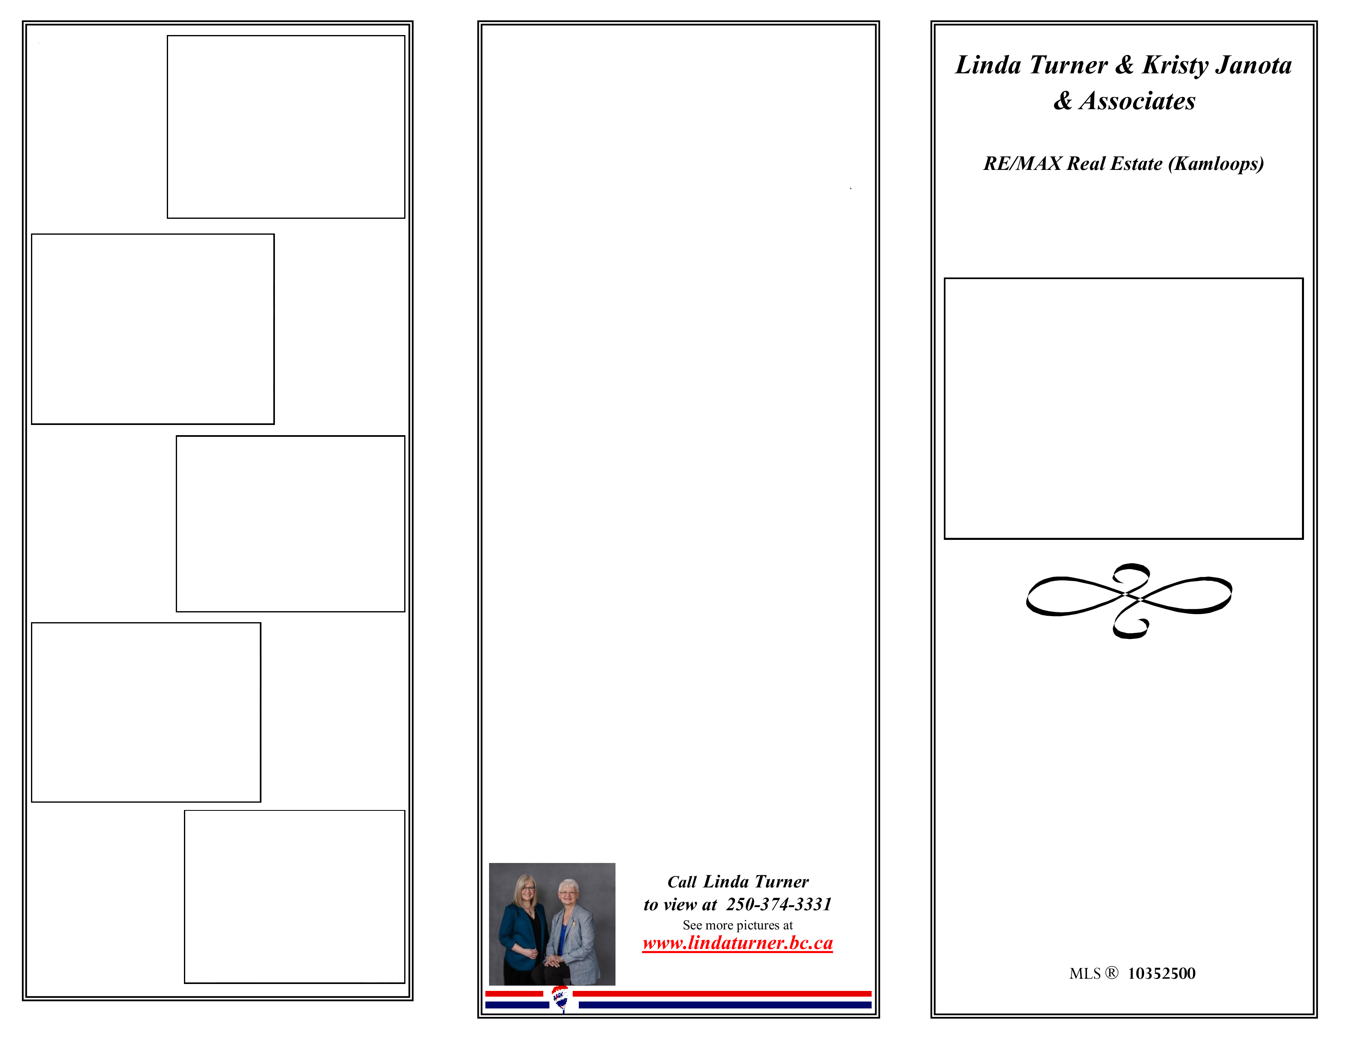
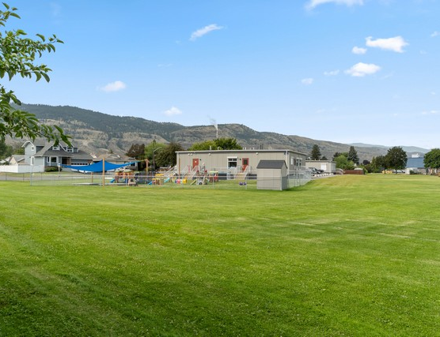
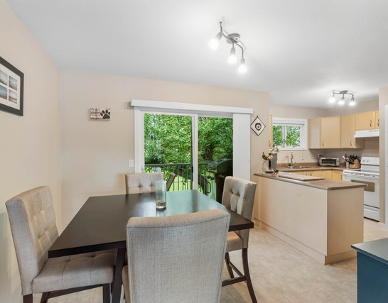
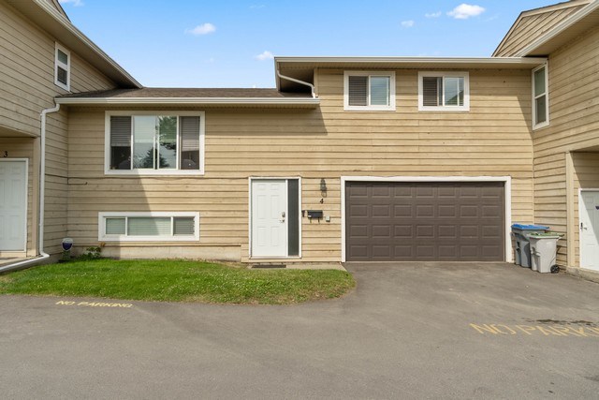
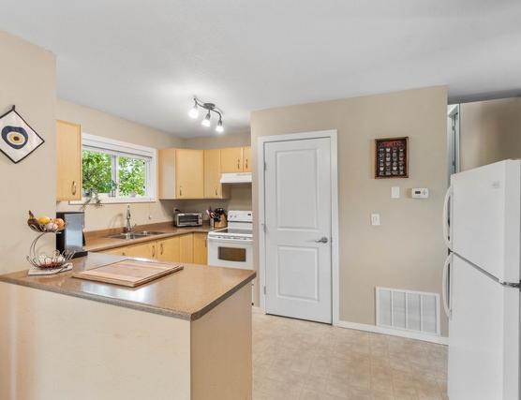
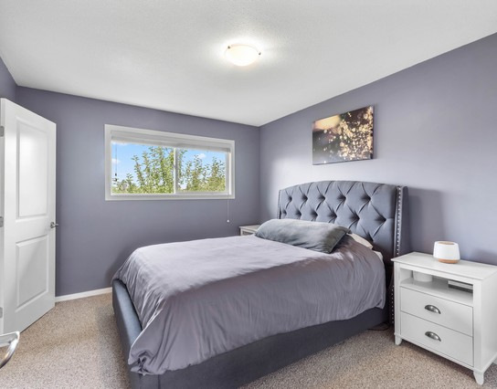
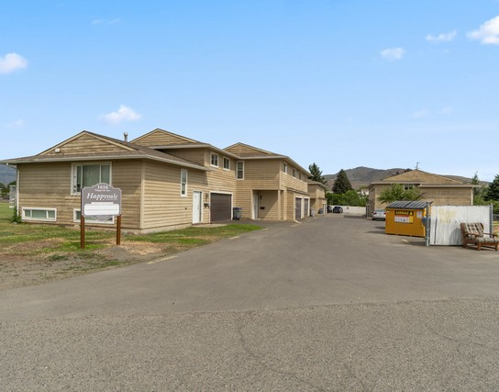
Wide, sunny backyard offering open space and great mountain views in the distance.
4-1616 Happyvale Ave, Kamloops, BC V2B 4H2
Bright and functional 3-level split townhome on Happyvale Avenue. Over 1,700 sq ft with a spacious layout. Updates noted as renovated in 2012. Double garage includes workshop space and a pass-through door to the rear yard. Pet- and rental-friendly complex with fees that include contingency reserve, insurance, maintenance grounds, management, sewer, snow removal, trash, and water.
4-1616 Happyvale Ave, Kamloops, BC V2B 4H2
Bright dining space opening to the backyard, flowing into a spacious kitchen.
Bright, open kitchen with ample cabinetry and sleek countertops—great space for everyday cooking and entertaining.
Primary bedroom highlight: plush tufted headboard, spacious layout, and soothing color palette.
Pet- And Rental-Friendly 3-Level Townhome With Double Garage, Mountain Views
Impressive front exterior with wide driveway and well-kept landscaping.
4 Bedrooms & 2 Baths
$499,900.00

Slide 2
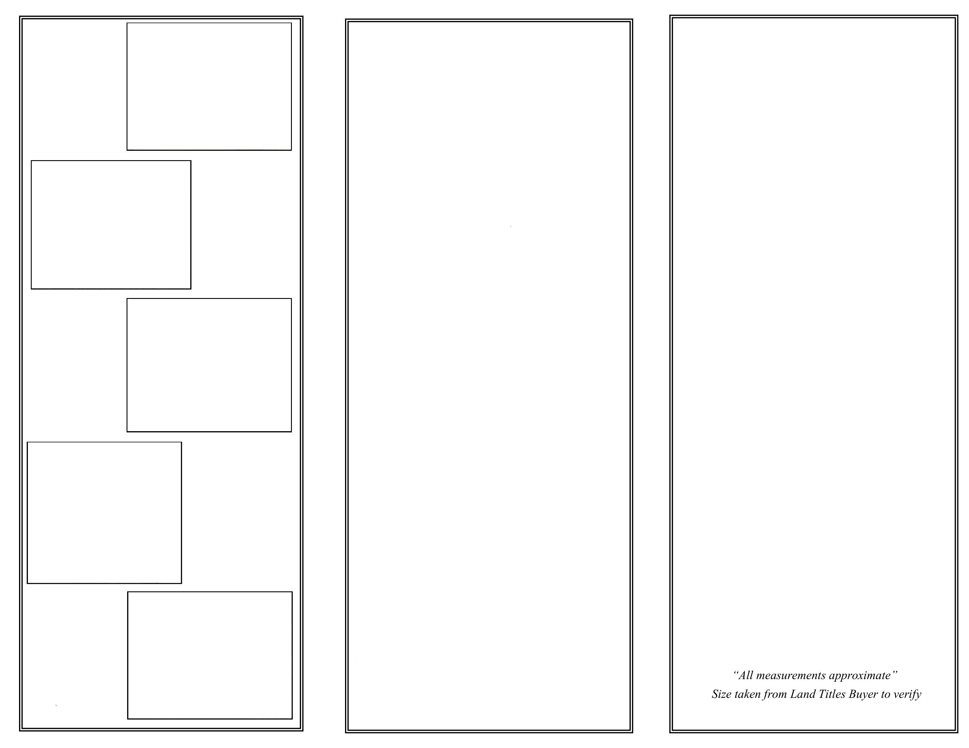
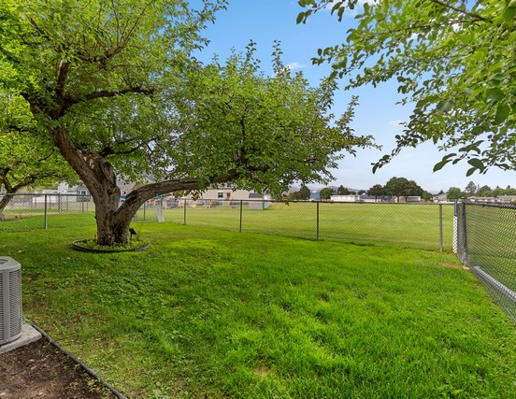
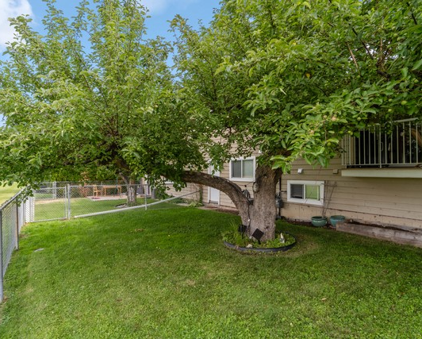
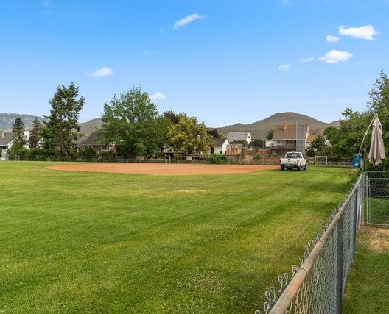
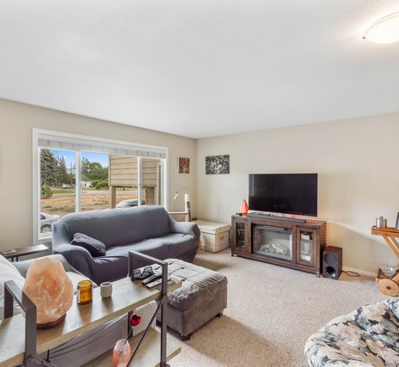
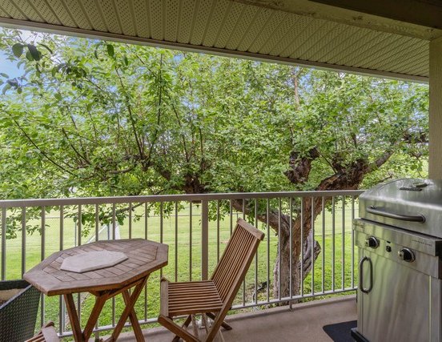
Bright backyard with lush grass and mature landscaping.
4-1616 Happyvale Ave, Kamloops, BC V2B 4H2
4-1616 Happyvale Ave, Kamloops, BC V2B 4H2
Location: Major Area: Kamloops and District
Minor Area: KAM - Brocklehurst
City: Kamloops
Postal Code: V2B 4H2
MLS®: 10353215
Style: Type: Townhouse
Style: Cathedral Entry
Heating: Forced Air
Central Air
Parking: Parking Total: 4
Garage Spaces: 2.0
Parking Features: Garage - Attached
Includes: Fee Includes: Contingency Reserve, Insurance, Maintenance Grounds, Management, Sewer, Snow Removal, Trash, Water
Age: Year Built: 1983
Renovation noted: 2012
Taxes: Taxes: $3,145 (2025)
INTERIOR (1,721 sqft (Total: 1,721 sqft))
Kitchen 10' 4" x 13' 11"
Living Room 14' 4" x 14' 9"
Dining Room 9' 2" x 8' 9"
Primary Bedroom 11' 8" x 10' 6"
Bedroom 8' 3" x 8' 9"
Bedroom 12' 7" x 12' 9"
Bedroom 8' 9" x 9' 9"
Bathroom - Full 4 PCE
Ensuite - Half 2 PCE
Laundry 9' 3" x 3'
Family Room 19' 3" x 12' 6"
Storage 18' 9" x 6'
Backyard retreat with a fenced boundary and shade from mature trees.
Generous, well-kept backyard with patio-style space and mountain views—ideal for outdoor entertaining.
Comfortable living room with large TV wall, big window views, and plenty of space to relax.
Step out to the covered balcony—an ideal spot for outdoor dining with a view of the green yard.
Total (1,721 sqft sq. ft.)

