Slide 1
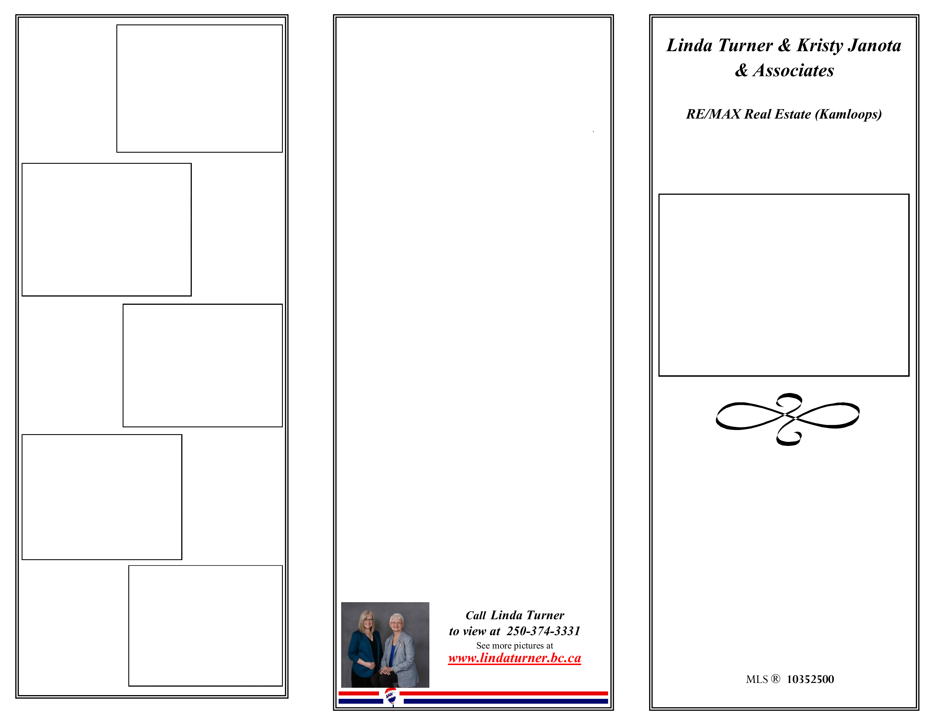
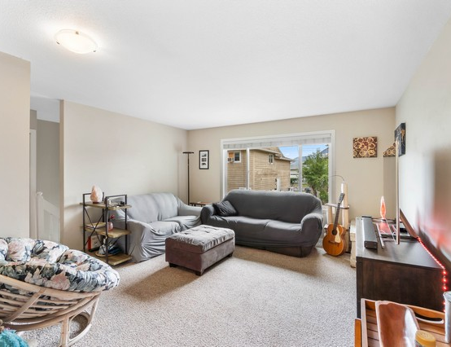
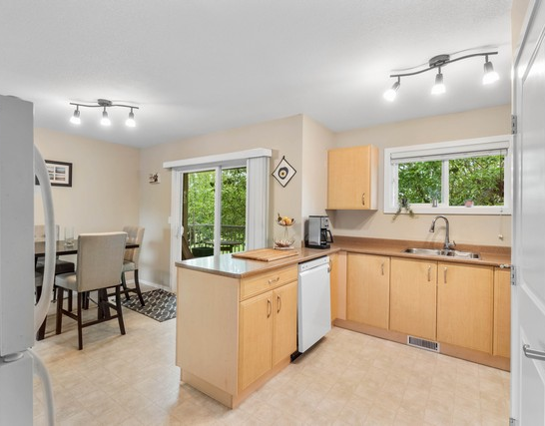
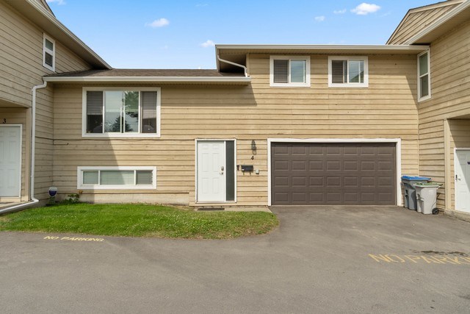
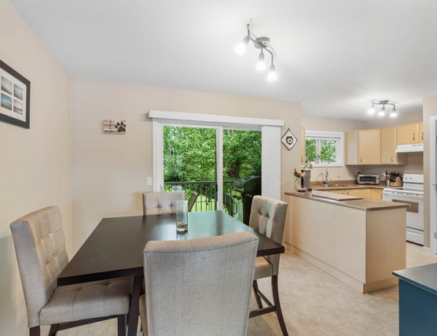
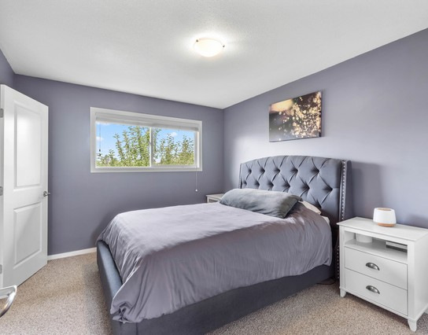
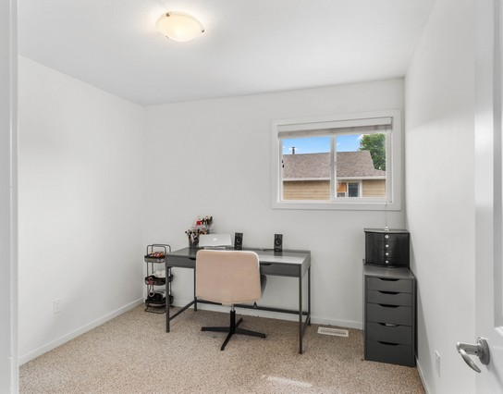
4-1616 Happyvale Ave
A bright living room offers comfortable space and a wide front window.
This 4-bedroom, 2-bath cathedral-entry townhome offers over 1,700 square feet across a practical three-level split layout.
Set on desirable Happyvale Avenue, the home backs onto peaceful school district land for privacy and open outlooks.
Thoughtful 2012 updates include the kitchen, flooring, appliances, windows, roof, decks, and railings for lasting value.
The sunny dining room opens to a sundeck overlooking the fenced backyard and mature green space beyond.
Flexible living includes main-floor laundry, a generous rec room, and a basement bedroom ideal for guests or office use.
A double garage with workshop space, rear yard pass-through, and four total parking spaces adds everyday convenience.
4-1616 Happyvale Ave
The kitchen and dining area pair ample cabinetry with leafy window views.
The dining area connects easily to the kitchen and greenery beyond.
Bright Brocklehurst Living With Private Green Space Views
The spacious primary bedroom features a large window and calming accent walls.
4 Bedrooms & 2 Baths
A bright secondary bedroom is staged as a practical home office.
$499,900

Slide 2
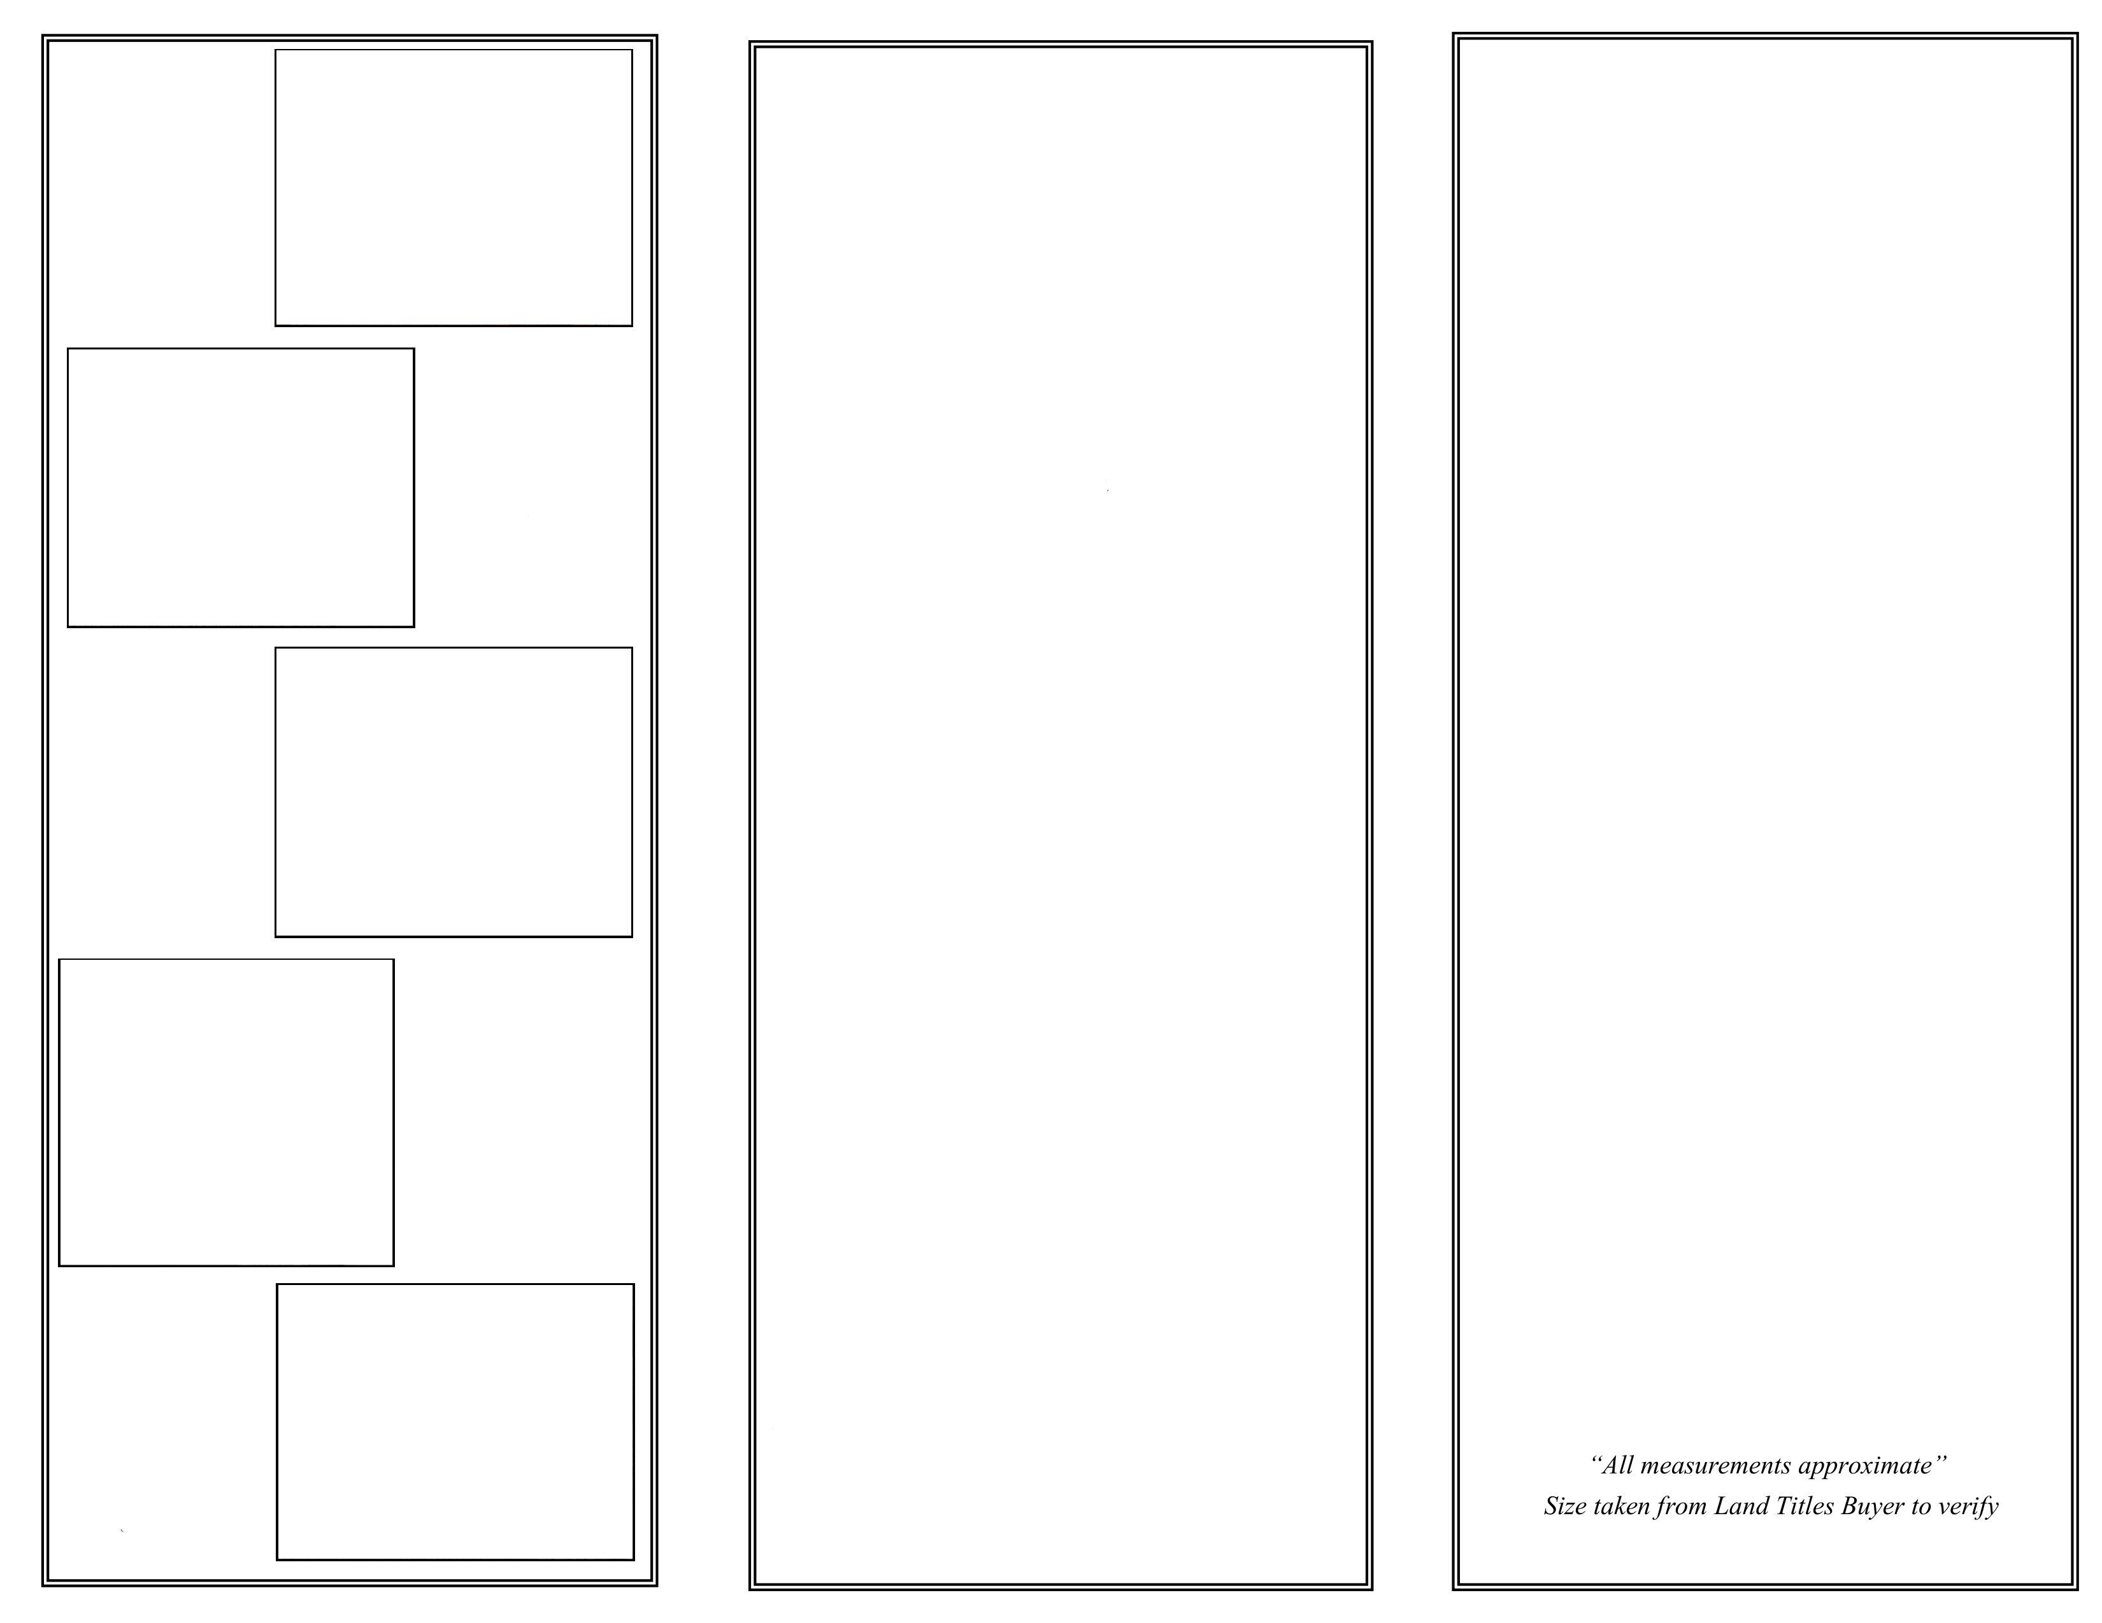
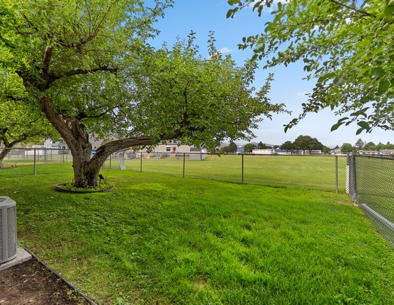
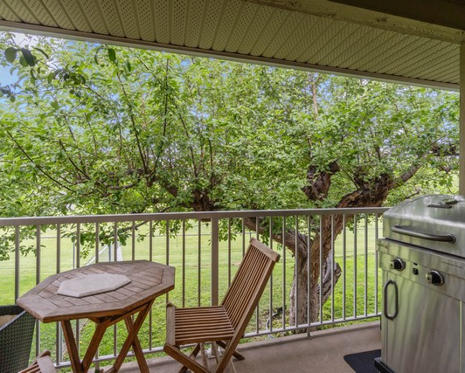
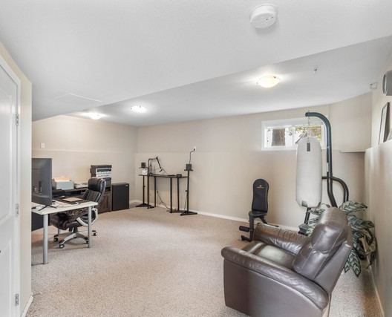
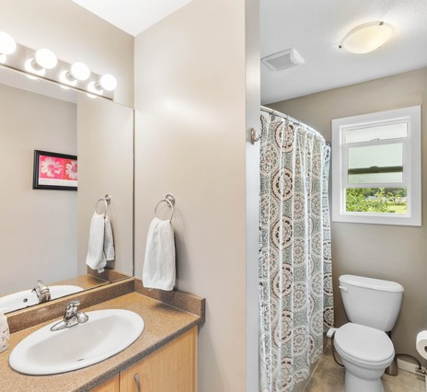
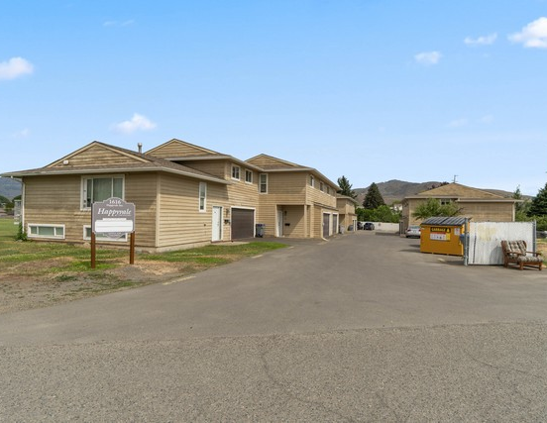
4-1616 Happyvale Ave
4-1616 Happyvale Ave
The fenced backyard offers mature shade trees and open lawn views.
Location: Brocklehurst
Style: Cathedral Entry
Heating: Forced Air
Central Air
Includes: Dishwasher
Electric Range
Refrigerator
Washer/Dryer
Deck
Private Yard
Pet Friendly
Rental Friendly
Taxes: $3,145 (2025)
Main (1,046 sq. ft.)
Kitchen 10' 4" x 13' 11"
Living Room 14' 4" x 14' 9"
Dining Room 9' 2" x 8' 9"
Primary Bedroom 11' 8" x 10' 6"
Bedroom 8' 3" x 8' 9"
Bedroom 9' 8" x 9' 9"
Bathroom - Full 4 PCE
Ensuite - Half 2 PCE
Laundry 9' 3" x 3'
Basement (674.9 sq. ft.)
Bedroom 12' 7" x 12'
Family Room 19' 3" x 12' 6"
Storage 18' 9" x 6'
A covered balcony overlooks green space, creating an inviting outdoor retreat.
The lower-level rec room provides flexible space for work, fitness, or relaxing.
The full bathroom includes a large vanity mirror and natural window light.
Total (1,721 sq. ft.)
A wide exterior view highlights driveway access and surrounding open space.

