Slide 1
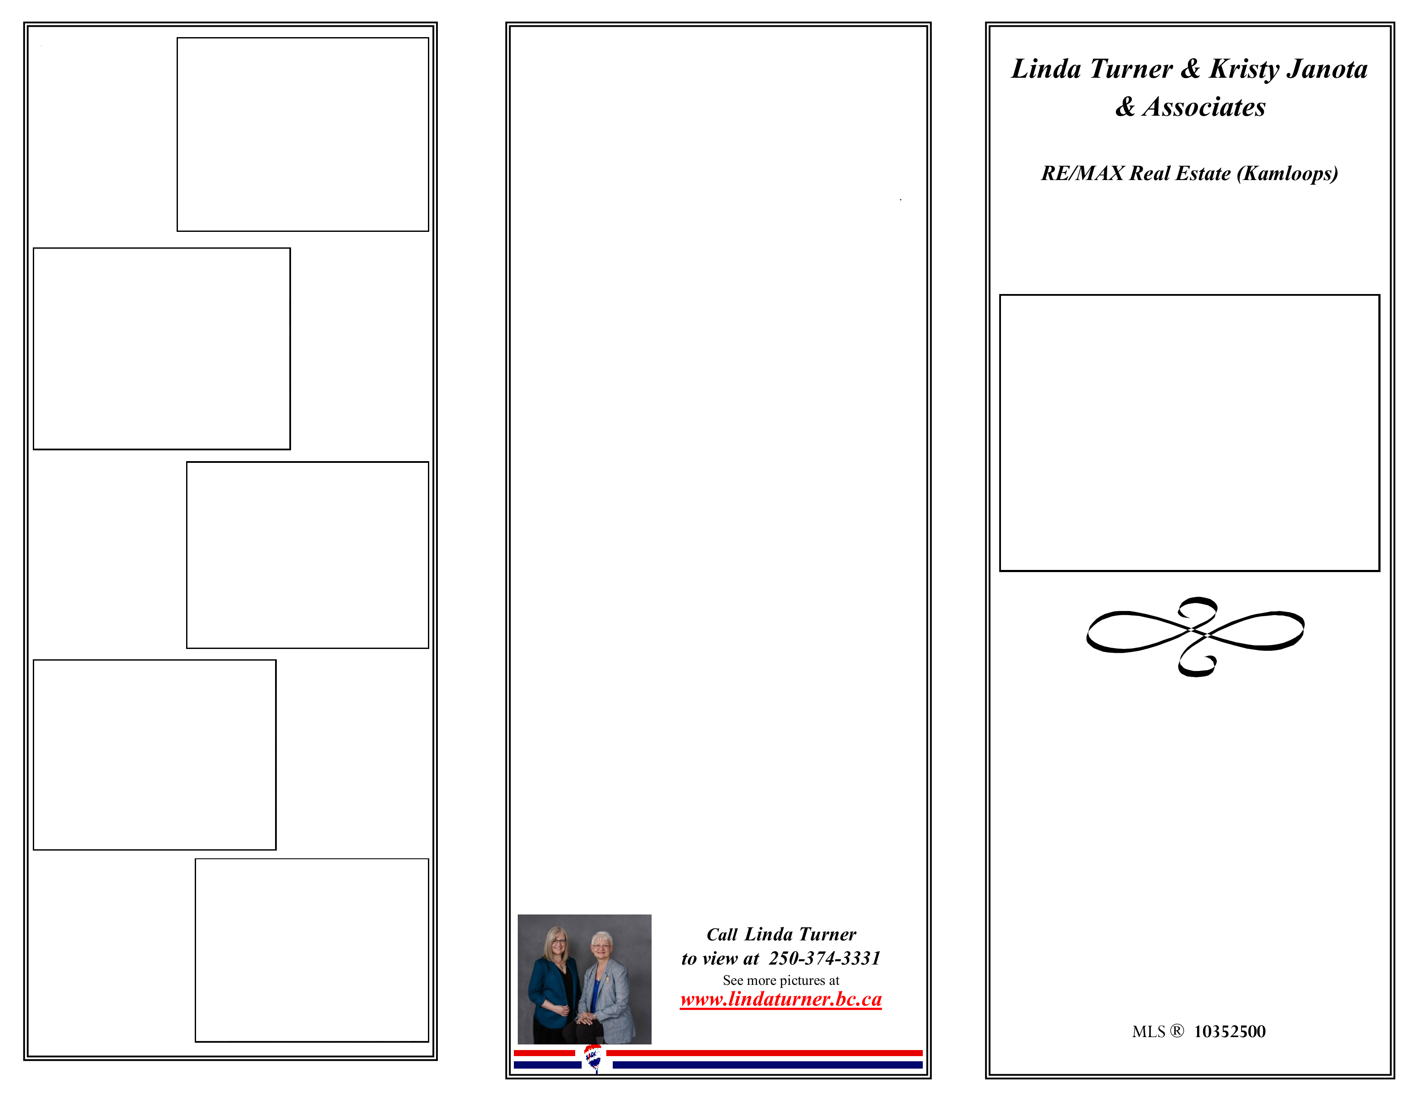
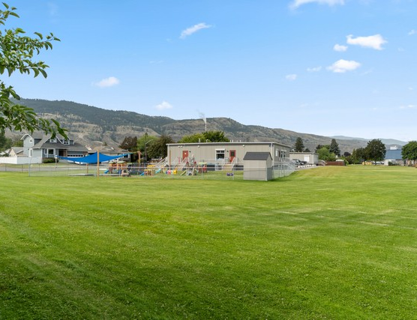
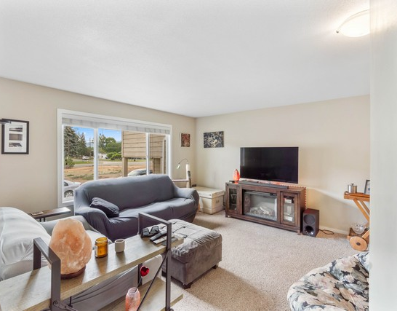
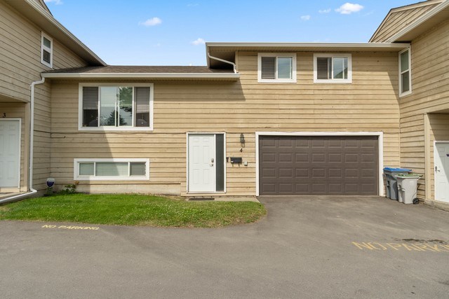
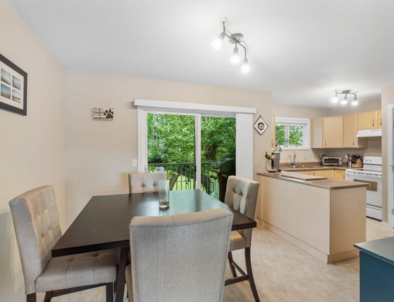
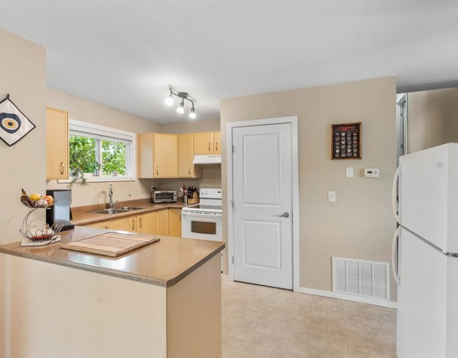
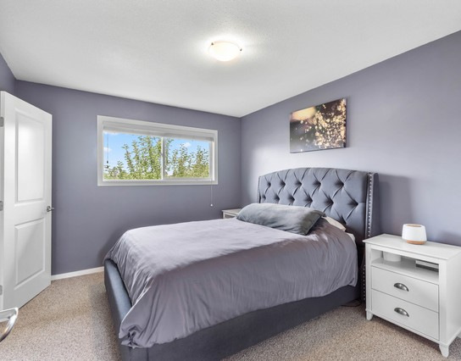
Expansive backyard with mountain backdrop, perfect for entertaining, play, and weekend.
4-1616 Happyvale Ave
Enjoy over 1,700 sq ft across three levels, ready for work, play, and everyday comfort in Brocklehurst.
Renovated in 2012 with modern updates including kitchen, flooring, appliances, windows, roof, and refreshed lighting.
Dine with ease as the main-floor dining room opens to a sundeck and fenced backyard with green-space views.
Main-floor laundry plus a generous rec room and flexible basement bedroom make hosting and home offices effortless.
Double garage with workshop space and pass-through access supports storage, hobbies, and smooth yard use.
Four total parking spaces include two in the garage, one in the driveway, and one assigned stall for convenience.
4-1616 Happyvale Ave
Comfortable living room with a large window and cozy setup for relaxing evenings at home.
Dining area with sliding-door access and an open flow into the kitchen for easy living.
Bright, modern kitchen with spacious countertops, light cabinetry, and stainless appliances.
Renovated Brocklehurst Home With Cathedral Entry and Private Backyard
Primary bedroom with a stylish upholstered headboard, soft lighting, and calming room to.
4 Bedrooms & 2 Baths
$499,900.00

Slide 2
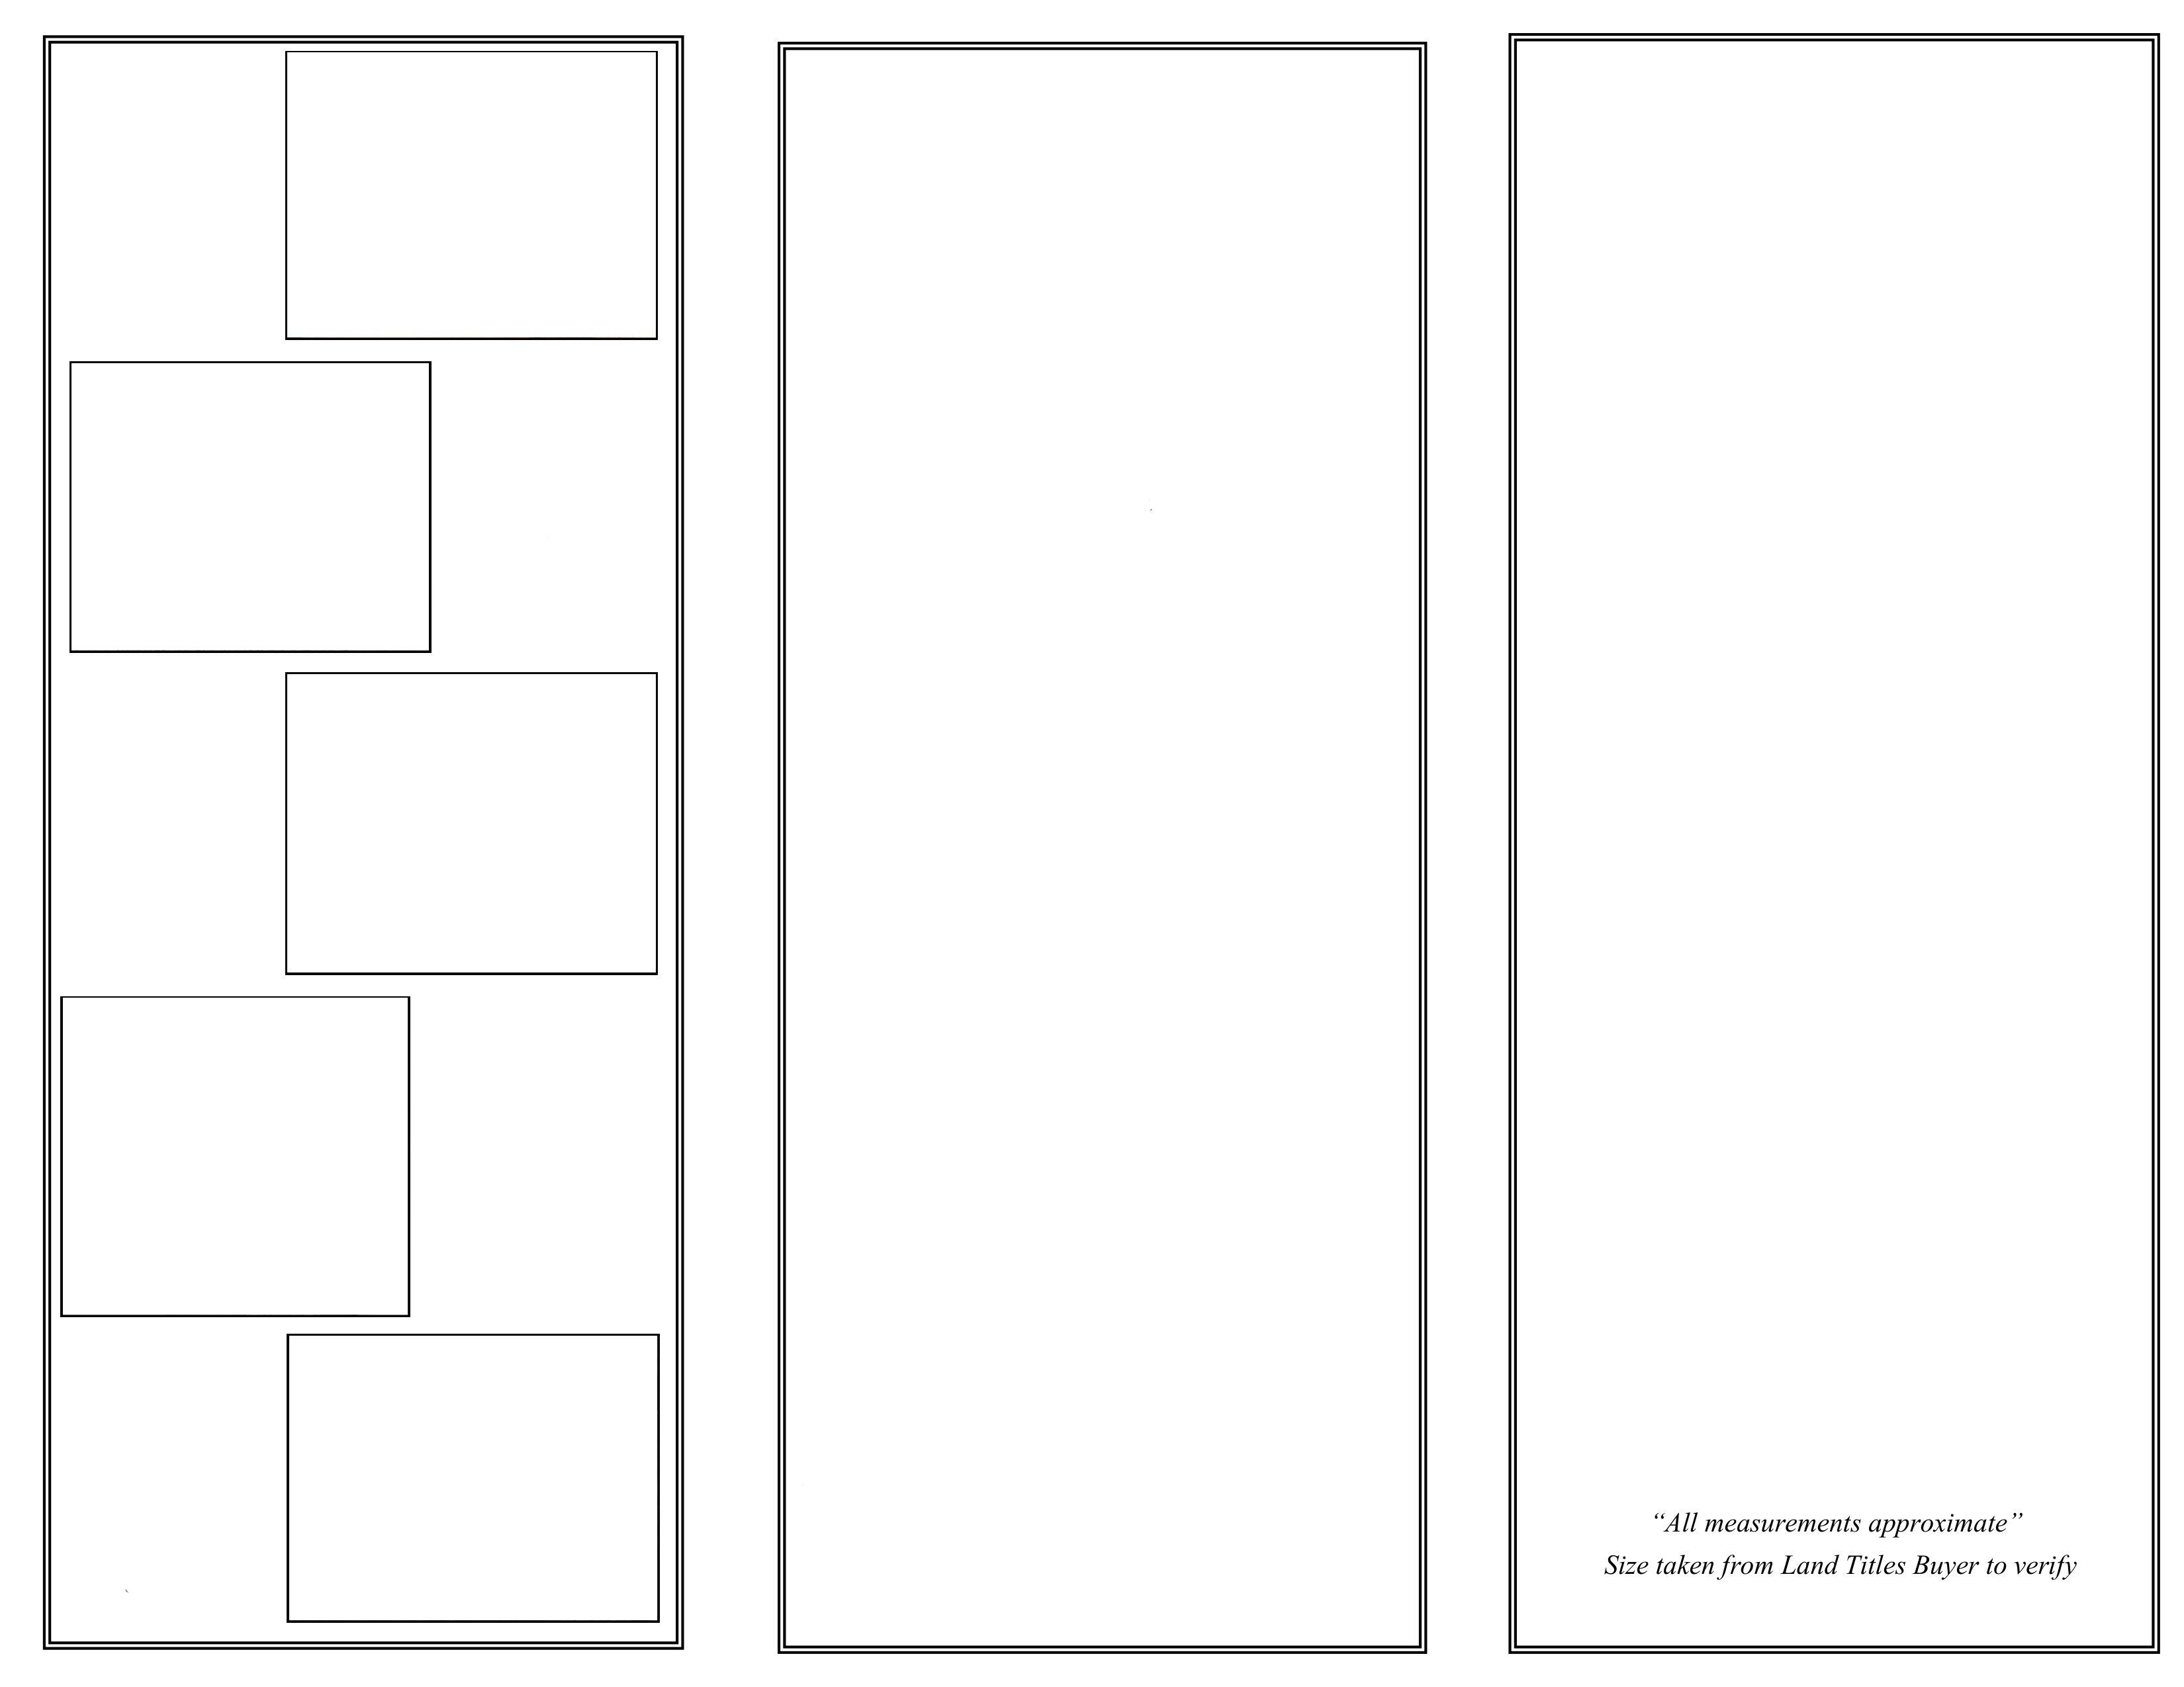
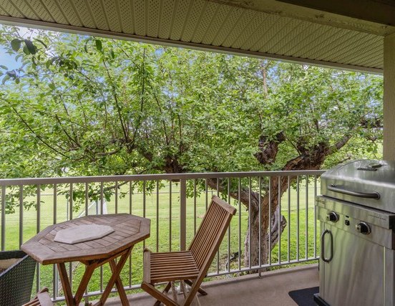
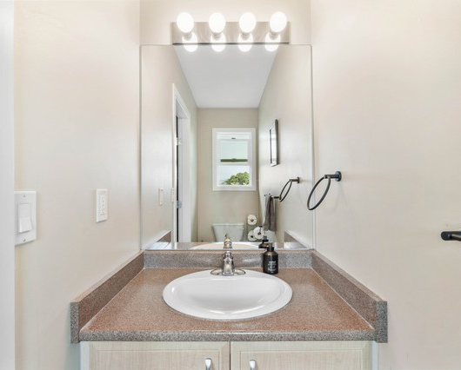
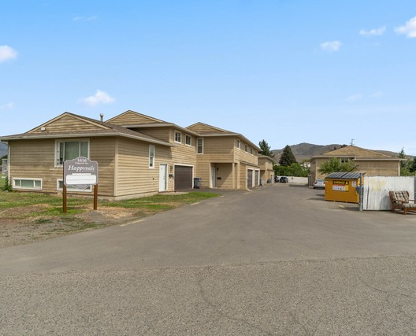
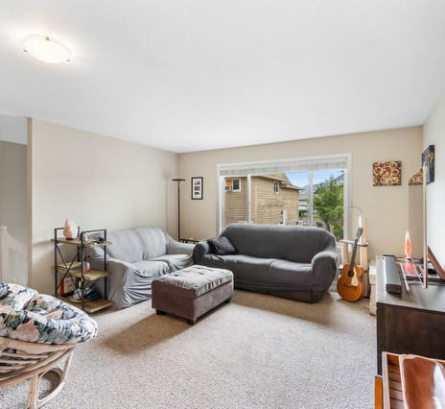
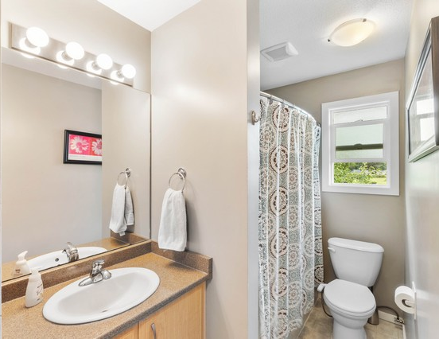
Relax on the covered deck overlooking mature trees, an inviting spot for outdoor dining.
4-1616 Happyvale Ave
4-1616 Happyvale Ave
Location: Brocklehurst
Style: Cathedral Entry
Heating: Forced Air
Central Air
Parking: 2 Car Garage
Includes: Dishwasher
Electric Range
Refrigerator
Washer/Dryer
Deck
Private Yard
Taxes: $3,145 (2025)
Lot Size: Lot size (acres): not provided
Basement (674.9 sq. ft.)
Lower / Basement bedroom
Basement (1046 sq. ft.)
Kitchen 10' 4" x 13' 11"
Living Room 14' 4" x 14' 9"
Dining Room 9' 2" x 8' 9"
Primary Bedroom 11' 8" x 10' 6"
Bedroom 8' 3" x 8' 9"
Bedroom 12' 7" x 12' 9" 8' 9"
Bathroom 4 piece
Ensuite 2 piece
Laundry 9' 3" x 3'"
Family Room 19' 3" x 12' 6"
Storage 18' 9" x 6'"
Bright, refined bathroom vanity with dual lighting for a clean, refreshed daily routine.
Great curb appeal from the driveway with attractive frontage and room for outdoor living.
Bright living room with comfortable seating and direct access outdoors for effortless.
Updated full bathroom with a bright vanity and a clean, tiled shower/tub area.
Total (1,721 sq. ft.)

