Slide 1




Towards a Customizable Text-to-
speech Personal Assistant
Project demo
Shupei Li, Chenyu Shi, Siwen Tu, Shuang Fan
Dec.5 2023

Slide 2


https://www.ypppt.com/
01
VITS
02
Our Contributions
CONTENTS
03
Training
04
Results
05
Demo Show
VITS: Conditional Variational Autoencoder with Adversarial Learning for End-to-End Text-to-Speech

Slide 3
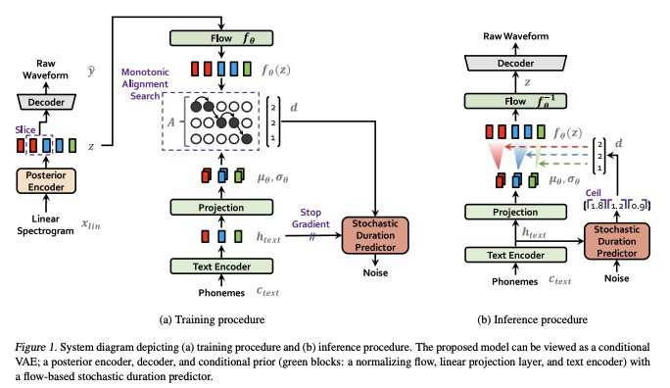
VITS Model

Slide 4
Main Idea, VITS and Our Contributions
New language support
Train the VITS model on Chinese datasets from scratch.
Main idea
1. Use the VITS model as the backbone.
2. A parallel end-to-end TTS method.
3. Adopt variational inference augmented with normalizing flows.
4. Improve the expressive power of generative modeling.
Fine-tune the VITS model on Chinese and Japanese with pre-trained model weights.
New
speaker support

Slide 5
Training
Chinese support
Fine-tuning: Chinese and Japanese
· Dataset: Chinese Standard Mandarin Speech Corpus（10000 Sentences）
· Hardware: 1 Titan Xp GPU.
· Train the model for 96,000 steps. (~ 48 hours)
· DEMO: "我爱计算机科学！"
Use a pretrained model.
Dataset: AISHELL-3 for Chinese, JVS for Japanese.
Fine-tuning the model for 84,500 steps in total. (~ 16 hours)
Add five speakers(Chinese): child voice, young female voice, middle-aged female voice, young male voice, middle-aged male voice.
Add six speakers(Japanese).
DEMO

Slide 6
Results for Training
5000
steps
50000
steps
96000 steps
Original speaking in dataset
Generated speaking
Train from scratch on Chinese dataset for 96000 steps
“我爱计算机科学”
“ I love computer science”
Then apply the model to generate specific sentence
“沉鱼落雁，闭月羞花”
“fish sink and geese fall, eclipse the moon and flowers blush”

Slide 7
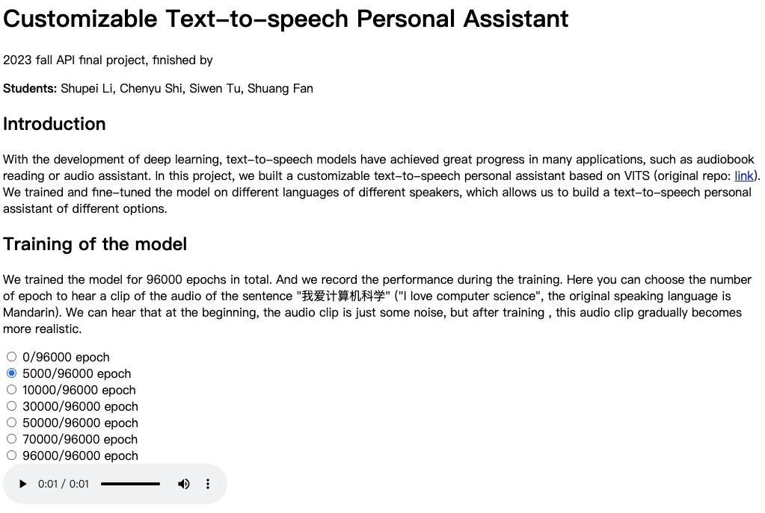
Our Website and Demo Shows
https://sd12321sd.github.io/api_project.github.io/

Slide 8
Goals for Demo Day(Finished)
Accomplish the text-to-speech task based on VITS model.
New language support. Train the VITS model on a Chinese dataset from scratch.
O1
New speaker support. Fine-tune the model on multi-speakers Chinese datasets and Japanese datasets.
O2
O3

Slide 9

Thanks!

