Slide 1


node2vec: Scalable Feature Learning
for Networks
Authors: Aditya Grover and Jure Leskovec
Chenyu Shi and Shupei Li
Leiden Institute of Advanced Computer Science November 18, 2022

Slide 2
In.troduction
R.elated Work
M. ethodology
E.xperiment
O.ur work
F.ut.u.re work
.
.
.
.
.
. . .
Introduction
Related Work
Methodology
Experiment
Our work
Future work

Slide 3
In.troduction R.elated Work M. ethodology
. . .
E.xperiment
O.ur work
F.ut.u.re work
.
.
. . .
Introduction to Graph Embeddings

Slide 4
In.troduction
R.elated Work
M. ethodology
E.xperiment
O.ur work
F.ut.u.re work
. .
.
.
.
. . .
Related Work

Slide 5

In.troduction
R.elated Work
M. ethodology
E.xperiment
O.ur work
F.ut.u.re work
.
.
.
.
.
. . .
Feature Learning Framework
Aim: Given a network G=(V, E), find a
projection $f:V→R^{d}$
Generate a d-dimesion vector representation
for each node
$f$ can be formulated as a matrix of size $|V|∙d$

Slide 6
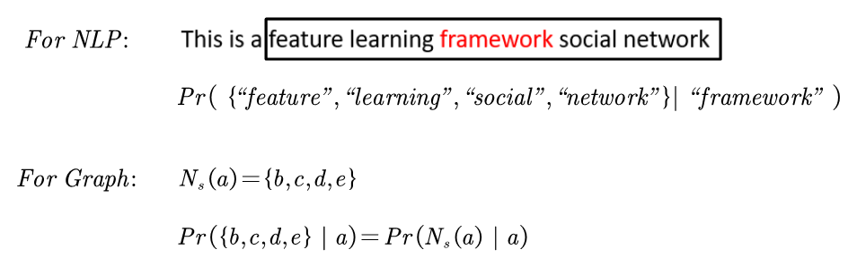



In.troduction
R.elated Work
M. ethodology
E.xperiment
O.ur work
F.ut.u.re work
.
.
.
.
.
. . .
Feature Learning Framework
Extending skip graph architecture to
networks.
Formulate feature learning in networks as a maximum likelihood optimization problem:
$N_{s}(a)$ is the network neighborhood set
generated by neighborhood sampling
strategy S for node a
Important: $N_{s}(a)$ isn’t equavalent to
direct local neighborhood

Slide 7

In.troduction
R.elated Work
M. ethodology
E.xperiment
O.ur work
F.ut.u.re work
.
.
.
.
.
. . .
Feature Learning Framework
Extending skip graph architecture to
networks.
Formulate feature learning in networks as a maximum likelihood optimization problem:
$N_{s}(a)$ is the network neighborhood set
generated by neighborhood sampling
strategy S for node a
Two problems to be solved:
1. How to define $N_{s}(a)$ ?
2. How to compute $Pr(N_{s}(a) | a)$ ?
Important: $N_{s}(a)$ isn’t equavalent to
direct local neighborhood

Slide 8


In.troduction
R.elated Work
M. ethodology
E.xperiment
O.ur work
F.ut.u.re work
.
.
.
.
.
. . .
Maximum Likehood Optimization
Formulate feature learning in networks as a maximum likelihood optimization problem:
Two standard assumptions:
1. Conditional independence:
2. Symmetry in feature space:

Slide 9
In.troduction
R.elated Work
M. ethodology
E.xperiment
O.ur work
F.ut.u.re work
.
.
.
.
.
. . .
Maximum Likehood Optimization
Formulate feature learning in networks as a maximum likelihood optimization problem:
Finally, the optimization problem is converted into the form of:
Two standard assumptions:
Use gradient decent stochastic to obtain projection f
1. Conditional independence:
2. Symmetry in feature space:

Slide 10
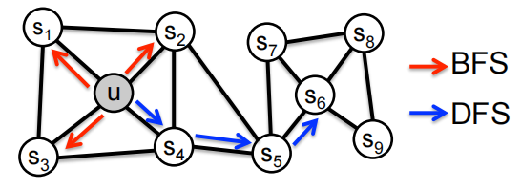
In.troduction
R.elated Work
M. ethodology
E.xperiment
O.ur work
F.ut.u.re work
.
.
.
.
.
. . .
Network Neighborhood Sampling Strategy
Use classic search strategies:
Breadth-first Sampling (BFS) and Depth-first Sampling (DFS)
There are two kinds of similarities:
1. homophily (such as u and s1)
2. structural equivalence (such as u and s6)
DFS tends to discover homophily , BFS tends to discover structural equivalence
How to discover both kinds of similarities?

Slide 11


In.troduction
R.elated Work
M. ethodology
E.xperiment
O.ur work
F.ut.u.re work
.
.
.
.
.
. . .
Network Neighborhood Sampling Strategy
Use basic random walk to discover both
homophily and structural equalvalence similarities
basic random walk with length $l$ from source node $u$ :
$c_{i}$ : the i-th node in the walk
$v$ : current node
$π_{vx}$ : unnormalized transition probability
$Z$ : normalization constant

Slide 12
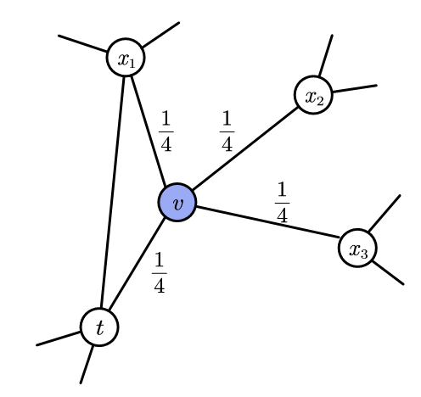

In.troduction
R.elated Work
M. ethodology
E.xperiment
O.ur work
F.ut.u.re work
.
.
.
.
.
. . .
Network Neighborhood Sampling Strategy
$π_{vx}$ : often set $π_{vx}=w_{vx}$ in weighted graphs.
in unweighted graph : $π_{vx}=1$
$π_{vx}$ : often set $π_{vx}=w_{vx}$ in weighted graphs.
in unweighted graph : $π_{vx}=1$

Slide 13
In.troduction
R.elated Work
M. ethodology
E.xperiment
O.ur work
F.ut.u.re work
.
.
.
.
.
. . .
Network Neighborhood Sampling Strategy
$π_{vx}$ : often set $π_{vx}=w_{vx}$ in weighted graphs.
in unweighted graph : $π_{vx}=1$
Ramdom walk can combine features of DFS and BFS, and
discovery both two kinds of similarities
Still not enough:
It’s hard for us to guide and control the walking process

Slide 14
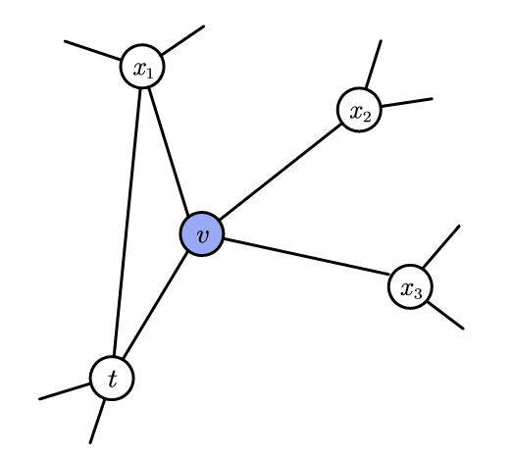
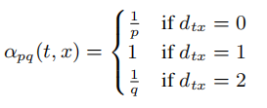
In.troduction
R.elated Work
M. ethodology
E.xperiment
O.ur work
F.ut.u.re work
.
.
.
.
.
. . .
Network Neighborhood Sampling Strategy
Use second order bias random walk to get
control of the walking process
$$π_{vx}=α_{pq}(t,x)∙w_{vx}$$
$v$ : current node
$t$ : last node in the walk
$x$ : the next node to be chosed

Slide 15
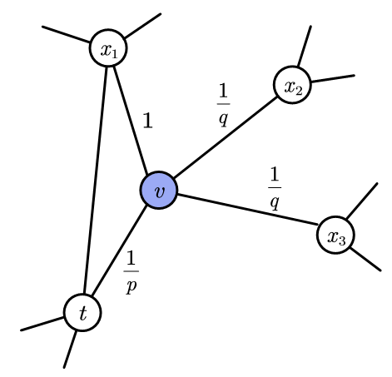
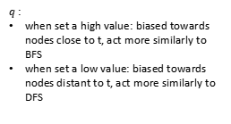

In.troduction
R.elated Work
M. ethodology
E.xperiment
O.ur work
F.ut.u.re work
.
.
.
.
.
. . .
Network Neighborhood Sampling Strategy
$p$ : return parameter
$q$ : in-out parameter
$p$ :
when set a high value: less likely to sample an already visited node
when set a low value: likely to step back, then walk locally near the source node u
$q$ :
when set a high value: biased towards nodes close to t, act more similarly to BFS
when set a low value: biased towards nodes distant to t, act more similarly to DFS

Slide 16

In.troduction
R.elated Work
M. ethodology
E.xperiment
O.ur work
F.ut.u.re work
.
.
.
.
.
. . .
Learning Edge Features
Use node2vec, we have found a projection $f:V→R^{d}$, which allocates each node vector embedding representation.
These embedding vectors can be used in node-related downstream tasks
But how to learn edge features and deal with edge-related downstream tasks?

Slide 17
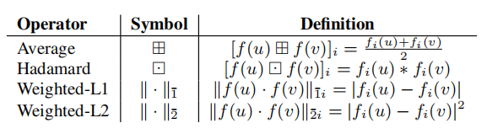

In.troduction
R.elated Work
M. ethodology
E.xperiment
O.ur work
F.ut.u.re work
.
.
.
.
.
. . .
Learning Edge Features
Use node2vec, we have found a projection $f:V→R^{d}$, which allocates each node vector embedding representation.
These embedding vectors can be used in node-related downstream tasks
But how to learn edge features and deal with edge-related downstream tasks?
Given projection f obtained by node2vec and two nodes u and v along with edge (u,v), apply binary operator on f(u) and f(v) to generate representation g(u,v), where $g:V×V→R^{d’}$

Slide 18
In.troduction
R.elated Work
M. ethodology
E.xperiment
O.ur work
F.ut.u.re work
.
.
.
.
.
. . .

Slide 19
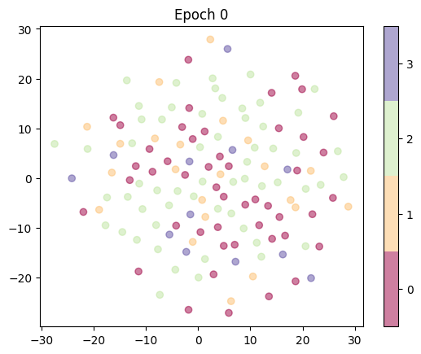
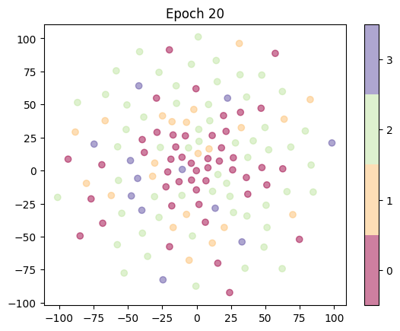
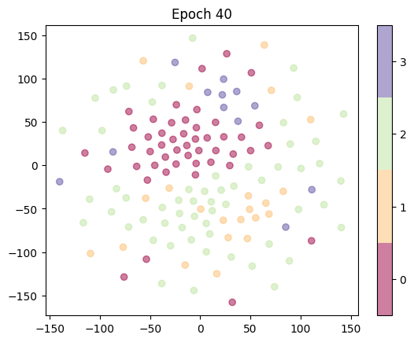
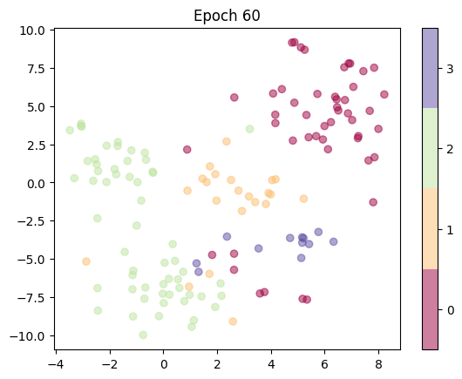
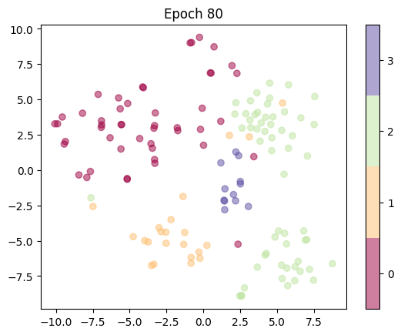
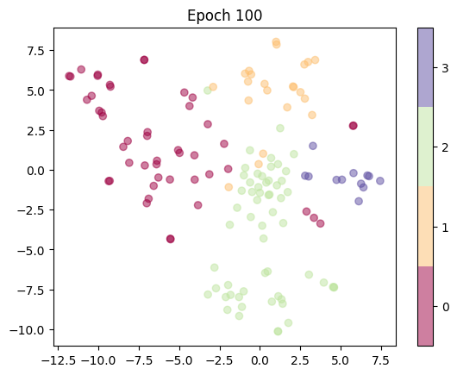
In.troduction
R.elated Work
M. ethodology
E.xperiment
O.ur work
F.ut.u.re work
.
.
.
.
.
. . .
AIFB dataset: each node has a category label, there are 4 claases in total
With training node2vec, nodes embedding change from chaos to

Slide 20
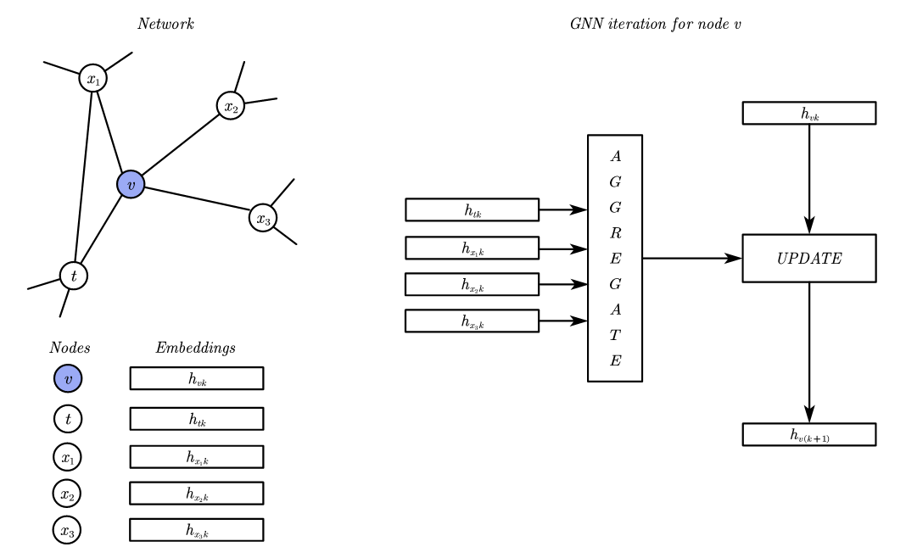

In.troduction
R.elated Work
M. ethodology
E.xperiment
O.ur work
F.ut.u.re work
.
.
.
.
.
. . .
Graph Neural Network
Graph Neural Network is a deep learning
framework for graph
General GNN iteration formula:
$$h_{u}^{(k)}=σ(W_{self}^{(k)}h_{u}^{(k−1)}+W_{n}^{(k)}\sum_{v∈N(u)}{h_{v}^{(k−1)}}+b^{(k)})$$
$h_{u}^{(k)}$ : k-th layer output embedding of node u
$W^{(k)}$ : weights of k-th layer (trainable)
Aggregate: To aggregate embedings of u’s neighborhood
$b^{(k)}$ : bias of k-th layer (trainable)
Update: To update u’s embbeding using aggregate result and previous
u’s embbeding
$σ$ : activation function

Slide 21
In.troduction
R.elated Work
M. ethodology
E.xperiment
O.ur work
F.ut.u.re work
.
.
.
.
.
. . .
Graph Neural Network
$$h_{u}^{(k)}=σ(W_{self}^{(k)}h_{u}^{(k−1)}+W_{n}^{(k)}\sum_{v∈N(u)}{h_{v}^{(k−1)}}+b^{(k)})$$
Fianl output embedding can be used for calculating
predictions, and use these predictions to compute loss
and use back propagation to train parameters

Slide 22
In.troduction
R.elated Work
M. ethodology
E.xperiment
O.ur work
F.ut.u.re work
.
.
.
.
.
. . .
Graph Neural Network
$$h_{u}^{(k)}=σ(W_{self}^{(k)}h_{u}^{(k−1)}+W_{n}^{(k)}\sum_{v∈N(u)}{h_{v}^{(k−1)}}+b^{(k)})$$
Fianl output embedding can be used for calculating
predictions, and use these predictions to compute lossand use back propagation to train parameters
Problem: how to produce $h_{u}^{0}$ for each node?
1. use one-hot vector for each node
-- drawback: the total number of nodes are large, use one-hot vector for each node will cause the input tensor too sparse

Slide 23
In.troduction
R.elated Work
M. ethodology
E.xperiment
O.ur work
F.ut.u.re work
.
.
.
.
.
. . .
Graph Neural Network
$$h_{u}^{(k)}=σ(W_{self}^{(k)}h_{u}^{(k−1)}+W_{n}^{(k)}\sum_{v∈N(u)}{h_{v}^{(k−1)}}+b^{(k)})$$
2. transfer pretrained embedding from other similar tasks
-- drawback: not all networks can find a similar tasks to import embedding
Fianl output embedding can be used for calculating
predictions, and use these predictions to compute lossand use back propagation to train parameters
Problem: how to produce $h_{u}^{0}$ for each node?
1. use one-hot vector for each node
-- drawback: the total number of nodes are large, use one-hot vector for each node will cause the input tensor too sparse

Slide 24
In.troduction
R.elated Work
M. ethodology
E.xperiment
O.ur work
F.ut.u.re work
.
.
.
.
.
. . .
Graph Neural Network
$$h_{u}^{(k)}=σ(W_{self}^{(k)}h_{u}^{(k−1)}+W_{n}^{(k)}\sum_{v∈N(u)}{h_{v}^{(k−1)}}+b^{(k)})$$
2. transfer pretrained embedding from other similar tasks
-- drawback: not all networks can find a similar tasks to import embedding
Fianl output embedding can be used for calculating
predictions, and use these predictions to compute lossand use back propagation to train parameters
3. Use trainable embbeding layer to allocate random initialized embedding for each node
-- drawback: random initialized embedding could have negative impact on training process
Problem: how to produce $h_{u}^{0}$ for each node?
1. use one-hot vector for each node
-- drawback: the total number of nodes are large, use one-hot vector for each node will cause the input tensor too sparse

Slide 25
In.troduction
R.elated Work
M. ethodology
E.xperiment
O.ur work
F.ut.u.re work
.
.
.
.
.
. . .
Combine node2vec and GNN
node2vec can produce embedding for each node
with graph information
GNN lacks a good general method to initialize its input nodes’ embedding
We could use node2vec to produce initial input nodes’ embedding for GNN to improve traning process of GNN and obtain better performance
It’s a general method because there is no specific requirement of graphs when applying node2vec and GNN

Slide 26
In.troduction
R.elated Work
M. ethodology
E.xperiment
O.ur work
F.ut.u.re work
.
.
.
.
.
. . .

