Slide 1
CSE 4110 Project Find4 Presented By- 1707001,1707018,1707023

Slide 2
Game Description
A 2 player, Human vs AI connecting board game.
Players will alternately place balls of separate colors in a user interface of 7 columns across and 6 rows high.
Each ball will be placed on the lowest free position of the selected column.
The game will be over upon reaching any one of 3 predefined conditions

Slide 3
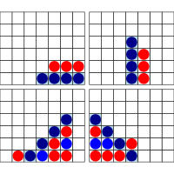
Game Description
When a player completes one of these four combinations first, the game ends displaying the winner.

Slide 4
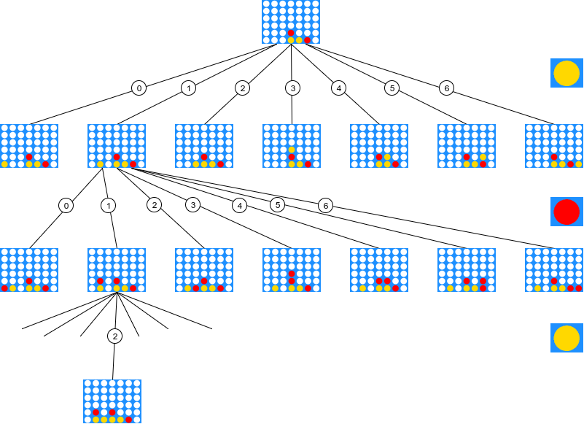
Game Description

Slide 5
Development Steps
Create a user interface
Specify how players will be given the colors (for example: red, blue).
Code the algorithm with which the AI system will choose the position autonomously .
Set a timer.
Detect the winner.

Slide 6
Development Tools
Programming Language: Python
Algorithm: Minimax
UI design Platform: Pygame

Slide 7
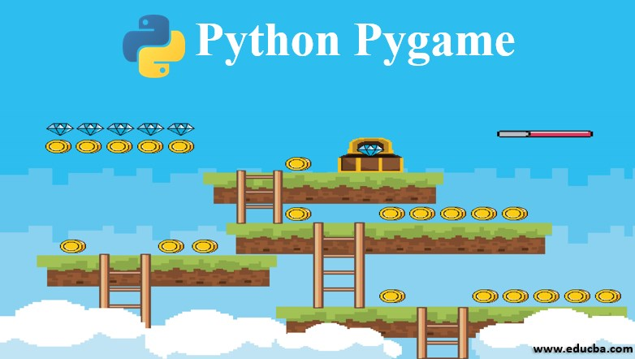
Pygame
Pygame is a cross-platform ,open source python library that was made specifically for video game designing.

Slide 8
Thank You

