Slide 1
Managing projects and source code with GitLab
Web-based Git repository manager
Presented by Dimitar Dimitrov
May 5, 2016

Slide 2
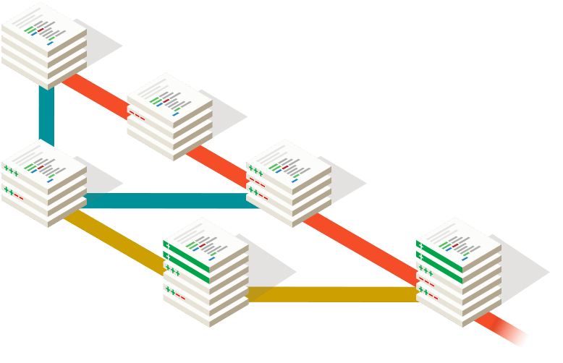
History and Objectives
Source Control
What is source control
Who / Why needs it
How did it evolve
Where are we now
Git
What is Git
Why is everyone using it
What can Git do for you
GitLab
What is GitLab
Why GitLab (as opposed to…)
Who has access to GitLab
What are the key features

Slide 3



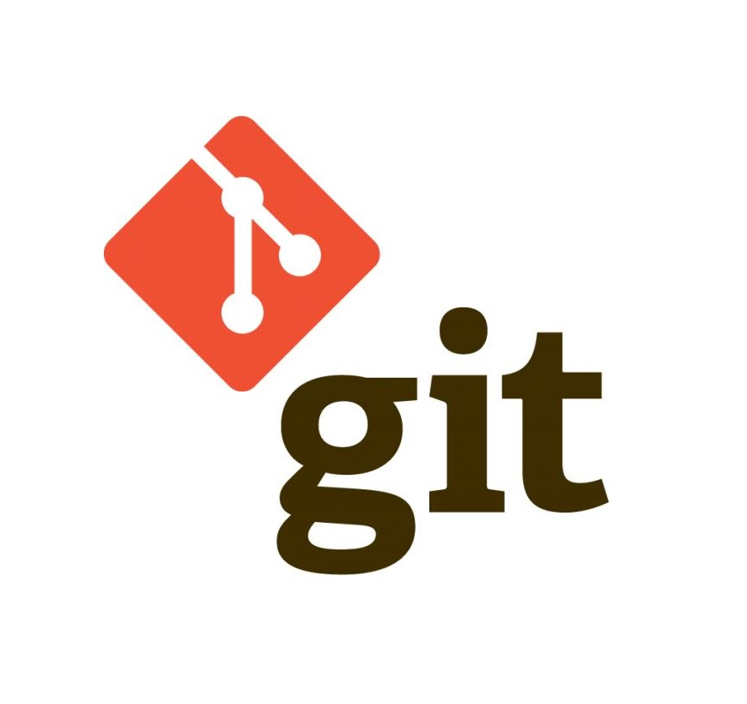
GitLab at-a-glance
GitLab is an Open Source Git Repository Management
It’s offered in two flavors
GitLab CE (Community Edition)
GitLab EE (Enterprise Edition)
Key Features
User / Group / Team Management
Project Wiki / Activity Stream
Issues tracking / File Browser
Tasks / ToDos
Merge / Fork / Commit
Integration with other systems (GitHub, Jira)
Continuous Integration (CI)
Support for Git LFS (large files)
Web Hooks (events for when something is happening with your project)

Slide 4
What is Source Control (aka Version Control)
Source Control / Version Control / Revision Control is the process of managing changes to documents, programs, and other collections of files and information in a logical, consistent, and traceable way.
Version Control systems have existed in one form or another for over 40 years.
Throughout their history they have been improving – from manual towards automated and from individual to centralized.
Prehistory
One person working on one file; somewhat manual; limited to the type and complexity of the changes that were made; file locks; local
Classic
Beginning to handle multiple file changes on multiple systems; merges must happen before you can commit; server-based
Middle Ages
Enhancements on the Classics; still aversion to branching and merging; better administrations and permissions control
Modern times
Allow merge and commits to be separated; distributed; embrace merging and branching

Slide 5
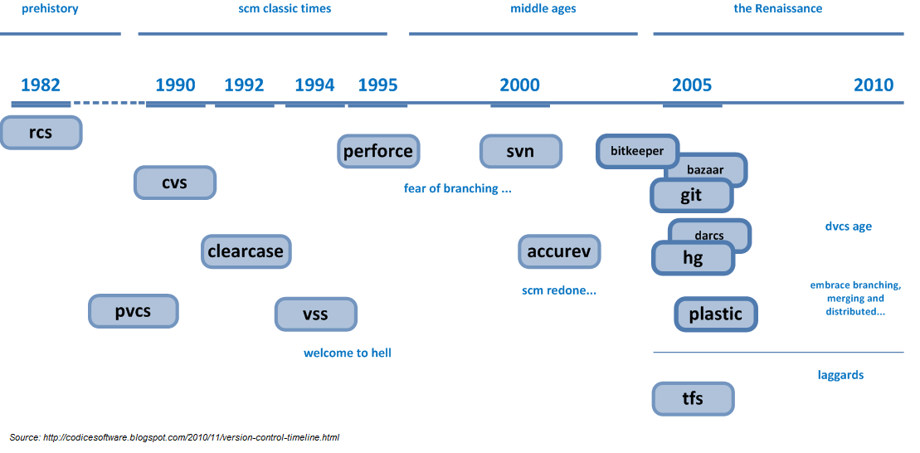
Evolution of Source Control

Slide 6
Source Control Systems
RCS – Revision Control System – allows for changes to be saved as delta-increments in a text file. Usually in the same folder and with basically the same file name (+,v)
CVS – Concurrent Versions System – client-server oriented. It allowed multiple people to develop from multiple systems. Resolving conflicts was difficult.
VSS – Visual SourceSafe – Microsoft’s attempt at version control. Aimed at small projects, relying on locking and generally discouraging collaboration
(Rational) ClearCase – proprietary software, used primarily in the corporate world. Heavy network use (meant for LANs)
SVN – (Apache) Subversion – Enhanced CVS. Still not fully embracing branching and merging. Flexible, but not quite there yet.
Mercurial (Hg) – more scalable, faster, fully-distributed solution. Much better handling of text and non-text files. Keeps a running list (revlog) of the changes to files and folders. Generally creates new branches as their own separate repositories
Git – focus on distributed, non-linear development. Fast and simple. Commits are done to a local repo and then pushed/merged to the central one. Large files are a small drawback.

Slide 7
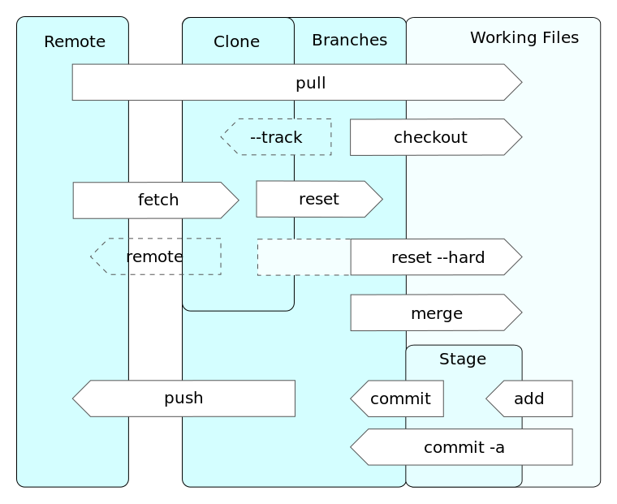
Basic Source Control Operations (the lingo)
There are 18 basic operations that can be done with/by source control systems
Create (the repository)
Checkout (the repository)
Commit
Update
Add (a file)
Edit (a file)
Delete (a file)
Rename (a file)
Move
Status (of the repository)
Diff
Revert
Log
Tag (name a version of the repo)
Branch
Merge
Resolve (conflicts)
Lock

Slide 8



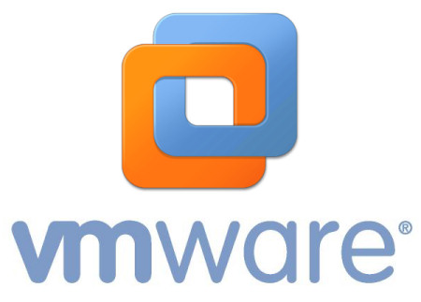
GitLab Intro
GitLab started as a fully open-source project to provide a web-based front end to an otherwise standard Git repository/server.
In 2013 it split into
GitLab CE
GitLab EE
GitLab Cloud
GitLab EE is a Ruby Rails application running on Nginx with a PostgreSQL backend. Also uses Redis.
Can be compiled from source or installed from the Yum repo.
Actively developed. New (EE) features are often incorporated in the CE branch.
Quite memory heavy on the server.
Currently being used by

Slide 9
GitLab – Users and Groups
Every Partners HealthCare user can (technically) login to GitLab.
Users can personalize their profile
Select avatar
Specify identity (LDAP)
Users can be organized into groups of one or more.
Users can be assigned to groups and they can also be given the ability to create groups.
Users within groups can have different roles, such as Guest, Reporter, Developer, Owner, Master.
Groups can be
Private
Public
Internal
Users can specify their own SSH keys for deployment and pull/push, etc.

Slide 10
GitLab – Projects
Every user is allowed to create 25 projects.
Projects can be
Internal
Private
Public
Projects can be shared with group members.
Projects can have unique URLs
Projects can be imported directly from GitHub, Bitbucket, etc.
Each project has its own dashboard that can list
Recent Activity
Files
Commits
Milestones
Issues
Merge Requests
Labels
Wiki
Forks

Slide 11
GitLab – Issues/Todos
A Project can have Issues associated with it.
Issues can describe a problem/bug with the code and/or the overall project.
An issue has
Title
Description
Assignee
Milestone
Label
Attachment(s)
Issues can be moved from one project to another
A new branch can be created directly from an issue.
An issue can be commented on and/or closed (reopened).
If you mention a user with “@”, a “Todo” item will be created in that user’s Todo list.

Slide 12
GitLab – Labels/Milestones/Wiki
Labels can be created to visually differentiate between issue types and merge requests.
Labels have
Title
Description
Color (coding)
Milestones are points in the project that specify the reaching or completion of a special part of the project.
Wiki – you can create pages for a wiki. The information is stored in Git.

Slide 13
GitLab – Hooks, Builds, Runners, and CI
GitLab allows for the creation of Hooks – binding events to GitLab user/project actions. These are URLs that the system calls. Can be configured globally and on a per-project basis.
Continuous Integration
GitLab was designed to be used with projects that leverage CI.
It allows you to setup runners, track code builds (and background processes).
You can specify deployment keys to directly connect to servers and services.
Builds are triggered by Merge Request and/or Push.
You need to configure the “runner” process.
More info (http://doc.gitlab.com/ce/ci/quick_start/README.html)

Slide 14
GitLab – APIs and Integration
GitLab exposes an API that allows you to
Administer GitLab, Users, Groups, Projects, Repositories, Builds …
GitLab also integrates with other products and applications, such as
Jira
Bamboo CI
HipChat
PivotalTracker
Redmine
Slack

Slide 15

GitLab – Parting Thoughts and Demo
So why GitLab?
Hosted Internally
Users managed through standard Partners processes
Security, Scalability, and Flexibility
Built-in issue tracker
Powerful integration with other tools ( )
Very good user access control
Can be tailored to your project
How can I sign up?
Go to https://gitlab.partners.org (available only internally to the network/VPN)
Login with your username and password
  You will be told you are blocked – that’s OK – it’s supposed to do that.
  If your GitLab account is not unblocked within an hour, send an e-mail to rcc@partners.org to request that your account be unblocked.
    In that e-mail you can specify if you want to be able to create groups, more than 25 projects, and any other relevant information to your project

Slide 16

GitLab – Demo

Slide 17
GitLab – References and Resources
https://gitlab.partners.org
Gitlab CE Documentation - http://doc.gitlab.com/ce/
https://about.gitlab.com/gitlab-ce-features/
https://about.gitlab.com/gitlab-ce-features/
Other sources/images
http://codicesoftware.blogspot.com/2010/11/version-control-timeline.html
http://ericsink.com/vcbe/vcbe_a4_lo.pdf
Wikipedia (of course)

