Slide 1
Лекц 5. Cascading Style Sheets (CSS) - Responsive Design
Интернэт технологийн үндэс
2024 оны намар

Slide 2
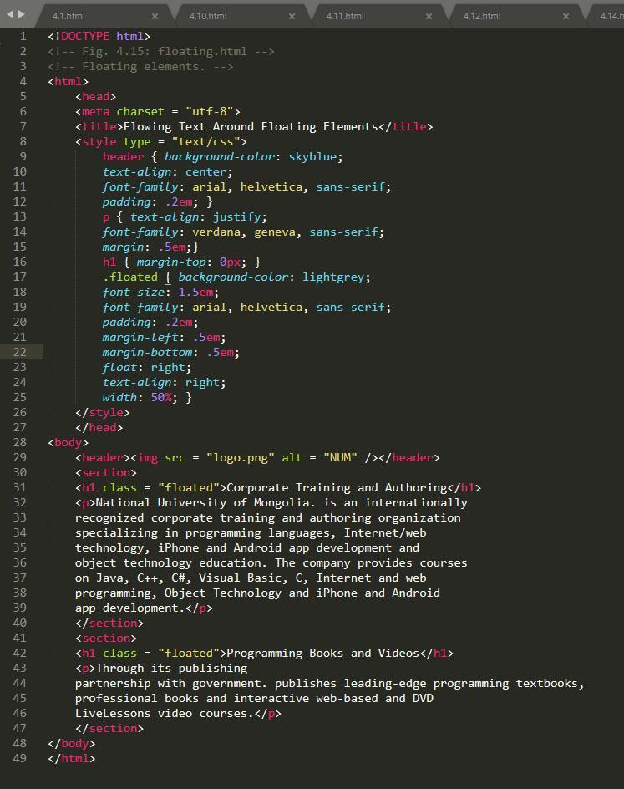
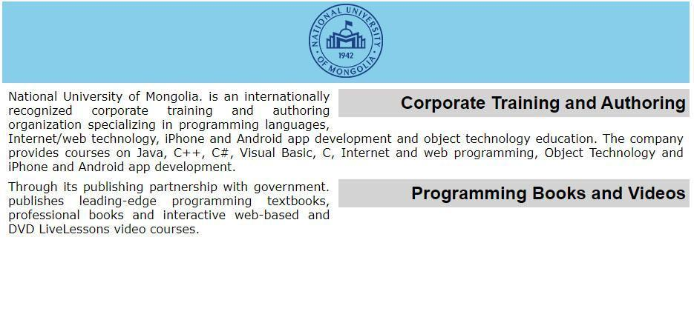
Floating элементүүд
Floating элементийн тусламжтайгаар элементийг түүний зэргэлдээ байрлах элементийн зүүн эсвэл баруун талд байршуулах боломжтой бөгөөд энгийн үгээр хэлбэл бид тесктийг ар араас нь бичдэгтэй адилхан элементүүдийг ар араас нь байрлуулах боломжтой юм.

Slide 3
Өнөөдрийн агуулга
What is Responsive Design
What it contains?
What tools or frameworks are best for responsive web design?
More ….

Slide 4
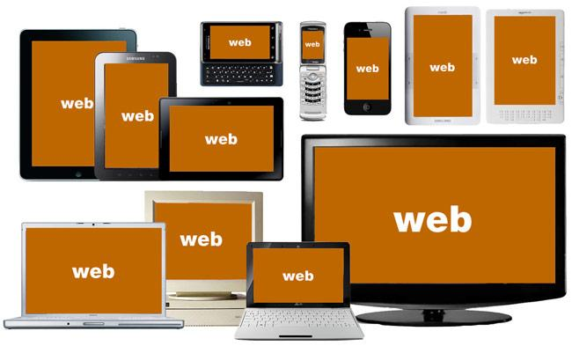
Орчин үеийн вэб сайтын №1 шаардлага

Slide 5
“Anyone who slaps a ‘This page is best viewed with browser X’ label on a web page appears to be yearning for the bad old days, before the web, when you had very little chance of reading a document written on another computer, another word processor, or another network.”
Tim Berners-Lee in Technology Review, July 1996

Slide 6
What is Responsive Web Design?
Вэб дизайн нь бүх төрлийн төхөөрөмжүүдээр үзэхэд хамгийн тохиромжтой байдлаар өөрчлөгдөж байгааг хэлнэ.
An approach to web design that provides an optimal viewing experience across a wide range of devices.
Source: http://www.alistapart.com/articles/responsive-web-design/
Notes:
First introduced in 2009 by Ethan Marcotte who has also written a book with the same title.

Slide 7
Elements of Responsive Web Design
Fluid Grid
Resizable Images
Media Queries
Notes:
First introduced in 2009 by Ethan Marcotte who has also written a book with the same title and which I also recommend.
I’ve spent the last two years learning about and really digging into responsive Web design and I’ve gotta say, It is the beginning of a new era in the Web.

Slide 8
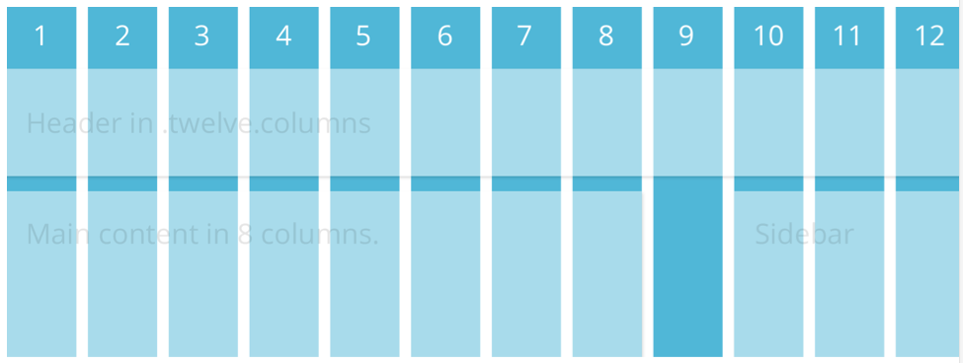
Grids

Slide 9
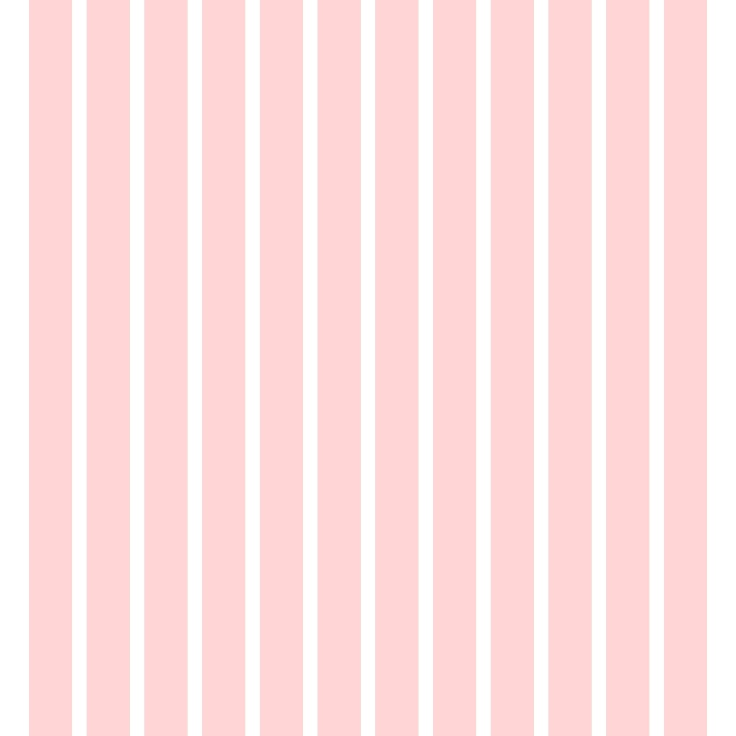

Slide 10
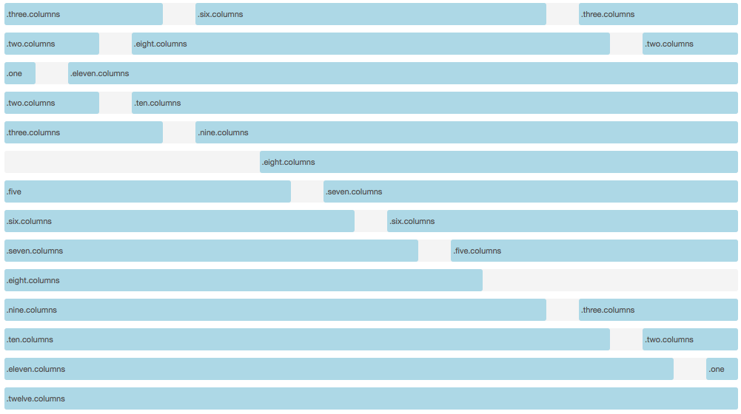
How do grid systems work?
Example based on Foundation Zurb Framework (http://foundation.zurb.com). A 12 column grid system

Slide 11
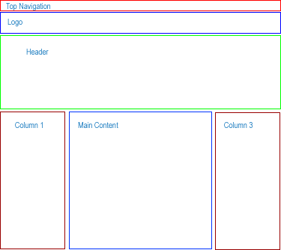
Bonus (Use HTML5 and Responsive syntax to create following layout)

Slide 12
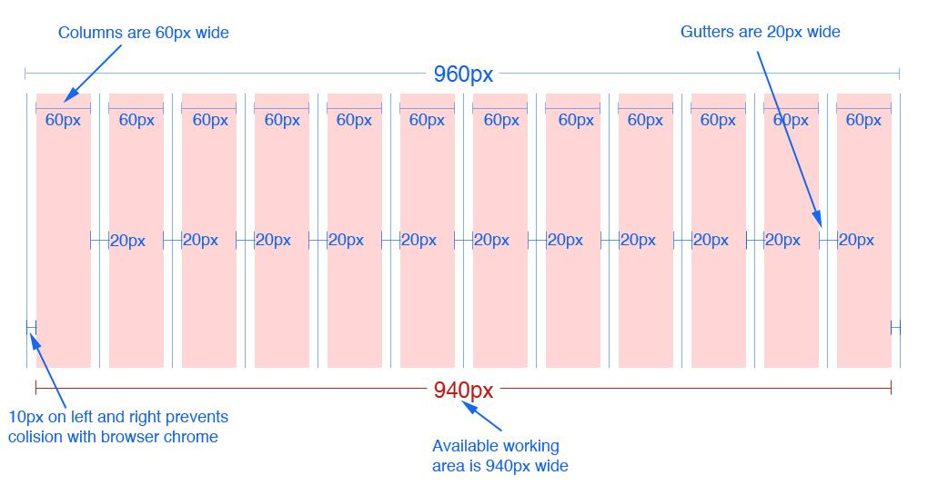
12 column version
Source: 960.gs
Notes:
In the 16 column version each column is 40px wide. Everything else remains the same

Slide 13
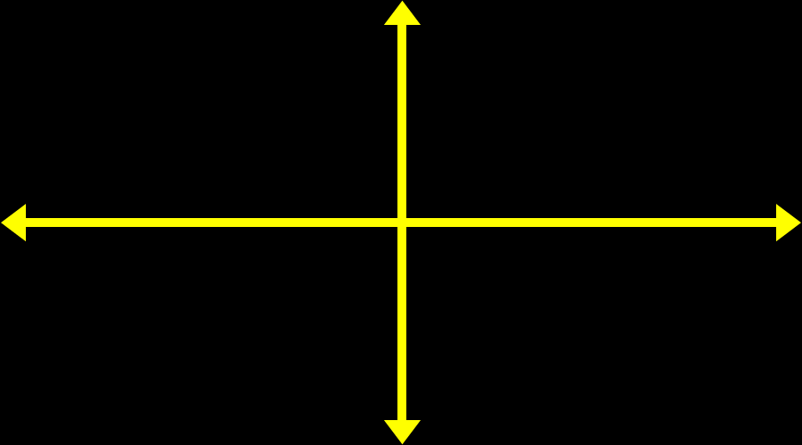
Resizable Images
img {
max-width: 100%;height: auto;
}

Slide 14
Media Queries
A CSS3 module that renders web pages based on conditions such as screen resolution
Drafted in 2001 by the W3C
Became a recommended standard in June 2012
Source: Wikipedia.org
Notes:
First introduced in 2009 by Ethan Marcotte who has also written a book with the same title and which I also recommend.
I’ve spent the last two years learning about and really digging into responsive Web design and I’ve gotta say, It is the beginning of a new era in the Web.

Slide 15
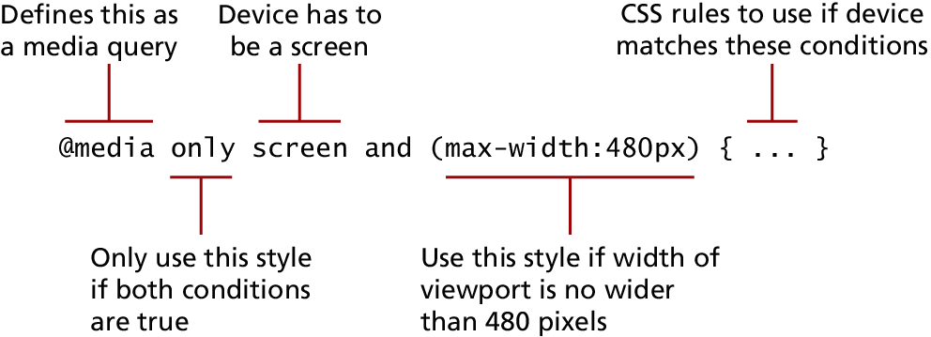
Media Queries
The other key component of responsive designs is CSS media queries.
A media query is a way to apply style rules based on the medium that is displaying the file. You can use these queries to look at the capabilities of the device, and then define CSS rules to target that device.

Slide 16
Media Queries
Contemporary responsive sites will typically provide CSS rules for phone displays first, then tablets, then desktop monitors, an approach called progressive enhancement, in which a design is adapted to progressively more advanced devices
Browser features you can Examine with Media Queries
Feature | Description
width | Width of the viewport
height | Height of the viewport
device-width | Width of the device
device-height | Height of the device
orientation | Whether the device is portrait or landscape
color | The number of bits per color

Slide 17
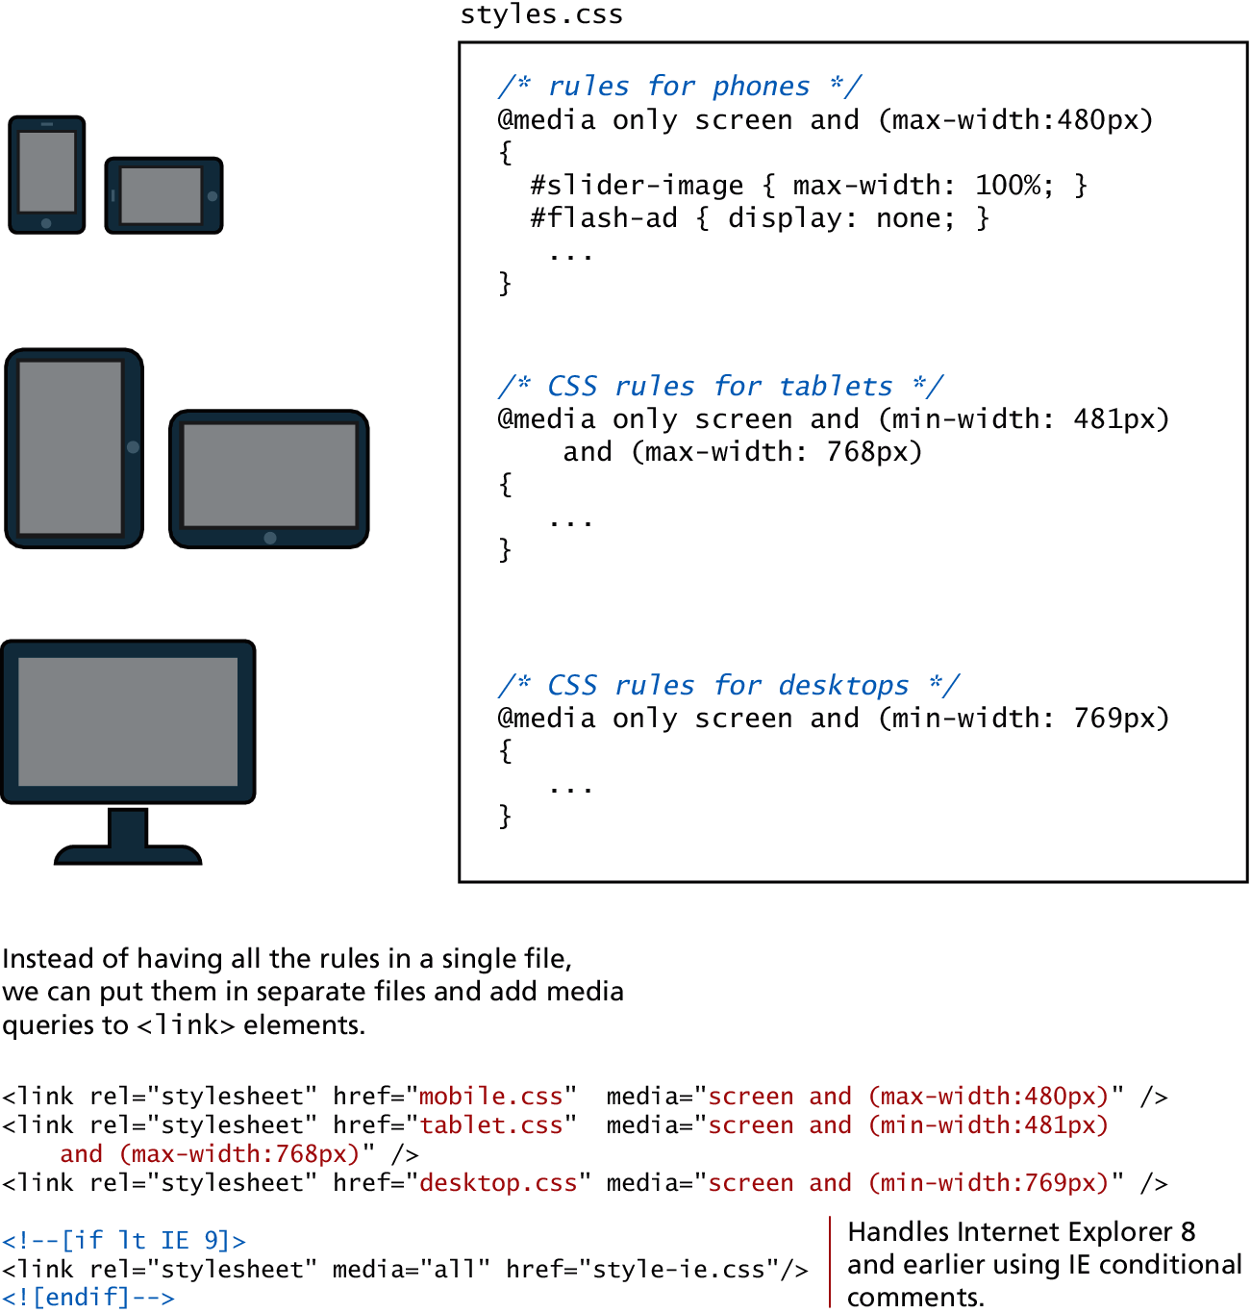
Media queries in action

Slide 18
Common Breakpoints
Label | Layout Width
Smartphones | 480px and below
Portrait Tables | 480px to 768px
Landscape Tablets | 768px to 940px
Default | 940px and up
Large Screens | 1210px and up

Slide 19
Why We Need CSS Frameworks
Project requirements determine the framework
Fluid Grid System
Responsiveness
Offer more than just a grid (pre-defined styles for typography, tables, buttons, navigation, forms elements, etc.)
Also…
Great documentation
Maintained regularly by the community or creator
Open Source (free)

Slide 20
CSS Frameworks
A CSS framework is a precreated set of CSS classes or other software tools that make it easier to use and work with CSS.
They are two main types of CSS framework:
Grid systems
CSS preprocessors.

Slide 21
Grid Systems
Grid systems make it easier to create multicolumn layouts. Some of the most popular are
Bootstrap (twitter.github.com/bootstrap)
Material UI
Tailwind
Print designers typically use grids as a way to achieve visual uniformity in a design. In print design, the very first thing a designer may do is to construct, for instance, a 5- or 7- or 12-column grid. The rest of the document, whether it be text or graphics, will be aligned and sized according to the grid

Slide 22
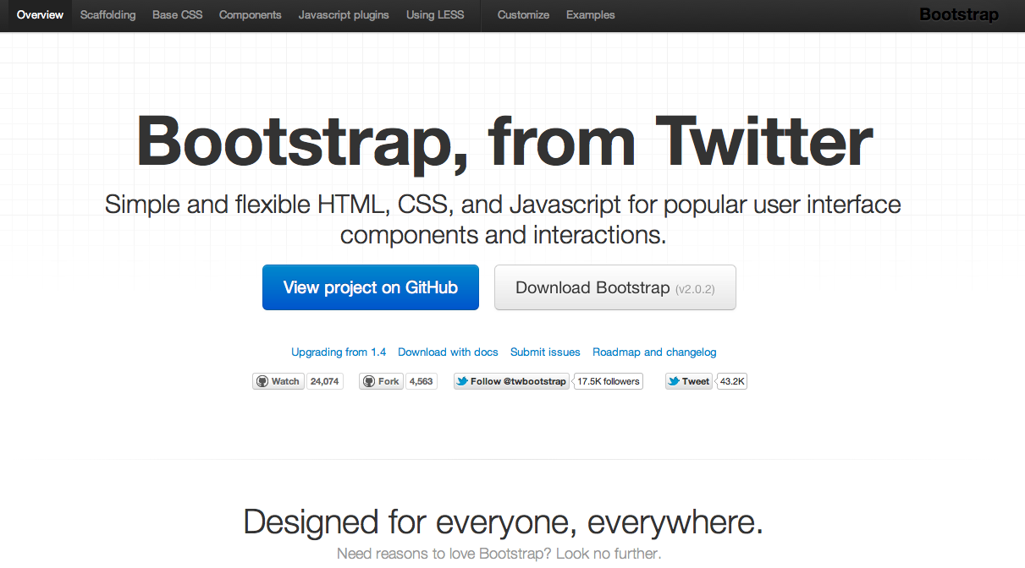
What
Source: http://twitter.github.com/bootstrap/

Slide 23
Twitter Bootstrap
A freely available design framework for websites and web applications
Based upon HTML5, CSS and JavaScript
Supports all major browsers (even IE7!)
Released on GitHub in August 2011

Slide 24
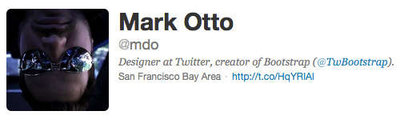
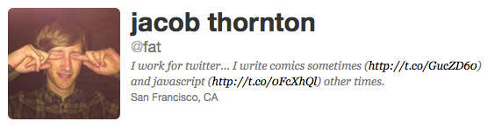
Created By

Slide 25
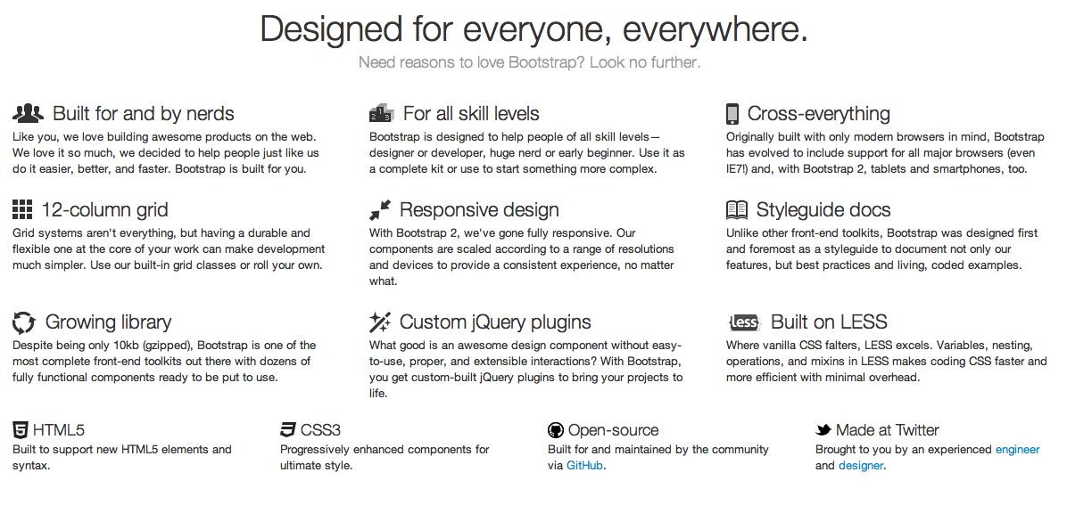
Why
Reason #1: Rich Features

Slide 26
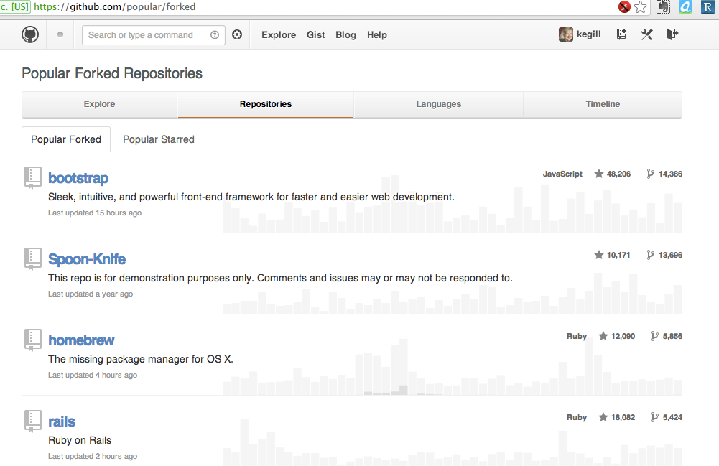
Why
Reason #2: Popularity

Slide 27



Why
Reason #3: Browser Support
Also MSIE and Opera

Slide 28
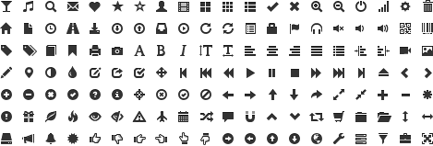
Why
Reason #4: Glyph Icon Set

Slide 29
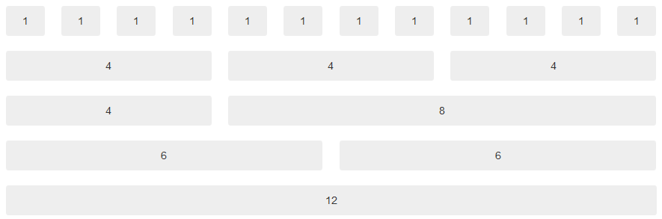
Why
Reason #5: Grid System
Notes:
Bootstrap is using a grid system base on 12 columns.
What is a grid system? A grid system is a way to create a solid foundation to build your project on.
If you want your web application to have a left navigation you could design your HTML using row number 3
If you do not want any navigation and you want your content to be as wide as possible then you could use row number 5
This grid design was popularized by 960 grid system http://960.gs and BluePrint http://www.blueprintcss.org

Slide 30
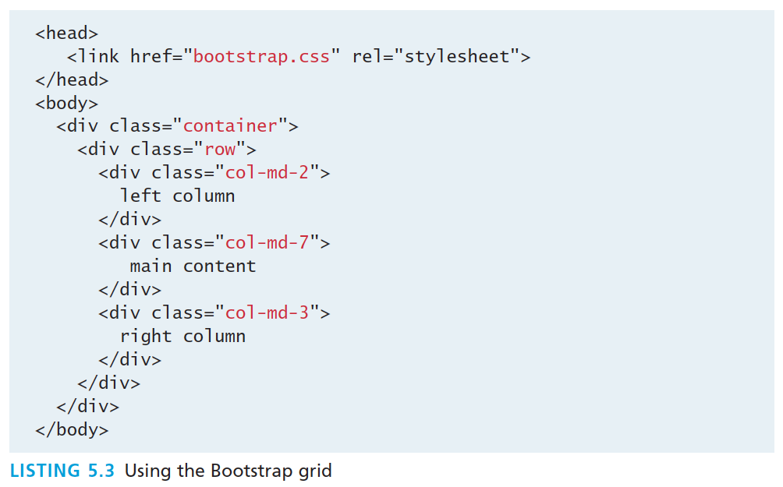
Grid Systems – Bootstrap
http://getbootstrap.com/css/

Slide 31

Why
Reason #6: Components
Buttons:
Tabs:
Breadcrumb:
Pagination:
Alerts:
Progress bar:
Notes:
Here is a list of some of the CSS component available. There are dozens of them available with bootstrap.

Slide 32
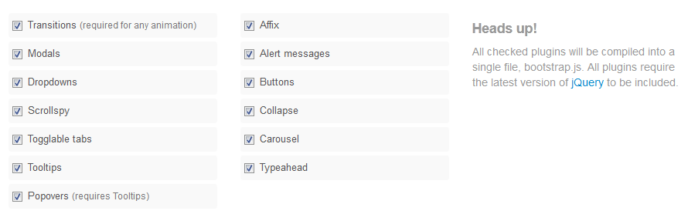
Why
Reason #7: Javascript/jQuery
Notes:
Bootstrap gives life to its UI by using Jquery plugins.

Slide 33
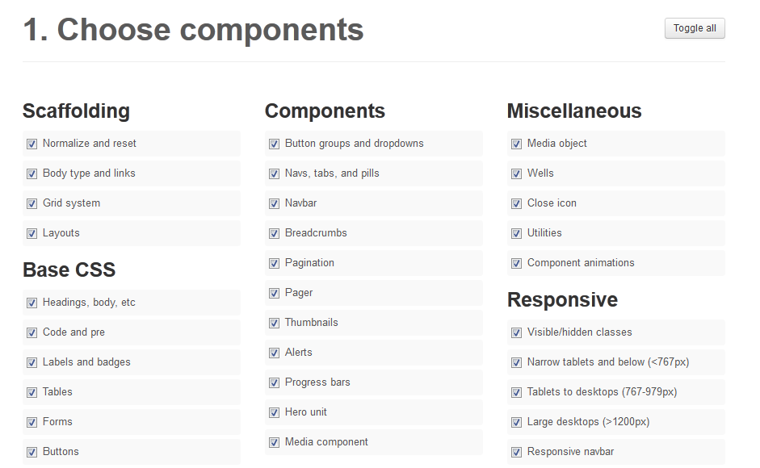
Why
Reason #8: Customization
Notes:
Bootstrap provides a web-based customizer that allow you to generate a CSS file based on your specific needs.

Slide 34
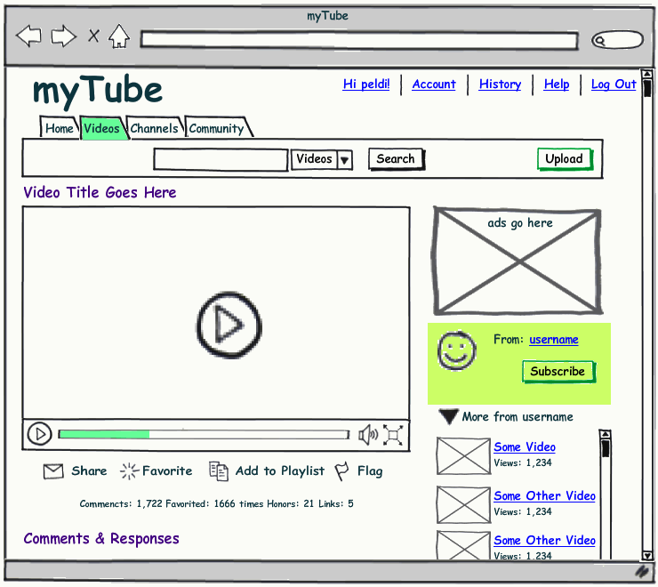
Why
Reason #9: Live Mock-Ups

Slide 35
Questions?

