Slide 1
Лекц 7. SEO – Search Engine Optimization
Интернэт технологийн үндэс
2024 оны намар

Slide 2
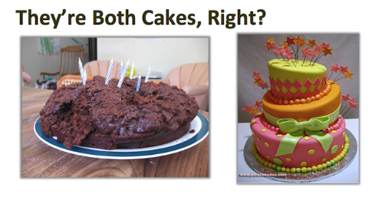
Let’s talk about the SEO

Slide 3
What is SEO?
SEO = Search Engine Optimization – Хайлтын системийн оновчлол
SEO is simply a matter of making sure your site is structured in a way that search engines understand. Search engines have two major functions: crawling and building an index, and providing search users with a ranked list of the websites they've determined are the most relevant.
Хайлтын системийн оновчлол гэдэг нь таны вэб сайт нь хайлтын систем ойлгохуйц байдлаар бүтэцлэгдсэн байхын хэлнэ.
Refers to the process of “optimizing” both the on-page and off-page ranking factors in order to achieve high search engine rankings for targeted search terms. Хайлтын утганд зориулан хамгийн тохиромжтой үр дүнгийн эрэмбийг вэб сайтуудын on-page болон off-page утгуудад тулгуурлан гаргах процесс юм.
Refers to the “industry” that has been created regarding using keyword searching a a means of increasing relevant traffic to a website

Slide 4
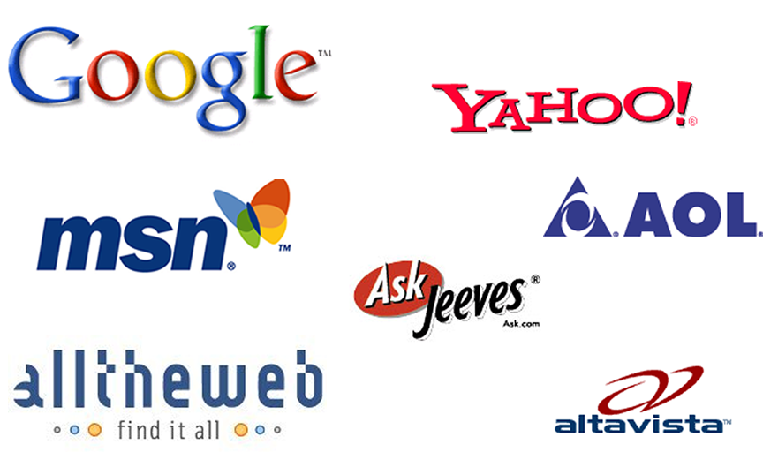
Popular Search Engines
77.4% - Google
8.1% - Baidu - China
7.3% - Bing
5.6% - Yahoo
1.6% - All the rest

Slide 5
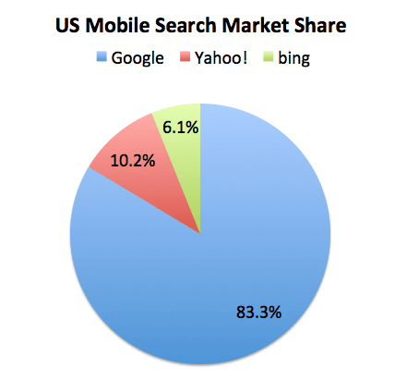
Search Engine Market Share
Search starts with the Web, made up of over 600 TRILLION Pages & Growing

Slide 6
How Do Search Engines Work?
Spider “crawls” the web to find new documents (web pages, other documents) typically by following hyperlinks from websites already in their database
Search engines indexes the content (text, code) in these documents by adding it to their databases and then periodically updates this content
Search engines search their own databases when a user enters in a search to find related documents (not searching web pages in real-time)
Search engines rank the resulting documents using an algorithm (mathematical formula) by assigning various weights and ranking factors

Slide 7
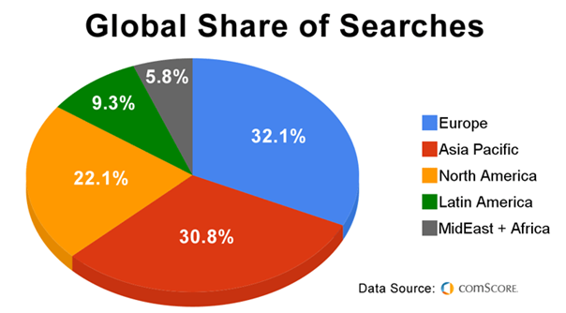
100+ Billion Searches / Month

Slide 8
Important?
80% of consumers find your website by first writing a query into a box on a search engine (Google, Yahoo, Bing)
90% choose a site listed on the first page
85% of all traffic on the internet is referred to by search engines
The top three organic positions receive 59% percent of user clicks.
Cost-effective advertising
Clear and measurable ROI
Operates under this assumption:
More (relevant) traffic + Good Conversions Rate = More Sales/Leads

Slide 9
Ranking Factors
On-Page Factors (Code & Content)
#Title tags <title>
#Header tags <h1>
#ALT image tags
#Content, Content, Content (Body text) <body>
#Hyperlink text
#Keyword frequency & density
Off-Page Factors
#Anchor text
#Link Popularity (“votes” for your site) – adds credibility

Slide 10
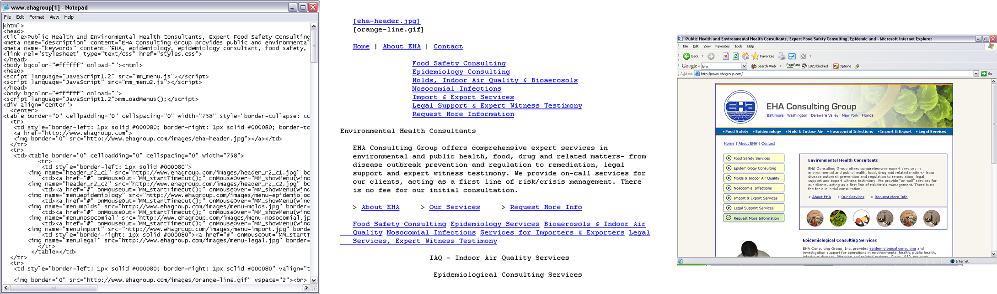
What Search Engine Sees
View > Source (HTML code)

Slide 11
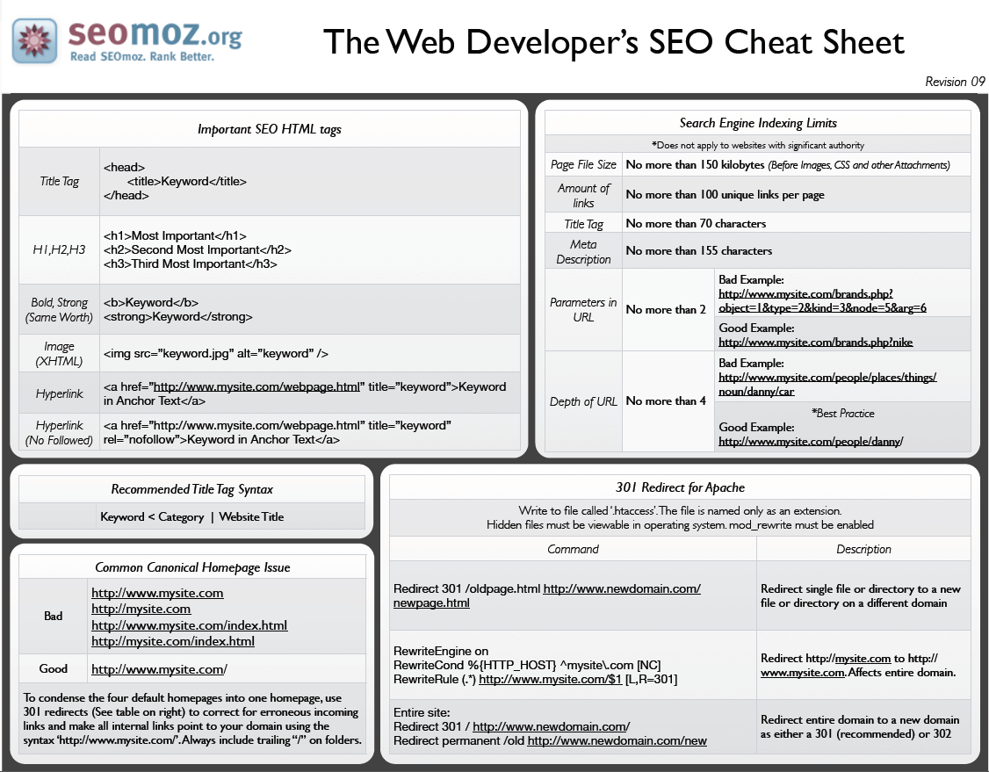

Slide 12
Title Tag
The title element of a page is meant to be an accurate, concise description of a page's content.
Keyword phrase use in the title tag is the most important place to achieve high rankings
Place important keywords close to the front
Don't overdo SEO keywords (cloaking)
Give every page a unique descriptive title

Slide 13
Description Meta Tag
Accurately summarize the page's content
Write a description that would both inform and interest users if they saw your description meta tag as a snippet in a search result. First words count more.
Avoid using generic descriptions like "Page about WWII"
Avoid Filling the description with only keywords
Avoid long descriptions – Two or three sentences is Good.
Use unique descriptions for each page.
Avoid using a single description meta tag across all of your site's pages or a large group of pages.

Slide 14
Keywords and Popularity
The level of key word phrase query popularity is how they are ranked.
How you build your website will effect how popular your site it.
We’re talking about the ‘key word’ Meta Statement
Key word phrase is better than a simple ‘key word’
Search engines measure how keywords are used on pages to help determine the relevance of a query.
Keyword Abuse – Stuffing & Cloaking

Slide 15
The Use of the keyword phrase:
In the meta title tag at least once. Try to keep the keyword phrase as close to the beginning of the title tag as possible.
In a <h1> html tag.
Once prominently near the top of the page and body.
At least two or three times, including variations, in the body of the page.
At least once in the alt attribute of an image on the page.
Once in the URL If possible.
At least once in the meta description tag.
Key word Meta Statement not important.

Slide 16
Content – Body of Website
Easy to use, navigate and understand.
Avoid duplicate text from your site or others
Design for user not SEO
Use ‘breadcrumb’ lists on pages
Provide direct, high quality, legitimate, credible content.
Use the alt tag on images
Avoid sloppy text with spelling and grammatical mistakes
Avoid varying topics with out subheadings ( <h?> tags )
Actionable information relevant to the query – blogs surveys
HTML/CSS3 compliant and responsive
YouTube embedded
Have a useful 404 page.

Slide 17
Anchor Text
<a href=http://www.b24.net/Mission-18March1944.htm title=Mission Details of 18 march>Mission Details of 18 March 1944</a>
The Anchor Text should tell users and Google something about the page you're linking to
Choose descriptive text
The anchor text you use for a link should provide at least a basic idea of what the page linked to is about.
Avoid writing generic anchor text like "page", "article", or "click here”
Write concise text
Aim for short but descriptive text-usually a few words or a short phrase.
Avoid using excessively keyword-filled or lengthy anchor text just for search engines

Slide 18
Internal links & links to your site.
Internal Navigational Links
Try to have navigational links higher up in the body HTML coding
Every page should be reachable from at least one static text link.
External links have more influential that internal links
Links to pages that have spam may devalue your website
Make anchor text meaningful and accurate description of link
Sitemap.htm Sitemap.xml Robot.txt

Slide 19
Internal links & links to your site.
External links pointed to your website
Links from unique domains matter – more is better.
Links from sites close to your content are helpful
Links from more important, popular, trusted sites pass more value
Links to/from YouTube, Facebook and other social media have value.

Slide 20
Popularity
Sites are ranked by Google by a page popularity index from 1 -10 - http://pr.eyedomain.com
CNN.com 9
wikipedia.org 9
Foxnews.com 8
Ebay.com 8
B24.net 5
8thAFHS.org 4
492nd bomb group 3
Heritage League 3
The number of sites linked to you and their popularity index have significance.
The Number of clicks on google for your site based on keywords.

Slide 21
PPC vs. “Organic” SEO
Pay-Per-Click | “Organic” SEO
results in 1-2 days easier for a novice or one little knowledge of SEO ability to turn on and off at any moment generally more costly per visitor and per conversion fewer impressions and exposure easier to compete in highly competitive market space (but it will cost you) Ability to generate exposure on related sites (AdSense) ability to target “local” markets better for short-term and high-margin campaigns | results take 2 weeks to 4 months requires ongoing learning and experience to achieve results very difficult to control flow of traffic generally more cost-effective, does not penalize for more traffic SERPs are more popular than sponsored ads very difficult to compete in highly competitive market space ability to generate exposure on related websites and directories more difficult to target local markets better for long-term and lower margin campaigns
We will learn this more on “E-Business” lesson.

Slide 22
References
Beginners Guide to SEO: https://moz.com/beginners-guide-to-seo
Google Guide: http://www.google.com/webmasters/docs/search-engine-optimization-starter-guide.pdf
Webmaster tools: https://www.google.com/webmasters/tools Need gmail account
Test for Mobile Friendly: https://search.google.com/test/mobile- friendly/
Validate website: https://validator.w3.org/
Sitemap Generator https://www.xml-sitemaps.com/
SEO tools https://www.xml-sitemaps.com/seo-tools.html
Google Tips: https://support.google.com/webmasters/answer/40349?hl=en&ref_topic=3309300
Page Ranking: http://pr.eyedomain.com

Slide 23
Анхаарал хандуулсанд баярлалаа

