Slide 1
Digital Image Watermarking using Discrete Wavelet Transform
Author of the presentation: Shureev Kasum

Slide 2
Table of Contents
Abstract
Objectives
Materials and Methods
Experiments
Discussion
Conclusions

Slide 3

Abstract
Digital watermarking is an essential technique to add copyright notice, secret messages or verification messages to digital image signals, audio, video, or documents which is used for identifying the original creator and owner of digital content.

Slide 4
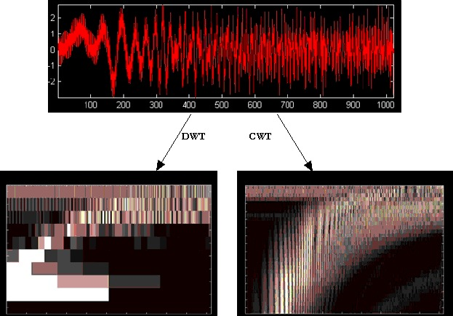
Objectives
Technique watermarking algorithms are broadly categorized into two: Blind and Non-blind watermarking.
Non-blind watermarking is used which requires original image for extraction
Discrete wavelet transform(DWT) vs complex wavelet transform(CWT)

Slide 5
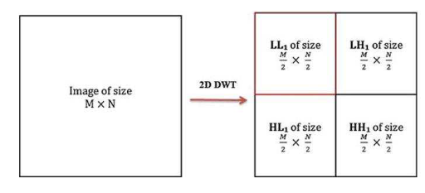
Discrete Wavelet transform
Discrete Wavelet transform (DWT) is a mathematical tool for hierarchical decomposition of an image.
WT decomposes an image into sub images or sub bands, three details and one approximation.
Sub-bands formed after 1-level DWT

Slide 6
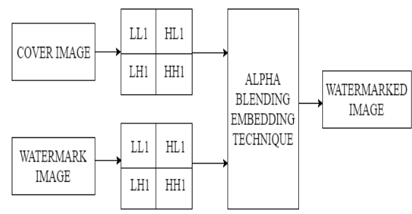
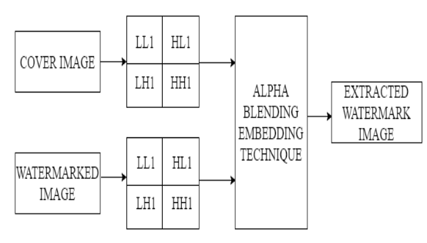
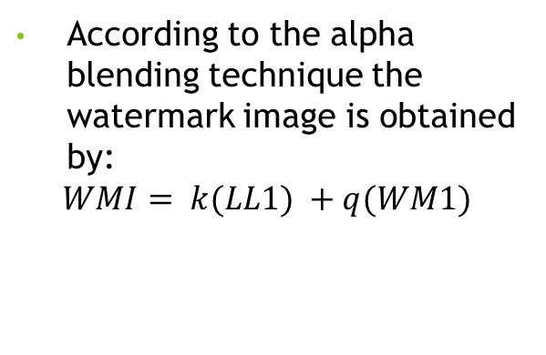
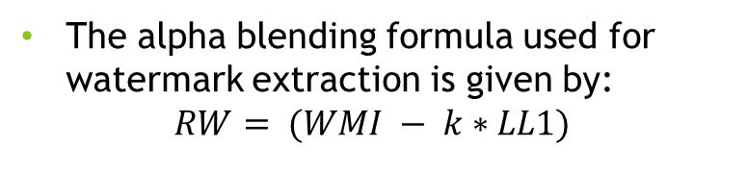
Alpha Blending Technique
According to the alpha blending technique the watermark image is obtained by:
$$WMI= k(LL1) +q(WM1)$$
The alpha blending formula used for watermark extraction is given by:
$$RW= (WMI − k∗LL1)$$
Watermark Embedding Process
Watermark Extraction Process

Slide 7
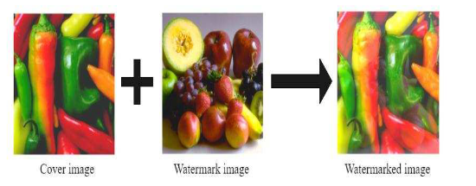
Embedding process
Watermark embedding is done by varying the value of k from 0.1 to 0.9 keeping q constant at 0.1.
Best results are obtained when k is 0.5. With the decreasing value of k below 0.4 watermark image gets brighter and completely destroys the cover image.
Watermark embedding process 1-level DWT

Slide 8
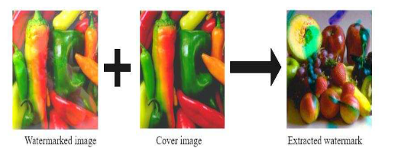
Extraction process
Recovery of watermark image is done by varying value of k from 0.1 to 0.9. With the decreasing value of k below 0.2 recovered watermark becomes darker and completely invisible.
Watermark extraction process 1-level DWT

Slide 9

Experiments
Used pepper image as the cover image and the fruits image as the watermark which are (b) respectively. Both the images are of equal size of 512×512.
The alpha blending technique used here adds the low frequency contents of the two images hence both images of equal size are taken.
Cover image

Slide 10


Discussion
Watermarking ensures authenticating ownership, protecting hidden information, prevents unauthorized copying and distribution of images over the internet and ensures that a digital picture has not been altered.
LOCAL WATERMARK ON A 100 RUBLE BANKNOTE

Slide 11
CONCLUSIONS
Digital image watermarking technique based on discrete wavelet transform using alpha blending technique is implemented.
The cover image is required in the extraction process. The quality of recovered watermark image and watermarked image is depends on the scaling factors k and q.
Results obtained show that this technique is robust to various image processing operations

Slide 12
Thank you for your attention
Kasum Shureev
k-shureev@mail.ru
Касым Шуреев (vk.com)

