Slide 1

Digital Image Watermarking using Discrete Wavelet Transform
Authors of the presentation: Shureev Kasum
1

Slide 2
Table of Contents
Abstract
Objectives
DISCRETE WAVELET TRANSFORM
Alpha Blending Technique
Experiments
Materials and Methods
Discussion
CONCLUSIONS

Slide 3

Abstract
Digital watermarking is an essential technique to add copyright notice, secret messages or verification messages to digital image signals, audio, video, or documents which is used for identifying the original creator and owner of digital content.
3

Slide 4
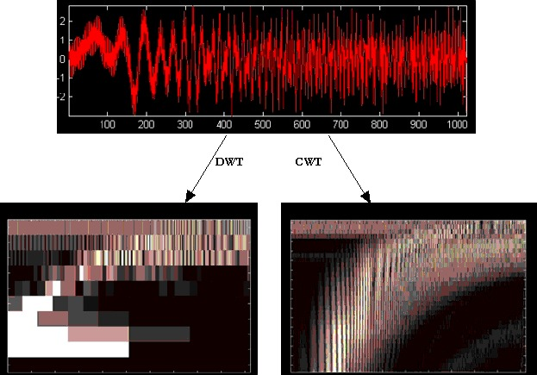
Objectives
Based on the extraction technique watermarking algorithms are broadly categorized into two: Blind and Non-blind watermarking.
In this paper non-blind watermarking is used which requires original image for extraction
4

Slide 5
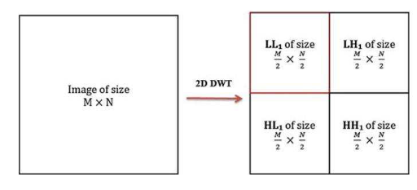
DISCRETE WAVELET TRANSFORM
Discrete Wavelet transform (DWT) is a mathematical tool for hierarchical decomposition of an image. WT decomposes an image into sub images or sub bands, three details and one approximation. The bands are LL, LH, HL and HH. Figures shows the sub bands in DWT.

Slide 6
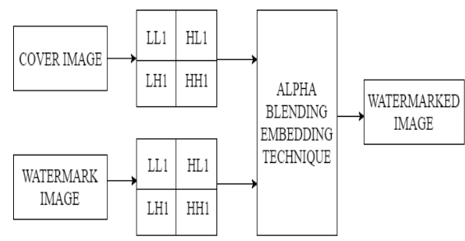
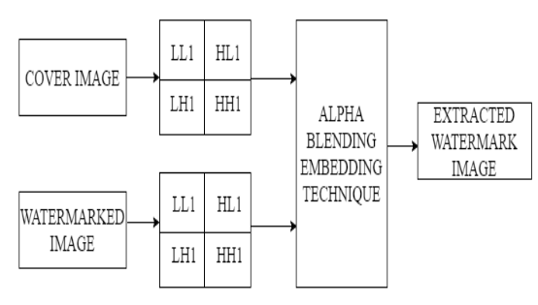
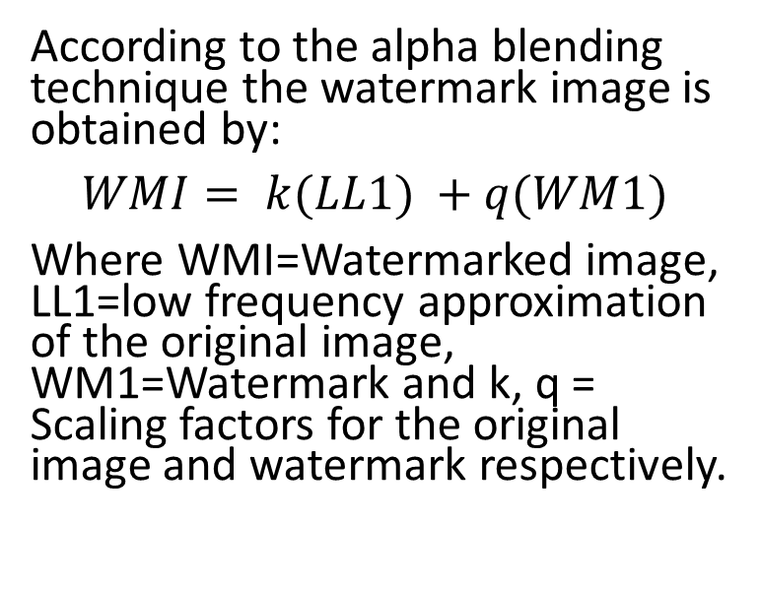
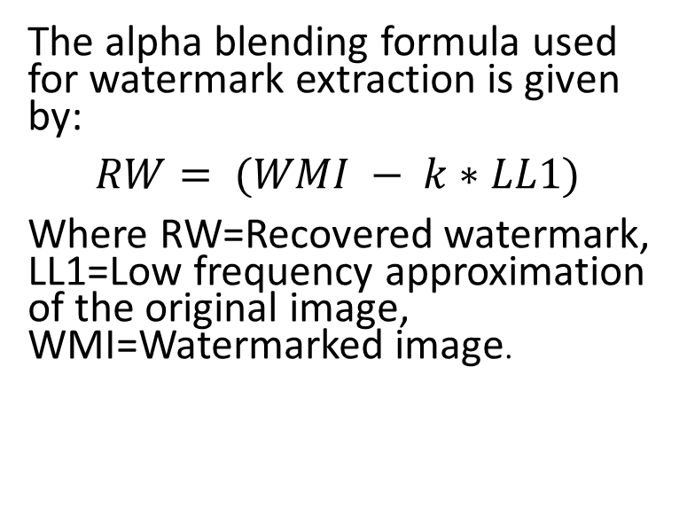
Alpha Blending Technique
According to the alpha blending technique the watermark image is obtained by:
$$WMI= k(LL1) +q(WM1)$$
Where WMI=Watermarked image, LL1=low frequency approximation of the original image, WM1=Watermark and k, q = Scaling factors for the original image and watermark respectively.
The alpha blending formula used for watermark extraction is given by:
$$RW= (WMI − k∗LL1)$$
Where RW=Recovered watermark, LL1=Low frequency approximation of the original image, WMI=Watermarked image.

Slide 7

Experiments
In this paper we have used pepper image as the cover image and the fruits image as the watermark which are (b) respectively. Both the images are of equal size of 512×512. The alpha blending technique used here adds the low frequency contents of the two images hence both images of equal size are taken.

Slide 8

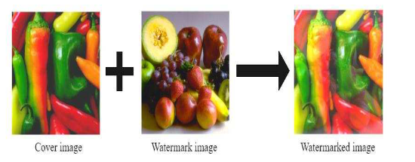
Materials and methods
Figure shows watermark embedding process. Shows the watermarked image. Watermark embedding is done by varying the value of k from 0.1 to 0.9 keeping q constant at 0.1. Best results are obtained when k is 0.5. With the decreasing value of k below 0.4 watermark image gets brighter and completely destroys the cover image.

Slide 9
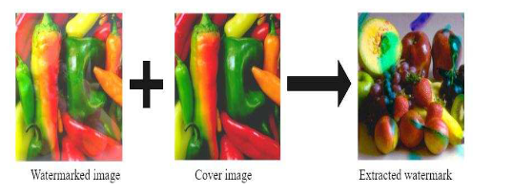

Materials and methods
Figure shows the watermark extraction process. And shows the extracted watermark image. Recovery of watermark image is done by varying value of k from 0.1 to 0.9. With the decreasing value of k below 0.2 recovered watermark becomes darker and completely invisible.

Slide 10
CONCLUSIONS
In this paper a digital image watermarking technique based on discrete wavelet transform using alpha blending technique is implemented. This technique embeds visible watermark into the cover image.
The cover image is required in the extraction process. The quality of recovered watermark image and watermarked image is depends on the scaling factors k and q. Results obtained show that this technique is robust to various image processing operations

Slide 11
Thank you for your attention
Shureev Kasum
k-shureev@mail.ru
Касым Шуреев (vk.com)
11

