Slide 1
컴파일러 최적화
김성범, 김민재, 김문겸, 황명빈

Slide 2




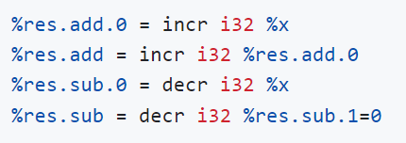

Arithmetic Replacement
(1) Shift replacement
(2) And replacement
(3) Addition/Subtraction replacement

Slide 3
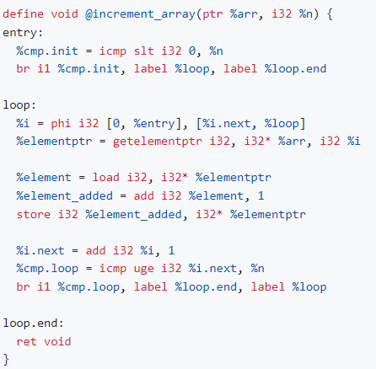
Vector in Loop

Slide 4
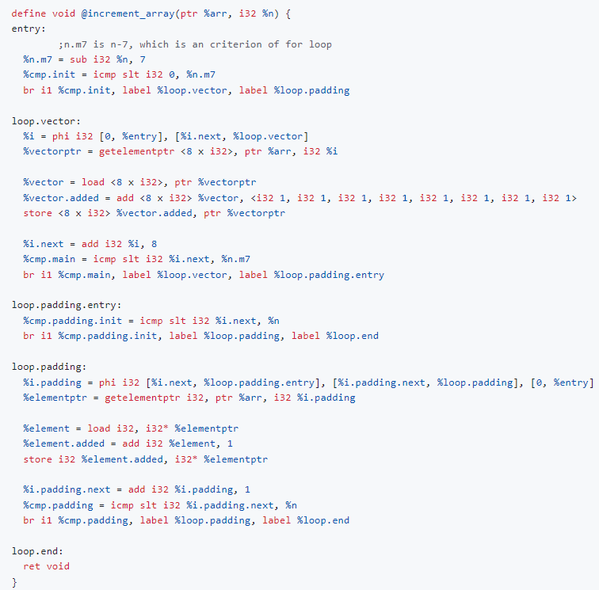
Vector in Loop

Slide 5
Vector in Loop

Slide 6
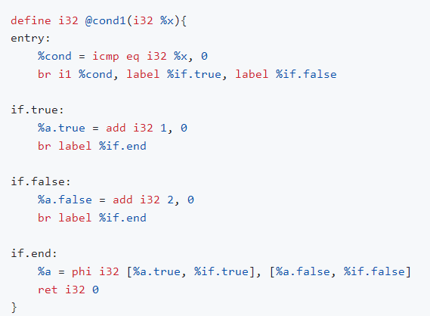
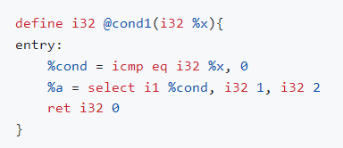
Simple branch to ternary

Slide 7
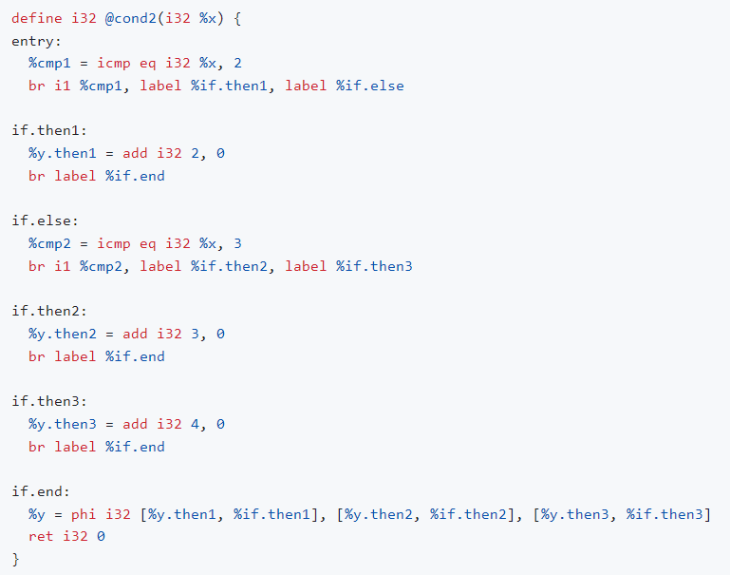
If/else if/else to switch

Slide 8
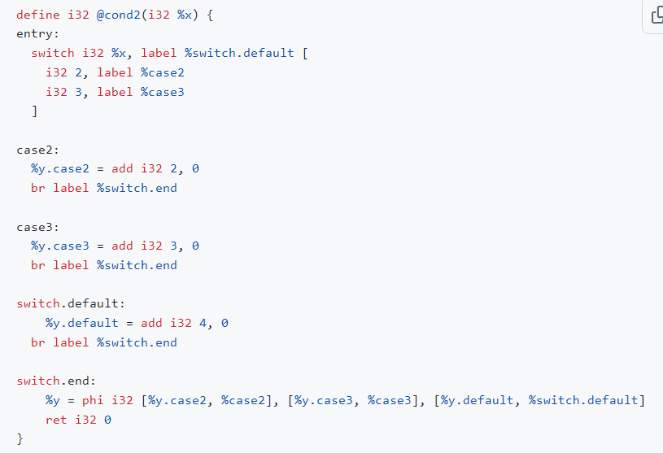
If/else if/else to switch

Slide 9
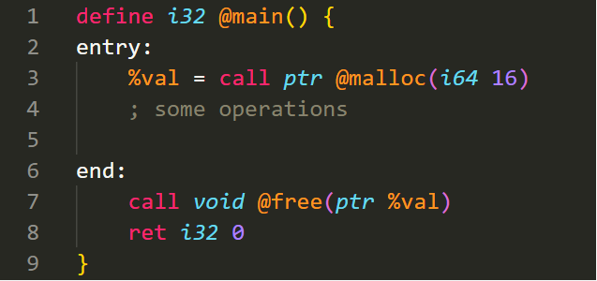
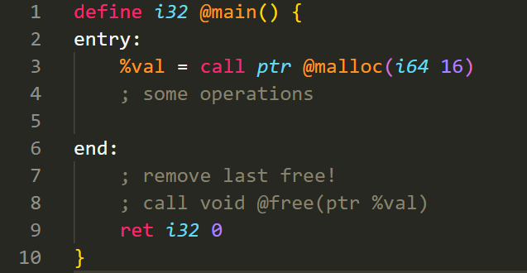
Remove last free

Slide 10
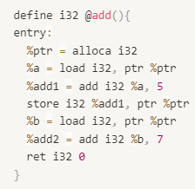
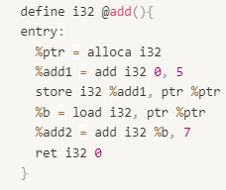
Load after malloc replacement

