Slide 1
SWPP Team 12
박재민, 정현서, 김희서

Slide 2
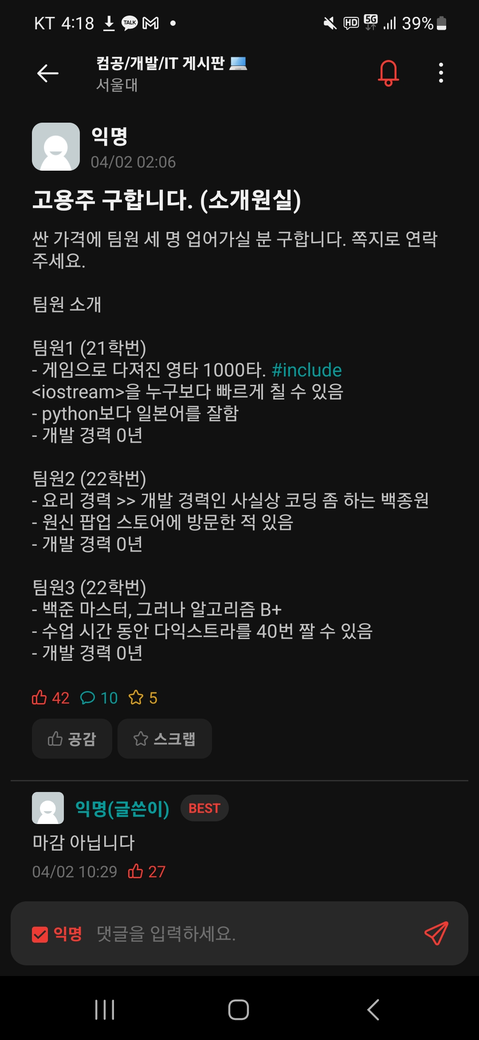
Team Introduction

Slide 3


Team Introduction

Slide 4

Team Introduction

Slide 5
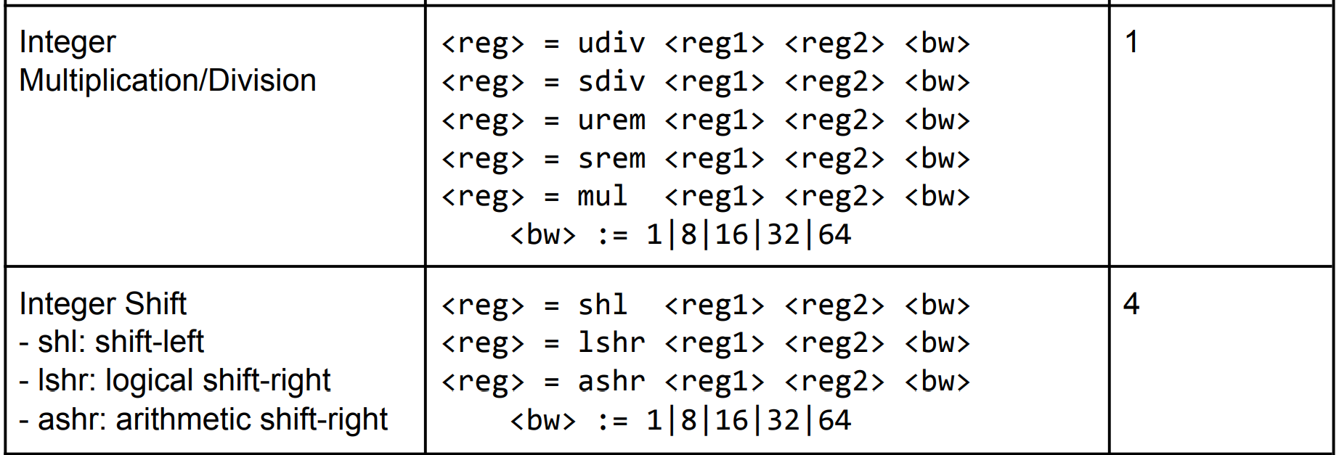
Optimization 1
Motivation
Bitwise Shifting is more expensive than Integer Multiplication!

Slide 6
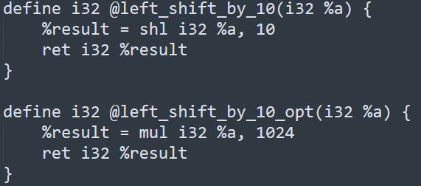
Optimization 1
Example
1 : left_shift_by_10
2 : left_shift_by_10_opt
Search for all operations such as 1, and change it to the form of 2.
Hardcode for possible constant multiplications found in the code.

Slide 7
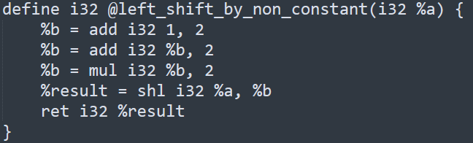
Optimization 1
Example
Even if “b” was not explicitly as constant value, if it could be known in compile-time,
We can apply the same optimization!
Make a use-define chain of variables, and if all indegree vertices of variable “b” originate from
constant value, precalculate “b”, and use the same optimization.

Slide 8
Optimization 2
Motivation
Bitwise Shifting is more expensive than Integer Multiplication!

Slide 9
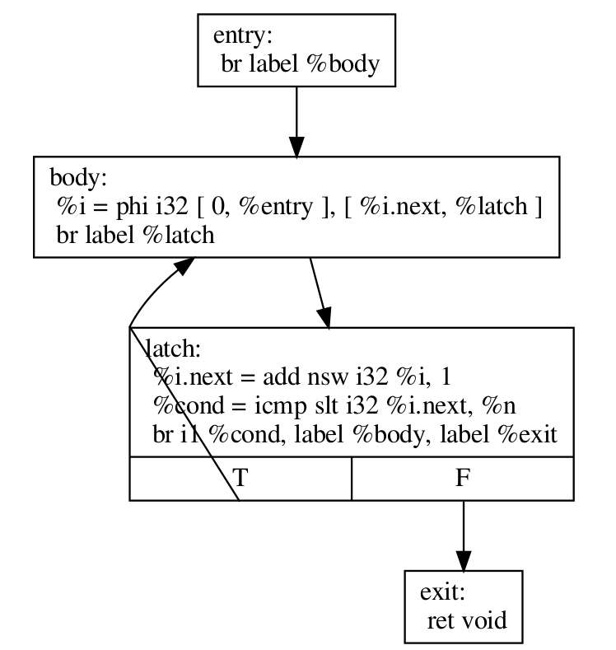
Optimization 2, 3
Motivation
Since the LLVM IR itself originated from a human-written C code,
Can we find for/while loops with just structural analysis in LLVM IR?
Further discussion is needed on loop detections…

Slide 10
Optimization 2
Motivation
Why do we want to find for/while loops?
Generally, a for loop uses the following operations.
Entry
Conditional Branch : True
Conditional Branch : True
Conditional Branch : True
…
Conditional Branch : True
Conditional Branch : False
Exit

Slide 11
Optimization 2
Motivation
(A)
Entry
Conditional Branch : True
Conditional Branch : True
Conditional Branch : True
…
Conditional Branch : True
Conditional Branch : False
Exit
(B)
Entry
Conditional Branch : False
Conditional Branch : False
Conditional Branch : False
…
Conditional Branch : False
Conditional Branch : True
Exit
(B) is more optimal than (A)!

Slide 12
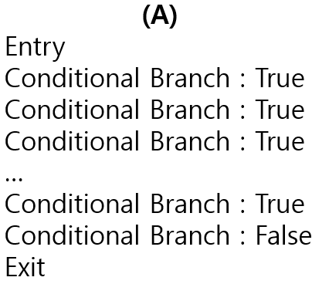
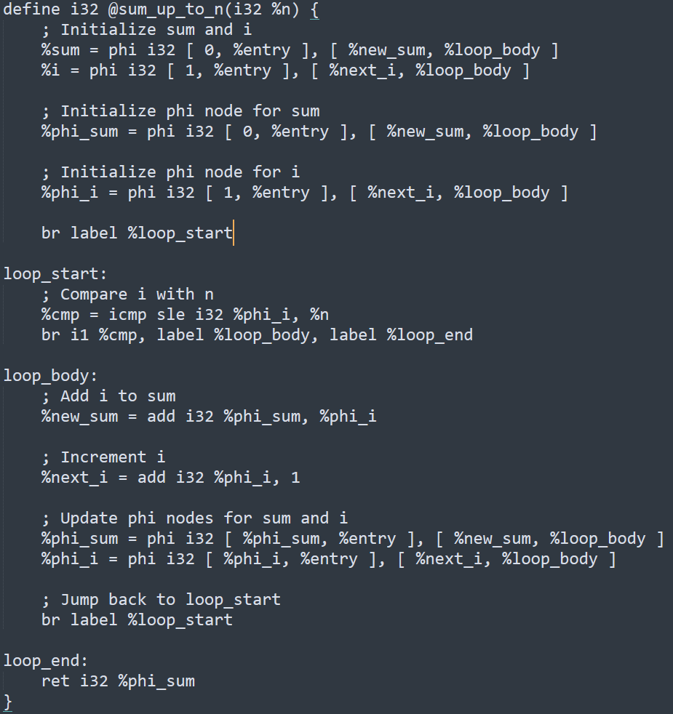
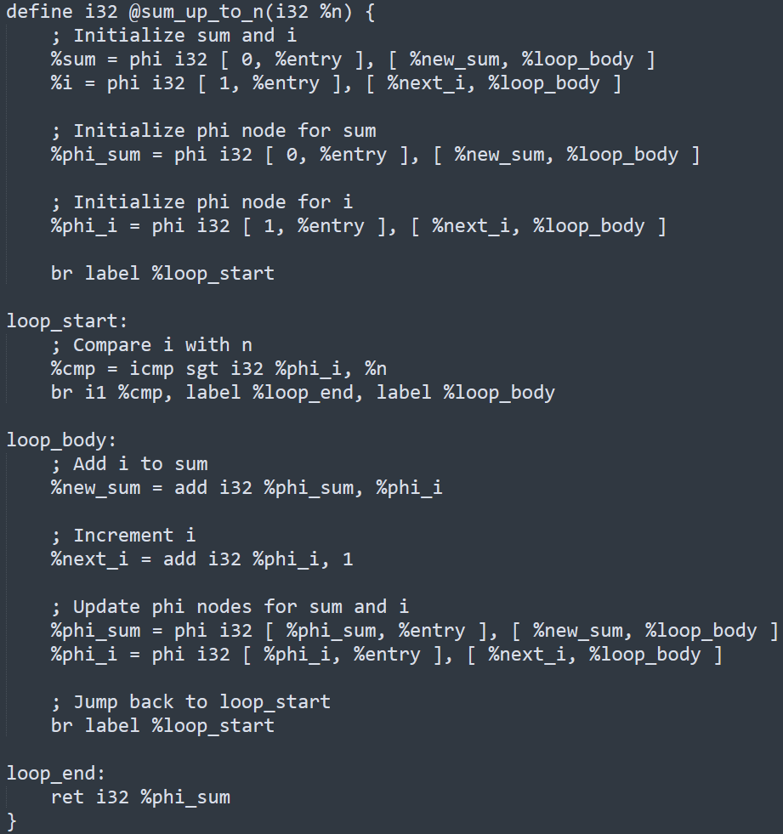
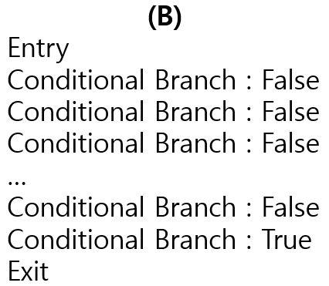
Optimization 2
Example

Slide 13
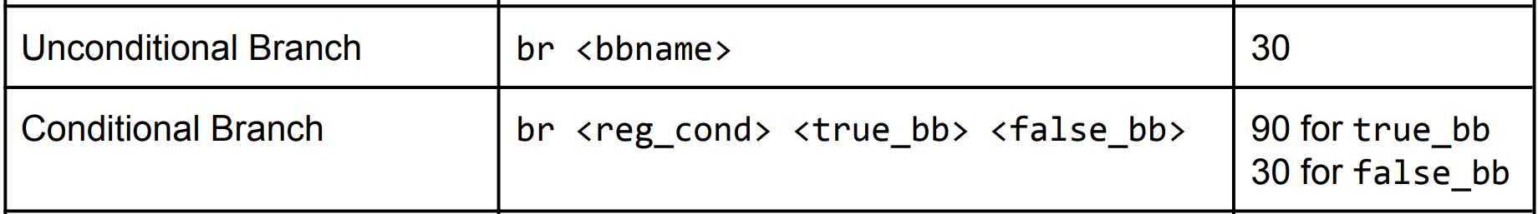
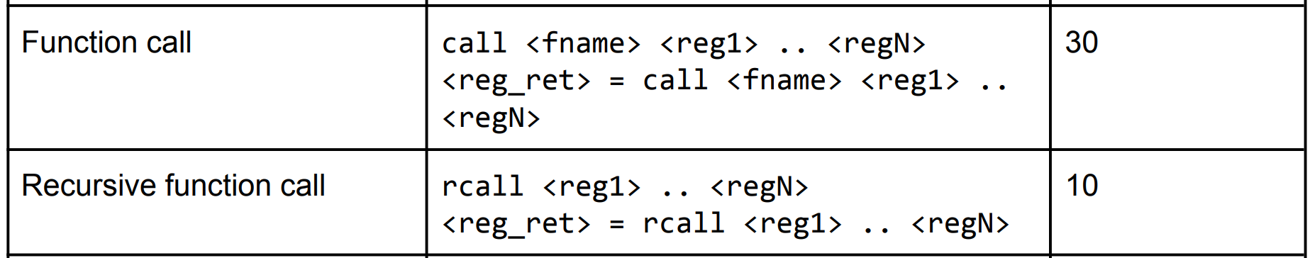
Optimization 3
Motivation

Slide 14
Optimization 3
Motivation
(A) For Loop
Entry
Conditional Branch : True
<Do Something>
Unconditional Branch
Conditional Branch : True <Do Something>
Unconditional Branch
Conditional Branch : True
<Do Something>
Unconditional Branch
…
Conditional Branch : True
<Do Something>
Unconditional Branch
Conditional Branch : False
Exit
(B) Recursion?
Entry
Conditional Branch : True
<Do Something>
Recursive Function Call
Conditional Branch : True <Do Something>
Recursive Function Call
Conditional Branch : True
<Do Something>
Recursive Function Call
…
Conditional Branch : True
<Do Something>
Recursive Function Call
Conditional Branch : False
Exit
(B) is more optimal than (A)!

Slide 15
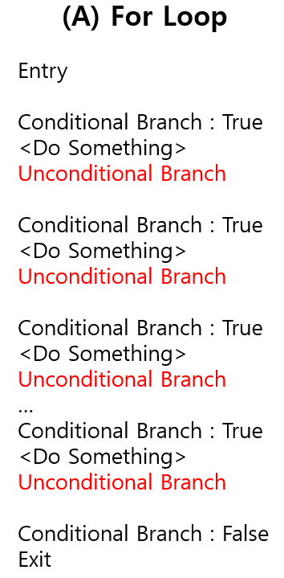
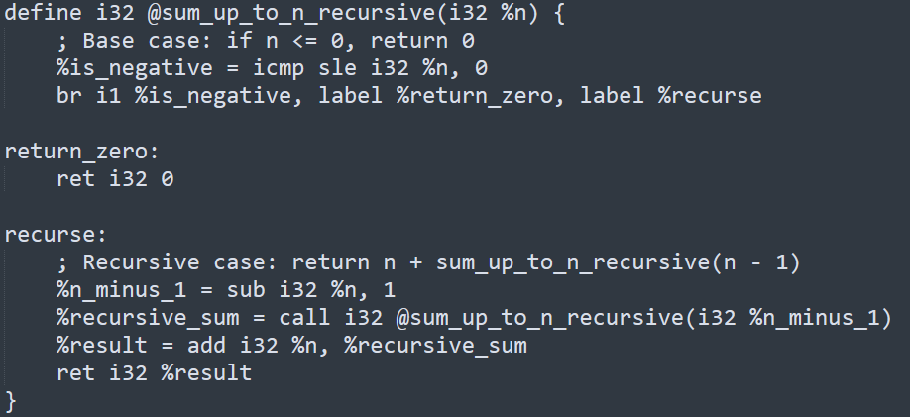
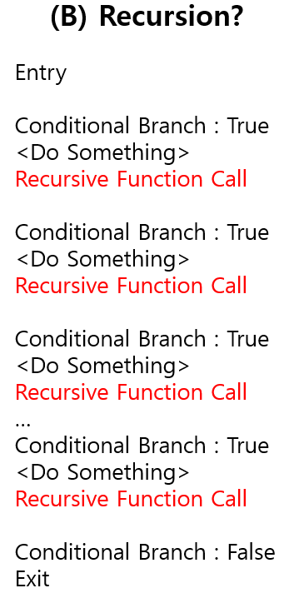
Optimization 3
Example

Slide 16
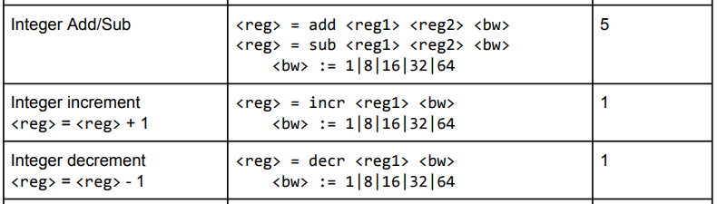
Optimization 4
Motivation
Integer Add/Sub is too expensive!

Slide 17
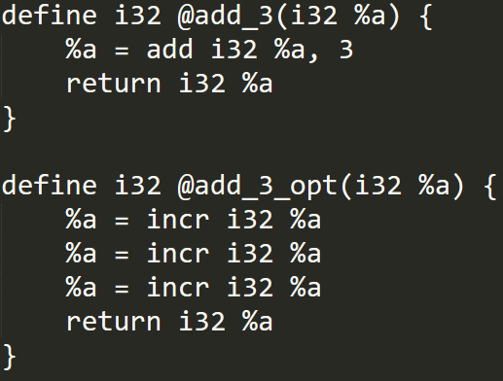
Optimization 4
Example
1 : add_3
2 : add_3_opt
Search for all operations such as 1, and change it to the form of 2.
Efficient when adding a constant less than 5, and add operation updates same register

Slide 18
Optimization 5
Motivation
Consecutive unconditional branches are wasteful!

Slide 19
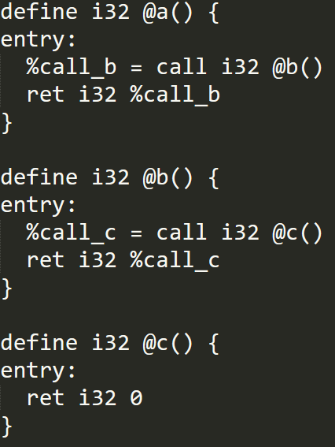
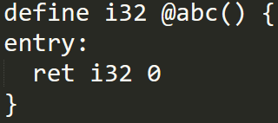
Optimization 5
Example
No conditional branch in a->b->c
Just merge it!
More Developed Idea: detect for loop -> merge into big block

Slide 20
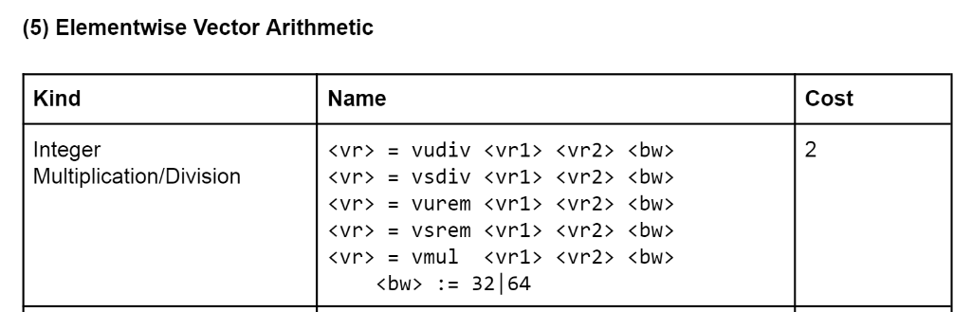
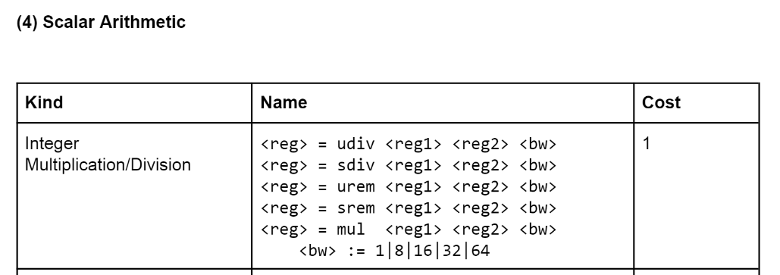
Optimization 6
Motivation

Slide 21
Optimization 6
Loop:
…
%a1 = add i32 %b1, %c1
store i32 %a1 %reg1
…
A brief example
for (int i = 0; i < n; i++) {
a[i] = b[i] + c[i]
}
Loop:
…
%a1 = add <8 x i32> %b1, %c1
store <8 x i32> %a1 %reg1
…
C code

