Slide 1
SWPP Team3
2019-15313 강혁준
2019-12190 김한별
2019-11730 신현지
2019-17586 황보준형

Slide 2
Outline
Motivation
Optimization Ideas

Slide 3
I. Motivation
Experience an Agile development process
practice writing effective pull requests (PRs) and managing clean commit logs for smooth collaboration.
Apply design patterns.
Learn how to write readable C++ code for team members.
Learn how to write test codes to develop bug-free programs.
Learn the process of designing and developing large software, and based on this, develop the ability to create correct and efficient software.

Slide 4
II. Optimization Ideas
Rcall
Redundant Branch
Function Inlining
0x01 and -> % 2 operation
Heap redundant zero initialization
Loop unrolling

Slide 5
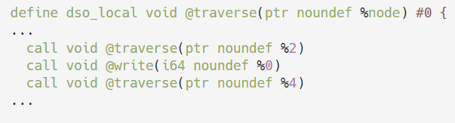
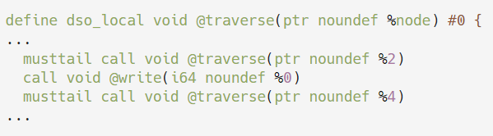
II. Idea 1: Rcall
Recursive Call to Rcall
musttail call

Slide 6
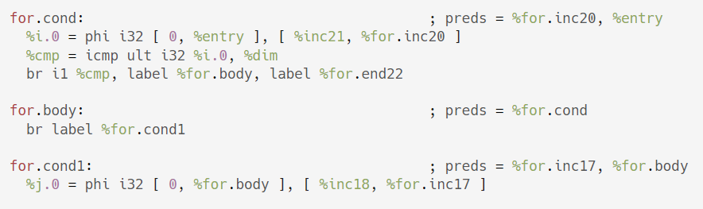

II. Idea 2: Redundant Branch

Slide 7
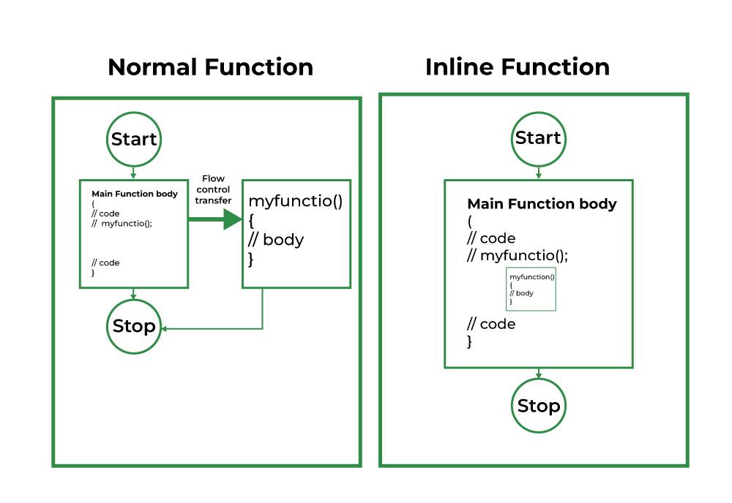
II. Idea 3: Function Inline
Normal Function
Inline Function

Slide 8
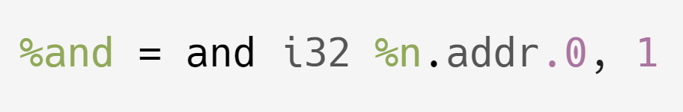

II. Idea 4: 0x01 and -> % 2 operation
Lower Cost

Slide 9
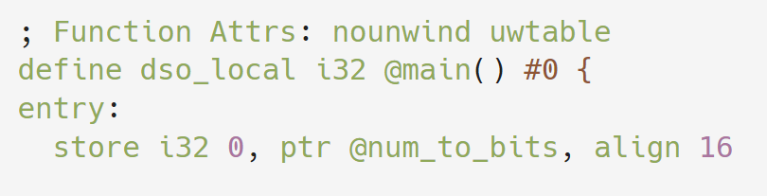
II. Idea 5: Heap redundant zero init
Heap is already initialized to 0
No need for zero init

Slide 10
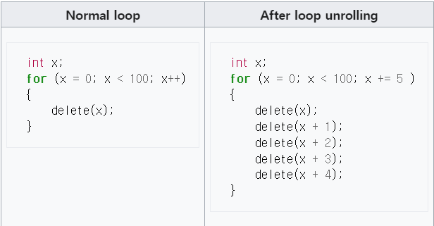
II. Idea 6: Loop Unrolling

