Slide 1
Compiler Team 9
2024 Spring, SWPP
김경호, 오준석, 나동현, 홍순범

Slide 2
TABLE OF CONTENTS
01
05
Team Introduction
Optimization 3
02
06
Goals
Optimization 4
03
07
Optimization 1
Optimization 5
04
08
Optimization 2
Optimization 6
A brief team introduction
Bitwise to Misc
what we want to accomplish
Heap to Stack
Addition to Multiplication
Global Var Optimization
Shift to Multiplication
Swap True False <br>

Slide 3
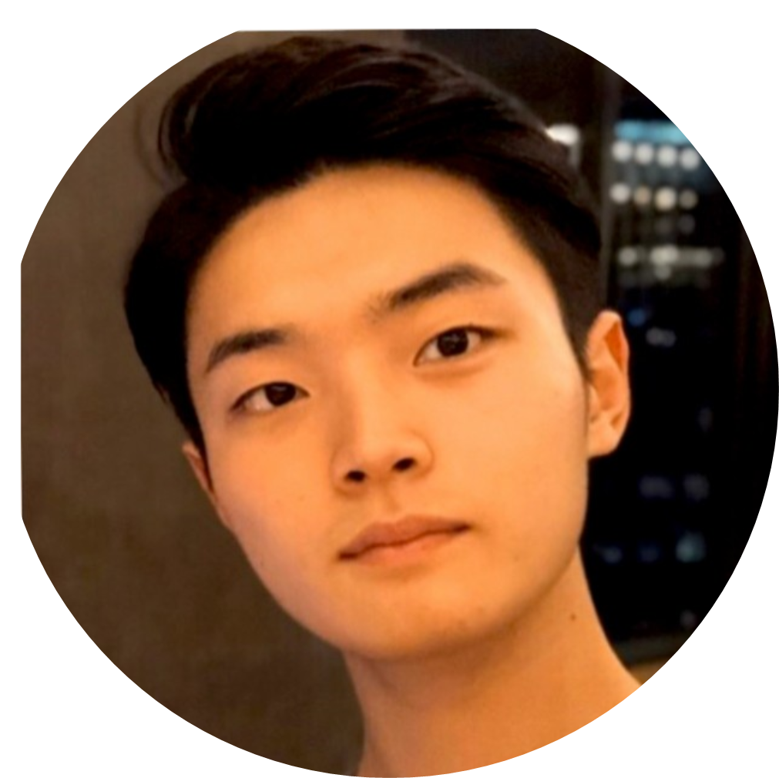
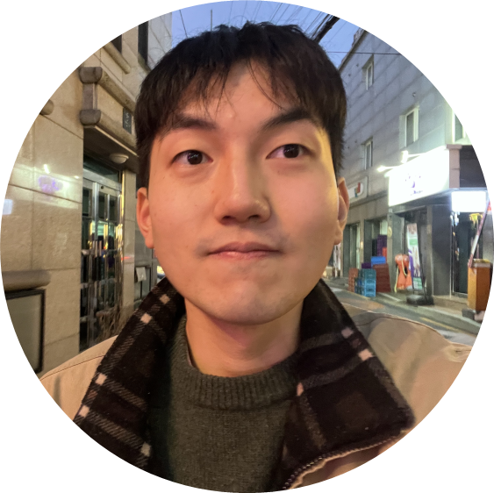

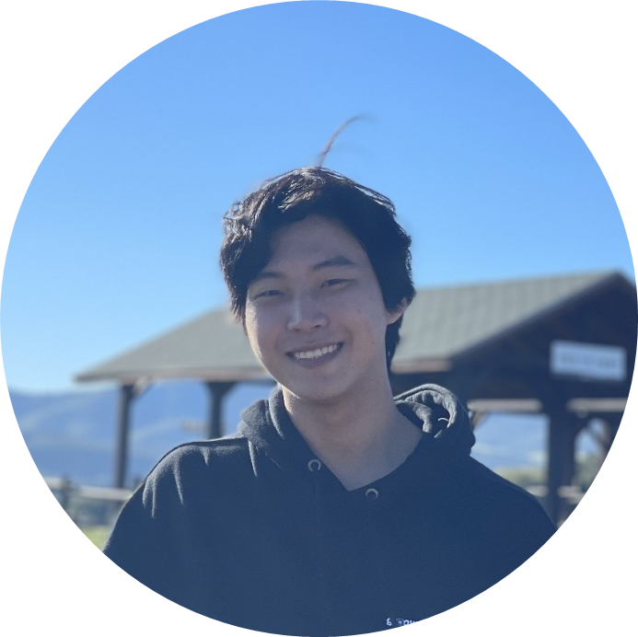
Team Introduction
김경호
오준석
나동현
홍순범

Slide 4


Goals
Version Control – Git & CI/CD
Compiler Optimization
Learn Best Practices
Effectively collaborate with peers
Try LLVM optimizations to improve runtime
Learn the best SWE fundamentals

Slide 5
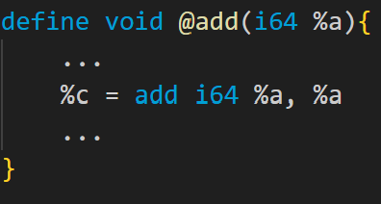
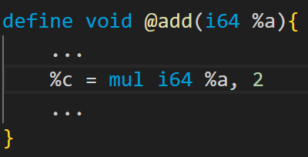
Opt 1 - Addition to Multiplication

Slide 6
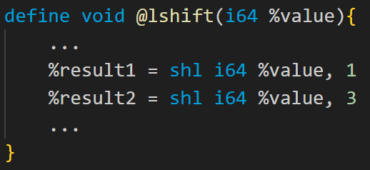
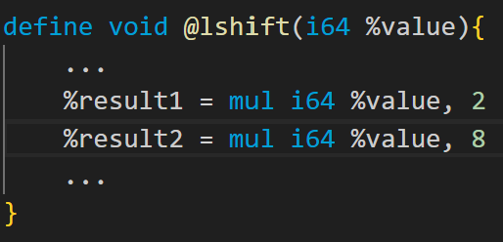
Opt 2 - Shift to Multiplication

Slide 7
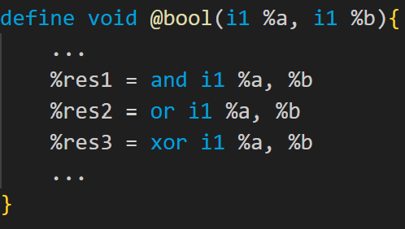
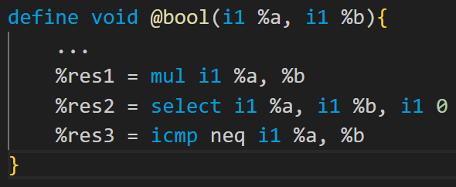
Opt 3 - Bitwise to Misc

Slide 8
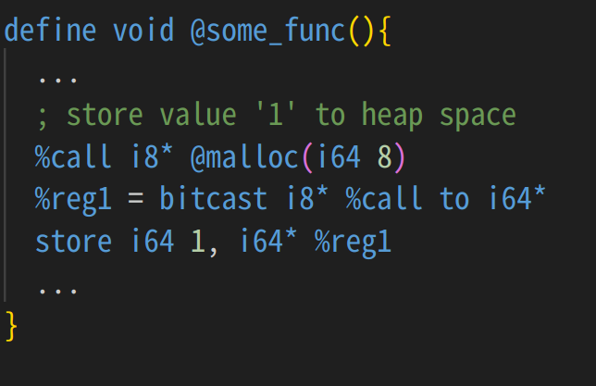
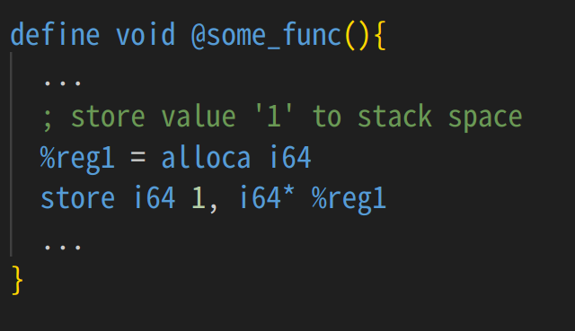
Opt 4 - Heap to Stack

Slide 9
Opt 4 - Heap to Stack
Malloc - free in same function
Non-Dynamic Allocation
Non Stack Overflow

Slide 10
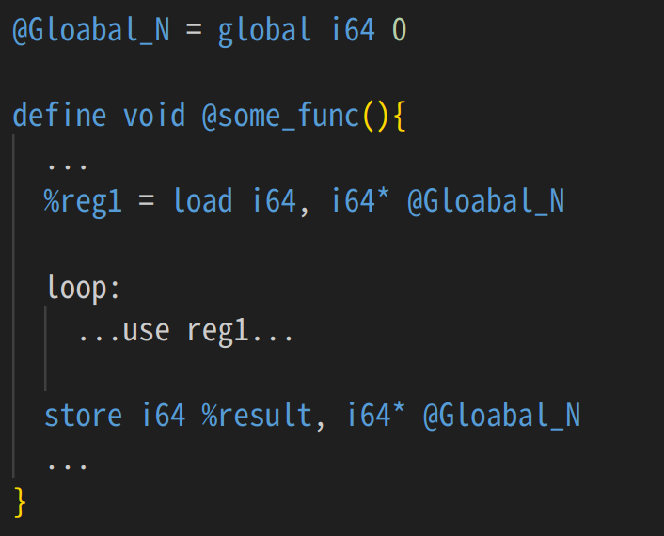
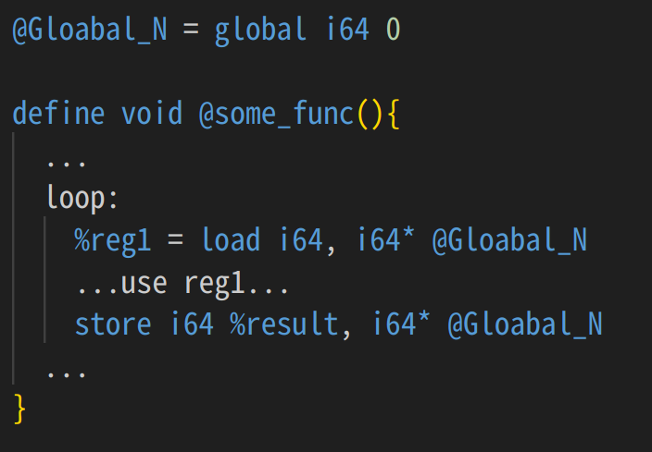
Opt 5 - Global Var. Optimization
move out of loop
change to stack(for multiple stores) …

Slide 11
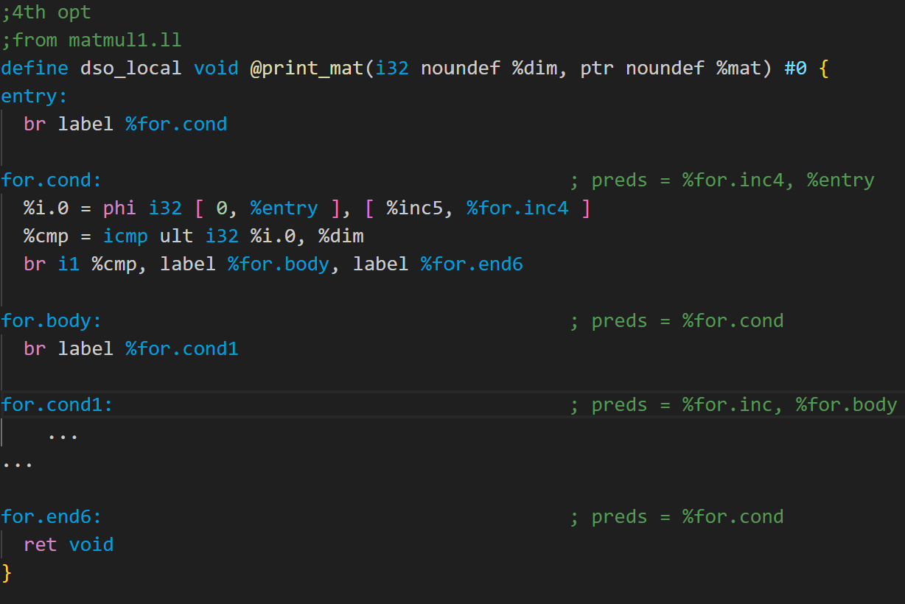
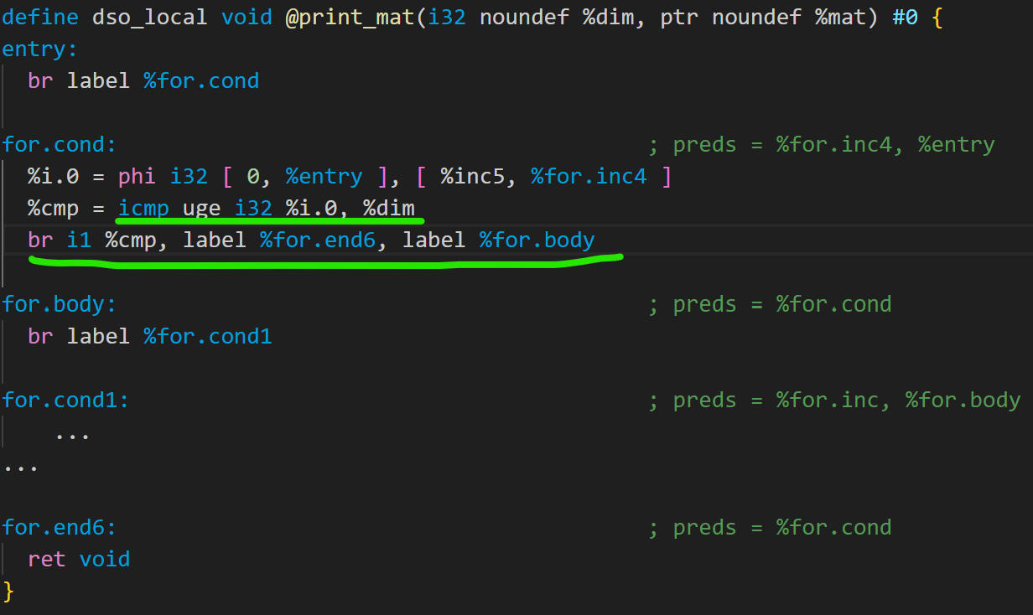
Opt 6 - Swap True to False br

Slide 12
THANK YOU!
Compiler Team 9

