Slide 2
Seminar Cryptography and Data Security
Exploring the Bitcoin P2P network
Chris Rüttimann & Thushjandan Ponnudurai
Bern, 6. April 2022

Slide 3
Outline
Exploring the Bitcoin P2P network
Peer to Peer fundamentals
How Bitcoin P2P networks work
Bitcoin P2P protocol
Deanonymization attacks
Mitigations
Our Bitcoin mainnet network analysis

Slide 4
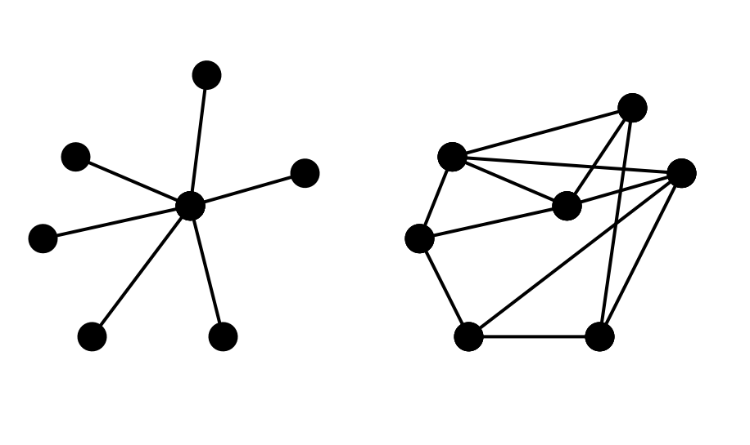
Peer to Peer Network
Exploring the Bitcoin P2P network
Server based
P2P

Slide 5
Bitcoin P2P Protocol
Exploring the Bitcoin P2P network
Public P2P networks
Different P2P networks
Mainnet
Testnet
signet
Regtest (local)
Differentiation over TCP ports, magic bytes and use cases

Slide 6
Bitcoin P2P Protocol
Exploring the Bitcoin P2P network
Private Relay Network
FIBRE (Fast Internet Bitcoin Relay Engine)
UDP
Error Correction
Bitcoin Relay Network
Predecessor of FIBRE
Source: https://bitcoinfibre.org/
Notes:
https://bitcoin.stackexchange.com/questions/56485/can-someone-please-explain-fibre-to-me-like-im-5-and-why-is-it-useful

Slide 7
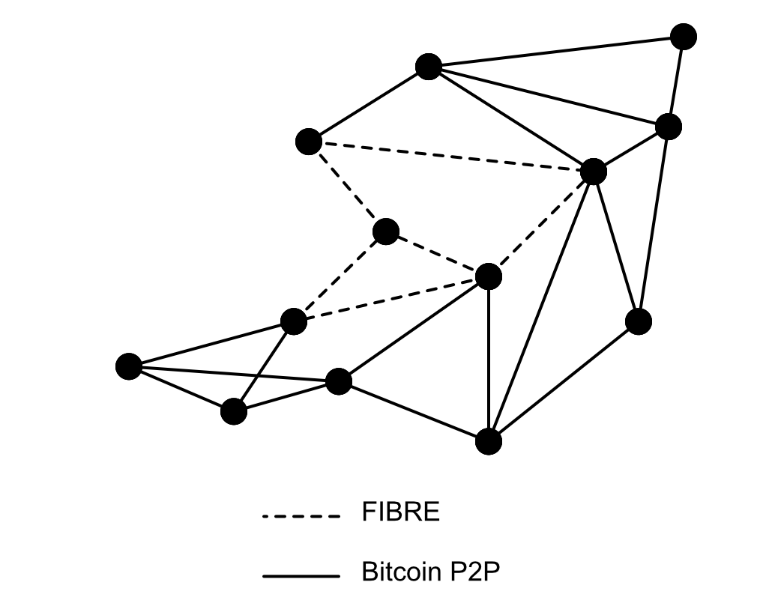
Bitcoin P2P Protocol
Exploring the Bitcoin P2P network

Slide 8
Bitcoin P2P Protocol
Exploring the Bitcoin P2P network
How to find peers?
DNS Record
Bitcoin Main Network: https://github.com/bitcoin/bitcoin/blob/master/src/chainparams.cpp#L121
addr messages
Sent as response to getaddr message
Sent by peers to announce new peers
vSeeds.emplace_back("seed.bitcoin.sipa.be."); // Pieter Wuille, only supports x1, x5, x9, and xd
vSeeds.emplace_back("dnsseed.bluematt.me."); // Matt Corallo, only supports x9

Slide 9
Bitcoin P2P Protocol
Exploring the Bitcoin P2P network
Version message
Information about transmitting node
Needs to be exchanged before other messages
Followed by a verack message

Slide 10
Bitcoin P2P Protocol
Version message
0b110907 # Magic
76657273696f6e0000000000 # Command
56000000 # Length
a71a4acd # Checksum
7f110100 # Version
0000000000000000 # Services
9298396200000000 # Timestamp
0000000000000000 # addr_recv services
00000000000000000000ffff # addr_recv IPv6 part
c0a80014 # addr_recv IPv4
075b # port_recv
0000000000000000 # from services
000000000000000000000000 # sender IPv6 part
00000000 # sender IPv4 part
0000 # sender port
ab1e7b09b53138b4 # Nonce
00 # Agent Bytes
52190900 # Starting Height
00 # relay
Header
Payload

Slide 11
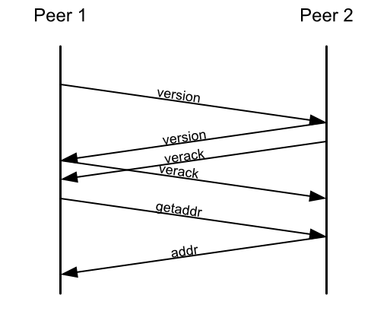
Bitcoin P2P Protocol
Exploring the Bitcoin P2P network
Connecting to peers

Slide 12
Bitcoin P2P Protocol
Exploring the Bitcoin P2P network
Demo

Slide 13
Bitcoin P2P Protocol
Exploring the Bitcoin P2P network
Addrman
A node maintains 256 buckets, which can save up to 64 address
Total 16’384 addresses
GetAddr returns only a subset
23% from addrman
Max 1000 addresses
Endpoints pseudo randomly from addrman selected
Nodes from different ASN or address range (/16 for IPv4) are chosen
A node can maintain up to 125 connections (default)
10 outbound connections
Notes:
Max Getaddr return: https://github.com/bitcoin/bitcoin/blob/master/src/net_processing.cpp#L166
https://github.com/bitcoin/bitcoin/blob/master/src/addrman.h

Slide 14
Bitcoin P2P Protocol
Exploring the Bitcoin P2P network
Misbehavior
IPs can be banned for 24h for rogue behaviour
Penalty score
Not following the protocol
Invalid data
Trying to build invalid chain
Valid header with invalid tx
Flooding
Ex. Sending more than 1000 addresses in addr msg
Notes:
https://bitcoin.stackexchange.com/questions/88604/under-what-circumstances-will-a-full-node-disconnect-a-peer

Slide 15
Discovering Bitcoin's Network Topology
Exploring the Bitcoin P2P network
Motivation / Attacks
Who is operating a bitcoin node?
Where is the weakest point in the chain to attack?
Split the network
Link user pseudonyms to IP addresses where the transactions are generated
Notes:
https://www.cs.umd.edu/projects/coinscope/coinscope.pdf

Slide 16
Discovering Bitcoin's Network Topology
Exploring the Bitcoin P2P network
Motivation / Research
Is the Bitcoin network really decentralized?
Super nodes
Point of failures
Private peering agreement between miners (private relay)
Metrics should be exposed by the Bitcoin software itself
Notes:
https://www.cs.umd.edu/projects/coinscope/coinscope.pdf

Slide 17
Discovering Bitcoin's Network Topology
Exploring the Bitcoin P2P network
Coinscope
Addrman maintains a timestamp to every known address
Timestamp of active connections are updated within 20mins
Timestamp of a new address doesn't change once added to addrman
Notes:
https://www.cs.umd.edu/projects/coinscope/coinscope.pdf
https://github.com/bitcoin/bitcoin/blob/0da559e02e442f246c18b3d94ed166b97d1fb649/src/net_processing.cpp#L3026

Slide 18
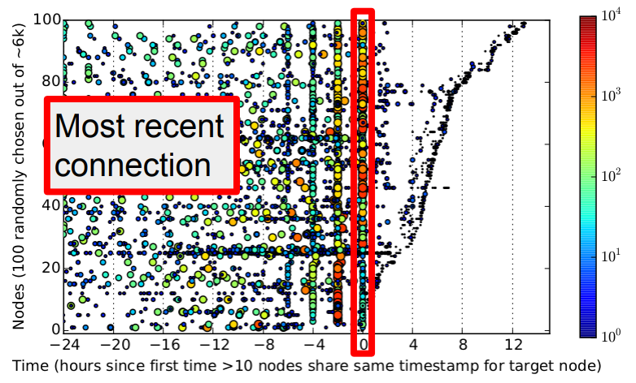
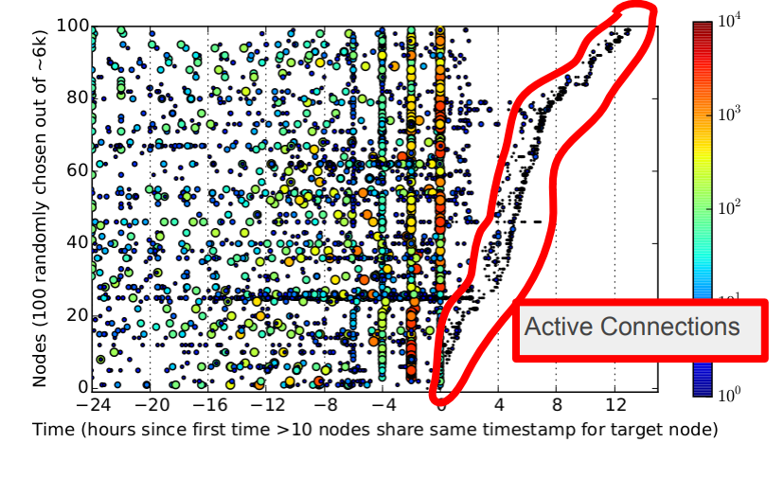
Discovering Bitcoin's Network Topology
Exploring the Bitcoin P2P network
Coinscope
Text hinzufügen
Source: https://montreal2015.scalingbitcoin.org/files/presentations/Day1/10-Andrew-Miller-Coinscope_Shadow-ScalingBitcoin.pdf
Notes:
https://www.cs.umd.edu/projects/coinscope/coinscope.pdf
https://montreal2015.scalingbitcoin.org/files/presentations/Day1/10-Andrew-Miller-Coinscope_Shadow-ScalingBitcoin.pdf
https://www.youtube.com/watch?v=KukBgg0Qmqo

Slide 19
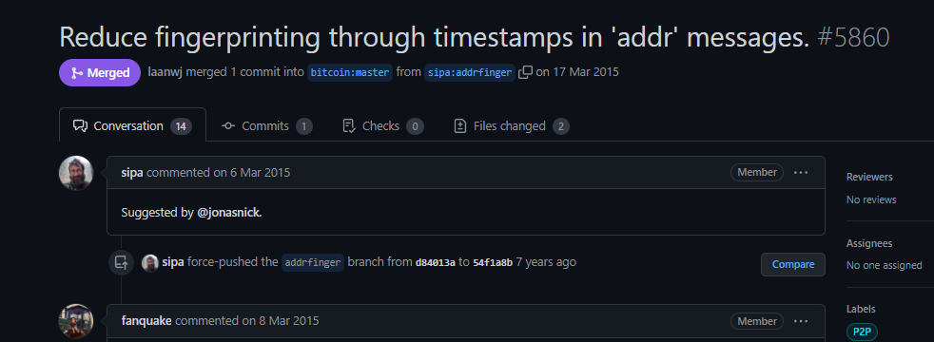
Discovering Bitcoin's Network Topology
Exploring the Bitcoin P2P network
Coinscope - Mitigations
Notes:
https://www.cs.umd.edu/projects/coinscope/coinscope.pdf

Slide 20
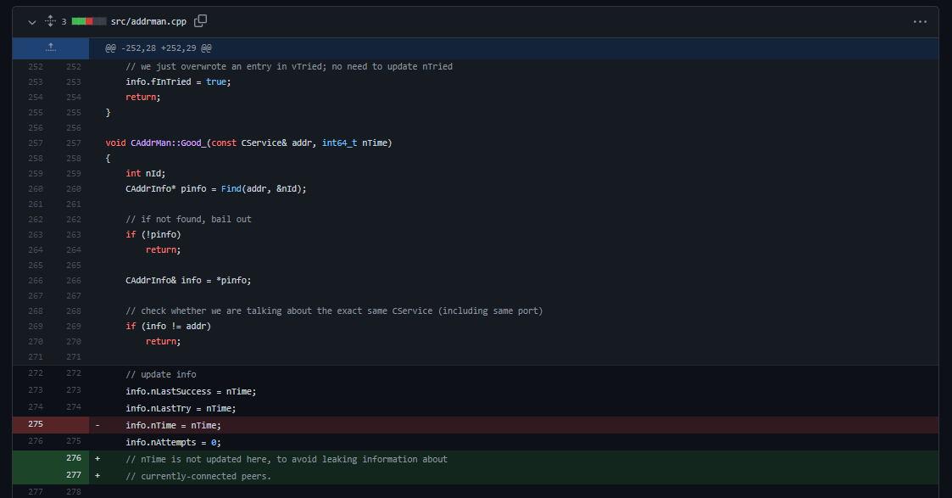
Coinscope
Exploring the Bitcoin P2P network
Mitigation
Notes:
https://www.cs.umd.edu/projects/coinscope/coinscope.pdf

Slide 21
Coinscope
Exploring the Bitcoin P2P network
Mitigation
Notes:
https://www.cs.umd.edu/projects/coinscope/coinscope.pdf

Slide 22
Discovering Bitcoin's Network Topology
Exploring the Bitcoin P2P network
TxProbe
inv message
Used to announce new blocks or transactions
Contains only hashes of blocks or transactions
get_data message
Used to request certain block or transaction
Uses hashes to request certain item

Slide 23
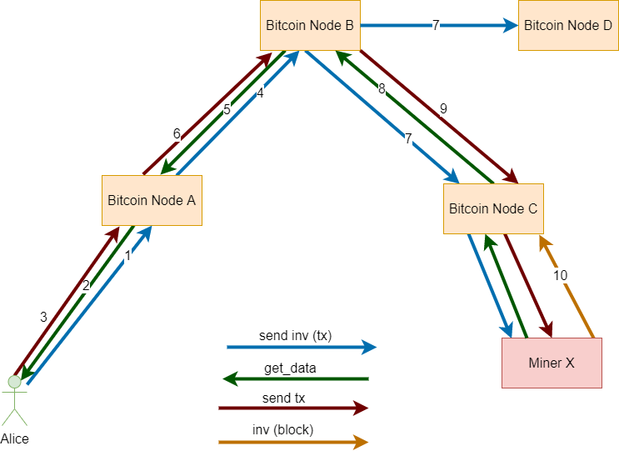
Discovering Bitcoin's Network Topology
Exploring the Bitcoin P2P network
Relay mechanism

Slide 24
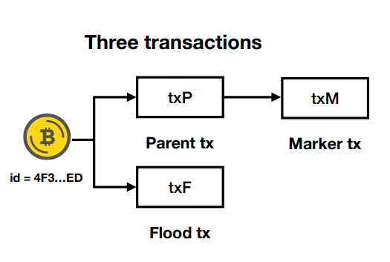
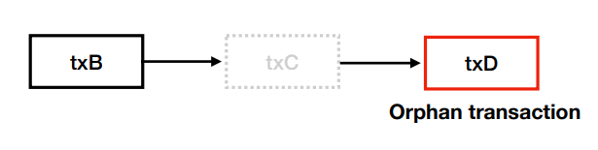
Discovering Bitcoin's Network Topology
Exploring the Bitcoin P2P network
TxProbe
Orphans transactions are used to probe connections between nodes
Source: Delgado-Segura, Sergi, et al. “TxProbe: Discovering Bitcoin’s Network Topology Using Orphan Transactions.” Crossref, https://srgi.me/resources/slides/CESC19-TxProbe.pdf.
Source: Delgado-Segura, Sergi, et al. “TxProbe: Discovering Bitcoin’s Network Topology Using Orphan Transactions.” Crossref, https://srgi.me/resources/slides/CESC19-TxProbe.pdf.

Slide 25
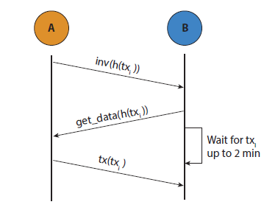
Discovering Bitcoin's Network Topology
Exploring the Bitcoin P2P network
TxProbe
Source: Delgado-Segura, Sergi, et al.
“TxProbe: Discovering Bitcoin’s Network Topology Using Orphan Transactions.”
Crossref, https://doi.org/10.1007/978-3-030-32101-7_32.

Slide 26
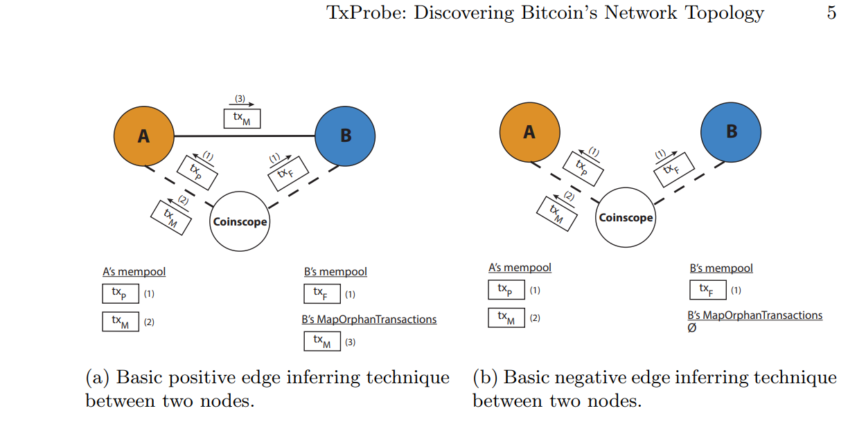
Discovering Bitcoin's Network Topology
Exploring the Bitcoin P2P network
TxProbe
Source: Delgado-Segura, Sergi, et al. “TxProbe: Discovering Bitcoin’s Network Topology Using Orphan Transactions.” Crossref, https://doi.org/10.1007/978-3-030-32101-7_32.

Slide 27
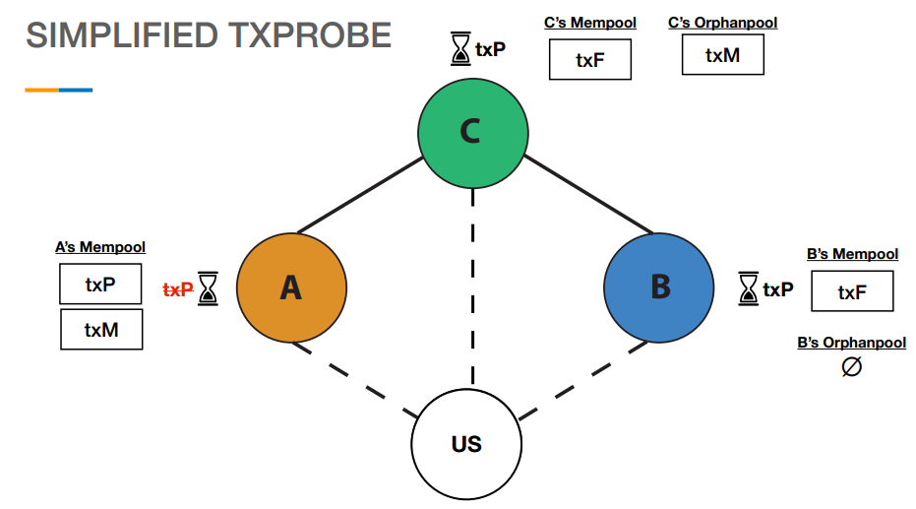
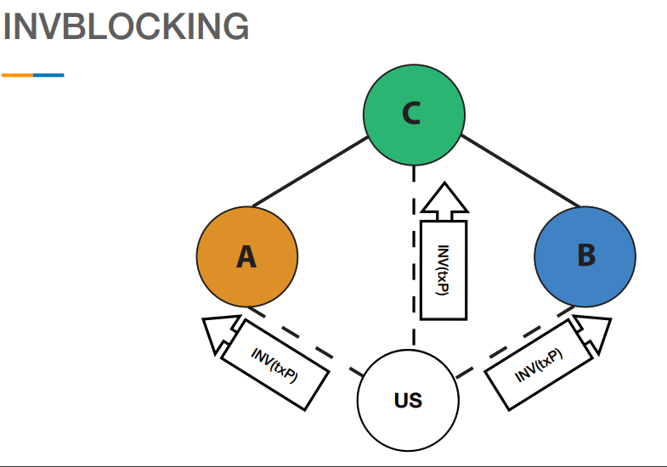
Discovering Bitcoin's Network Topology
Exploring the Bitcoin P2P network
TxProbe
Source: Delgado-Segura, Sergi, et al. “TxProbe: Discovering Bitcoin’s Network Topology Using Orphan Transactions.” Crossref, https://srgi.me/resources/slides/CESC19-TxProbe.pdf.

Slide 28
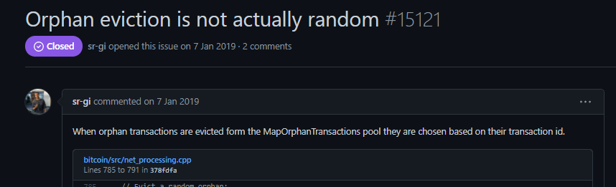
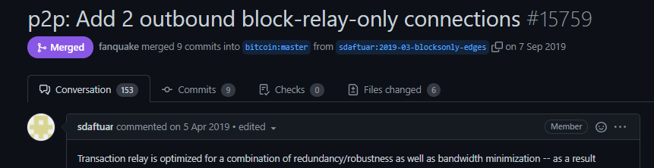
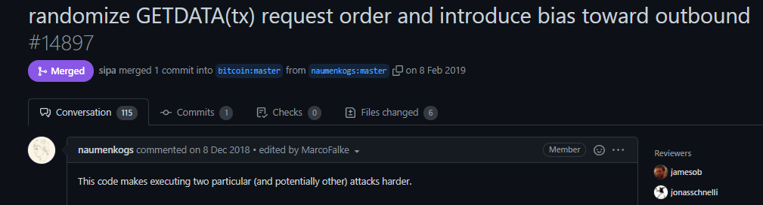
TxProbe
Exploring the Bitcoin P2P network
Mitigations

Slide 29
TxProbe
Exploring the Bitcoin P2P network
Mitigation – Orphan pool
Bug: Transaction with lowest hash was evicted
Not truly random
Fix: Select a random position in a list of orphaned transactions

Slide 30
TxProbe
Exploring the Bitcoin P2P network
Mitigation - InvBlock
Bug: Not accepting any tx from other nodes after sending get_data to a node
Fix: Randomized fetch order
Outbound connections are preferred over inbound connections

Slide 31
TxProbe
Exploring the Bitcoin P2P network
Mitigation – Outbound block-only relay
Bug: Possible to infer the topology graph
Fix: Additional 2 block-only relay outbound connections
Hide 2 additional connections from outside
Only block messages are relayed
Addr & tx message are not relayed

Slide 32
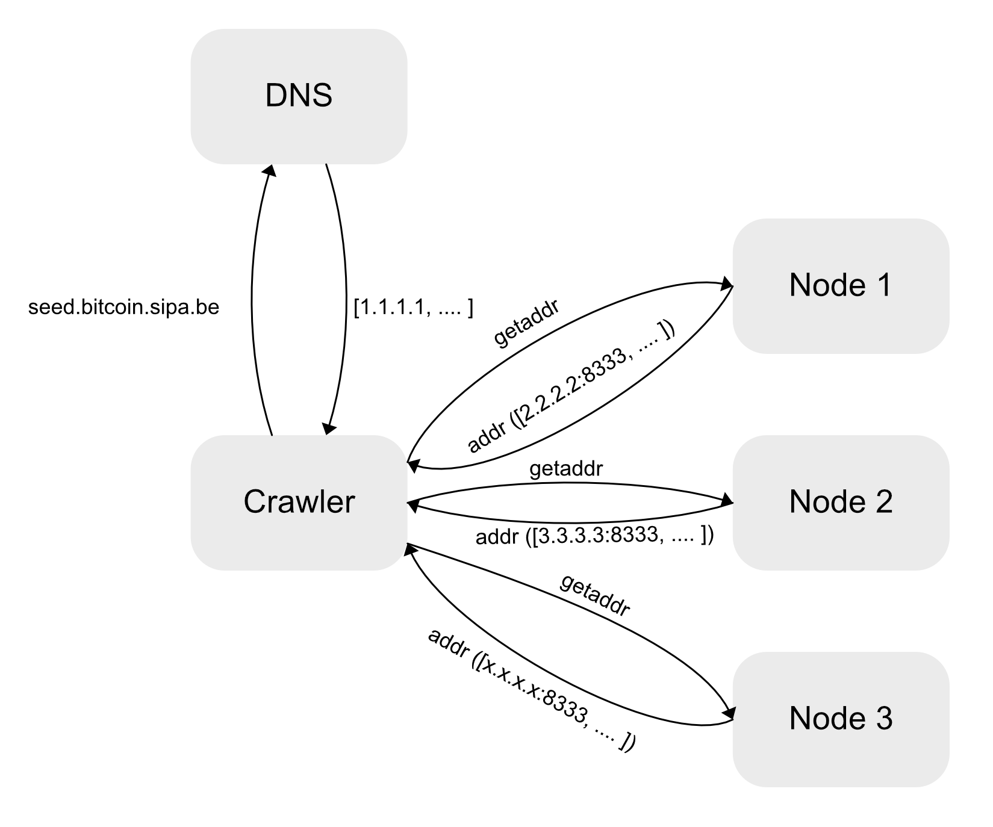
Seminar Project
Exploring the Bitcoin P2P network​
Crawler

Slide 33
Seminar Project
Exploring the Bitcoin P2P network
Tools
Python3
MaxMind GeoLite2 location database
Accuracy 50km
MaxMind GeoLite2 ASN database
DNS resolution
Bitcoin-seeder
https://github.com/sipa/bitcoin-seeder

Slide 34
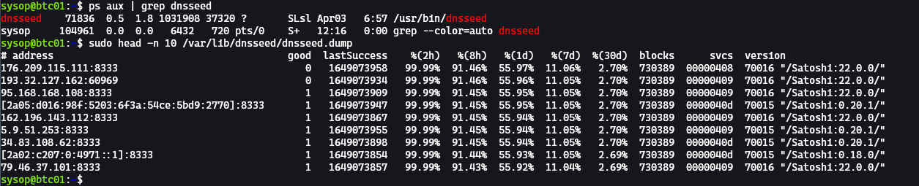
Seminar Project
Exploring the Bitcoin P2P network
Tools

Slide 35
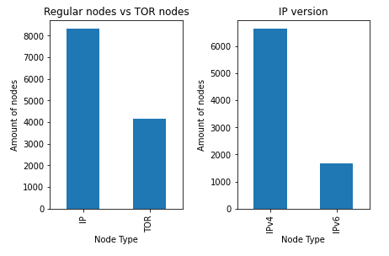
Seminar Project
Exploring the Bitcoin P2P network
Reachability of Bitcoin nodes

Slide 36
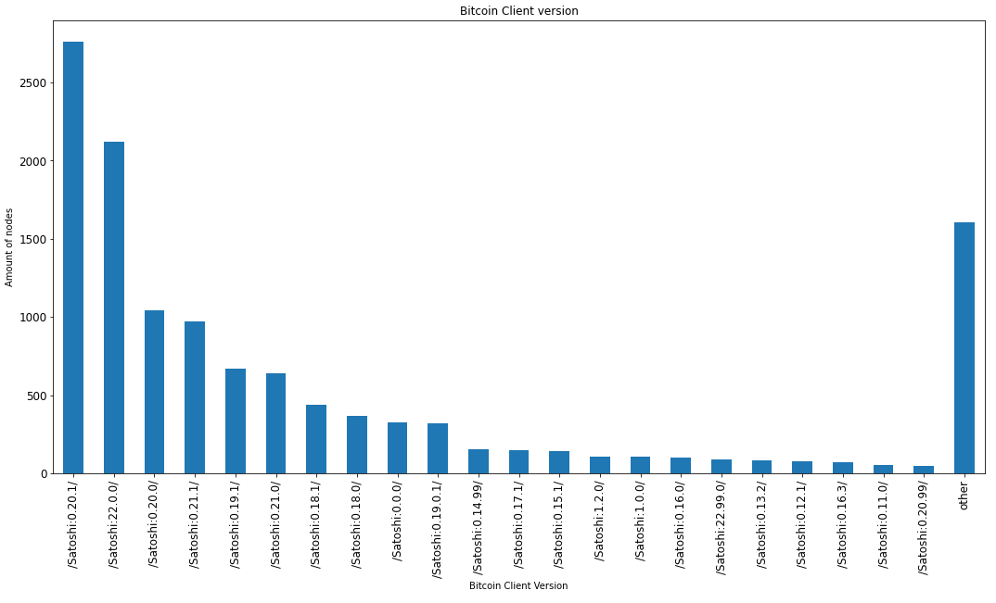
Seminar Project
Exploring the Bitcoin P2P network
Bitcoin nodes grouped by Version

Slide 37
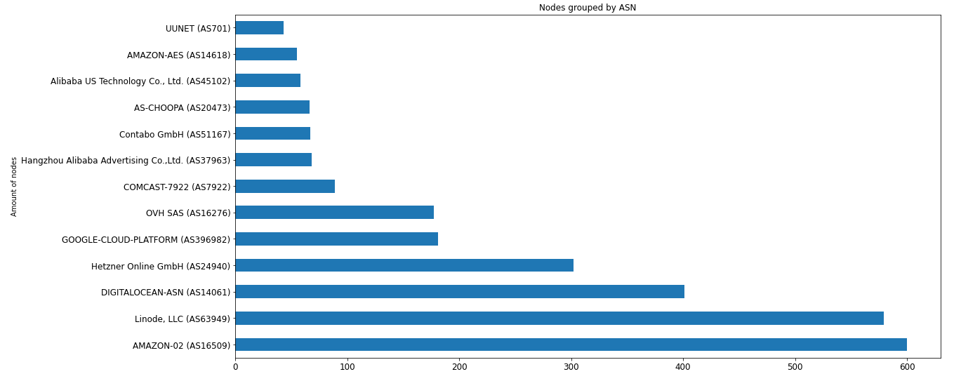
Seminar Project
Exploring the Bitcoin P2P network
Bitcoin nodes grouped by ASN

Slide 38
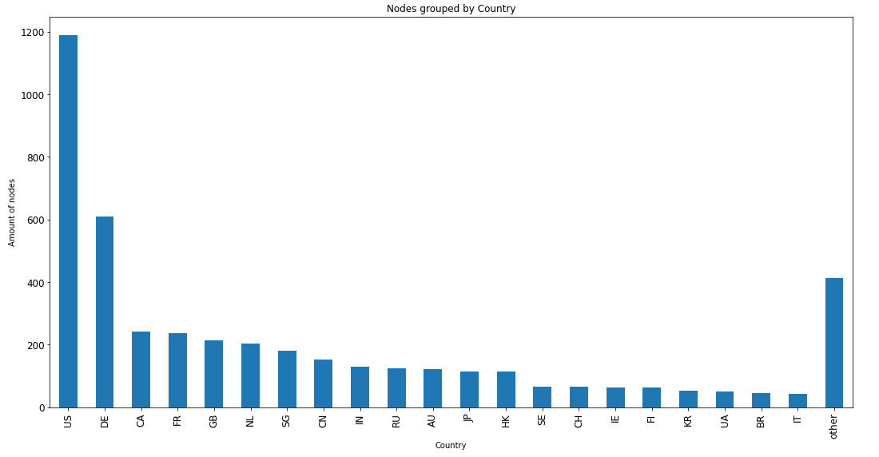
Seminar Project
Exploring the Bitcoin P2P network
Bitcoin nodes grouped by country

Slide 39
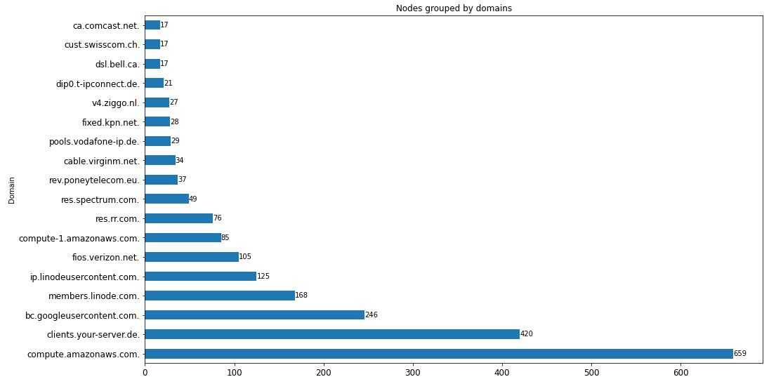
Seminar Project
Exploring the Bitcoin P2P network
Bitcoin nodes grouped by domain

Slide 40
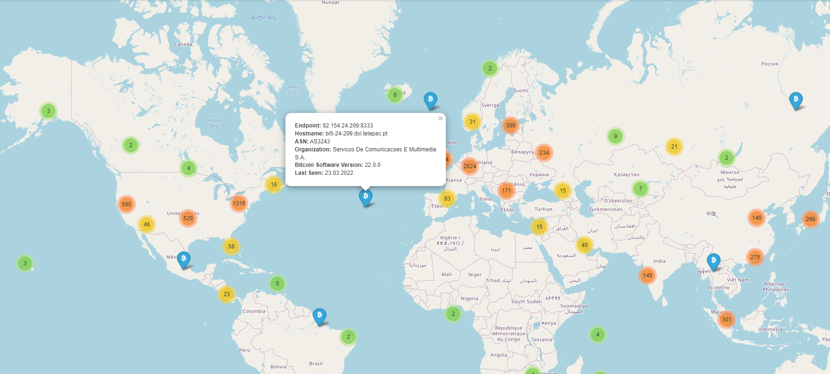
Seminar Project
Exploring the Bitcoin P2P network
IPv4 & IPv6 Bitcoin nodes in mainnet

Slide 41

Thank you
For your attention
Chris Rüttimann & Thushjandan
Bern, 6. April 2022

Slide 42
References
Exploring the Bitcoin P2P network

