Slide 1
HOSPITALITY
ANALYTICS DASHBOARD
Revenue · Bookings · Occupancy · Performance
PERIOD
CITIES
HOTELS
DATA POINTS
May – July 2024
4 Metro Cities
7 Atliq Properties
134,590 Bookings
Team Members:
Shrutee Sujit Revankar
Veekshita K S
Bhavika Bodlekar
Archana Kumari
Sarika Sudarshan Telore
Nagireddy Gariswetha
Panduranga V R
Prepared by: Hospitality Analytics Team | Tools: Power BI · Excel · SQL

Slide 2
01 | PROJECT OVERVIEW
🎯 Project Goal
🏨 Properties Covered
Analyze hospitality performance across 4 cities and 7 hotels using multi-source data to drive revenue and operational decisions.
Atliq Exotica · Atliq Palace · Atliq City · Atliq Blu · Atliq Bay · Atliq Grands · Atliq Seasons: across Mumbai, Bangalore, Hyderabad, and Delhi.
📊 Scope
🛠️ Tools Used
3-month dataset (May–July 2024) covering 134,590 bookings, revenue trends, room classes, booking platforms, and cancellation patterns.
· Power BI & Tableau for interactive dashboards
· SQL for data extraction
· Excel for initial exploration and cleaning.
₹1.71B
1,34,590
70.15%
24.83%
₹569.6M
Total Revenue
Total Bookings
Occupancy Rate
Cancellation Rate
Avg Monthly Rev

Slide 3
02 | DATA CLEANING & PREPARATION
01
Data Collection
📋 Dataset Overview
Imported raw booking data from hotel, covering reservations, revenue, room class, city, and platform details for 3 months.
Column | Type | Description
booking_id | ID | Unique booking identifier
hotel_name | Text | Property name
room_class | Category | Elite / Premium / Std / Pres
city | Category | Mumbai / Delhi / Bangalore / Hyd
check_in_date | Date | Guest check-in date
booking_status | Category | Checked Out / Cancelled / No Show
revenue_realized | Numeric | Actual revenue collected
booking_platform | Text | Journey / MakeMyTrip / Direct etc.
02
Null & Duplicate Handling
Identified and removed duplicate entries. Filled missing revenue values using median imputation per room class.
03
Date & Type Formatting
Standardized date formats to YYYY-MM-DD. Converted categorical fields (booking_status, room_class) to consistent labels.
04
Derived Columns
Created new columns: Week_Type (Weekend/Weekday), Month_Name, Revenue_per_Booking, and Utilization Rate for deeper slicing.
⚡ Final cleaned dataset: 134,590 rows · 15 columns · Zero nulls · Validated across all booking platforms

Slide 4
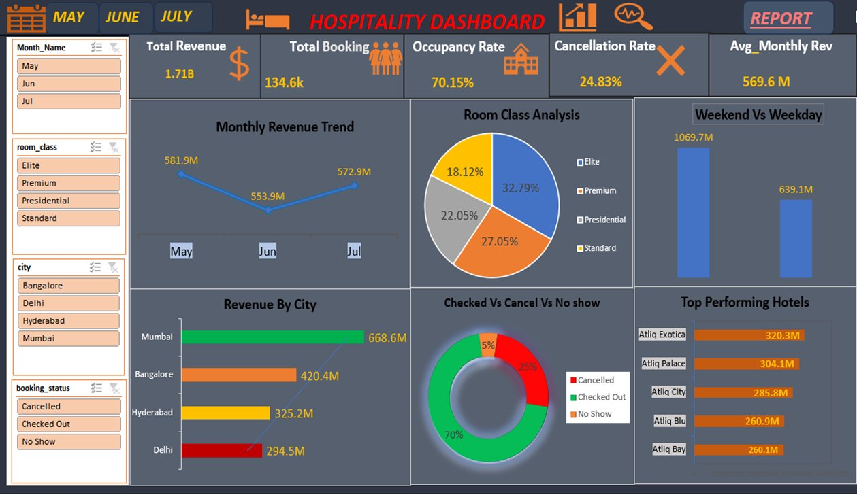
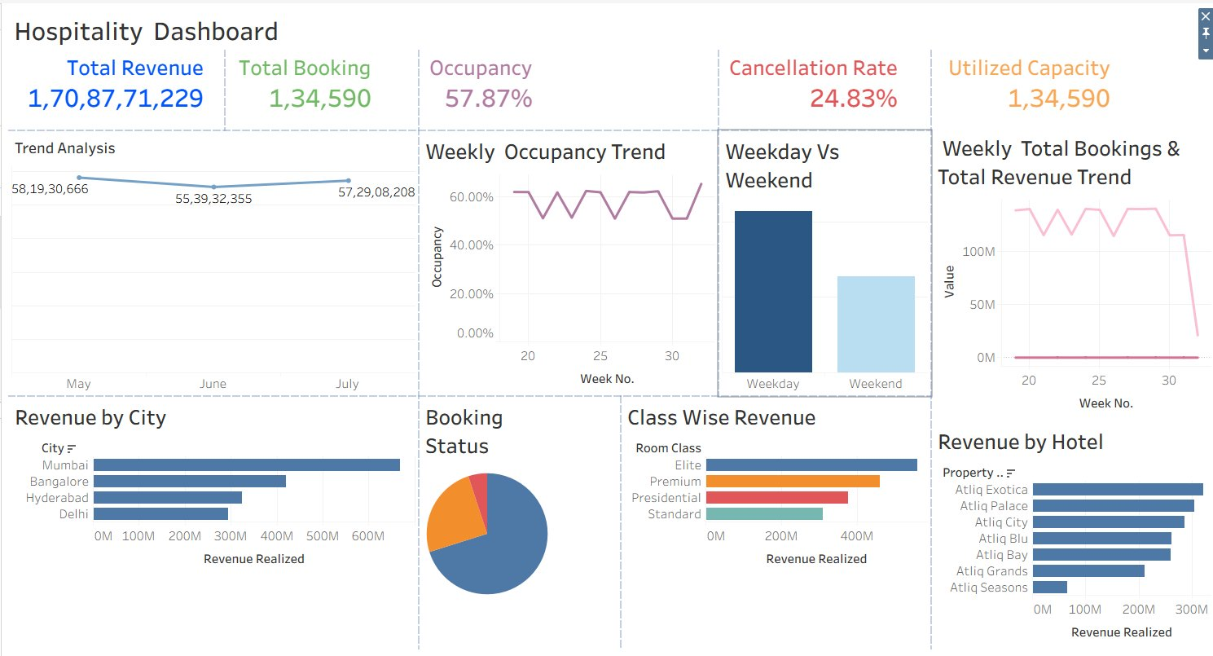
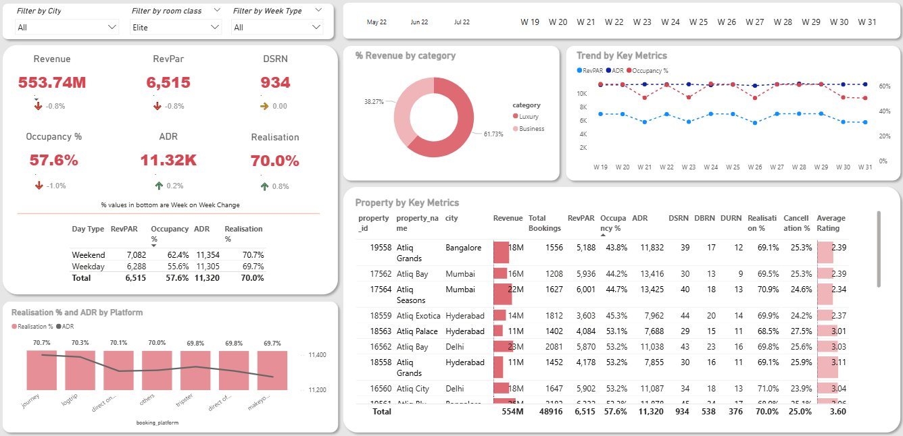
03 | DASHBOARD OVERVIEW
📌 Excel Dashboard: Revenue, occupancy, city-wise & hotel performance with slicer filters
📌 Tableau Dashboard — Weekly trends & booking status breakdown
📌 Power BI Dashboard — Elite class deep-dive with property metrics table
✦ Interactive Slicers
✦ Weekly Drill-Down
✦ City & Hotel Filters
✦ Multi-KPI Cards
✦ Cross-Visual Filtering

Slide 5
04 | KPI ANALYSIS
₹1.71B
1,34,590
70.15%
24.83%
₹6,515
Total Revenue
Total Bookings
Occupancy Rate
Cancellation Rate
RevPAR
May–Jul 2024
Across all hotels
Elite class: 57.6%
Needs improvement
Revenue per avail room
Revenue Trend
Weekend vs Weekday
Jun dipped to ₹553.9M (low) before recovering to ₹572.9M in Jul; May was highest at ₹581.9M
Weekday revenue (₹1,069.7M) nearly double weekend (₹639.1M) — corporate demand drives business
Room Class Split
ADR (Avg Daily Rate)
Elite leads at 32.79% revenue share; Standard lowest at 18.12%; Premium contributes 27.05%
₹11,320 overall; Weekend ADR slightly higher at ₹11,354 vs Weekday ₹11,305
City Performance
Top Hotel
Mumbai #1 at ₹668.6M; Delhi lowest at ₹294.5M despite being capital; Bangalore #2 at ₹420.4M
Atliq Exotica leads with ₹320.3M revenue; Atliq Bay closes list at ₹260.1M
Booking Status
Platform Realisation
70% bookings Checked Out (healthy); 25% Cancelled (high churn); 5% No Show
Journey and LogTrip top realisation at ~70.7%; MakeMyTrip slightly lower at 69.7%

Slide 6
05 | INSIGHTS & SUGGESTIONS
🔍 Key Insights
📉 Revenue dipped in June by 4.8% vs May, suggesting mid-quarter demand slack or pricing gap.
📅 Weekday revenue is 67% higher than weekends, showing heavy corporate booking dependency.
🏙️ Delhi underperforms vs its market potential — ₹294.5M vs Mumbai's ₹668.6M despite comparable hotel count.
⭐ Elite rooms drive 32.79% of revenue but show 57.6% occupancy — room to upsell and improve fill rate.
❌ Cancellation rate of 24.83% is high — directly impacting occupancy and revenue realization.
📱 Journey & LogTrip platforms have highest realisation (70.7%) — OTAs like MakeMyTrip slightly lower.
💡 Recommendations
→ Launch weekend promotions to boost leisure occupancy
→ Invest in direct booking channels to improve ADR margins
→ Introduce flexible cancellation policies to reduce churn
→ Focus marketing spend on Delhi properties to close gap

Slide 7
06 | CONCLUSION
This hospitality analytics project delivered a comprehensive view of revenue performance, booking behaviour, and occupancy trends across 7 Atliq properties in 4 Indian cities over Q2–Q3 2024. The Power BI dashboards enabled real-time, filterable insight across room classes, platforms, cities, and time periods — empowering data-driven decisions at every level.
01
02
03
Revenue is Recoverable
Cancellations are Solvable
Weekday Dominance Needs Balance
A June dip of ~5% was reversed in July — targeted pricing strategies can smooth quarterly volatility and protect ₹1.71B annual run-rate.
24.83% cancellation rate = lost revenue. Dynamic deposit policies and loyalty incentives could recapture 10–15% of cancelled bookings.
67% weekday revenue share indicates under-served leisure segment. Weekend packages and experiential offers can unlock new revenue streams.
Thank You · Questions Welcome · Hospitality Analytics Dashboard | Atliq Hotels Group

