Slide 1
ANALYTICS DASHBOARD
MANUFACTURING
Team Members:
Chandrashekhar Naidu
Dhanireddy Chandana Reddy
Tanusha Sanjay Mahale
Priyanka Singh
Gurtej Singh
Shrutee Sujit Revankar
Sarika Sudarshan Telore
Prepared by: Manufacturing Analytics Team | Tools: Power BI · Excel · SQL

Slide 2
Project Overview
Objective:
• Monitor manufacturing performance and production efficiency
• Track manufactured, processed and rejected quantities
• Analyze machine, employee a department performance
• Identify wastage trends and operational bottlenecks

Slide 3
Business Requirements
• Production Monitoring
• Quality & Rejection Analysis
• Department Performance Tracking
• Machine Utilization Analysis
• Employee Productivity Analysis
• Wastage Monitoring
• Trend & Forecast Reporting

Slide 4
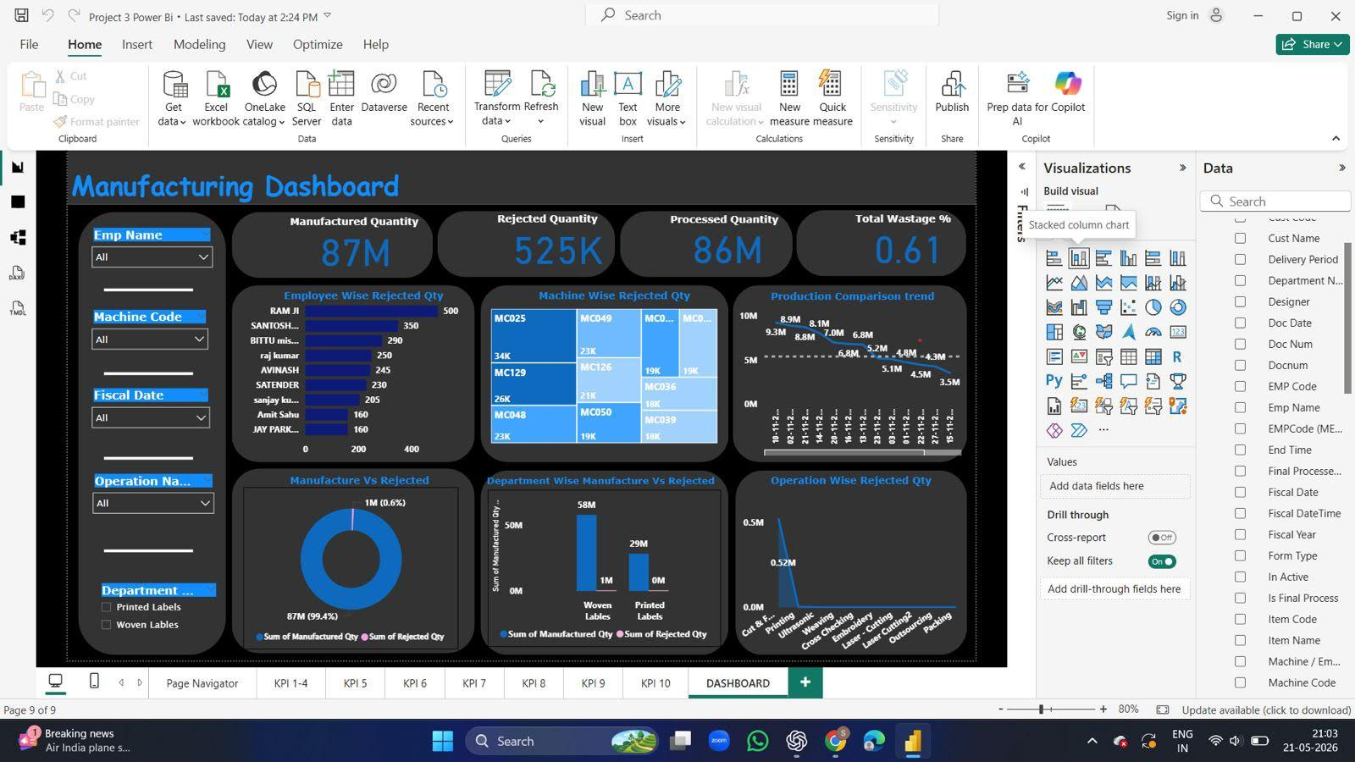
Executive Manufacturing Dashboard

Slide 5
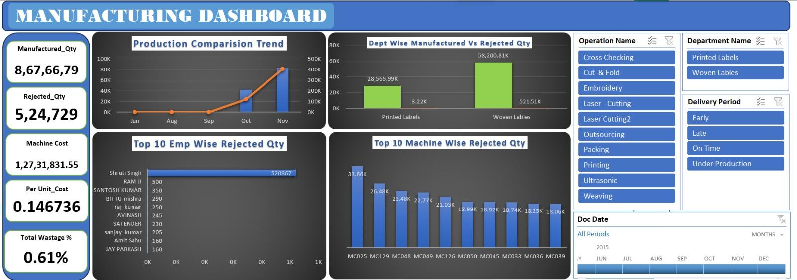
Production & Rejection Analysis

Slide 6
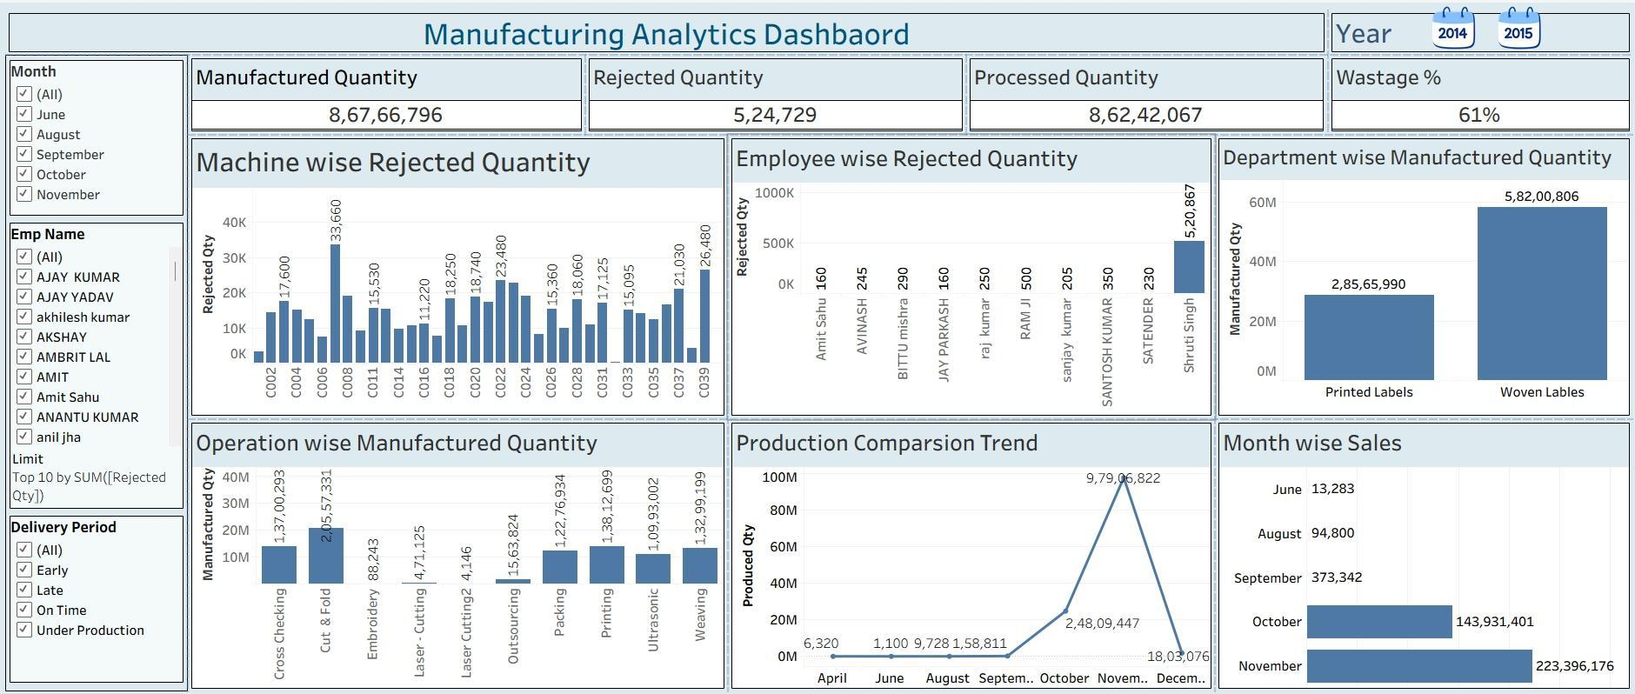
Manufacturing Analytics View

Slide 7
Key KPIs & Insights
KPIs:
• Manufactured Quantity
• Processed Quantity
• Rejected Quantity
• Total Wastage %
• Machine Cost & Per Unit Cost
Insights:
• Identify top rejection sources
• Compare department performance
• Monitor production trends

Slide 8
Recommendations & Conclusion
Recommendations:
• Reduce rejection through quality checks
• Improve machine efficiency
• Monitor high wastage operations
• Optimize department productivity
Conclusion:
Manufacturing dashboard provides a centralized view of production, quality, and operational performance for better decision making.

