Slide 1
ENGLISH WORK 2017/1
Names: Bruno Alves, Gabriel Mazzardo, Gabriel Righi e João Nunes
Class: CC

Slide 2
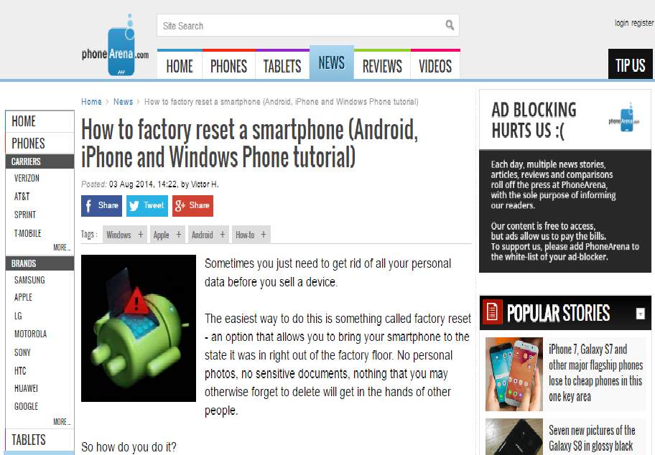

Slide 3
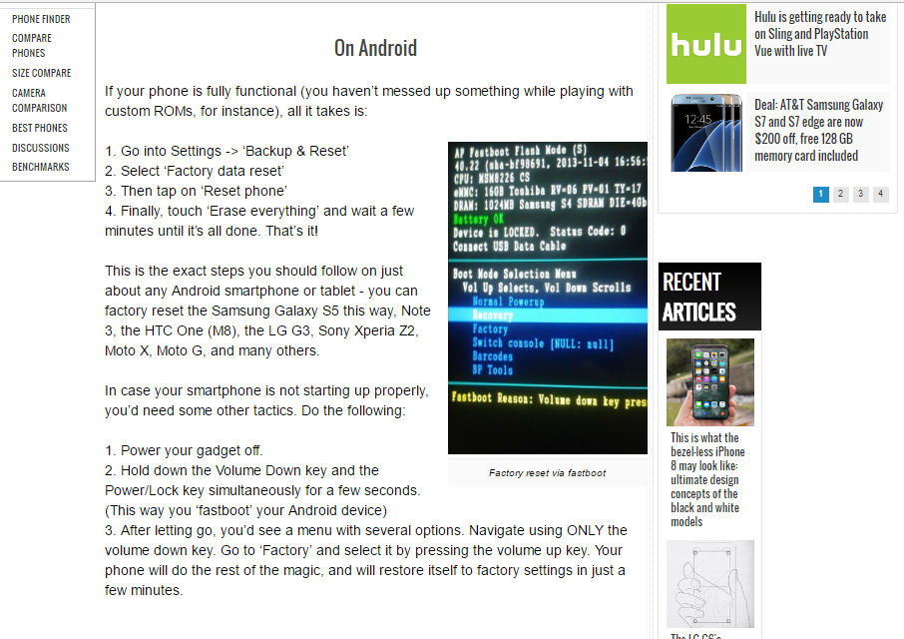

Slide 4
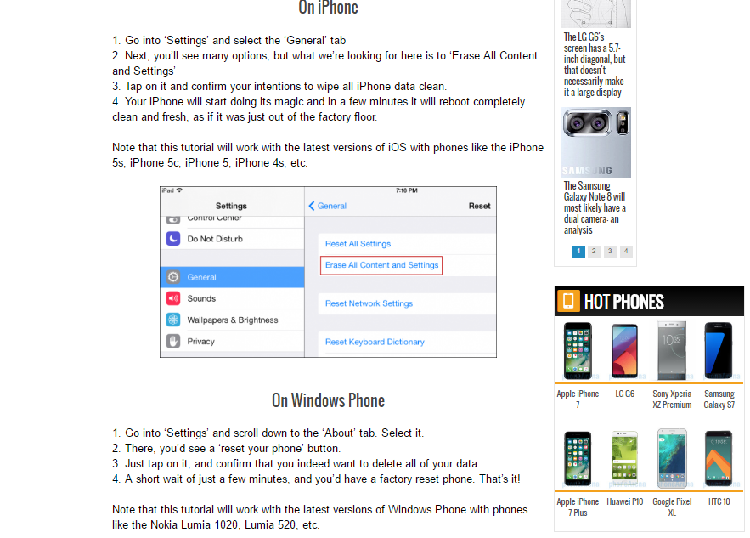

Slide 5
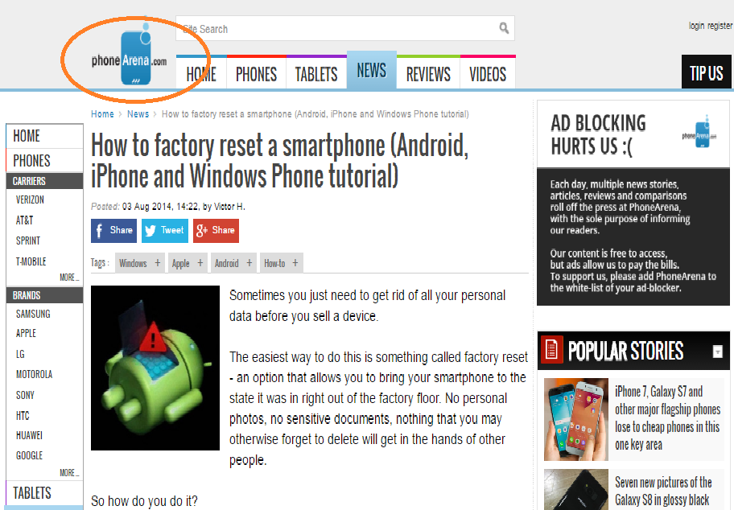
Place of publication

Slide 6
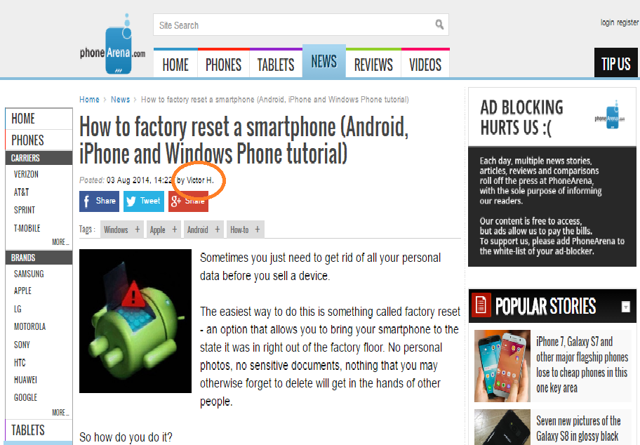
Author

Slide 7
Target audience
People who need to reset their smartphones.
People who want to learn how to reset a smartphone.
People who want to sell their smartphones.
...

Slide 8
Purpose
Teach or help people to factory reset their smartphones (Android, iOS, Windows Phone).

Slide 9
Motivation
Sell a device
Fix a problem
Save memory
Restore device

Slide 10
Similarities and differences
Similarities:
Step by step explanation.
Presence of images.
Introductory paragraph.
Imperative mode.
Differences:
Text divided by area of interest (Android, iOS, Windows Phone).

Slide 11
Examples in imperative mode

Slide 12
Referência:
http://www.phonearena.com/news/How-to-factory-reset-a-smartphone-Android-iPhone-and-Windows-Phone-tutorial_id58927

