Slide 1
YggFinance
A Personal Finance Web Application
Alan Holman, Austin Kerr, Blake Hudson

Slide 2
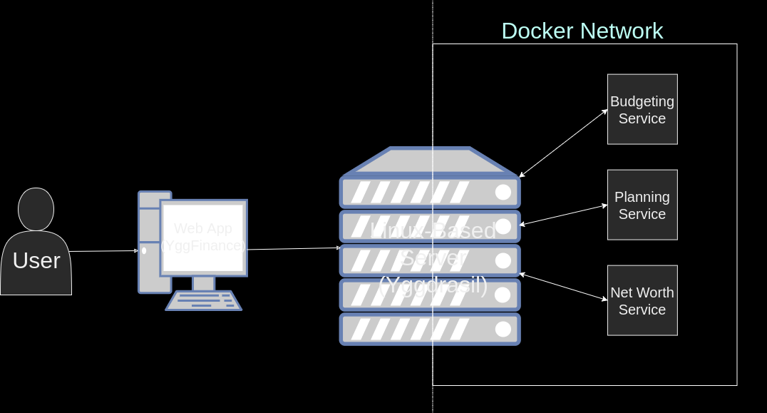
YggFinance: What is it?
Webpage-based application
Browser must support cookies
Interactive user interface
Multi-tab menu
Tab for each financial planning subject
Subject-related tools on respective tabs
Microservice architecture
Each tool will be delegated to a single service

Slide 3
What Will It Do? (Contents of the Top Menu)
Welcome Page:
Short descriptions of the Monthly Budget, Savings Planner, and Net Worth Tracking pages along with their included tools.
Savings Planner Page:
Investment calculator
Monthly contributions
Time frame selection for investments
Monthly Budget Page:
Plan a monthly budget
Enter transactions throughout the month
Reconcile user inputted transactions with tracked transactions from bank statements
Net Worth Tracking Page:
Net worth tracked via user input
Pie chart graphic for visualization

Slide 4
Savings Planner
Initial investment amount
User input validated to correct form
Warning display will appear if not correct
Required field for calculation
Average rate of return
Will have a form and warning similar to initial amount
Required field
Monthly contributions
Not required for calculation
Will have form validation and warning messages
Will default to zero if left empty
Timeline
Slider bar form in units of years
Selectable range from one to eighty years

Slide 5
Monthly Budget
Categories for budgeting
Gas
Groceries
Utilities
Rent/Mortgage
Car Payment
Cellular/Wireless/Cable
Other recurring
Other non-recurring
Transactions
Consist of: category, merchant, type, date, amount
Income or expenses
Reconciliation
Takes a month’s budget history
Compares listed budget with bank transactions

Slide 6
Net Worth Calculator
Net Worth Fields
Real Estate
Checking Accounts
Savings Accounts
Retirement
Automobiles
Other Assets
Remaining Mortgage Balance
Personal Loans
Auto Loans
Student Loans
Consumer Debt
Other Liabilities
Pie Chart Visualization
Gives listed percentages of assets and liabilities

Slide 7
Possible Challenges
Reconciliation (Monthly Budget)
CSV files may not format properly upon reading
Bank statement info may not be available from the institution in CSV
Many institutions have different standards for available statement file formats and data formatting
Users may often have to default to manual entry
Transactions (Monthly Budget)
Auto-updating to show remaining budget balance
Allowing some visual cue to allow users to see they have encountered an error in real time

