Slide 1

YggFinance
Design Documentation

Slide 2
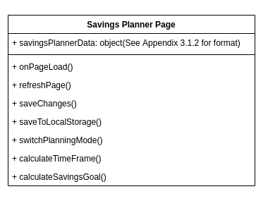
Modules and Services
Savings Planner Page

Slide 3
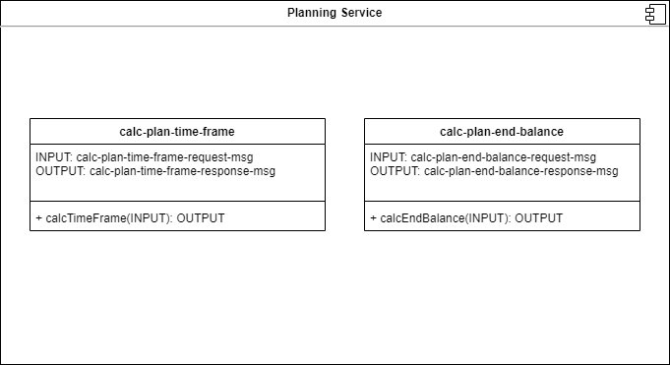
Modules and Services
Planning Service

Slide 4
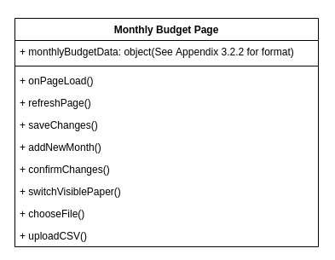
Modules and Services
Monthly Budget Page

Slide 5
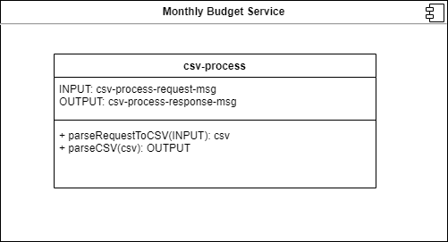
Modules and Services
Monthly Budget Service

Slide 6
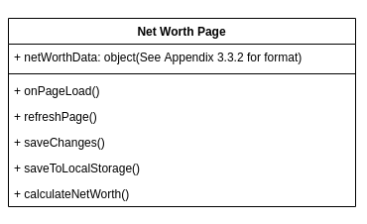
Modules and Services
Net Worth Page

Slide 7
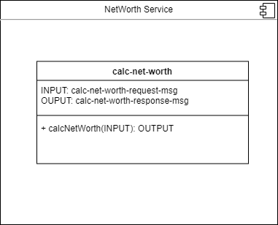
Modules and Services
Net Worth Service

Slide 8
Storage Paradigm
No Databases
All data stored client side
Local Storage

Slide 9
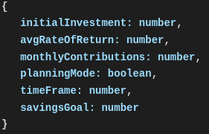
Savings Planner Storage
Entry: savings-planner-data
Value:

Slide 10
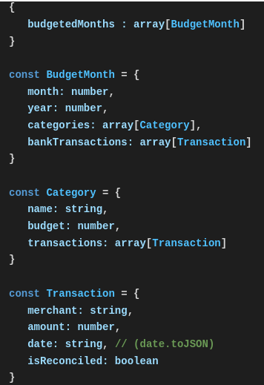
Monthly Budget Storage
Entry: monthly-budget-data
Value:

Slide 11
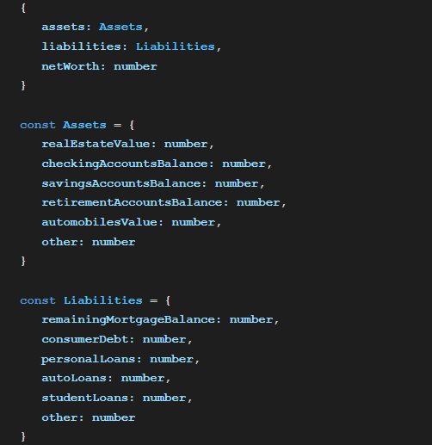
Net Worth Tracking Storage
Entry: net-worth-data
Value:

Slide 12
API Structure
HTTP Calls
RESTful? (compromised)
Primarily JSON messages
Exception: One FormData message request is necessary to send a csv file to the server.
Exception? The HTML for the WebApp itself (should have been obvious)

Slide 13
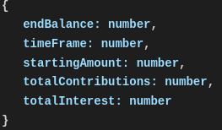
Planning Service API
calc-plan-end-balance
calc-plan-end-balance-request-msg
Request Content-Type: “application/json”
Request JSON Contract:
“savings-planner-data” entry (On Previous Slides)
calc-plan-end-balance-response-msg
Response Content-Type: “application/json”
Response JSON Contract:
calc-plan-time-frame
calc-plan-time-frame-request-msg
Request Content-Type: “application/json”
Request JSON Contract:
“savings-planner-data” entry (On Previous Slides)
calc-plan-time-frame-response-msg
Response Content-Type: “application/json”
Response JSON Contract:

Slide 14
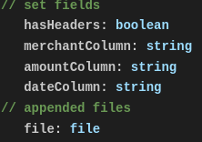
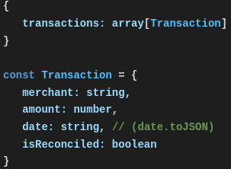
Monthly Budget Service API
csv-process-request-msg
Request Content-Type: “multipart/form-data”
Request Form Contract:
csv-process
csv-process-response-msg
Response Content-Type: “application/json”
Response JSON Contract:

Slide 15

Net Worth Service API
calc-net-worth-request-msg
Request Content-Type: “application/json”
Request JSON Contract:
“net-worth-data” entry (On Previous Slides)
calc-net-worth
calc-net-worth-response-msg
Response Content-Type: “application/json”
Response JSON Contract:

Slide 16
Web Server Service API
get-web-app
get-web-app-response-message
Response Content-Type: “text/html”
Response Content: The YggFinance WebApp

Slide 17
Application and User Interface
Users connect via web browser URL
Javascript must be supported and enabled
Access to web browser’s local storage required
Material UI style library will be used for graphical elements
Webpage will accommodate a display supporting a 16:9 aspect ratio at 720p
Other aspect ratios and resolutions may function, while unoptimized

Slide 18
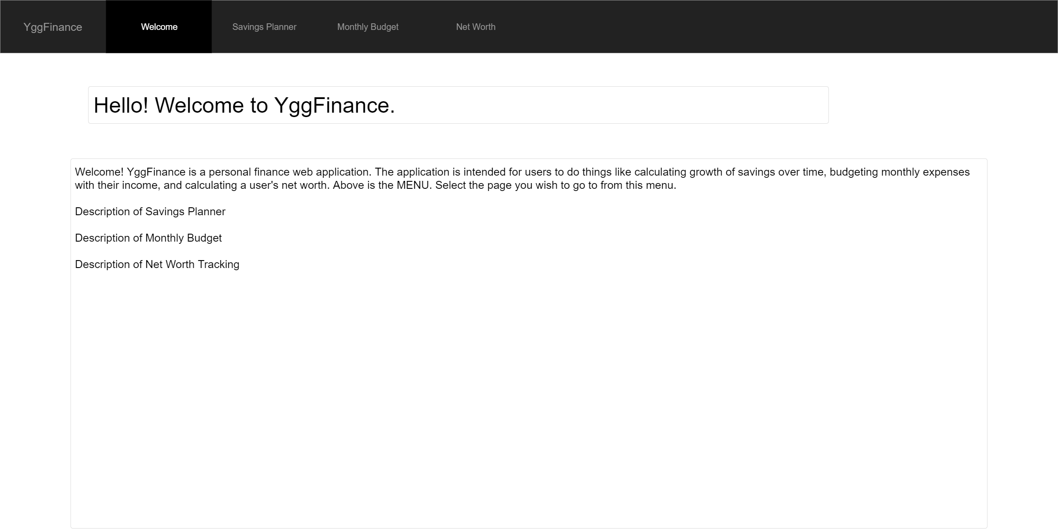
Welcome Page Wireframe

Slide 19
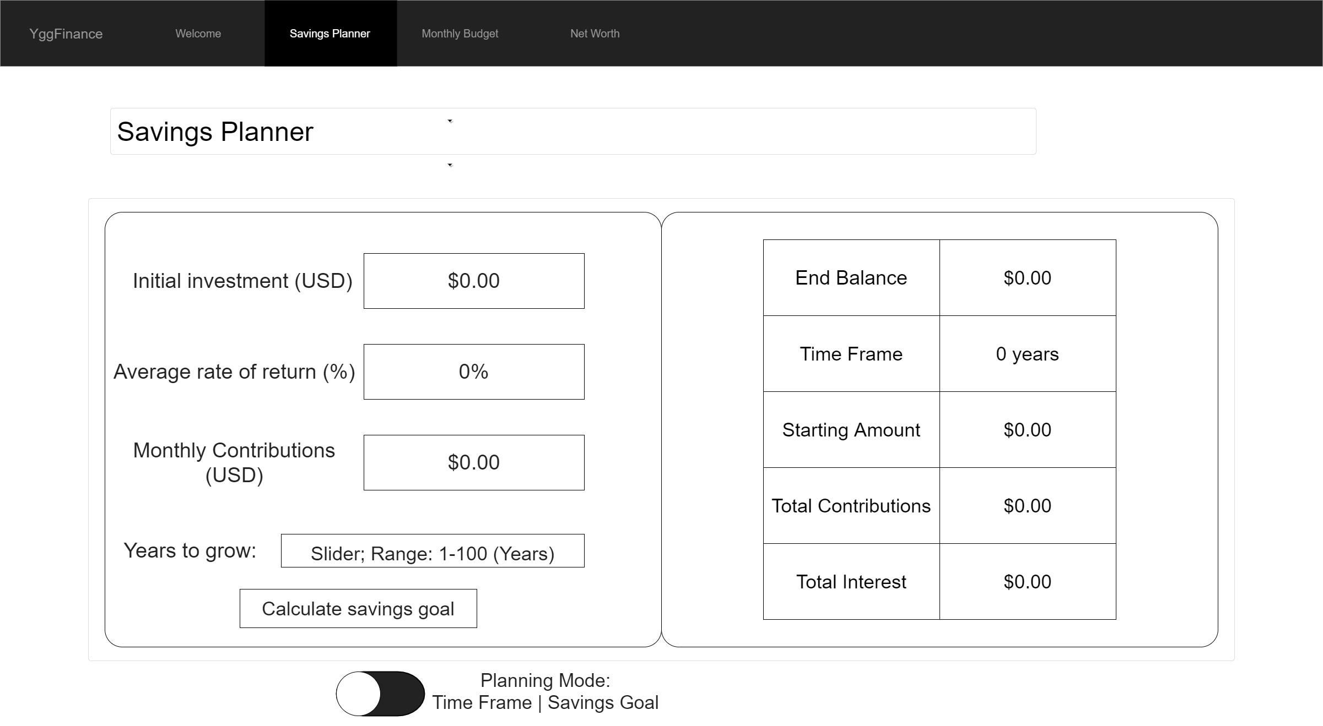
Savings Planner Time Frame Mode Wireframe

Slide 20

Savings Planner Savings Goal Mode Wireframe

Slide 21
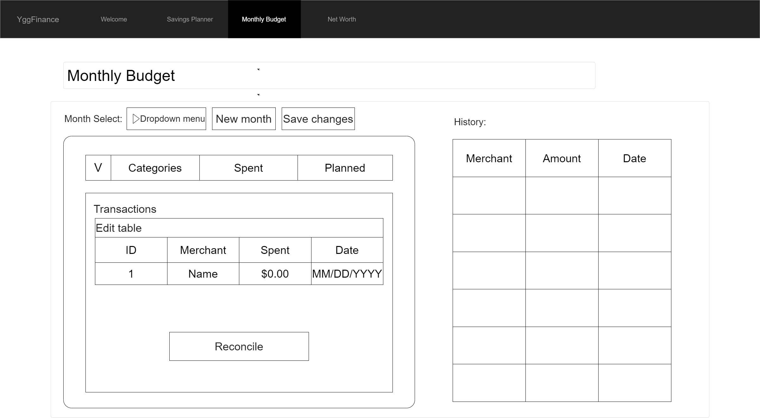
Monthly Budget Wireframe

Slide 22
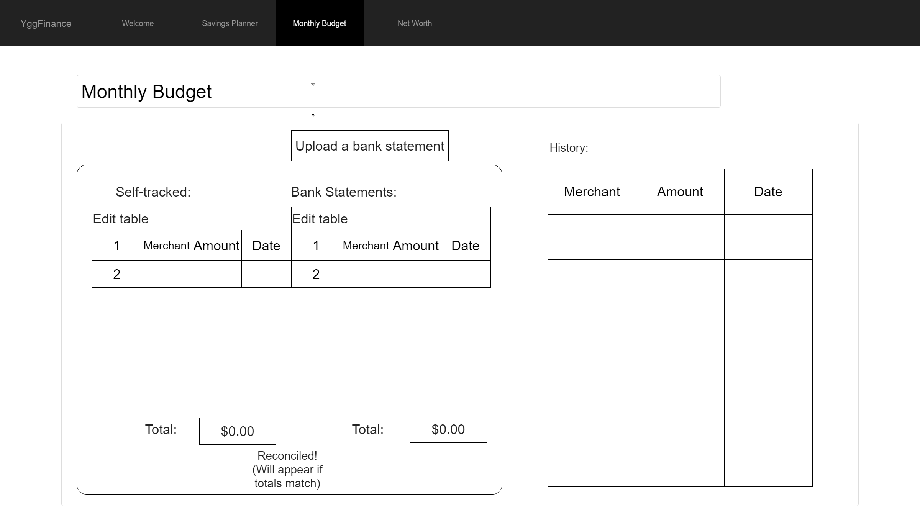
Monthly Budget Reconciliation Mode Wireframe

Slide 23
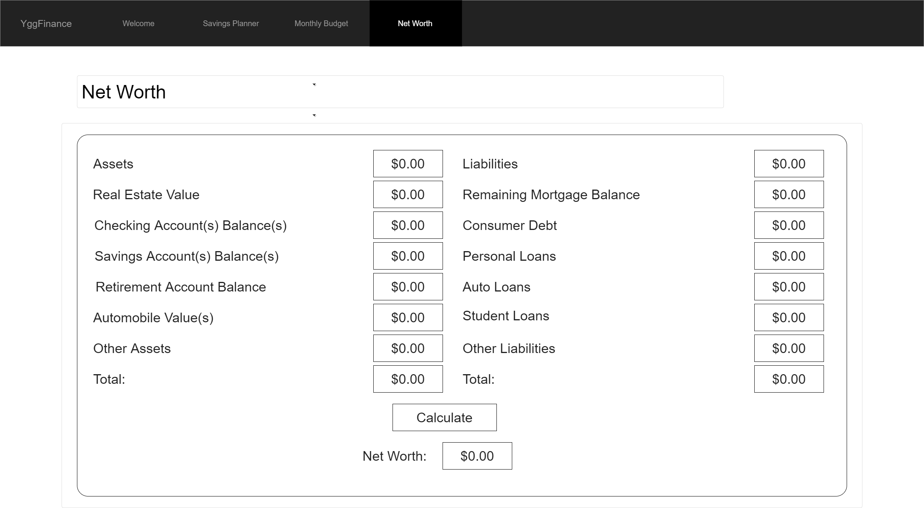
Net Worth Wireframe

