Slide 1

Summer Trainning
By:
Shuruq Baabdullah

Slide 2

Introdoction
Why do we use data analysis?
It is the process of cleaning transforming and mining data to help gain information, help decision-makers, and solve and discover problems.
It helps businesses optimize their performances.

Slide 3


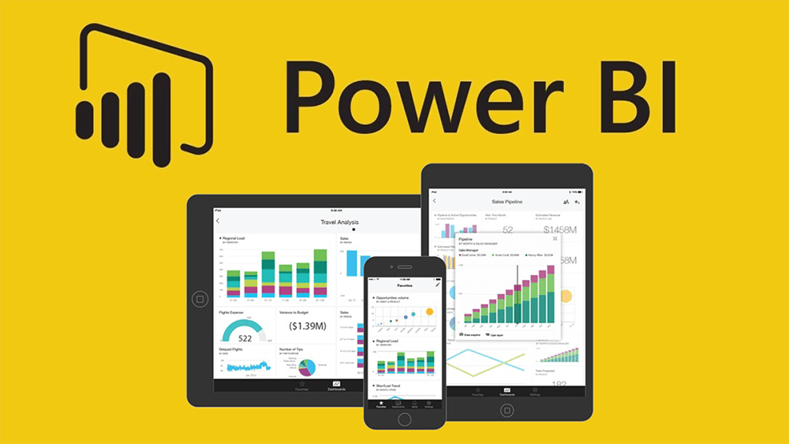
Tools
SQL Server management studio
Visual Studio
Power BI

Slide 4

Data Warehouse
Data Warehousing integrates data and information collected from various sources into one comprehensive database.
Fact table contains measurements, metrics, and facts.
Dimension table contains descriptive attributes to be used as query constraining.

Slide 5
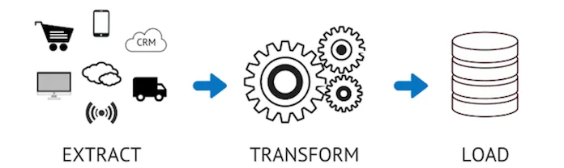
ETL (Extract tranform and load)
EXTRACT data from its source.
TRANSFORM data by deduplicating, combining it, and ensuring quality.
LOAD data into the target database.

Slide 6

ETL Advantages
Business intelligence is an ETL use case.
Delivering a single point-of-view.
Providing historical context.
improving efficiency and productivity

Slide 7
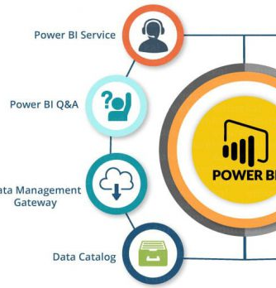
Power BI Reports
Power BI is a secure Microsoft-hosted cloud service that lets users view dashboards, reports, and Power BI apps.
Evaluate your strategies and performance based on these reports.
Focus your reader on the core elements of your story.
Visuals can deliver information more directly.

Slide 8
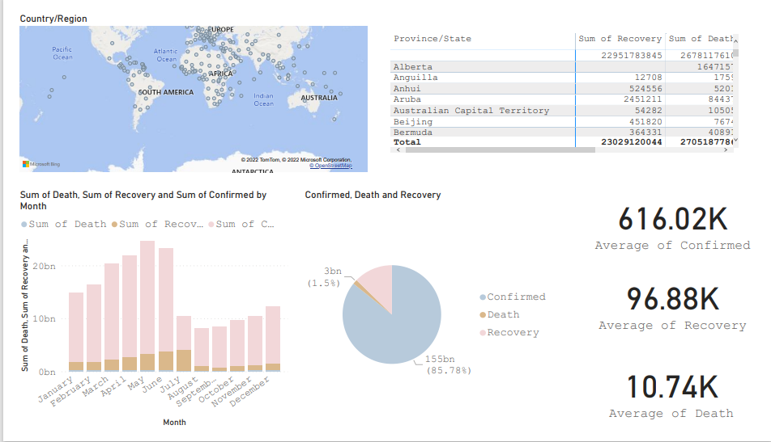

Slide 9
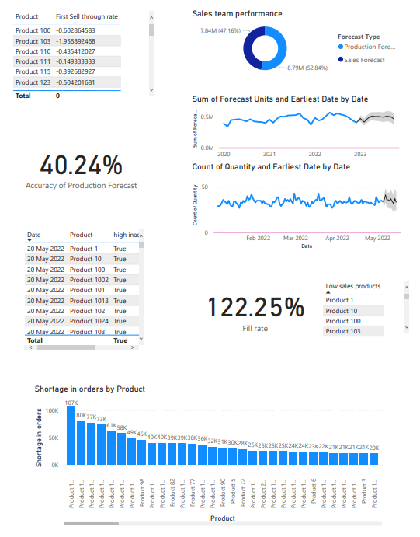

Slide 10
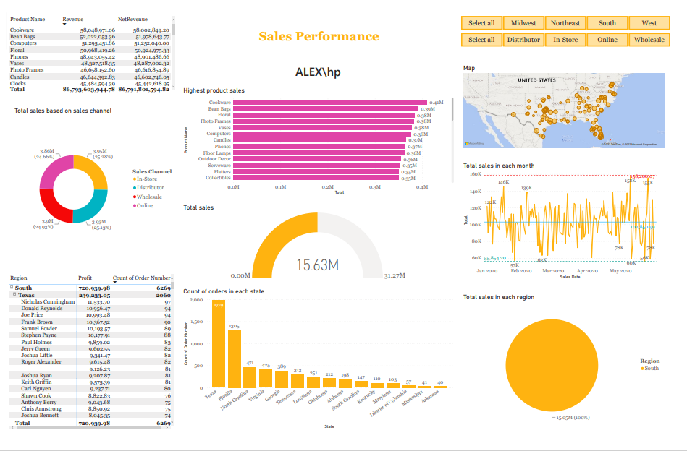

Slide 11

Challenges
Learning new tools.
What information should be presented in a report.
The data has many missing values, handling errors.

Slide 12
Thank You

