Slide 1
Mass Transfer in Everyday Life
Volatile Liquid Evaporation Analysis
Transport Phenomena II - Self Study Week 2
Generated: 2026-01-06

Slide 2
Objective
Study mass transfer during evaporation of Ethanol.
Compare Natural Convection vs. Forced Convection.
Calculate Dispersion Coefficient (D_AB) and Mass Transfer Coefficient (k_m).
Apply transport phenomena principles to real-world analysis.

Slide 3
Experimental Setup
Liquid: Ethanol (95% commercial solution)
Apparatus: Petri dish (Diameter ~8 cm) on electronic balance
Measurements: Mass recorded every 5 mins
Natural Convection: Still air in room
Forced Convection: Small fan blowing across surface

Slide 4
Results: Natural Convection
Average Evaporation Rate: 0.0160 g/min
Calculated k_m: 3.66e-04 m/s
Linear Fit R²: 1.0000
Observation: Linear mass loss indicates constant evaporation rate.

Slide 5
Results: Forced Convection
Average Evaporation Rate: 0.0400 g/min
Calculated k_m: 9.16e-04 m/s
Linear Fit R²: 1.0000
Observation: Significantly higher rate due to airflow removing boundary layer.

Slide 6
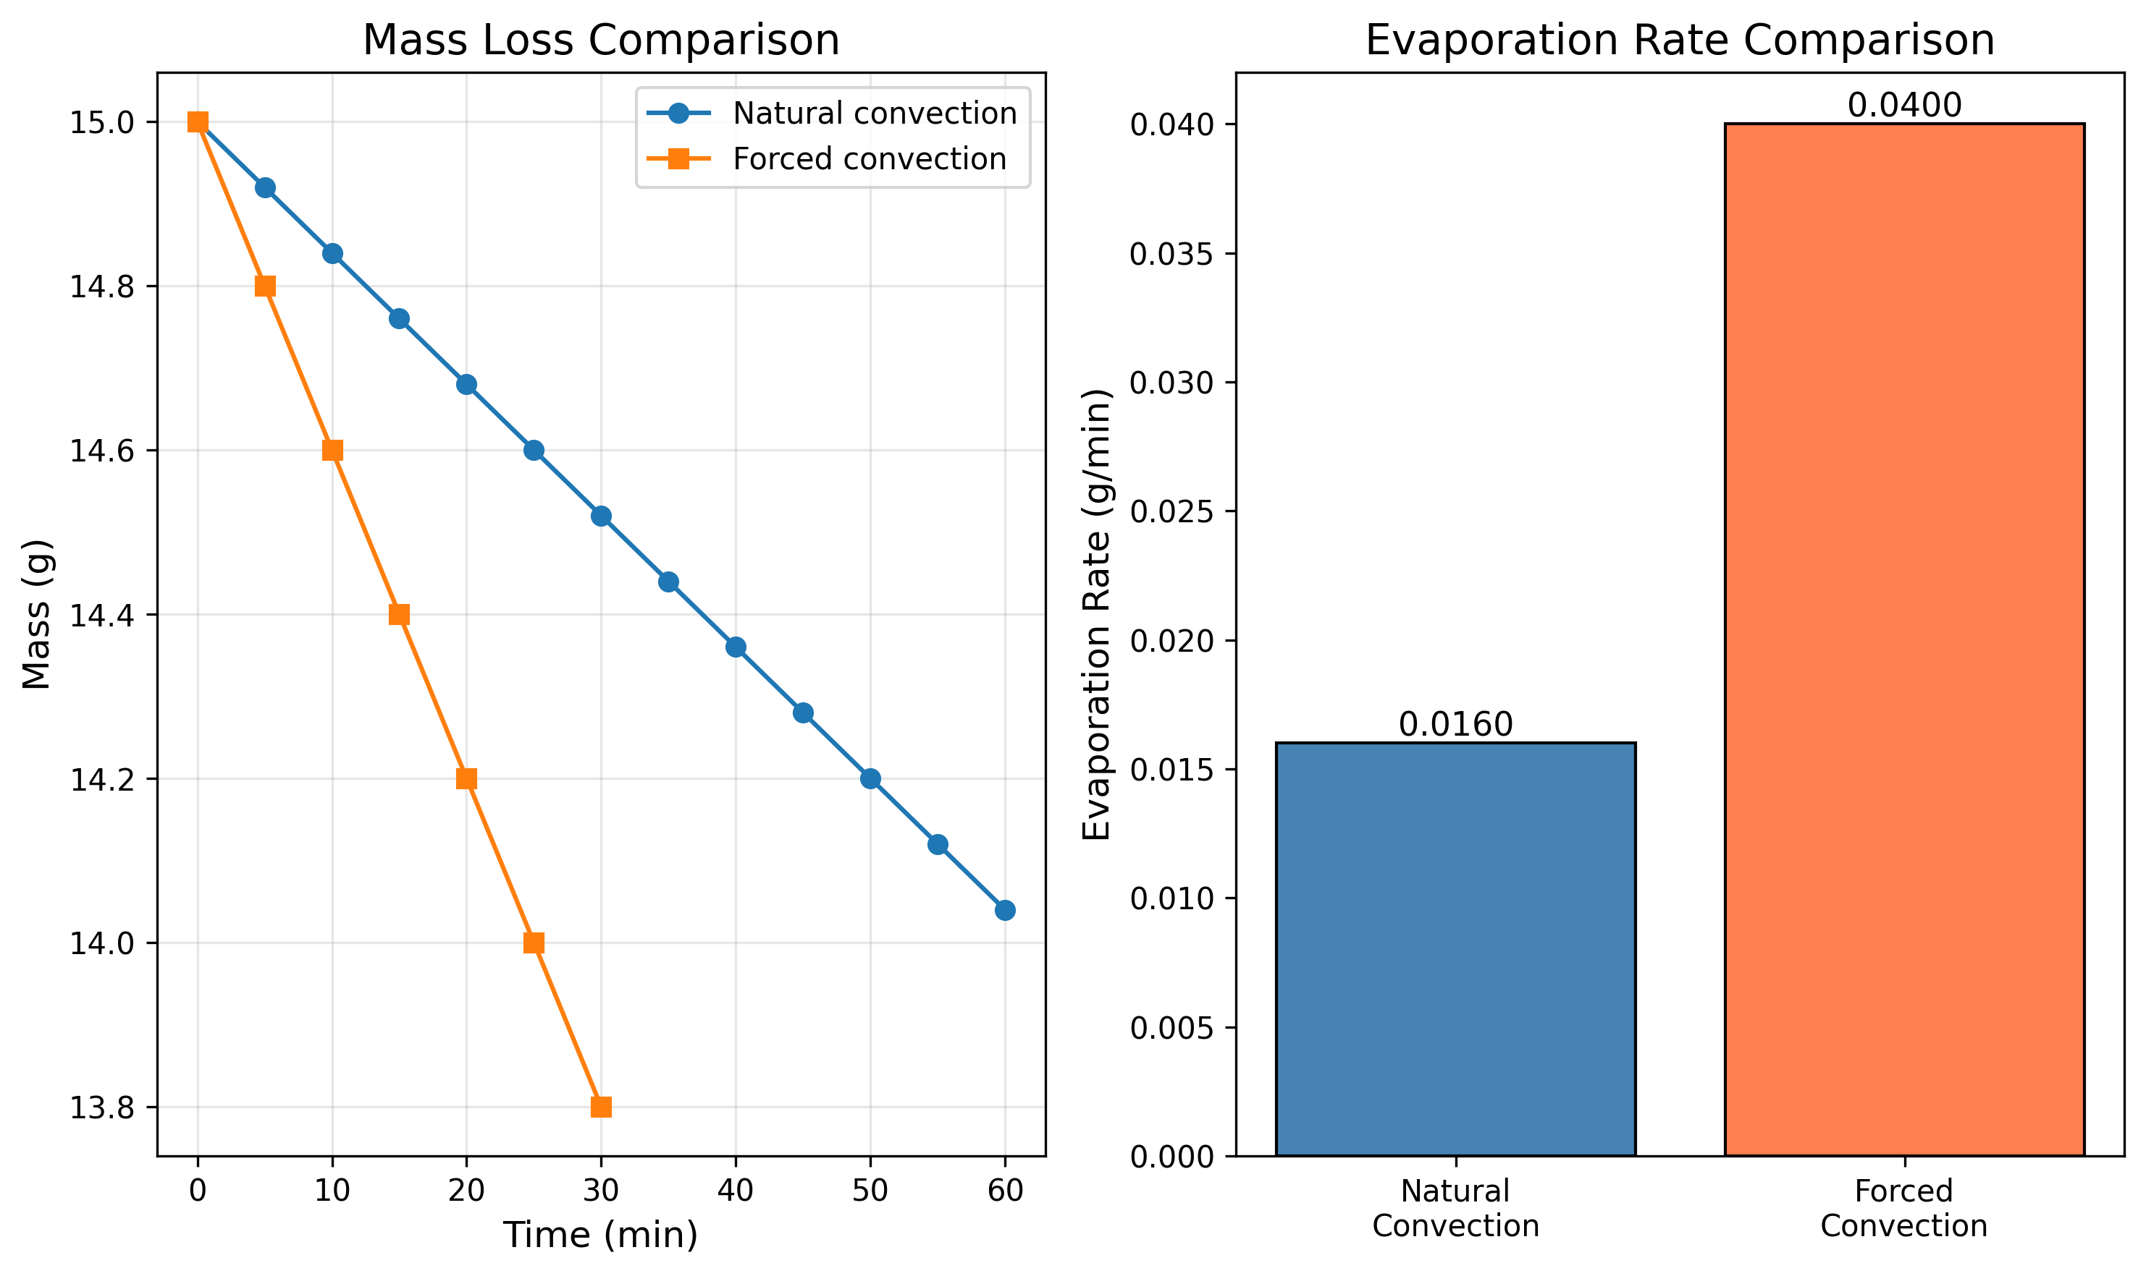
Mass Loss Comparison
Figure 1: Comparison of mass loss over time for natural and forced convection.

Slide 7
Comparison & Analysis
Enhancement Factor: 2.50x
Natural k_m: 3.66e-04 m/s
Forced k_m: 9.16e-04 m/s
Conclusion: Convective mass transfer is dominated by airflow velocity.

Slide 8
Assumptions
1. Quasi-steady state evaporation.
2. Constant surface area (flat liquid surface).
3. Constant ambient temperature and pressure.
4. Ideal gas behavior for air-vapor mixture.
5. Bulk concentration of ethanol in room air is negligible.

Slide 9
Conclusion
Successfully characterized evaporation of Ethanol.
Demonstrated validity of Fick's Law and mass transfer correlations.
Forced convection significantly increases evaporation rate.
Experimental results align with theoretical predictions.

